Slide 1
THE RESEARCH QUEST: The Search for a Thesis
Detail of a miniature of a hermit at work on a manuscript, from the Estoire del Saint Graal, France
(Saint-Omer or Tournai?), c. 1315 – 1325, Royal MS 14 E III, f. 6v
Notes:
Detail of a miniature of a hermit at work on a manuscript, from the Estoire del Saint Graal, France (Saint-Omer or Tournai?), c. 1315 – 1325, Royal MS 14 E III, f. 6v - See more at: http://britishlibrary.typepad.co.uk/digitisedmanuscripts/2014/06/the-burden-of-writing-scribes-in-medieval-manuscripts.html#sthash.9tVvNEdQ.dpuf

Slide 2
WRITING A RESEARCH PAPER IS LIKE EMBARKING ON A QUEST (WELL, SORT OF)
Certainly, there will be dangers (like missing deadlines and discovering that you are actually a gnostic heretic) and drudgeries along the way, but you can always find help - librarians ready with insight and tools - to speed you on your journey.
Edmund Leighton, God Speed, 1900
Notes:
Writing a research paper is like embarking on a quest (well, sort of) - certainly, there will be dangers (like missing deadlines and discovering that you are actually a gnostic heretic) and drudgeries along the way, but you can always find help - librarians ready with insight and tools - to speed you on your journey. And, like a quest or an adventure, the point of a research paper ultimately is less about the end product than it is the process of getting there - what you learn and how you change along the way.
(NOTE - this is a much more helpful analogy to keep in mind than thinking about a paper as an exercise in siege war craft wherein you grudgingly pound away at an unyielding foe until one of you breaks down from starvation or sheer exhaustion). More than anything, remember . . .

Slide 3
WRITING A RESEARCH PAPER IS LIKE EMBARKING ON A QUEST (WELL, SORT OF)
And, like a quest or an adventure, the point of a research paper ultimately is less about the end product than it is the process of getting there - what you learn and how you change along the way.
Edmund Leighton, God Speed, 1900
Notes:
Writing a research paper is like embarking on a quest (well, sort of) - certainly, there will be dangers (like missing deadlines and discovering that you are actually a gnostic heretic) and drudgeries along the way, but you can always find help - librarians ready with insight and tools - to speed you on your journey. And, like a quest or an adventure, the point of a research paper ultimately is less about the end product than it is the process of getting there - what you learn and how you change along the way.
(NOTE - this is a much more helpful analogy to keep in mind than thinking about a paper as an exercise in siege war craft wherein you grudgingly pound away at an unyielding foe until one of you breaks down from starvation or sheer exhaustion). More than anything, remember . . .

Slide 4
IN THE BEGINNING . . .
Notes:
Starting a research paper can feel like the beginning of the creation story – like the earth, your blank page is “tohu vabohu – without form and void” and full of darkness

Slide 5
IN THE BEGINNING . . .
Starting a research paper can feel like the beginning of the creation story – like the earth, your blank page is “tohu vabohu – without form and void” and full of darkness
Notes:
Starting a research paper can feel like the beginning of the creation story – like the earth, your blank page is “tohu vabohu – without form and void” and full of darkness

Slide 6
LET THERE BE – A THESIS
You know that you need a thesis – and possibly divine intervention – to help bring order to the chaos, but where and how can you find a thesis?
Notes:
You know that you need a thesis – and possibly divine intervention – to help bring order to the chaos – but where and how can you find a thesis?

Slide 7
FINDING YOUR THESIS
A thesis is an assertions about something. So to argue a thesis, you first need to know what you are making an assertion about. This is a matter of finding connections or intersections among:
What you want to know (your interests, values),
What you need to know (your assignment, course, or task at hand), and
What you can know (your access to enough credible sources)

Slide 8
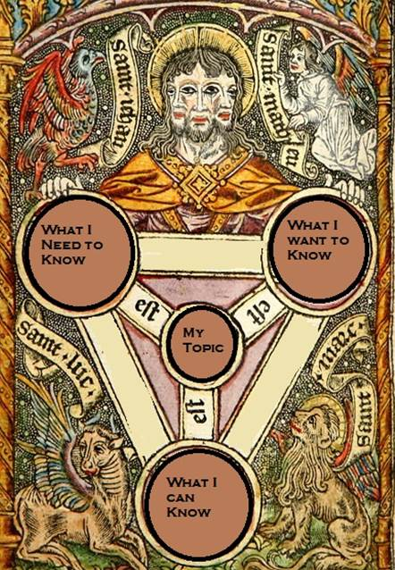
It is, appropriately, Trinitarian.
If you are having trouble thinking of a topic – feel free to stop by the library. We are always glad to help you brainstorm.
Notes:
It is, appropriately, Trinitarian.
If you are having trouble thinking of a topic – feel free to stop by the reference office. We are always glad to help you brainstorm.

Slide 9
TANGENT: LIKE YOUR TOPIC
When selecting a topic for a research paper, please make sure it is something that interests you. Because if you don’t like it now, you really won’t like it at 2:00 am the morning before its due to be turned in.
“I tried to warn ye. I told ye not to choose ‘Joseph of Arimathea’ as your topic. But oh, no! You wouldn’t listen. ”
Notes:
When selecting a topic for a research paper, please make sure it is something that interests you. Because if you don’t like it now, you really won’t like it at 2:00 am the morning before its due to be turned in.

Slide 10
ONCE YOU HAVE YOUR TOPIC, START ASKING QUESTIONS
“Oh man! What happened? How am I ever going to explain this?”

Slide 11
A THESIS IS A QUESTION REPHRASED AS AN ASSERTION.
? ! = Thesis
Ask a question about the topic.
Rephrase it as a statement.
That becomes your working thesis.
Notes:
A thesis is a question rephrased as an assertion. Thus once you have a topic, the next step is to start asking questions.

Slide 12
FOR EXAMPLE: HOW IS IT THE CRUSADES AND ST. FRANCIS ARE BOTH EXPRESSIONS OF MEDIEVAL CHRISTIANITY?

Slide 13
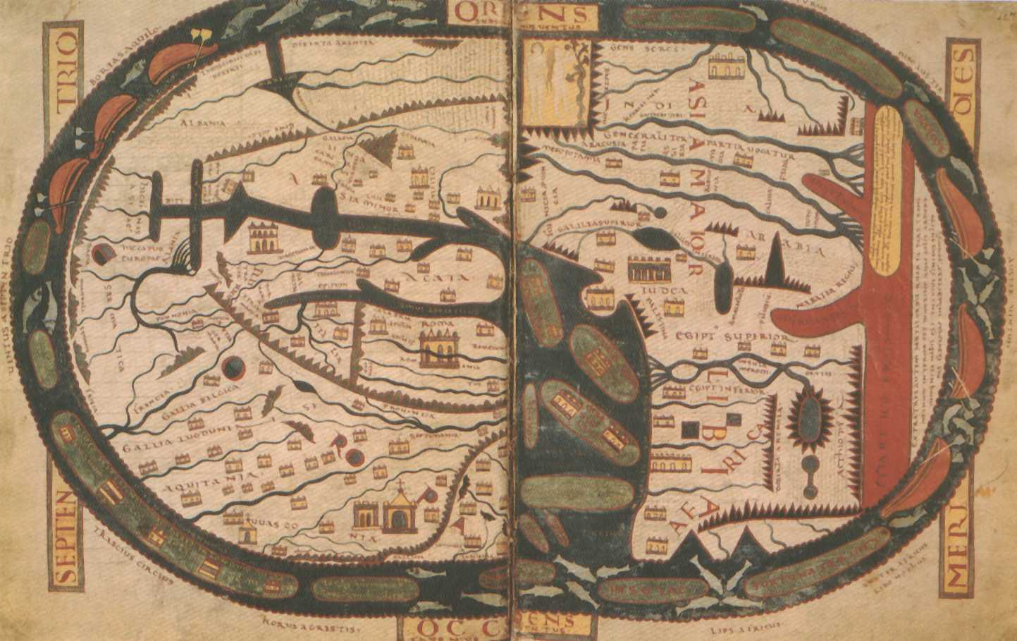
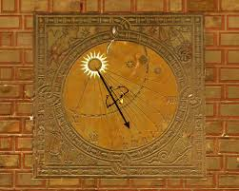
TANGENT: MANAGING SPACE AND TIME
SPACE
Frame your thesis so that it is an appropriate size for the number of pages your assignment requires.
TIME
Divide the time you have to complete the assignment by the number of tasks you have to do to complete it.

Slide 14
GET THEE TO A DICTIONARY
In order to ask the kinds of questions that will help you form your thesis, you need to know something about your subject
Notes:
In order to ask the kinds of questions that will help you form your thesis, you need to know something about your subject

Slide 15
RESEARCH REQUIRES SOURCES (DIRECT DIVINE ILLUMINATION IS UNFORTUNATELY NOT A COMMON OCCURRENCE )
St. Bridget's Eucharistic Vision, from St. Bridget of Sweden, Revelations and other texts, in Latin, Italy, Naples, Late 14th century
Notes:
As you are doubtless aware, direct divine illumination is unfortunately not a common occurrence. The Almighty seems to be content working through more mundane means, which means that choosing appropriate, authoritative sources is essential.

Slide 16
RESEARCH REQUIRES SOURCES (DIRECT DIVINE ILLUMINATION IS UNFORTUNATELY NOT A COMMON OCCURRENCE )
As you are doubtless aware, direct divine illumination is unfortunately not a common occurrence.
The Almighty seems to be content working through more mundane means, which means that choosing appropriate, authoritative sources is essential.
St. Bridget's Eucharistic Vision, from St. Bridget of Sweden, Revelations and other texts, in Latin, Italy, Naples, Late 14th century
Notes:
As you are doubtless aware, direct divine illumination is unfortunately not a common occurrence. The Almighty seems to be content working through more mundane means, which means that choosing appropriate, authoritative sources is essential.

Slide 17
RESEARCH IS LIKE A SPIRAL
Like a good conversation, research is a give-and-take process of asking questions, going to sources for information, which leads to further questions and additional research FOREVER (not really – that is why God has graciously given us deadlines)
Notes:
Like a good conversation, research is a give-and-take process of asking questions, going to sources for information, which leads to further questions and additional research FOREVER (not really – that is why God has graciously given us deadlines)

Slide 18
REMEMBER: YOUR THESIS IS AN ASSERTION BACKED BY RESEARCH (BOTH THE ASSERTION, AND THE RESEARCH ARE ESSENTIAL)

Slide 19
AUTHORITY MATTERS (YOUR WORK IS ONLY AS GOOD AS YOUR SOURCES)
“Oh yes. He is the bishop. I read it on Wikipedia.”
Notes:
Reynard the fox preaching to birds, British Library MS Royal 10 E IV, late 13th/early 14th century http://www.bl.uk/catalogues/illuminatedmanuscripts/ILLUMIN.ASP?Size=mid&IllID=40418

Slide 20
ASK (FOR HELP), AND YE SHALL RECEIVE
Your librarians are here to help!
David Schmersal dschmersal@austinseminary.edu Contact us any time at libraryiq@austinseminary.edu with any questions.

