Slide 1
Keeping Safe
at CVPS with
ALiCE
Notes:
Safety goes beyond intruders. Fire, student in crisis, and gas leaks are just a few.

Slide 2
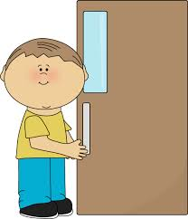
School Safety
How do we stay safe at CVPS?
Notes:
Talk about the lockdown drill done at school last year.

Slide 3
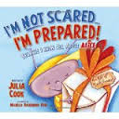
ALiCE
The adults in your building care about you and your safety. With the help of ALiCE, we can keep you safe.
Notes:
Talk about principals, teachers, paraprofessionals, cafeteria employees, custodians, noon-time aids, and bus drivers

Slide 4
ALiCE
You have all recently heard the book “I’m Not Scared...I’m Prepared”. In that book, the teacher helps to keep her students safe.
Notes:
Bring students to a reading area to read, “I’m Not Scared. I’m Prepared.”

Slide 5
ALiCE
Alert
Lockdown
Inform
Counter
Evacuate
Notes:
Introduce the letters of ALiCE

Slide 6
Alert
Alert means to be aware of your surroundings.
If you see something… say something.

Slide 7
Alert
Look!
Listen!
Smell!

Slide 8
Alert
Tell an adult if you…
see a person without this badge…
Notes:
Show your badge and talk about the visitor badge Talk about “trusted adults”.

Slide 9
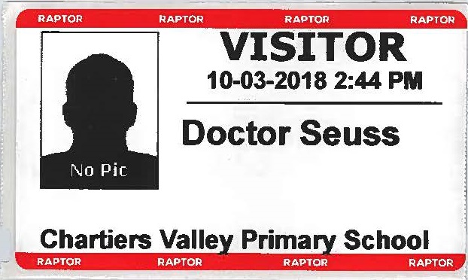
Alert
…or see a person without this sticker
Notes:
Explain to students our new system for visitor check-in.

Slide 10
Alert
These special badges and stickers mean that these people are allowed in our building.

Slide 11
Alert
Tell an adult if you…
see one of our outside doors left open. NEVER
open an outside door
for ANYONE!
Notes:
Explain how important it is that outside doors are pullled closed and that students should never open a door for a stranger.

Slide 12
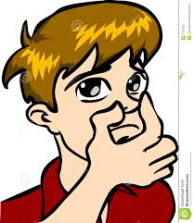
Alert
Tell an adult if you…
smell something unfamiliar.
Notes:
Talk about the smell of smoke, gas, or other chemicals. Share how a building can quickly evacuate to a safe place. Fire drills, etc

Slide 13
Alert
Tell an adult if you…
hear a sound that is not normal.
Notes:
Listen for loud sounds that you don’t normally hear

Slide 14
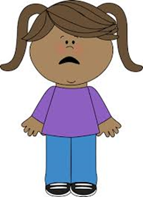
Alert
Tell an adult if you…
see a stranger who is acting inappropriately or upset.
Notes:
Does a child or an adult seem to be having difficulty? Upset? Sick or in need of medical attention? How about to hurt himself/herself or others?

Slide 15
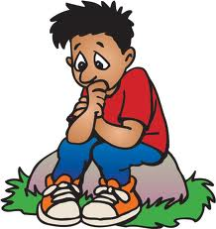
Alert
Tell an adult if you…
see something that makes you feel uncomfortable.
Notes:
Use your gut. If you aren’t sure, tell an adult anyway.

Slide 16
Alert
The adults at Chartiers Valley are keeping Alert for your safety. You can help them.

Slide 17
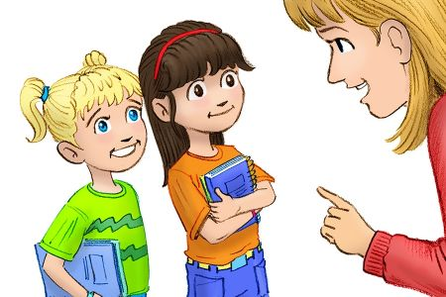
Lockdown
If an unsafe situation occurs at our school, we have to listen to our teachers’ directions.

Slide 18
Lockdown
Sometimes we have to make a quick decision at school to help us stay safe.
Notes:
Listening when someone is on the P.A. system is always important.

Slide 19
Lockdown
We might hear the fire alarm or an announcement from the
office.
Notes:
Listening when someone is on the P.A. system is always important.

Slide 20
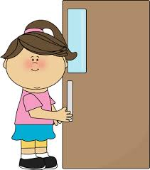
Lockdown
Your teacher will quickly check the hallway for students, pull the magnet, and close the door.
Notes:
Demonstrate these steps.

Slide 21
Lockdown
If you are in the hallway or bathroom, run to the nearest room.

Slide 22
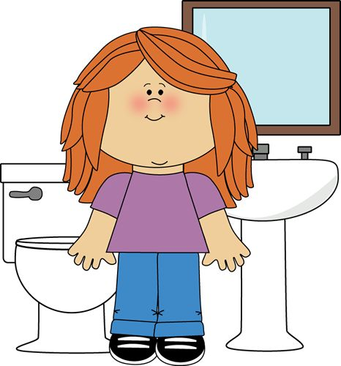
Lockdown
If that door is locked, it is important that you make a quick and safe decision. That might mean to:
Run out of the building to a safe place.
Hide in the bathroom.
Notes:
Talk about how to hide in the bathroom. Talk about safe places

Slide 23
Lockdown
Listen carefully to your teacher.
He or she may ask you to do several things and may even change the directions.
Notes:
Tell them that in the past the teacher may have been quiet. This time the teacher will be telling them exactly what to do.

Slide 24
Lockdown
In an emergency your teacher might turn off the lights or move heavy furniture into the doorway.
Notes:
Show them what furniture you might move.

Slide 25
Lockdown
Your teacher might tell you:
sit quietly in the corner.
Notes:
Have the students talk how this was the only procedure last year.

Slide 26
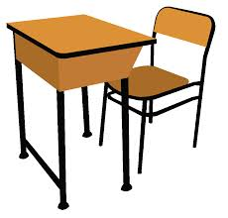
Lockdown
Your teacher might tell you:
move under your desk.
Notes:
Let the students demonstrate. There could be a situation when this is the best option.

Slide 27
Lockdown
Remember!
Directions may change. Be sure to listen carefully to the teacher.

Slide 28
Inform
Sharing information is important. It helps everyone make better decisions.

Slide 29
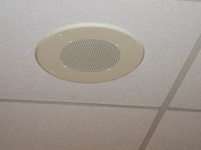
Inform
Information can be shared in many ways:
An announcement might be made on the Intercom.
Notes:
Talk about the importance of listening.

Slide 30
Inform
Information can be shared in many ways:
Your teacher might tell you some information in the room.

Slide 31
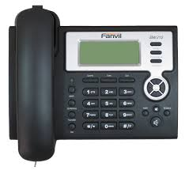
Inform
Information can be shared in many ways:
A phone call might be made.
Notes:
Talk about the importance of your own cell phone

Slide 32
Inform
Information can be shared in many ways:
Information can even be shared through our senses of hearing and smelling.
Notes:
Do not use the word gunshots, but let them know sounds may call for us to act quickly.

Slide 33
Inform
Whatever the situation, be sure to keep listening for new or changing directions.
Having all the information is important for your safety.

Slide 34
Counter
This is for teachers and adults only.
They are taught how to protect students.
Your job is to allow the adults to do what they need to do.

Slide 35
Evacuate
Evacuate means to leave the area immediately.

Slide 36
Evacuate
Remember to look for these signs in all buildings. They show us all the ways to get out.

Slide 37
Evacuate
There may be a time at school when you will need to evacuate with or without your teacher.
Notes:
.

Slide 38
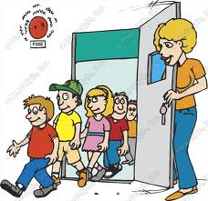
Evacuate
One way we evacuate the building is to leave when there is a fire drill. Leaving the building keeps
us safe.
Notes:
Review current fire drill procedures. Tell students that we will now add « open palms » as part of ANY evacuation.

Slide 39
Evacuate
Evacuating can also look very different for other types of emergencies.

Slide 40
Evacuate
You may need to get out very quickly. It might be loud. It may seem confusing, but there are adults to help guide you.
Notes:
Reassure students that even though it may not be orderly or look like our fire drill, it is the best thing to do. Tell them that the nearest exit is best and running is required.

Slide 41
Evacuate
You may even have to crawl out a window.
Notes:
Discuss that the teacher may need to break a window and even on the second floor this might be the best decision.

Slide 42
Evacuate
Run in a zig-zag formation with your hands in the air.
Be careful, but keep moving.
Notes:
Demonstrate and have students practice this.

Slide 43
Evacuate
It is important that you get out of the building quickly and move far away to a safe zone.
Notes:
Some possible safe zones are addressed in a future slide

Slide 44
Evacuate
You may get separated from your class. Just keep running to a safe zone.
Notes:
Explain to students that being safe is more important than staying with their class or even teacher.

Slide 45
Evacuate
A Safe Zone is an area that puts you far away from any danger.
Our Safe Zones might be:
The High School/Middle School
A neighborhood
The woods

Slide 46
Evacuate
School buses will pick you up from your safe zone and take you to meet your teachers or parents.
Notes:
Very important to spend time generating a list of good places for students to use as a safe zone. Safe zones are not necessarily our rally points.

Slide 47
Evacuate
Safe Zones allow us to find our teachers, friends, and give us a place to meet our parents.
Notes:
Explain that many staff members will be there to greet them and help them to reunite with parents.

Slide 48
Evacuate
The purpose of evacuating is to help keep you safe. We know you can be brave and make good decisions.
Notes:
Reassure the students that anywhere away from the danger is a good choice.

Slide 49
Now you are ready to follow our ALiCE procedures. YOU are an important part of helping everyone to stay safe in our school!

Slide 50
Time for Questions

