Slide 1
TAG currently serves:
** Pull out enrichment grades 3-4
** Pull out TAG at AP grades 5-6
Creative Mind STREAMing Units
Archaeology (TAG)
Coastal Ecology (TAG)
Space (TAG)
Greek Mythology (E)
Japan (E)
Robotics(E)
The Middle Ages (E)
Ancient Egypt (E)

Slide 2
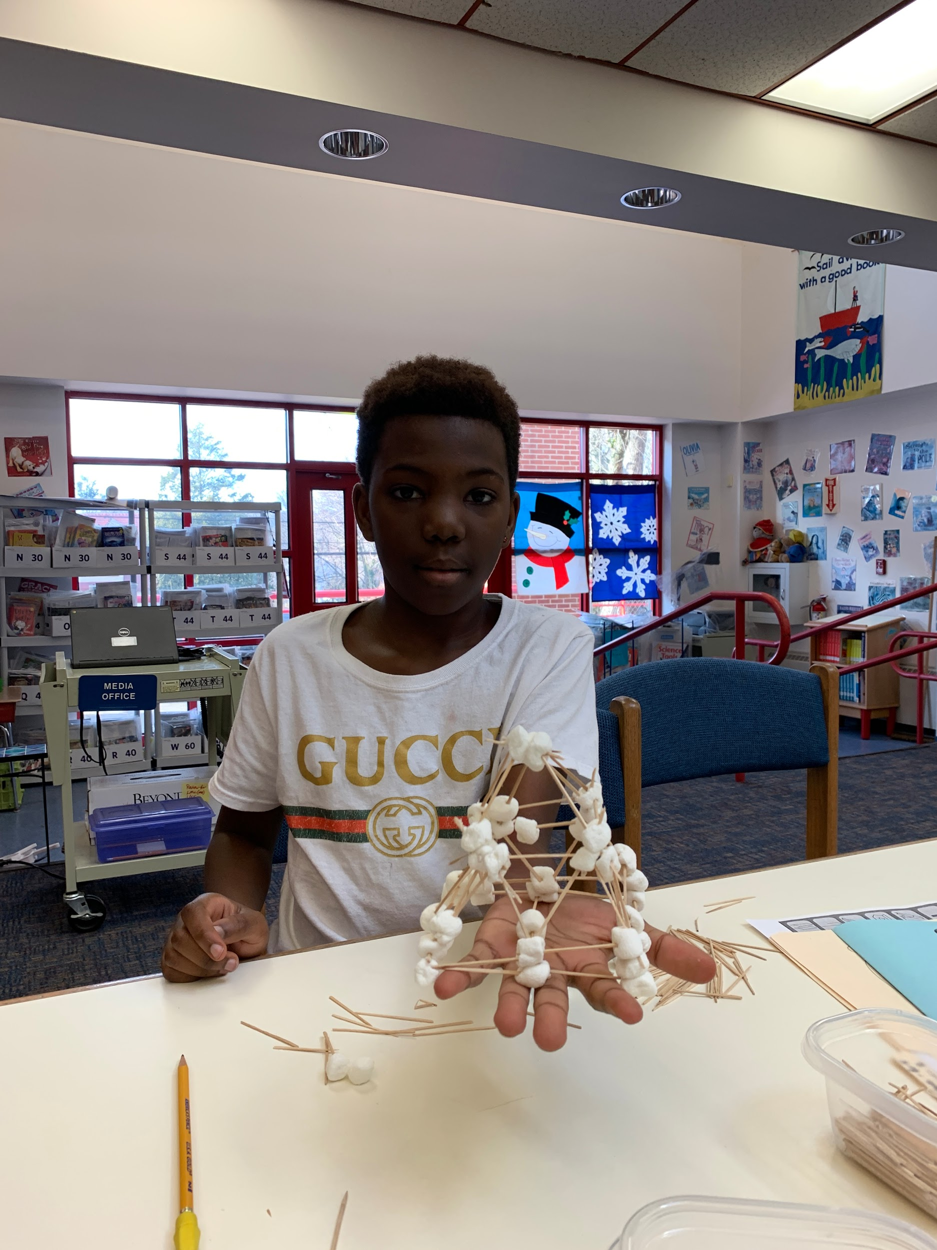
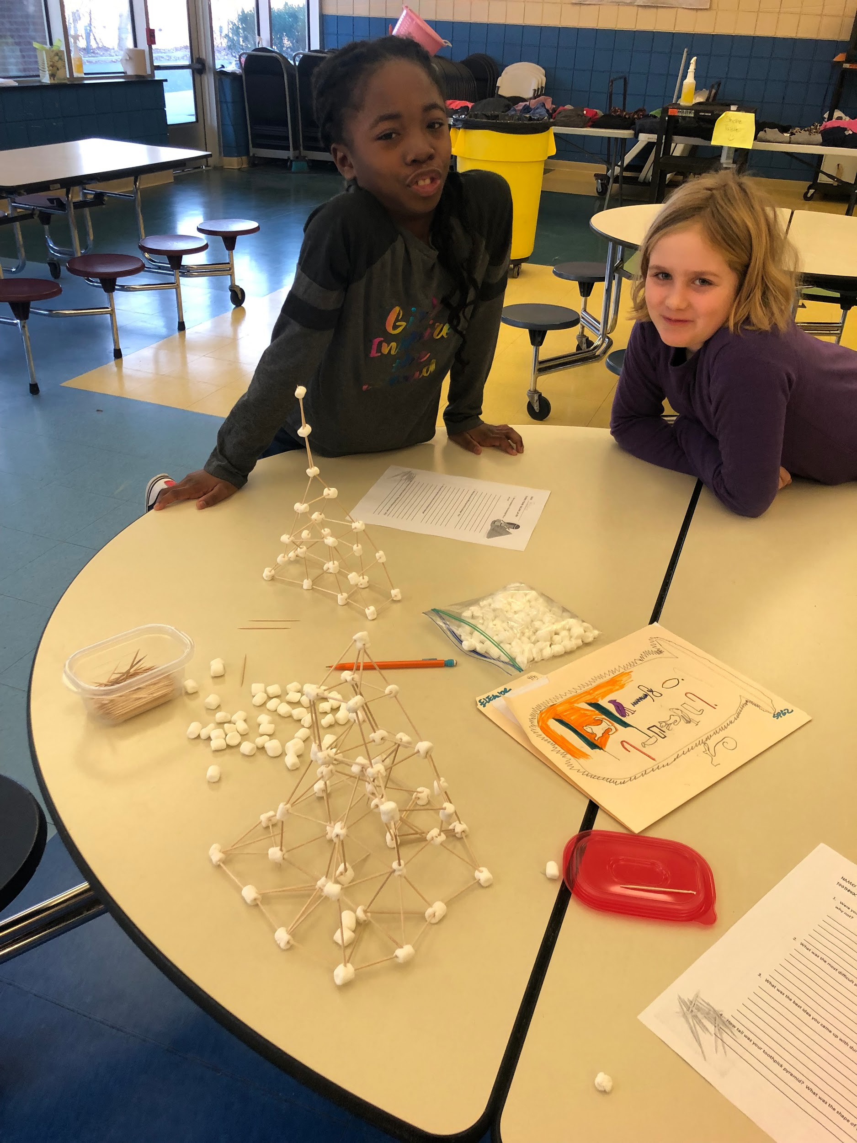
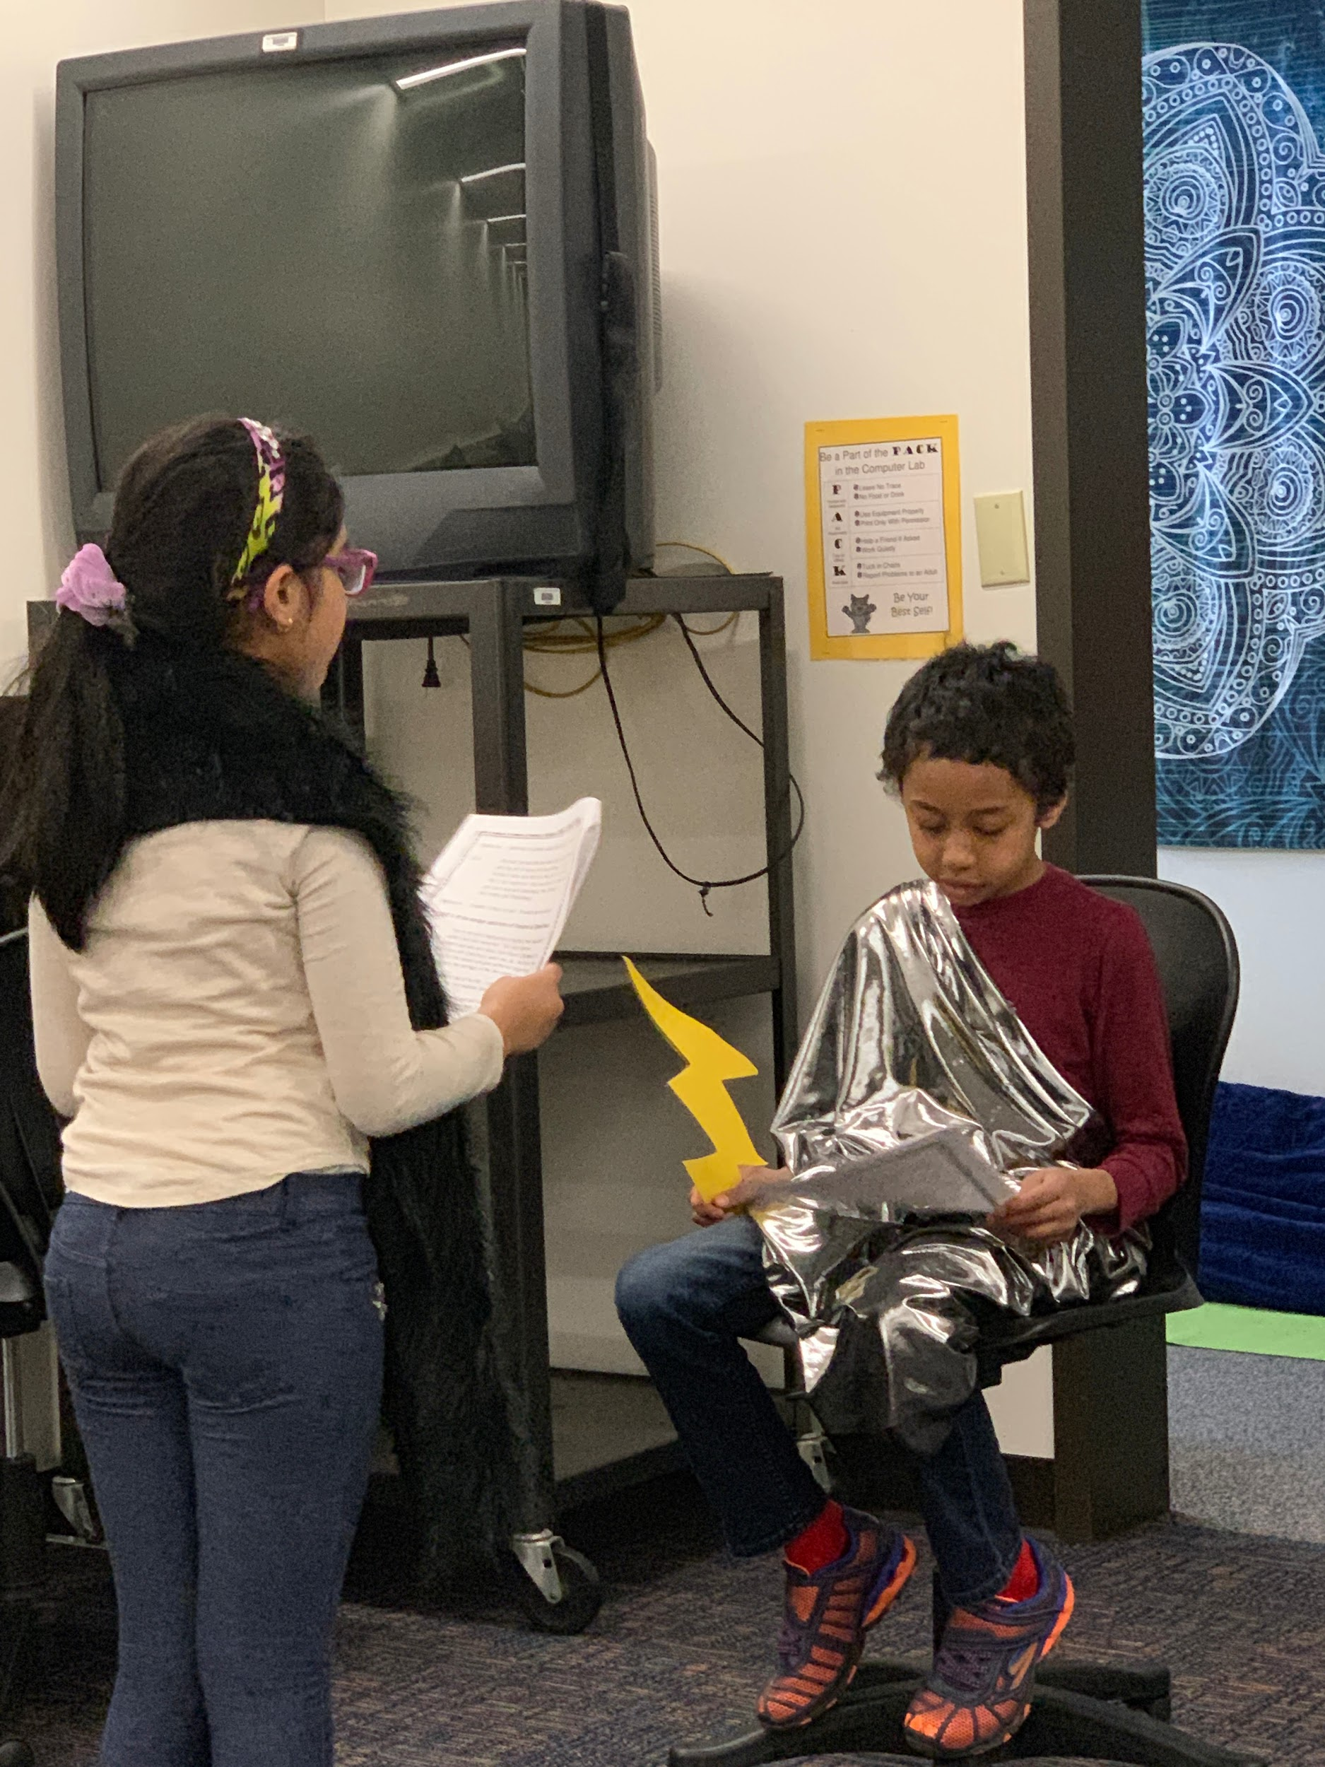
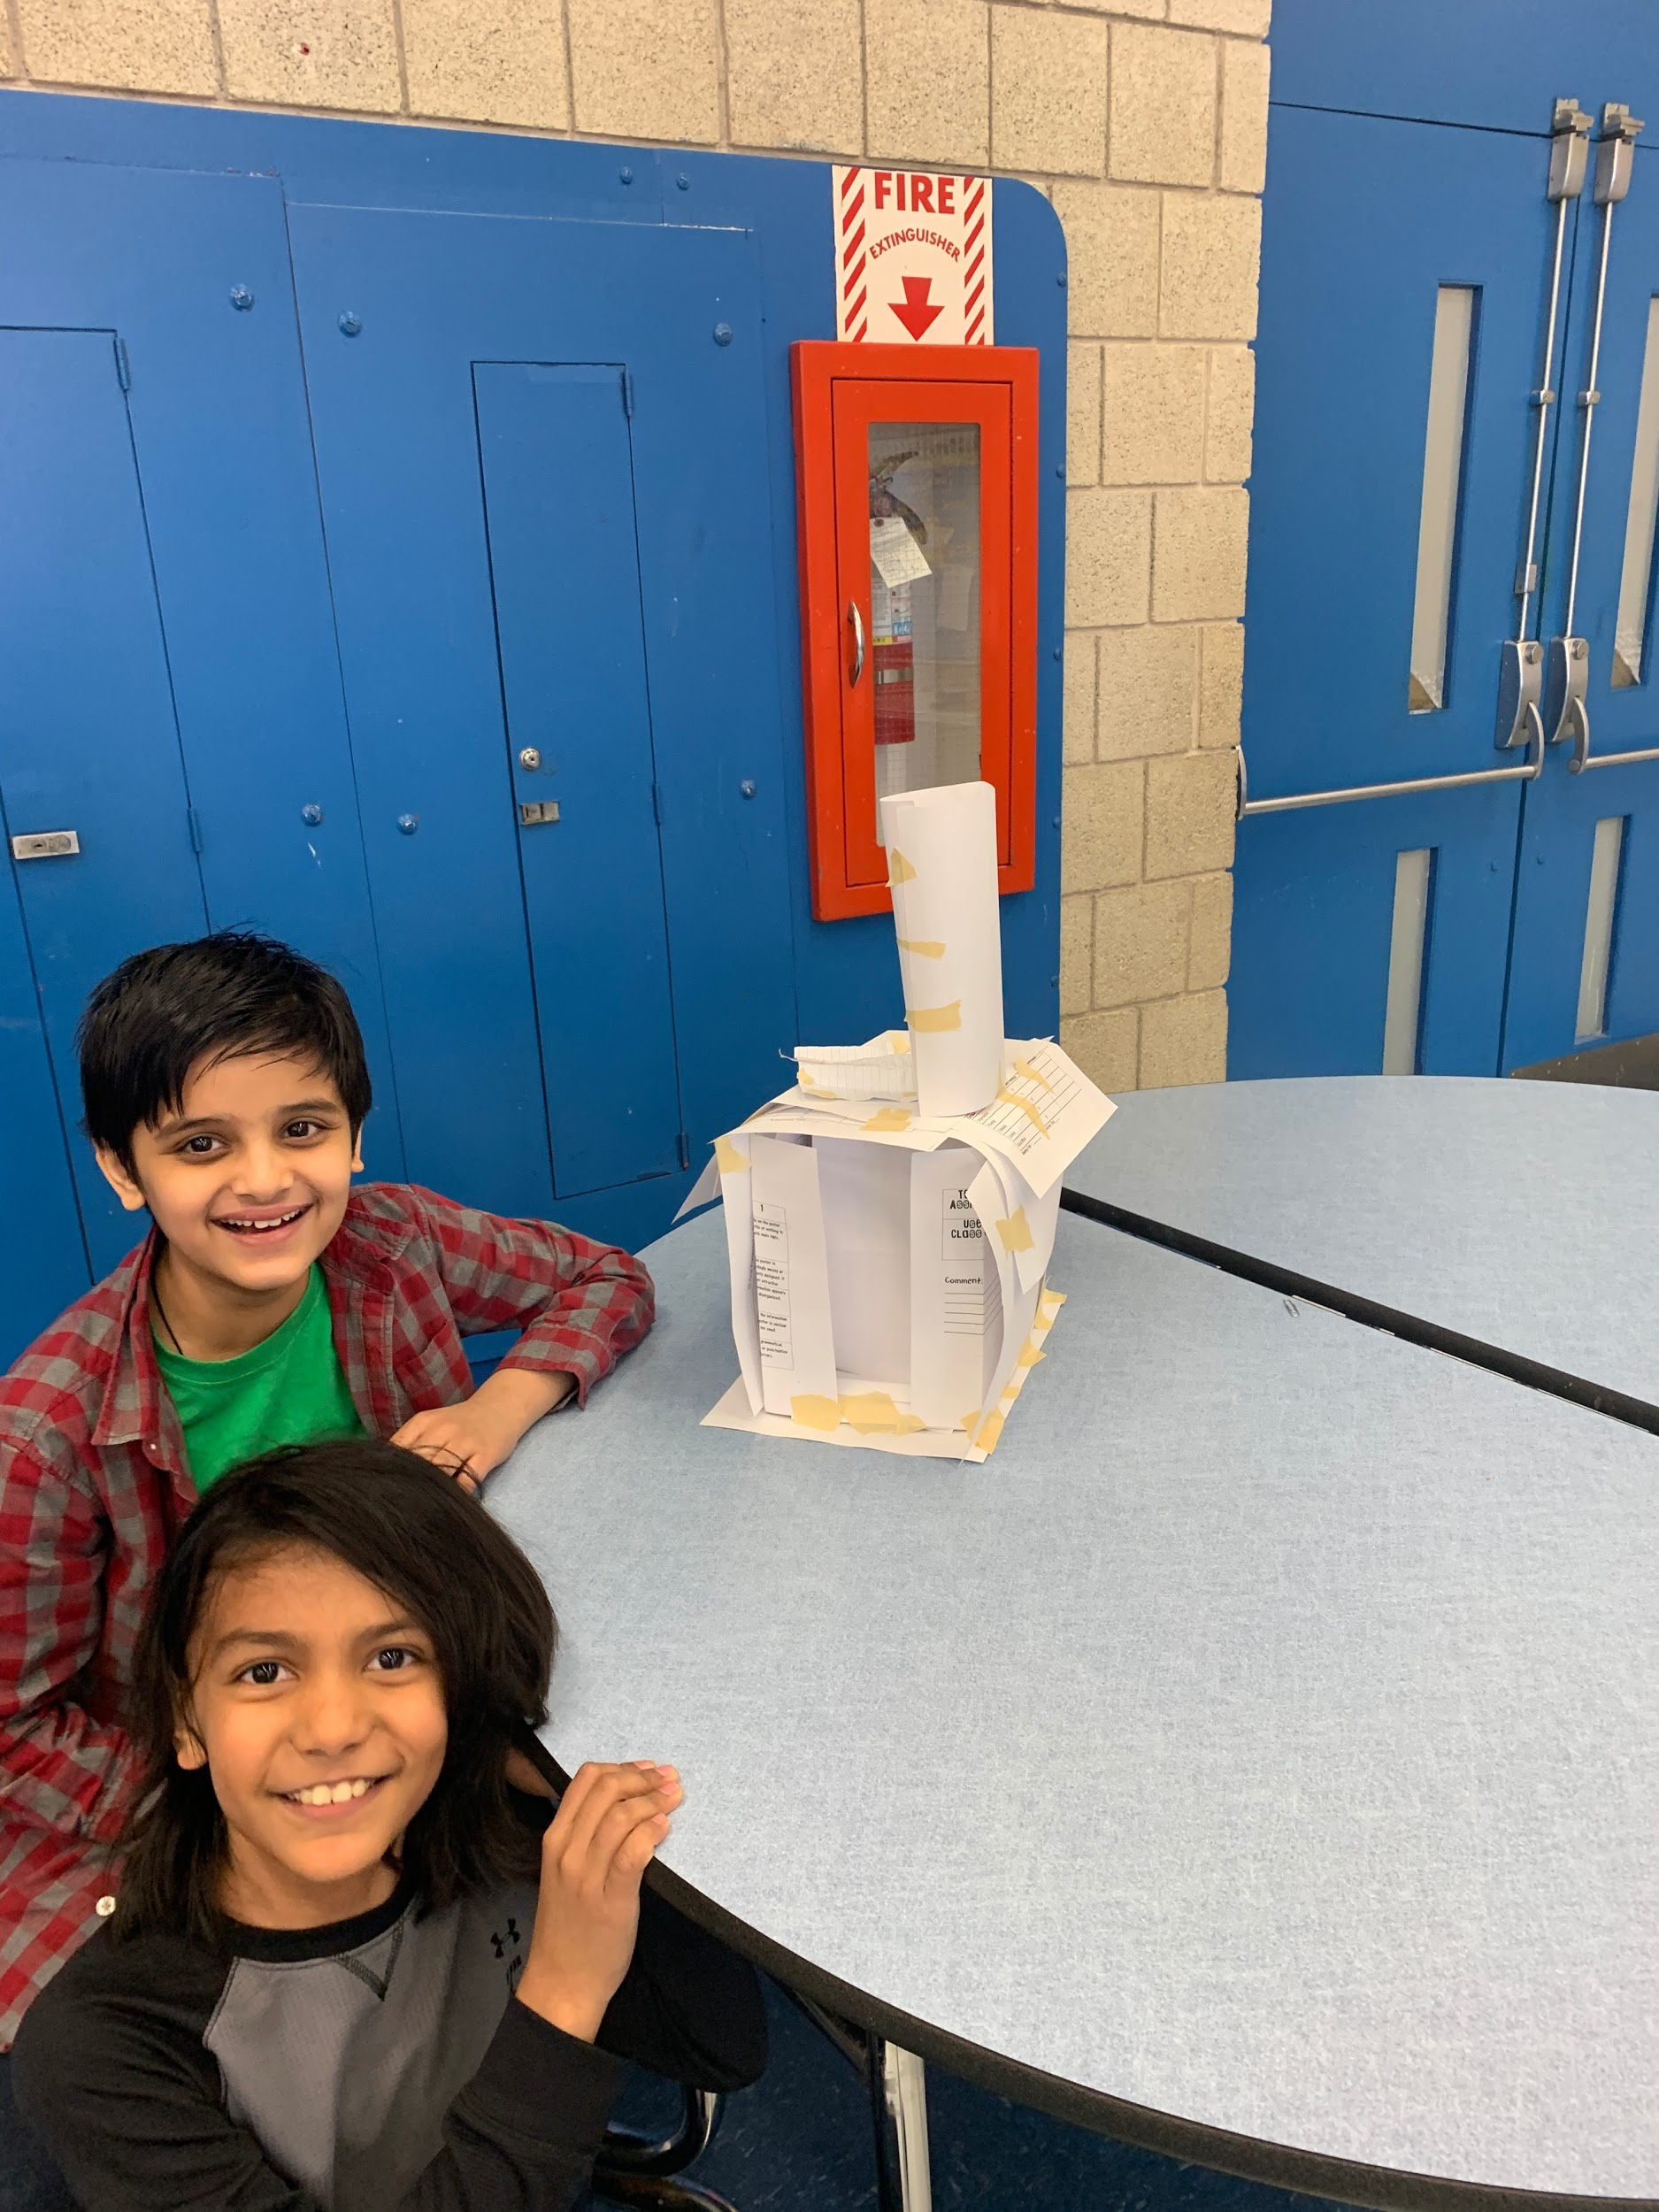
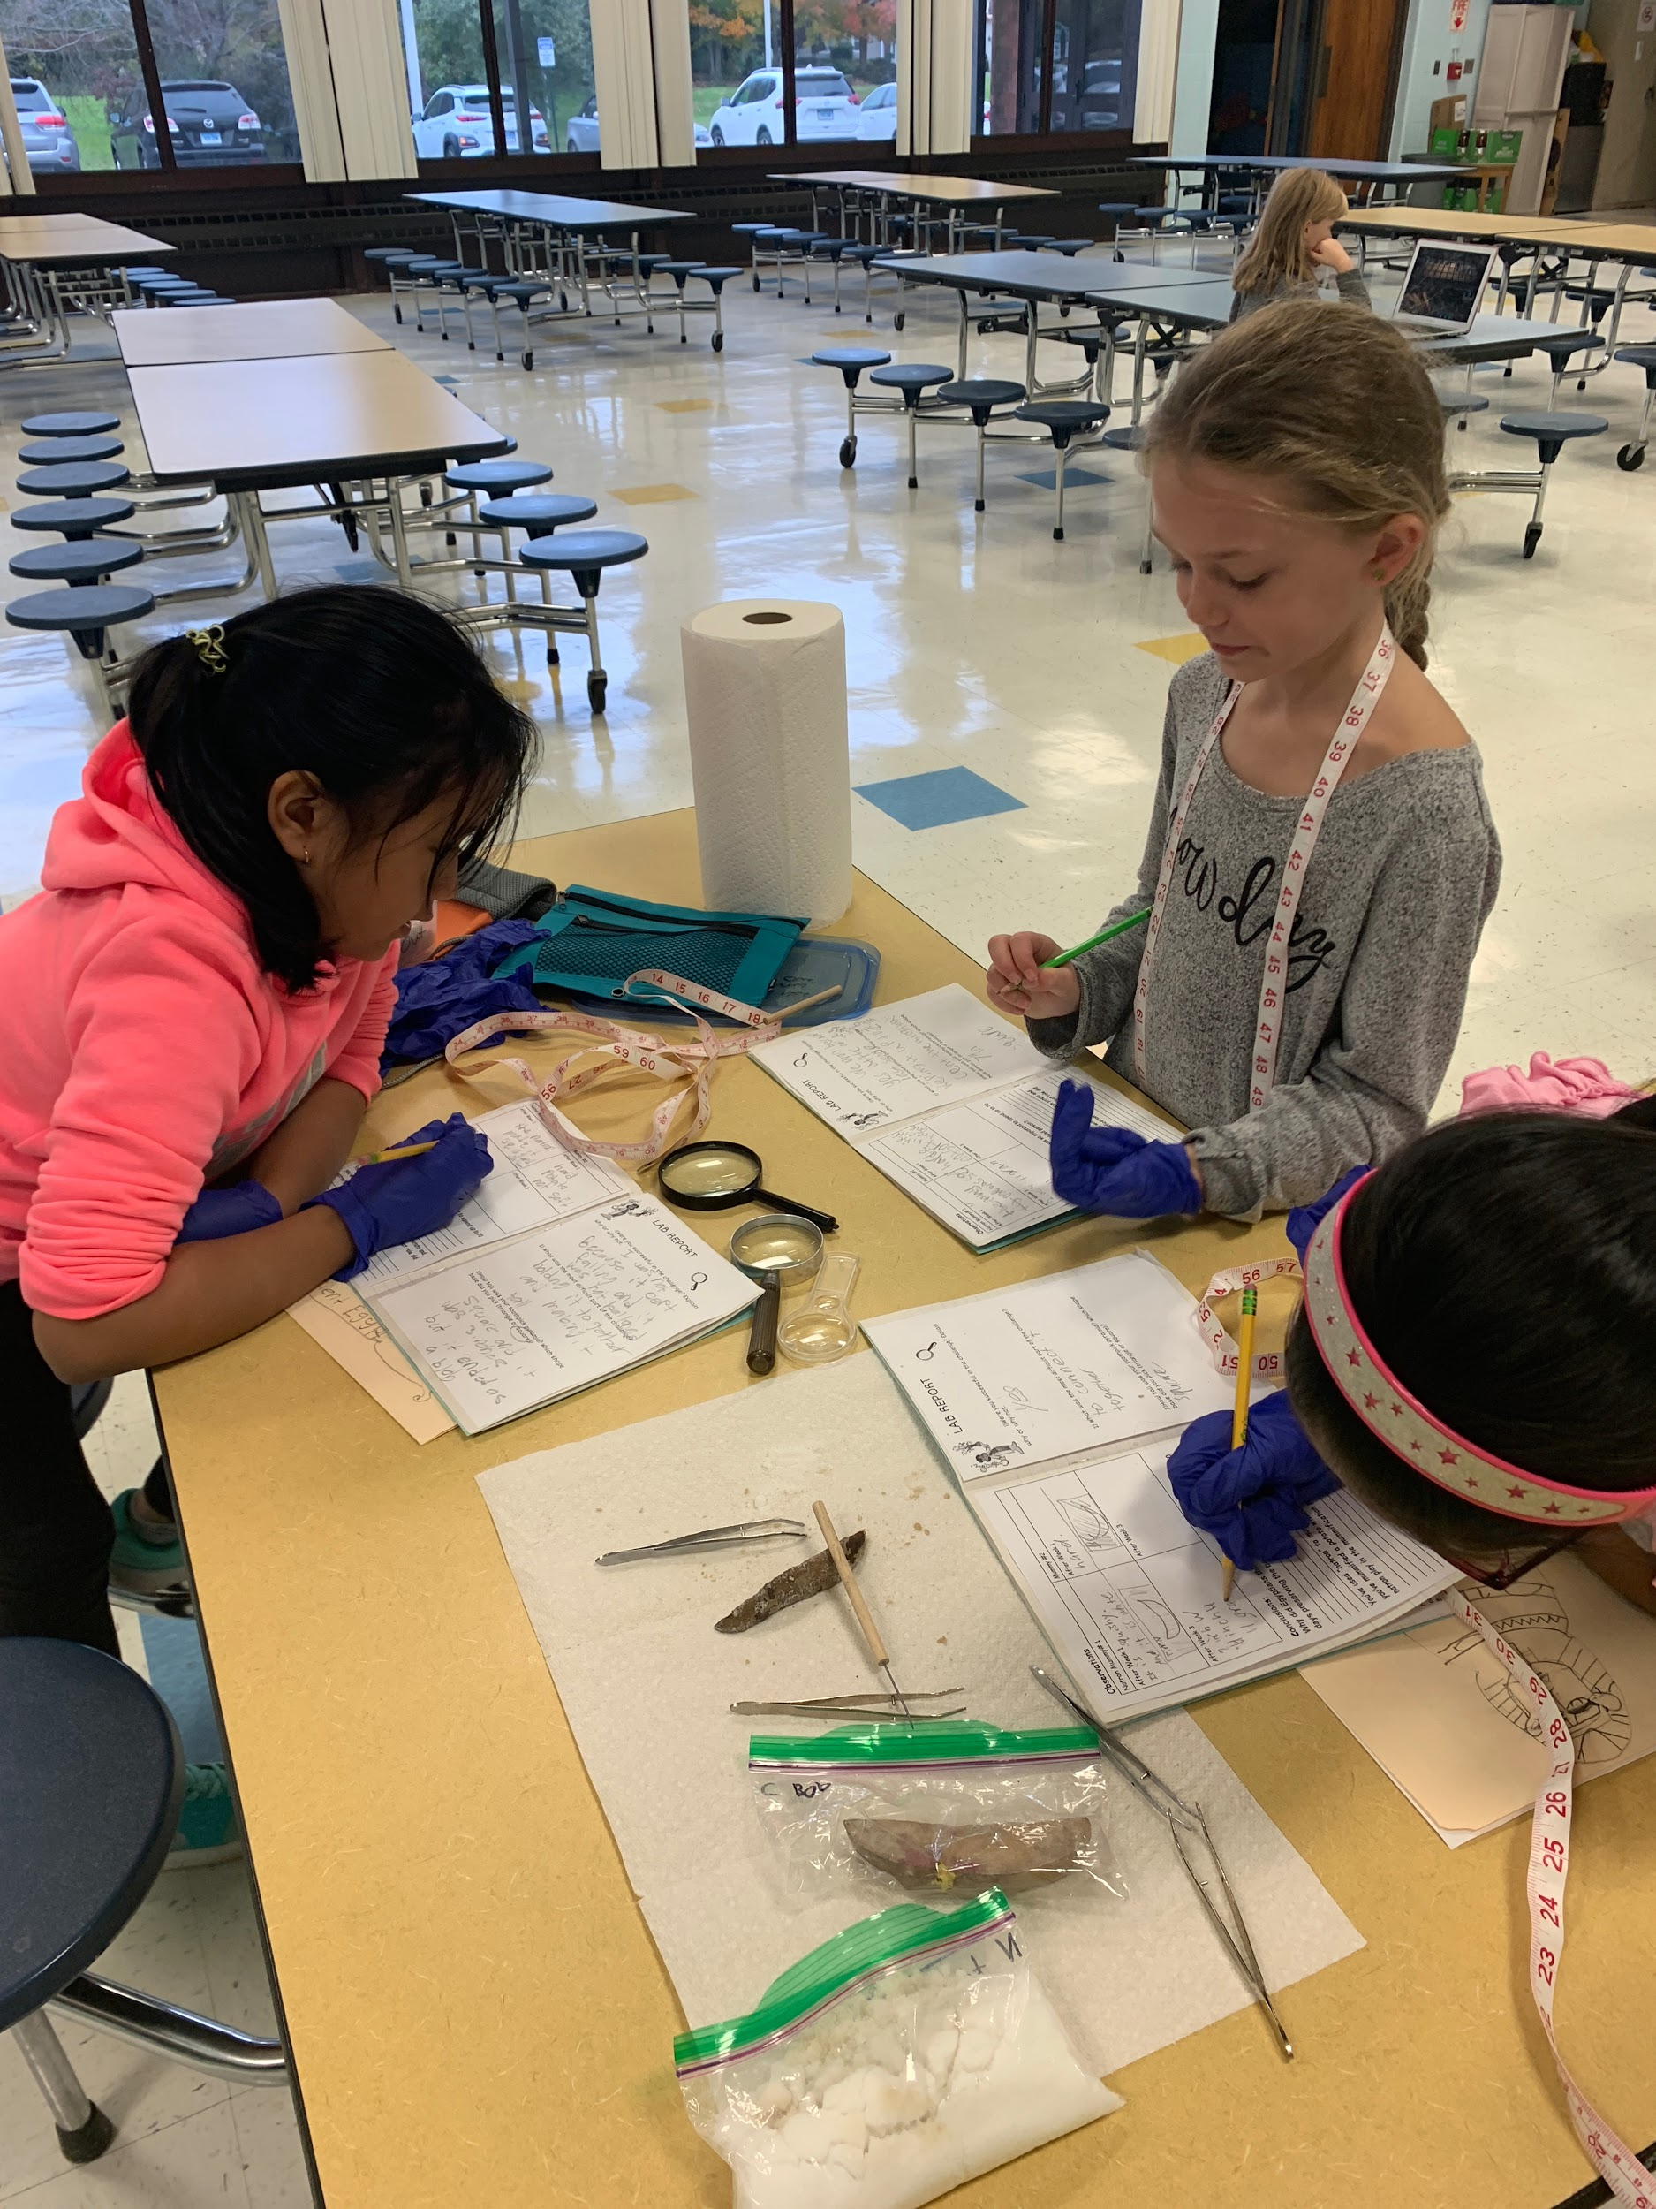

Slide 3
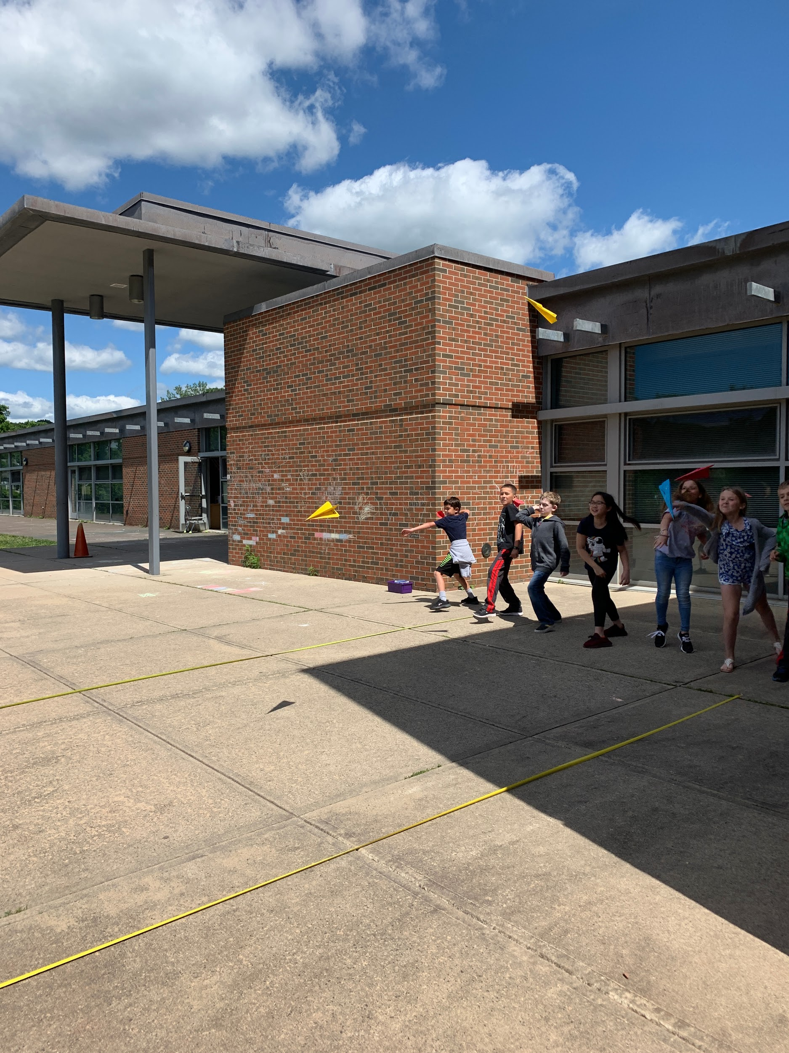
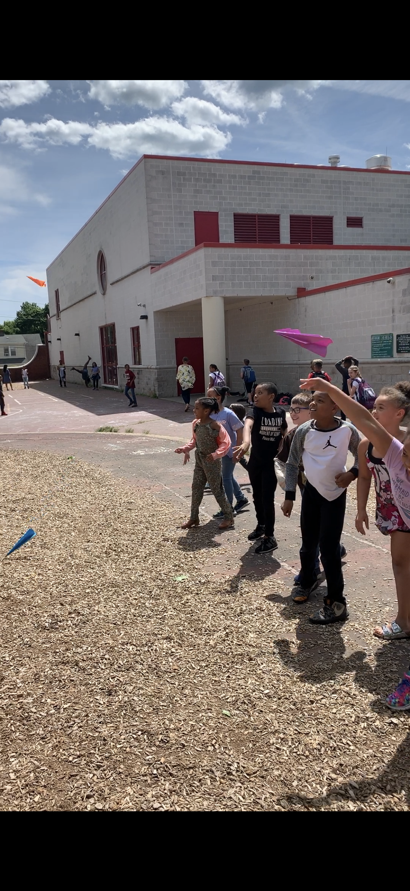
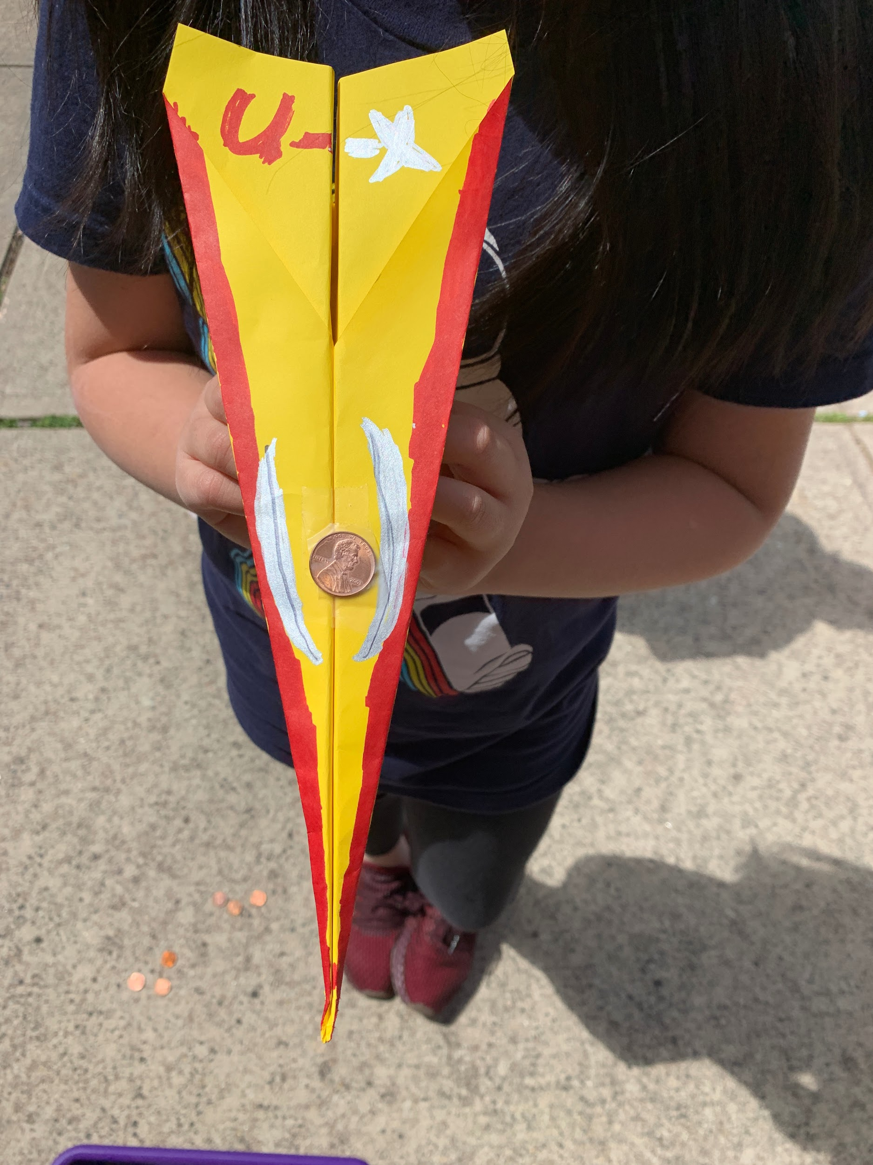
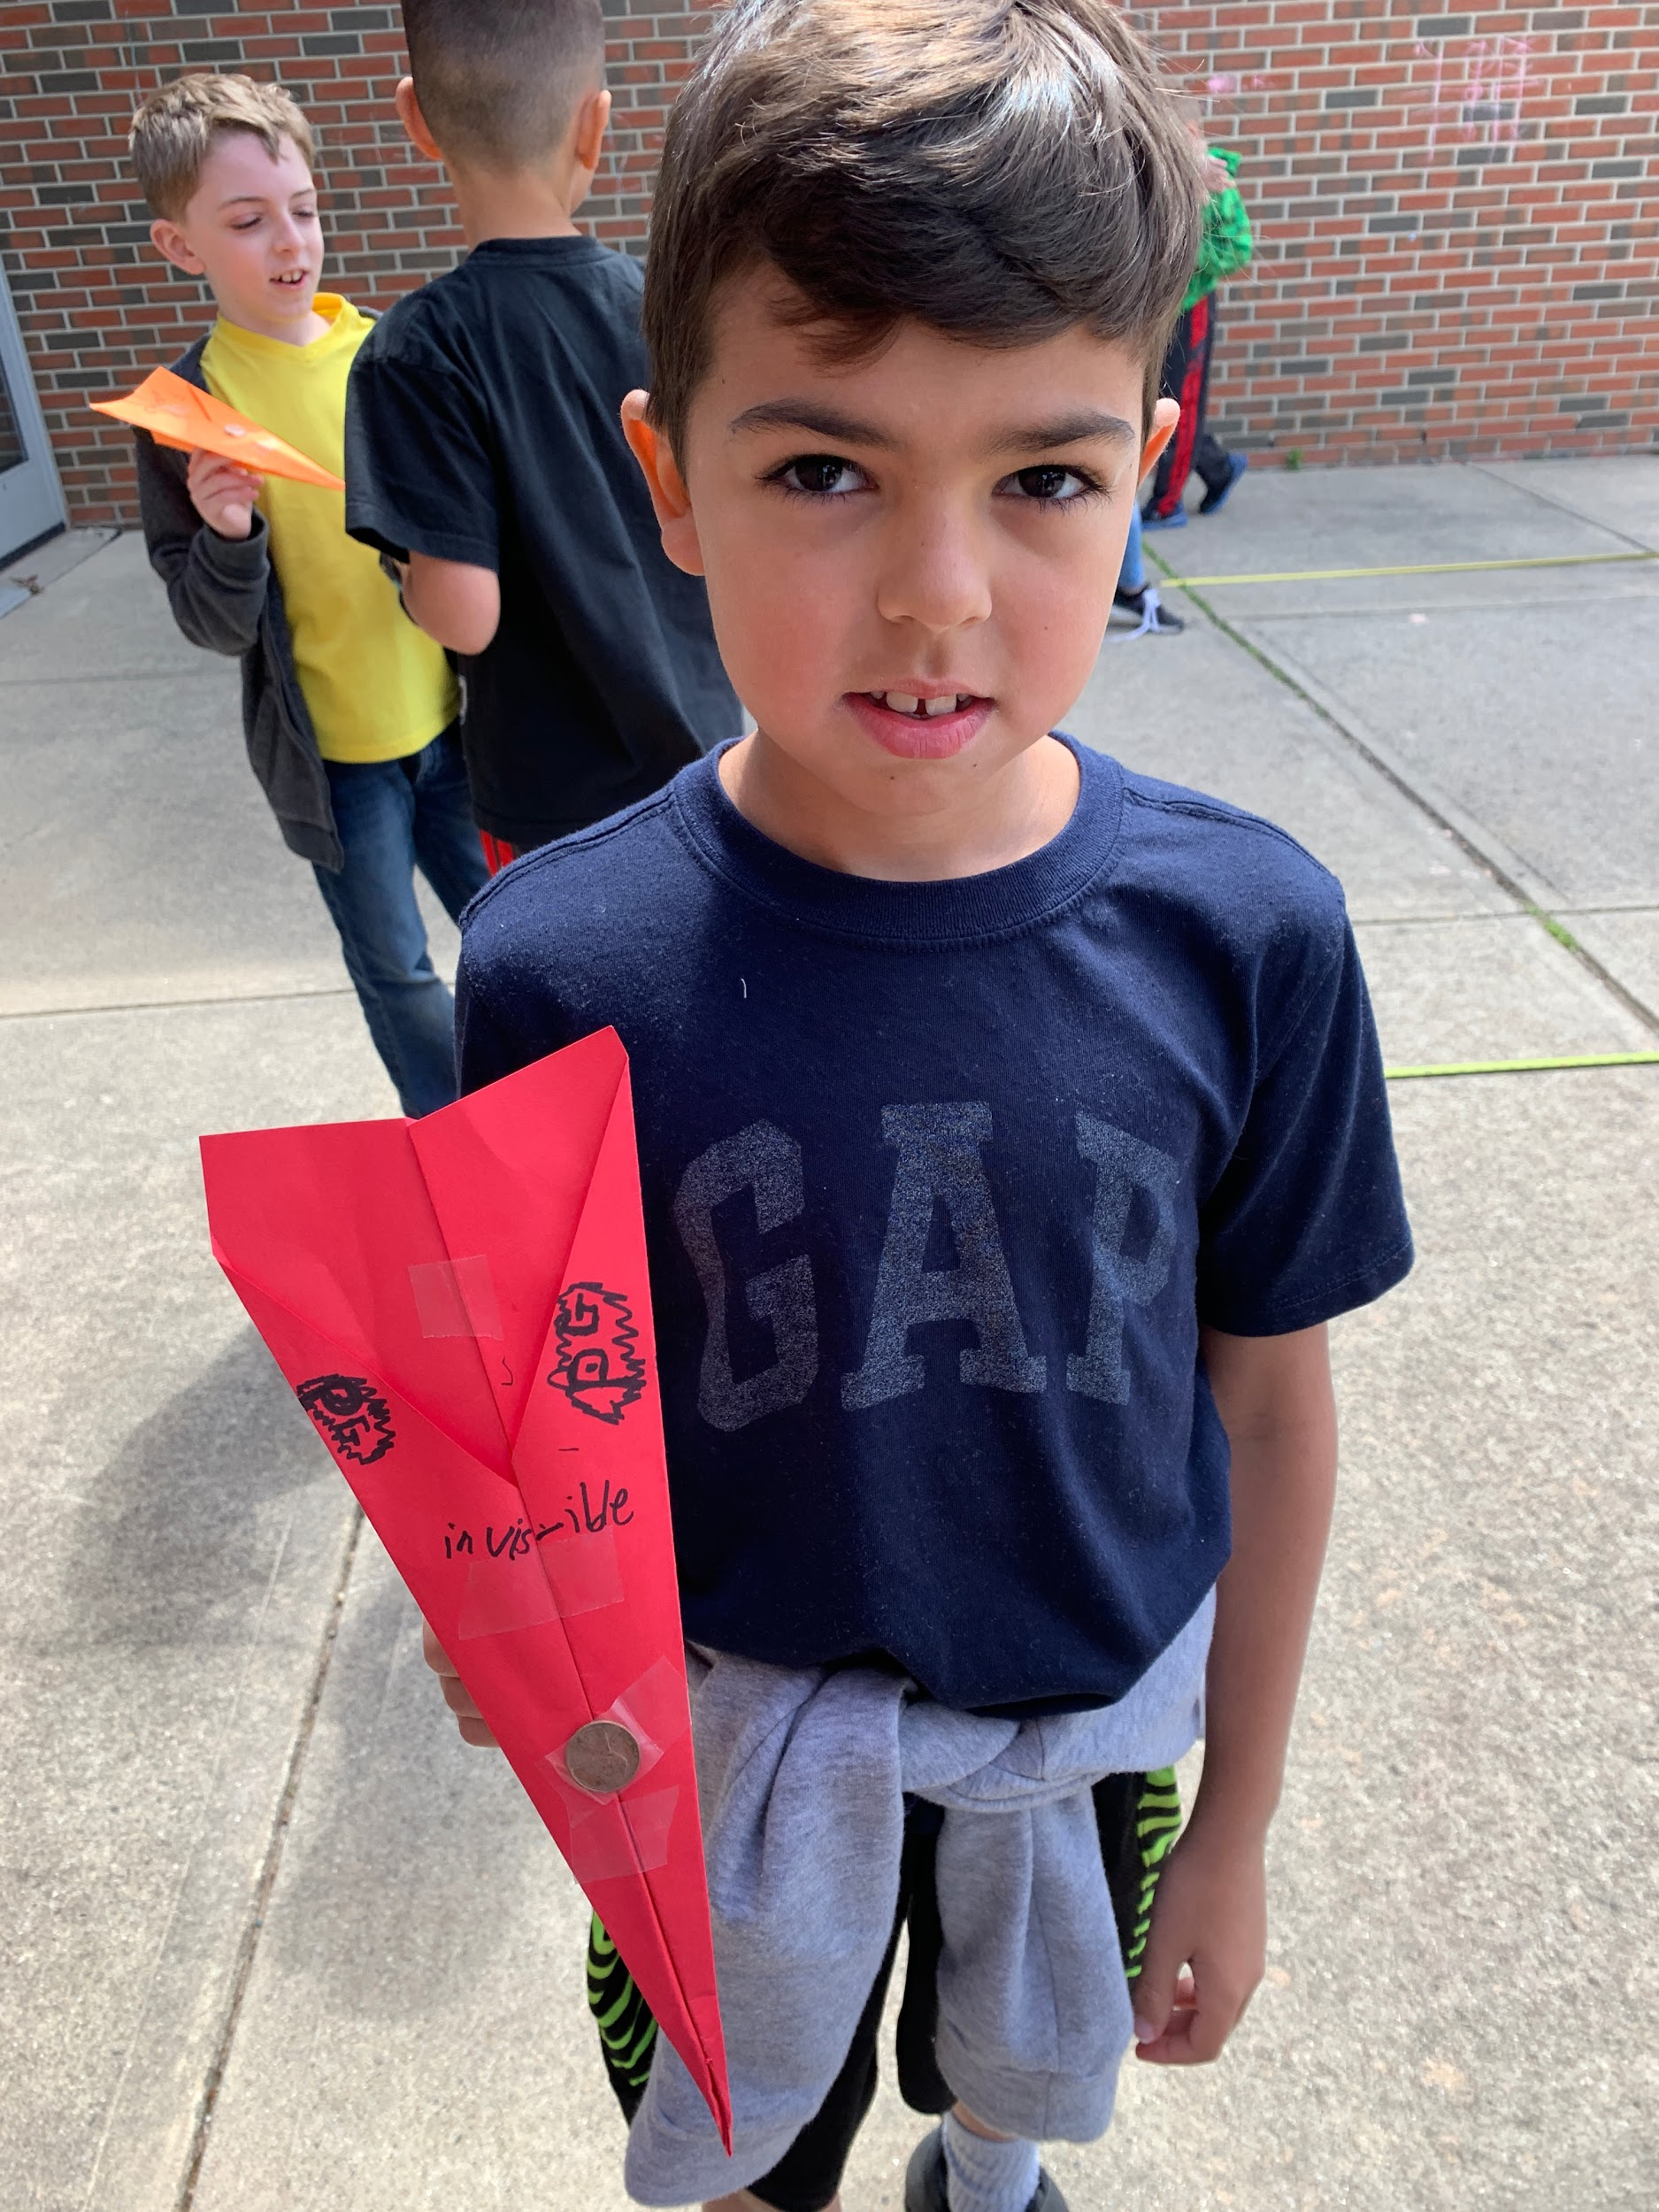

Slide 4
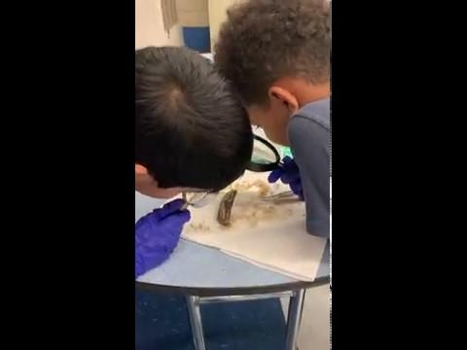

Slide 5
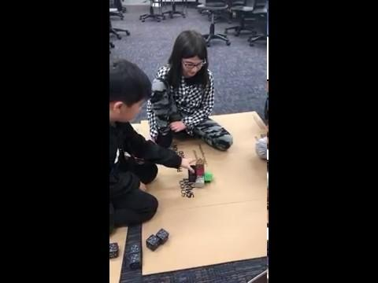

Slide 6
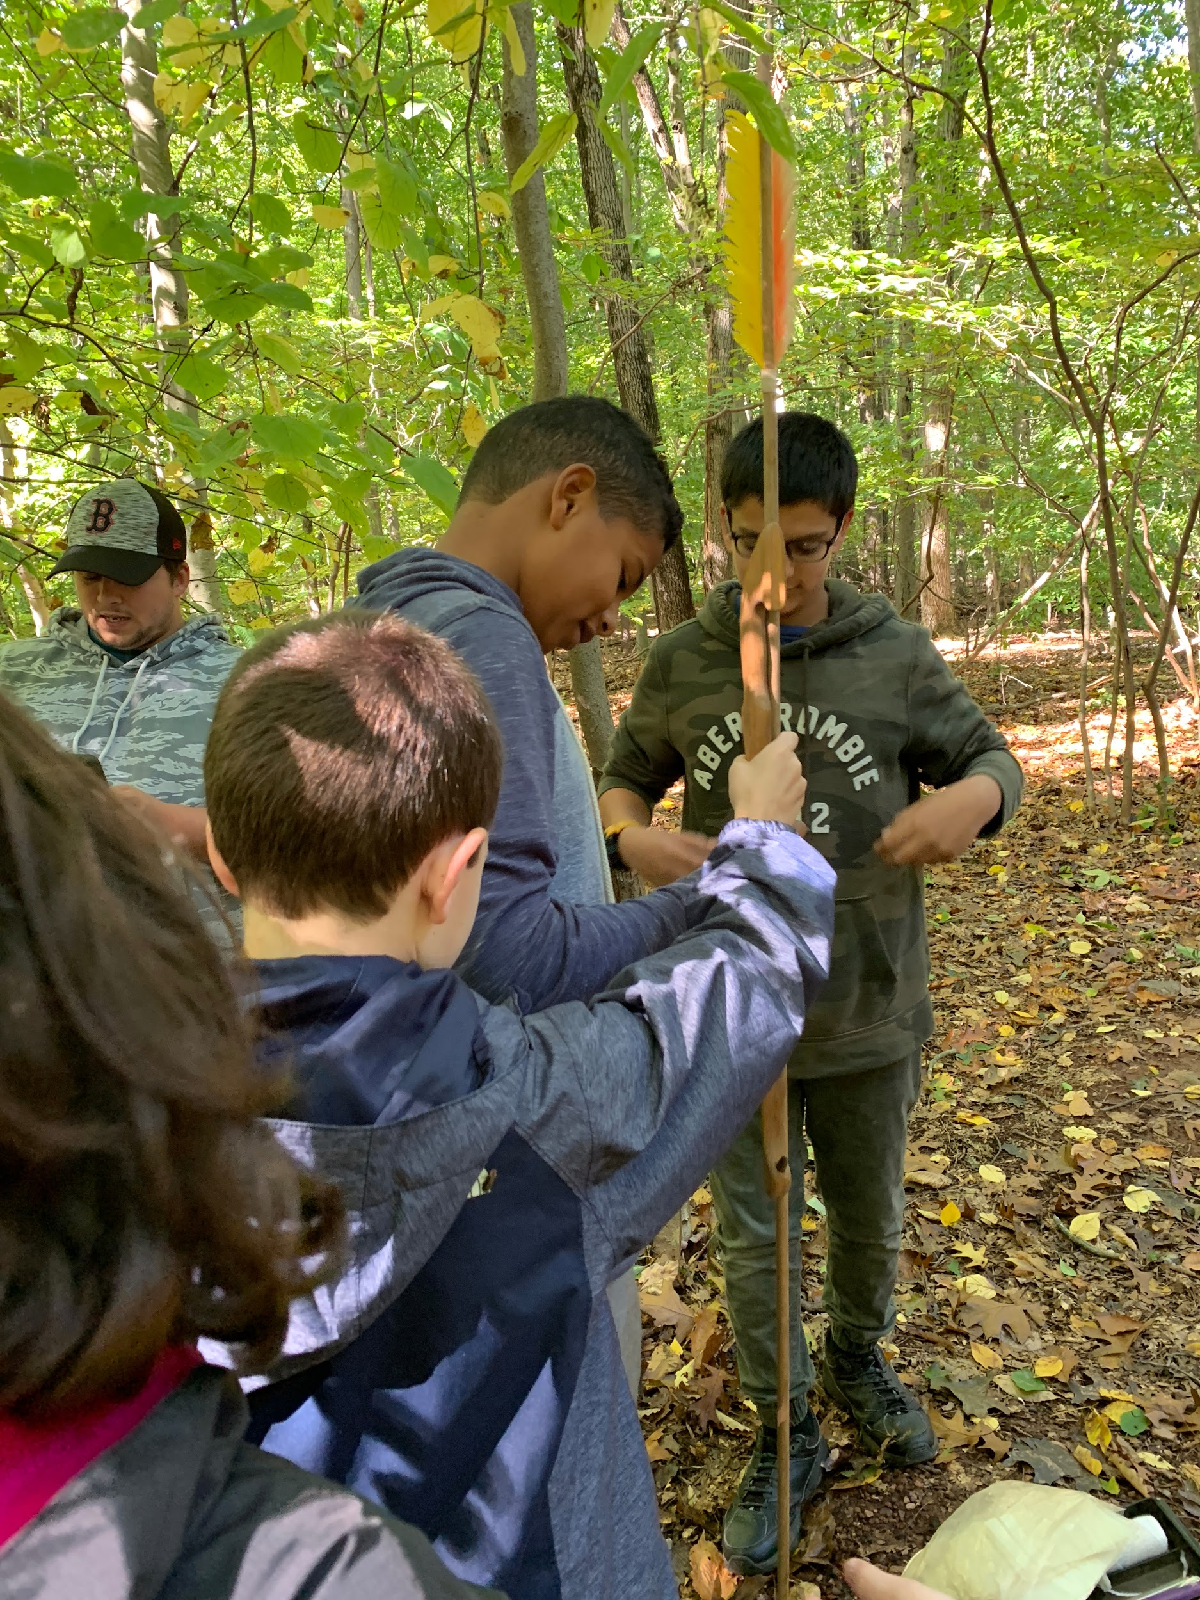
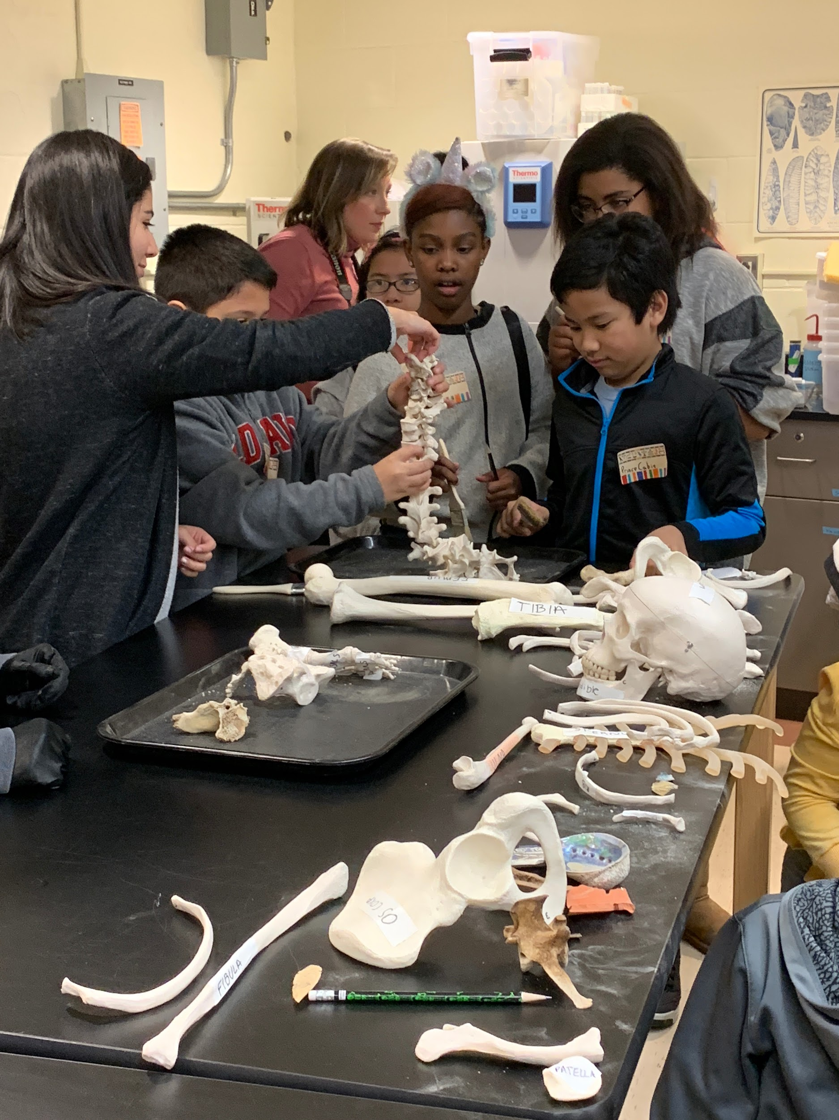

Slide 7
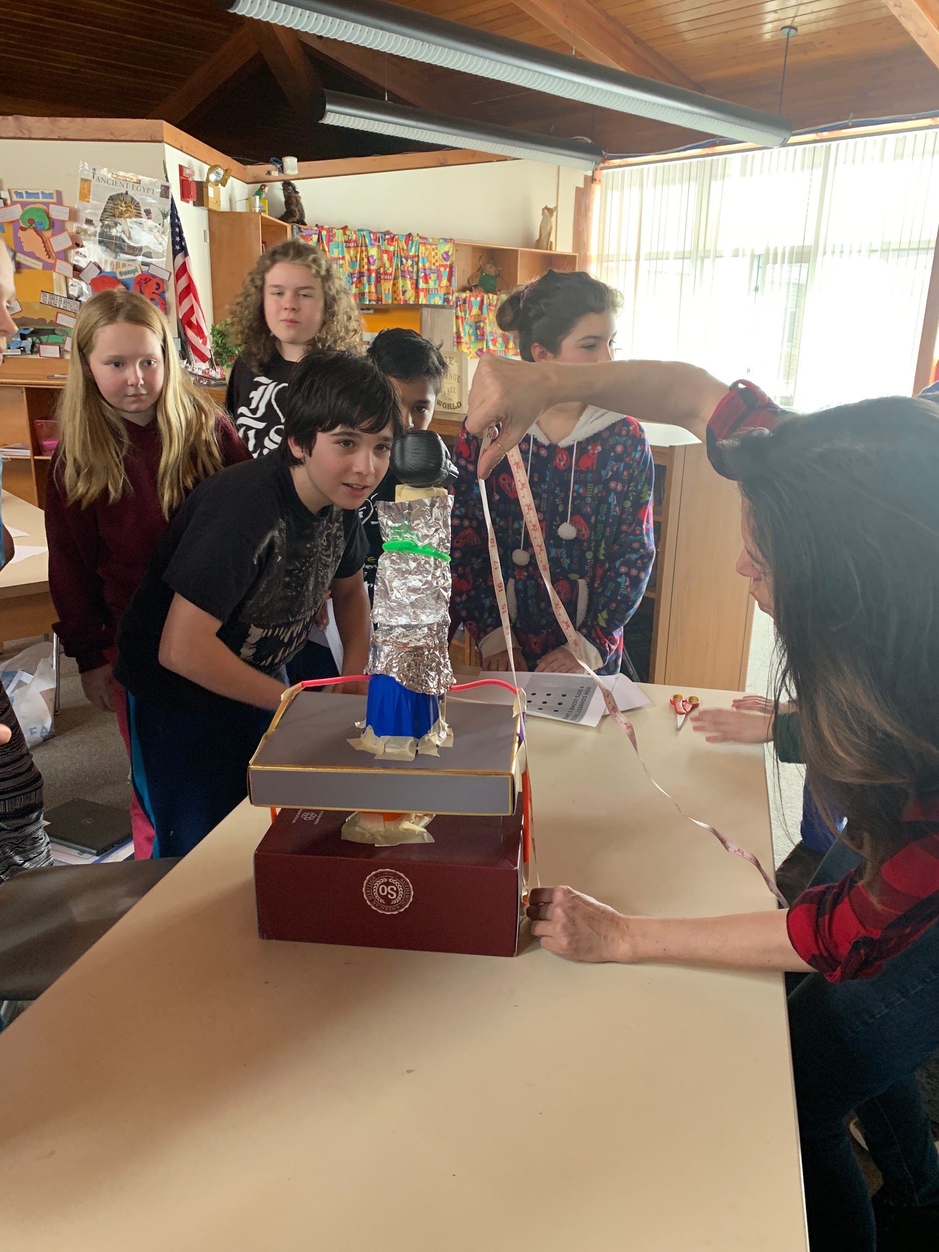
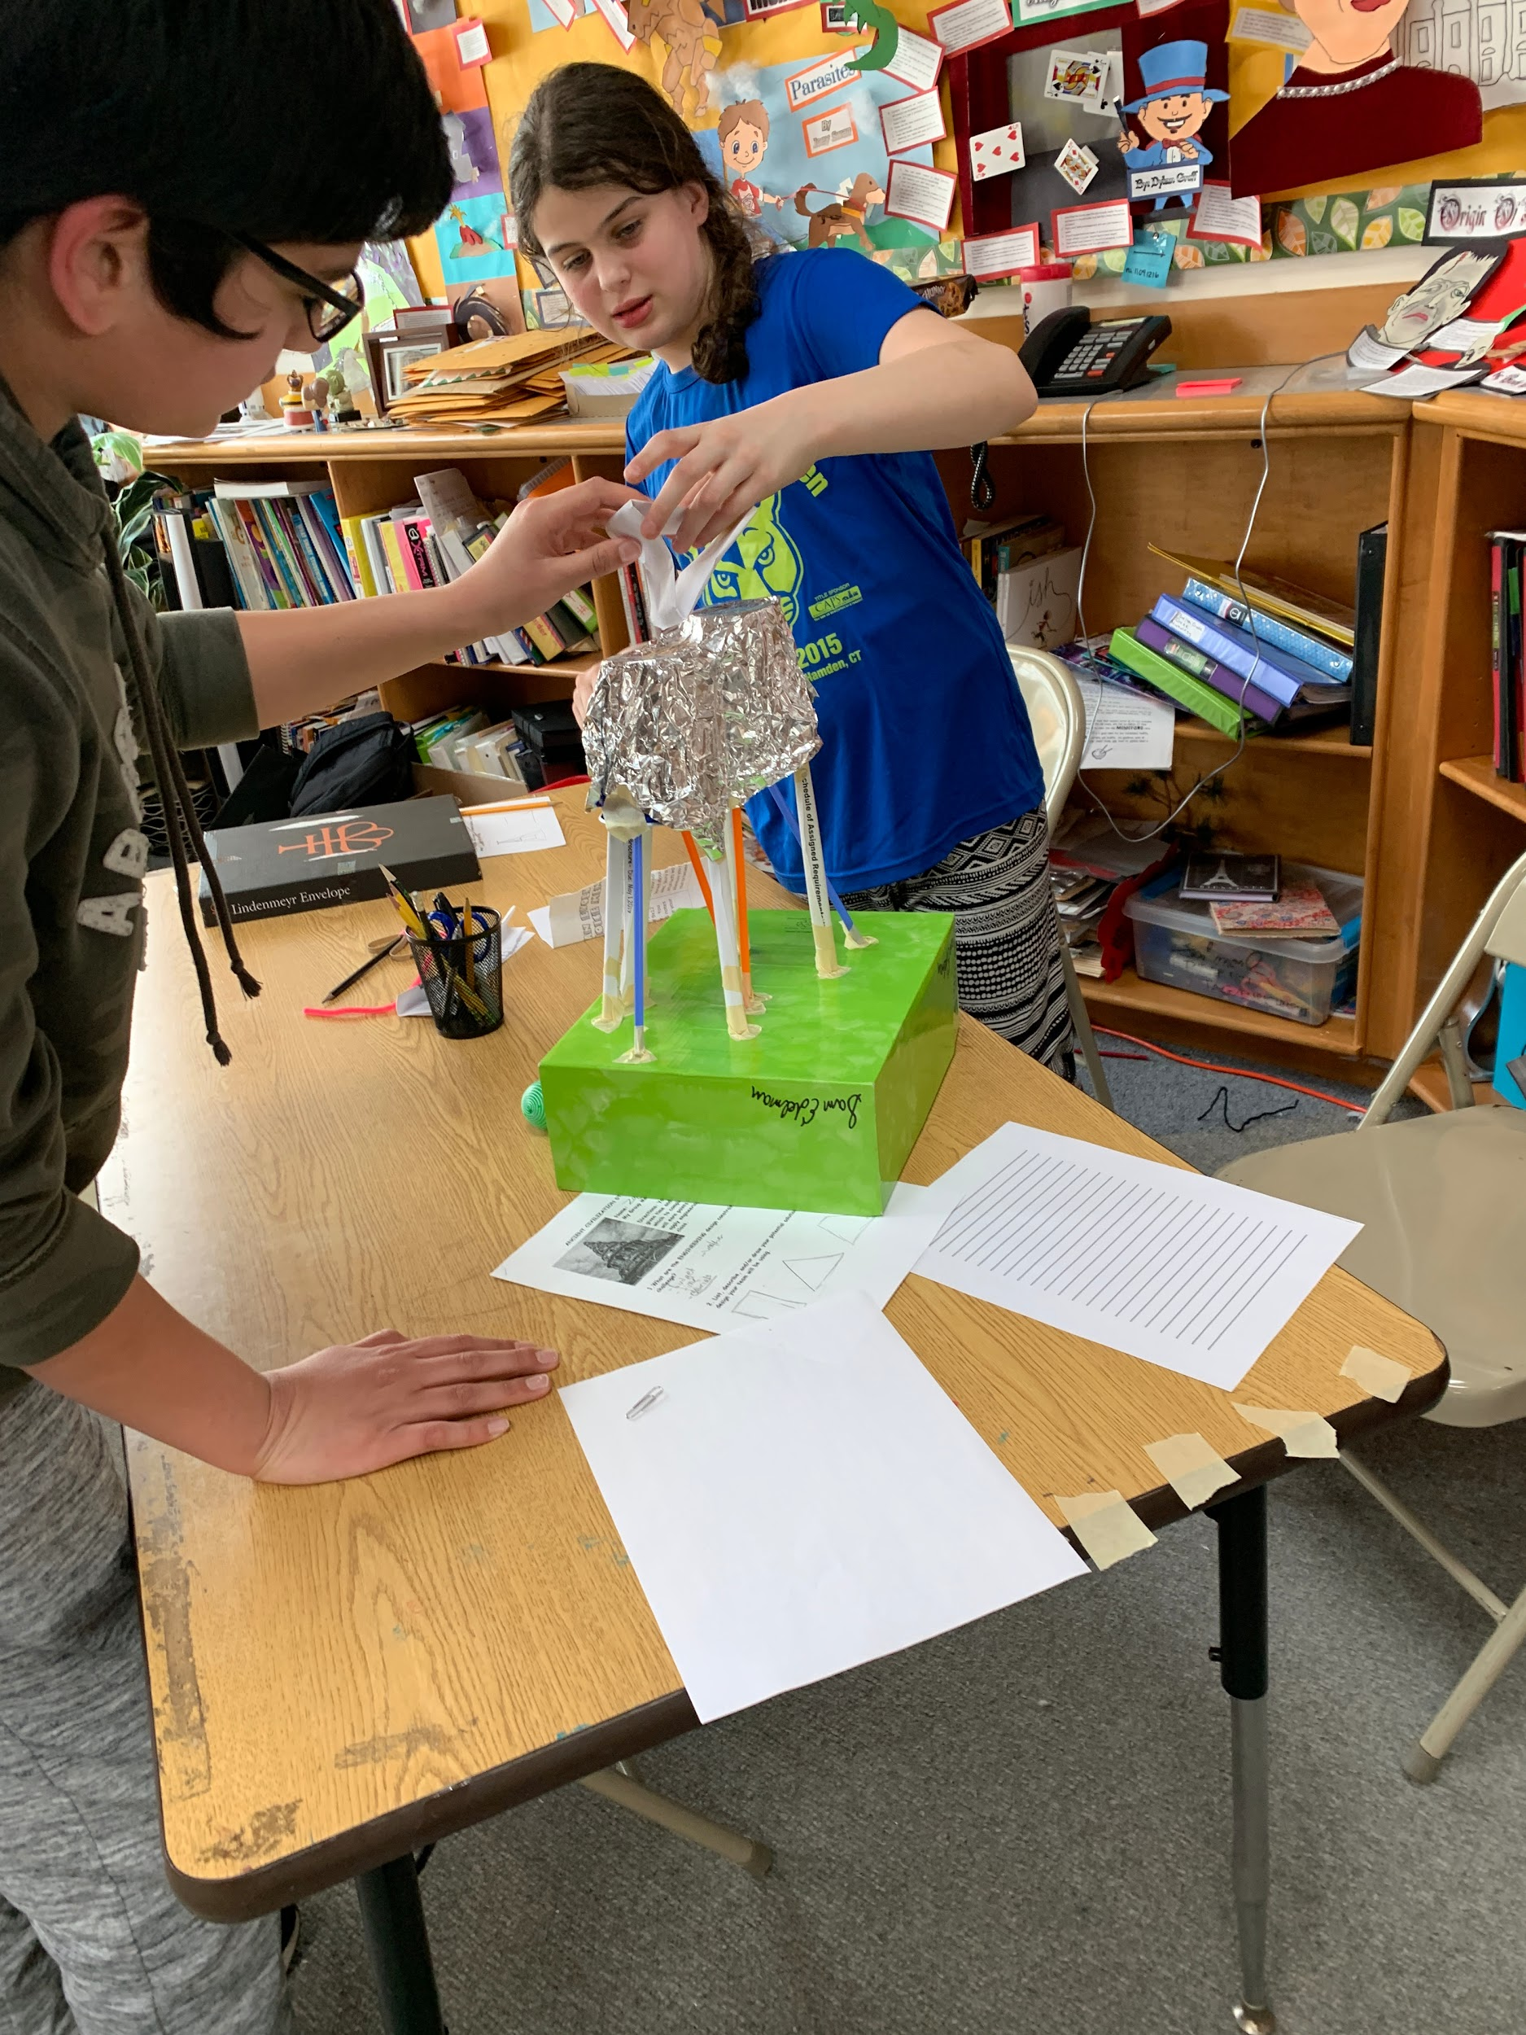
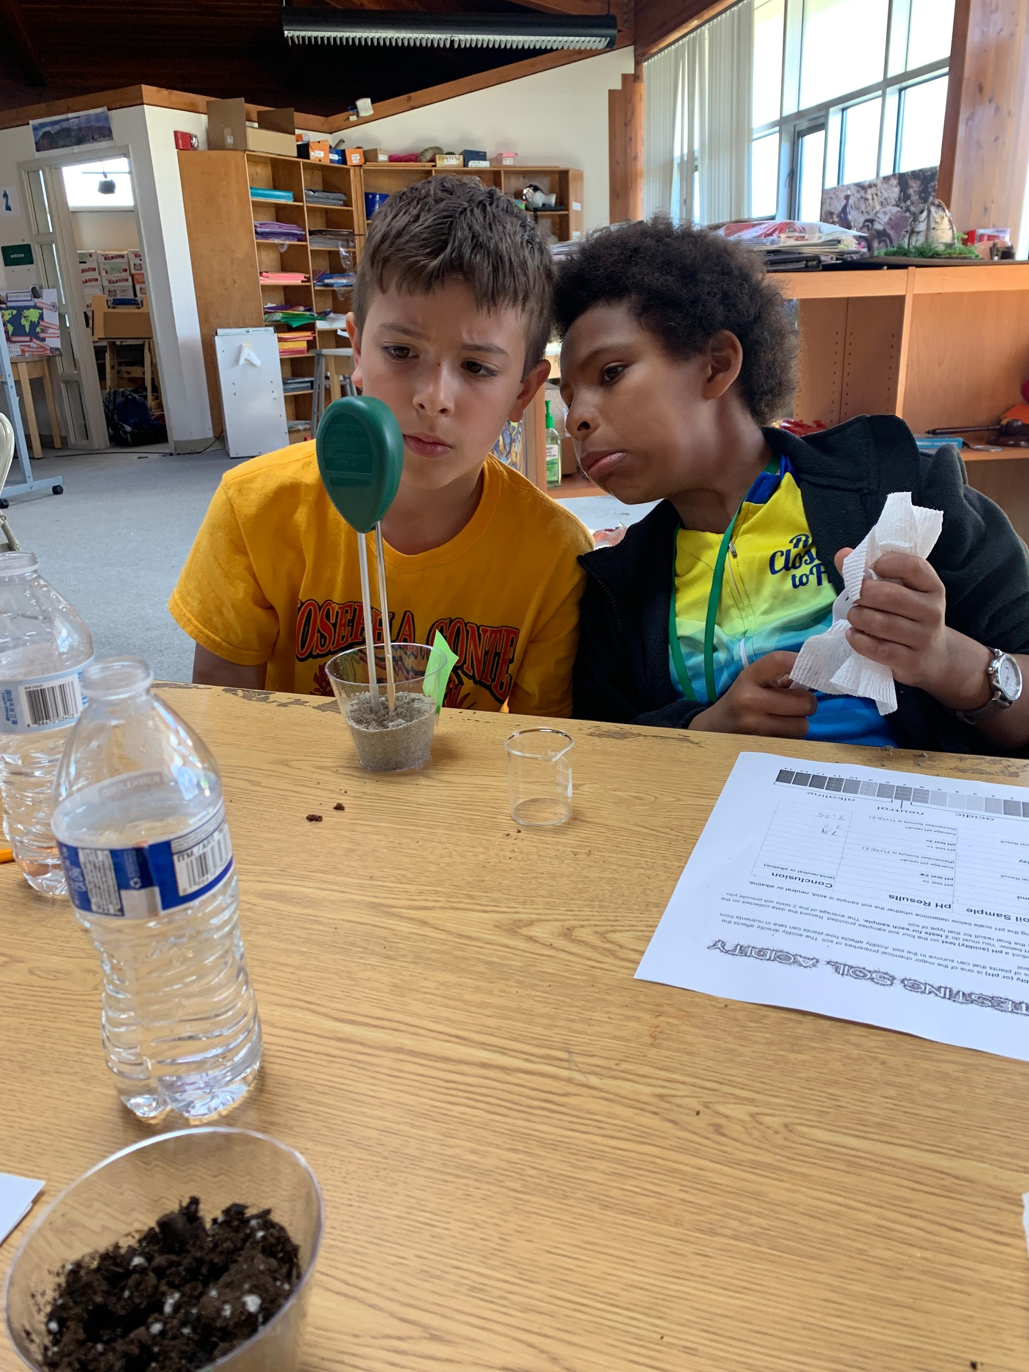
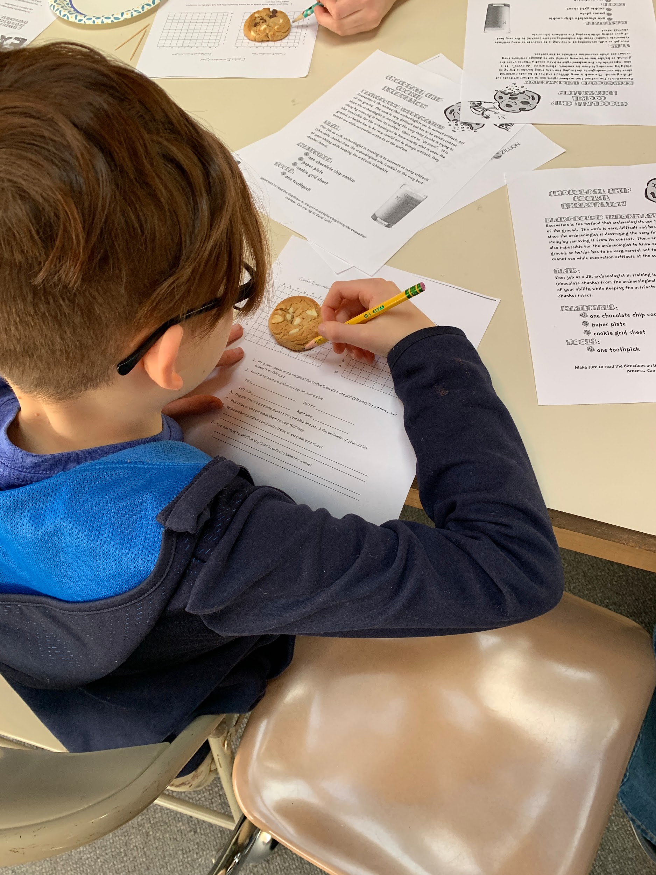
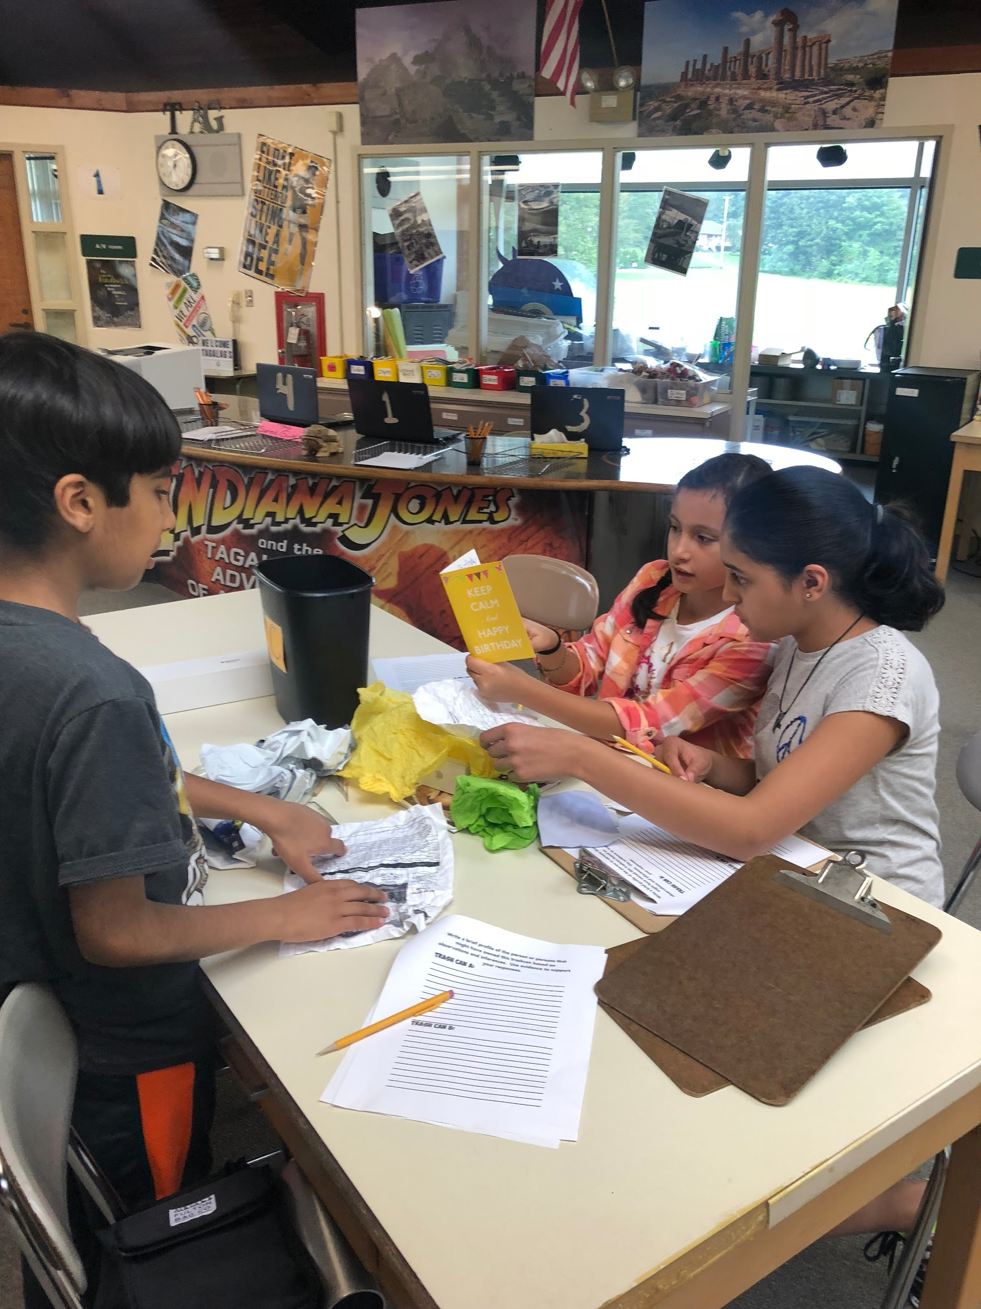

Slide 8
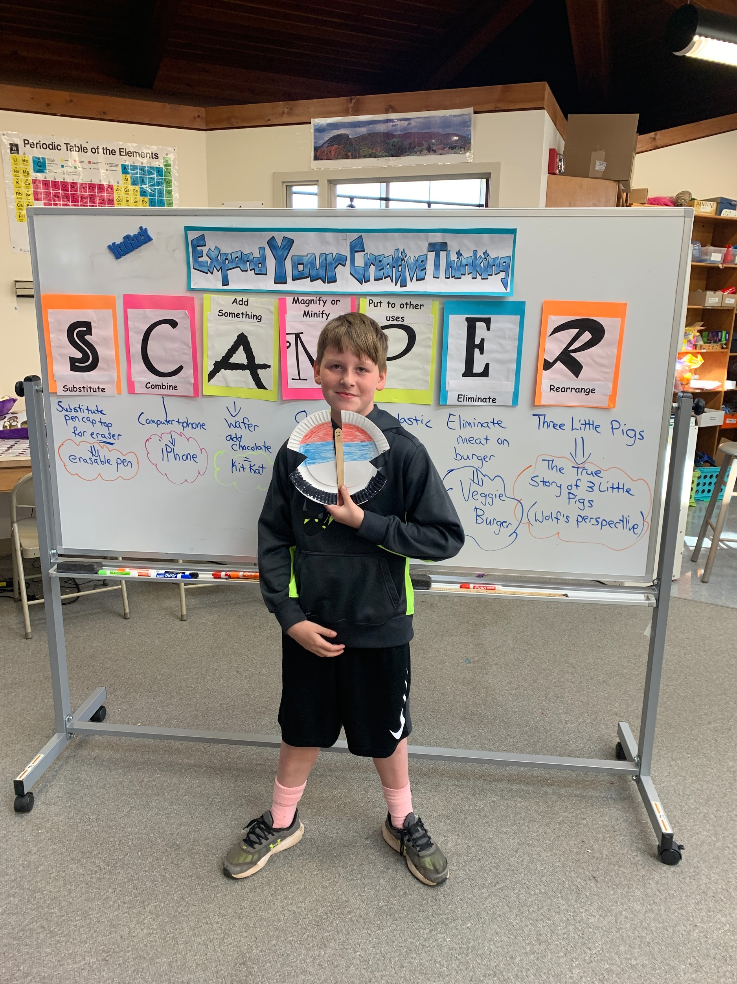
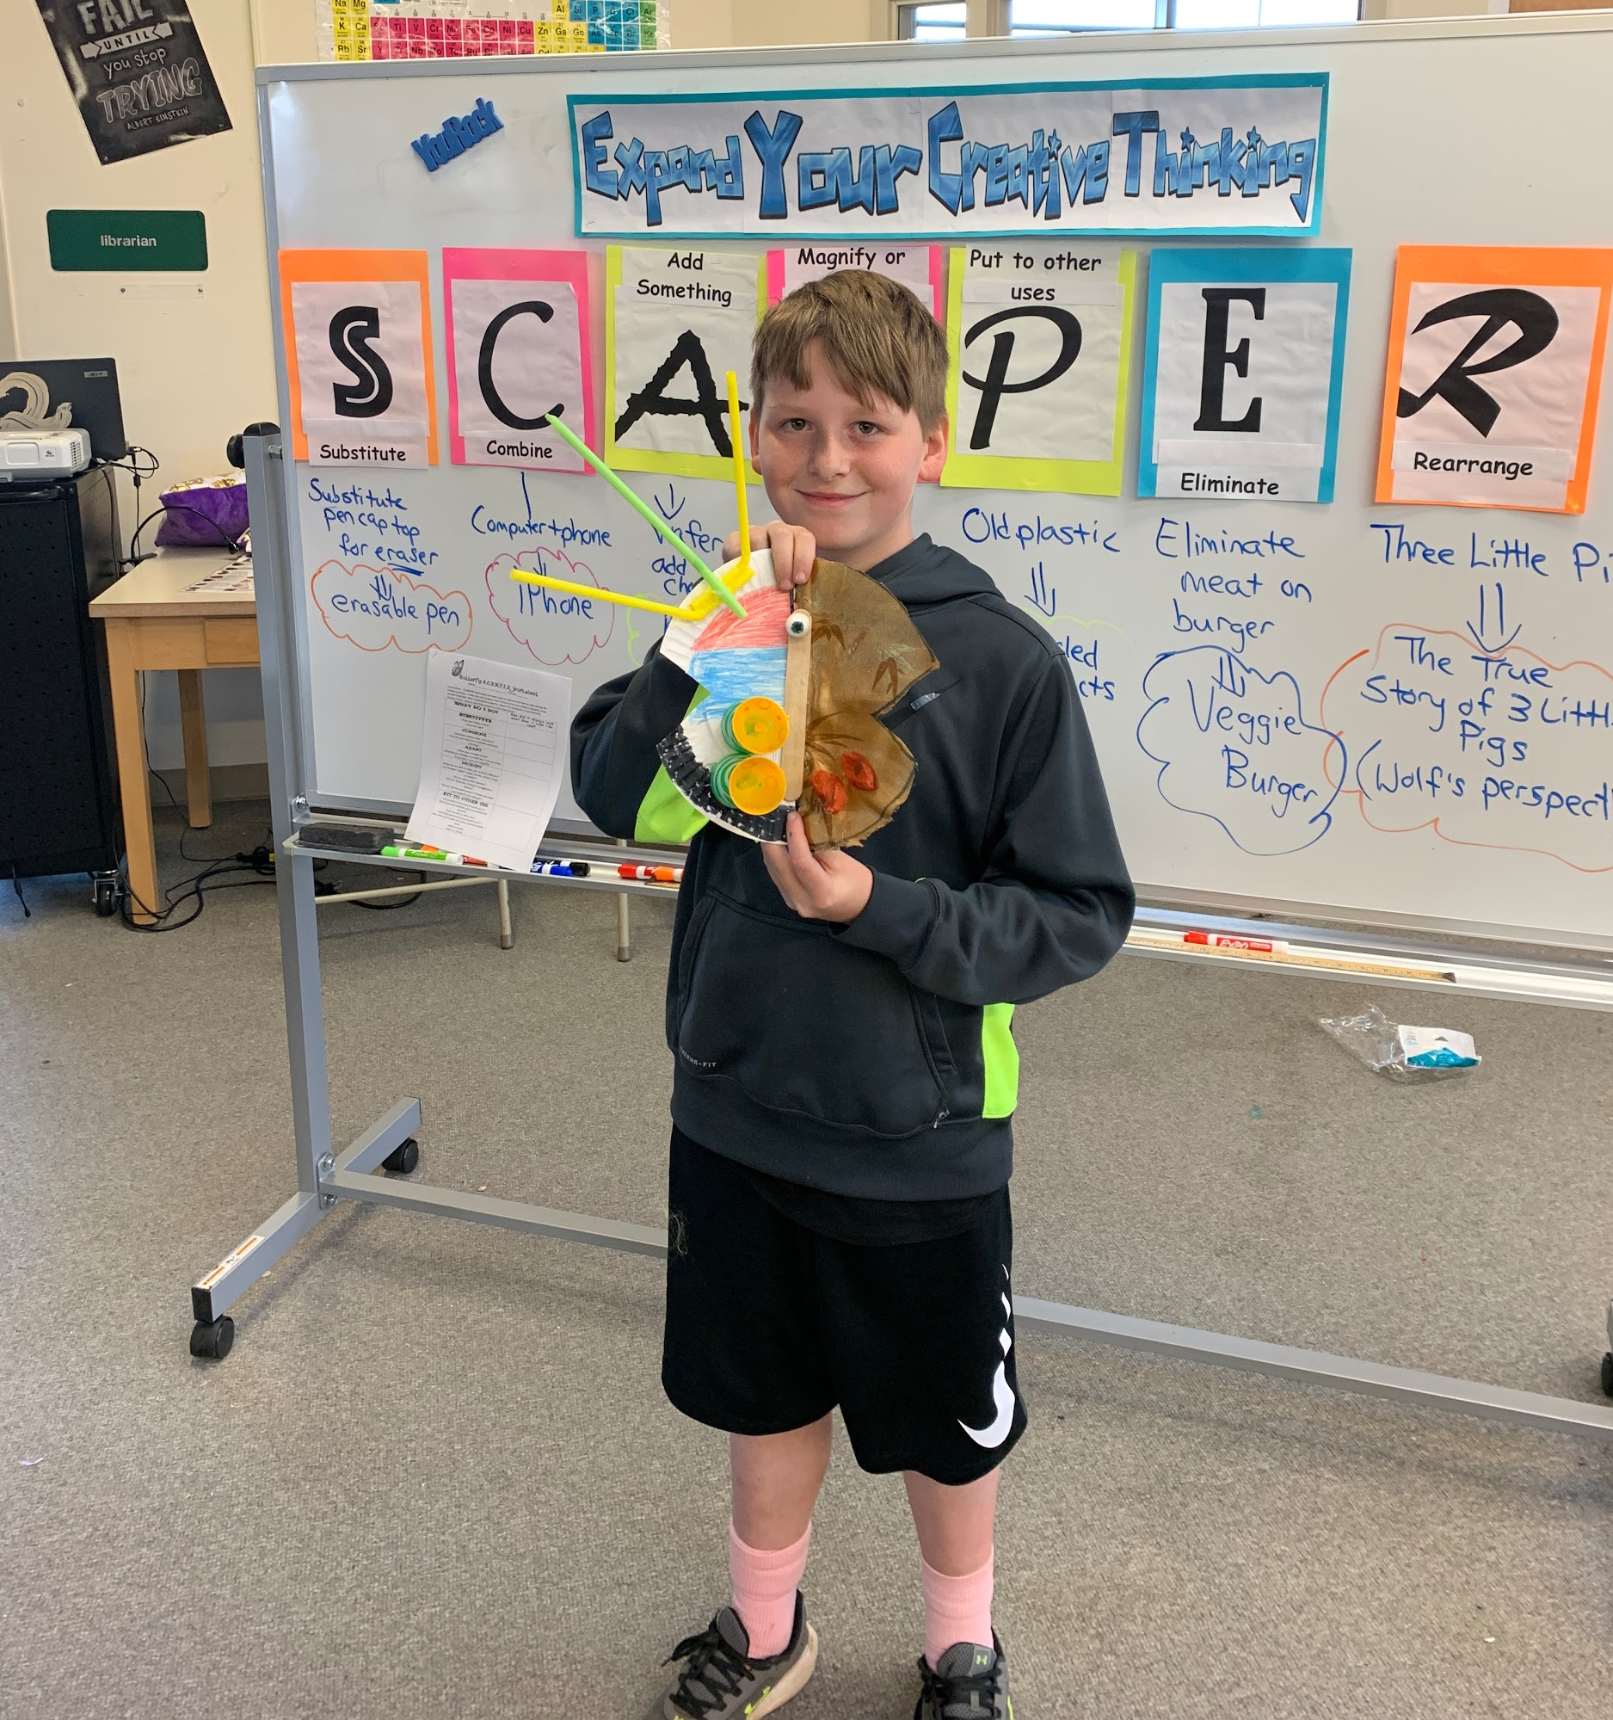

Slide 9
Student Choice Creates HIgh Interest
Choice Menus
Individual Investigations

Slide 10
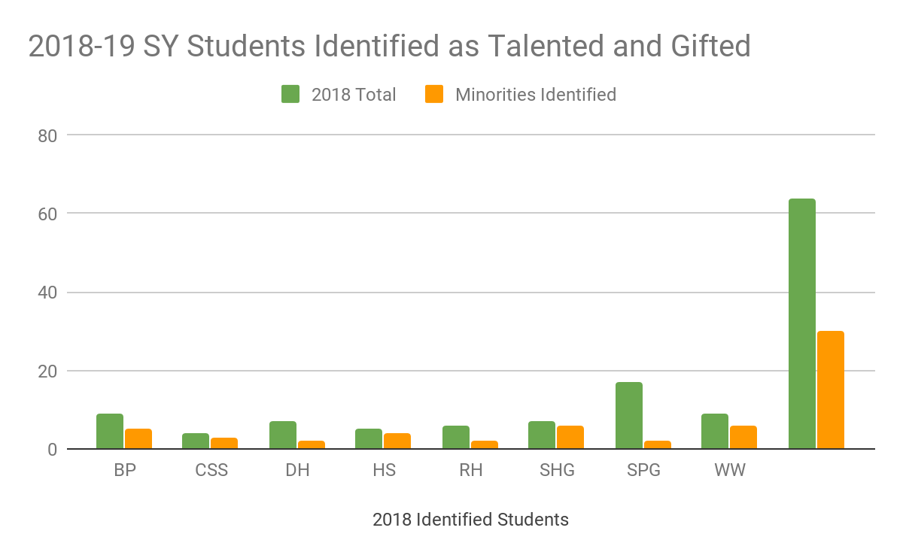
Students in TAG This Year

Slide 11
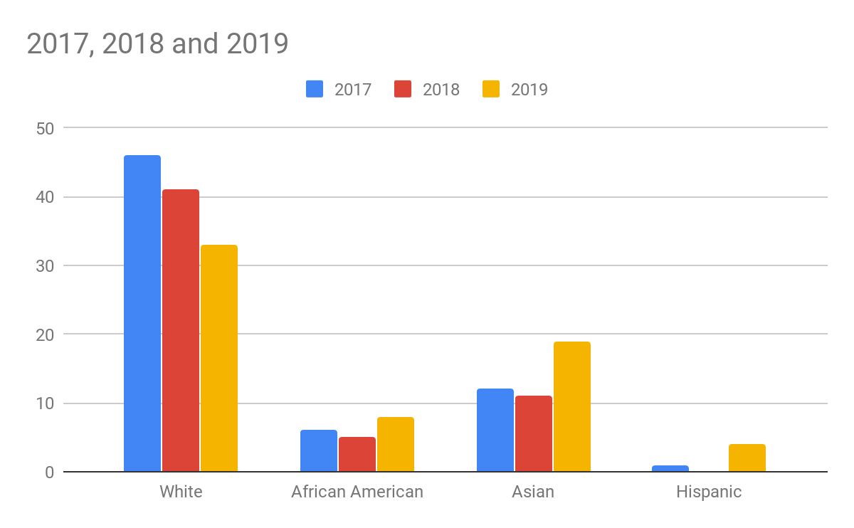
TAG Student Population

Slide 12
Current Identification Goal: To seek out students from underrepresented populations (such as children of color and children from low socioeconomic backgrounds).

Slide 13
Steps taken to address goal:
Using NWEA scores to find enrichment participants.
Creating a 4th session of enrichment.
Developing a performance task that assesses creativity for identification.
Trying alternative non-verbal testing.
Nominations open to parents.

Slide 14
115 Nominations- 2019
124 Nominations-2018
92 Nominations- 2017
93 Nominations-2016

Slide 15
Parent Nominations
Last Year
Bear Path 3
Dunbar Hill 1
Shepherd Glen 1
Spring Glen 16
West Woods 4

Slide 16
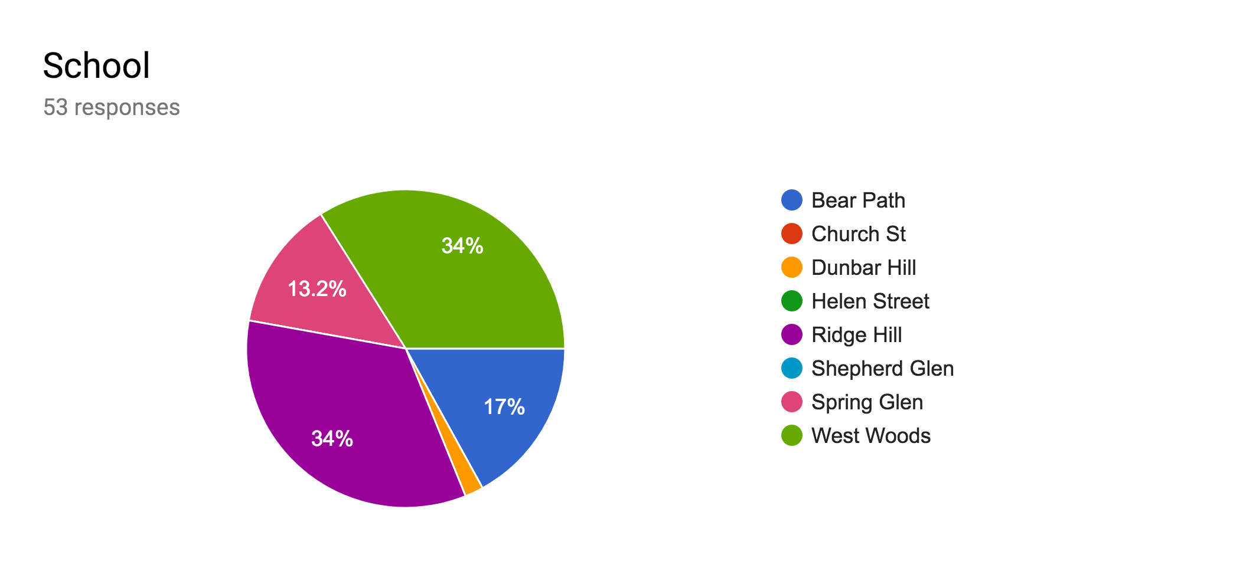
Parent Nominations This Year

Slide 17
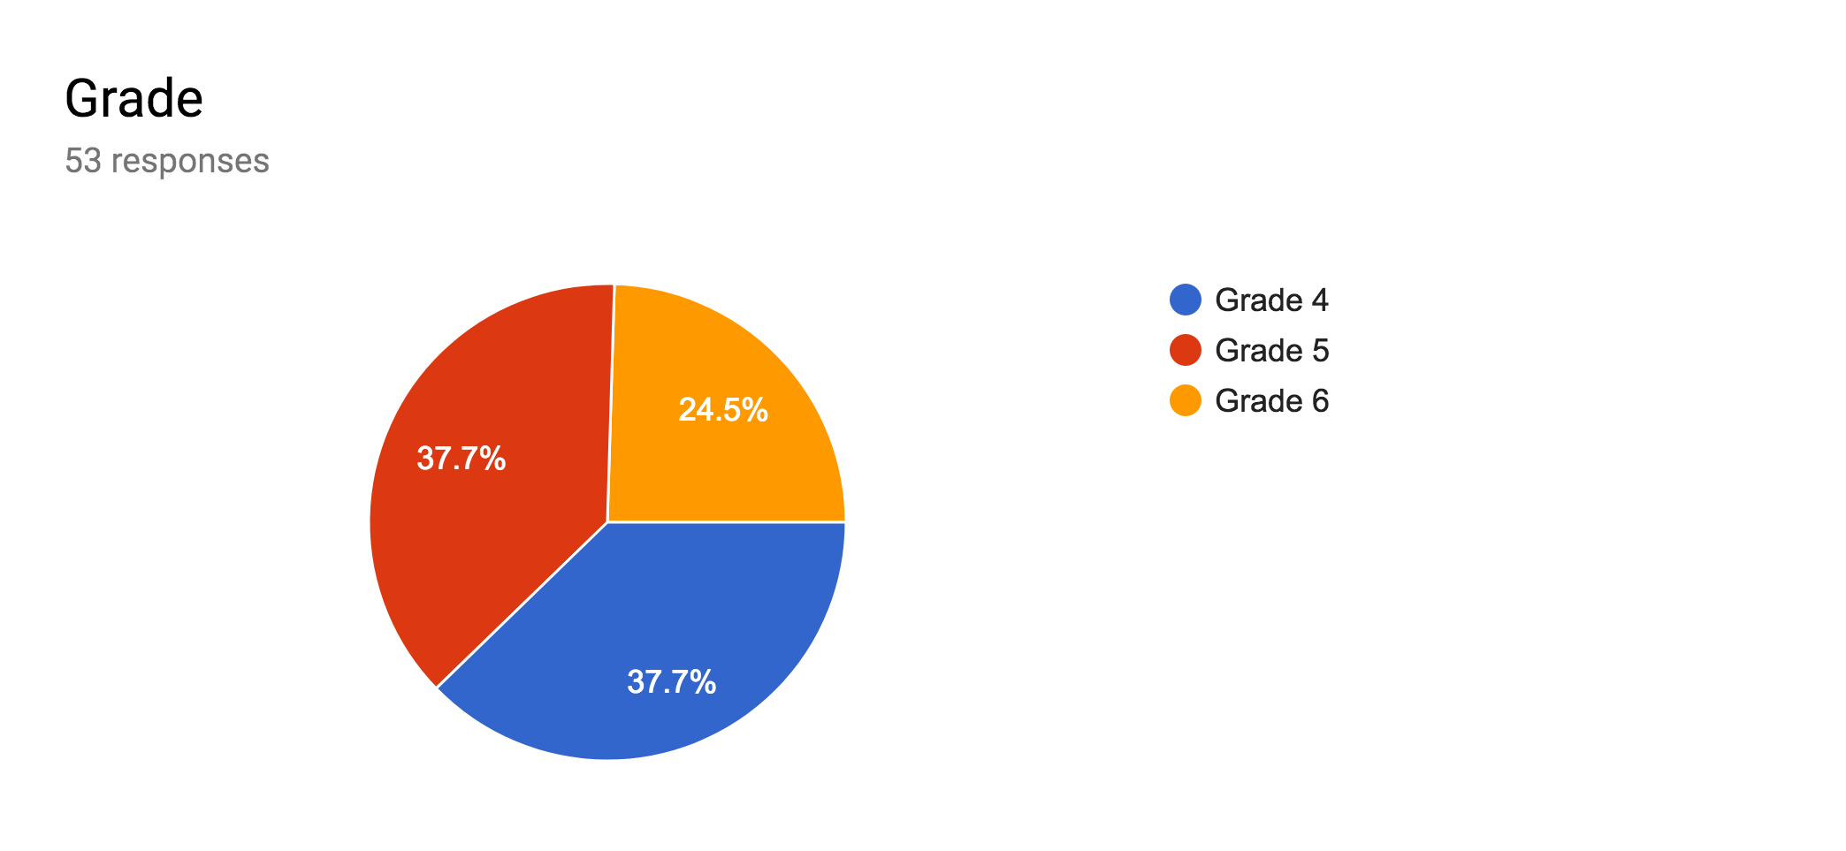
Parent Nominations This Year By Grade

Slide 18
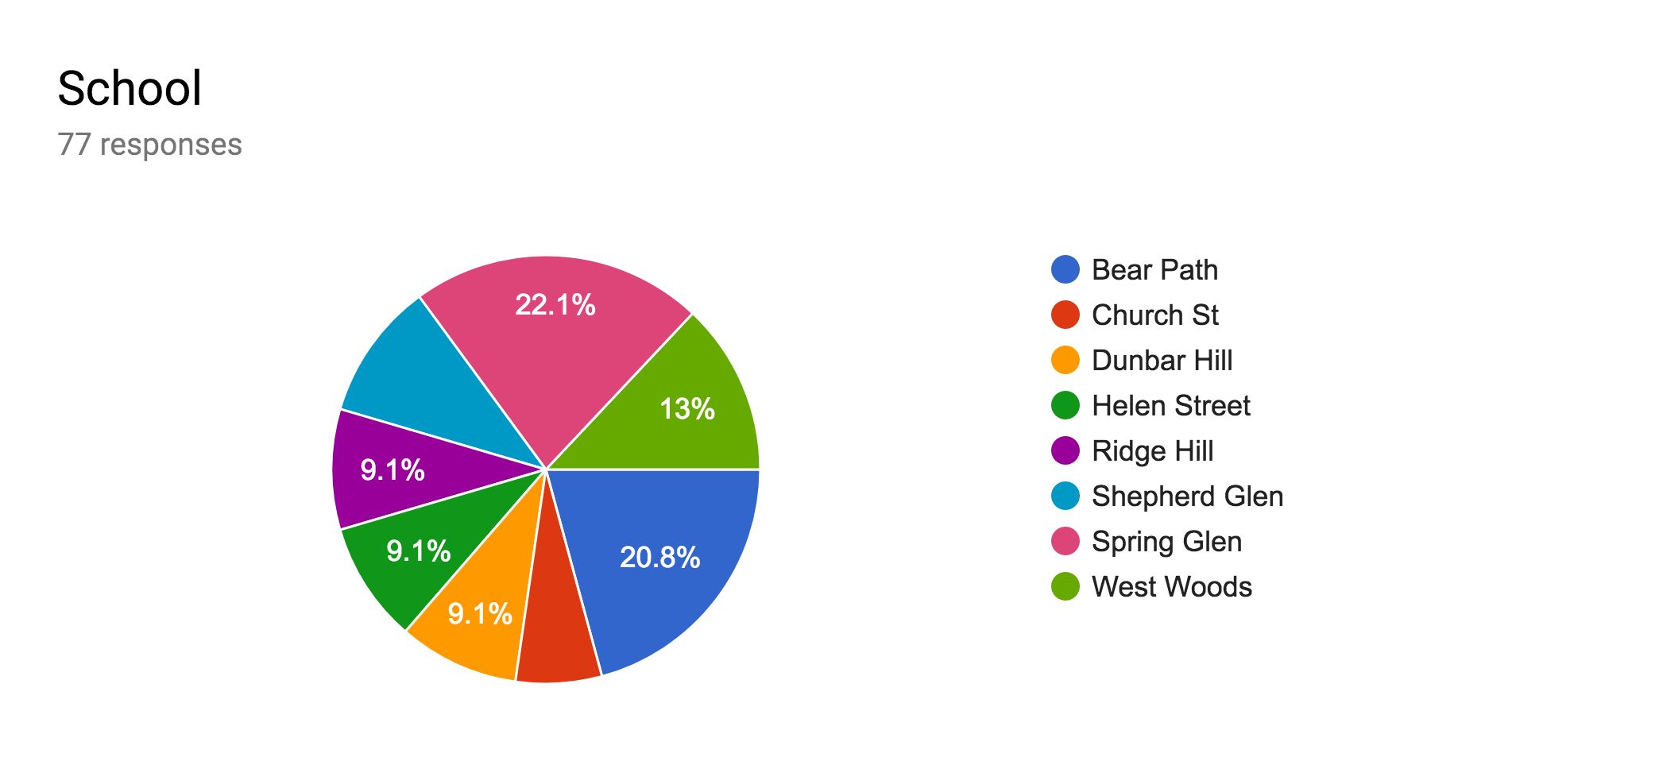
Teacher Nominations This Year By School

Slide 19
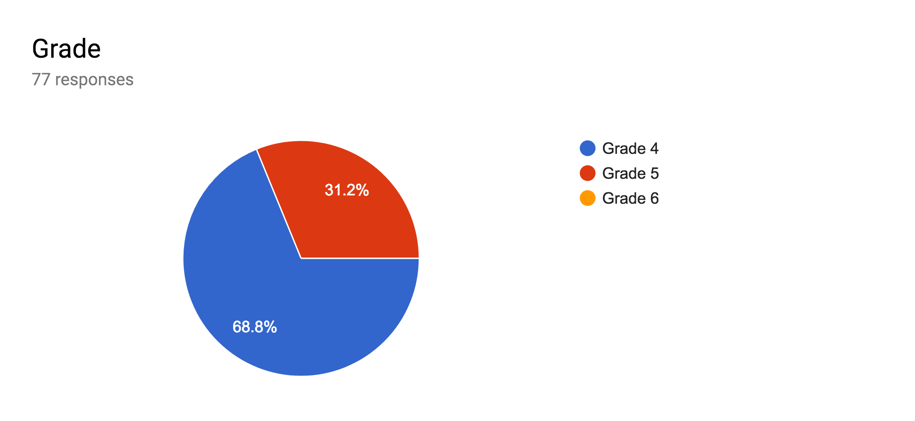
Teacher Nominations This Year By School

Slide 20
2018-2019 SY Students Serviced:
Enrichment - 400 students in grades
3 & 4 ( 53% minorities)
TAG - 64 students in grades
5 & 6 (48% minorities)

Slide 21
Current Year’s Identification Tools
Reading/Writing Performance Assessments
CogAt (Cognitive Abilities Test)*
Portfolio of Work
Teacher Rating Scale/Parent Rating Scale
SBAC (previous year)

Slide 22
Ability- CogAT
Performance Tasks- (Reading and Writing Tests)
Achievement: NWEA (Winter scores)
Creativity -Torrance Test (Similar)

Slide 23
TAG 2.0
Math Identification
Math/Engineering TAG
Identified Talented Students in the Arts Served
Tiered TAG/Enrichment System

