Slide 1

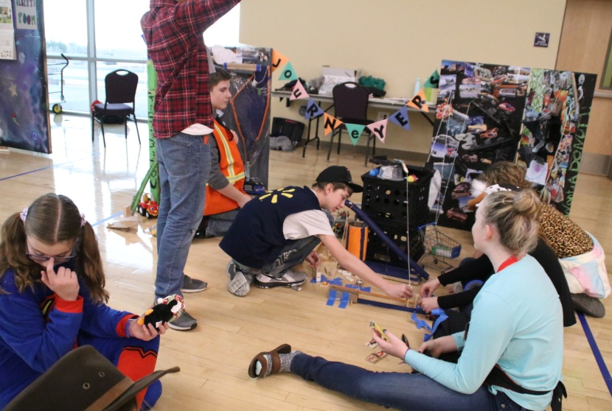
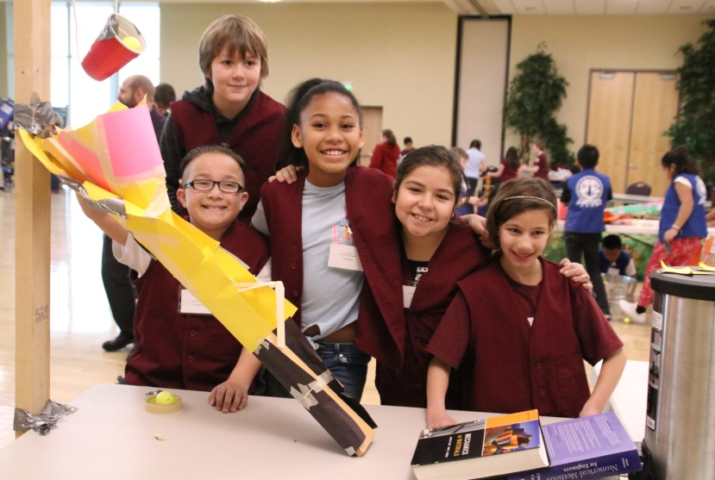
2019
UTAH AFA & WEBER STATE UNIVERSITY
UTAH REGION RUBE GOLDBERG COMPETITION
FEED THE PIG

Slide 2
2019 UAFA & WSU RUBE GOLDBERG COMPETITION
The Rube Goldberg Machine Contest (RGMC) is named after the late cartoonist Reuben Lucius Goldberg. Having died in 1970, he lives on in the RGMC as puzzling machines with crazy mechanisms are built in the spirit of his illustrations.
Rube Goldberg (1883-1970) was a Pulitzer Prize winning cartoonist best known for his zany invention cartoons. He was born in San Francisco on the 4th of July, 1883 – and graduated from U. Cal Berkeley with a degree in engineering.
Rube Goldberg, Inc. is dedicated to keeping laughter and invention alive through the legacy of its namesake. Annual competitions, image licensing, merchandising, and museum and entertainment opportunities continue to grow and enhance the brand. Think of the ‘Mouse Trap’ game.

Slide 3
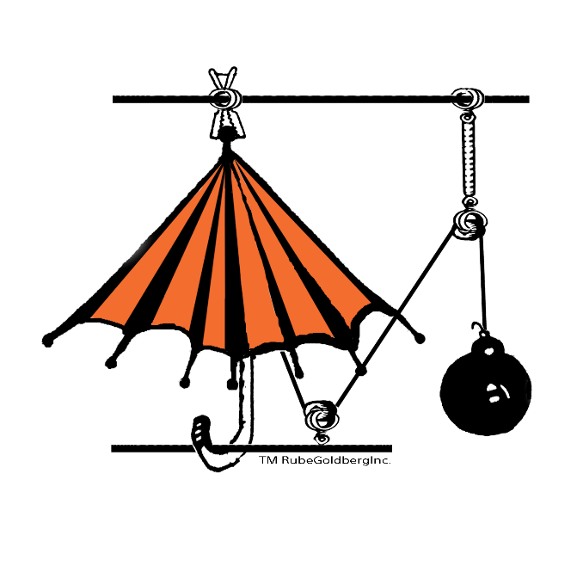
2019 UAFA & WSU RUBE GOLDBERG COMPETITION
2019 Objective is to Put Money in a Piggy Bank
  6th year of competition
Live Competitions stress:
  Innovation (complexity of and number of steps)
  Requirements and Design Processes
  Briefing skills
  Team Work
Three Divisions
  Apprentice – Age 8 to 11 (Elementary)
  I – Age 11 to 14 (Middle School)
  II – Age 14 to 18 (High School)
Teams Made Up of 3 to 10 Members
Utah Region Competition limited to 9 teams per division
Division I and II winners eligible for National competition

Slide 4
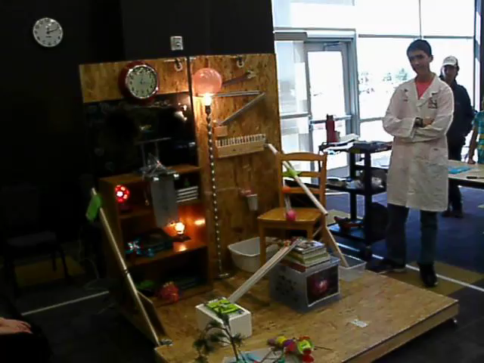
2019 UAFA & WSU RUBE GOLDBERG COMPETITION
This year’s competition: 11 January, Weber State University
All Three Divisions Competed
  Limited to 9 teams in each division
  Anticipate teams from northern Utah
  Grants available for portion of registration fee
Supporting organizations
  Hill AFB STEM Program
  Weber State University
  STEM Action Center
  Utah Air Force Association
NUAMES with Erase A Chalkboard Machine 2015

Slide 5
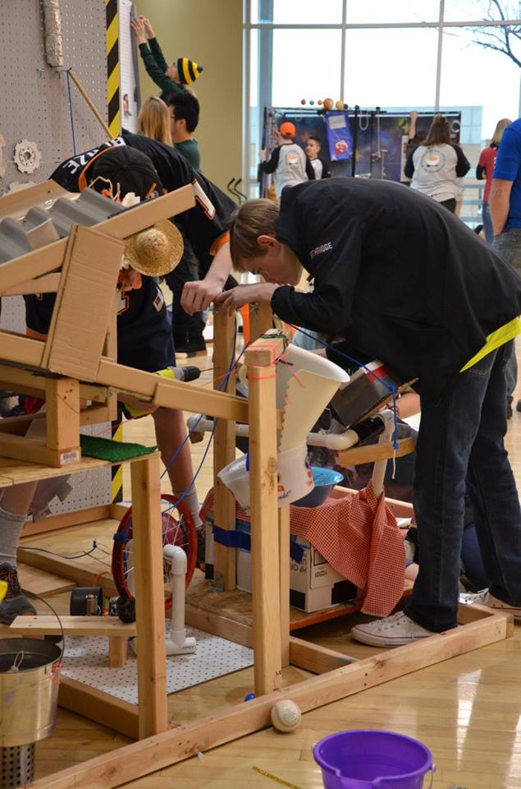
2019 UAFA & WSU RUBE GOLDBERG COMPETITION
Need to get the word out:
Any ideas are welcome
  Contact Jim Aadland (801) 497-6049 or Fran Bradshaw (801) 586-7494 or AFA Northern Utah Chapter 235 website Chapter Website

