Slide 1
Let’s look at some interesting facts about
Honduras

Slide 2
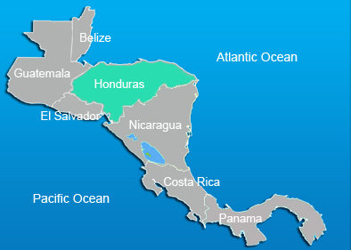
Land and Population
Honduras is located in Central America South of
America. It was once referred to as “Spanish Honduras”
and current day Belize as the “British Honduras”.
Honduras

Slide 3
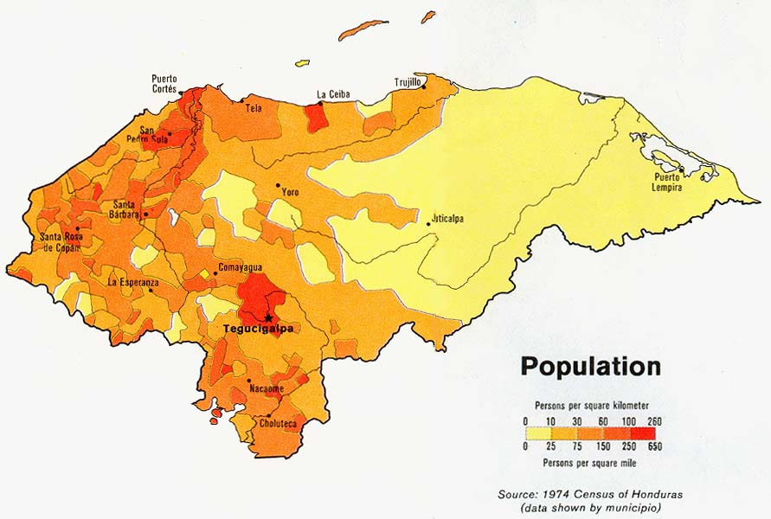
Land and Population
Honduras’ population is 8, 555, 072 with the urban areas being much more heavily populated. Not many cities or people are located on the eastern side of the county. More than 50% of the population in Honduras live below poverty level.

Slide 4
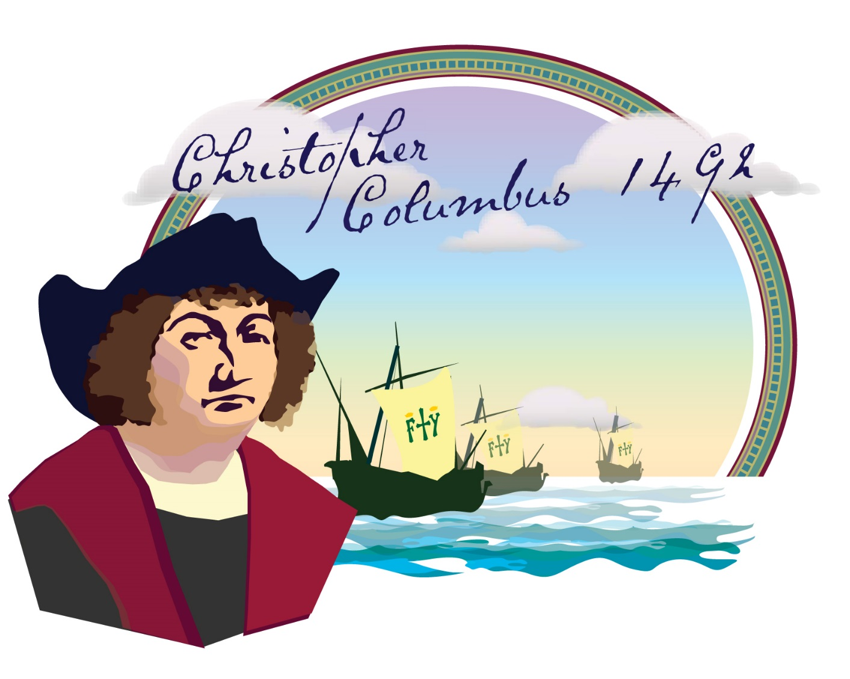
Land and Population
Honduras was discovered by Christopher Colombus!

Slide 5
The 5 stars on the Honduran flag represent the 5 countries in Central America, with the middle star representing Honduras because it’s the only country that touches four of the Central America countries.
Honduran Flag

Slide 6
Did you know?
It is completely normal to have blonde hair and blue eyes in Honduras on the bay islands. They are direct descendents of the British Pirates that came there over 500 years ago.

Slide 7
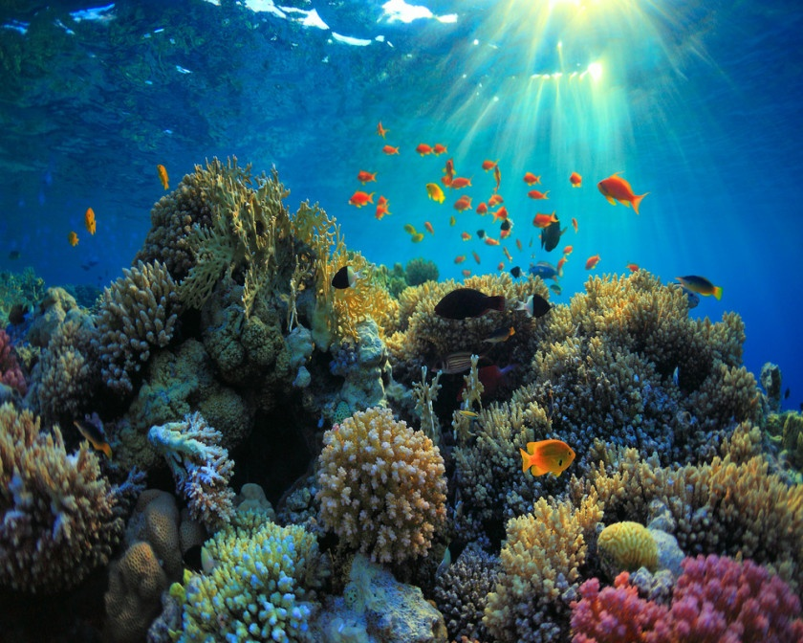
The city of Oaxaca is well-known for having one of the best Dia de Los Muertos (Day of the Dead) festivals in Mexico, a holiday celebrated in many parts of Latin America. In Mexico the festival can be traced back thousands of years ago to indigenous cultures such as the Zapotec and Aztec. In Oaxaca the Day of the Dead Festival starts at the end of October when families prepare the tombs for the return of the spirits. During this time tombs and home altars are decorated with flowers and families leave offerings for the spirits in the cemeteries
Popular Tourist Attractions
The Copan Mayan Ruins are considered the most important ruins for the fully intact hieroglyphs (writing in pictures). This is the main source of how we know Maya history today!
The Bay Islands sit on the
2nd larest coral reef in
the world!!

Slide 8
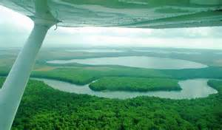
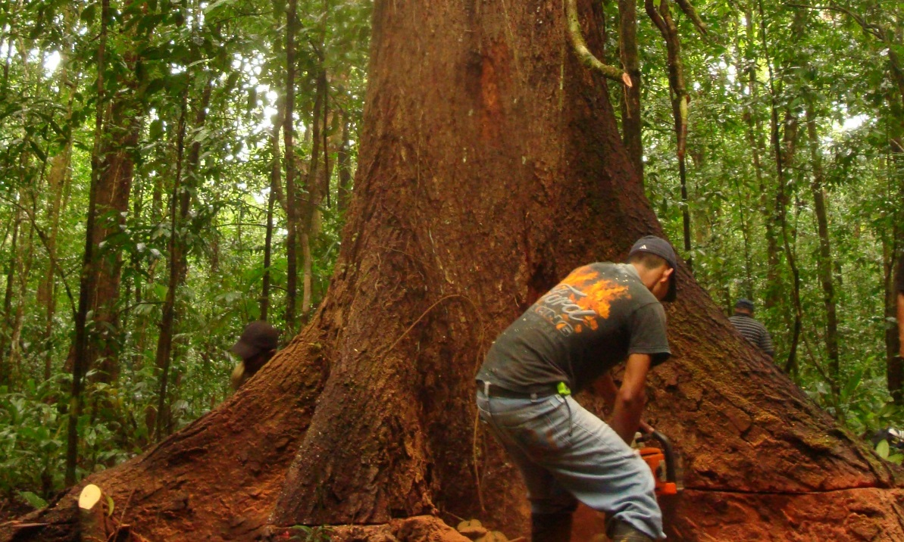
Popular Tourist Attraction
The Platano Forest in Honduras has been nominated
as one of the New Seven Wonders of the World, though
deforestation is a continuing problem.
The Platano Forest has now been nominated as one of the New Seven Wonders of the World. Though deforestation is also a large problem in Honduras.

Slide 9
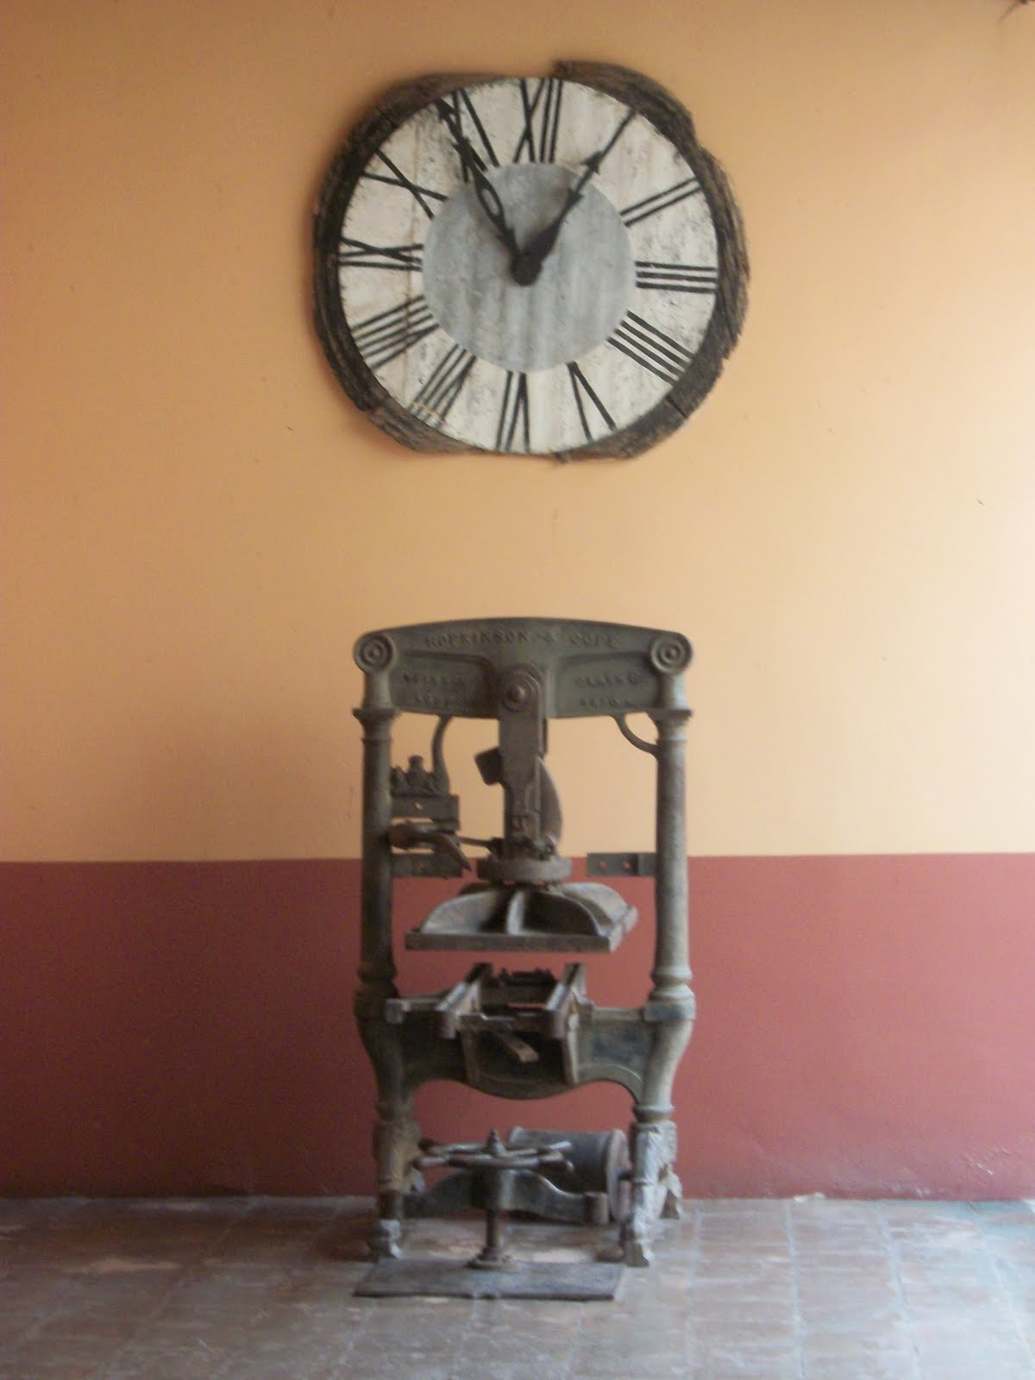
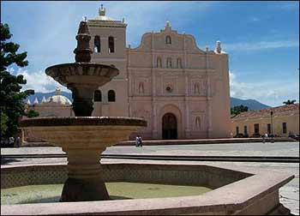
The Clock
The city of Comayagua has a cathedral that contains what is known to be the oldest clock in the America’s! It was given as a gift to the Bishop. Though it is the original clock, it has had to have touch ups over the years to be restored.

Slide 10
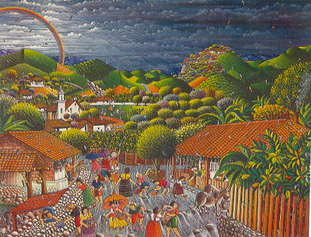
Honduran Celebrations
Since 1998, on an annual basis, the Festival de Lluvia de Peces, or “The Rain of Fish” is held here in June or July. Very interestingly, fish fall down from the sky during the festival and the festival is a celebration of this phenomenon. it is said to occur at least once and sometimes twice in a year in the small town of Yoro: during a massive rain storm, hundreds of small silver fish supposedly rain from the sky onto the streets of the small town.

Slide 11
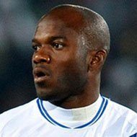
e
Celebrities from Honduras
Many famous people derive from Honduras, actors,
actresses, writers, scientists, but most of all soccer players! Soccer is a very popular sport in the Honduran culture!

