Slide 1
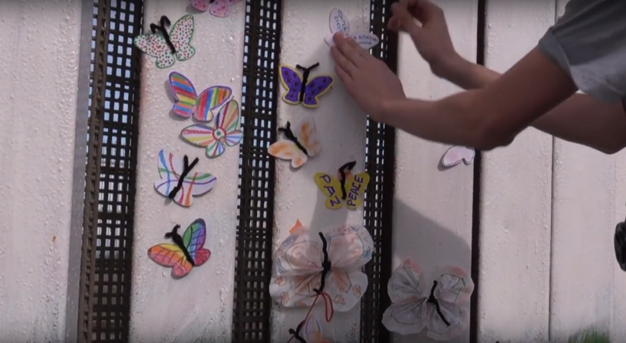
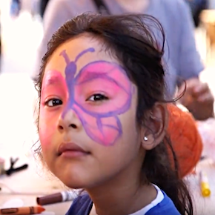
Crossing Borders: California – Mexico
Pingry School
June 13-17, 2019

Slide 2
Old Town San Diego
Day 1: Arrive San Diego
Students understand the culture of San Diego.
Sequent occupancy
Spanish colonial Western settlers and indigenous Mexican influences
Linked economies

Slide 3
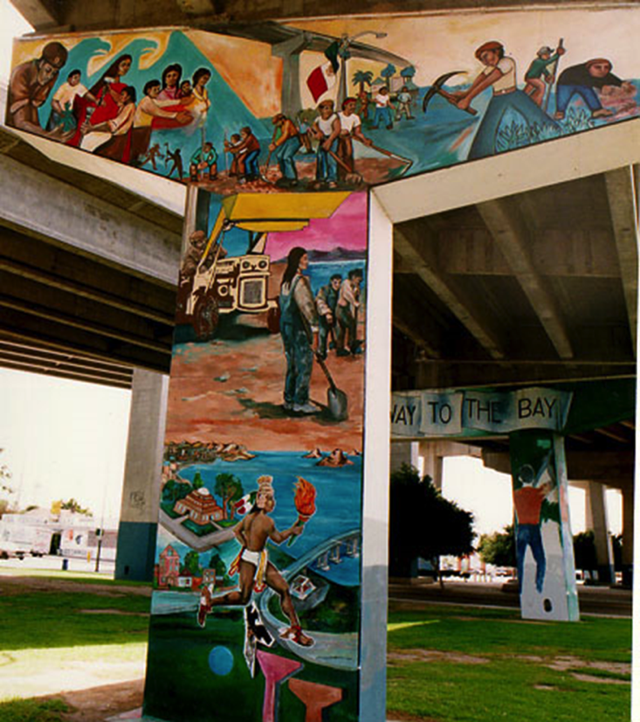
Day 2: Chicano Park
Designated as a national heritage site by the Obama administration, Chicano Park depicts mural art honoring the Latin-American heritage.

Slide 4
San Diego
Day 2: Chicano Park
Chicano Park offers a visual landscape celebrating a cultural identity and purpose.

Slide 5
San Ysidro Port of Entry
Day 2: Official Homeland Security Tour of the Border
Students learn of the challenges of patrolling the border
120,000 daily commuters
840 unauthorized crossers per month

Slide 6
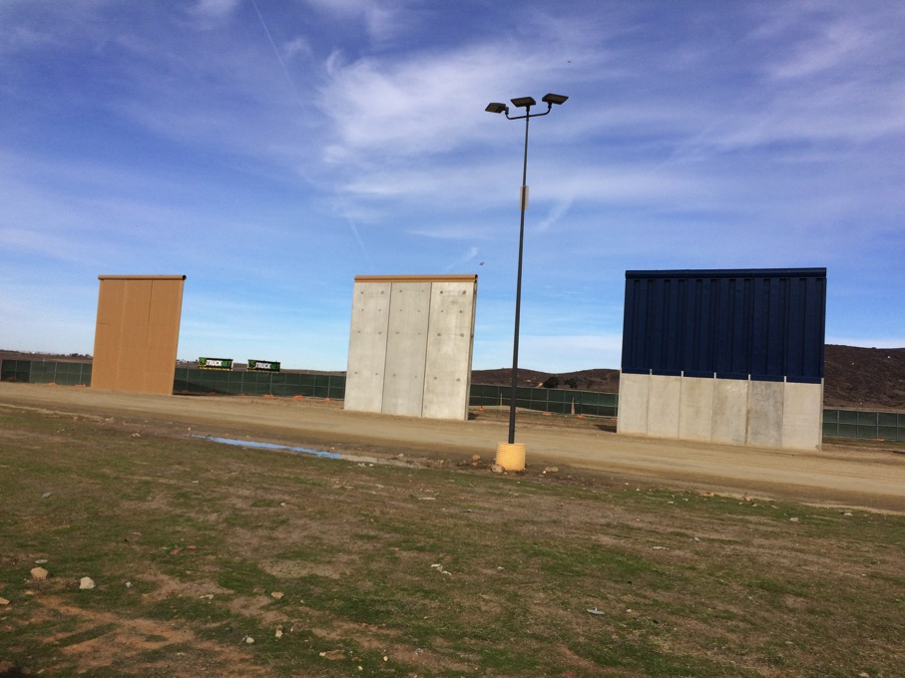
Day 2: Border Wall Prototypes
After crossing into Tijuana, the group will have a chance to view the Trump administration’s Border Wall Prototypes.

Slide 7
Playas de Tijuana
Day 3: Visit the border fence
Students will visit Playas border fence.
meet people involved in the bi-national garden
efforts to unify families separated by the border

Slide 8
Tijuana
Day 3: Meet the Migrants
Las Madres Deportadas

Slide 9
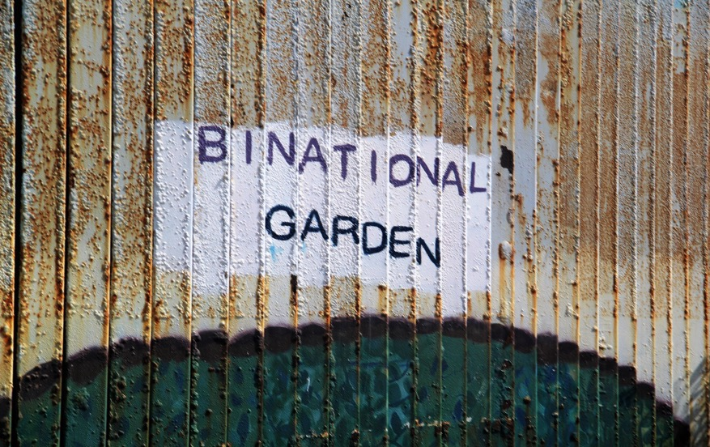
Tijuana
Day 4: Friendship Park
Deported U.S Veterans
Friends of Friendship Park

Slide 10
Tijuana
Day 4: Return to Tijuana, Casa del Emigrantes
Students volunteer to help prepare and serve food before sharing a meal with migrants.

Slide 11
Tijuana
Day 5: Cross the Border, Return to San Diego
Students observe the ease of border crossing for U.S. citizens, and the challenge for Mexican-Americans.

Slide 12
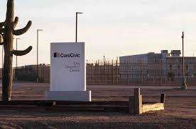
Tijuana
Day 5: Visit exterior of CORE CIVIC Detention Center
Drive by to observe the example of a detention center

Slide 13
Register at: www.Pingry.org/Global
JOIN US

