Slide 1
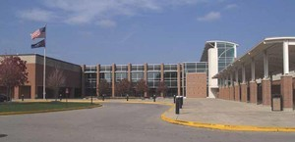
WELCOME TO
CARMEL HIGH SCHOOL!

Slide 2
AGENDA
Freshman Center
Diploma Types and New Graduation Pathways
Using the Program of Studies
Course Selections for the Freshman year
Scheduling Process

Slide 3
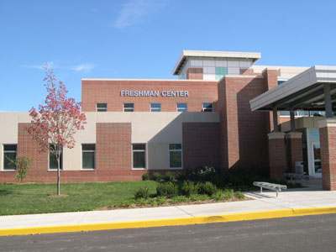
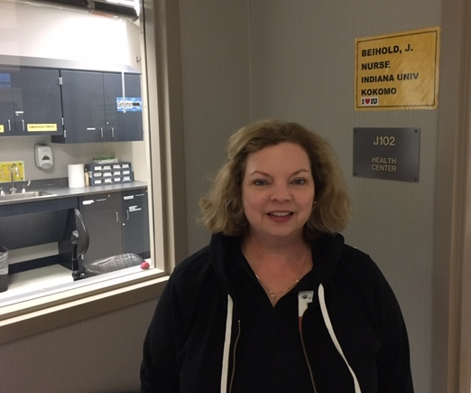
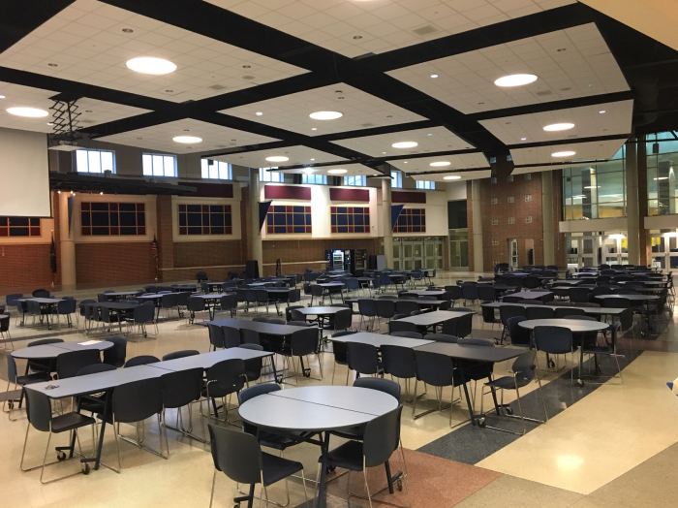
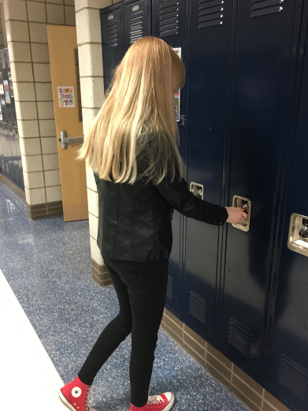
FRESHMAN CENTER
NURSE- Mrs. Biehold
CAFETERIA
FLOOR DESIGN

Slide 4
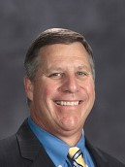
Carmel High School
Dr. Tom Harmas
Principal
Mrs. Skeens-Benton
Administrator
Mr. Glander
Administrator

Slide 5
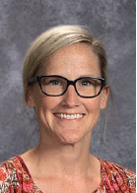
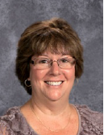
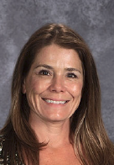
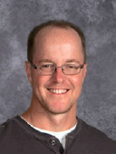

Freshman Center Counseling Office
Mrs. Barsten
Counselor
Mrs. Brown
Counselor
Ms. Cartwright
Social Worker
Mr. Schleper
Counselor
Mrs. Schwartz
Counselor

Slide 6
Block Schedule
EACH CLASS IS 90 MINUTES LONG WITH 10 MINUTE PASSING PERIODS
Blue Day | B 1 | B 2 | B 3 | B 4
Gold Day | G 1 | G 2 SRT | G 3 | G 4

Slide 7
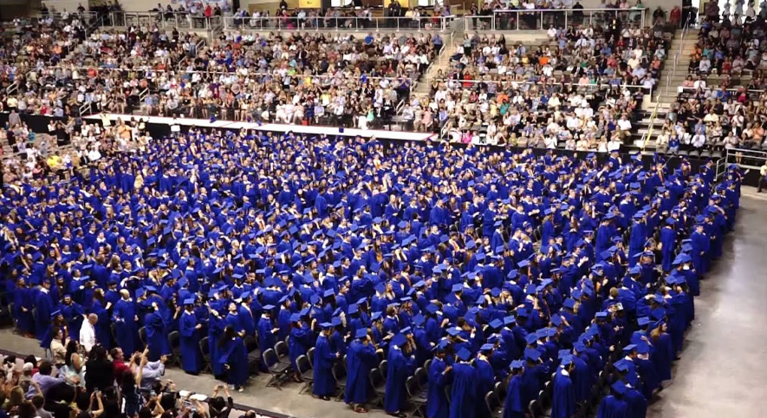
What are the different types of diplomas from the state of Indiana?

Slide 8
State Recognized Diplomas
1. Core 40
2. Academic Honors
3. Technical Honors
ALL ARE COLLEGE BOUND DIPLOMAS!

Slide 9


What are credits and how do I earn them?
1 Credit
(A, B, C, D)
0 Credit
(F)

Slide 10
Core 40
CORE 40 DIPLOMA
English 4 years | 8 credits
Math 3 years | 6 credits
Science 3 years | 6 credits
Social Studies 3 years | 6 credits
PE 1 and PE 2 | 2 credits
Health or IPR 1 semester | 1 credit
Electives | 11 credits
 | = 40 CREDITS

Slide 11
Academic Honors Diploma
Core 40 Diploma
English 4 years | 8 credits
Math 3 years | 6 credits
Science 3 years | 6 credits
Social Studies 3 years | 6 credits
PE 1 and PE 2 | 2 credits
Health or IPR 1 semester | 1 credit
Electives | 11 credits
 | 40 credits
1 more year of math 2 credits
3 years of 1 world 6 credits
language
or
2 years each of 2 different 4 credits
world languages
2 semesters of fine arts 2 credits
Grades of C- or higher in courses that count toward diploma
GPA of 3.0 or higher
One of the following:
4 semesters of either Dual Credit/ AP courses
Score 1250 on SAT
Score 26 on ACT
IB diploma

Slide 12
TECHNICAL HONORS DIPLOMA
Core 40 Diploma +
* 6 or more credits in a Career/Technical Program (Business, F &CS, Engineering)
* Must have a 3.0 gpa or higher and grade C – or above in courses that will count toward the diploma.
* Other additional requirements can be find in the Program of Studies.

Slide 13
New Graduation Pathways
Obtain one of the diplomas
2. Show employability skills by doing a service-based, project-based, or work-based learning experience.
3. Postsecondary-ready competencies
(Get the Academic Honors Diploma, or meet the benchmark scores for the ACT, SAT, or ASVAB)

Slide 14
Information contained in the Program of Studies:
Diploma information
Course descriptions
arranged alphabetically by department

Slide 15
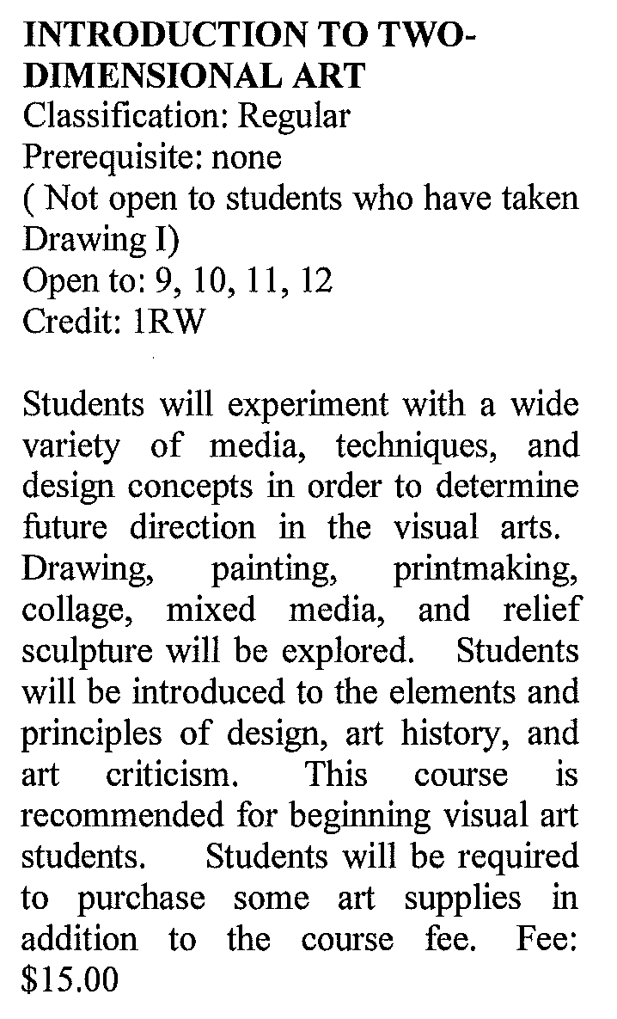
Name of Course:
Prerequisite:
Open to:
Credits/Credit Weight:
Course Description

Slide 16
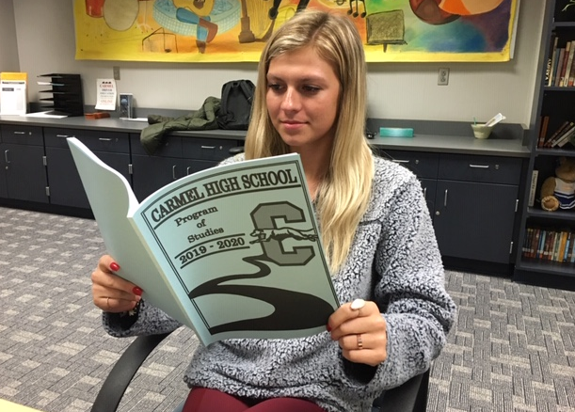
How do I select courses for my freshman year?

Slide 17
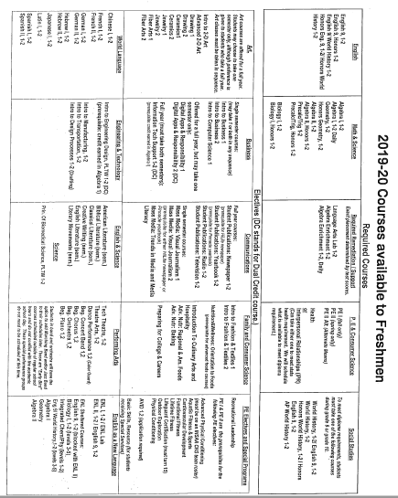
COURSE SELECTION
SHEET

Slide 18
Course Selections for the Freshman Year
All Freshmen will take the following:
  ENGLISH
  BIOLOGY
  WORLD HISTORY
  MATH – Students’ final Math placement will be determined in late Spring.

Slide 19
Course Selections for the Freshman Year
Some Freshmen will add :
    Math and /or English lab
    Resource (Basic Skills)

Slide 20
Course Selections for the Freshman Year
All students need 1 Health Credit
(Health or Interpersonal Relationships)

Slide 21
Course Selections for the Freshman Year (Con’t)
All freshmen take PE I and II
Options: Freshmen Year, summer school, PE II Waiver
PE II Waiver- IHSAA sanctioned sports, marching band, color guard, Accents, Ambassadors, Dance Team

Slide 22
SUMMER SCHOOL
INDIANA ONLINE ACADEMY (IOA)
Dates and Times:
June 3-July 17 (Final exam window is July 9TH or July 15-18 at CHS)
PE I is the only class available.
Registration Deadline is March 1, 2019
Students must register at Indianaonlineacademy.org
No Cost

Slide 23
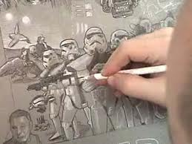

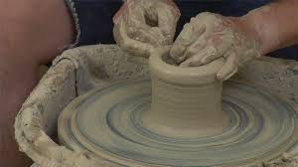
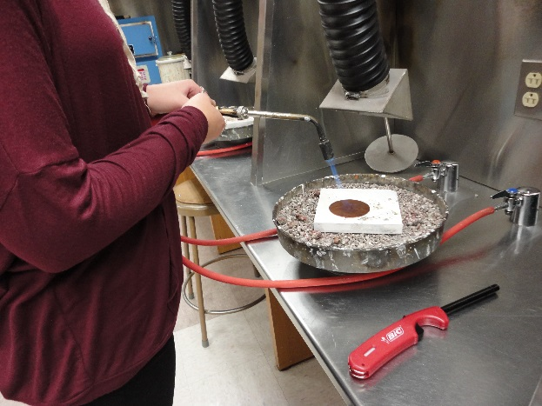
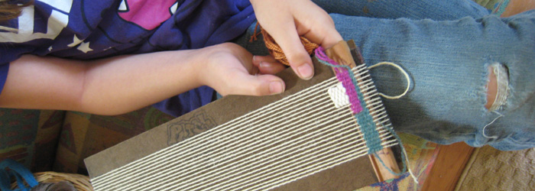
ELECTIVES- Art
INTRO TO 2D ART
DRAWING
ADVANCED 2D ART
CERAMICS
JEWELRY
FIBER ARTS

Slide 24



ELECTIVES
INTRO TO BUSINESS 1
INTRO TO BUSINESS 2

Slide 25

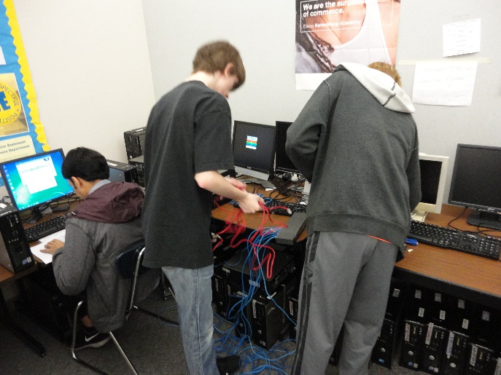
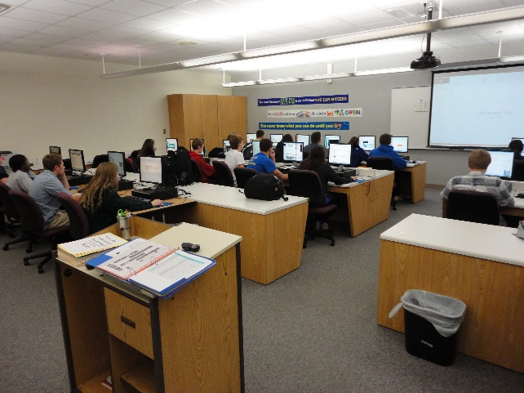
ELECTIVES- Business
DIGITAL APPLICATIONS AND RESPONSIBILITY (DAR)
INFORMATION TECH SUPPORT
INTRO TO COMPUTER SCIENCE

Slide 26

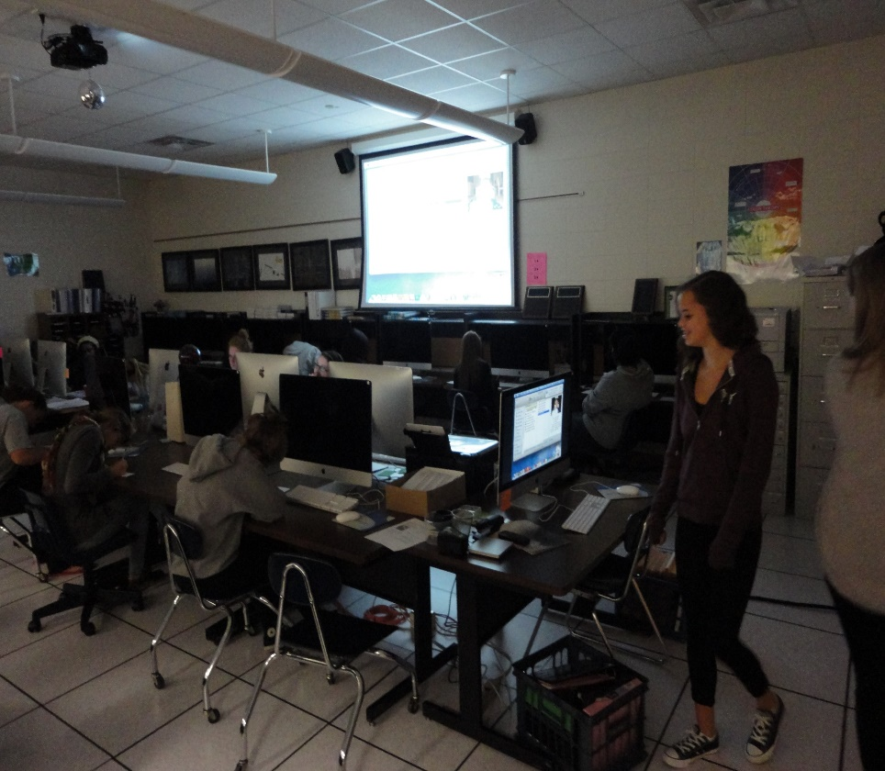
ELECTIVES- Communications
NEWSPAPER
YEARBOOK

Slide 27
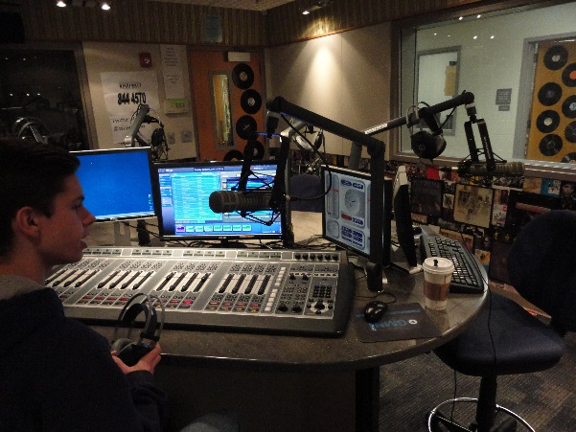
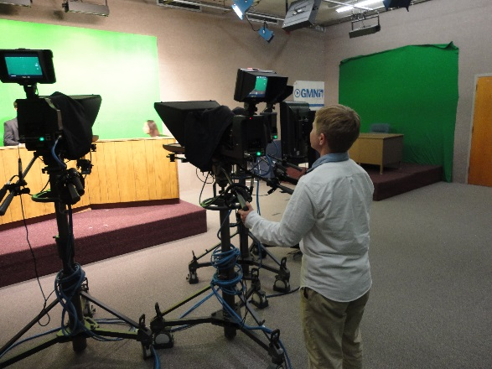
ELECTIVES- Communications
STUDENT PUBLICATIONS: RADIO
STUDENT PUBLICATIONS: TELEVISION

Slide 28
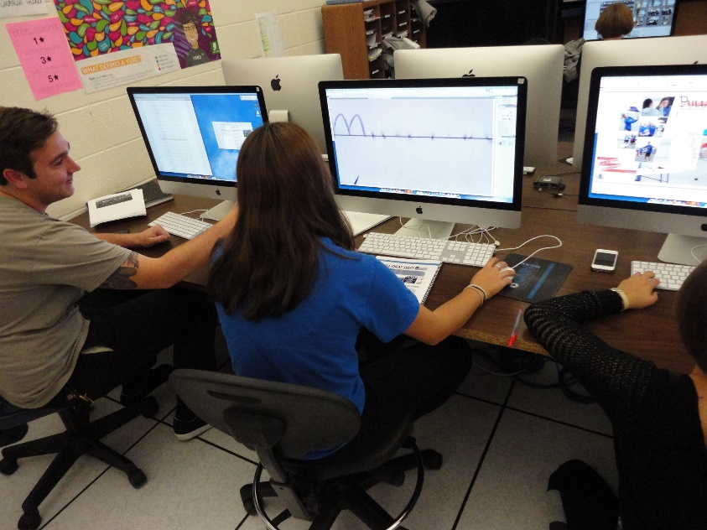
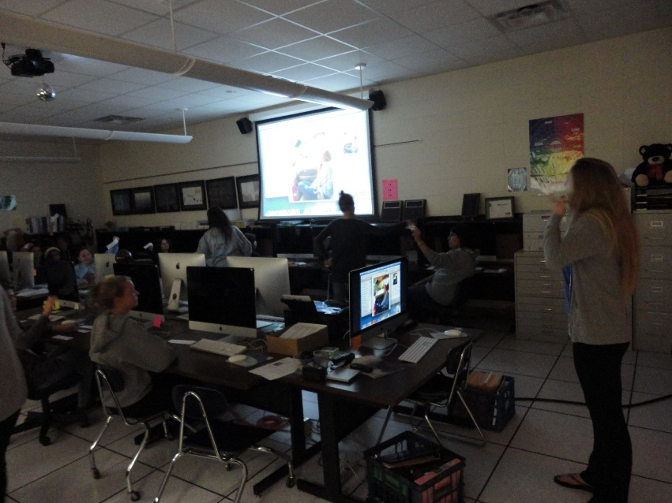
ELECTIVES- Communications
MASS MEDIA: VISUAL JOURNALISM
MASS MEDIA: TRENDS IN MEDIA AND MEDIA LITERATURE

Slide 29
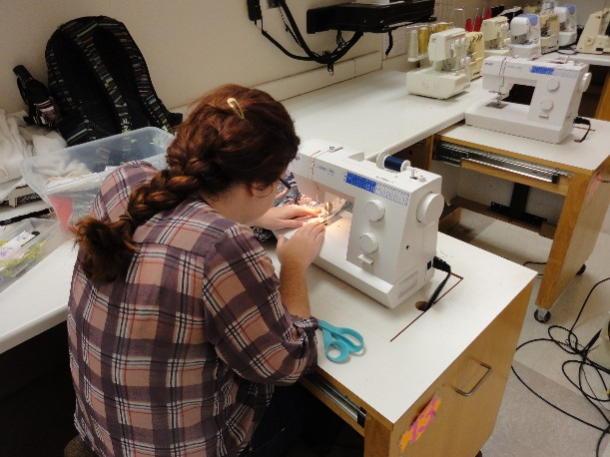
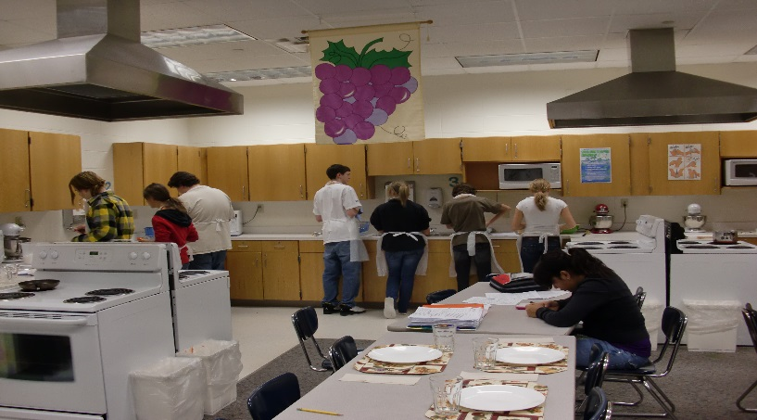
ELECTIVES
Family and Consumer Science
INTRO TO FASHION AND TEXTILES
NUTRITION AND WELLNESS

Slide 30

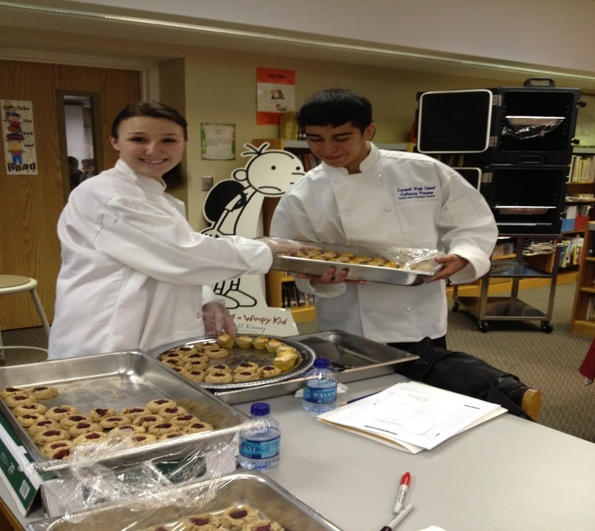
ELECTIVES
Family and Consumer Science
ADVANCED NUTRITION:
REGIONAL AMERICAN AND
FOREIGN FOODS
ADVANCED NUTRITION:
BAKING

Slide 31
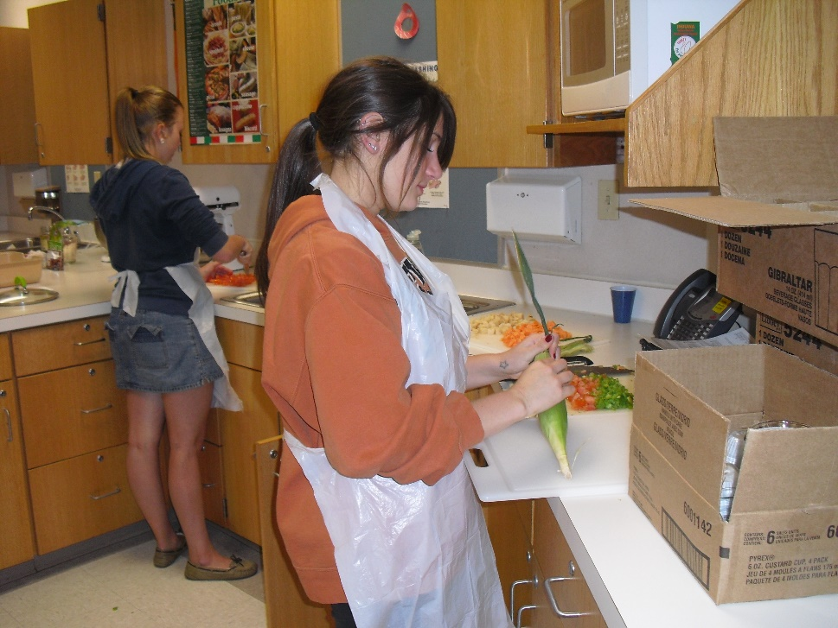

ELECTIVES
Family and Consumer Science
CULINARY ARTS AND HOSPITALITY
PREPARING FOR COLLEGE AND CAREERS

Slide 32
ELECTIVES- Physical Education
To take these classes, students must have already completed PE I and be waiving PE II.
Advanced Physical Conditioning (APC)
Physical Conditioning (PC)
Lifeguarding Certification (must turn 15 by the end of the class)
Cardiovascular Development
Functional Fitness
Lifetime Fitness
Aquatic Fitness and Sports
Outdoor Exploration

Slide 33

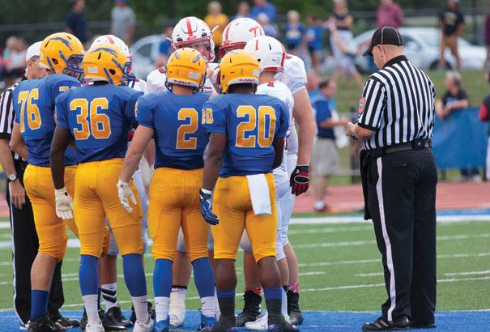

ELECTIVES- Physical Education
RECREATIONAL LEADERSHIP

Slide 34



ELECTIVES- World Language
CHINESE
FRENCH
GERMAN
HEBREW
JAPANESE
LATIN
SPANISH

Slide 35
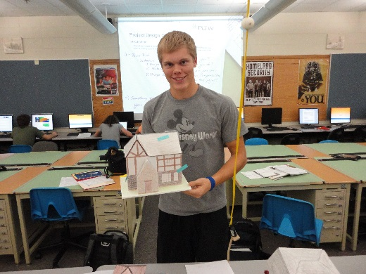
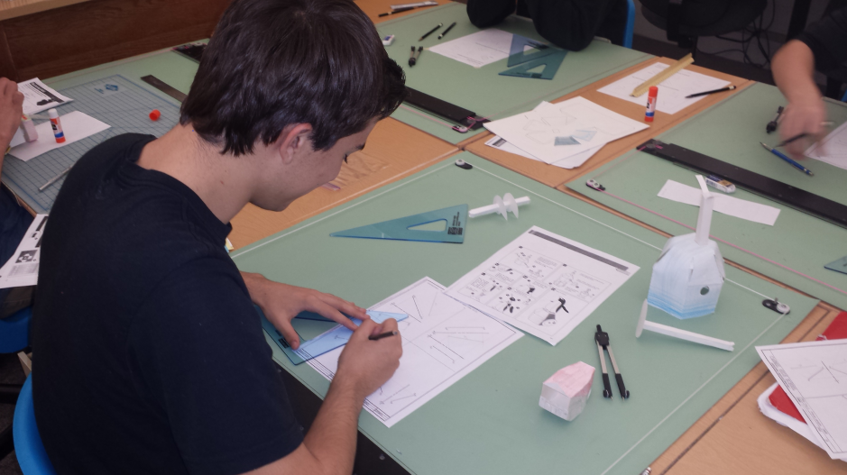
ELECTIVES
Engineering & Technology
INTRO TO ENGINEERING DESIGN (PLTW)
INTRO TO DESIGN PROCESSES (DRAFTING)

Slide 36
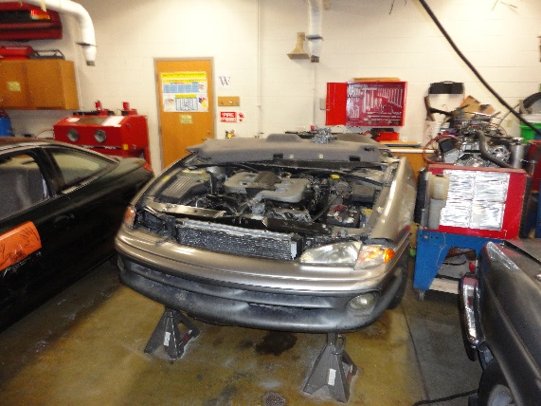
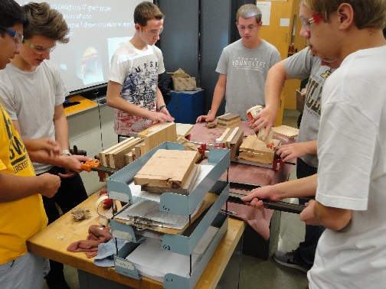
ELECTIVES
Engineering & Technology
INTRO TO TRANSPORTATION
INTRO TO
MANUFACTURING

Slide 37


ELECTIVES- English
CLASSICAL LITERATURE
CREATIVE WRITING
ENGLISH
LITERATURE
BIBLICAL LITERATURE
LITERARY
MOVEMENTS
AMERICAN LITERATURE

Slide 38
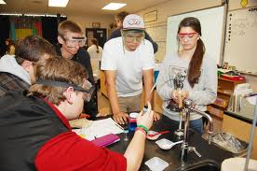
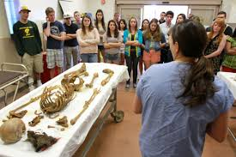
ELECTIVES- Science
PRINCIPLES OF BIOMEDICAL SCIENCE (PLTW)

Slide 39
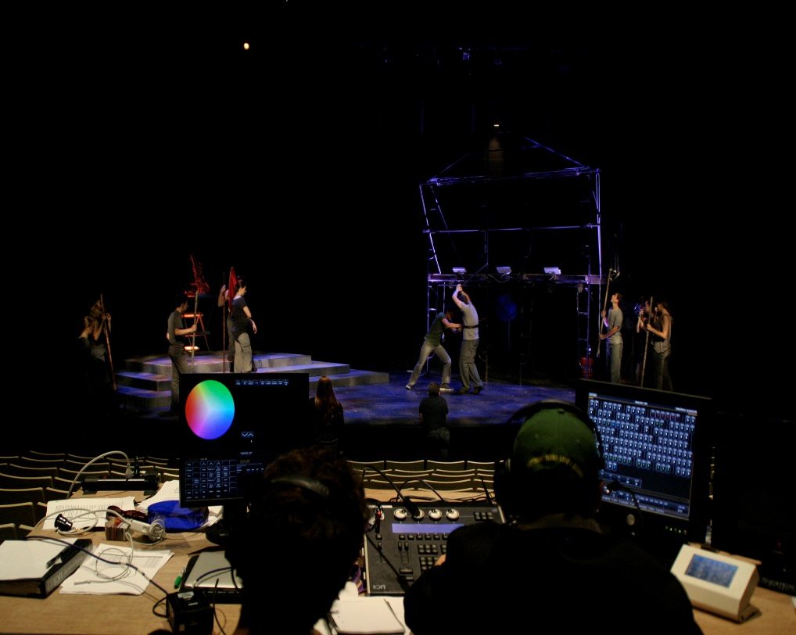
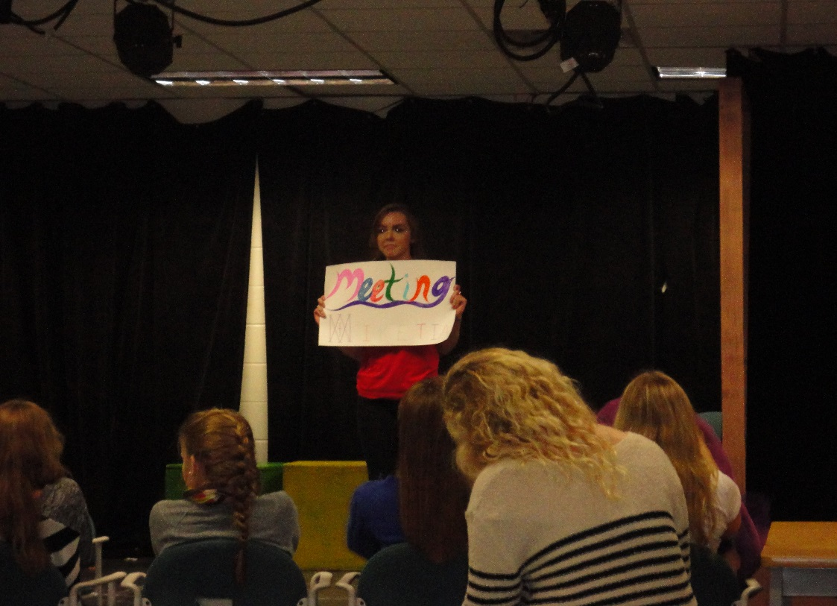
ELECTIVES- Performing Arts
TECH THEATRE
THEATRE ARTS

Slide 40


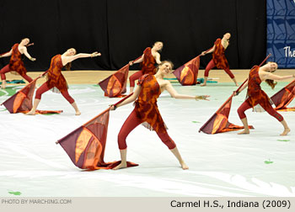
ELECTIVES- Performing Arts
DANCE PERFORMANCE
(COLOR GUARD)
BAND
ORCHESTRA

Slide 41
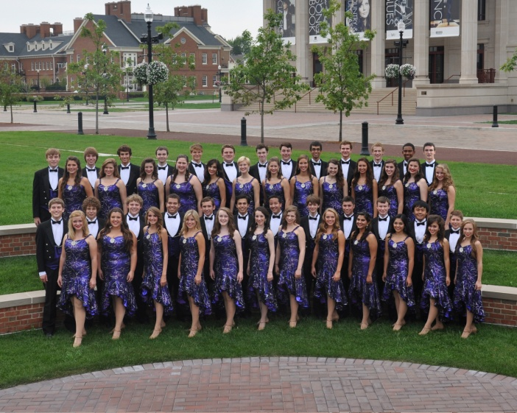
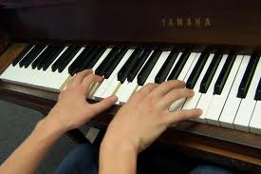
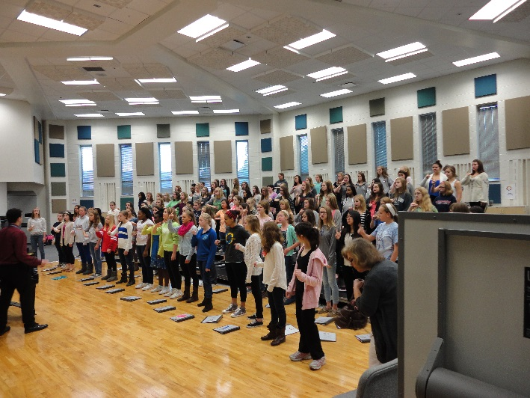
ELECTIVES- Performing Arts
CHOIR
BEGINNING PIANO

Slide 42
SPECIAL PROGRAMS
AVID (9-12)
AP CAPSTONE (10-12)
IB (11-12)

Slide 43
HOW DO I REGISTER?
SEMESTER 1 | SEMESTER 2
ENGLISH 9-1 | ENGLISH 9-2
ALGEBRA 1-1 | ALGEBRA 1-2
BIOLOGY 1 | BIOLOGY 2
WORLD HISTORY 1 | WORLD HISTORY 2
LATIN 1-1 | LATIN 1-2
CERAMICS 1 | HEALTH
ORCHESTRA | ORCHESTRA

Slide 44


Slide 45
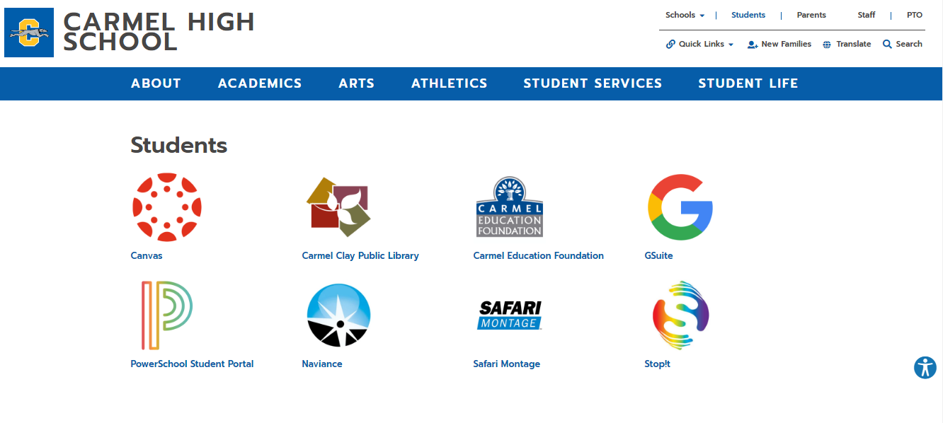

Slide 46
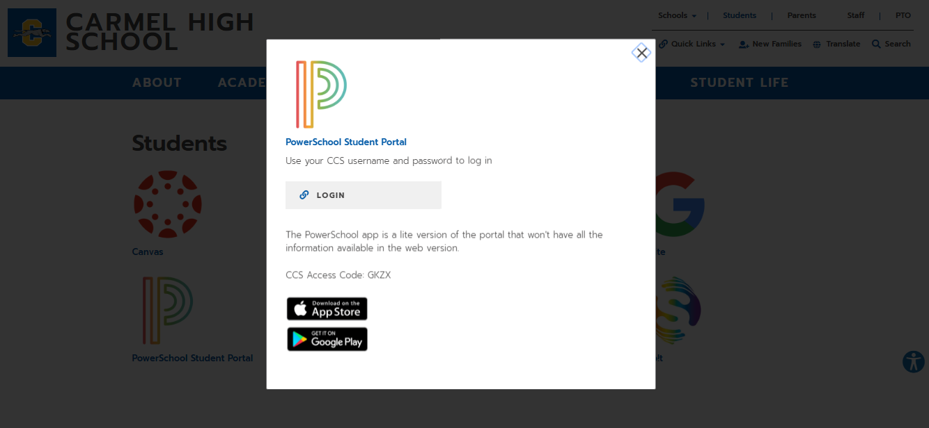

Slide 47
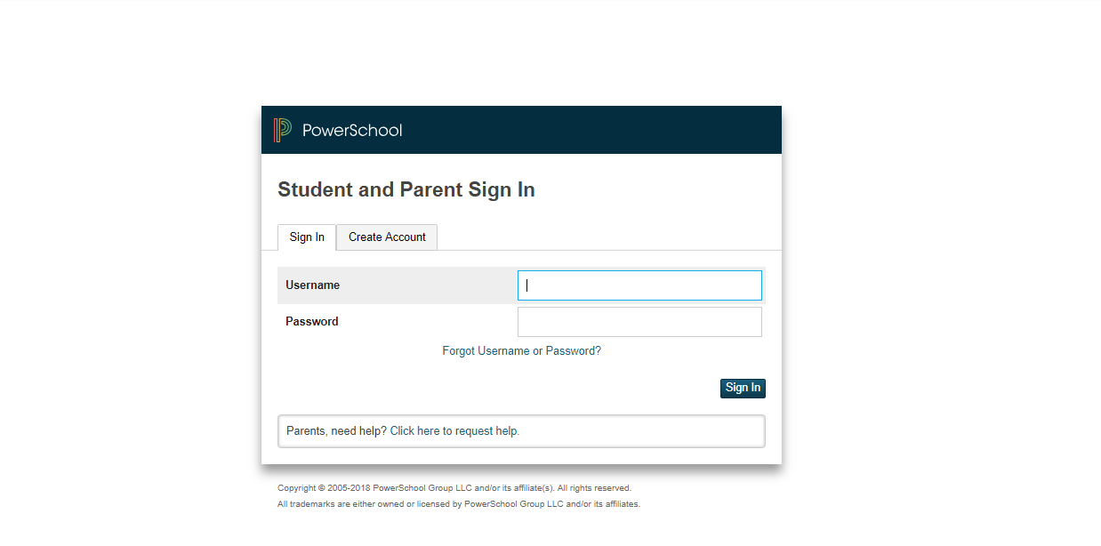
PowerSchool login information is the student’s CHS network username and password.

Slide 48
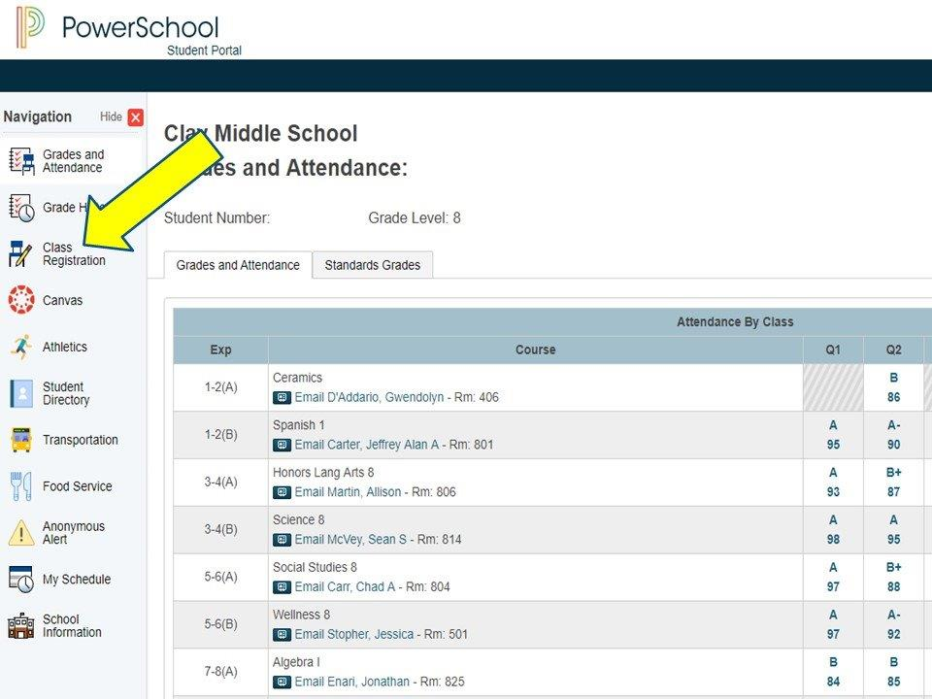

Slide 49
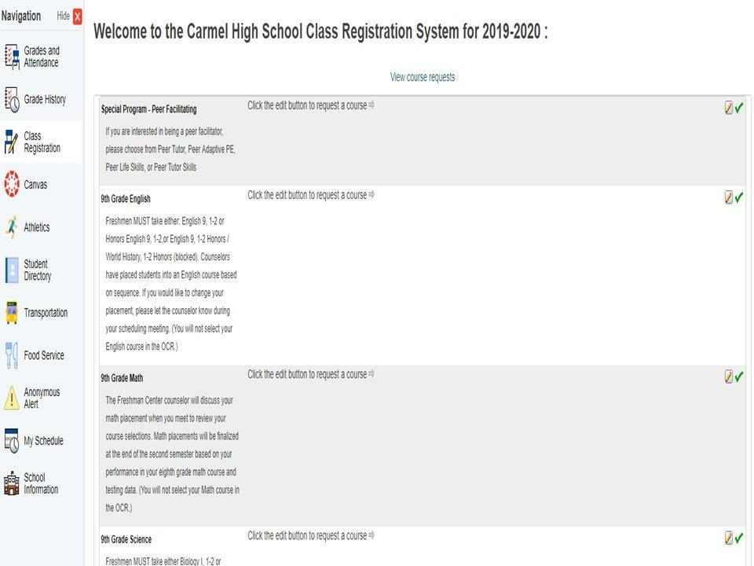

Slide 50
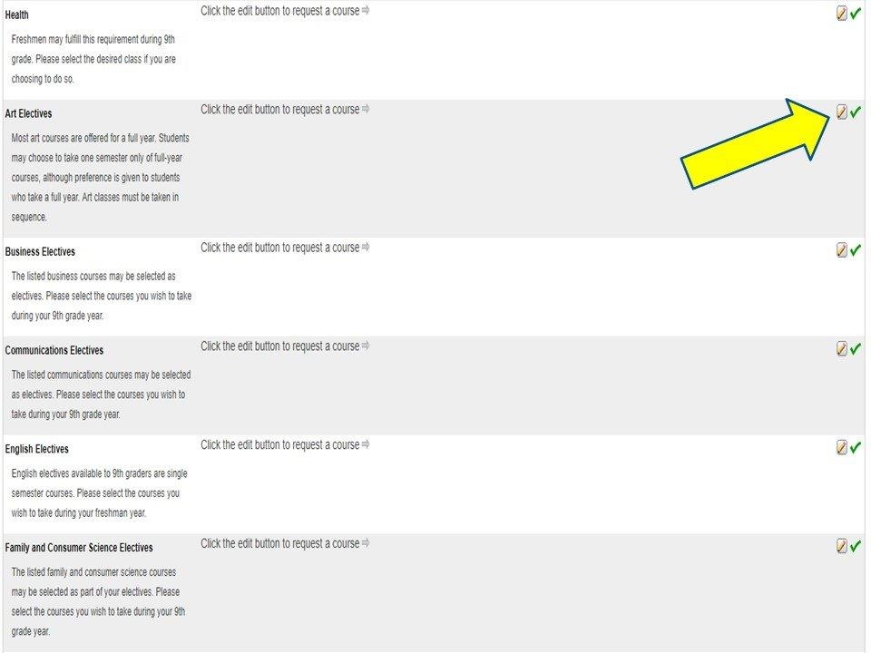

Slide 51
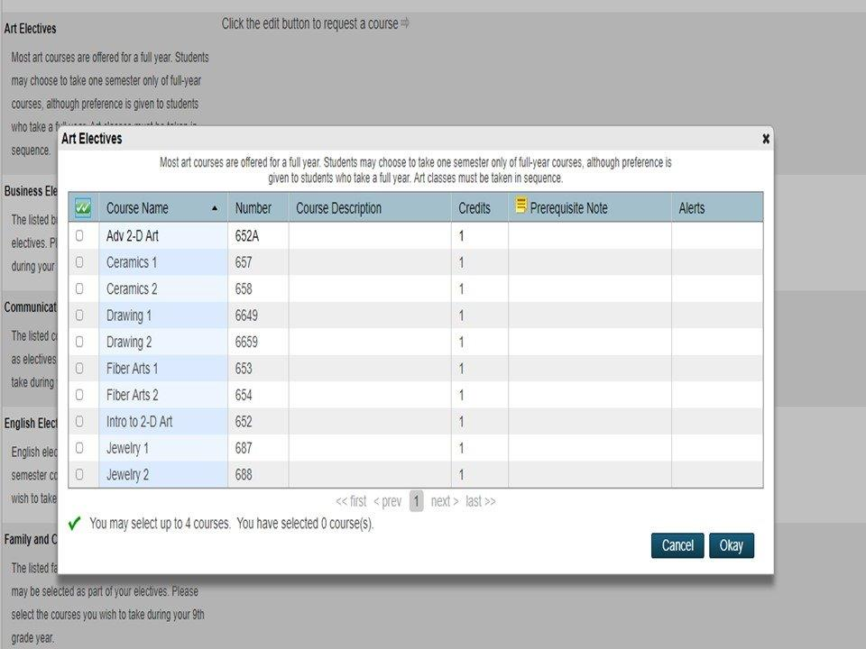

Slide 52
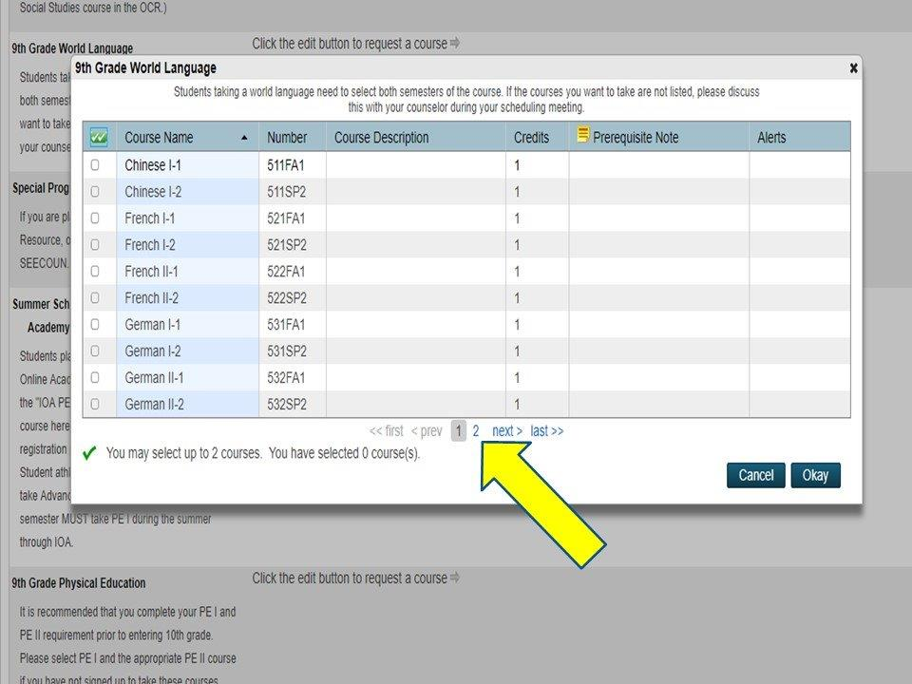

Slide 53


Slide 54


Slide 55


Slide 56
Examples of a schedule
SEMESTER 1 | SEMESTER 2
ENGLISH 9-1 | ENGLISH 9-2
ALGEBRA 1-1 | ALGEBRA 1-2
BIOLOGY 1 | BIOLOGY 2
WORLD HISTORY 1 | WORLD HISTORY 2
GERMAN 1-1 | GERMAN 1-2
APC | APC
TRANSPORTATION | TRANSPORTATION

Slide 57
Examples of a schedule
SEMESTER 1 | SEMESTER 2
ENGLISH 9-1 | ENGLISH 9-2
ALGEBRA DAILY 1-1 | ALGEBRA DAILY 1-2
ALGEBRA DAILY LAB | ALGEBRA DAILY LAB
BIOLOGY 1 | BIOLOGY 2
WORLD HISTORY 1 | WORLD HISTORY 2
BUSINESS 1 | HEALTH
TECH THEATRE | TECH THEATRE

Slide 58
Examples of a schedule
SEMESTER 1 | SEMESTER 2
ENGLISH 9-1/ WORLD HISTORY 1 | ENGLISH 9-2/ WORLD HISTORY 2
ALGEBRA 1-1 | ALGEBRA 1-2
BIOLOGY 1 | BIOLOGY 2
WORLD HISTORY 1/ ENGLISH 9-1 | WORLD HISTORY 2/ ENGLISH 9-2
2D ART | HEALTH
YEARBOOK | YEARBOOK
TECH THEATRE | TECH THEATRE

Slide 59
Examples of a schedule
SEMESTER 1 | SEMESTER 2
HONORS ENGLISH 9-1 | HONORS ENGLISH 9-2
GEOMETRY 1 | GEOMETRY 2
HONORS BIOLOGY 1 | HONORS BIOLOGY 2
AP WORLD HISTORY 1 | AP WORLD HISTORY 2
FRENCH II-1 | FRENCH II-2
PE I | HEALTH
CHOIR | CHOIR

Slide 60


Slide 61

What help is available if I get confused or have additional questions?
Parent Coffees at CHS
Thursday, Jan. 24
Thursday, Feb. 7
Freshman Center LGI
Begins at 6:30 PM

Slide 62
Greyhound Kick-off
Friday, August 9
9:30-2:30
The first day of school
is Tuesday,
August 13th
This is a wonderful opportunity for the students to become familiar with the Freshmen Center and CHS prior to that first day of school.
Forms for Greyhound Kick-off will be mailed to you in June. Return only the bottom part with your check. Keep the top part for your records to help you remember if you registered.

Slide 63
WELCOME TO THE GREYHOUND FAMILY!

