Slide 1
Sexting

Slide 2
Definition/Policy
The creation of, possession of, or sharing of sexually explicit messages, sexually explicit photos or videos that interrupts the academic and/or social processes within the school, a school related activity, or other locations which affect the environment at school

Slide 3
Prevalence of sexting
2011 Crimes Against Children Research Center-University of New Hampshire
Variety of surveys (Sex and Tech, Teen Online and Wireless Safety, AP-MTV Digital Abuse, etc.)
Findings are inconsistent and flawed in their design
Anywhere from 17% to 40% of teenagers engaging in sexting

Slide 4
Why do kids sext?
They may feel pressured by friends; especially someone in whom they are interested.
They may be responding to a sext they have received.
They may be sending it to a boyfriend / girlfriend as a part of their relationship.
They are curious / inquisitive about sex and nudity.

Slide 5
When Caring becomes Controlling

Slide 7
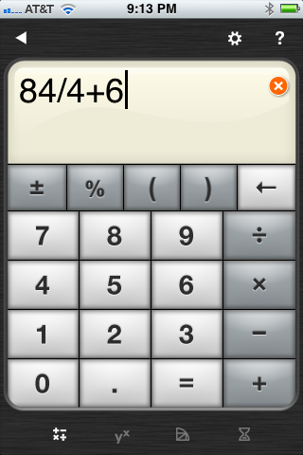
Hidden Apps
Best Secret Folder
By RV AppStudios LLC
View More by This Developer
Open iTunes to buy and download apps.
Description
* Extremely Hard to Notice Your Best Secret Folder Icon On Your iPhone/iPod Touch * * Secretly Hide Your Most Private Videos & Photos From Other People! * .

Slide 8
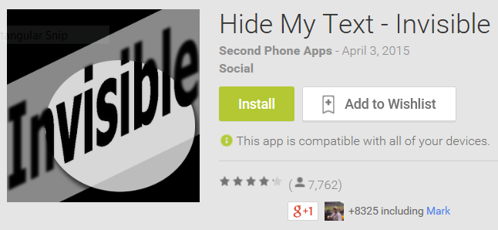
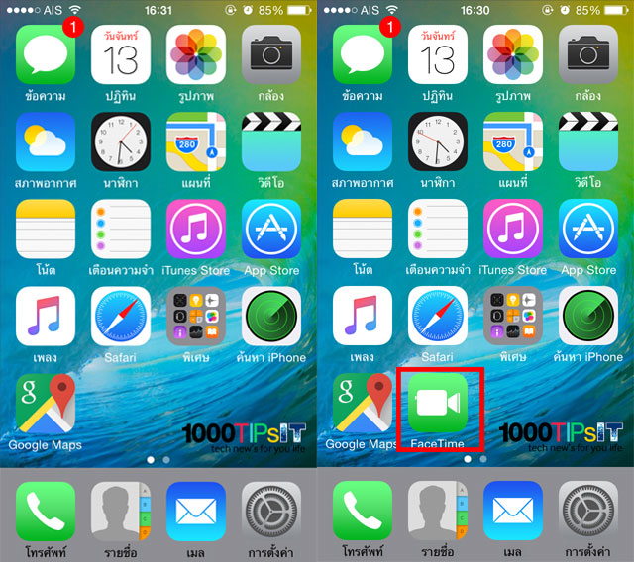
Decoy Apps
*Hide text messages/SMS messages for 5 contacts *Hide call logs for 5 contacts *Block unwanted text messages/SMS and Block calls *The icon is completely invisible – no one will see it *Change Status bar icon and descriptions *Requires a password to get into the app for privacy *Choose your own text message thread colors *See failed attempts to get into app in the “Log File” *Change contacts/password/home screen shortcut anytime *For “Unlimited” contacts see our “Full Version”

Slide 9
Hidden Folders and Encryption
Snapchat: My Eyes Only, Requires a PIN
Facebook Messenger: Tap “Me” and “Secret Conversations”
Sarahah: Honest, Anonymous Posts

Slide 10
Sexting acronyms
CU46 See You For Sex
PIR Parents In Room
WTTP Want To Trade Pictures
IPN I’m Posting Nude
KPC Keeping Parents Clueless
TDTM Talk Dirty To Me
SUGARPIC Erotic or Suggestive Photo
PRON Porn
ASL Age/Sex/Location
FYEO For Your Eyes Only

Slide 11
Risk Factors- Individual characteristics that increase or decrease the probability of repeating problematic behavior
Static vs Dynamic Risk factors
Static risk factors are historical and cannot change
Dynamic risk factors include, substance abuse, absenteeism, relationship problems, negative peer issues.
Dynamic risk factors are the focus of counseling and treatment.

Slide 12
ESTABLISHED RISK FACTORS OF STUDENTS WHO MAY HAVE PROBLEMS WITH SEXTING AND PORNOGRAPHY:
Substance abuse
Secret keepers
Limited relationship connections
Chronic conflict: arguing, fighting
Ignores emotional issues
Hard time staying regulated
Living for intense or extreme experiences
Little to no social interaction/isolation

Slide 13
Profile of someone most likely to relapse:
Controlling or disengaged parents
Loneliness and isolation
Model of unhealthy relationships
Negative social system
Early sexual experiences
“I’m bored”
Not prepared

Slide 15
What are the real consequences of sexting
Legal charges. Anyone found having sent it can be charged.
School suspension / expulsion.
Social repercussions : possible labeling or judgment from peers and/or their families.
Can become targets of bullying, harassment, or rumors.
The image can follow them forever. Once it’s out there is no getting it back.
Trust can be broken when someone breaks their confidence and forwards a photo that was shared in “private”.
Possible victimization by online predators.

Slide 16
How can a parent protect a child from sexting?
Have clearly defined house rules about cell phone / electronic use.
Discuss entirely and in depth about the consequences of sexting.
LOOK!!!! Be a parent and check their electronics for inappropriate material. Just because your child says they aren’t doing it doesn’t mean that they really aren’t.
If they break the house rules, limit their access to those devices until trust can be restored.
Communicate about your expectations for them and the steps you will take to uphold the rules.

Slide 17
What to teach youth to say/DO
First, teach all children to just say “no” if someone requests photos, videos, or sexual talk via text. Contact an adult immediately.
Think about the consequences.
Never take photos of yourself that you wouldn’t want everyone you know to see.
Remember: You can’t control where this photo goes, who sees it, or where it will get sent. Once sent, it can’t be retrieved.
If you forward a sexual photo of someone underage you are just as responsible as the original sender.
Report any sexual photos you receive to an adult you trust.
No, Go, Show

Slide 18
Resources for youth and parents
https://www.netsmartz.org
https://www.commonsensemedia.org/blog/talking-about-sexting
https://thatsnotcool.com/?ref=logo a website for teens about resisting cyber pressure
https://www.commonsensemedia.org/blog/sneaky-camera-apps-parents-should-know-about

