Slide 1
Young Adolescent Development
Making Sense:
a parent’s guide to changes
in middle grades students
Marsha Robinson, Education Programs Consultant, California Dept. of Education
Notes:
INTRODUCTION:
Let’s face it. Things are not the same as when your child was in elementary school. Your child is beginning to surprise you with new behavior. As former middle grades principal Robert Ruder said, “The once tender and loving pre-teen can become a new person as hormones begin surging through their bodies.” These hormones have an immense impact on their developing brain; the results can be observed in their odd or peculiar, and sometimes frightening behavior. Ruder goes on to say, “Parents often believe they are partially to blame for their young adolescent’s struggles. They think that maybe they did not give them enough attention during their formative years. Maybe they allowed the child to watch too much television or didn’t spend enough time reading to them during the pre-school years. And they sometimes think they are the only parents who feel this way!” (Ruder, Middle Ground, February 2009).
Right now, you are not alone and, hopefully, you’ll walk away from this presentation feeling less guilty, less baffled and more prepared. You may even start viewing middle grades NOT as a time to just get through, but as an opportunity to powerfully influence the growth and development of your child.
Sometimes parents are missing vital information about the dynamic nature of their child’s development during this time. Perhaps, too, there is a secret hope that the child will just stay the way he or she has been for the past 11 years. For instance, here are two actual comments made by parents that illustrate this.

Slide 2
Young Adolescent Development
1. Changes in the body
2. Changes in the brain
3. Changes in behavior
Source: Fabes, Martin: Exploring Child Development, 2000
Notes:
To better understand young adolescents, this presentation is broken down into three parts:
1. Changes happening in the body (physical)
2 Changes happening in the mind, (mental) and then
3 Changes happening with behavior (emotional).

Slide 3
Body
Hypersensitive to their appearance
Their body image influences 50%+ of their self-esteem (normal 25%)
“Everyone is looking at me!”
Adolescent Egocentrism
Source: S. Feinstein, Parenting the Teenage Brain, 2007
Notes:
Not since the first two years of life has the body had such a growth spurt. And as young adolescents change, and see others changing differently than themselves, they become hypersensitive to their own appearance.
During adolescence, body image becomes much more important. Normally, body image influences only about 25% of an adult’s self-esteem. However, for middle grades students, it accounts for over 50%. How they look means everything! They are painfully self-conscious about their appearance. As adults, we have a bad-hair day from time to time. For the early young adolescent, every day is a bad hair day.
A hallmark of their thinking is: “Everyone’s looking at me!” Walking through the halls or dribbling a ball down the basketball court, they think the world is looking at them. This has to do with another phenomenon…
Adolescent egocentrism. T
This is a classic phase that young adolescents go through as they figure out how the world is perceiving them. It’s a belief that their thoughts, feelings, and experiences are so unique and special that no one else—not even their families or teachers—can understand them. And, might this account for some of the conflict adolescents have with their parents? The phase is more than self-centeredness. It is an unrealistic perception of themselves. “Adolescents have trouble distinguishing between their own thoughts and the thoughts of others. They confuse the two. They develop the mistaken idea that other people are as concerned about their feelings and behavior as they are themselves.” This makes them even more self-conscious! It is as if they are on stage with an imaginary audience. For example, when Sally feels especially embarrassed about her writing, she thinks that everyone is looking down on her. When Tom is really proud of his track time, he thinks everyone is admiring him. (Richard Fabes & Carol Lynn Martin, Exploring Child Development, 2003)

Slide 4
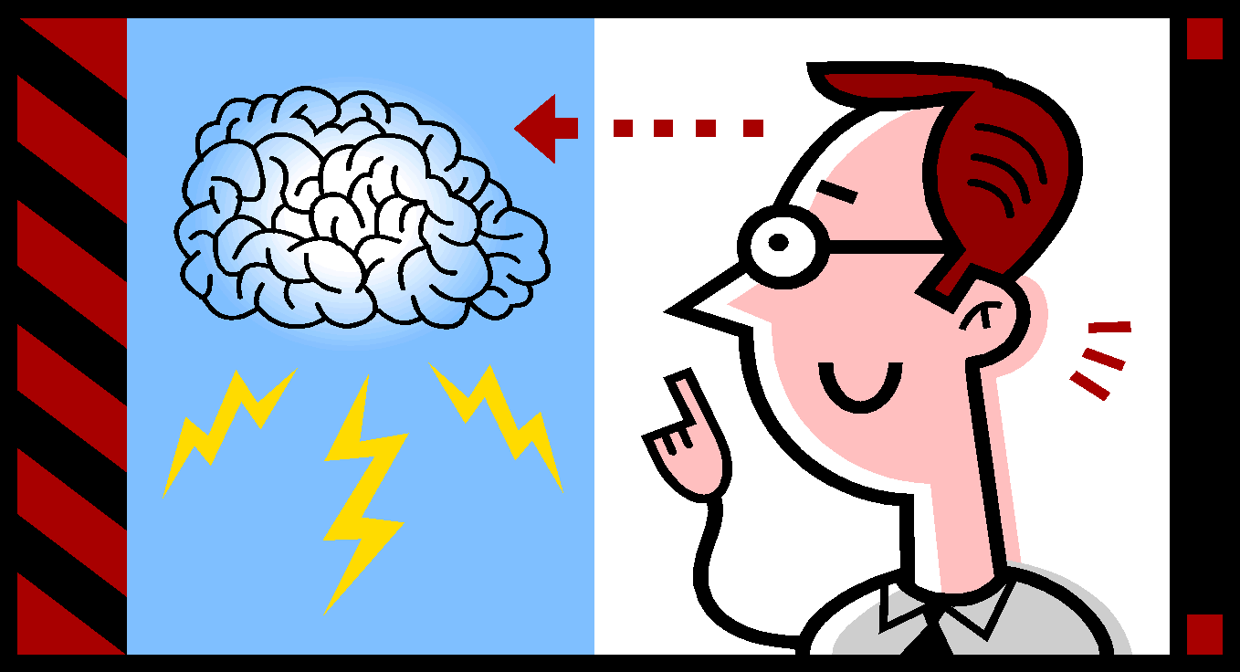
Body
What does this awkward growth mean to parents?
Notes:
So, what can you as parents do about it? After all, how you and the rest of the family respond to your child’s changes can have a lasting effect.

Slide 5
Body: Parenting Tips
Talk to your child about what is happening physically.
Do not tease about physical looks.
Compliment actions, not looks.
Engage in activities with your child.
Involve him/her in the community.
Source: S. Feinstein, Parenting the Teenage Brain, 2007
Notes:
Talk to them about what is happening physically and help them understand they are in the midst of some big changes. Also, reassure your child that the varying growth stages among his/her peers is normal.
Do not tease them or make comments about their physical looks.
Rather, take the focus off their looks and compliment them on something they do well.
Keep them engaged in things they liked to do as children (sports, singing, hobbies).
Get them involved as volunteers in the community and with non-profit organizations (food bank, nursing homes, ecology organizations).
[This the end of the “Body” section. You may ask for comments and questions before going on to the “Brain” section.]

Slide 6
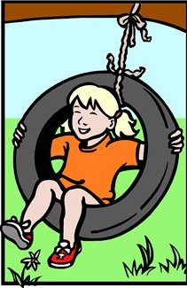
Brain #1 – Growth Spurt
Use it or lose it!
Whatever we practice becomes “hardwired.”
What teens do affects how their brains develop for life.
Source: B. Strauch, The Primal Teen, 2003
Notes:
USE IT OR LOSE IT!! To keep the brain efficient, neurons not being used are destroyed.
Now, for those neurons being used, they become “hardwired.” That means the neuronal pathway becomes permanent. Hardwiring makes the communication between neurons faster and more efficient. So whatever adolescents are practicing and learning actually changes the brain. They become very skilled at it…even if it’s being a couch potato! So parents need to pay attention to what is becoming hardwired in the brain of their child.
Dr. Giedd believes that what teens do during their adolescent years can affect how their brains develop for life because what they do a lot is going to get hardwired. So, is your child…
playing video games all the time or practicing a musical instrument?
watching MTV or working on puzzles?
reading books and playing sports or delving into risky behaviors?

Slide 7
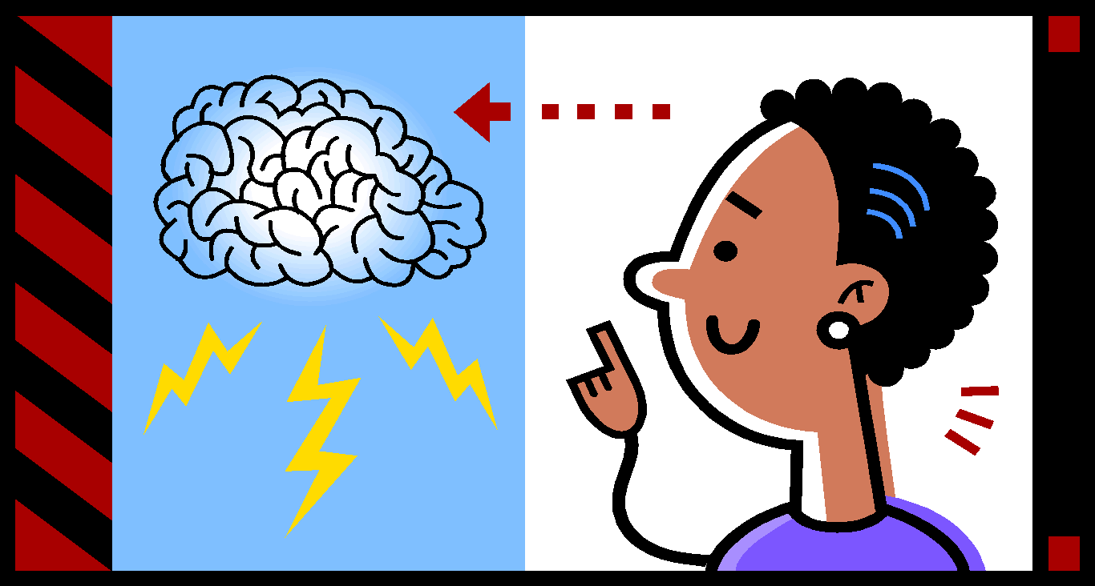
Brain #1 – Growth Spurt
What does this growth spurt mean for parenting?
Notes:
What does this growth spurt mean for parenting? I mean, besides monitoring what is becoming hardwired…

Slide 8
Brain #1 – Growth Spurt
Middle grades is a critical time to expose your child to all types of learning experiences and skills.
Notes:
Middle grades is a critical time to expose your child to all types of learning experiences and skills. For example…

Slide 9
Brain #1 – Growth Spurt
Parks and museums for information on geology, volcanoes, astronomy, plants, animals, and history
Concerts: classical, jazz, blue grass
Activities: skating, skiing, swimming, biking, hiking, dancing, gymnastics
Arts and crafts: Art media, art appreciation, sewing, cooking, photo journaling
Notes:
Here are some examples of what you could do:
Take trips to national and state parks and to museums to look for information on geology, volcanoes, astronomy, plants, animals, history.
Attend performances that expose children to all types of music: classical, jazz, bluegrass, folk, choral, meringue, opera, etc. Or listen to the different types of music in your home.
Do physical activities: skating, skiing, swimming, biking, hiking, dancing, gymnastics.
Experience new hobbies in arts and crafts: From having fun experimenting with different art media to art appreciation at museums.
Also, think about sewing, cooking, and photo journaling in albums.

Slide 10
Brain #2 – Thinking Matures
Adolescent minds are shifting from concrete thinking to abstract thinking.
☛
Source: Piaget, 1977
Notes:
The second brain change is…Thinking Matures
The adolescent mind is shifting from
concrete thinking
to
abstract thinking.
That means they are able to think about ideas, about things that they cannot see or touch. They are beginning to understand concepts like democracy, Newton’s laws of physics, and yes, even algebra.
They can think about what might be instead of what is. For example, a six-year-old thinks a smiling person is happy and a crying person is sad. A 14-year-old may tell you that a sad person smiles to hide his true feelings.
There are two problems associated with this transition for young adolescents. First, this abstract development is happening at different rates for different individuals. This creates a big challenge for teachers trying to teach students who are at varying levels.

Slide 11
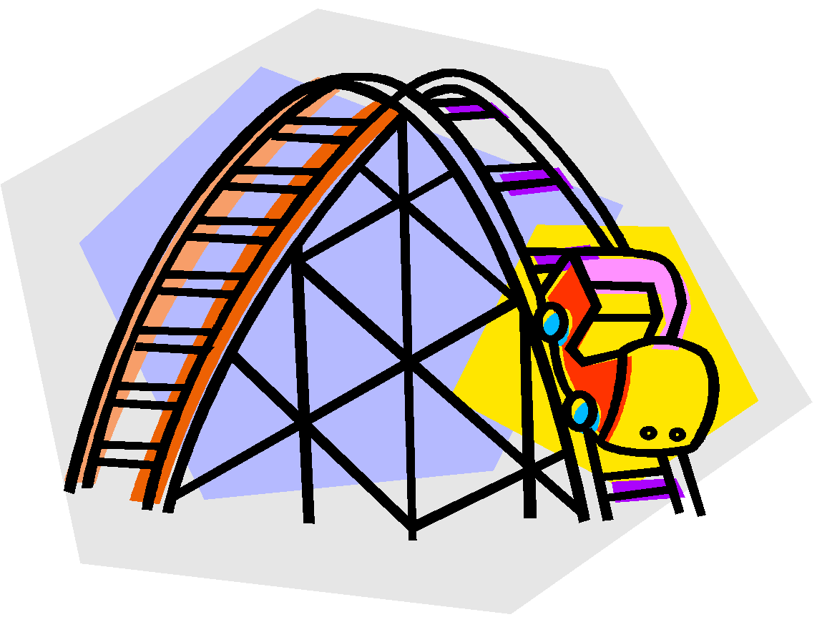
Brain #2 – Thinking Matures
Source: Calif. Dept. of Education, Caught in the Middle, 1987
Notes:
Second, there are daily fluctuations of development within the individual. For example, in the morning a student might be using abstract thinking and by the afternoon…
regress to concrete thinking.
As adults, teachers or parents, it is hard to know what to expect from them hour by hour!

Slide 12
Brain #2 – Thinking Matures
What does this shift of thinking mean to parents?
Source: S. Feinstein, Parenting the Teenage Brain, 2007
Notes:
What does this shift of thinking mean to parents?

Slide 13
Brain #2 – Thinking Matures
The ability to reason may change the way the young teen talks and acts around the parents.
Identity formation – exploring a range of possible identities.
Notes:
Within the family, the ability to reason may change the way a young teen talks to and acts around her parents. She begins to anticipate how her parents will react to something she says or does and prepares an answer or explanation.
These mental changes lead adolescents to consider who they are and who they may be.
This is a process called identity formation and it is a major activity during adolescence. Most young adolescents will explore a range of possible identities. To a parent, this phase seems to be like trying on Halloween costumes.

Slide 14
Brain #2 – Thinking Matures
Using analogies that bridge the gap between concrete and abstract thinking helps a student make this transition.
Using tangible, concrete objects to explain abstract concepts.
Source: J. Zadina, Six Weeks to a Brain-Compatible Classroom, 2008
Notes:
To help your child with the shift from concrete to abstract thinking, try…
Using analogies that bridge the gap between the concrete and abstract, and…
Using tangible objects to explain abstract concepts.

Slide 15
Brain #3 – Time Changes
The biological clock shifts.
Source: D Sousa, How the Brain Learns, 2006
Notes:
The third brain change is: The biological clock shifts. What is a biological clock?
Everyone has rhythms to his/her bodily functions—our temperature rises and falls at certain times; we wake up and fall asleep at certain times. When it says it is time to go to bed, the body secretes a hormone called melatonin, which makes us sleepy. Although adults and children vary slightly, there is a similar rhythm of wake and sleep. That pattern decisively shifts when children go through puberty.

Slide 16
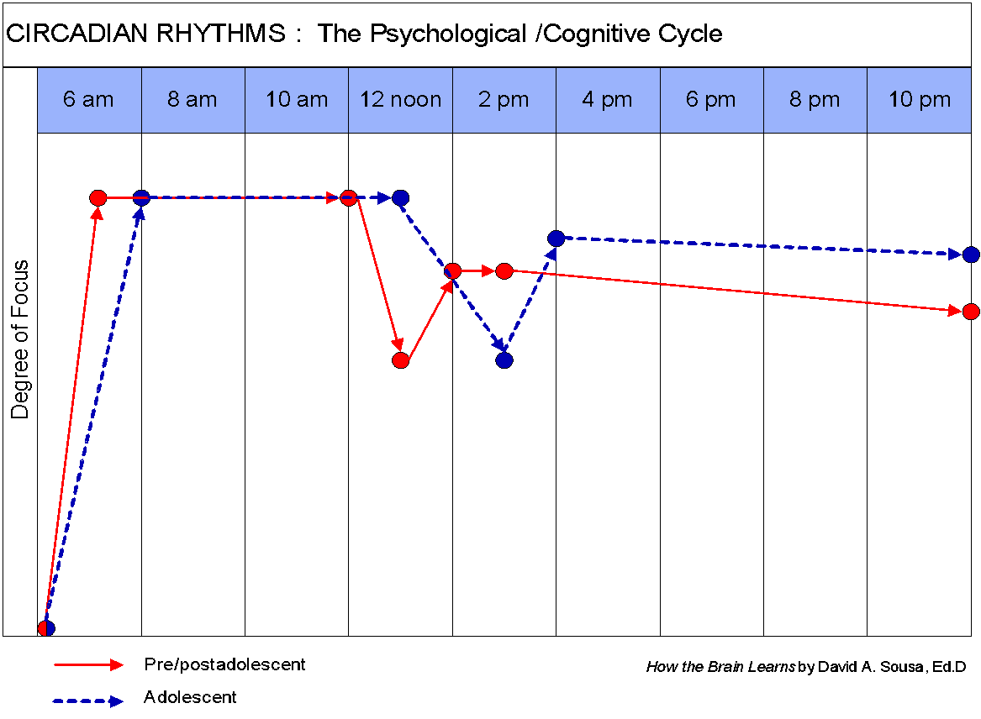
Notes:
A normal rhythm for adults and younger children is shown by the red line. The blue line shows the rhythm shift in adolescents. They wake up later, they experience the lull after lunch later, then they stay awake longer.

Slide 17
Brain #3 – Time Changes
The further along in puberty, the later melatonin is secreted.
Studies indicate adolescents need 9¼ hours of sleep a night.
School start times do not align to this biological clock shift.
Source: D. Walsh, Why Do They Act That Way? 2004
Notes:
The further along the adolescent is in puberty, the later melatonin is secreted…sometimes not until 11:00 p.m. or midnight.
Studies show that adolescents need 9¼ hours of sleep a night because of their rapid growth spurt. Also, getting the proper amount of sleep is vital for learning. What the child learns during the day is processed into the memory storage during sleep.
But if your child is not feeling sleepy until late, and must wake up early for school, he/she is sleep deprived. And parents wonder why their child sleeps until noon on Saturday! Making up for lost sleep on the weekend is not the solution. A good solution would be to have schools start later. However, middle and high schools have constraints with bus transportation and after-school sports.

Slide 18
Brain #3 – Time Changes
What does this time shift mean for parenting?
Notes:
What does this time shift mean for parenting?

Slide 19
Brain #3 – Time Changes
Monitor your child’s sleep – 9+ hours of sleep each night.
Keep the room dark – melatonin is secreted when it is very dark.
Help your child fall asleep by calming activities – reading, listening to soft music, or journaling (not TV!)
Source: S. Feinstein, Parenting the Teenage Brain, 2007
Notes:
Make sure that your child is getting the proper amount of sleep.
Melatonin is secreted when it is very dark so eliminate night lights or lights associated with electronic devices.
Allow only relaxing activities before bed. TV actually keeps the brain stimulated.

Slide 20
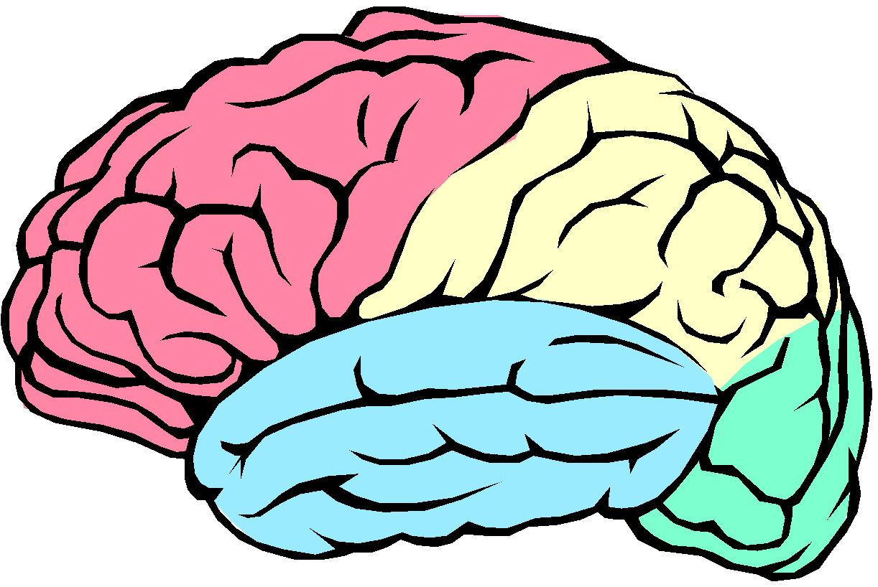
Brain #4 – Frontal Lobe Changes
Source: B. Strauch, The Primal Teen, 2003
Notes:
The last brain development we will talk about is the major changes going on in the frontal lobe.
The pink section is the frontal lobe. This part of the brain is being completely reorganized! And while it is being reorganized, it is sort of…“out to lunch.” It is not functioning normally. What is the frontal lobe’s normal function?

Slide 21
Brain #4 – Frontal Lobe Changes
Organize
Plan and strategize
Reason
Anticipate consequences
Focus and pay attention
Make acceptable social responses
Make sound decisions
Source: J. Willis, Research-based Strategies to Ignite Student Learning, 2006
Notes:
The frontal lobe’s job involves:
Organizing our “stuff”
Planning and strategizing – what comes next
Figuring out what is logical and what is reasonable
Anticipating consequences with certain actions
Focusing and paying attention to our surroundings and to the people talking to us
Making acceptable social responses that won’t embarrass us or get us in trouble
Making sound decisions based on all of the above

Slide 22
Brain #4 – Frontal Lobe Changes
Malfunctioning Adult Frontal Lobe
Disorganized
Impulsive
Not motivated or engaged
Stimulus-driven
Poor judgment
Irritable
Source: B. Strauch, The Primal Teen, 2003
Notes:
IF the frontal lobe is malfunctioning in an adult, not doing its job, the result is seen in the following behaviors:
Disorganized
Impulsive—acts before thinking or planning
Not motivated or engaged to do extensive thinking
Stimulus driven—wants to be excessively stimulated by loud noises, out of the ordinary sights, anything that makes them feel high, doing things that give a thrill, usually dangerous.
Poor judgment—does not make good choices or sound decisions
Irritable—can easily get into a bad mood
→Does this remind you of someone you know? Does this describe adolescents? Because the frontal lobe of adolescents is off being reorganized, you will see the same behaviors as dysfunctional adults.
Remember the frustration of the parent in the beginning slide when her child’s grades slipped? The grades might have gone down because the child became disorganized and distracted. Parents may see their child go from being a star pupil in elementary school to getting much lower grades in middle school, from having wonderfully organized binders to having backpacks that look like trash bins inside. Parents may blame the teachers, but we all have to take responsibility to understand the adolescent brain. When educators and parents do not understand the changes going on inside, it can be very frustrating and the adult reaction might not help the situation at all. Instead of yelling at the child for being so disorganized, what could be a more constructive approach?
Middle grades educators have to consider the special developmental needs of early adolescence. These students are not simply older elementary school students nor younger high school students. The dramatic changes that occur in the brain during this time require a radically different and unique approach to education that will keep them motivated and engaged. (Thomas Armstrong, The Best Schools, ASCD, 2006).

Slide 23
Brain #4 – Frontal Lobe Changes
How can parents help with the development of the frontal lobe?
Notes:
How can parents help with the development of the frontal lobe? Even though the frontal lobe is “under construction,” giving young adolescents practice using their frontal lobe processes is a great help in the reconstruction. You and the teachers are a team in educating your child. What is your part? Overall, parent involvement during middle grades helps a child’s achievement, but how a parent is involved really matters.

Slide 24
Brain #1 – Growth Spurt
Dr. Nancy Hill,
Harvard Graduate School of Education
Academic achievement declines during middle grades.
Source: Dr. Nancy Hill, 2009
Notes:
Dr. Nancy Hill of the Harvard Graduate School of Education wanted to find the most effective way parents could be involved in middle grades schools because research studies show that academic achievement declines during this time. In addition, parent involvement is a bit more complicated than it is in elementary school with one teacher in one classroom.

Slide 25
Brain #4 – Frontal Lobe Changes
Young adolescents often indicate they do not want their parents to visit the school.
Teachers are challenged with involving large numbers of parents.
Parents are challenged with developing relationships with 4-7 teachers.
School-based involvement usually entails assistance outside of the classroom.
Source: Hill & Chao, Families Schools and the Adolescent, 2009
Notes:
Parent involvement in the middle grades changes because of four factors:
As adolescents become more independent, they want to be trusted that they will manage their responsibilities so often indicate that they do not want their parents to visit the school. (Stevenson & Baker, 1987); (Collins & Laursen, 2004; Grotevant, 1998)
One of the biggest challenges for middle grades teachers in their attempts to involve parents is the large number of parents with whom they must develop relationships. It is virtually impossible.
Likewise for parents, it is difficult to develop productive relationships with all their child’s teachers (Hill & Chao, 2009).
School-based involvement during middle grades is less likely to be in the classroom. It is more likely to entail assisting with schoolwide fundraising, administrative duties in the office, monitoring lunch-time activities, or committee work in various school organizations.

Slide 26
Brain #1 – Growth Spurt
Effective Parent Involvement in middle grades:
Communicate expectations of how well your child should do at school.
Provide useful strategies for school work and with decision-making.
Give meaning to education and link it to the child’s goals and to the “real-world.”
Foster educational & career aspirations
Source: Hill & Chao, Families, Schools and the Adolescent, 2009
Notes:
Given these factors, Dr. Hill’s research found that student achievement increased with a type of involvement that worked well in the middle grades setting—it was not based solely on being at the school. The involvement occurs when parents:
Communicate their expectations of how well they want their child to do in school.
Provide useful strategies that their child can effectively use in their school work and in semi-autonomous decision-making.
Help their child understand the purposes and goals of education, and give meaning to what they are doing in school by linking the material with the child’s interests, goals, and to what they will be doing in the real-world.
Foster educational and career aspirations in their adolescents.
→ Interestingly, when parent involvement consisted of helping their children with homework, there was mixed results in student achievement .

Slide 27
Brain #4 – Frontal Lobe Changes
Discuss likes and dislikes
Find resources to explore career interests relating to likes
Plan how to reach goals
Go to work sites
Give projects that require planning and organizing
Notes:
Examples of how to facilitate that type of parent involvement might include the following:
Discuss their likes and dislikes--what they feel strongly about.
Help them find resources to explore career interests that relate to their likes and dislikes. Explore other careers they might not know about.
Plan how they will achieve their goals.
Take them to work sites.
Give them projects that require planning and organizing.
[This the end of the “Brain” section. You may ask for comments and questions before going on to the “Behavior” section.]

Slide 28
Behavior
What was s/he thinking????
Notes:
Now let’s turn our attention to some mysterious behaviors. The chances are you have already been shocked and bewildered at some point by your child’s actions that seemed to be totally out of character. We will look at two behaviors.

Slide 29
Behavior
Why are they now so willing to take risks?
Notes:
The first is risky behavior. Why now an impulse for risk-taking? Again, a look inside the young adolescent’s brain may help adults understand.
[Define risky behaviors: Back-talking to a teacher, cutting class/school, stealing a pack of gum, smoking and other drugs, bringing a weapon to school, refusing to do homework, going to places without parental permission, bullying, name-calling that may provoke a fight.]

Slide 30
Behavior #1 - Impulse
1. The “impulse control center” (frontal cortex) is under construction.
Source: G. Crawford, Brain-Based Teaching with Adolescent Learning in Mind, 2007
Notes:
Remember, the frontal cortex is under construction.

Slide 31
Behavior #1 - Impulse
Where are these frontal lobe functions being performed?
Controlling impulsive behavior
Anticipating consequences
Making acceptable social responses
Making sound decisions
Notes:
Then where are these functions frontal lobe functions being performed?
Controlling impulsive behavior
Anticipating consequences
Making acceptable social responses
Making sound decisions

Slide 32
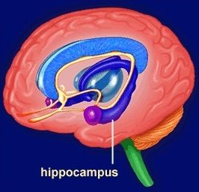
Behavior #1 - Impulse
2. The amygdala makes the decisions!
+ Hormones help trigger impulsive behavior.
amygdala
Source: D. Walsh, Why Do They Act That Way, 2004
Notes:
Without the use of the frontal lobe, the brain relies on another part of the brain to make decisions. It is called, the amygdala (ah-mig’-dala).
It’s the violet almond-shaped structure you see on the slide. You might know it as the fight-or-flight center.
It influences emotion—especially aggression and fear—and our impulsiveness.
And this is what the adolescent brain is relying on for decision-making in adolescents!
In addition, the amygdala has receptors—or docking stations—that just fit hormones like testosterone. Young adolescent boys can have 5-7 surges of testosterone a day and every surge overly stimulates the amygdala, which triggers fear, aggression, territoriality, sexual interest, dominance and impulsive behavior. As a result, boy become emotional powder kegs!
Dr. David Walsh says you can see how this is manifested by comparing the times you walked into your son’s room when he was eight years old to now, as a young adolescent. If you hear, “Get out of my room!” Those words mark territoriality coming from testosterone’s influence on the amygdala.
For girls, estrogen has docking stations that fit with the hippocampus, the deep purple horseshoe structure on the slide. The hippocampus is all about memory formation. This connection between estrogen and the hippocampus may give girls some advantage when it comes to academic tasks requiring memory.
Estrogen affects one of the brain’s chemicals, serotonin. Serotonin normally stabilizes our moods, but when estrogen interferes, hormonal levels can lead to dramatic, sudden mood swings. She can be laughing on the phone with her friend one minute and then a short while later sobbing because she doesn’t understand her math homework.
The hormonal effects of the brain chemicals amplify moods, so a seemingly small detail can have an emotional reaction blown way out of proportion.

Slide 33
Behavior #1 - Impulse
Adolescent brains get the gas with the amygdala...
…before they get the brakes from the frontal cortex!
Source: D. Walsh, Why Do They Act That Way, 2004
Notes:
To summarize, there is impulsive risk-taking in adolescents because there is a role reversal in the brain.
In adults, the frontal cortex is boss.
In adolescents, the amygdala is in control
and the frontal cortex takes a back seat.
Young adolescents are sometimes at the mercy of impulses that they are not always capable of controlling. And, the accompanying emotions they are feeling, are intense. This intensity of their feelings is often surprising even to them.

Slide 34
Behavior #2 – Misinterpret
Young adolescents are likely to misinterpret facial expressions and what adults say.
Source: R. Philp, Engaging ‘Tweens and Teens, 2007
Notes:
The second mysterious behavior is how they respond to facial expressions.
Things you say or the way you look may be misinterpreted and how they respond may surprise or shock you. Why is that?

Slide 35
Behavior #2 – Misinterpret
Studies show that adolescents are not very good at reading facial expressions.
Source: B. Strauch, The Primal Teen, 2003
Notes:
Researchers studied adolescents by showing the subjects pictures of faces with different emotional states—anger, sadness, surprise, fear, etc. They found that adolescents interpreted the emotions quite differently than adults.
The adolescents mistook fear and surprise as anger.
Your “Oh my!” or “Wow!” might receive a response like: “I don’t care what you think!!”…with his bedroom door slamming. You may wonder, “What was that all about?
So what was that all about? It is all about where the facial expressions are interpreted in the brain.

Slide 36
Behavior #2 – Misinterpret
Adolescents tend to misinterpret what adults say because they use a different part of the brain to interpret the information.
Adult Adolescent
Frontal Lobe
Amygdala
Source: S. Feinstein, Parenting the Teenage Brain, 2007
Notes:
The reason why adolescents mistake other emotions as anger is that a different part of the brain is used to interpret emotional faces.
Adults use the rational part of the brain—the frontal lobe.
Adolescents use the seat of fear and anger—the amygdala. It is as if they are seeing the world through “angry” glasses.

Slide 37
Behavior #2 – Misinterpret
Be home by 6:00 p.m.
“Don’t be late!”
“Clean up your room.”
Make your bed and pick the clothes up off the floor.
Source: S. Feinstein, Secrets of the Teenage Brain, 2004
Notes:
How can parents help with the interpretation so that it doesn’t get misinterpreted?
By using language that is as explicit as possible. For example, verbalize your feelings. Instead of “Oh my!” say, “I am surprised.”
What might be clear to adults, can leave the door wide open for multiple interpretations by adolescents.
For example:
“Don’t be late.” Is that statement clear or unclear?
“Be home by 6:00 p.m.” is precise.
“Clean up your room.” Is that statement clear or unclear?
“Make your bed and pick the clothes up off the floor,” is more explicit.
“Late” or “clean” to an adolescent may mean something quite different than it does to you…yes, even if you did teach him or her what clean meant when they were young.
The more specific you can be, the less you leave to be misinterpreted.

Slide 38
Behavior
What does “thinking” with the amygdala mean for parenting?
Notes:
If adolescents are using the amygdala instead of the frontal lobe, what does that mean for parenting?

Slide 39
Behavior
Lessen the chances of risky behavior by:
Helping your child see consequences of his/her actions or those of others
Giving real-life examples of making the right or wrong choices
Thinking through decisions together.
Source: S. Feinstein, Secrets of the Teenage Brain, 2004
Notes:
Lessen the chances of risky behavior by:
Helping your child see consequences of his/her actions or those of others
Giving real-life examples of making the right or wrong choices
Thinking through decisions together.

Slide 40
Remember!
Even though your child may pull away from and you, your child needs your guidance more than ever!
Notes:
Remember, even though your child may start pulling away from and you, your child needs your guidance more than ever!

Slide 41
Remember!
Your role as a parent is changing, but you are no less important to your child than when she or he was younger.
Notes:
Your role as a parent is changing, but you are no less important to your child than when she or he was younger.

Slide 42
Summary - Body
Talk to your child about what is happening physically.
Compliment actions, not looks.
Engage in activities with your child at home and in the community.
Notes:
Summary of the Body
Talk to your child about what is happening physically.
Compliment actions, not looks.
Engage in activities with your child at home and in the community.

Slide 43
Summary - Brain
Expose your child to all types of learning experiences and skills
Connecting what your child is learning in school—or is interested in learning—to outside activities and events.
Use tangible, concrete objects to explain abstract concepts
Monitor your child’s sleep of 9+ hours of sleep each night.
Notes:
Summary of the Brain
Expose your child to all types of learning experiences and skills
Connecting what your child is learning in school—or is interested in learning—to outside activities and events.
Use tangible, concrete objects to explain abstract concepts
Monitor your child’s sleep of 9+ hours of sleep each night.

Slide 44
Summary - Brain
Make real-world applications to whatever they are doing.
Give them projects that take planning and organizing
Discuss their career interests and help them plan how they will achieve their goals.
Notes:
Summary of the Brain
Make real-world applications to whatever they are doing.
Give them projects that take planning and organizing
Discuss their career interests and help them plan how they will achieve their goals.

Slide 45
Summary - Behavior
Help your child see consequences of his/her actions or those of others by
Be specific with directives to leave no room for misinterpretation
Notes:
Summary of the Behavior
Help your child see consequences of his/her actions or those of others by
Be specific with directives to leave no room for misinterpretation

Slide 46
Taking Center Stage—Act II (TCSII)
Marsha Robinson, M.A.
Education Programs Consultant
California Department of Education
Middle Grades Improvement Office
mrobinson@cde.ca.gov
916-319-0352
Author of “Adolescent Development” on Taking Center Stage—Act II

Slide 47
Taking Center Stage—Act II (TCSII)
A one-stop-shop for middle grades information and resources!
http://pubs.cde.ca.gov/tcsii

Slide 48
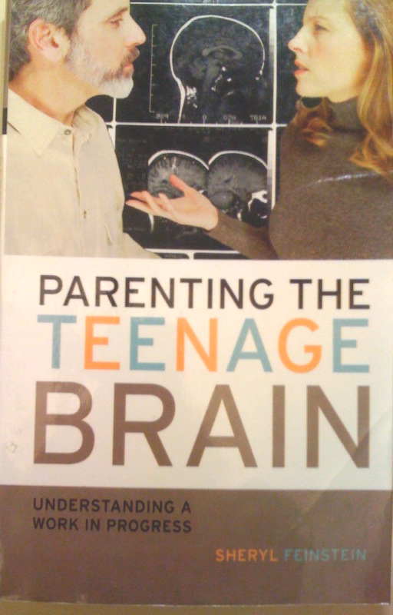
Bibliography
Sheryl
Feinstein

Slide 49
Bibliography
Nancy E.
Hill
Ruth K.
Chao

Slide 50
Bibliography
Barbara Strauch

Slide 51
Bibliography
David
Walsh

Slide 52
Bibliography
Anthony W.
Jackson
P. Gayle
Andrews

Slide 53
Bibliography
Raleigh Philp

Slide 54
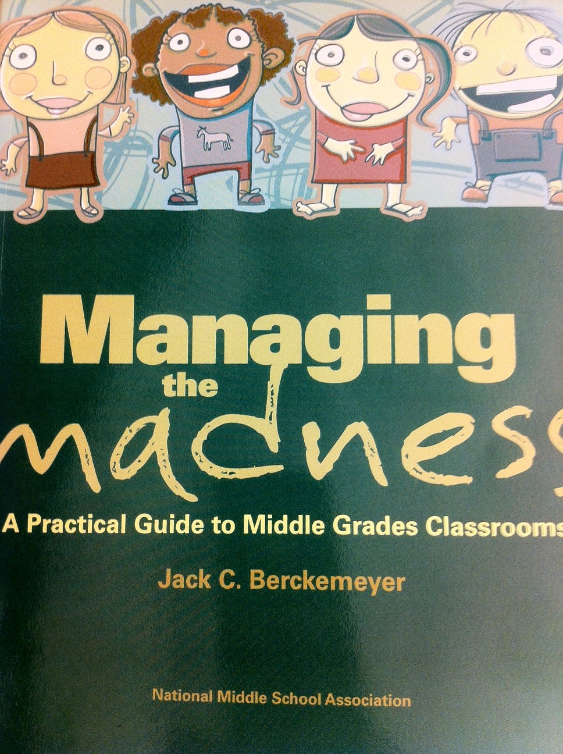
Jack C. Berckenmeyer

Slide 55
Richard Fabes and Carol Lynn Martin

