Slide 1
What You Need to Know about Financial Aid
2019-2020

Slide 2
Who Needs to File For Financial Aid?
Every student who desire to acquire Need-Based Financial Aid
If your school requires financial aid filing for Merit-Based Aid or Athletic Scholarships
Parents who want to apply for a parent loan through the federal government

Slide 3
Important Forms
FAFSA
CSS Profile (needed for some colleges)
Institutional Forms (university’s own form)
2017 1040 (A or EZ) – Federal Tax Return
Income Statement (2017 W-2 Form)
Bank/Investment/Mortgage Statements

Slide 4
Free Application for Federal Student Aid (FAFSA)
A standard form that collects demographic and financial information about the student and family
May be filed electronically (computer or FAFSA APP) or using paper form
Available in English and Spanish

Slide 5
FAFSA
Information used to calculate the Expected Family Contribution or EFC
The amount of money a student and his or her family may reasonably be expected to contribute towards the cost of the student’s education for an academic year
Colleges use EFC to award financial aid

Slide 6
FAFSA
May be filed at any time during an academic year, but no earlier than the October 1st prior to the academic year for which the student requests aid
For the 2019–20 academic year, the FAFSA may be filed beginning October 1, 2018
Colleges may set FAFSA filing deadlines

Slide 7
FAFSA on the Web
Website: www.fafsa.ed.gov (www.fafsa.gov)
2019–20 FAFSA on the Web (FOTW) available on October 1, 2018
FAFSA on the Web Worksheet:
Use as “pre-application” worksheet
Questions follow order of FAFSA on the Web

Slide 8
FAFSA on the Web
Necessary reasons to file electronically:
Built-in error detectors to prevent costly errors
The ease to use Internal Revenue Service (IRS) data retrieval
More timely submission of original application (date stamp of 1st submission) and any necessary corrections
More detailed instructions and “help” for common questions
Ability to check application status on-line
Simplified application process in the future

Slide 9
Federal Student Aid Personal Identification Number (FSA PIN)
Website: https://fsaid.ed.gov/ Sign FAFSA electronically
May be used by students and parents throughout aid process, including subsequent school years

Slide 10
Applying for a FSA ID
You can apply for a FSA ID by selecting APPLY For FSA ID from the list of options on the top of the FAFSA Home Page.
Follow the steps to establish your FSA ID
Complete the process with entering the Source Code that will be emailed to you at a stage in the creating your ID process.

Slide 11
FAFSA On The Web Worksheet (FOTW)
2019–20 FAFSA on the Web Worksheet (Handout): 4-page booklet containing:
Instructions
22 questions in 4 sections

Slide 12
WWW.FAFSA.ED.GOV
Click Here >
Notes:
Note: www.fafsa.gov takes you to www.fafsa.ed.gov

Slide 13
Help & Hints
BOX
STUDENT
Demographic Information
Notes:
Student Demo Info: The info is for student not parent (parents have made that mistake).
Help & Hint Box: Instructions for FAFSA. Info changes as curser moves from one box to the next.

Slide 14
SOME Eligibility Questions
Notes:
These questions help determine if you are eligible for aid and the type of aid. Final Eligibility is determined by the college.

Slide 15
Where did you go to
High School?
Notes:
Do not be surprised if you get this error. If the information is right just click on next. (If not typed exactly the way it is listed in the system this error will appear. ONLY means the high school is not yet in the system or is in the system typed differently. Example: Americus HS, Americus High School, Americus High.)

Slide 16
Heard this before?
“I am not sure which college”
List up to 10!
Kansas
Best School In Kansas

Slide 17
Does the student have to use their parents information?
Notes:
This might be a good place to go over any dependency questions.

Slide 18
What
if the parents refuse?
Notes:
Talk about unsub loan only options.

Slide 19
PARENT
Demographic
Information

Slide 20
Did Parents File Taxes?

Slide 21
Linking to the IRS is quick, easy and may save the student and/or parent from having to get a copy of their Tax Return Transcript.
Notes:
Starting for the 2012-2013 FAFSA, a copy of a tax return will no longer meet the requirements for verification. IF the tax return information was provided through the IRS Link without any changes made to the information provided by the link then in most cases this serves as verification documentation. Otherwise a copy of the Tax Return Transcript is the only documentation now accepted to verify information on the FAFSA.

Slide 22
IRS Data Retrieval
While completing FOTW, applicant may submit real-time request to IRS for tax data
IRS will authenticate taxpayer’s identity
If match found, IRS sends real-time results to applicant in new window
Applicant chooses whether or not to transfer data to FOTW

Slide 23
IRS Data Retrieval
Participation is voluntary (but highly recommended)
A tax transcript will be the alternate use of tax verification
Reduces documents requested by financial aid office
2019-2020 data retrieval will not show your tax figures on the FAFSA for security purposes.

Slide 24
Click
OK
to be taken to the IRS Website.

Slide 25
Name, SSN & DOB pre-populate.
You will need:
Filing Status &
Address
exactly as it appeared on your tax return.
Notes:
Name, SSN and DOB pre-populates. You will need to know the filing status and address exactly as it appears on the tax return to access the information.

Slide 26
Check the ‘Transfer My Tax Information’ Box
then Click ‘Transfer Now’
Notes:
Note the third column shows all the questions and their corresponding number that are answered by the match.

Slide 27
Answer the questions that were not answered by the IRS Transfer but Watch for questions that have ‘Transferred from the IRS’ above them.
Notes:
If you make changes to questions that were answered by the IRS (even if the IRS answer is blank) the transferred information will not count for verification documents. (Student would need to continue through FAFSA until reaching the end and submitting but we are going to switch back as if data match would not work.) note help and hints and neg balances for farm etc.

Slide 28
Some answers can be found on page 1 or 2 of the parents’ tax return or the parents’ w-2.
The remaining questions would come from outside sources i.e. bank statements, payment center, Social Security Office, etc.

Slide 29
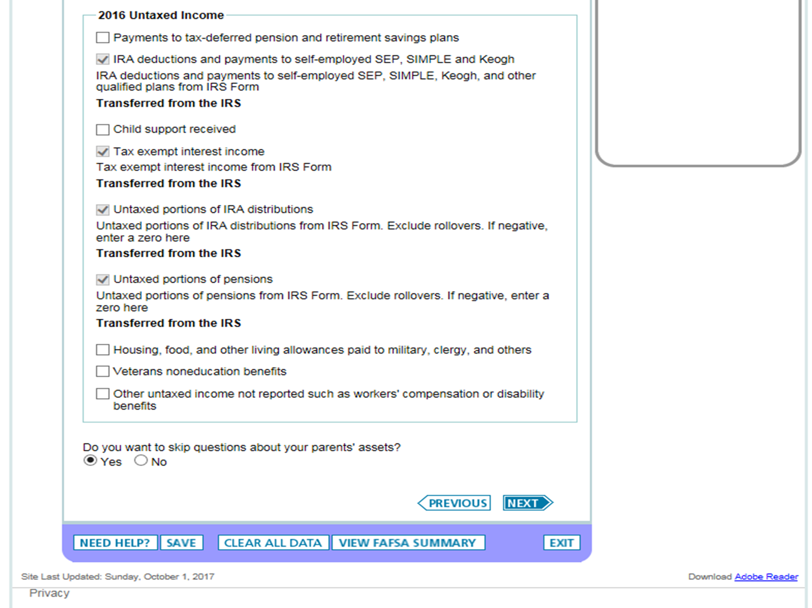

Slide 30
Did the student file?
Notes:
According to the IRS, dependents with earned income less than $5,700 were not required to fill out a tax return. If the student was required and has not, he will be required prior to receiving Federal Aid.

Slide 31
From the student’s W-2.

Slide 32
Some answers can be found on the student’s w-2.
The remaining questions would come from outside sources i.e. bank statements, payment center, Social Security Office, etc.

Slide 33
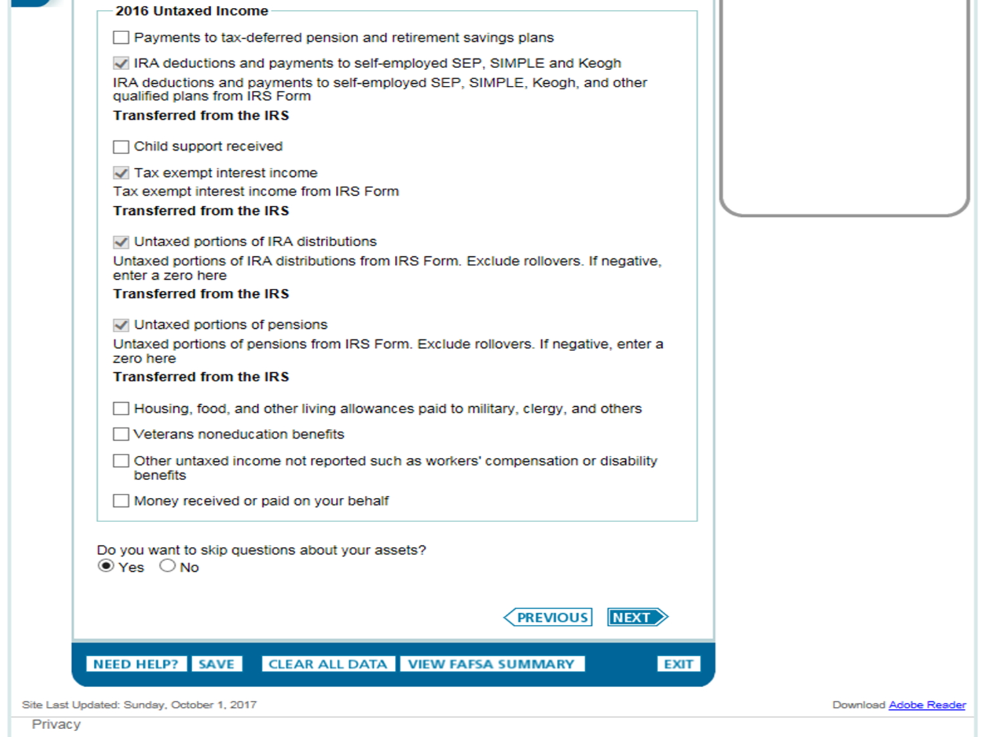

Slide 34
Almost Done!
Student Sign
Agree to Terms
Notes:
Faster to sign electronically but can mail in a signature page if electronic signatures are not possible. If not signing electronically, print the signature page and submit the FAFSA Electronically. Don’t forget to mail I the signature page. You can go back on the FAFSA and add the signature as a correction if unable to sign at time of completion.

Slide 35
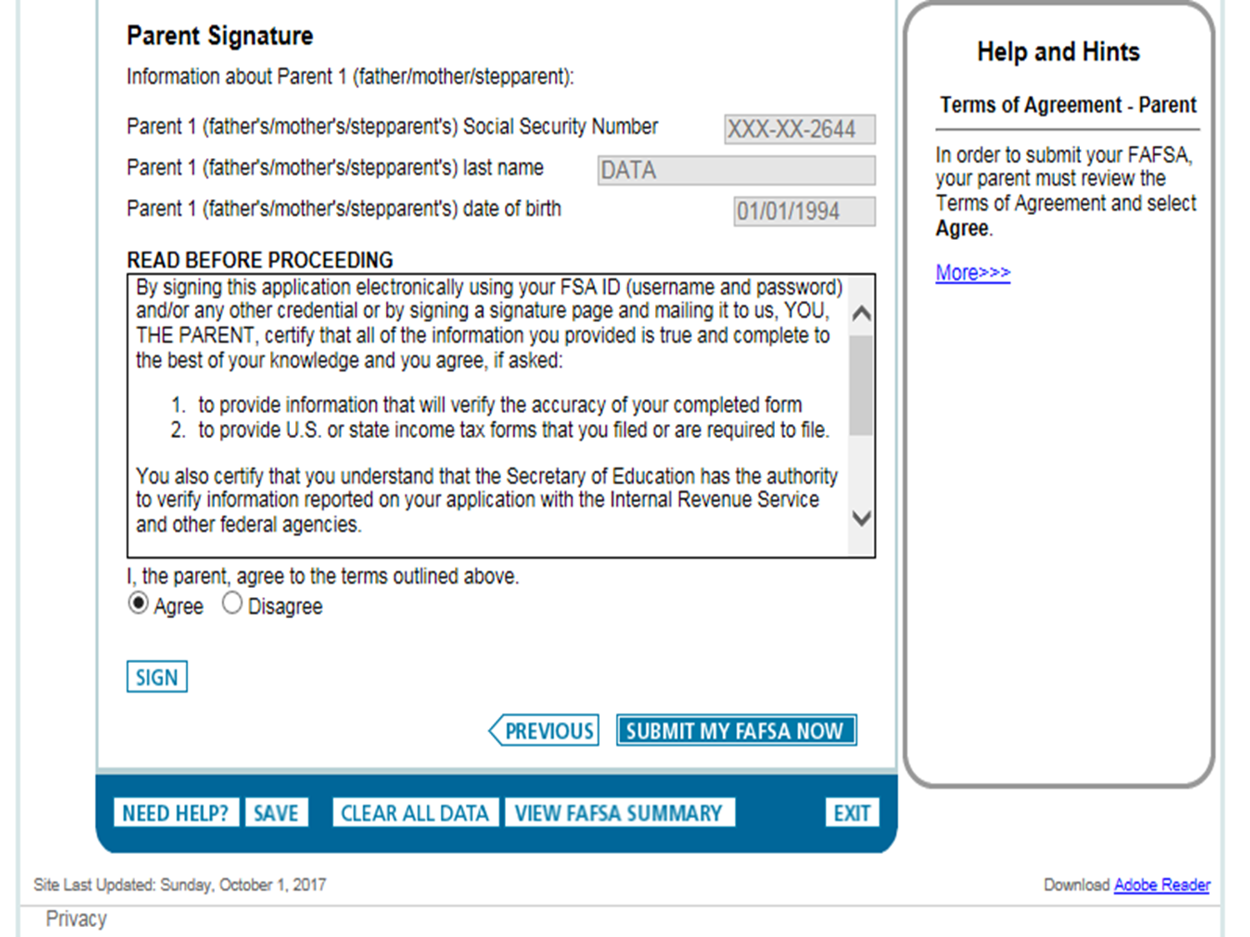

Slide 36
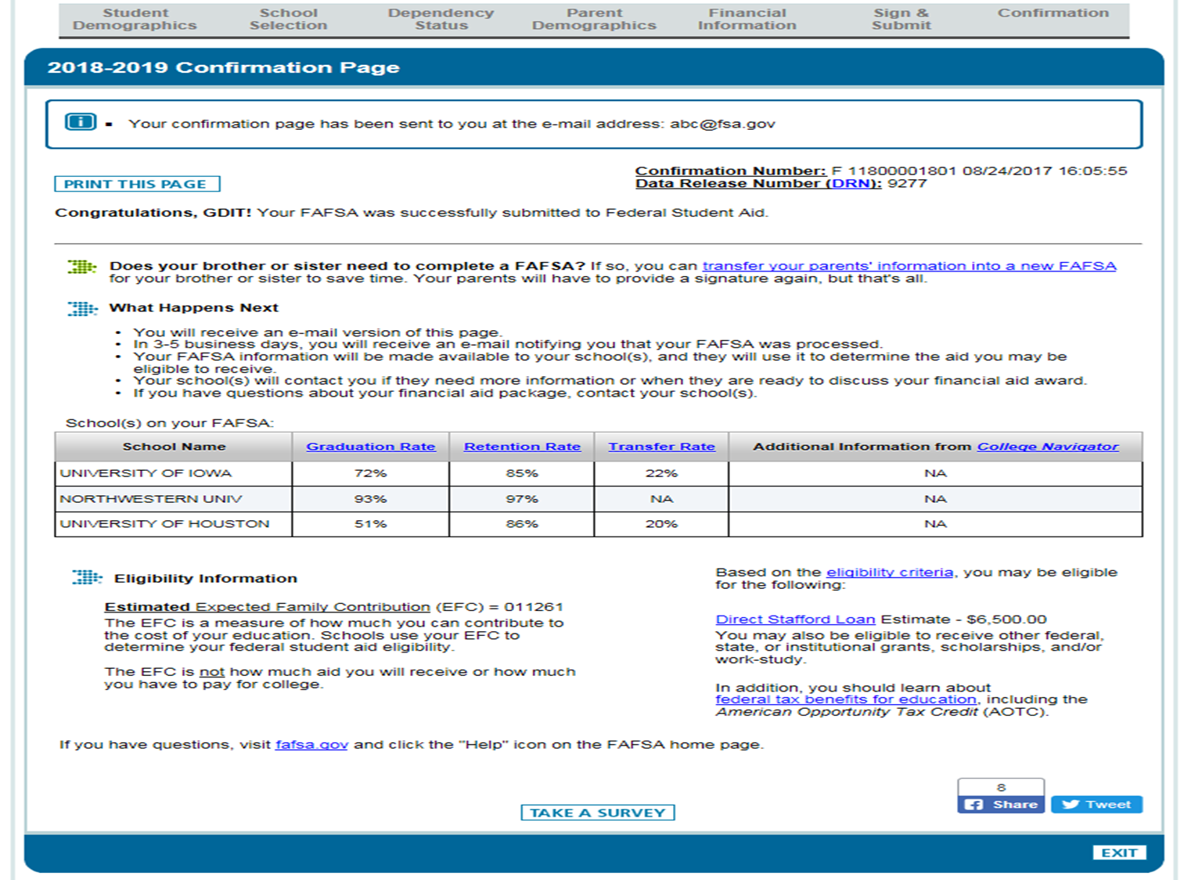

Slide 37
Frequent FAFSA Errors
Social Security Numbers is incorrect
Divorced/remarried parental information
Income earned by parents/stepparents
Untaxed income
U.S. income taxes paid
Household size
Number of household members in college
Real estate (excluding homestead) and investment net worth

Slide 38
FAFSA Processing Results
Central Processing System (CPS) notifies student of FAFSA processing results by:
Paper Student Aid Report (SAR) if paper FAFSA was filed and student’s e-mail address was not provided
SAR Acknowledgement if filed FAFSA On The Web and student’s e-mail address was not provided

Slide 39
FAFSA Processing Results
CPS notifies student of FAFSA processing results by:
E-mail notification containing a direct link to student’s on-line SAR if student’s e-mail was provided on paper or electronic FAFSA
Student, with FSA ID, may view SAR on-line at www.fafsa.ed.gov

Slide 40
FAFSA Processing Results
Institutional Student Information Record (ISIR) sent to colleges listed on FAFSA approximately 3-4 days after FAFSA submitted
College reviews ISIR
May request additional documentation, such as proof that a sibling is enrolled in college

Slide 41
Student Aid Report
Review data for accuracy
Update estimated information when actual figures are available

Slide 42
Making Corrections
If necessary, corrections to FAFSA data may be made by:
Using FAFSA on the Web (www.fafsa.ed.gov) if student has a FSA ID;
Updating paper SAR (SAR Information Acknowledgement cannot be used to make corrections); or
Submitting documentation to college’s financial aid office

Slide 43
Special Circumstances
Cannot report on FAFSA
Send written explanation to financial aid office at each college
Change in employment status
Medical expenses not covered by insurance
Change in parent marital status
Unusual dependent care expenses
Student cannot obtain parent information

Slide 44
CAUTION!!!
Avoid being charged a fee to file the FREE Application for Federal Student Aid (makes sure you are on the correct site)
Completion and processing of the FAFSA is FREE
www.fafsa.ed.gov

Slide 45
CSS Profile
College Scholarship Service (CSS)
Institutional Form used by Private colleges and universities and some upper tier Public college and universities
Requires more detailed information than the FAFSA
A College Board service for these colleges
You will use your College Board username and password to access this form
https://student.collegeboard.org/css-financial-aid-profile

Slide 46
Information you will need for the CSS Profile
2017 Tax returns, 2017 W-2 (or 1099) income statement, estimated 2018 income, and projected 2019 income
Bank statements
Homestead and rental property information (Purchase year, current market value, purchase price, and mortgage balance (If you have a balance))
Asset information not in retirement account or Annuity accounts (nor insurance cash value)
Some schools will also ask about the year, make, model, and purchase prices of all vehicles

Slide 47
After CSS Profile is Submitted
Once the college receives this information, they will assess their own Estimated Family Contribution (EFC)
This alternate EFC can be different from the FAFSA EFC based on this detailed assessment
Additional college forms may still be required
Some colleges patriciate with the College Board IDOC Service (Institutional Documentation Service) to upload your tax return and W-2 and/or non-tax filer form if the parent or student did not file a return
Please refer to the college’s website financial aid section to see additional requirement
Most colleges will have a financial aid portal, please visit the site for additional required forms

Slide 48
What is Cost of Attendance (COA)
Includes
Tuition & Fees
Room & Board
Books, supplies, transportation, and misc. personal expenses
Sometimes can include
Loan fees
Study abroad costs
Dependent care expenses
Varies widely from college to college

Slide 49
What is the Expected Family Contribution (EFC)
Amount family can reasonably be expected to contribute
Stays the same regardless of college
Two components
Parent contribution
Student contribution
Calculated using data from a federal application form and a federal formula

Slide 50
What is Financial Need
Cost of Attendance
– Expected Family Contribution
= Financial Need

Slide 51
Types of Financial Aid
Scholarships
Grants
Loans
Employment

Slide 52
Scholarships and Grants
Money that does not have to be paid back
Awarded on the basis of merit, skill, or unique characteristic
Usually awarded on the basis of financial need

Slide 53
Loans
Money students and parents borrow to help pay college expenses
Repayment usually begins after education is finished
Only borrow what is really needed
Look at loans as an investment in the future

Slide 54
Employment
Allows student to earn money to help pay educational costs
A paycheck; or
Non-monetary compensation, such as room and board

Slide 55
Sources of Financial Aid
Federal government
States
Private sources
Civic organizations and churches/religious organizations
Employers

Slide 56
Federal Government
Largest source of financial aid
Aid awarded primarily on the basis of financial need
Must apply every year using the Free Application for Federal Student Aid (FAFSA)

Slide 57
States
Residency requirements
Award aid on the basis of both merit and need
Use information from the FAFSA
Deadlines vary by state; check paper FAFSA or FAFSA on the Web site (Priority for Texas is March 1st)*

Slide 58
Private Sources
Foundations, businesses, charitable organizations
Deadlines and application procedures vary widely
Begin researching private aid sources early
SBISD Naviance

Slide 59
Civic Organizations and Churches
Research what is available in community
To what organizations and churches do student and family belong?
Application process usually spring of senior year
Small scholarships add up!

Slide 60
Employers
Companies may have scholarships available to the children of employees
Companies may have educational benefits for their employees

Slide 61
Common Federal Aid Programs
Federal Pell Grant
Teacher Education Assistance for College and Higher Education Grant (if not cut by DOE)
Federal Supplemental Educational Opportunity Grant
Federal Perkins Loan (if not cut by DOE)
Federal Work-Study
Subsidized and Unsubsidized Loans
PLUS Loans

Slide 62
Federal Pell Grant
Awarded amount based on EFC, COA, and enrollment status (full-time, half-time, etc.)
Generally awarded to undergraduate students only, few exceptions
Maximum award for 2019-2020 = $5920* (if there are no budget cuts)

Slide 63
TEACH Grant (pending)
U.S. citizen
Be enrolled in course work that is necessary to begin a career in teaching or plan to complete such course work.
Meet certain academic achievement requirements (scoring above the 75th percentile on one or more portions of a college admissions test or maintaining a cumulative GPA of at least 3.25)
Sign a TEACH Grant Agreement to Serve
Teach full time as a highly qualified teacher at a low income school in a high need field for 4 years after degree completion.
If you do not complete the required teaching service obligation, TEACH grant funds you received will be converted to a Federal Direct Unsubsidized Stafford Loan that you must repay, with interest charged from the date of each TEACH Grant disbursement.

Slide 64
FSEOG (Federal Supplemental Educational Opportunity Grant)
Annual award amounts vary from $100 to $4,000 a year
Students with the lowest EFC’s are awarded first
Priority goes to Federal Pell Grant recipients

Slide 65
Federal Work Study (FWS)
Provides part-time employment while you are enrolled in school
Employment may be on or off campus
Even if you don’t qualify for FWS you may still be able to have an on campus job!
Inquire about jobs at your college’s Student Employment Office

Slide 66
Federal Perkins Loan (pending)
Priority to students who show exceptional need
Interest rate: 5% fixed
Nine month grace period, repayment may be up to 10 years
Deferment and cancellation provisions available for qualifying employment
Maximum annual award
$4,000 for undergraduate students
$6,000 for graduate students

Slide 67
Federal Direct Loans
Subsidized
must demonstrate need
U.S. Department of Education will pay (subsidize) the interest that accrues while in school
Unsubsidized
not based on need
most everyone can qualify

Slide 68
Direct Loans – Annual Loan Limits
Annual Loan Limits (combined subsidized and unsubsidized)
Classification Dependent Independent
Freshman $5,500 $9,500
Sophomore $6,500 $10,500
Each remaining year $7,500 $12,500
Graduate/Professional N/A $57,500

Slide 69
Loan Interest Rates
Direct Subsidized Loans (Undergraduates) is 4.45%* in repayment
Direct Unsubsidized Loans (Undergraduates) is 4.45%* from disbursement
Federal Perkins Loans is fixed at 5%

Slide 70
Plus Loans
Parents of dependent undergraduate students
Graduate/Professional students
Repayment begins immediately but can be deferred upon request
Direct interest rate: 7.00%*
If a parent is unable to borrow (denied) a parent PLUS loan, a student may be eligible for additional unsubsidized loan

Slide 71
Sample Financial Aid Award Letter

Slide 72
