Slide 2
Spring Branch ISD 2017 Bond Program
2017 Bond Program
Status Update

Slide 3
Spring Branch ISD 2017 Bond Program
On November 7, 2017,
the Spring Branch ISD voters approved an
$898.4 million
Bond Program.

Slide 4
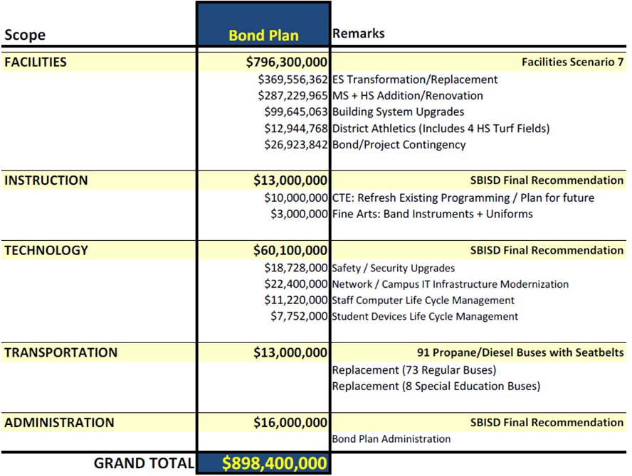
Spring Branch ISD 2017 Bond Program

Slide 5
Spring Branch ISD 2017 Bond Program
Instruction Updates:
Career and Technical Education Scope includes:
Refresh existing programming/Plan for future
Fine + Performing Arts Scope includes:
Band instruments + uniforms

Slide 6
Spring Branch ISD 2017 Bond Program
Technology Updates:
Technology Scope includes:
Safety/Security Upgrades
Network/Campus IT Infrastructure Modernization
Staff Computer Life Cycle Management
Student Devices Life Cycle Management
Transportation Updates:
Transportation Scope includes:
Replacement of 91 Buses
Consists of 73 regular + 8 special education buses
Consists of a mix of propane and diesel
All new buses equipped with seatbelts

Slide 7
Spring Branch ISD 2017 Bond Program
Facilities Updates:
Facilities Scope includes:
Replacement of nine elementary schools
Replacement of one middle school
New classroom building at one elementary school
Facility upgrades at three elementary schools
New classroom building at two high schools
New 1,000 seat auditorium at one high school
Renovation of cafeteria and library at one high school
Upgrade safety and security and building systems at all campuses
New classroom furniture at six middle schools and five high schools
New synthetic turf fields at four high schools

Slide 8
Spring Branch ISD 2017 Bond Program
Communications Update:
2017 Bond Program website updated
Template site developed for Campus Bond Work
Bond Project signage created
Awarded 2018 National School Public Relations Association Gold Medallion Award for 2017 Bond Program

Slide 9
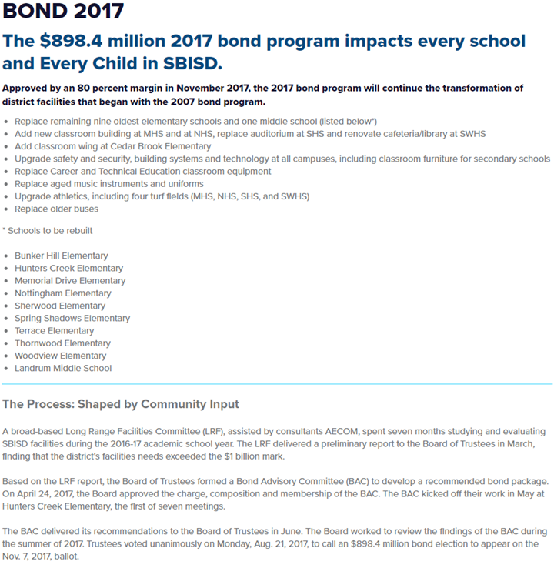
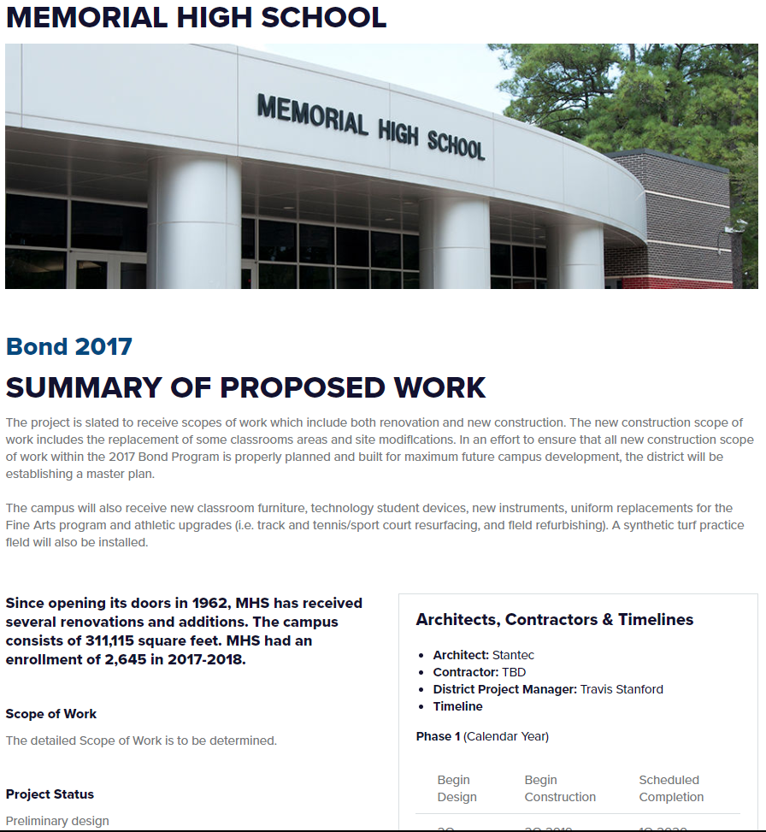
Spring Branch ISD 2017 Bond Program
Communications Update:
www.springbranchisd.com/about/bond-2017

Slide 10
Spring Branch ISD 2017 Bond Program
Finance Updates:
$146 million issued (sold) on June 12, 2018
Proceeds including premium = $ 147,079,693
Expenditures
Total Expenditures as of 7/31/18 = $ 2,263,032
Includes Issuance costs of $ 1,079,693
Interest
Total Interest Earned as of 7/31/18 = $ 247,532

Slide 11
Spring Branch ISD 2017 Bond Program
Career & Technology Education (CTE) Updates:
The CTE Task Force completed Phase I of its work on June 5, which included:
150 one-on-one interviews with students, parents, campus and District staff, business partners, and community leaders
Identification of our CTE program strengths and opportunities, and stakeholder’s aspirations
An interim report of findings to the Board on June 25
The CTE Task Force will kick off Phase 2 of its work on August 28, which will include:
Conducting site visits to outstanding CTE programs in the area and State to review facilities, models for instructional delivery, and innovative programming
Defining what a “world class” CTE program should be and do
Examining other opportunities and challenges raised by stakeholders in Phase 1
Final recommendations are due to the Board in December

Slide 12
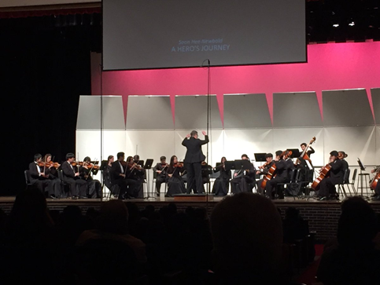
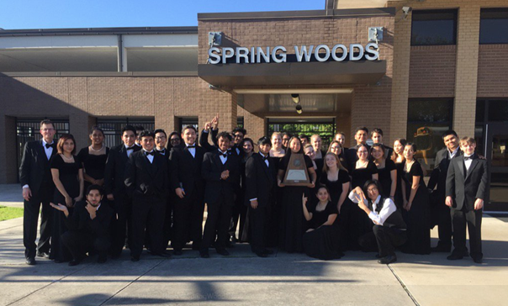
Spring Branch ISD 2017 Bond Program
Fine & Performing Arts Updates:
Over $2,000,000 in band and orchestra instruments have been ordered; as of July 19th many have been received and others are currently being processed by the vendors.
High school drill team uniforms replacement cycles begin the 2018/2019 school year.
Memorial HS Orchestra Spring Woods HS Chorale

Slide 13
Spring Branch ISD 2017 Bond Program
Technology Updates:
Information related to devices and digital expansion shared at August 13th Board Workshop. Student devices to arrive on campuses starting first semester and continuing throughout the year.
Supporting efforts completed this summer include:
Completed Readiness Rubric
Assessed secondary school MDF/IDF closet(s)
Completed Cybersecurity assessment

Slide 14
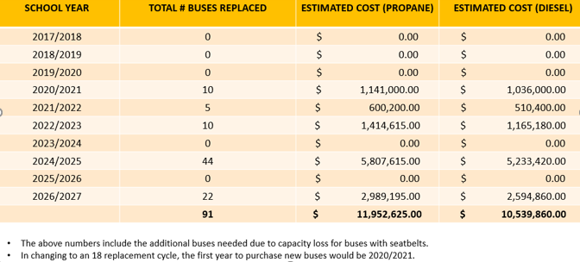
Spring Branch ISD 2017 Bond Program
Transportation Updates:
Original Bus Replacement Schedule
25 buses will be ordered in the 2018/2019 school year

Slide 15
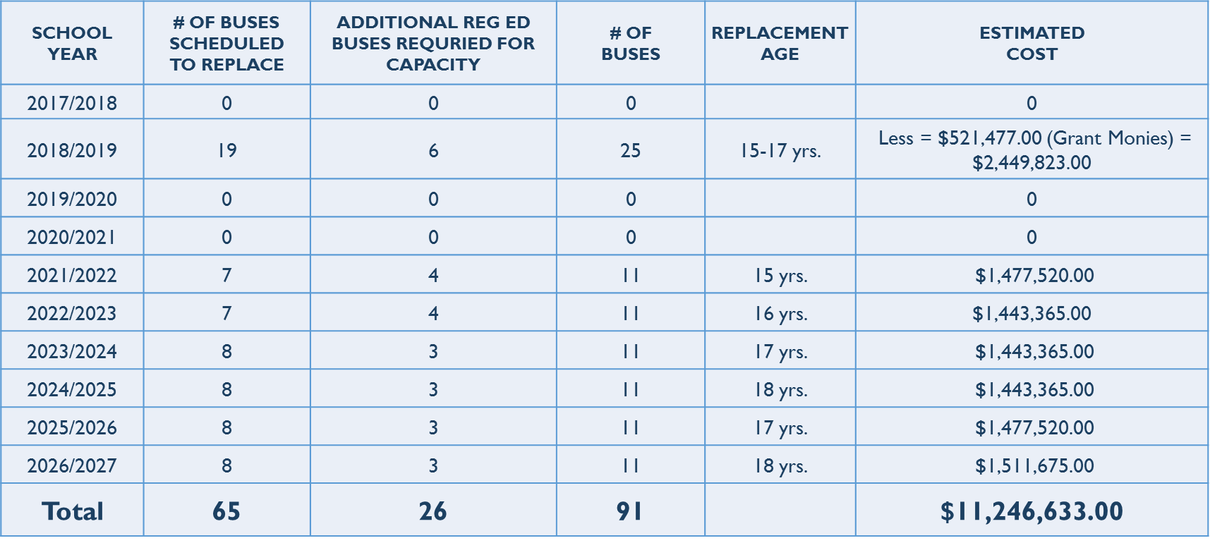
Spring Branch ISD 2017 Bond Program
Transportation Updates:
Revised Bus Replacement Schedule (2 grants received)
25 buses will be ordered in the 2018/2019 school year

Slide 16
Spring Branch ISD 2017 Bond Program
Facilities/Planning & Construction Project Updates:
In March 2018 the Board approved the following seven firms to provide Architectural Services for the 2017 Bond Program:
Cre8 Architects, Inc.
Huckabee & Associates, Inc.
Page Southerland Page, Inc.
PBK Architects, Inc.
Pfluger Associates, L.P.
Stantec Consulting Services, Inc.
Texas-IBI Group, Inc.
In addition the District received proposals for the following professional services: Civil Engineers, Geotechnical Testing, Surveyors, Structural, MEP, HVAC Test & Balance and Building Commissioning.

Slide 17
Spring Branch ISD 2017 Bond Program
Facilities/Planning & Construction Project Updates:
School: Pre-K Centers, Bear Blvd & Lion Lane
Scope of Work: Chiller Replacement & Courtyard Lighting Project
Project Manager: Kris Drosche
Architect/Engineer: Johnston, LLC
Contractor: Bass Construction
Status: Construction Phase

Slide 18
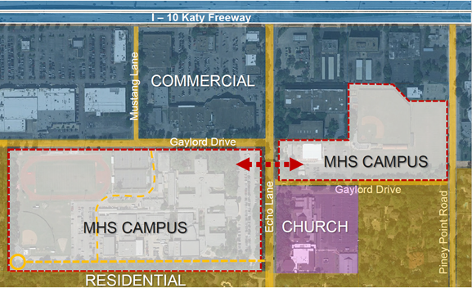
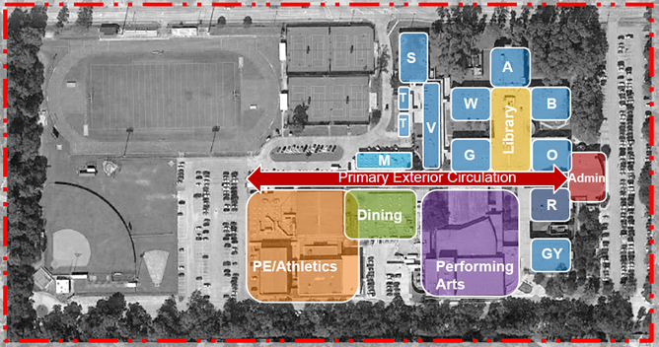
Spring Branch ISD 2017 Bond Program
Facilities/Planning & Construction Project Updates:
School: Memorial HS
Scope of Work: Development of Campus Master Plan
Project Manager: Travis Stanford
Architect/Engineer: Stantec Architects
Contractor: TBD
Status: Pre-Development Phase (MPAT Sept. 2018 – Dec. 2018)

Slide 19
Spring Branch ISD 2017 Bond Program
Facilities/Planning & Construction Project Updates:
School: Spring Woods HS
Scope of Work: Major MEP Upgrades, Renovations to Library and Cafeteria
Project Manager: Kris Drosche
Architect/Engineer: PBK Architects, Inc.
Contractor: TBD
Status: Design Phase (PAT Aug. 2018 - Dec. 2018)

Slide 20
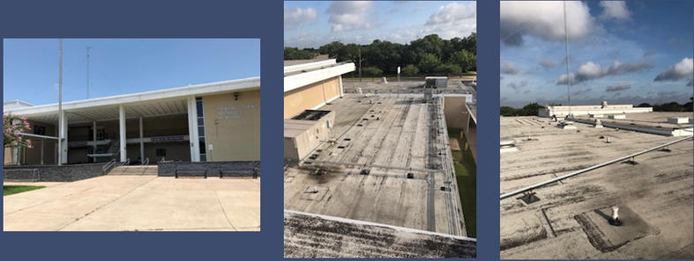
Spring Branch ISD 2017 Bond Program
Facilities/Planning & Construction Project Updates:
School: Spring Oaks MS
Scope of Work: Renovation Project
Project Manager: Noel Moreno
Architect/Engineer: Pfluger Associates, L.P.
Contractor: TBD
Status: Design Phase

Slide 21
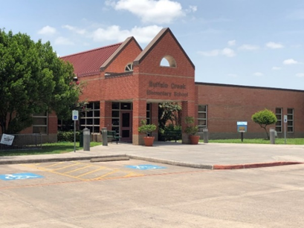
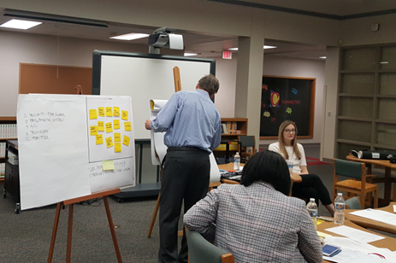
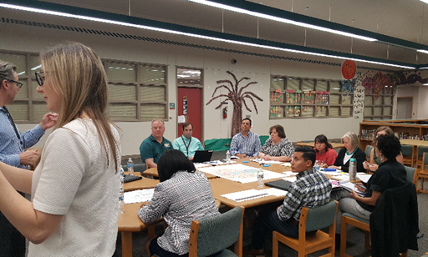
Spring Branch ISD 2017 Bond Program
Facilities/Planning & Construction Project Updates:
School: Buffalo Creek ES
Scope of Work: Renovation Project
Project Manager: Matisia Hollingsworth
Architect/Engineer: Huckabee & Associates, Inc.
Contractor: TBD
Status: Design Phase (PAT Sept. 2018 – Nov. 2018)

Slide 22
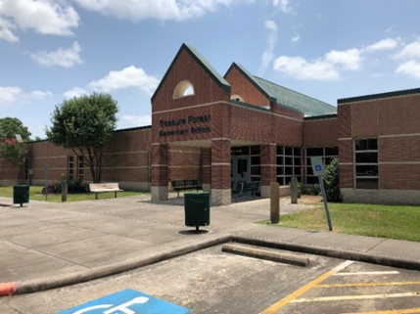
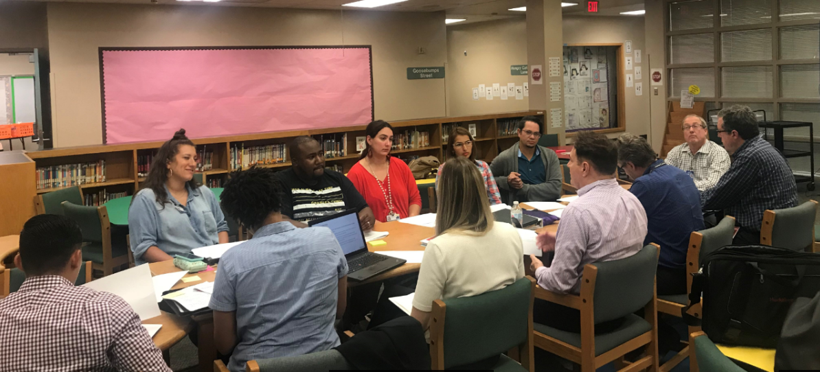
Spring Branch ISD 2017 Bond Program
Facilities/Planning & Construction Project Updates:
School: Treasure Forest ES
Scope of Work: Renovation Project
Project Manager: Matisia Hollingsworth
Architect/Engineer: Huckabee & Associates, Inc.
Contractor: TBD
Status: Design Phase (PAT Sept. 2018 – Nov. 2018)

Slide 23
Spring Branch ISD 2017 Bond Program
Facilities/Planning & Construction Project Updates:
District Wide Initiatives
Complete - Development of Turf Field Standards
Complete - Development of High School Auditorium Specifications and Standards
Complete - Refinement of Middle School Specifications for Landrum MS
In Process - Request for Qualifications (RFQ) for Construction Manager at Risk (Recommendation for September Board Approval)

Slide 24
Spring Branch ISD 2017 Bond Program
Next Steps for 2017 Bond Activities:
Pre-K Centers – Tiger Trail & Wildcat Way
Beginning design for chiller replacement and courtyard lighting project.
Cedar Brook ES
Fall 2018 begin fact finding & preliminary meetings with principal and architects in preparation of new construction/addition & renovation project.
Hunters Creek ES
Fall 2018 begin fact finding & preliminary meetings with principal and architects in preparation of replacement project.
Landrum MS
Fact finding & preliminary meetings underway with principal to gain a full understanding of school operations in preparation of replacement project.

Slide 25
Spring Branch ISD 2017 Bond Program
Next Steps for 2017 Bond Activities:
Memorial HS
Fall 2018 begin fact finding & preliminary meetings with principal and architects in preparation of new construction/replacement & renovation project.
Northbrook HS
Fall 2018 begin fact finding & preliminary meetings with principal and architects in preparation of new construction/addition & renovation project.
Stratford HS
Fall 2018 begin fact finding & preliminary meetings with principal and architects in preparation of new construction/replacement & renovation project.

Slide 26
Spring Branch ISD 2017 Bond Program
Next Steps for 2017 Bond Activities:
Elementary Furniture, Fixtures & Equipment (F,F&E):
Fall 2018 begin to establish a “F,F&E Committee” to help identify and determine the F,F&E needs for the new replacement elementary schools. The F,F&E Committee will be compromised of teachers, students, principals and District Staff and Administration.
Secondary School’s Classroom Furniture:
Fall 2018 begin to establish a “Furniture Committee” to help to identify and determine the classroom furniture needs for middle and high school campuses. The Furniture Committee will be comprised of teachers, students, principals and District Staff and Administration.

Slide 27
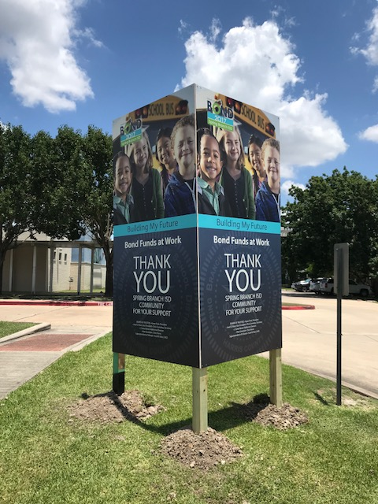
Spring Branch ISD 2017 Bond Program

Slide 28
Spring Branch ISD 2017 Bond Program
Thank you

