Slide 1

Scholarships
Where to find them and application tips
Martha Zender- Sehome High School

Slide 2


Slide 3

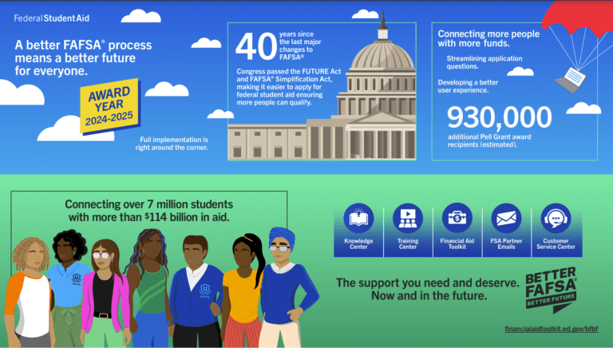
Talk to your parents.
Are they willing to share their information for the FAFSA?
Are they willing to apply for a Parent Plus Loan?
Can they help you fund your college education?
This Photo by Unknown Author is licensed under CC BY-ND
This Photo by Unknown Author is licensed under CC BY-NC-ND

Slide 4

Thursday, November 19th
Options High School
6:00-8:00pm
Wednesday, January 13th
Squalicum High School
6:00-8:00pm
Come for help with your FAFSA or WASFA

Slide 5
Know where you are going and what it will cost! *
Bellingham Technical College Whatcom Community College | $ 4,431 $ 5,450
Eastern Washington University | $ 8,037
Western Washington University | $ 8,808
The Evergreen State College | $ 8,643
Central Washington University | $ 9,417
UW Seattle | $13,406
Washington State University | $14,358
Gonzaga University Saint Martin’s University | $58,390 $48,264
Seattle University Seattle Pacific University | $59,400 $45,648 * Tuition only, doesn’t include fees or room and board…for one year.
www.collegetuitioncompare.com

Slide 6
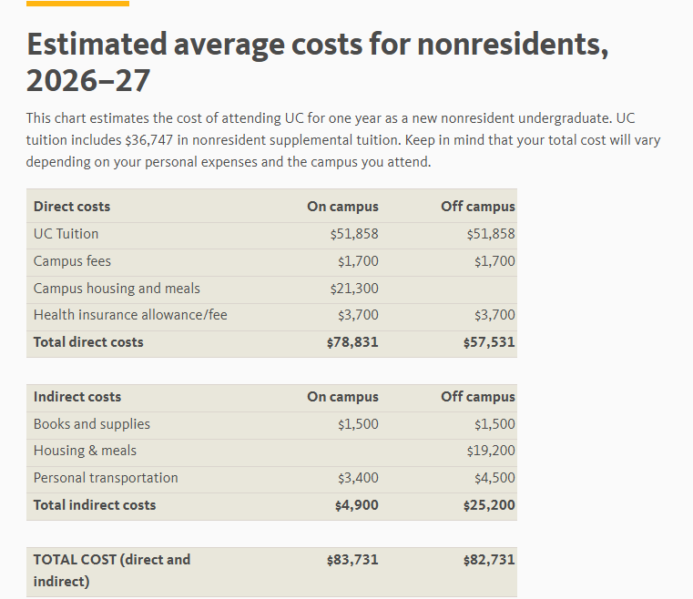
Out of state-UC

Slide 7
Costs to consider
Tuition & Fees
Room and board
School supplies/equipment (laptop, books/codes)
Room needs: refrigerator, bedding, storage
Travel expenses- Tickets for airfare? Snow tires?
Extra food and personal hygiene
Extracurricular spending money- Greek life, clubs
Emergency unexpected items

Slide 8


Where do I find the
Scholarships through the college you apply to.
Merit and Academic Scholarships- athletic too!
Schoolinks! Click on District for local /regional.
Your parents’ place of employment …or yours.
Scholarship Search Engines- WashBoard, Scholarship of America
Summer job- great for the extra expenses!
Working a job on campus

Slide 9



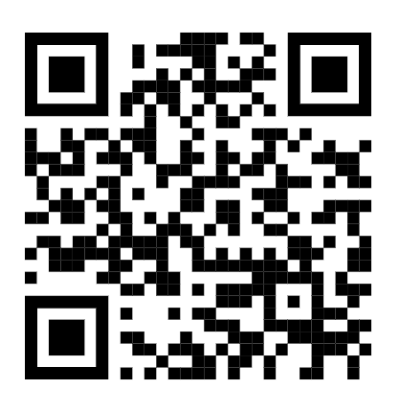
4-year- STEM, healthcare and trades
Up to $22,500 (over 4 years) Must attend in WA state.
Career and Tech- $1,500 per quarter!
2027 amounts may be more!
https://waopportunityscholarship.org/
Opens Jan 13, 2026
Deadline Feb 25, 2027
Opens March17, 2026
Deadline April 15, 2027 reapply each quarter

Slide 10
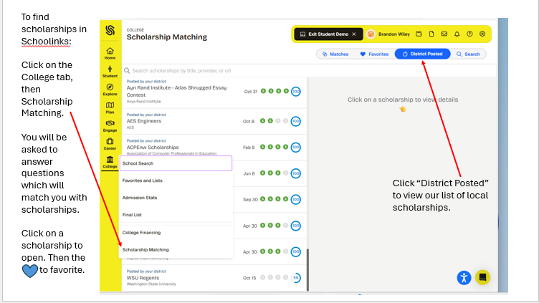

Slide 11

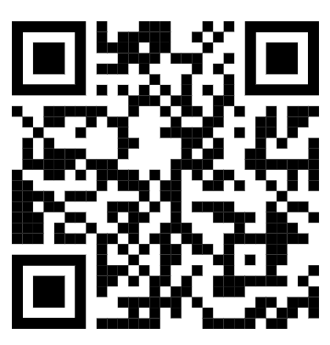
Can be more financial need based. Complete profile, update every quarter. Informational videos by college students on financial aid and scholarships.

Slide 12
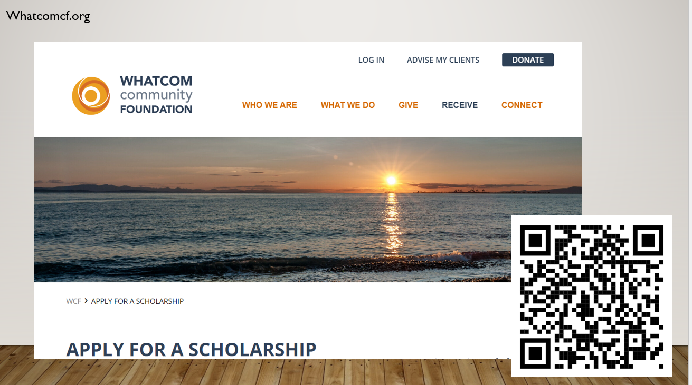

Slide 13

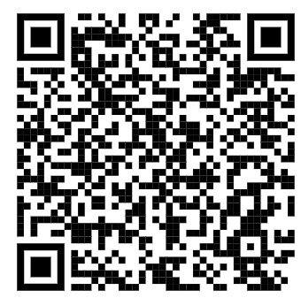

Slide 14
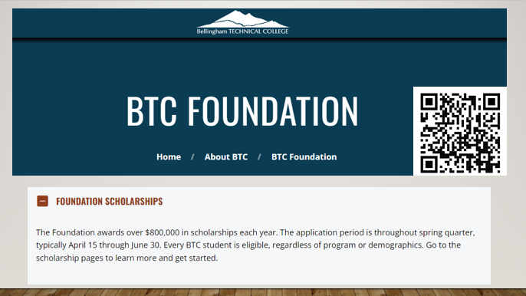

Slide 15

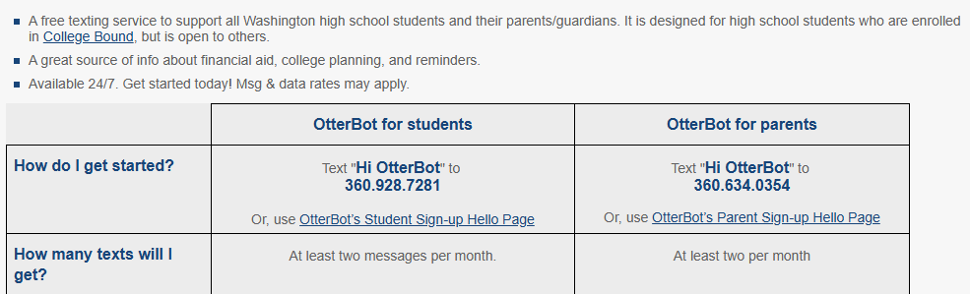
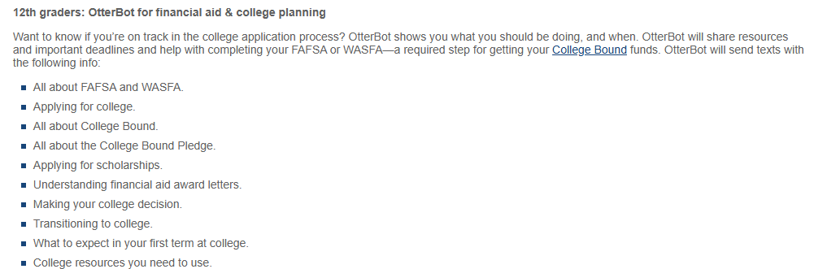
A FREE texting support for students and parents!

Slide 16
Create a Spreadsheet to track your scholarships
Deadline | Scholarship | Website | Requirements- additional info | Amount | Won/ renewable | Thank-you

Slide 17

The Letter of Rec
How many letters do you need for each scholarship?
Complete the Brag sheet in Schoolinks or an Autobiographical Form and give it to the adult you are requesting a letter from. It will outline your qualities and let the adult know more about you.
What sources is the scholarship requesting them from?
Give your recommender at least 3 weeks- know your deadlines!
Let them know what the criteria is.
Remember to say

Slide 18

Set up a professional email account
Never invest more money than the cost of a stamp
Answer the optional questions- this should result in twice as many scholarship matches.
NEVER share your SSC#, bank or credit card numbers, mother’s maiden name
Clear up FaceBook, Instagram, blogs… some scholaships use winners to advertise in the future.
Know when the scholarship will be paid out and how.
Will they pay the college directly?
When will the payment be made? Typically, after the first quarter or semester.
More Helpful Tips

Slide 19

Time to get to work!
“The more you put yourself out there the greater your chance of success.”
Confessions of a Scholarship Winner

