Slide 1



2026–27 Annual Title I &
Family Engagement Meeting
American Way Middle School
September 1, 2026
Mrs. Rochelle Sanders, Title I PLC Coach
Mrs. Larissa Jackson, Principal
Home of the Eagles
American Way Middle School Eagles • Annual Title I & Family Engagement Meeting

Slide 2
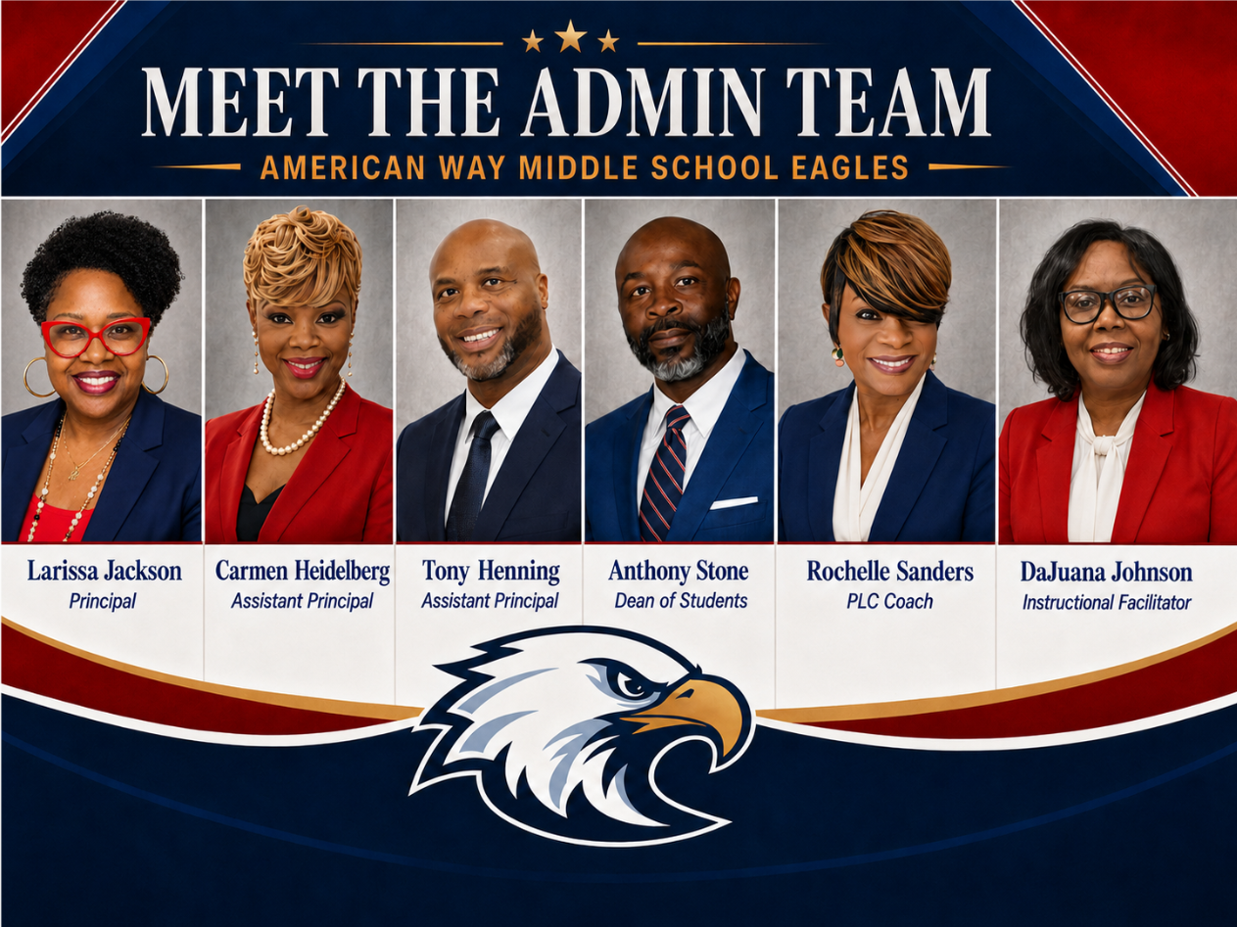
Welcome to the Eagles Family!
Home of the Eagles
American Way Middle School Eagles • Annual Title I & Family Engagement Meeting

Slide 3
Why are we here?
American Way Middle School
The Every Student Succeeds Act (ESSA) requires that each Title I school hold an annual meeting of Title I families in order to:
      inform you of our school’s participation in Title I,
      explain the requirements of Title I, and
      explain your rights as parents and family members to be involved.
American Way Middle School Eagles • Annual Title I & Family Engagement Meeting

Slide 4
What will I learn?
American Way Middle School
What is a Title I school?
What are my rights?
What can Title I funds be used for?
How does our school use Title I funds?
What is the SIP?
What are our schoolwide program goals?
How is parent and family engagement funded?
What is the Parent and Family Engagement Policy?
What is the School-Parent Compact?
What curriculum does our school use?
What tests will my child be taking?
How can I be involved? (Parent & Family Engagement Requirements; Parent-Teacher Conferences; Availability of Parent Training)
Who can I contact for help?
Parents’ Right to Know (including Teacher Qualifications)
American Way Middle School Eagles • Annual Title I & Family Engagement Meeting

Slide 5
What is a Title I school?
American Way Middle School
Title I was passed in 1965 under the Elementary and Secondary Education Act (ESEA). It is the largest federal assistance program for our nation’s schools.
Title I schools receive extra funding (Title I dollars) from the federal government. These dollars are used to:
      identify students experiencing academic difficulties and provide assistance to help these students;
      purchase additional staff, programs, materials, and/or supplies; and
      conduct parent and family engagement meetings, trainings, events, and/or activities.
American Way Middle School Eagles • Annual Title I & Family Engagement Meeting

Slide 6
What can Title I funds be used for?
American Way Middle School
In general, Title I funds may be used for:
      additional paraprofessionals,
      additional training for school staff,
      extra time for instruction (before and/or after school programs),
      parent and family engagement activities, and/or
      a variety of supplemental teaching materials, equipment, and technology.
American Way Middle School Eagles • Annual Title I & Family Engagement Meeting

Slide 7
How does our school use Title I funds?
American Way Middle School
In 2026-27, our school was allotted approximately $612,452.73 in Title I funding.
We developed a Schoolwide Program, which means we plan to spend our funds on the following:
      Supplemental staff:
        Instructional Facilitator
        Interventionists
        Computer Lab Assistants for Reading & Math Labs
        ISS Monitor
        Professional School Counselor
      Programs/Materials/Supplies:
        Copiers (lease & maintenance), math calculators, iReady Workbooks, headphones, copy paper, art supplies, iPads & Charging carts, IXL, Nearpod, and various other instructional materials/supplies
      Teacher Professional Development:
        Early Return Inservice Week
        State & National Educational Conferences
American Way Middle School Eagles • Annual Title I & Family Engagement Meeting

Slide 8
What is the SIP?
American Way Middle School
The SIP is the School Improvement Plan. It includes:
      the identification of the school planning team and how they will be engaged in the planning process;
      a needs assessment and summary of academic and non-academic data;
      prioritized goals, strategies, and action steps to help address the academic and non-academic needs of students;
      teacher and staff professional development needs; and
      budgets and the coordination of resources.
The school must include family representatives on our school planning team. If you would like to be a part of our team, please see Mrs. Sanders immediately after our meeting.
American Way Middle School Eagles • Annual Title I & Family Engagement Meeting

Slide 9
What are our schoolwide program goals?
American Way Middle School
By May 2029, American Way Middle will increase the percentage of students who score proficient in 6th – 8th ELA for all students from 17.6% (2026) to 25.46% (2029), students with disabilities (SWD) from 17.1% (2026) to 25.04 (2029), and English Language Learners (ELL) from 6.3% (2026) to 15.86% (2029) on the TCAP in order to meet or exceed the priority/CSI exit criteria.
By May 2029, American Way Middle will increase the percentage of students who score proficient in 6th – 8th Math for all students from 16.7% (2026) to 24.70% (2029), students with disabilities (SWD) from 9.0% (2026) to 18.5% (2029), and English Language Learners (ELL) from 10.2% (2026) to 19.17% (2029) on the TCAP in order to meet or exceed the priority/CSI exit criteria.
By May 2029, American Way Middle School will decrease its chronic absenteeism rate from 27.5% (2026) to 15.2% (2029).
American Way Middle School Eagles • Annual Title I & Family Engagement Meeting

Slide 10
What is our school’s designation status?
American Way Middle School
In accordance with Tennessee’s accountability system, the Tennessee Department of Education (TDOE) determines designations for all public schools. Designations include:
      Reward Schools: Recognizes schools with high levels of performance or student growth, including the top 5% of schools.
      CSI (Comprehensive Support and Improvement): Also known as Priority schools, these are identified for being in the bottom 5% of overall performance or having a graduation rate below 67%.
      TSI/ATSI (Targeted/Additional Targeted Support and Improvement): Also known as Focus schools, these are identified when specific student groups underperform.
      American Way Middle is currently a CSI School.
American Way Middle School Eagles • Annual Title I & Family Engagement Meeting

Slide 11
What is the State Report Card?
American Way Middle School
TDOE releases an annual Report Card on Tennessee schools.
This report displays state-, district-, and school-level data for each school year.
It includes information on demographics, achievement, academic growth, attendance, graduation rate and more.
You can view the data statewide, or you can choose a specific district or school.
You can view the report card here:
      https://www.tn.gov/education/families/report-card.html
      American Way Middle’s State Report Card score for the 2025-2026 school year is a C.
American Way Middle School Eagles • Annual Title I & Family Engagement Meeting

Slide 12
What curriculum does our school use?
American Way Middle School
The Tennessee Academic Standards provide a common set of expectations for what students will know and be able to do at the end of a grade for each subject area.
Tennessee's academic standards form the framework for everything taught at American Way Middle School.
For more information about Tennessee’s academic standards, see: Academic Standards
American Way Middle School Eagles • Annual Title I & Family Engagement Meeting

Slide 13
What curriculum does our school use?
American Way Middle School
American Way Middle School uses the following curricula to guide students toward mastery of state standards per grade level:
ELA (Reading) – My Perspectives
Math – iReady
Science – Savvas Elevate Science
Social Studies – McGraw Hill
RTI²-A – i-Ready
American Way Middle School Eagles • Annual Title I & Family Engagement Meeting

Slide 14
What tests will my child be taking?
American Way Middle School
Universal Screener (Fall, Winter, Spring)
  The proficiency expectation is all students will score above the 25th percentile.
CFAs (Common Formative Assessment) administered tri-weekly
  The proficiency expectation is all students will score at or above 70%.
Interim Assessments administered at the end of every quarter.
The proficiency expectation is all students will score at or above 70%.
TCAP (April 2027)
  The proficiency expectation is all students score on-track or mastered on all content areas.
    American Way Middle School has a Federal designation as a CSI school.
    The following link is to the MSCS Assessment Calendar. This calendar identifies when all scheduled assessments will be administered during SY27. https://www.scsk12.org/calendar25/files/26/MSCS%20Assessment%20Calendar%202026%202027%20FINAL%20PDF%2007_13_26.pdf
    For access to various assessment resources, please click the link(s) below:
    https://www.scsk12.org/calendar25/files/26/2026-2027%20MSCS%20Reporting%20Periods.pdf
American Way Middle School Eagles • Annual Title I & Family Engagement Meeting

Slide 15
What is parent and family engagement?
American Way Middle School
Family engagement is a shared responsibility in which schools and other community agencies and organizations are committed to reaching out to engage families in meaningful ways and in which families are committed to actively supporting their children's learning and development.
Family engagement is continuous across a child’s life and entails enduring commitment but changing family roles as children mature into young adulthood.
Effective family engagement cuts across and reinforces learning in the multiple settings where children learn – at home, in pre-kindergarten programs, in school, in after-school programs, in faith-based institutions, and in the community.
Source: The National Association for Family, School, and Community Engagement (https://nafsce.site-ym.com/page/definition)
American Way Middle School Eagles • Annual Title I & Family Engagement Meeting

Slide 16
What is parent and family engagement?
American Way Middle School
“Through effective communication with parents, teachers can have the greatest impact on their day-to-day success with students. With parents on their side, teachers can more effectively manage most academic and behavioral issues that arise. When the most important adults in a child’s life are working together, students benefit enormously.”
                —Lee and Marleen Canter
Source: Parents on your Side: A Teacher’s Guide to Creating Positive Relationships with Parents
American Way Middle School Eagles • Annual Title I & Family Engagement Meeting

Slide 17
What is a Parent and Family Engagement Policy?
American Way Middle School
These plans address how the district and school will implement the parent and family engagement requirements of ESSA. Components should include:
      how parents and families can be involved in decision-making and activities;
      how parent and family engagement funds are being used;
      how information and training will be provided to families; and
      how the school will build capacity in families and staff for strong parent and family engagement.
You, as a Title I parent or family member, have the right to be involved in the development of these plans.
American Way Middle School Eagles • Annual Title I & Family Engagement Meeting

Slide 18
What is a Parent and Family Engagement Policy?
American Way Middle School
The district Parent and Family Engagement Policy can be found here:
      Memphis Shelby County Schools
      District Website – Community tab – Family Engagement
The school Parent and Family Engagement Policy has also been shared as a handout during this evening’s Annual Title I meeting. In addition, the policy can be found here:
      District Website – Schools – American Way Middle School – Parent & Students – Title I
American Way Middle School Eagles • Annual Title I & Family Engagement Meeting

Slide 19
How is Parent and Family Engagement funded?
American Way Middle School
Any district with a Title I allocation exceeding $500,000 is required by law to set aside 1% of its Title I allocation for parent and family engagement.
Of that 1%, 10% may be reserved at the district for system-wide initiatives related to parent and family engagement. The remaining 90% must be allocated to all Title I schools in the district.
You, as Title I parents and family members, have the right to be involved in how this money is spent.
American Way Middle School Eagles • Annual Title I & Family Engagement Meeting

Slide 20
How is Parent and Family Engagement funded?
American Way Middle School
In 2026-27, we received approximately $7,432.73 in parent and family engagement funding. We plan to use these funds for:
      Parent and Family Engagement Meeting and Events
        Annual Title I Meeting – August 25, 2026
        Muffins with Moms – September 24, 2026
        Doughnuts with Dads – October 22, 2026
        Data Café: Sip, Snack & See the Growth – November 2026
        Parents Financial Literacy Workshop – February 2027
        Pastries with Parents – April 2027
      Materials/Supplies
        Materials for Annual Title I Meeting
        Refreshments for Muffins with Moms & Doughnuts with Dads
        Refreshments & Data Books for Data Café
        Materials for Parent Resource Room
        Materials for Parents Financial Literacy Workshop
        Refreshments for Pastries with Parents
American Way Middle School Eagles • Annual Title I & Family Engagement Meeting

Slide 21
What is a School-Parent Compact?
American Way Middle School
A school-parent compact is a written commitment that outlines how the entire school community – teachers, families, and students will share the responsibility for improved academic achievement.
The compact must describe how the school will:
      provide high-quality curriculum and instruction;
      hold parent-teacher conferences;
      provide parents with reports on their child’s progress;
      provide parents reasonable access to staff.
      provide parents opportunities to volunteer; and
      ensure regular two-way meaningful communication between family members and staff, to the extent practicable, in a language family members can understand.
You, as a Title I parent or family member, have the right to be involved in the development of the compact.
American Way Middle School Eagles • Annual Title I & Family Engagement Meeting

Slide 22
What is a School-Parent Compact?
American Way Middle School
The school-parent compact has been shared as a handout during this Annual Title I meeting on September 1, 2026. In addition, the compact can be found here:
      District Website – Schools – American Way Middle School – Parent & Students – Title I
American Way Middle School Eagles • Annual Title I & Family Engagement Meeting

Slide 23
What are the benefits of family engagement?
American Way Middle School
For students:
Higher grades and test scores
Better attendance
More positive attitudes and better behavior
Higher graduation rates
Greater enrollment in postsecondary education
For Parents and Families:
More confidence and trust in the school
Increased confidence in their parenting skills
Creates a home environment that encourages learning
Encourages families to form stronger relationships with teachers and other families
For Schools and Teachers:
Improved teacher and staff morale
Higher ratings of schools and teachers by families
More support from families
Higher student achievement
Increased and improved relationships within the community
American Way Middle School Eagles • Annual Title I & Family Engagement Meeting

Slide 24
How can I be involved?
American Way Middle School
We need you! Research has proven that family engagement in education has more impact on student achievement than any other factor.
To get involved with the SIP, please make note of all meetings from the invitation (flyer, Class Dojo, Blackboard communication – text and/or email, and school’s social media outlets) and plan to attend each meeting.
The planning meeting for this year’s Parent and Family Engagement Policy has already taken place. Families may continue to share feedback and suggestions regarding how the school can strengthen family engagement. To get involved with the School Parent Compact, please make note of the planning meeting from the invitation (flyer, Class Dojo, Blackboard communication – text and/or email, and school’s social media outlets) and plan to attend the planning meeting.
The planning meeting for this year’s School-Parent Compact has already occurred. Families are encouraged to review the compact and provide feedback or recommendations for future revisions.
American Way Middle School Eagles • Annual Title I & Family Engagement Meeting

Slide 25
How can I be involved?
American Way Middle School
Some examples of how you can be involved in your child’s education include, but are not limited to:
    encouraging attendance;
    monitoring grades and schoolwork on an online system or portal;
    be knowledgeable and understand the Student Code of Conduct
    attending family events and meetings;
    observing or volunteering in classrooms;
    joining family groups and committees (e.g., PTA/PTO, advisory councils, etc.); and
    reading school/classroom newsletters or utilizing websites that contain examples of learning activities families can do with students at home.
Additionally, American Way Middle School’s FEP describes several other opportunities for you to be involved in the education of your child.
American Way Middle School Eagles • Annual Title I & Family Engagement Meeting

Slide 26
What are my rights?
American Way Middle School
The families and parents of Title I students have a right, by law, to:
      be involved in decisions made at both the school and district level;
      be provided with information on your child’s level of achievement on tests in reading/language arts, writing, mathematics, and science;
      request and receive information on the qualifications of your child’s teacher and paraprofessionals who are working with your child by contacting the principal and
      request opportunities for regular meetings to formulate suggestions and to participate, as appropriate, in decisions about the education of your child. The school is required to respond to any such suggestions as soon as practicably possible.
American Way Middle School Eagles • Annual Title I & Family Engagement Meeting

Slide 27
What are my rights?
American Way Middle School
Every Student Succeeds Act (ESSA)
Parents’ Right-To-Know
All parents have the right to request the following:
• A teacher’s professional qualifications, which include: state qualifications, licensure, grade/s certification, waivers
• A teacher’s baccalaureate and /or graduate degree, fields of endorsement, previous teaching experience
• A paraprofessional’s qualifications
• An assurance that their child’s name, address, and telephone listing not be released to military recruiters
All parents will receive information on the following:
• Their child’s level of achievement in each of the state academic assessments
• Their option to request a transfer to another school within the district if their child is the victim of a violent crime at school
• Their right to timely notification that their child has been assigned, or has been taught for four or more consecutive weeks by, a teacher who is not highly qualified
American Way Middle School Eagles • Annual Title I & Family Engagement Meeting

Slide 28
Who can I contact for help?
American Way Middle School
For general questions, call the front office at: 901.416.1250
To reach the principal, Principal Jackson, call: 901.416.1250
To reach the school counselors:
6th Grade – Dr. Lillie Pinkston, call: 901.416.1272
7th Grade – Ms. Marquis Healey, call: 901.416.1258
8th Grade – Ms. Sonja Jackson Thomas, call: 901.416.1267
To reach our Family Engagement Specialist, Mrs. LaSonya Newsom, call: 901.416.4010
To reach your child’s teacher, call the front office or view our staff directory at: Meet Our Team
American Way Middle School Eagles • Annual Title I & Family Engagement Meeting

Slide 29
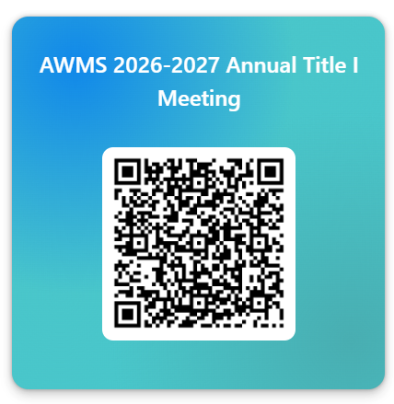
WE JUST WANT TO SAY…
THANK YOU!
Please take a moment to scan the QR Code & take our survey.
American Way Middle School Eagles • Annual Title I & Family Engagement Meeting
Notes:
Be sure to thank families for their time.

