Slide 1

Welcome!
Parent Informational Meeting
October 27, 2026

Slide 2


Welcome to
TUSD’s Parent Information Night for Gifted & Talented Education
We are
Tracy Unified School District’s Elementary Cohort
of GATE Teachers :
      Anuja Mathew ~ 2nd
      Andrea Haro ~ 2nd
      Ciara Winters ~ 3rd
      DeAnna Hazelbaker ~ 4th
      Kimberly McNeely ~ 4th
      Linda Villa ~ 5th
      Sandra Marquez~ 5th

Slide 3



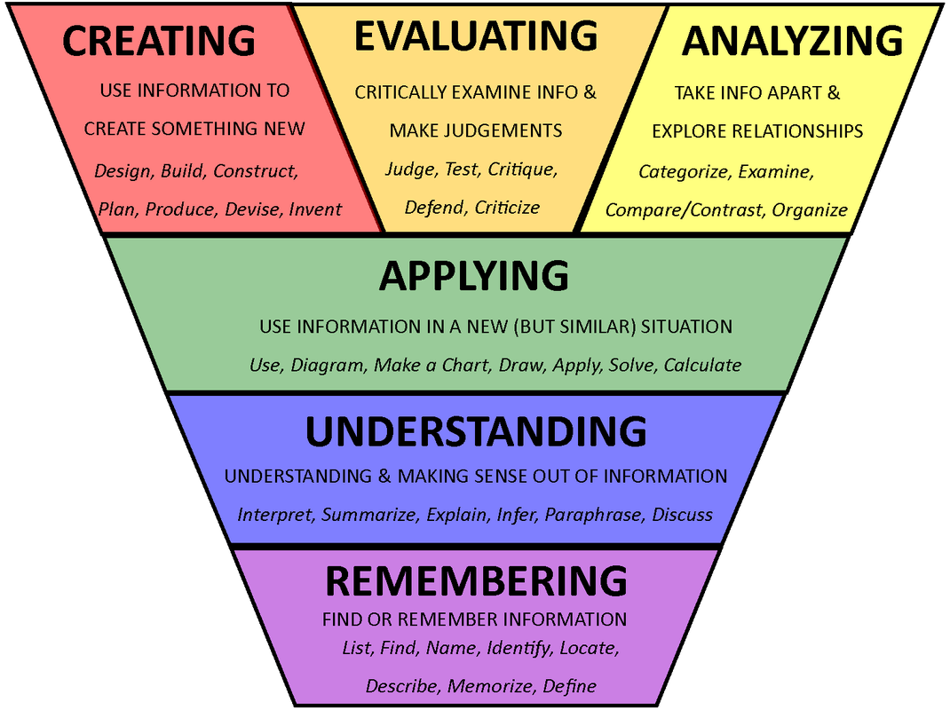
What makes GATE different?
Responsibility Effort Achievement Citizenship Hard work
Beyond Basics
Fostering Creativity
Academic Rigor
21st Century Citizens
Notes:
Meet the needs of students

Slide 4

Differentiation is the name of the game …
Depth | In-depth, elaborate, and rigorous concepts.
Complexity | Look for patterns to make complex things simpler ~ not harder.
Novelty | Carefully crafted peak moments.
Acceleration | Building up areas to improve and maximize student’s strengths.
Notes:
Depth- students go further, deeper and more elaborately within a subject area. Complexity- students make relationships and associations across and between subject areas. They study relationships over time and from different points of view. Novelty- students personalize their understanding. They express their knowledge in their own words and way. Acceleration- students can move at a faster pace or with more difficulty.
Acceleration - Faster presentation of content to more closely match the speed at which gifted students learn. Compare with grade skipping.

Slide 5








GATE kids think big!
Critical thinking
Details
Patterns
Big Ideas
Across the Disciplines
Unanswered Questions
Language of the Discipline
Rules
Trends
Ethics
Multiple Perspectives
Notes:
Independent Workers
Work well with others

Slide 6
Passion Project
GENIUS HOUR to develop their passion on a new idea or skill
Allows students to research a topic of choice to promote creativity and innovative thinking
Notes:
DeAnna Hazelbaker

Slide 7
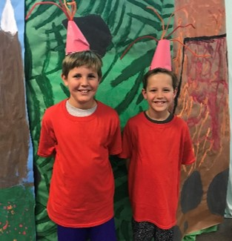

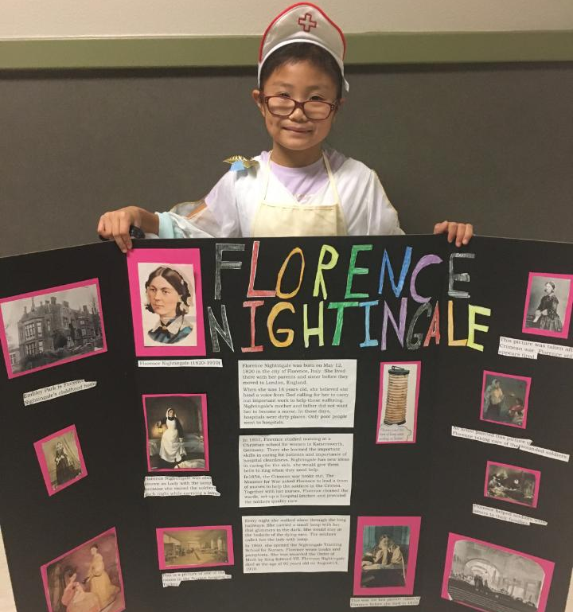
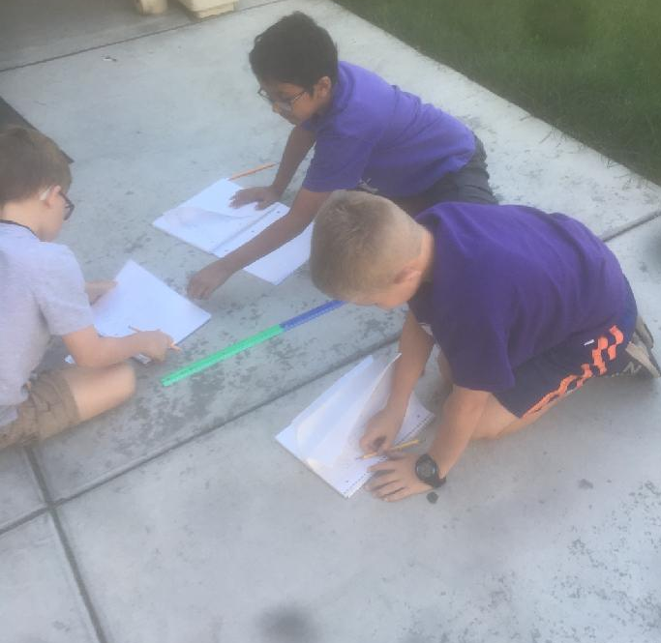
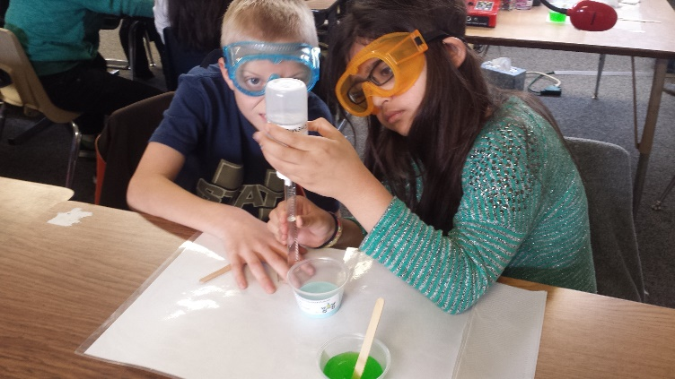
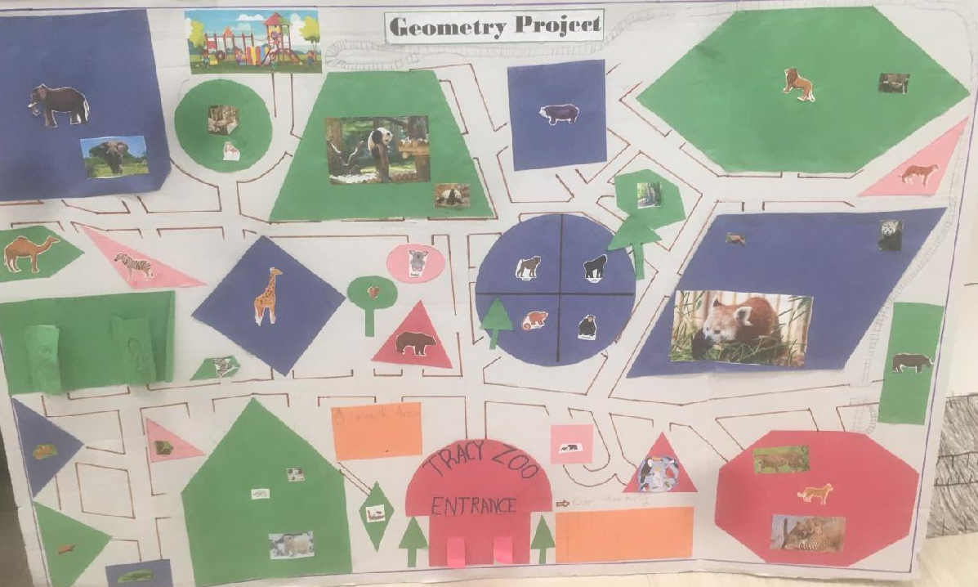
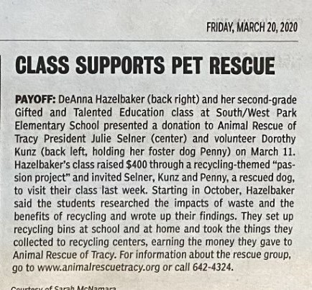
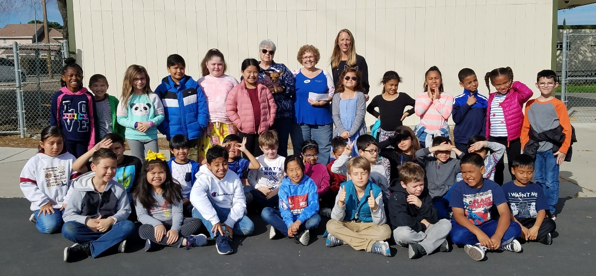
GATE Success
Notes:
DeAnna Hazelbaker

Slide 8
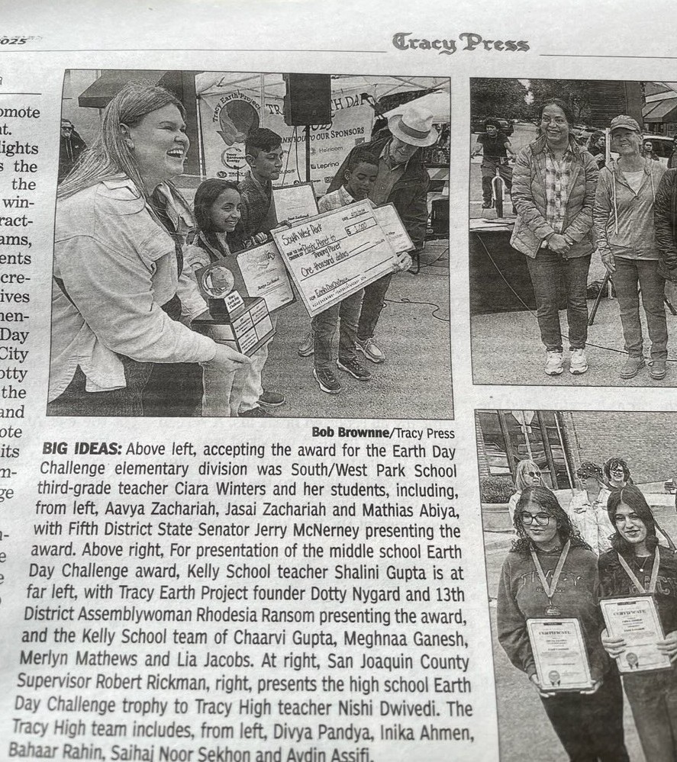
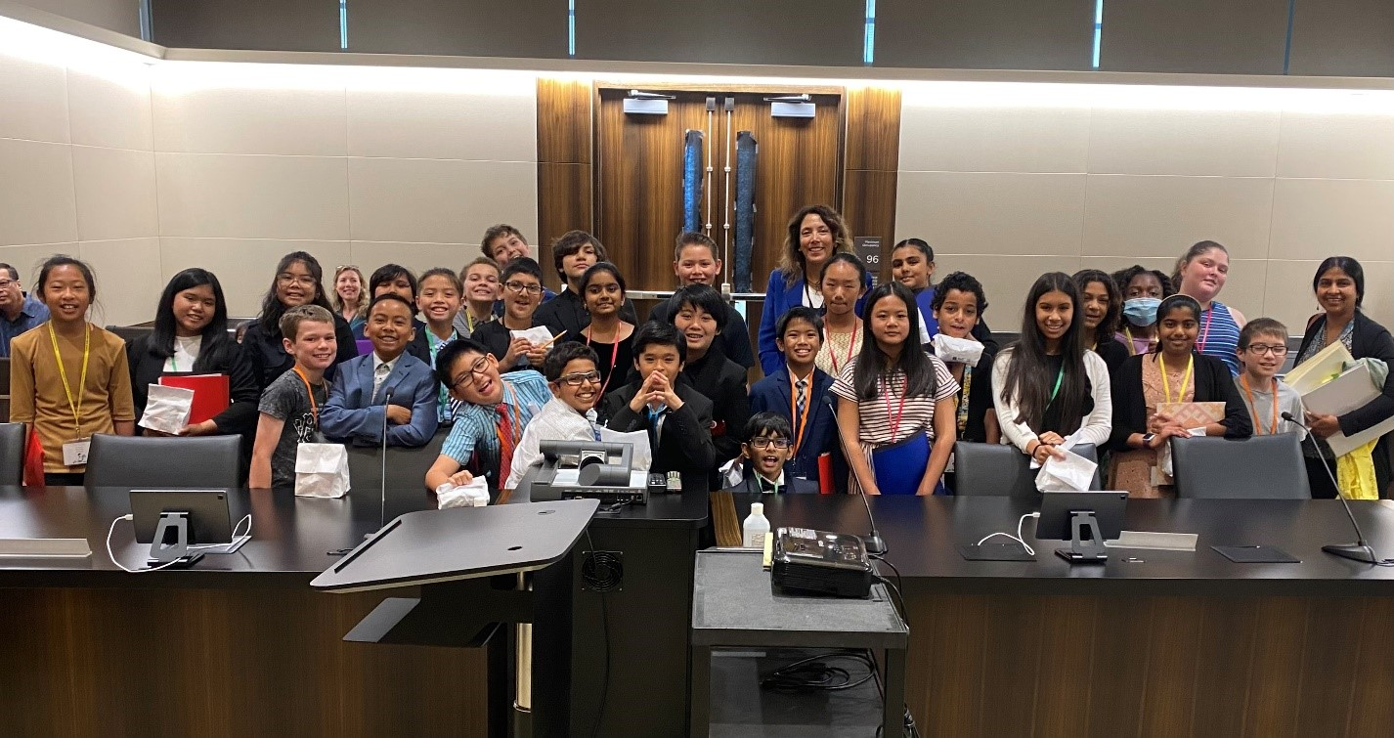
GATE Success
Notes:
DeAnna Hazelbaker

Slide 9
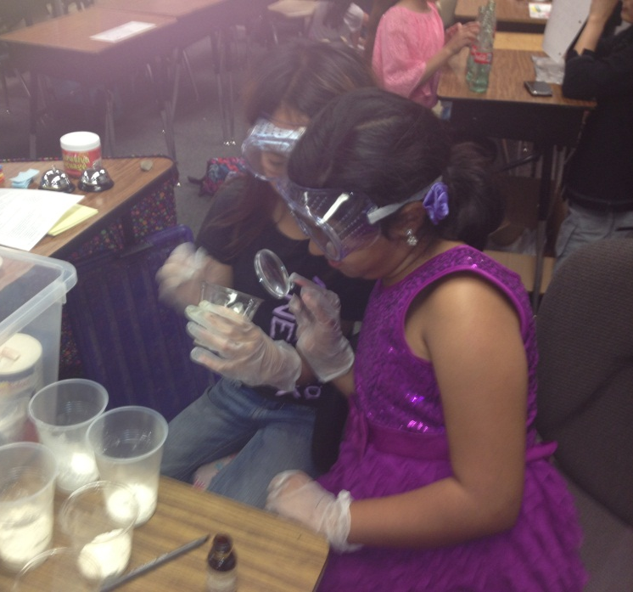

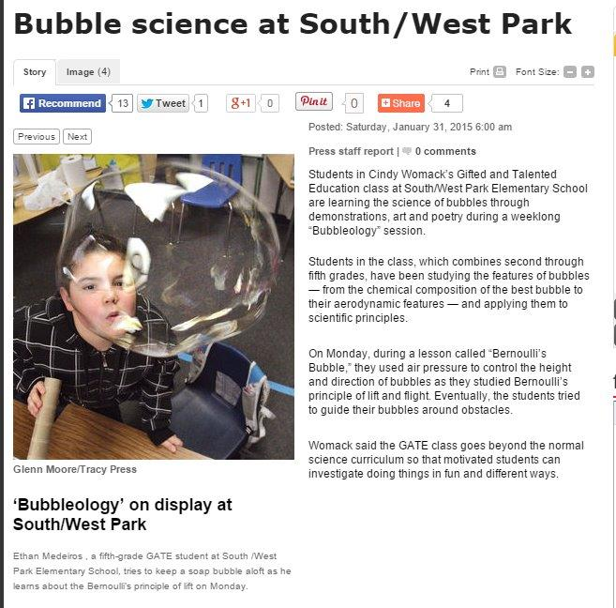
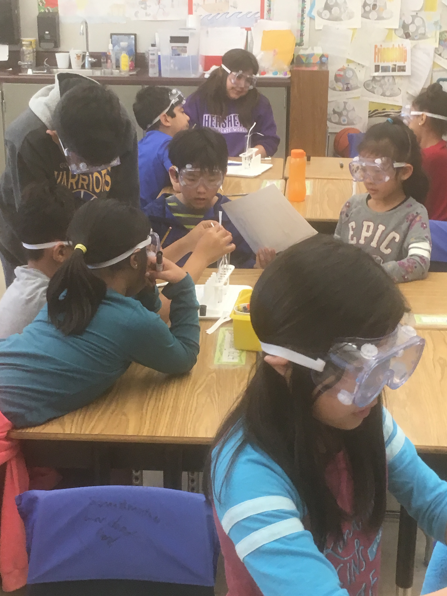
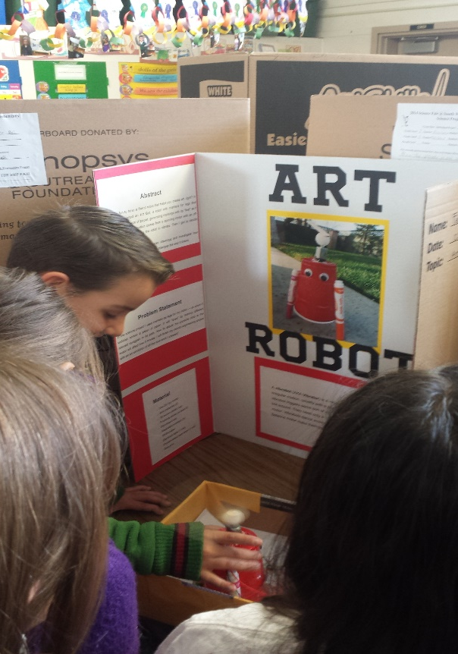
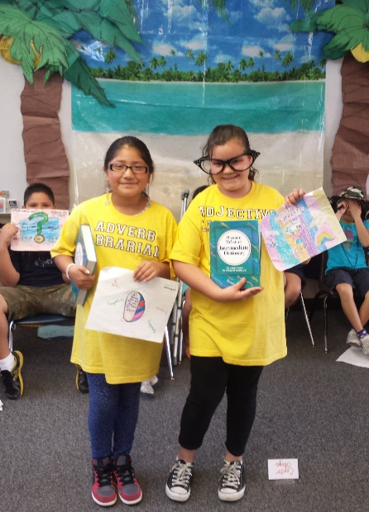
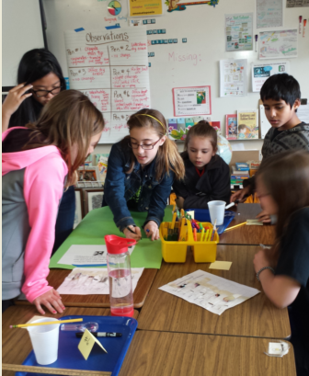
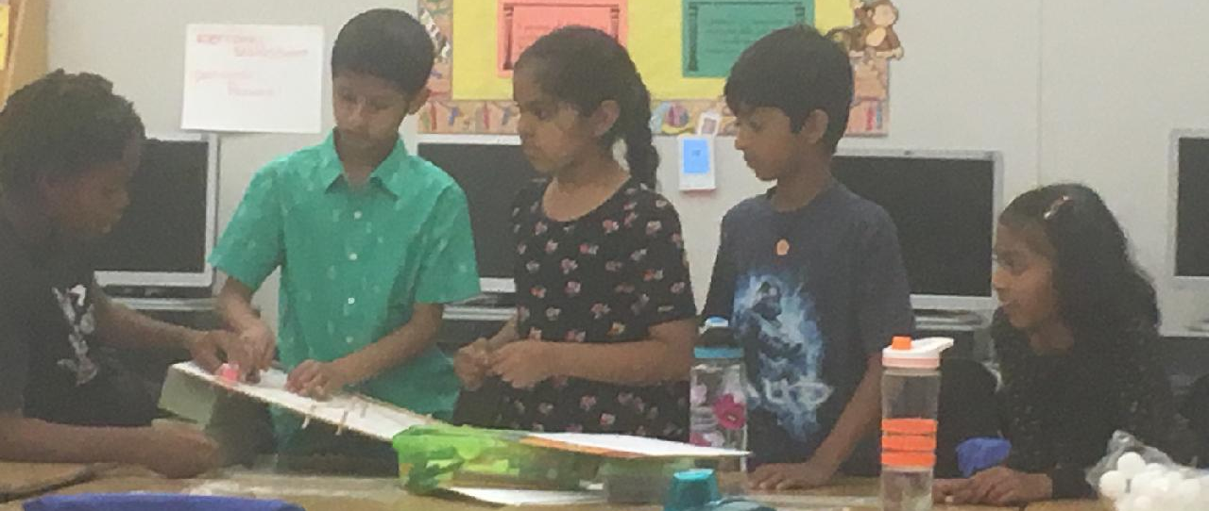

Think Big!
GATE Students Achieve
Notes:
DeAnna Hazelbaker

Slide 10

What kind of story do you want for your child?
“We are all stories in the end, just make it a good one.”
~Dr. Who
Notes:
DeAnna- myself, kids…like minded…success- valedictorian-colleges- top 15 in current class from GATE Program

Slide 11

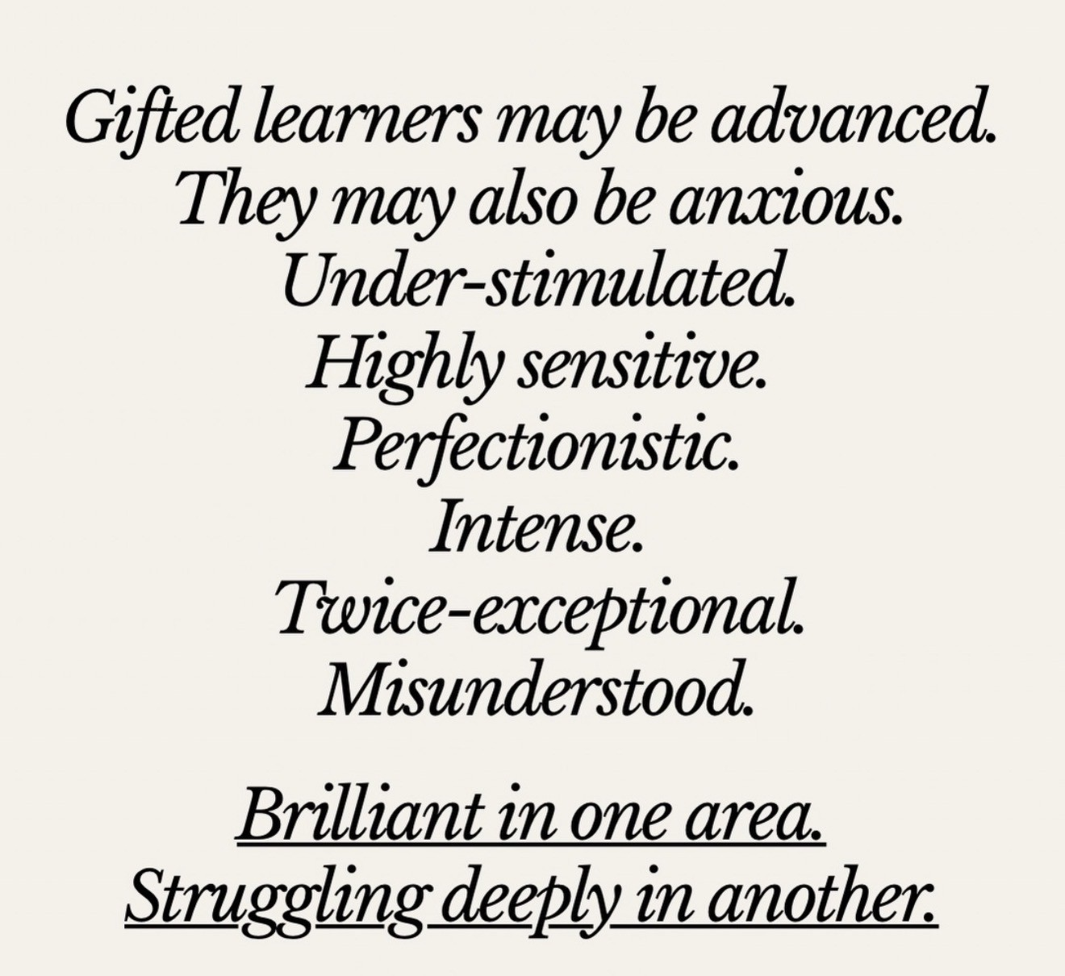


Slide 12

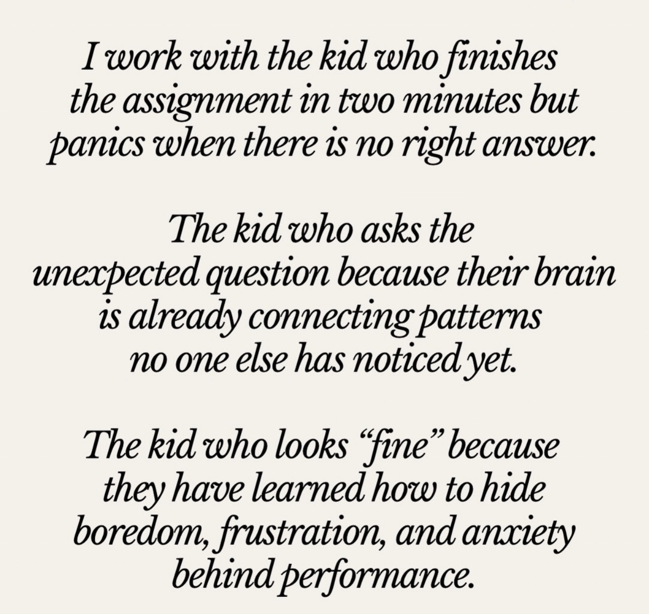
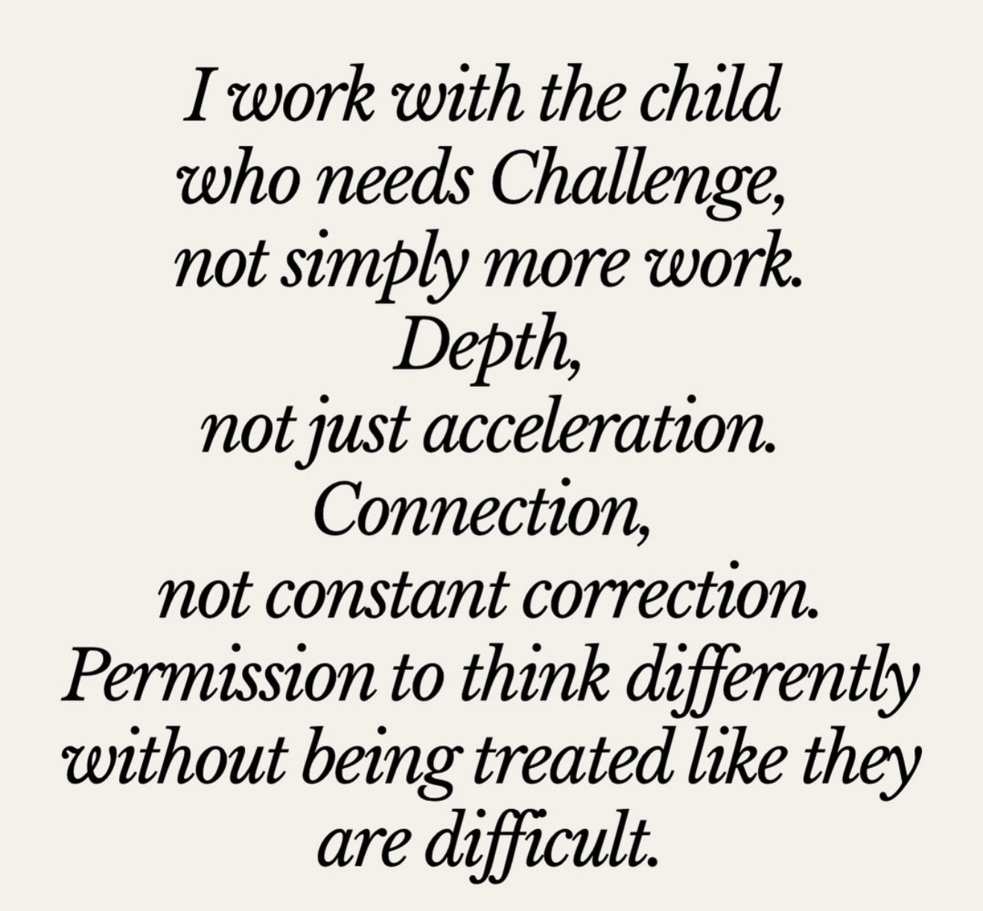

Slide 13



Slide 14


Slide 15
South/West Park
GATE Program Details
Self-contained classrooms @ SWP
Grades 2-5
Free Breakfast/Lunch
Free After School Program (Boys and Girls Club)
Safe and Secure School
Spelling Bee Grades 4-5
Science Olympiad Grades 4-5
Math Olympiad Grades 4-5
Notes:
?

Slide 16
Student Qualifications for GATE
Students are assessed using
IQ tests: the NNAT3 for grades 1 – 7
  85% + = GATE identified
  79% - 84 % = High Achiever + Checklist for observed behaviors
  73% - 78% = High Achiever pending interview results
School Site Psychologists
administer the test
Parents or teachers may request
GATE testing
Notes:
Florence

Slide 17
What do these tests assess?
Not a Standardized Academic Test.
Visual and reasoning and critical
thinking tests.
Practice test from the test makers is not available
Notes:
Florence

Slide 18
Helpful Tips for Test Preparation
Good nights rest
Breakfast
Use of Restrooms
Coping Skills:
  Deep Breathing Exercises
  Positive Self-Talk
Positive Affirmations
Notes:
Florence

Slide 19
GATE Testing-Out of District
As of the 2025-2026 School year, Jefferson School District as well as other neighboring school districts are no longer approving NEW transfers to TUSD for the GATE program.
    As a result, TUSD will no longer be offering GATE testing to students that do not live within TUSD boundaries.
    If you have a student that attends a private school but lives within TUSD boundaries, they can still take the GATE assessment.

Slide 20
Transfers
As of the 2025-2026 school year, Student Services has implemented a new transfer process stating that, any student attending a school other than their zoned school to participate in a special program (GATE) is required to fill out a transfer. (This form only needs to be filled out once)
This includes both new and current students.
  If you have a current GATE student and did not fill out a transfer form, please do so as soon as possible, QR code to follow.
    If you are unsure if you have already submitted a transfer form for your student, please contact the GATE clerk or Student Services.
If your student tests and qualifies for the GATE program, you will
be required to fill out the transfer form before the enrollment into the
program can be completed!
GATE testing day is on January 23rd, 2027.
The open window to accept transfers is 10/15/2026 - 1/15/2027,
however, the transfer deadline DOES NOT APPLY TO GATE STUDENTS.

Slide 21
Sibling Transfers
If your testing student has a sibling and you would like for them to attend the same school, you will need to submit a transfer for the sibling BEFORE THE TRANSFER DEADLINE! (10/15/2026 - 1/15/2027)
1. Late submissions for siblings of GATE hopefuls will NOT be accepted.
2. On the transfer form, for “Reason for Transfer”, you MUST put
“Has a sibling testing for GATE”
3. Transfer acceptance for siblings is not guaranteed.
4. For additional information regarding transfers,
Please contact Student Services at…
(209) 830-3280 Ext 1600
rvirgencasas@tusd.net

Slide 22
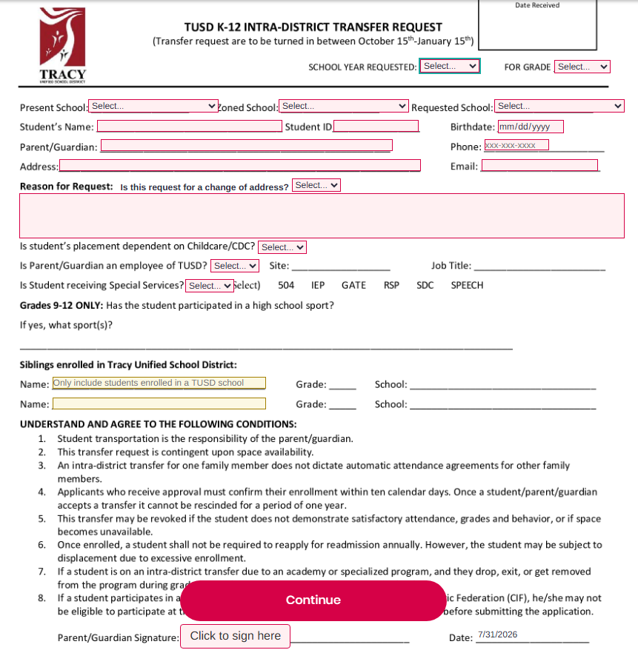
GATE

Slide 23
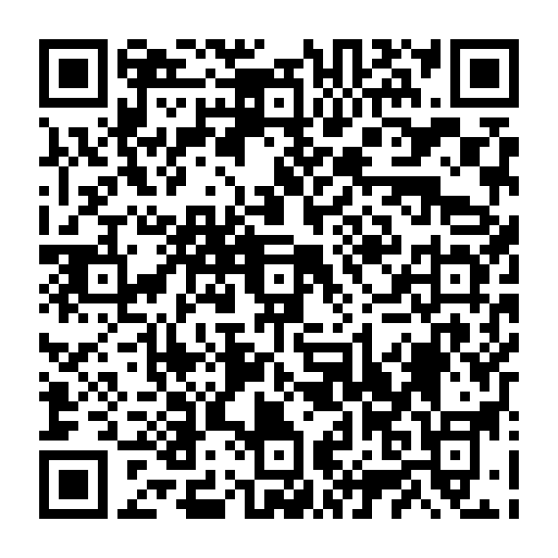
What We Recommend…
Fill out a transfer!
Scan the QR code
Save it to fill out later,
Fill one out now,
Fill one out for your testing student,
Fill one out for their sibling

Slide 24

Important GATE Dates to Remember
GATE applications Last day to submit.
January 23, 2027
New school year begins!
December 18th, 2026
August 2027
GATE Assessment for students currently in grades 1st - 7th grade
Notes:
Michael

Slide 25
Thanks!
Any questions?
You can find us here:
Michael Bunch, Ed. D. mbunch@tusd.net
Director of Continuous Improvement, State & Federal Programs
Leia Osborne losborne@tusd.net
Clerk Typist
Notes:
Michael

Slide 26
Presentation design
This presentation uses the following typographies:
Titles: Vidaloka
Body copy: Lora
Download for free at:
https://www.fontsquirrel.com/fonts/vidaloka
https://www.fontsquirrel.com/fonts/lora
You don’t need to keep this slide in your presentation. It’s only here to serve you as a design guide if you need to create new slides or download the fonts to edit the presentation in PowerPoint®

