Slide 1

Welcome to the
GATE Program
An informational meeting for parents interested in helping their children’s gifted minds grow

Slide 2

What Makes GATE Different?
Academic Rigor
Beyond Basics
Fostering Creativity
Excceding Teamwork
Better Education
Responsibility
Effort
Achievement
Citizenship
Hard work

Slide 3

GATE Students Aspects
Depth | Students analyze details to more deeply understand concepts.
Complexity | Students apply critical thinking to multiple facets of a concept.
Novelty | Students personalize their understanding through their passions.
Acceleration | Students can move at a faster pace.

Slide 4






Critical Thinking
Details
Patterns
Big Ideas
Across the Discipline
Language of the Discipline
Rules
Ethics
Unanswered Questions
Trends
Multiple Perspectives
This Photo by Unknown Author is licensed under CC BY-NC
This Photo by Unknown Author is licensed under CC BY

Slide 5
Habits Taught to GATE Scholars
Ponder Ideas
Intellectual Risk-taking
Preparation
Excellence
Academic Humility
Curiosity
Multiple Perspectives
Perseverance
Varied Resources

Slide 6
Middle School Offerings
6th grade self-contained with integration for PE and elective
7th and 8th grade GATE for ELA/SS.
Advanced math for those who qualify in 7th and 8th grade
Academic Competitions

Slide 7

Middle School GATE Teachers
Monte Vista Middle School
6th grade: Dawn Arbogast
7th & 8th grade: Carol Wyant
Williams Middle School
6th grade: Jordan McCallum
7th grade: Bryan Kauk (ELA) Aroma Bhargava (SS)
8th grade: Bryan Kauk, (ELA) Cheryl Reszka (SS)

Slide 8
GATE Testing
✦Students are assessed using
IQ tests: the NNAT3 for
grades 1 – 7
✦School Site Psychologists
administer the test
✦Parents or teachers may request GATE testing
✦Parents or teachers may request GATE testing

Slide 9

Important Dates
GATE Applications open October 28, 2026 – December 18, 2026
Testing Date January 23, 2027
Letter of intent due February 26, 2027

Slide 10
GATE Testing-Out of District
As of the 2025-2026 School year, Jefferson School District as well as other neighboring school districts are no longer approving NEW transfers to TUSD for the GATE program.
    As a result, TUSD will no longer be offering GATE testing to students that do not live within TUSD boundaries.
    If you have a student that attends a private school but lives within TUSD boundaries, they can still take the GATE assessment.

Slide 11
Transfers
As of the 2025-2026 school year, Student Services has implemented a new transfer process stating that, any student attending a school other than their zoned school to participate in a special program (GATE) is required to fill out a transfer. (This form only needs to be filled out once)
This includes both new and current students.
  If you have a current GATE student and did not fill out a transfer form, please do so as soon as possible, QR code to follow.
    If you are unsure if you have already submitted a transfer form for your student, please contact the GATE clerk or Student Services.
If your student tests and qualifies for the GATE program, you will be required to fill out the transfer form before the enrollment into the program can be completed!
GATE testing day is on January 23rd, 2027.
The open window to accept transfers is 10/15/2026 - 1/15/2027, however, the transfer deadline DOES NOT APPLY TO GATE STUDENTS.

Slide 12
Sibling Transfers
If your testing student has a sibling and you would like for them to attend the same school, you will need to submit a transfer for the sibling BEFORE THE TRANSFER DEADLINE! (10/15/2026 - 1/15/2027)
Late submissions for siblings of GATE hopefuls will NOT be accepted.
On the transfer form, for “Reason for Transfer”, you MUST put “Has a sibling testing for GATE”
Transfer acceptance for siblings is not guaranteed.
For additional information regarding transfers,
Please contact Student Services at…
(209) 830-3280 Ext 1600
rvirgencasas@tusd.net

Slide 13
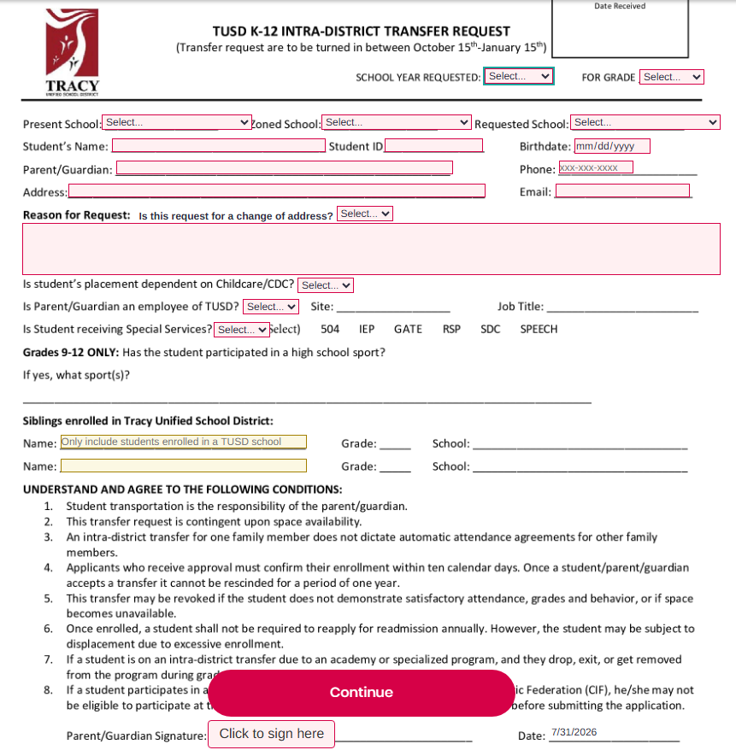
GATE

Slide 14
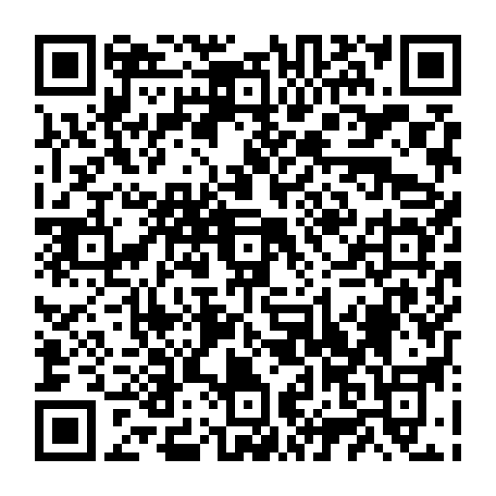
What We Recommend…
Fill out a transfer!
Scan the QR code
Save it to fill out later,
Fill one out now,
Fill one out for your testing student,
Fill one out for their sibling

Slide 15
What Does This Test Look Like?
It is not a standardized academic test.
It is reasoning and critical thinking tests.
It is a visual test.
There is not a practice test from the test makers

Slide 16
Helpful Tips for Test Preparation
✦Good night’s rest
✦Breakfast
✦Use of Restrooms
✦Coping Skills:
✧Count to ten
✧Socialize
✧Positive Self-Talk
✦Positive Affirmations
✦Use Breathing Tactics:
✧Combat Breathing

Slide 17
Student Qualifications for GATE
✦GATE testing score
✦Application
✦SBAC
✦District Assessments
✦Teacher Recommendations
✦Interviews

Slide 18
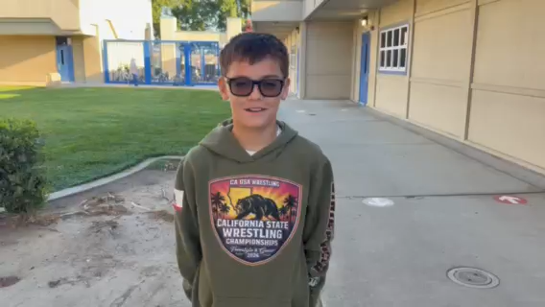
7th Grade GATE Interviews
Here is a short video that shows what the 7th grade GATE students think about the GATE Program.

Slide 19

Thank You!
Any questions?
You can find us here:
✦Michael Bunch mbunch@tusd.net
Director of Special Programs
Michael Stagnaro
✦Coordinator of Continuous Improvement
mstagnaro@tusd.net
✦Leia Osborne losborne@tusd.net
GATE Clerk

