Slide 1

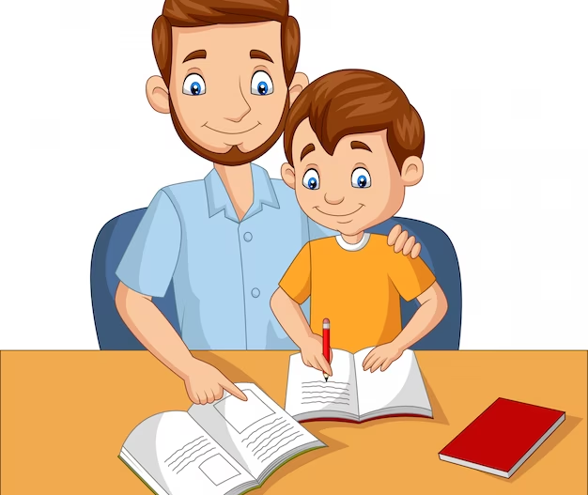



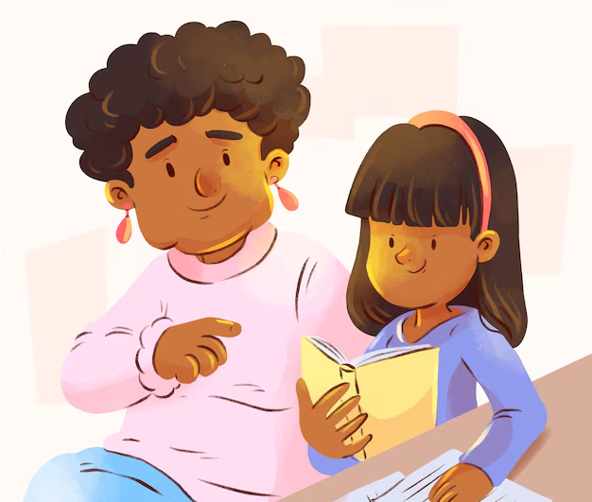
Title I Parent Workshop

Slide 2

Hot Standards
(Fifth Grade)

Slide 3
Multi-digit Multiplication
5.NR.2 Multiply and divide multi-digit whole numbers to solve real-life, mathematical problems.
5.NR.2.1 Fluently multiply multi-digit (up to 3-digit by 2-digit) whole numbers to solve real-life problems.
MATH

Slide 4
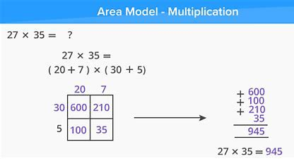
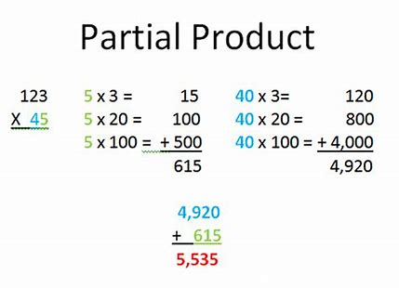
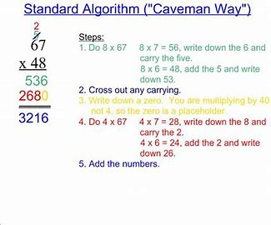
Students can choose the strategy that works best for them.
Multiplication Strategies

Slide 5

Math Resources
ALEKS (Based on Student's STAR Score)
LearnZillion (Math videos)
Khan Academy (Math videos/practice problems)
Georgia Department of Education
Tutor.com

Slide 6
Plant Classification
S5L1. Obtain, evaluate, and communicate information to group organisms using scientific classification procedures.
    Develop a model that illustrates how plants are sorted into groups (seed producers, non-seed producers) using data from multiple sources.
SCIENCE

Slide 7
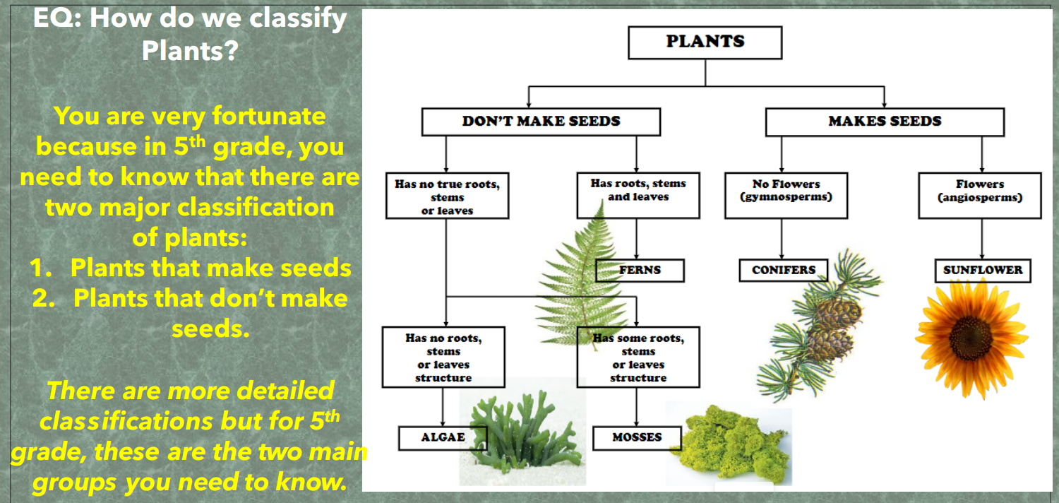
Plant Classification

Slide 8



Lexile 830L-1010L

Slide 9

Current Reading Curriculum

Slide 10
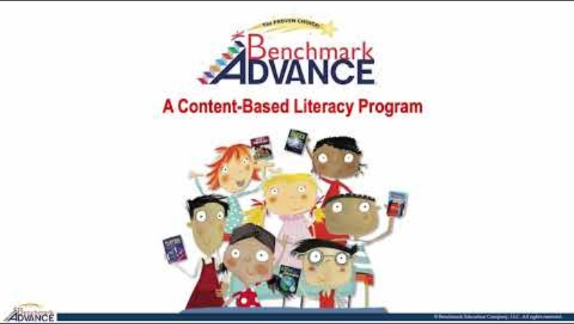

Slide 11
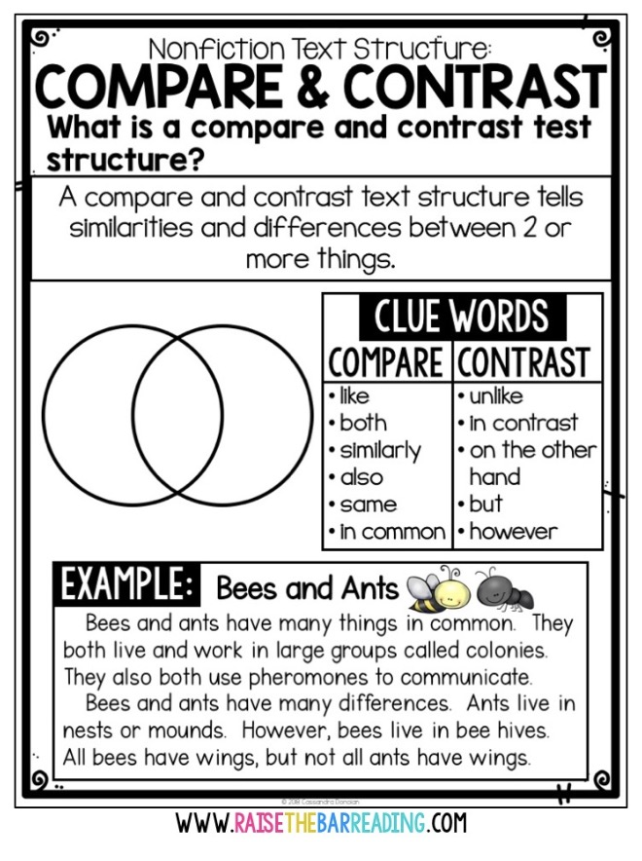

5RL3:
Compare and contrast two or more characters, setting or events in a story or drama, drawing on specific details in a text.
ELA

Slide 12
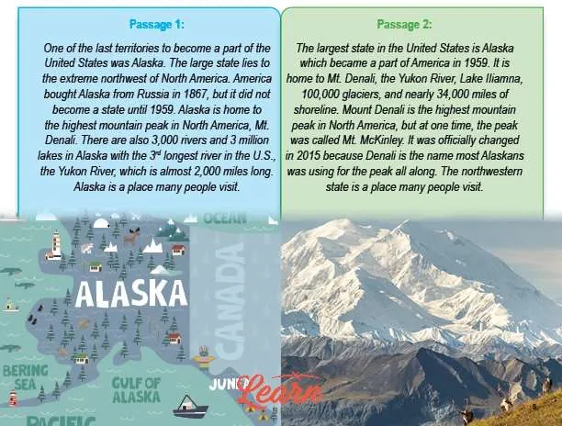
Integrating Information from two text
ELAGSE5W4: Produce clear and coherent writing in which the development and organization are appropriate to task, purpose, and audience.
Compares and Contrasts the text structures in two or more texts
Plan and draft writing independently
Summarize and paraphrase information
Identify important information in a text
Organize information from multiple sources Use information from multiple sources to write and speak about a subject knowledgeably.
Find common details about a topic from different texts
Determine what information is most important · Integrate key details from multiple texts
Writing

Slide 13
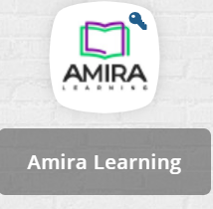
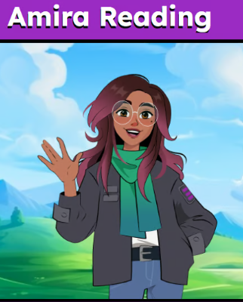
AMIRA
This school year Rockdale County Public Schools has partnered with
Amira Learning to provide personalized, research-based reading support
to help every child grow as a reader.
Amira will:
provide teachers with current, reliable and valid data quickly so they can target instruction,
monitor progress, provide students with appropriate instructional materials, and intervene with at-risk students.
gather meaningful insights into your child’s reading abilities, such as fluency, comprehension, and vocabulary

Slide 14

TUTOR.COM
Tutor.com, an online tutoring resource that provides academic support when Needed. The app is located on the students' laptops in Classlink.
Students can receive assistance with:
homework
studying
writing assignments
math problems
other academic subjects.
Students can connect with qualified tutors for one-on-one support, ask questions, review difficult concepts, and build confidence in their learning.

Slide 15

Georgia Milestones
GEORGIA
MILESTONES

Slide 16


Literacy Day– Thursday, Oct. 29th
Independent Learning Day-Friday, Oct. 30th
Parent/Teacher conference- Nov. 11th
(See classroom teacher for details)

Slide 17



