Slide 1

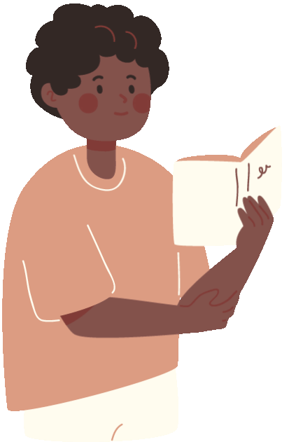






Kindergarten Hot Standards!!
Welcome to
Literacy Night

Slide 2
What are Hot Standards?
  Priority
  Essential for academic success.

Slide 3
ELA Hot Standards
  Letter Identification
  Letter Sounds
  High Frequency Words
  Rhyming Words

Slide 4
MATH Hot Standards
  Number Recognition
  Writing Numerals
  Counting Objects
  Counting Sequences
  (1-100 by ones and tens)

Slide 5
Reading Literary
With Prompting and Support...
  Ask and answer key details about a text
  Identify character, setting, and major events in a story
  Ask and answer questions about unknown words in a text
  Describe the relationship between illustrations/story in a text

Slide 6
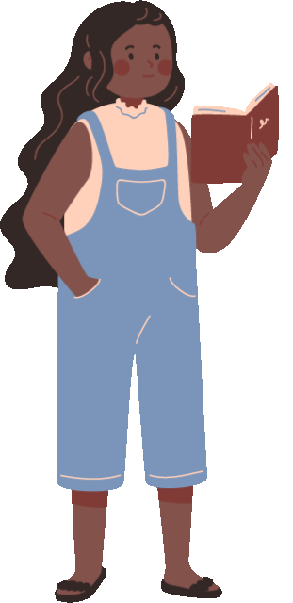
Reading Informational
With Prompting and Support...
  Ask and answer key details about a text
  Identify the main topic and retell key details in a text
  Describe connection between two individuals, events, ideas, or pieces of information in a text
  Ask and answer questions about unknown words in a text
  Describe the relationship between illustrations and the text
  Identify basic similarities and differences between two texts on the same topic

Slide 7
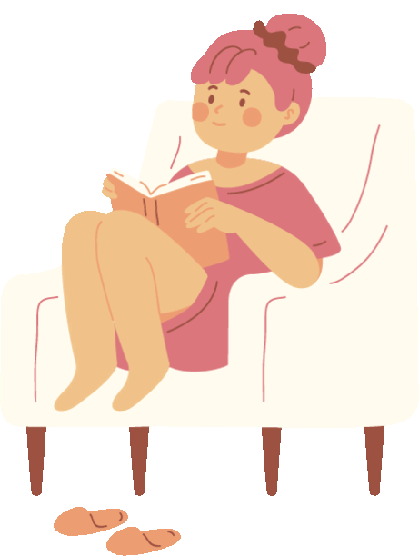
Reading Foundational
  Organization/features of print
  Spoken words can be written/space between words
  Upper and Lowercase Letters
  Rhyming Words
  Count, pronounce, blend, segment syllables
  Onset and rimes

Slide 8

Reading Foundational Cont’d
• Isolate and pronounce initial, medial, and final sounds
Substitution
One to one letter sound correspondence for consonants
Long and short vowel sounds
Distinguish between similiarly spelled words
Read common high-frequency words and emergent readers

Slide 9
Language
  Consistently print 36-51 letters
  Nouns and verbs, frequently occurring verbs
  Produce and expand complete sentences
  Capitalization
  Write letters
  Identify new meanings to familiar words (duck)
  Inflections and affixes

Slide 10
Writing
Use drawing dictating and writing to compose the following:
  Opinion Pieces
  Informational Text
  Narratives
  With support participate in writing/research projects

Slide 11
How can you help?
Read EVERYTHING!!
Practice retelling a story
Describe story elements
Ask questions about a story or text
Practice writing often
Practice letter sounds
Identify and practice high frequency words
Practice blending and segmenting

Slide 12
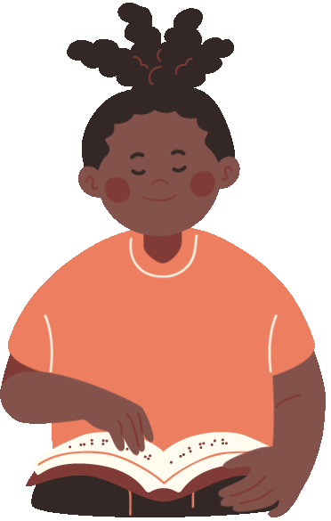
Make Literacy a Priority!
Read with your
child

Slide 13
www.tutor.com

Slide 14
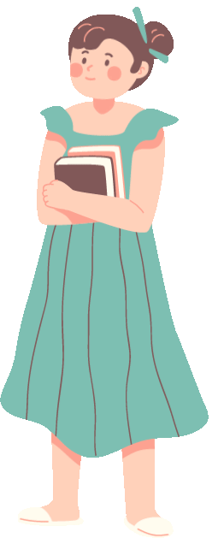
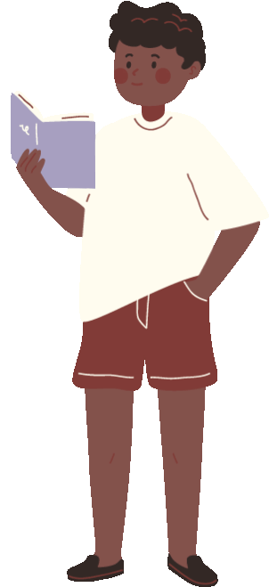
Thank you!
From your Kindergarten Team

