Slide 1


Slide 2


Slide 3


Slide 4


Slide 5


Slide 6


Slide 7


Slide 8


Slide 9


Slide 10



Slide 11


Slide 12


Slide 13


Slide 14


Slide 15
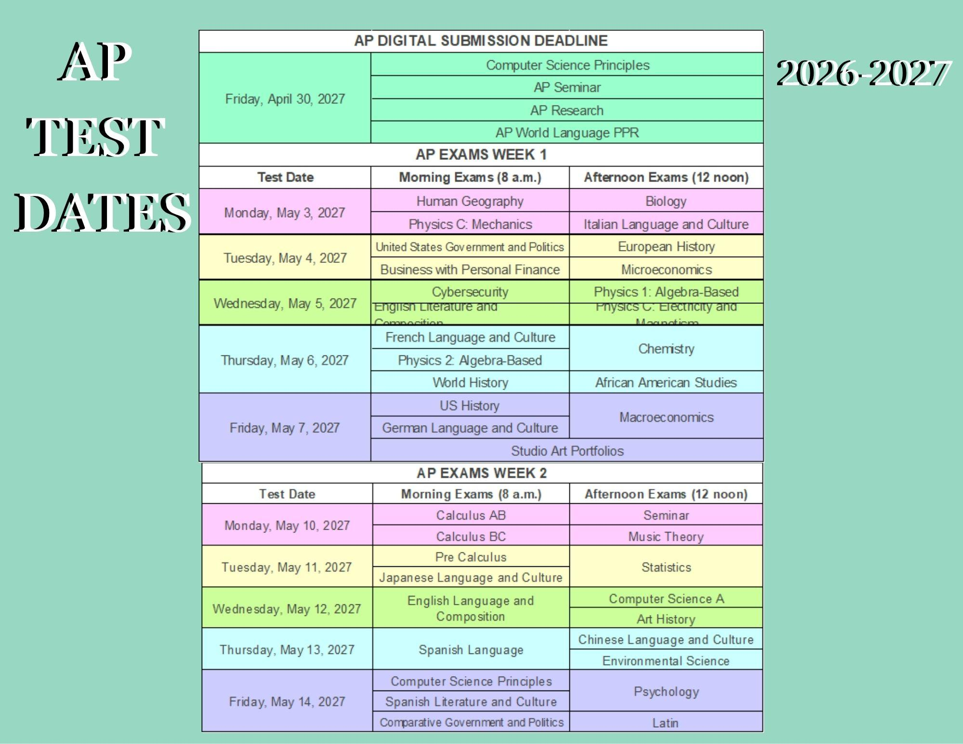

Slide 16


Slide 17


Slide 18


Slide 19


Slide 20


Slide 21


Slide 22


Slide 23
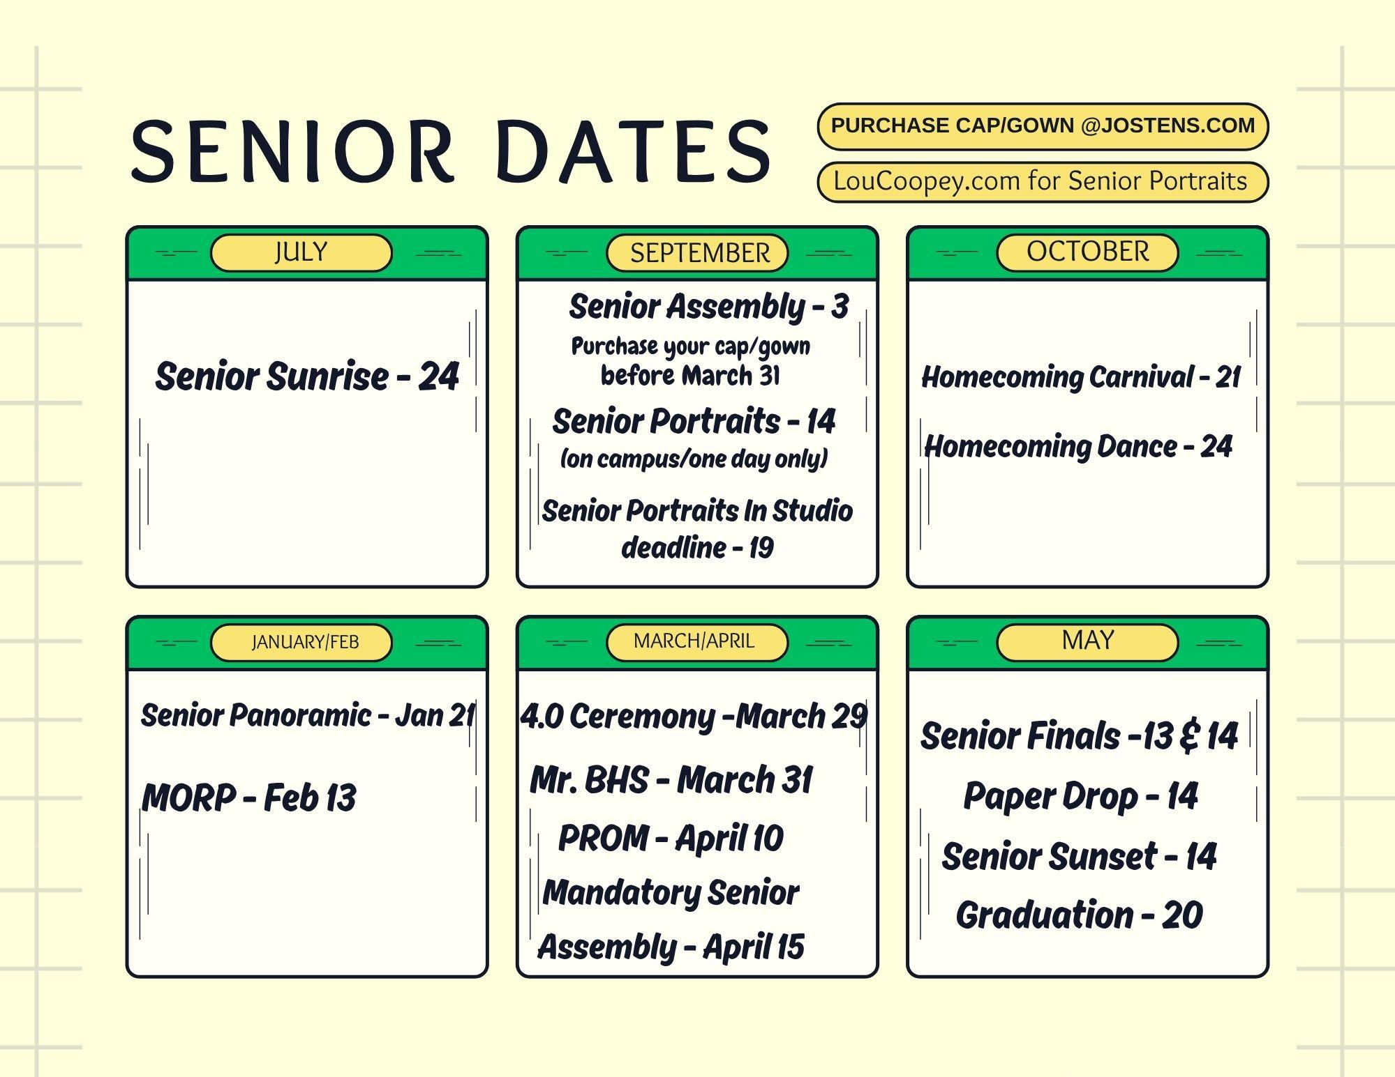

Slide 24


Slide 25



Slide 26


Slide 27


Slide 28


Slide 29

New Library rules for the new year!
No FOOD or DRINK.
No rough play.
No inappropriate language.
Water is acceptable.
Please keep the library clean.
Stay awesome and respect the space!

