Slide 1
School board meeting
Oct. 20, 2026

Slide 2
Superintendent’s report
SUPT. DR. KIM HIEL
Notes:
Good evening Chair Prince, Vice Chair Brooks, school board members and stakeholders:
As we continue this school year, our focus remains on being the best place to learn, the best place to work, and a district where every scholar has the opportunity to thrive.
We have continued visiting our schools and sites, learning about their experiences, and seeing firsthand the incredible work happening across our district. Our assistant superintendents are also spending time alongside principals and school teams, working collaboratively to identify challenges, provide support, and remove barriers that may stand in the way of student success. Our goal is not simply to identify what needs to improve, but to work together to determine what we can do differently to help every scholar succeed.
I also want to recognize our school board members who have attended some of our sites during conferences to welcome families and create opportunities to listen. These moments matter. They give us a chance to hear directly from families about their hopes for their children, their experiences with our schools, and what they need from our district.
It truly takes a community working together to ensure our scholars are successful. Our responsibility is to make sure that community is not just invited to the conversation, but genuinely heard, valued, and included in shaping the direction of our district.
Transparency is an ongoing commitment, and it begins with listening, asking questions, acknowledging what we learn, and being willing to act on what we hear. We will not always have every answer, and we will not always get everything right. However, we can commit to being open about our work, learning from the voices of our families, scholars, staff, and community, and using that learning to guide our decisions.
Ultimately, this work is about more than programs or individual initiatives. It is about people, relationships, and the shared responsibility we have to create the conditions in which every scholar can learn, belong, and thrive. That is how we continue building One Community for All.

Slide 3
Points of Pride
SUPT. DR. KIM HIEL AND CABINET MEMBERS
Notes:
A regular part of the superintendent’s report is to share Points of Pride in our district.
By sharing our Points of Pride, we are taking time to recognize and celebrate, the scholars, staff and community members who are contributing to the accomplishment of our mission.
I have members of our District Cabinet here to assist in sharing some examples from the last month.

Slide 4

Notes:
In the area of ACHIEVING DREAMS
Lucy Anderson, a fourth grader at Basswood Elementary School, is currently performing in the Chanhassen Dinner Theater’s production of “Annie” that runs from now until Feb. 27. Based on the popular comic strip, “Annie” tells the story of a spunky little orphan full of optimism that shines through the most difficult situations.
Lucy plays one of the other orphans on stage, Molly, in half of the performances. Lucy landed the role after auditioning at the Mall of America and attending an “Annie bootcamp” to prepare the child actors to join the adult cast.

Slide 5
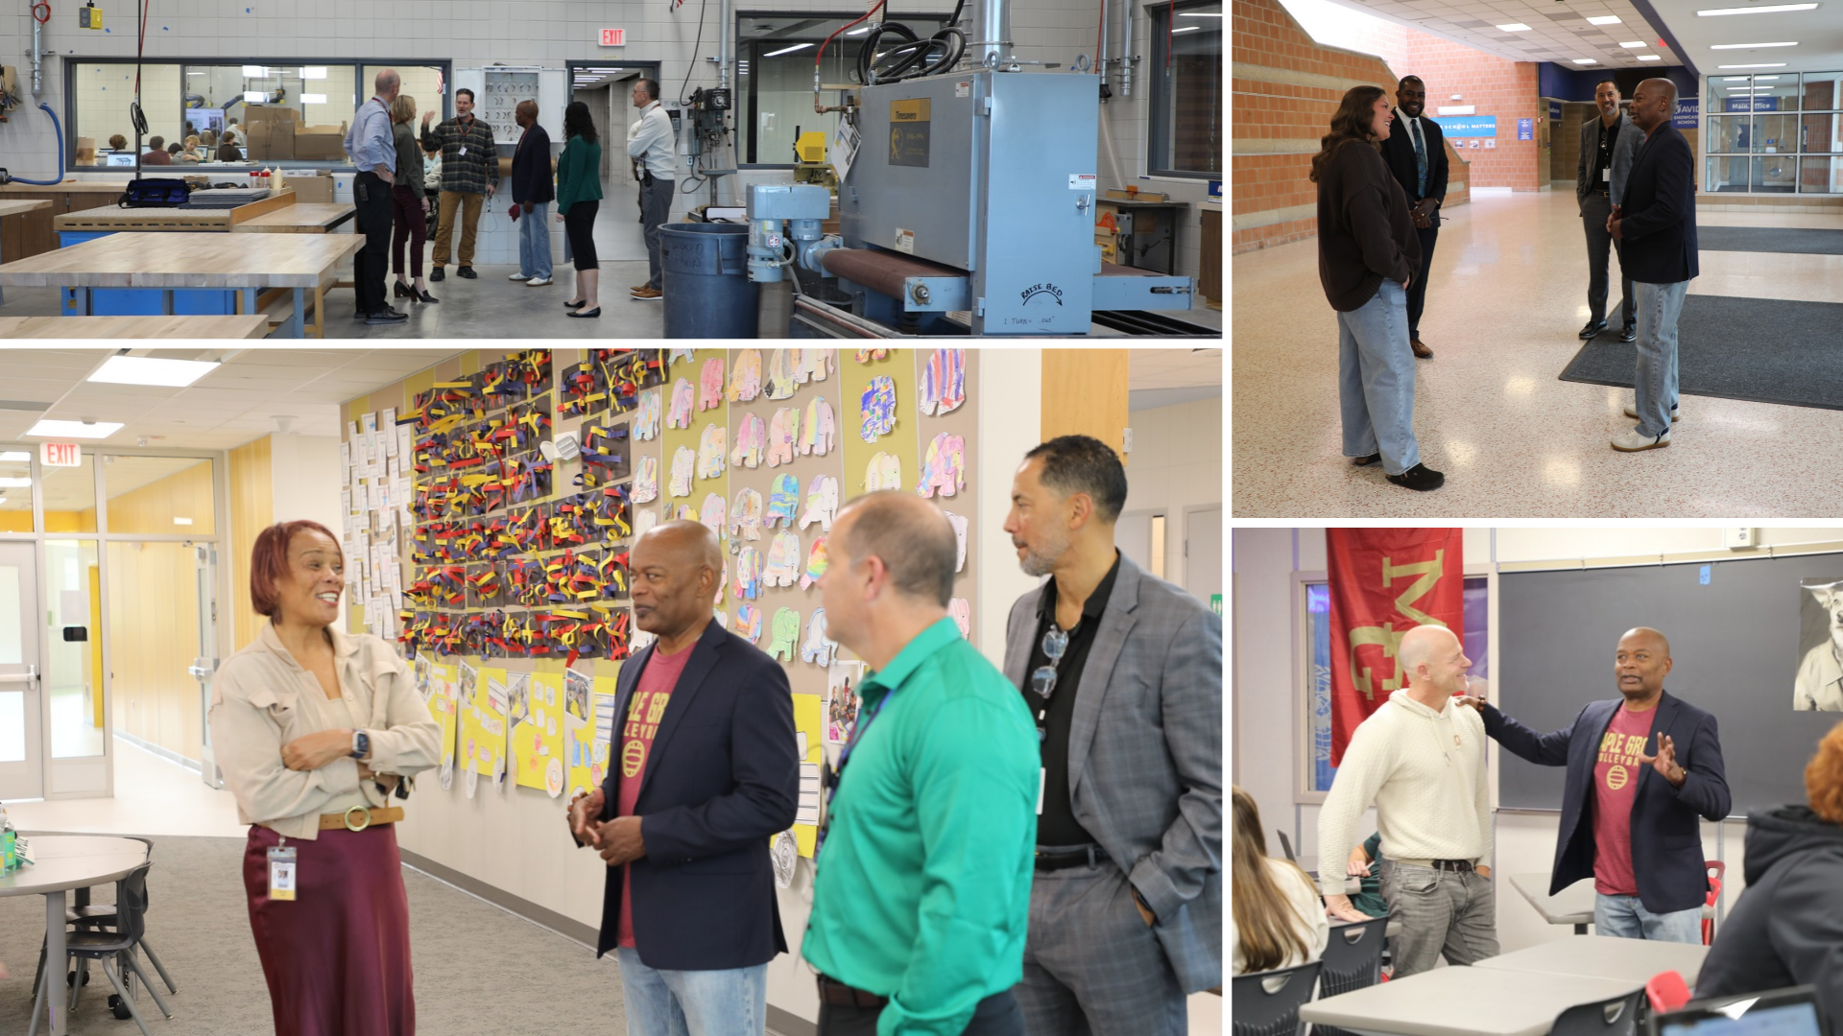
Notes:
Minnesota’s Education Commissioner, Willie Jett, made stops at three district schools Oct. 8. Jett toured facilities, met with school leaders and visited with students and staff during his morning at Aspen Ridge Elementary School, Maple Grove Middle School and Maple Grove Senior High School.
Jett graduated from Osseo Senior High School and later worked at both Osseo and Park Center senior high schools on his path to becoming the state’s education commissioner in 2023.

Slide 6
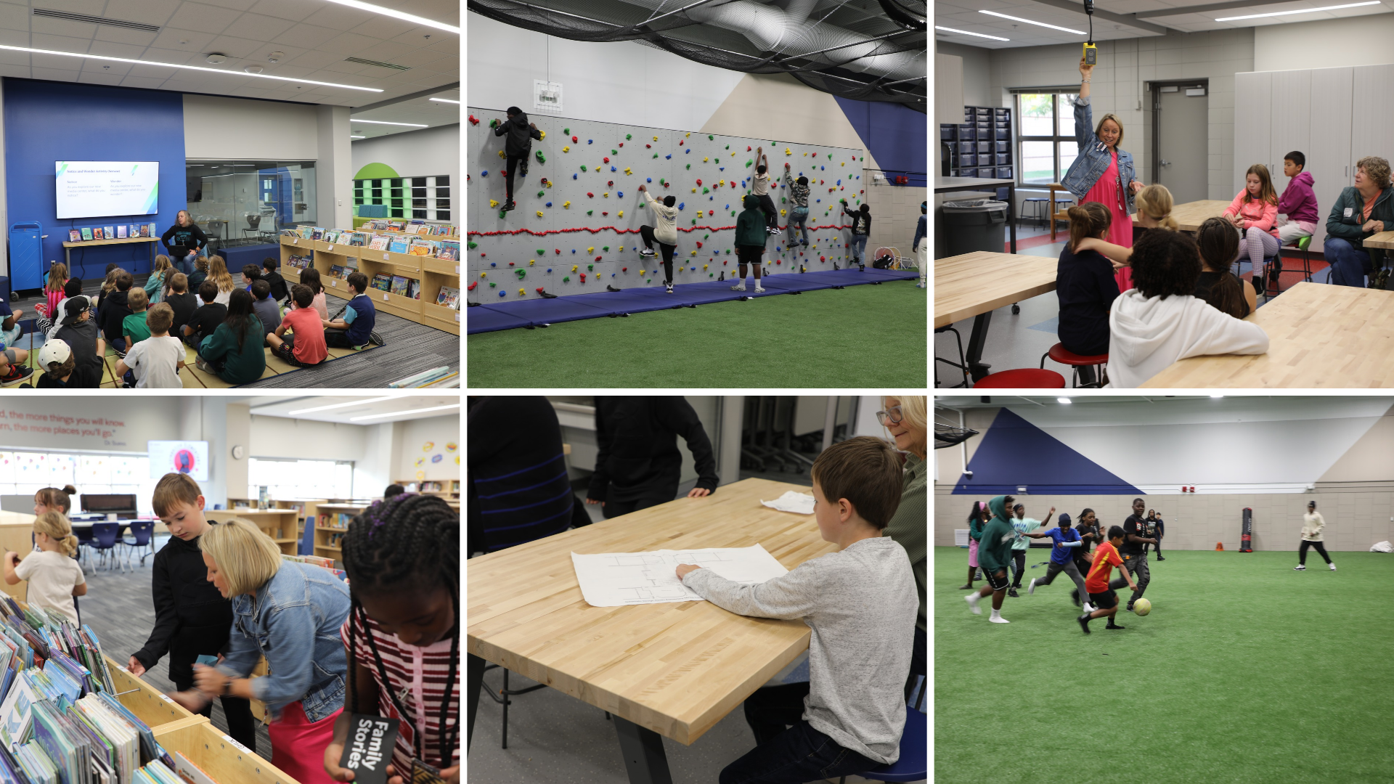
Notes:
New spaces from recent Building a Better Future projects are being put through their paces as the 2026-27 school year rolls into month two. Work continues at Maple Grove and Park Center senior high schools and the new community school in Brooklyn Park throughout this school year, with another slate of projects scheduled to take place next summer.

Slide 7
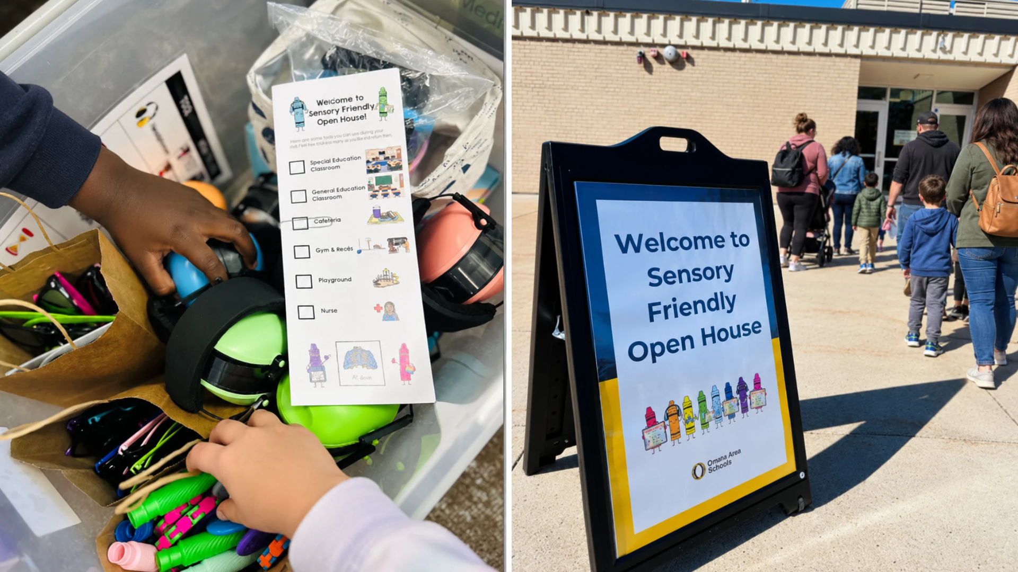
Notes:
In the area of CONTRIBUTING TO COMMUNITY
Osseo Area Schools recently welcomed students and families to sensory-friendly open house events at Basswood, Cedar Island, Garden City, Palmer Lake and Woodland elementary schools. The events were designed for students and families who would benefit from a calm, supportive and sensory-friendly opportunity to experience their school before the start of the new year. Over 100 students and their families attended the events.

Slide 8
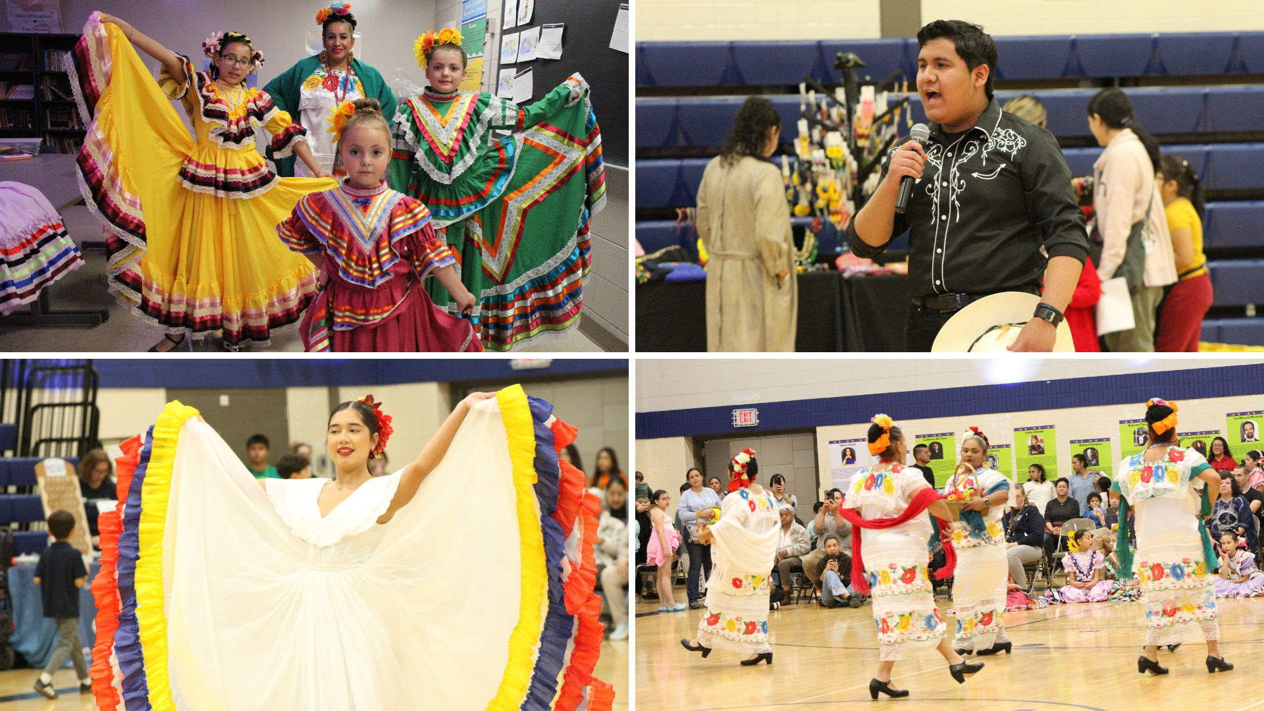
Notes:
In the area of LIFELONG LEARNING
The Multilingual and Family and Community Engagement departments came together to host the district’s fourth annual Hispanic Heritage Month celebration Sept. 25, welcoming more than 600 families for an evening filled with culture, connection and community.
Families enjoyed food trucks, activities and cultural performances from scholars and community members, including Venezuelan, Aztec, Folkloric and Colombian dances. Many district scholars shared their talents through singing, playing music, reading poetry, dancing and other performances, as well as helping to decorate for and host the event.

Slide 9
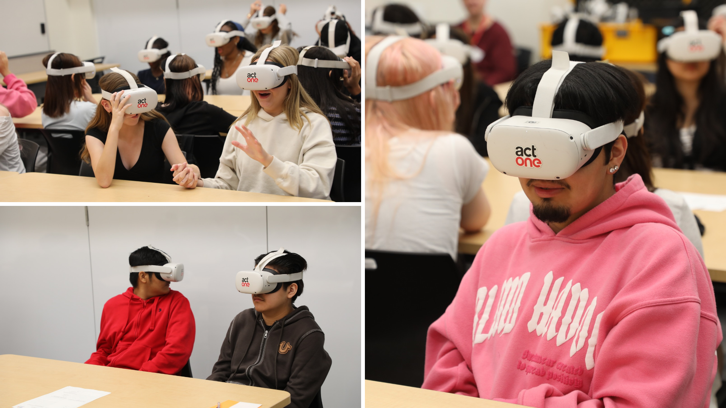
Notes:
On Oct. 9, students at Osseo Senior High School had the opportunity to participate in a virtual reality or VR field trip, thanks to a collaboration between Perpich Center for Arts Education and the nonprofit organization Act One. The VR headsets brought students on visual and audio journeys to explore different cultures, without having to leave the walls of the classroom. The experiences included visiting Phoenix to see a Mariachi band and following a Navajo weaver through his entire process, from herding his sheep, gathering and preparing the wool and weaving it on a loom. The lessons were not only interesting and relevant to the students with their coursework, but also timely as they occurred concurrently with both Hispanic Heritage Month and Indigenous Peoples Day.

Slide 10
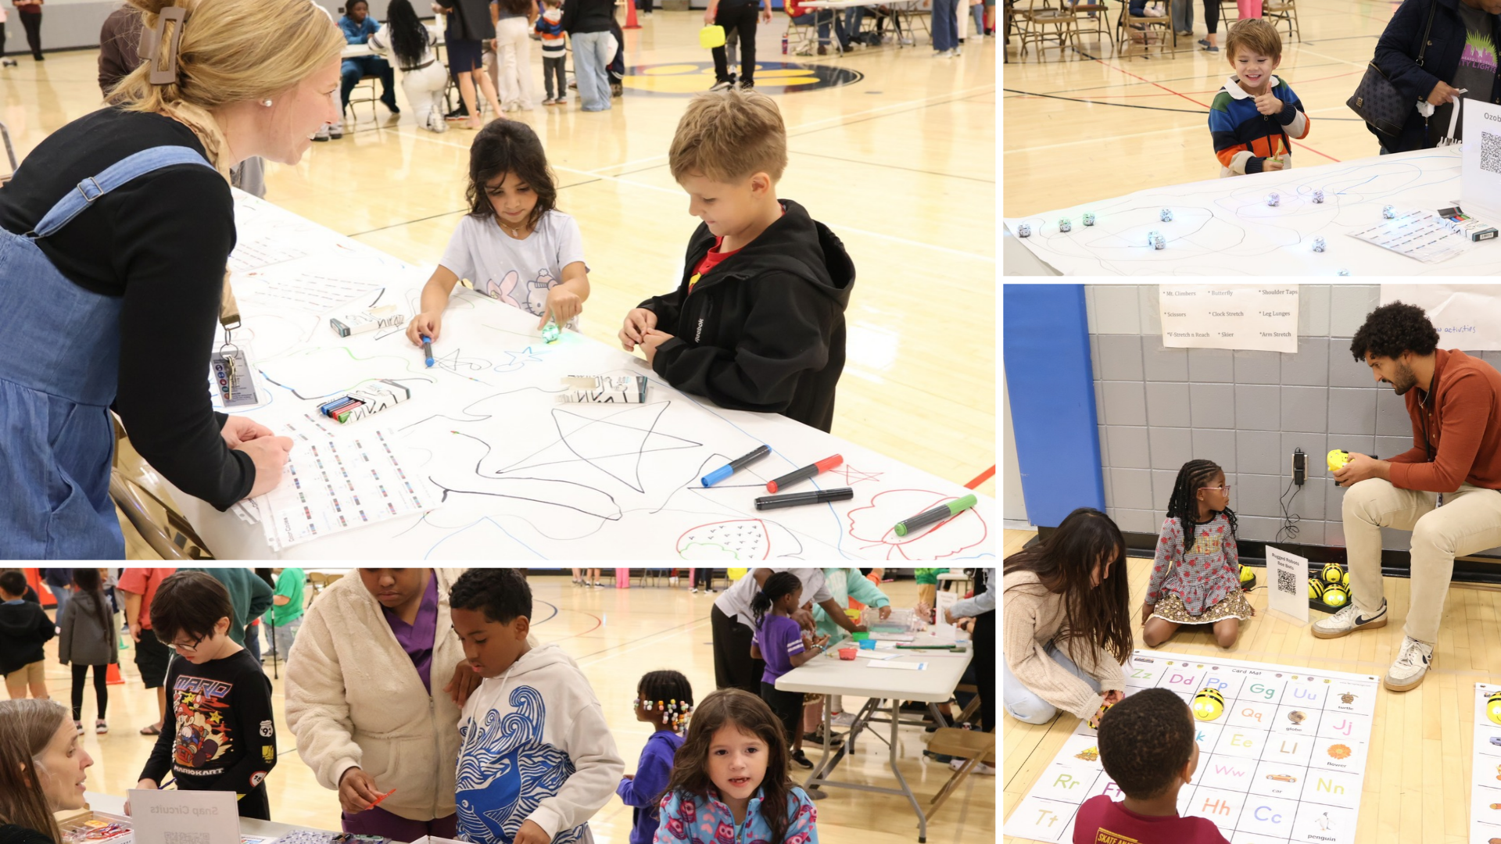
Notes:
A core focus of Zanewood Community: A STEAM School's mission is to bring experiences related to science, technology, engineering, arts and mathematics to life in meaningful ways. One way the school helps to achieve this mission is through its annual Engineering Night. This well-attended event brings families in to see and experience firsthand the value-added, hands-on learning experiences afforded to Zanewood’s students.

Slide 11
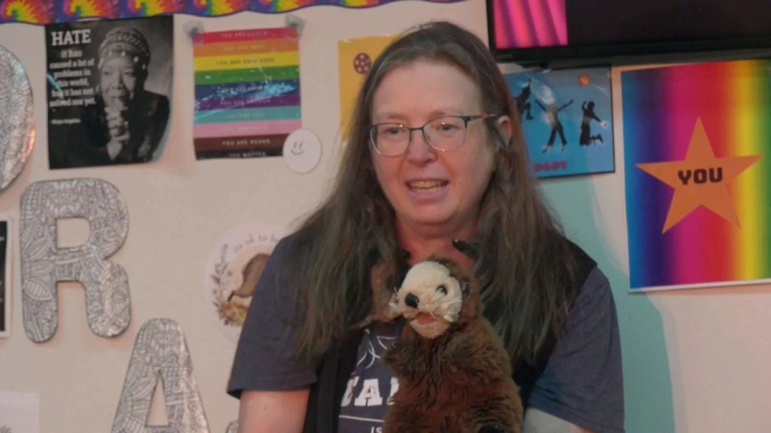
Notes:
In the area of MISSION DRIVEN EMPLOYEES
CCX Media recently featured Birch Grove School for the Arts’ Kris Holsen, who was given the Minnesota Educational Theater Association Theater Educator of the Year Award.
Birch Grove Principal Stephanie Webster said about Holsen, “She directs, she leads, she teaches, she performs. She is one of the hardest workers I have ever had the pleasure of working with, and her passion for the arts is unmatched.”

Slide 12
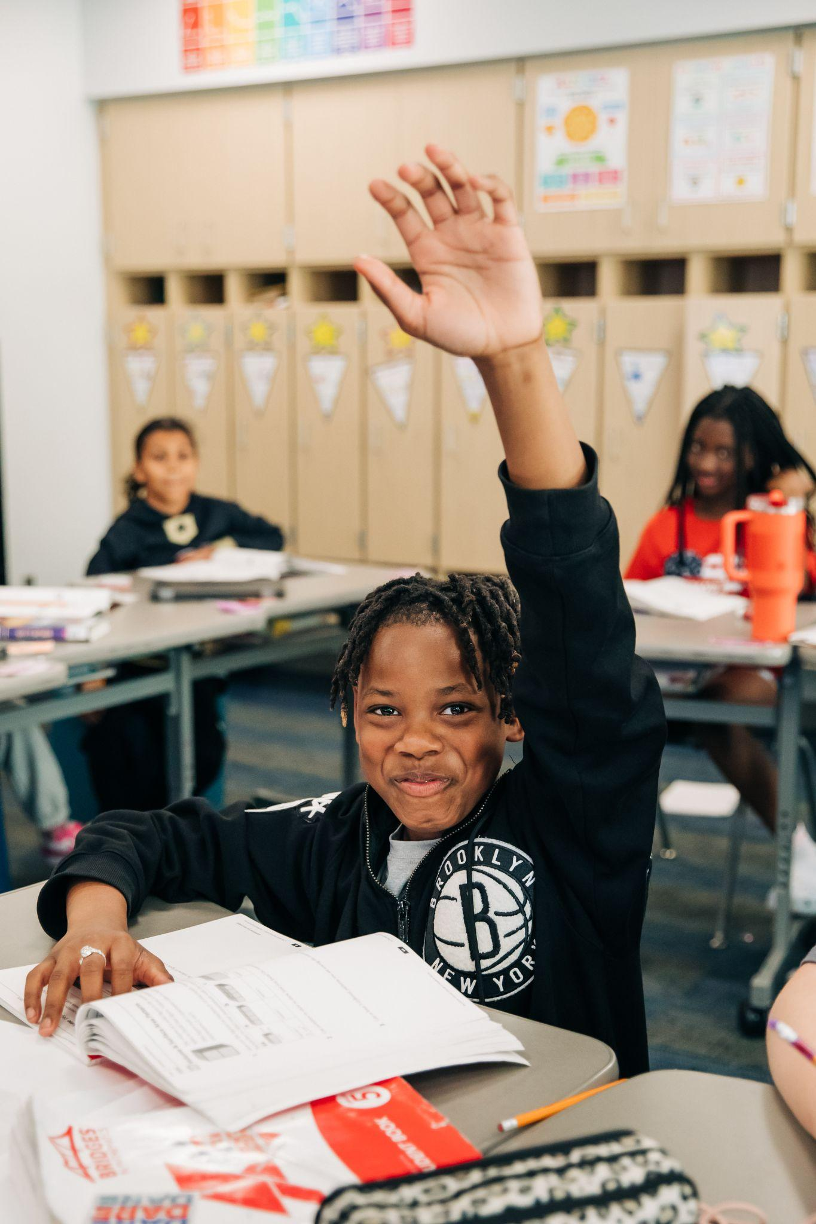
Notes and reminders
Constitutional amendment on the ballot this fall that impacts school funding: OsseoSchools.org/Amendment
Notes:
A few final notes and reminders for tonight.
There is a constitutional amendment on the ballot this fall that impacts school funding. The amendment seeks to change the funding disbursement levels of an existing state fund and does not raise taxes or fees. To learn more, visit OsseoSchools.org/Amendment

Slide 13
School board meeting
Oct. 20, 2026

