Slide 1

Stop The Judgment Project
Tom Bott and Sherry Jo Matt
Co-Founders
in partnership with
Dr. C. Thomas Brophy, DO, FASAM
Medical Director - Ellen O’Brien Gaiser Center

Slide 2
MEET SIENA

Slide 3
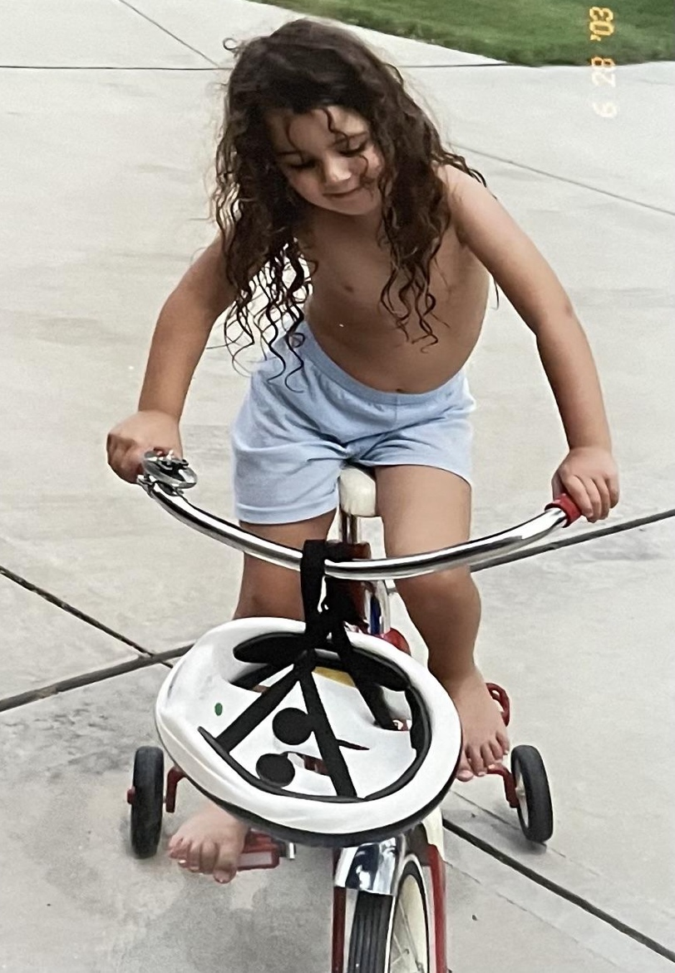

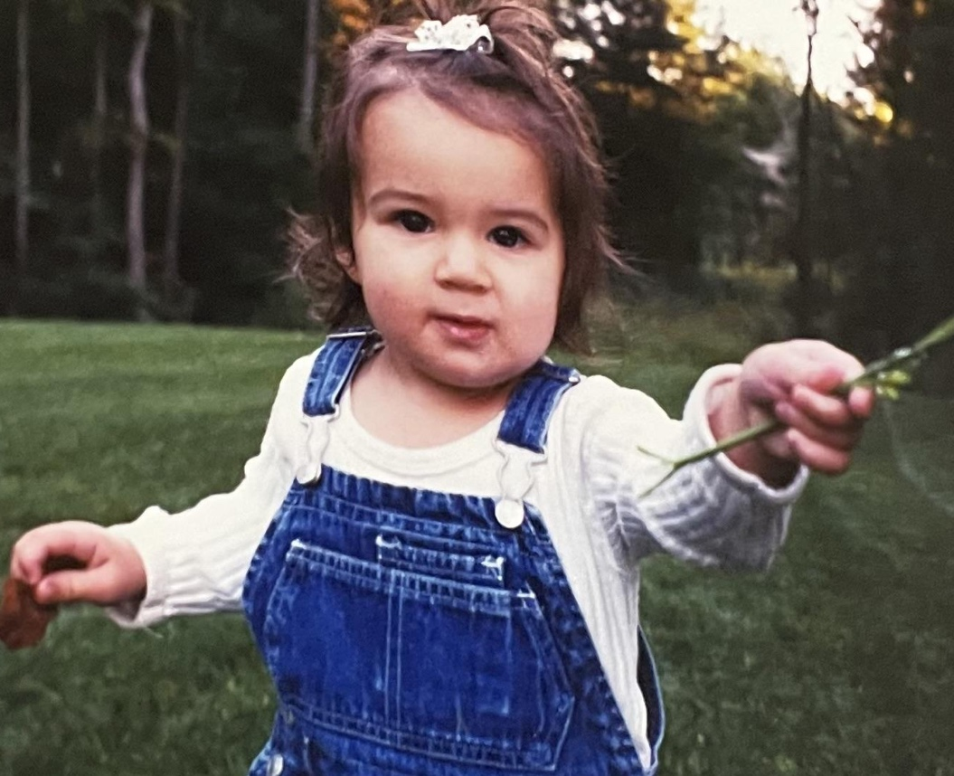
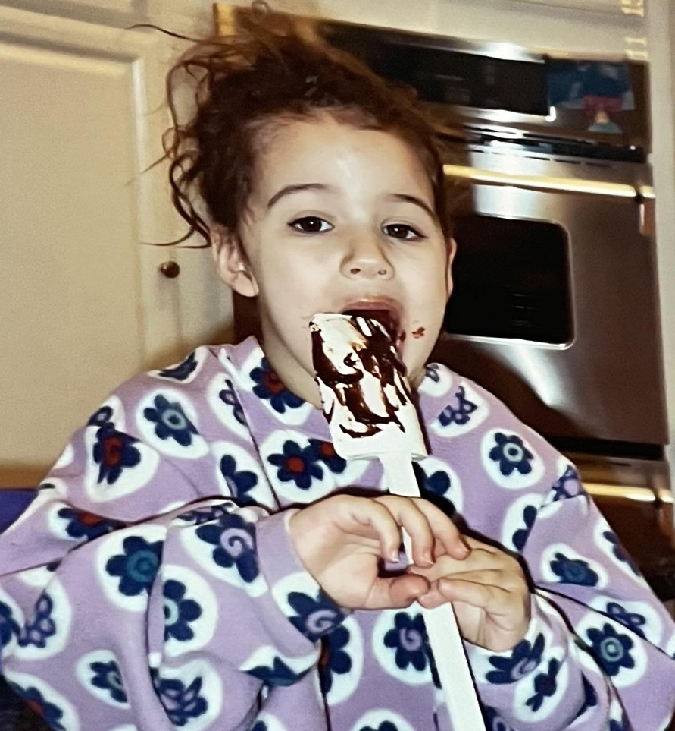
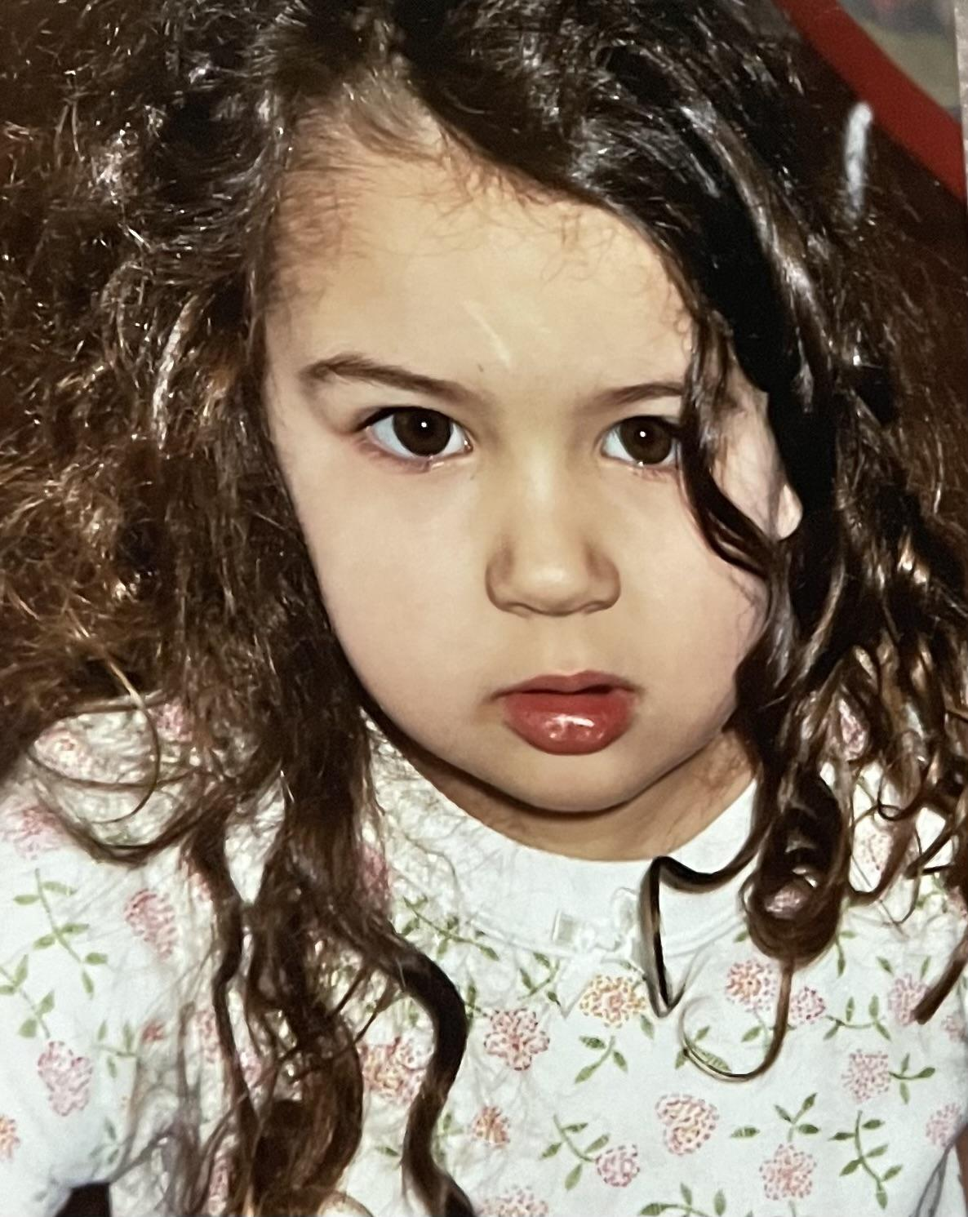



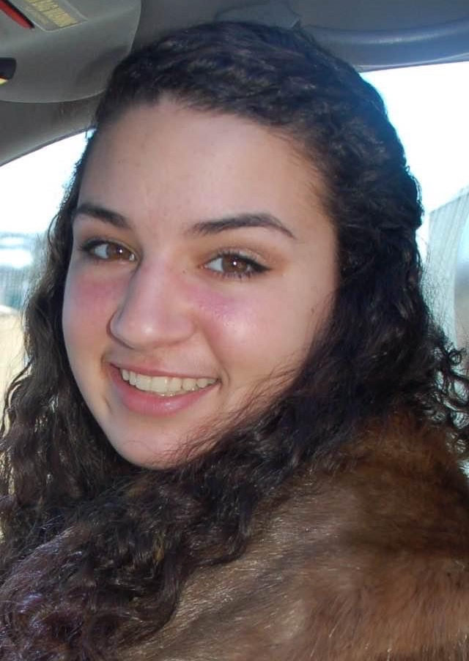


Slide 4


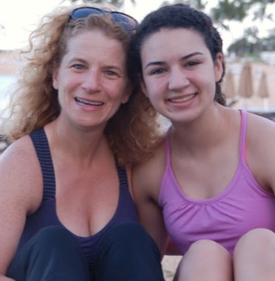
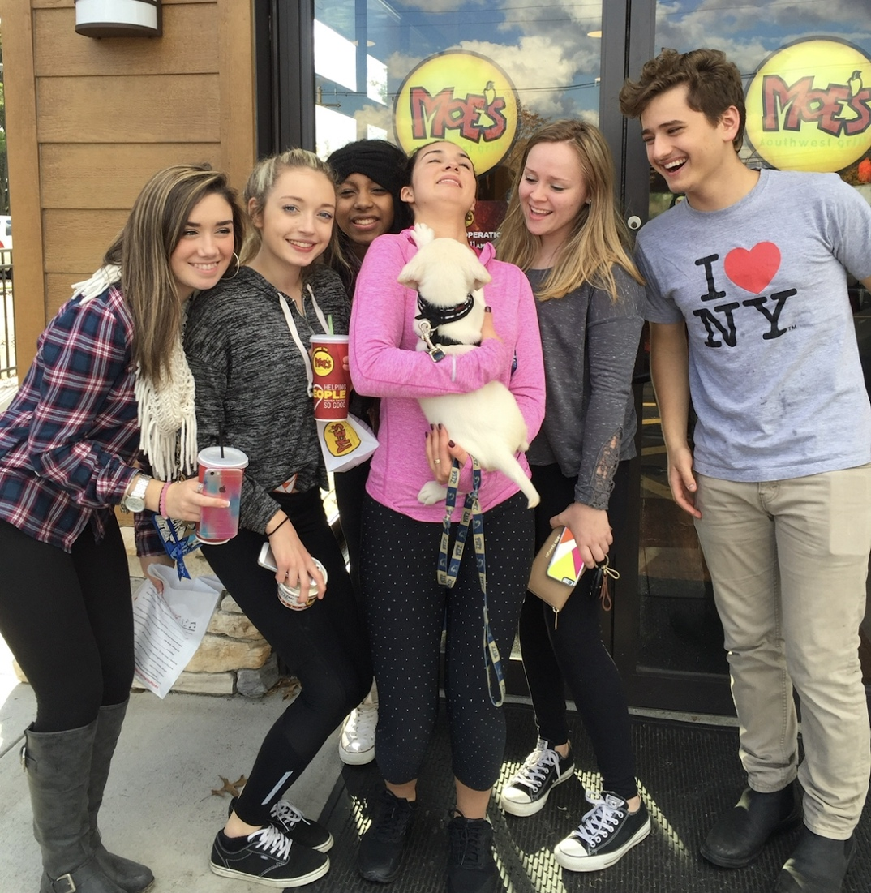


Slide 5
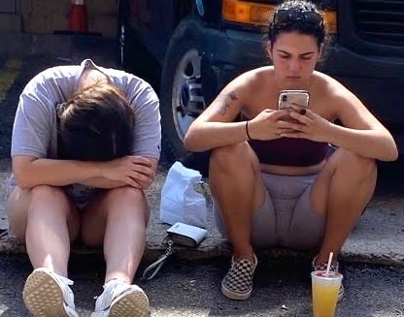
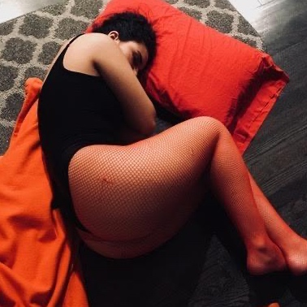
Siena’s Story
On the inside, Siena was struggling…
Her struggles with mental illness began at age 12 after a sexual assault by 4 boys
Struggled with low self-esteem and shame
Began cutting to cope with her struggles
Turned to alcohol to cope (age 14)
Diagnosed with bipolar disorder and borderline personality disorder (age 17)
Began Isolating herself from friends and family that loved her (age 18)
Surrounded herself with an “unfriendly group” (downward peer group migration)
Percocet became her coping mechanism (age 20)

Slide 6
AT THE AGE OF 21,
on September 14, 2020…
Siena lost her life

Slide 7
Siena died from a fentanyl overdose
She took what she thought was a Percocet (one pill) …
but the pill she took was made in a counterfeit press and was 100% fentanyl.

Slide 8

In Loving Memory of
Siena “Sadie” Bott
July 21, 1999 -
September 14, 2020
Forever 21

Slide 9

In Honor of
Siena “Sadie” Bott
Stop the Judgment Project
was created
Our Mission:
Bringing awareness to the STIGMA AND JUDGMENT associated with substance use disorders and mental health disorders in adolescents and young adults

Slide 10
Three Take-Aways From Today’s Presentation

Slide 11
Take-Away #1
Reach out for help if you are struggling with mental health and/or substance use
Talk to someone you trust
  your school counselor/therapist
  A family member or friend
Do not isolate and keep your struggles
to yourself
THERE ARE PEOPLE WHO CARE ABOUT YOU THAT WANT TO HELP YOU.
- But they can’t help you if they don’t know about your struggles

Slide 12
Take-Away #2
Be kind to your friends, fellow students, family members who may be struggling
Don’t shame or judge them
  Lowers that person’s self esteem
  Reinforces isolation
  Prevents that person from seeking help
Encourage them to seek help
Walk alongside them and support them
Show compassion
YOU JUST MAY END UP SAVING A LIFE !!

Slide 13
COMPASSION
People struggling with mental health and substance use disorders shouldn’t be relieved to be met with compassion …
… Compassion should be the standard

Slide 14
The Neuroscience of Compassion
James R. Doty, MD - Clinical Professor in the Department of Neurosurgery at Stanford University School of Medicine
> When we behave compassionately, it has a powerful healing effect on our bodies
> Being compassionate inspires others to be compassionate

Slide 15
Take-Away #3
Be kind to yourself
Self stigma leads to …
  Negative self image
  Social withdrawal/isolation
  Allowing others to treat you poorly
Practice self-compassion
  Offer yourself the same kindness and compassion you would give a loved one/friend/fellow student
YOU ARE THE MOST IMPORTANT PERSON IN YOUR LIFE !!

Slide 16
Follow Us On Social Media!
Instagram: @stopthejudgmentproject
Facebook: Stop The Judgment Project
Website: stopthejudgment.org

Slide 17
