Slide 1
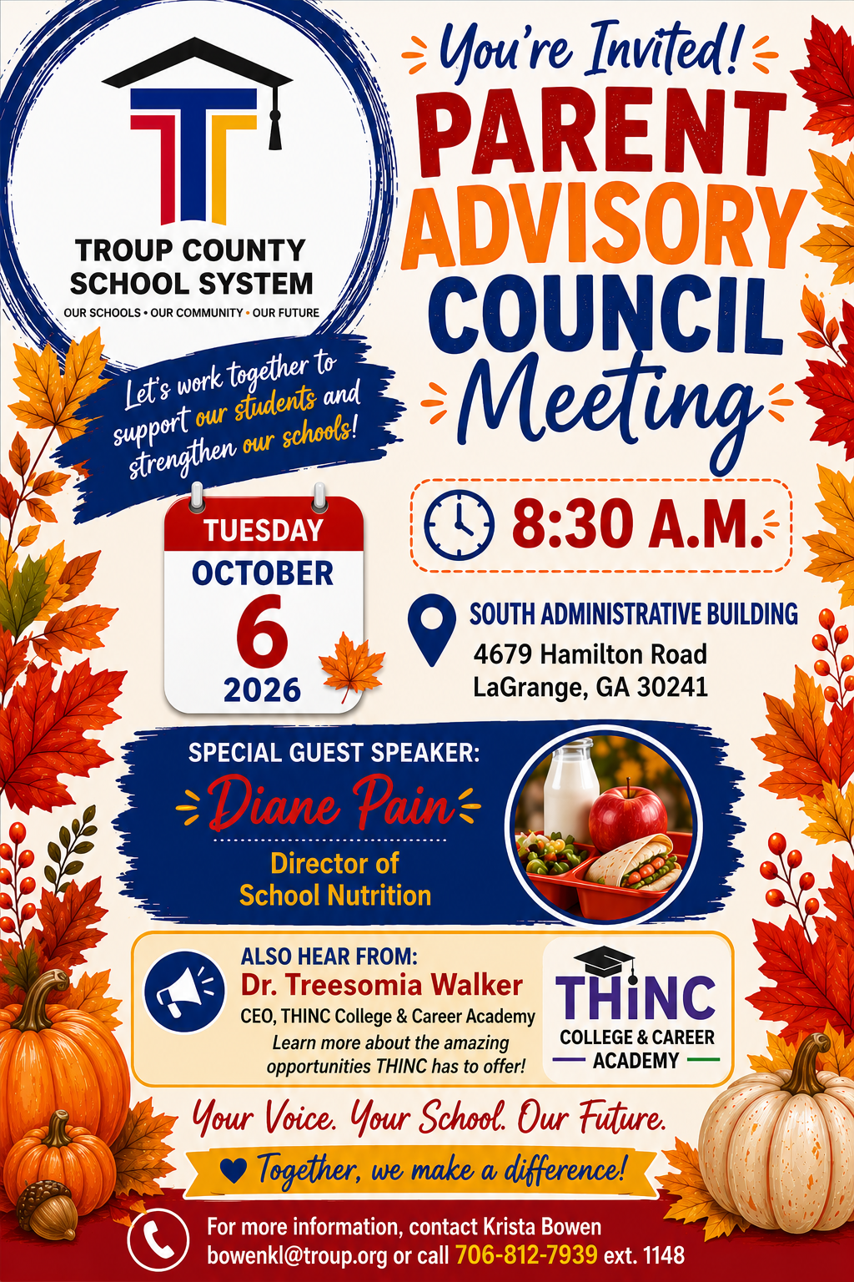
TITLE I
Parent Advisory
Council Meeting
Tuesday • October 6, 2026 • 8:30 a.m.
Old Rosemont School
South Administrative Building
4679 Hamilton Road • LaGrange, GA 30241
Training Room
Your Voice. Your School. Our Future.
Together, we make a difference!

Slide 2
Welcome to Our Parent Advisory Council
We are glad you are at the table.
• Mandi Pike — Federal Programs Director
• Krista Bowen — Title I Parent and Family Engagement Coordinator
• Family Liaisons: please introduce yourself and your school.
• Family Liaisons: introduce the parent(s) representing your school.
Opening prompt: Name • School • One thing you hope families gain from PAC this year
Strong schools are built when families have a seat at the table.

Slide 3
Purpose & Mission of PAC
Families have a voice in how we strengthen schools.
• Bring parent and family perspectives into district Title I planning.
• Share information, questions, needs, and ideas from each school community.
• Learn about district programs and resources that support students and families.
• Provide meaningful input that can guide family engagement efforts.
Strong schools are built when families have a seat at the table.

Slide 4
Our District Goals
How PAC connects to the work of Troup County School System
1
2
3
Strengthen High-Quality Instruction
and Student Achievement
Foster a Supportive, Engaging,
and Future-Ready Learning Environment
Build Professional Capacity through
Collaborative Leadership and Data-Driven Practices
Strong schools are built when families have a seat at the table.

Slide 5
Special Presentation
THINC College & Career Academy
Dr. Treesomia Walker
CEO, THINC College & Career Academy
Learn more about the opportunities THINC offers students as they prepare for college, careers, and their future.
Questions for families to consider:
What opportunities would you like to know more about? • What information would help you support your child’s future planning?
Strong schools are built when families have a seat at the table.

Slide 6
Special Guest Speaker
School Nutrition
Diane Pain
Director of School Nutrition
A conversation about School Nutrition and information that can help families support students throughout the school day.
Parent questions and feedback are welcome.
Strong schools are built when families have a seat at the table.

Slide 7
Your Voice Matters
Opportunity for Parent & Family Input
• What is working well for families at your school?
• What is one challenge families are experiencing?
• What information, workshop, or resource would be most helpful this year?
• How can we make it easier for families to participate and feel connected?
• What should we take back to schools after today?
Strong schools are built when families have a seat at the table.

Slide 8
Thank You for Serving on PAC
Your participation strengthens our schools.
Next Parent Advisory Council Meeting
Tuesday, December 1, 2026 • 8:30 a.m.
Please take what you learned today back to the families you represent — and bring their voices with you next time.
Strong schools are built when families have a seat at the table.

Slide 9
Family Liaisons
PAC concludes • Family Liaison Meeting begins at 9:30 a.m.
Thank you to our parent representatives!
Family Liaisons: We will take a brief break before continuing with the Family Liaison agenda.
Strong relationships grow when we plant seeds of trust,
nurture connections, and make every family feel they belong.

Slide 10
Check-In, Good News & Family News
School updates and family celebrations
Add notes, examples or training materials here
Strong relationships grow when we plant seeds of trust,
nurture connections, and make every family feel they belong.

Slide 11
Attendance and Questions
Attendance updates and questions for discussion
Add notes, examples or training materials here
Strong relationships grow when we plant seeds of trust,
nurture connections, and make every family feel they belong.

Slide 12
Clear Connect Training
Training materials and demonstration
Add notes, examples or training materials here
Strong relationships grow when we plant seeds of trust,
nurture connections, and make every family feel they belong.

Slide 13
Compact Cover Letter & Conference Uploads
Upload requirements and examples
Add notes, examples or training materials here
Strong relationships grow when we plant seeds of trust,
nurture connections, and make every family feel they belong.

Slide 14
FY27 Parent Conferences: K–2
Twice a year: October and March
Paperwork to upload
Add notes, examples or training materials here
Strong relationships grow when we plant seeds of trust,
nurture connections, and make every family feel they belong.

Slide 15
FY27 Parent Conferences: Grades 3–12
Grades 3–5, middle school and high school
Once a year
Where to upload and what is needed
Add notes, examples or training materials here
Strong relationships grow when we plant seeds of trust,
nurture connections, and make every family feel they belong.

Slide 16
Conferences in the Middle of the Year
Procedures and questions
Add notes, examples or training materials here
Strong relationships grow when we plant seeds of trust,
nurture connections, and make every family feel they belong.

Slide 17
Kami: Merging Files
Merging files into one document
Add notes, examples or training materials here
Strong relationships grow when we plant seeds of trust,
nurture connections, and make every family feel they belong.

Slide 18
Next Family Liaison Meeting
December 1, 2026 at 8:30 a.m.
Strong relationships grow when we plant seeds of trust,
nurture connections, and make every family feel they belong.

