Slide 1
RED BANK CATHOLIC
HIGH SCHOOL
JUNIOR/PARENT PRESENTATION
“PREPARE AT RBC”
2026-2027

Slide 2
WELCOME
GUIDANCE DEPARTMENT
Cathy Scaramuzzino–Director
Emma Stark Koba-Counselor
Ted Jarmusz-Counselor
Matt Koba-Counselor
Sister Regina-Freshman Advisor
Jeanne Toomey-Freshman Learning Consultant
Susan Miller- LDTC
Leslie Galvin-Freshman Advisor
Nicole Wall-SAC
Kristie Bergin- Social Worker
Tina Brendel- Registrar
Danielle Cioffi- Guidance Secretary

Slide 3
Red Bank Catholic Guidance Website
www.redbankcatholic.org
Highlights of the website include:
College Planning
Scholarships
Financial Aid
Summer Programs
Resume Building

Slide 4

How Colleges Select Students…
They consider the following:
Academic Record
Difficulty of Course Load
SAT Scores/ACT Scores
Letters of Recommendation
College Essay
Extra-Curricular Activities
Personal Interview
SRAR may be required for completion
Community Service
Special Talents
Demonstrated Interest

Slide 5
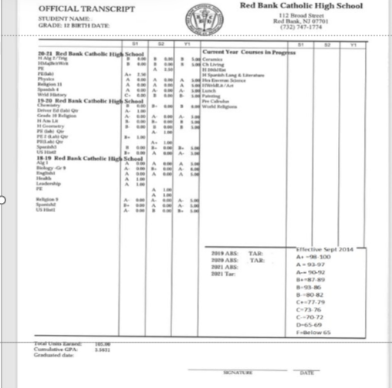

Slide 6
PSAT
Students should create a College Board Account at Collegeboard.org using their personal email address(not parent emails). By creating an account, students can access scores, sign up for future tests, and practice for upcoming digital tests.
Your Score Explained
There are 2 options for accessing your scores:
Ask your school or counselor for your PSAT/NMSQT score report.
Access the Big Future School mobile app if you provided your mobile number on the test day.
As always, students age 13 and older may use a personal College Board student account to view additional insights online.
Score Summary
On your score report PDF, you can view the four scores available from your PSAT/NMSQT assessment--total score, Reading and Writing section score, Math section score, and NMSC Selection Index score

Slide 7
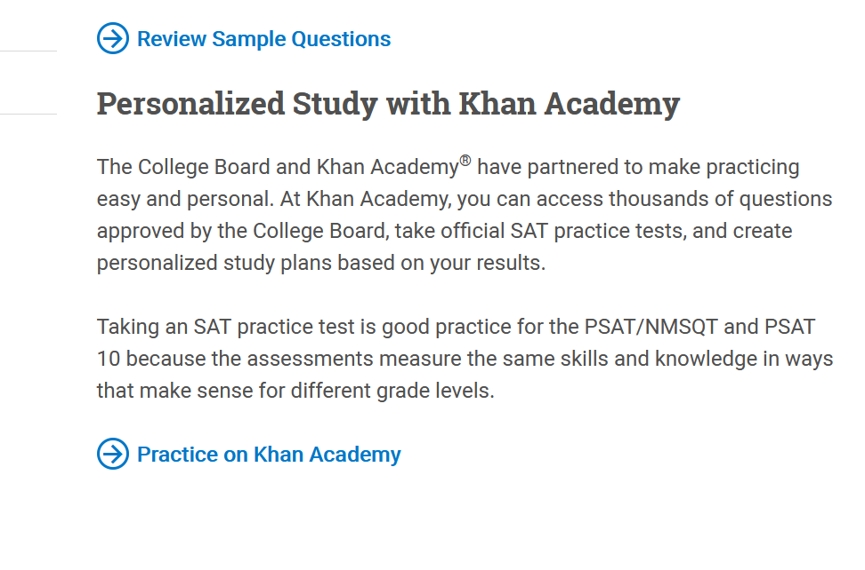

Slide 8
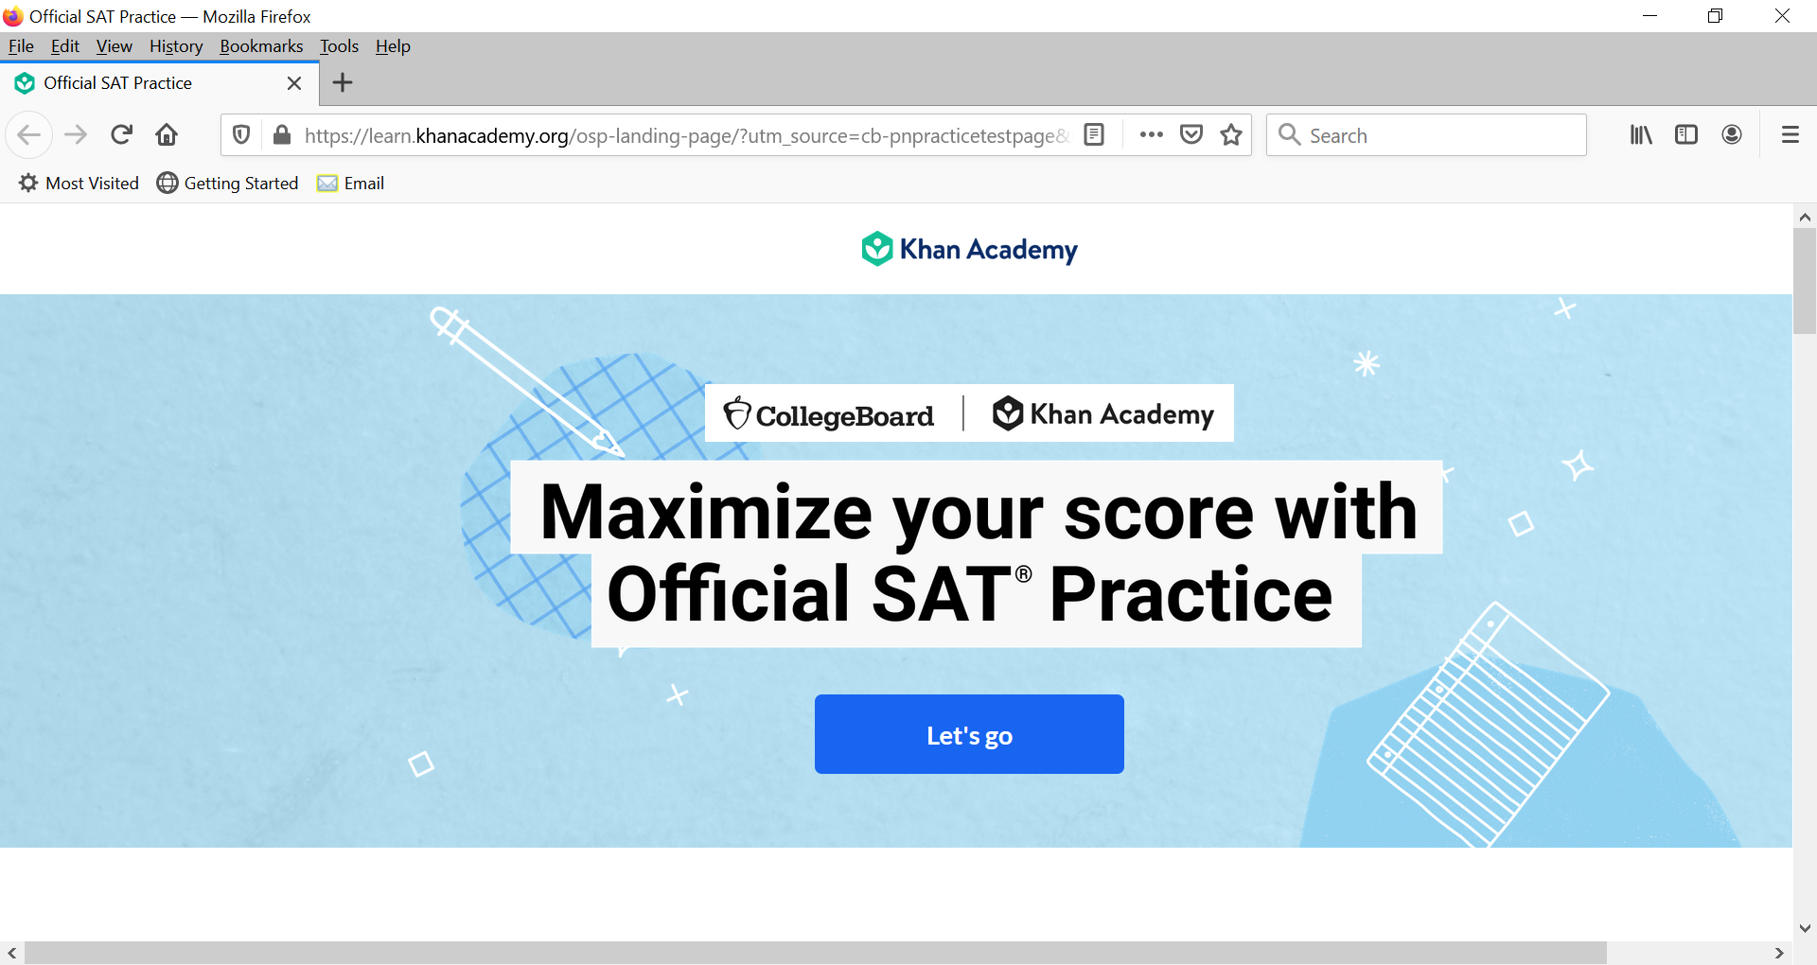

Slide 9
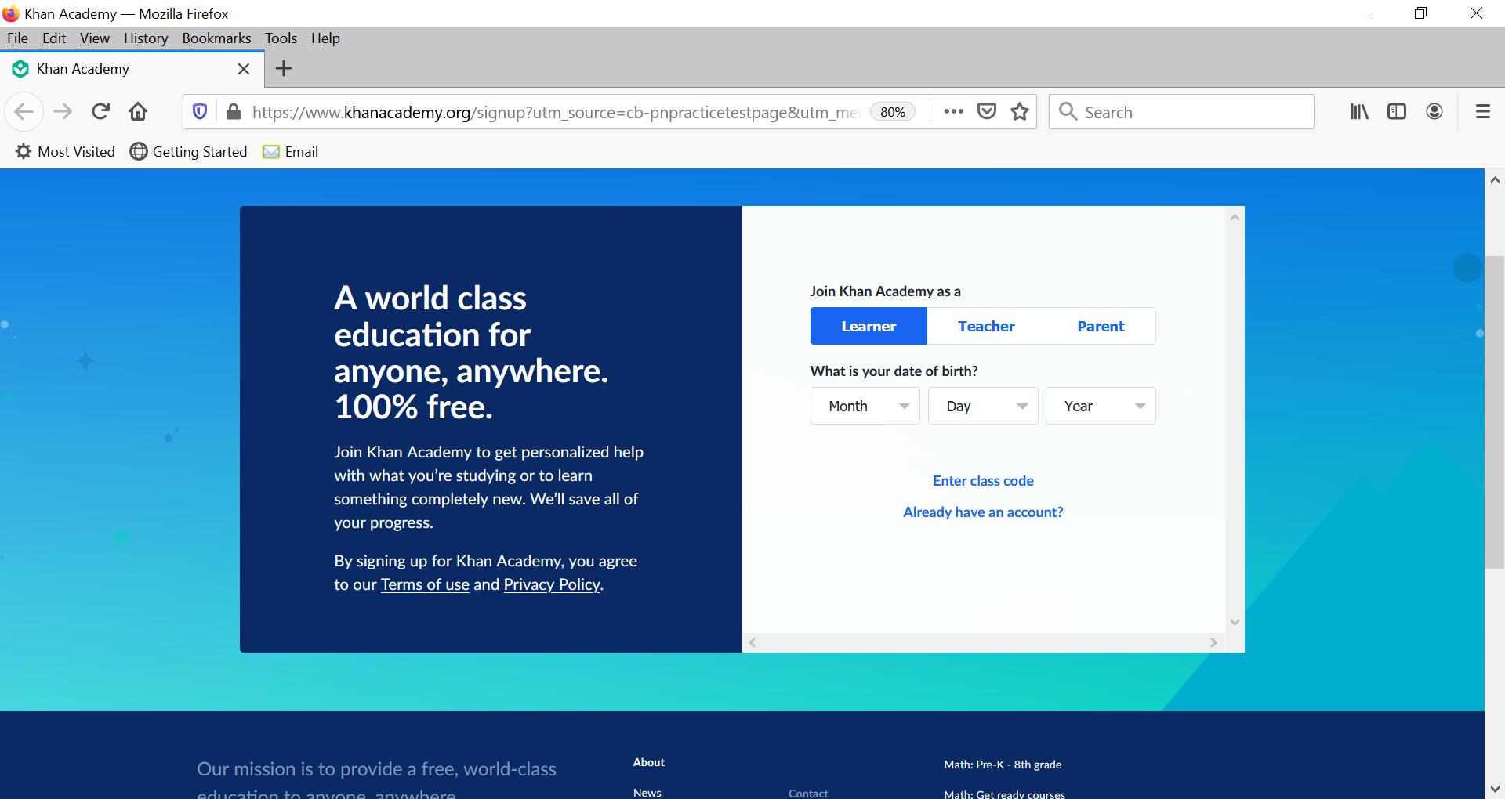

Slide 10
Selectivity of Admission
REACH- To be admitted at this school may be possible, but it is not a definite occurrence.
TARGET- The majority of previously admitted freshmen had scores, grades, and other activities slightly better or equal to your own.
QUALITY SAFETY- Admission at this college is highly likely and probable due to the strength of your application.

Slide 11
Early Decision
Early decision plans allow you to apply early (usually in November) and get an admissions decision from the college well in advance of the usual notification date. Some colleges also offer Early Decision II, but there is a catch. Early decision plans are BINDING meaning if you apply as an early decision candidate, you agree to attend the college if you are accepted.
Although you can apply to only one college for early decision, you may apply to other colleges through the regular admissions process. If you're accepted by your first-choice early decision college, you must withdraw all other applications. Usually, colleges insist on a nonrefundable deposit well before May 1.
Early decision sometimes prevents you from knowing your financial aid package ahead of time.
RESTRICTED EARLY ACTION- cannot apply Early Decision to another school.
(www.collegeboard.com)

Slide 12
Early Action
Early action applications allow you to learn early in the admission cycle (usually in January or February) whether a college has accepted you. But unlike early decision, most early action plans are not binding, meaning you do not have to commit to a college to which you've applied for early action. Under these plans, you may apply to other colleges. Usually, you can let the college know of your decision in the late spring or whenever you've decided.
(www.collegeboard.com)

Slide 13
Regular and Rolling Admission
Regular Decision: While the application submission deadlines will vary between institutions, Regular Decision deadlines typically fall in early January, and offers of admission are sent out in late March or early April. These students will have until May 1 to either accept or decline their offers, and each student is only permitted to submit a matriculation fee (or fee waiver) to one of the institutions to which they have been admitted.
Rolling Admission colleges and universities evaluate applications as they arrive, and decisions are mailed shortly thereafter usually within two months. Places are filled on a first-come, first-served basis. Thus, when considering Rolling Admission schools, it usually makes sense to apply as soon as possible. We say “usually” because, if your junior grades were weaker than your norm or if you’re hoping to improve SAT or ACT scores, then it can be wise to postpone your application until you have stronger qualities to show the colleges.

Slide 14
Researching Post-Secondary Programs
NAVIANCE-FAMILY CONNECTION
Research College Websites
College Virtual Tours
Objective Guides
Rugg’s College Handbook
The College Board Handbook
Barron’s Profiles of American Colleges
Subjective Guides
  Fiske Guide to Colleges
  The Insider’s Guide to Colleges
  U.S News Best Colleges
Institutional Materials
College Fair at Brookdale Community College/ Monmouth University
College Fair in Ocean County

Slide 15
Researching Colleges Cont.
What Makes a Good College?
1. Fact Finding
2. Reflection
3. Assessment
4. Action
What are the important factors about this college?
What majors and programs?
What are your impressions?
Could this be a good match for me?
What are the next steps?

Slide 16
Visiting Colleges
Book Early
Virtual Tours
Virtual Student/Professional Panels
Interviews
Attend In person Rep Visits at RBC
College Rep Visits Outside of School

Slide 17
Web Sites
COLLEGE WEB SITES
Cappex www.cappex.com
Peterson’s Online www.petersons.com
Common Application www.commonapp.org
College Board www.collegeboard.com
ACT www.act.org
SAT/ACT Optional Schools www.fairtest.org
FINANCIAL AID WEB SITES
Financial Aid Information Page www.finaid.com
Fast Web www.fastweb.com
U.S. Dept. of Education nces.ed.gov/ipeds/cool
NJ Dept. of Higher Ed www.nj.gov
NCAA Clearinghouse www.ncaaclearinghouse.net/
FAFSA www.fafsa.ed.gov
CSS Profile https://profileonline.collegeboard.com/prf/index.jsp

Slide 18
What college is right for me?
Where? How big? What will I major in? Will I be admitted?

Slide 19
Admissions Counselors Consider
Student Record/Transcript
Strength of Schedule
Scores (SAT/ACT/Optional)
Activities Resume
Essays
Recommendations
  Submit your Parent Brag sheet and Recommendation Questionnaire to your counselor by Spring of Junior Year
  Ask your teacher if he or she is willing to write your Letter of Recommendation by May of Junior Year.
  Interview (recommended)
  RBC offers a 1 week Summer Common Application/ Essay class. More details will be sent in the spring.
  **We will now hold a senior parent/ student Guidance meeting in June since so many applications open earlier now.**

Slide 20
Student Should Consider
Location (Urban, Suburban, Rural)
Distance
Academic Rigor
Size
Extra-curricular (i.e. athletics)
Field of Study/Major
Financial Aid

Slide 21
Understanding College
Course Requirements
Be sure to look at RBC’s Curriculum Guide to get an idea of what classes you would like to take next year
Some colleges require a fourth year of science
Specific majors may require a certain level of math

Slide 22
What is the best match for you?
“College is not a prize to be won, but a match to be made.”
Let’s get started…..

Slide 23
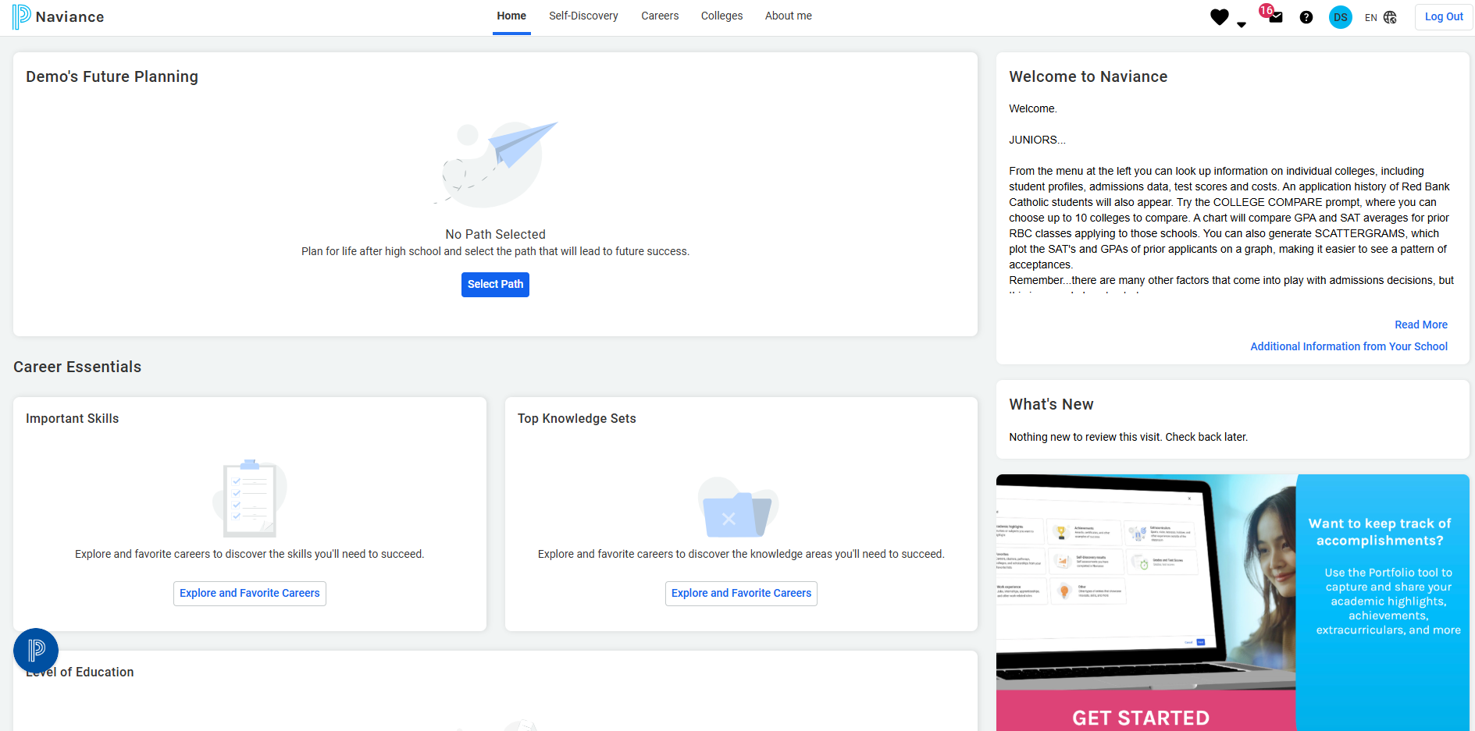
NAVIANCE
Naviance can help students find valuable information about colleges and careers.

Slide 24
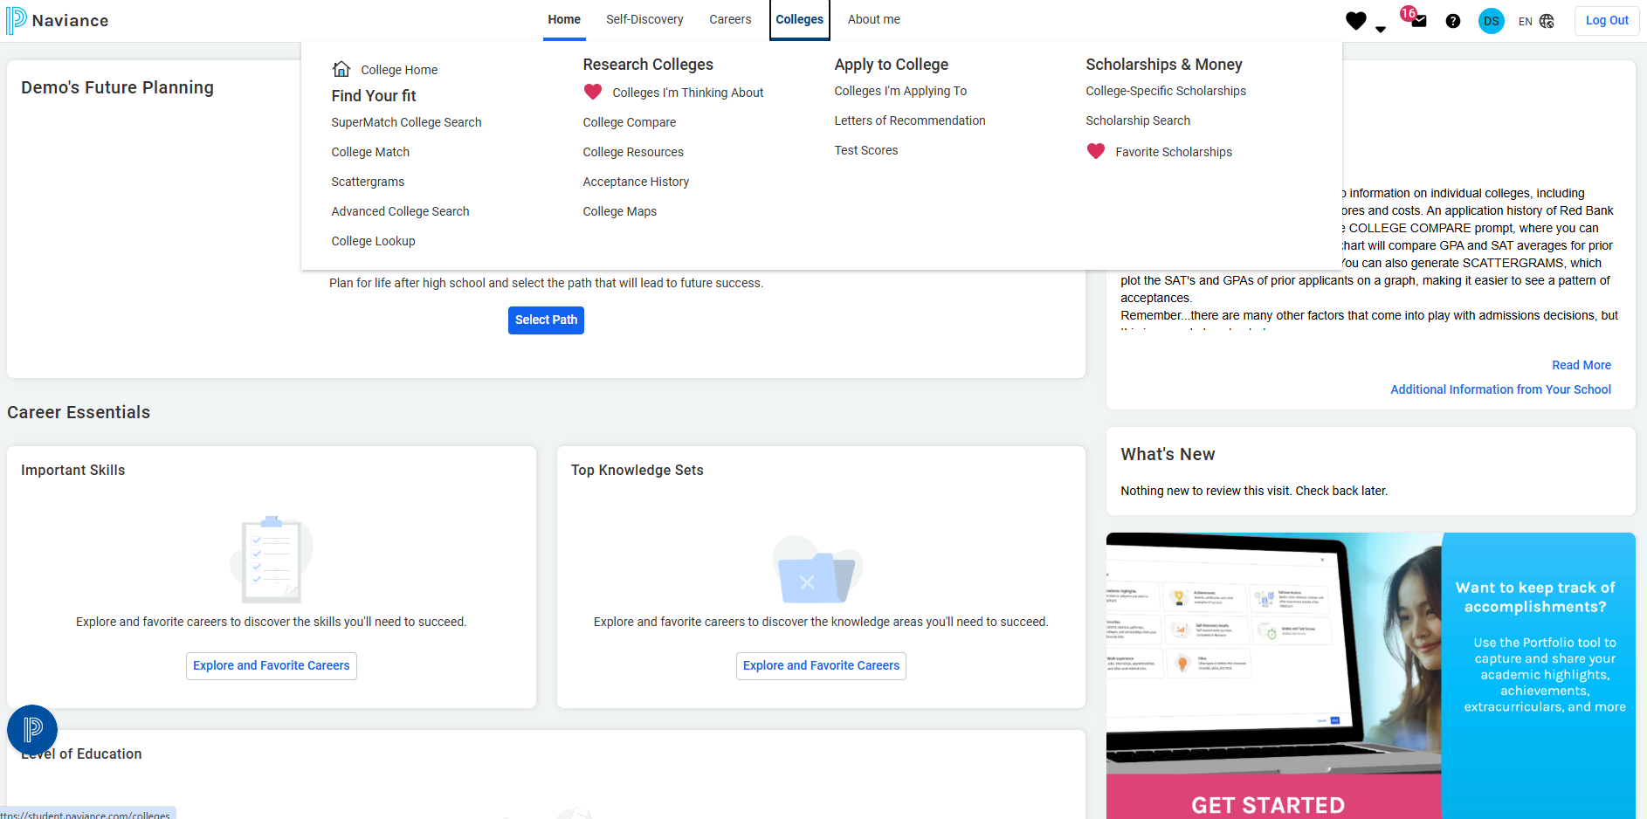
Student Connection

Slide 25
The College Tab
Advanced College Search: This feature will help you find colleges that match your preferences, size, location, campus climate, athletics and more.
Scattergrams: This feature will create a graph to show the GPA and SAT combination of applicants to a college from Red Bank Catholic.
Colleges I’m Thinking About: This tool will allow you to make a working list of schools that interests you. It can be modified at any time.

Slide 26
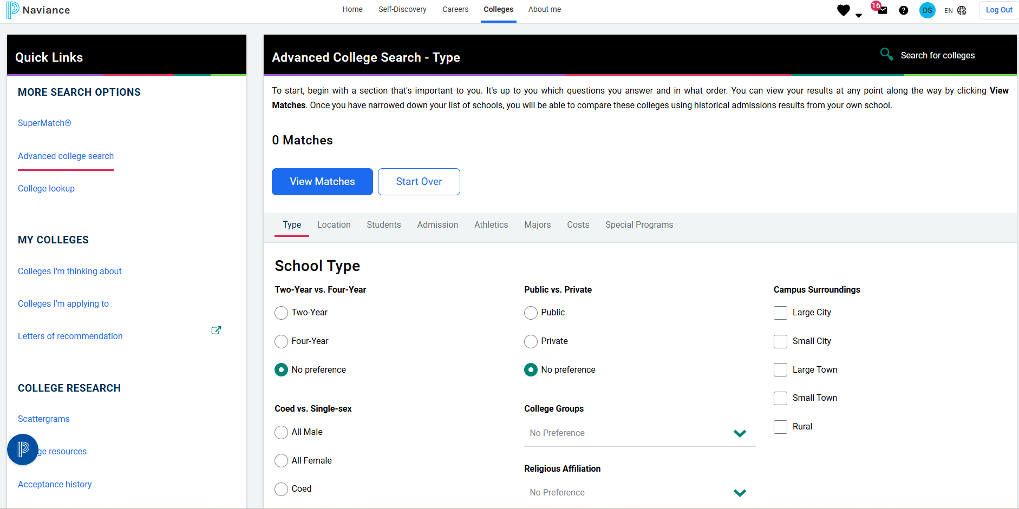
Advanced College Search & Scattergrams

Slide 27
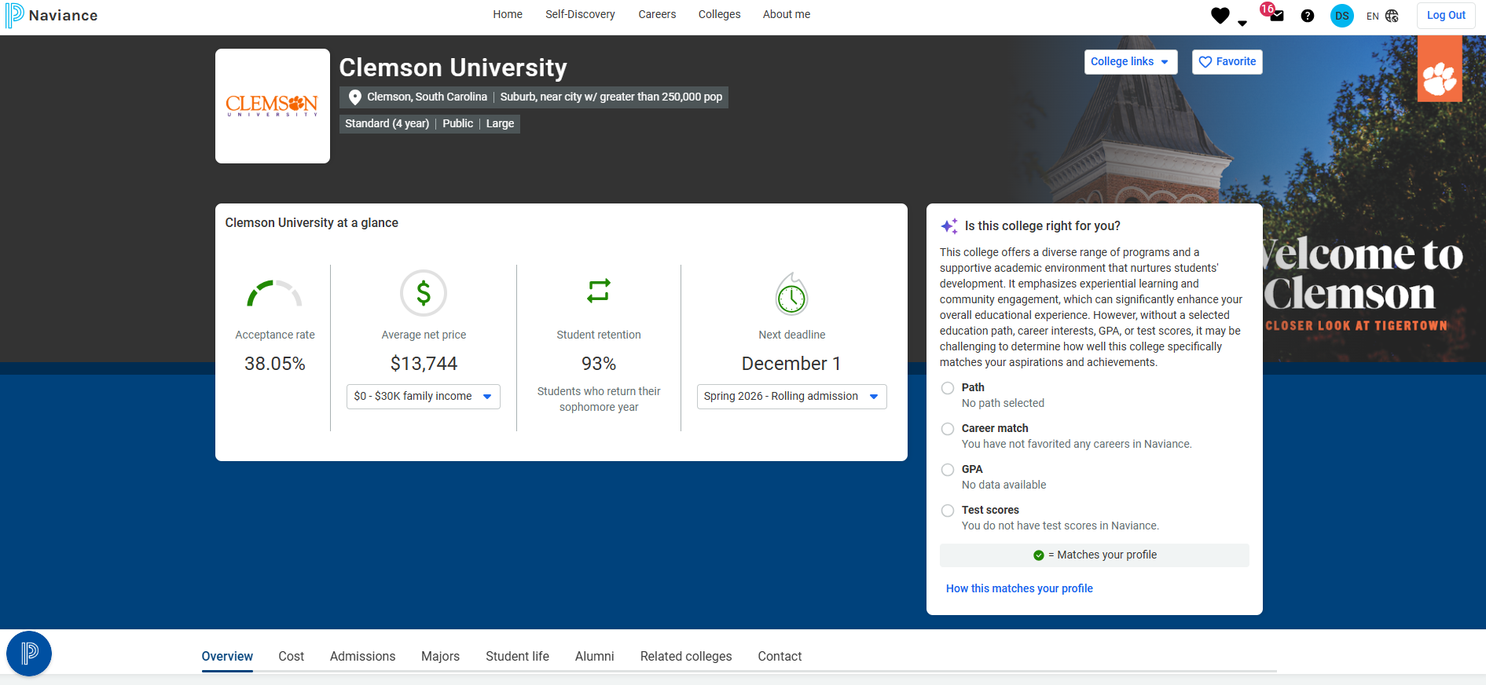
Scattergrams

Slide 28
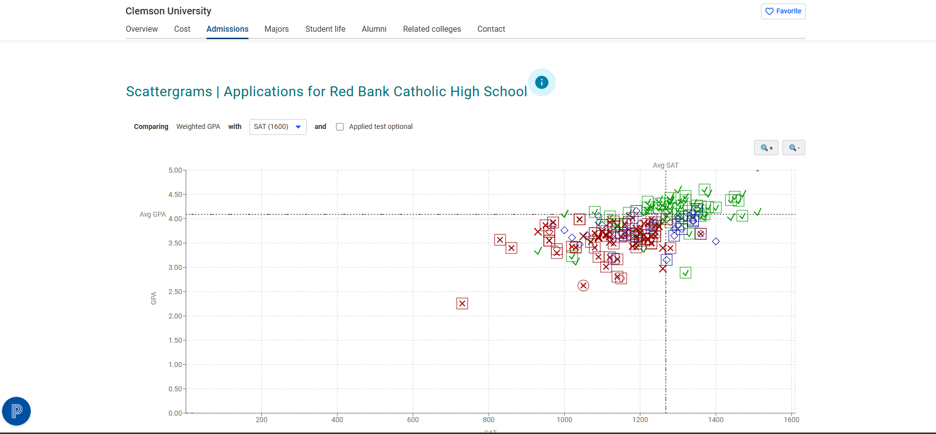
Scattergrams

Slide 29


Slide 30
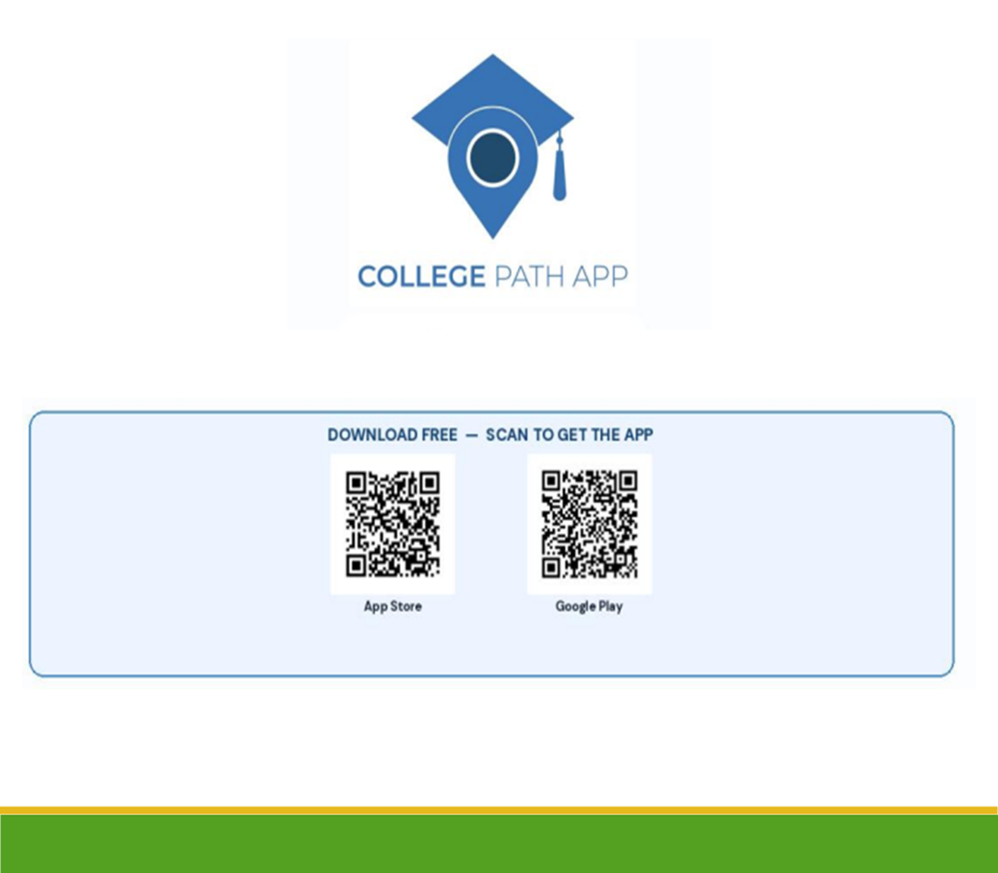

Slide 31
SAT
In the past we have recommended taking your first SAT in March of Junior Year. Due to fewer test centers being open – register early. The test should not be taken more than 3 times. Some colleges will let you use the “Score Choice Option”
Check to see if colleges have gone Test Optional.
www.collegeboard.com/students
SAT Tutorials are free through the College Board website.
Several Apps available on Iphone such as KHAN Academy.

Slide 32
ACT
The ACT is a college entrance test option. It is a diagnostic test that tests you on high school content (material you are learning in your classes)
There is an ACT on February 27th that you should take – register by Jan 22nd at www.act.org
There are 5 sections to the exam: English, Math, Reading, Science and Writing
  The science section measures the skills required in the natural sciences: interpretation, analysis, evaluation, reasoning, and problem solving.
The score ranges from 1-36 COMPOSITE SCORE. Competitive colleges look for a 28 composite score or above.
ACT tutorials are available online at www.actstudent.org
  There is also a free practice test in the ACT booklet (available in the guidance office).

Slide 33
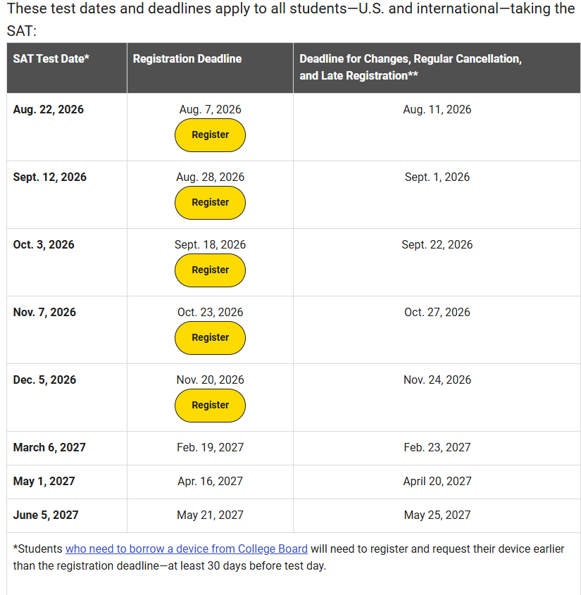
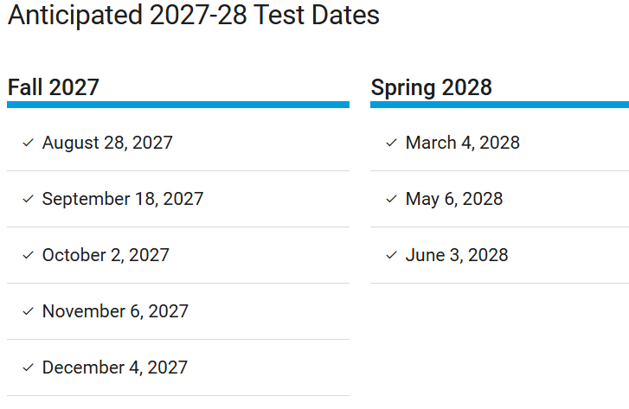
SAT
www.CollegeBoard.org
Junior Year
Senior Year
Junior SAT School Day
March 5, 2027
Registration Deadline
February 16, 2027
Senior SAT School Day
TBD

Slide 34
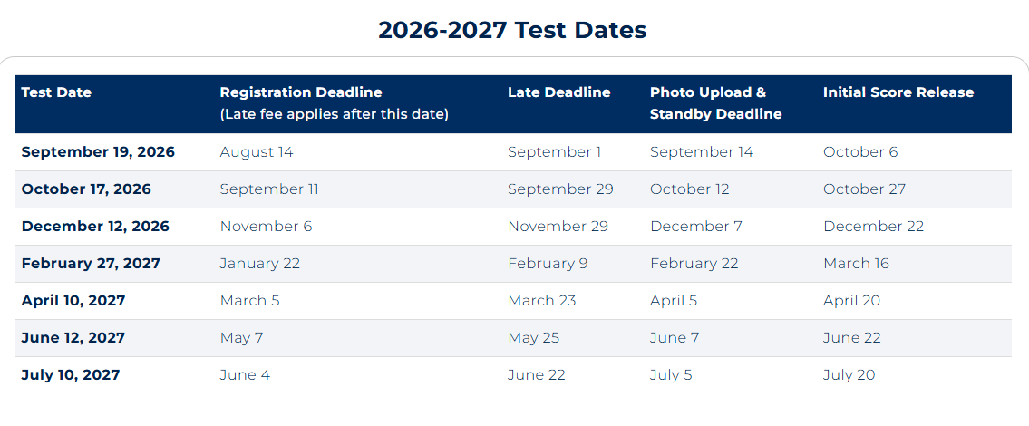
ACT www.actstudent.org

Slide 35
Dual Enrollment Classes
Dual enrollment classes that offer college credit.
Courses offered through Seton Hall University, Stockton University, Rowan University and University of Delaware

Slide 36
Dual Enrollment Courses
Seton Hall University
Stockton University
AP Chemistry
AP Physics including Labs 1&2
AP World History
AP Government & Politics US
AP English ( English Lit. & Comp.)
Honors Economics ( Micro/Macro)
World Religion
Honors Globalization/ Justice
Honors 20th Century
Honors World Literature
Honors French III
Honors French IV
Honors Spanish III
Honors Spanish IV
University of Delaware
Intro to Business
Rowan University
Honors Intro to Engineering

Slide 37
Pathways and Concentrations
Criminal Justice and Law
Health and Medical Science
Business and Entrepreneurship
The Fine Arts
Engineering and Design
Social Science & Humanities
Performing Arts
Environmental Science

Slide 38
Pathways and Concentrations
What is Required:
  Complete a minimum of four (4) courses within the focus area
  Pathways will also include a required course/ experience, such as a final project, Capstone or Internship, where the student exhibits quality and depth of knowledge in the selected Pathway
  Students should notify their Guidance Counselor if they are interested in pursuing a Pathway

Slide 39
Capstone Program
The RBC Capstone Program gives qualified, motivated students the opportunity to pursue college level work beyond the typical AP experience. This extracurricular program is designed to prepare students for the university classroom by exposing them to the rigor, pace, methodology, research tools, and hands-on experience typically found in a higher educational setting. The traditional teacher/student relationship is modified, whereby teachers become mentors and facilitators, passing along their experience and knowledge to student protégés.
Students will present their capstone project with recognition by Principal.
PLEASE REFER TO RBC Website
Teachers who have worked with students in the Capstone Program:
Ms. Beth Boylan
Mr. Gary Gleitz
Mr. Brian Nesci

Slide 40
THE COLLEGE SEARCH PROCESS
STUDENTS CONSIDER
Location/Distance
Size
Extra-curricular (i.e. athletics)
Field of Study/Major
COLLEGES CONSIDER
Student Record/Transcript
Strength of Schedule
Scores (SAT/ACT/Optional?)
VISIT COLLEGES!
TIMELINE
December ‘22
Junior Lessons (3)
January ‘23
Junior College Planning Night
February
SCHOOL
COUNSELOR
NAVIANCE
Junior Meetings
March
VISIT COLLEGES
April
May
NAVIANCE
June
SAT/ACT
PROSPECT LIST (10-30 SCHOOLS)
July
August
VISIT COLLEGES
September
October
November
December
FINAL LIST (6-12 SCHOOLS)
NAVIANCE
APPLY
http://connection.naviance.com

Slide 41
The College Interview
The informative conversation.
If it is recommended, consider it required.

Slide 42
Be Prepared
Dress neatly.
Take the interview seriously.
Get to know the college. Use Naviance to visit websites, college review books, catalogs, etc.
Be prepared to talk about yourself and to ask questions about the school.
Practice interviewing…with anyone.

Slide 43
College Interview
Make a positive first impression. Give firm handshakes, make eye contact and introduce yourself clearly.
Elaborate…give more details than your application can display.
Be proud of your accomplishments.
Do not be afraid to discuss a weakness.
Pay attention to the questions.
Come with prepared questions specific to college.

Slide 44
Sample Questions To Ask:
What is the strongest program on campus?
What is the most popular department/course on campus?
How many classes are taught by graduate assistants?
Given my proposed major, will I be able to study abroad?
How accessible are faculty?
What is the most important aspect of a student’s application?
What improvements are being made on campus?
What is the size of the freshman class?

Slide 45
Sample Questions To Answer:
Which of your activities has given you the most satisfaction?
Tell me about Red Bank Catholic High School.
Have you considered a major?
Is there a weakness in your application?
What is something about you, that colleges would not find on your application?
If your friend was asked to describe you, what would he/she say?

Slide 46
Be Appreciative
At the end, thank the interviewer for his/her time and ask for a business card.
Remember the interviewer’s name.
Make some notes for yourself.
Send a thank you e-mail.

Slide 47
Our Final Recommendations:
Please don’t choose your top choice school for your 1st interview.
If unable to interview, meet with the college representatives when they visit Red Bank Catholic during your senior year.
Prepare for each college meeting as if it was a formal interview.

Slide 48
College visit
Tour first.
Attend information session/ visit virtually
Go while school is in session.
Visit Career Services Center.
Eat in cafeteria if possible.
See a freshman dorm.
Visit the infirmary.
See the music/athletic facilities if possible.
Look for anything else that will be important to you.
Send e-mail to thank the school for information and tour

Slide 49
Financial Aid/Scholarships
Financial Aid Meeting will be a via zoom in September 2026.
FAFSA – Application opens up October 1, 2026 Early completion is preferable-if you are applying for any loans, FAFSA has to be completed.
College Scholarship Service – CSS profile. Some schools use this service. Usually due sometime in November 2026.

Slide 50
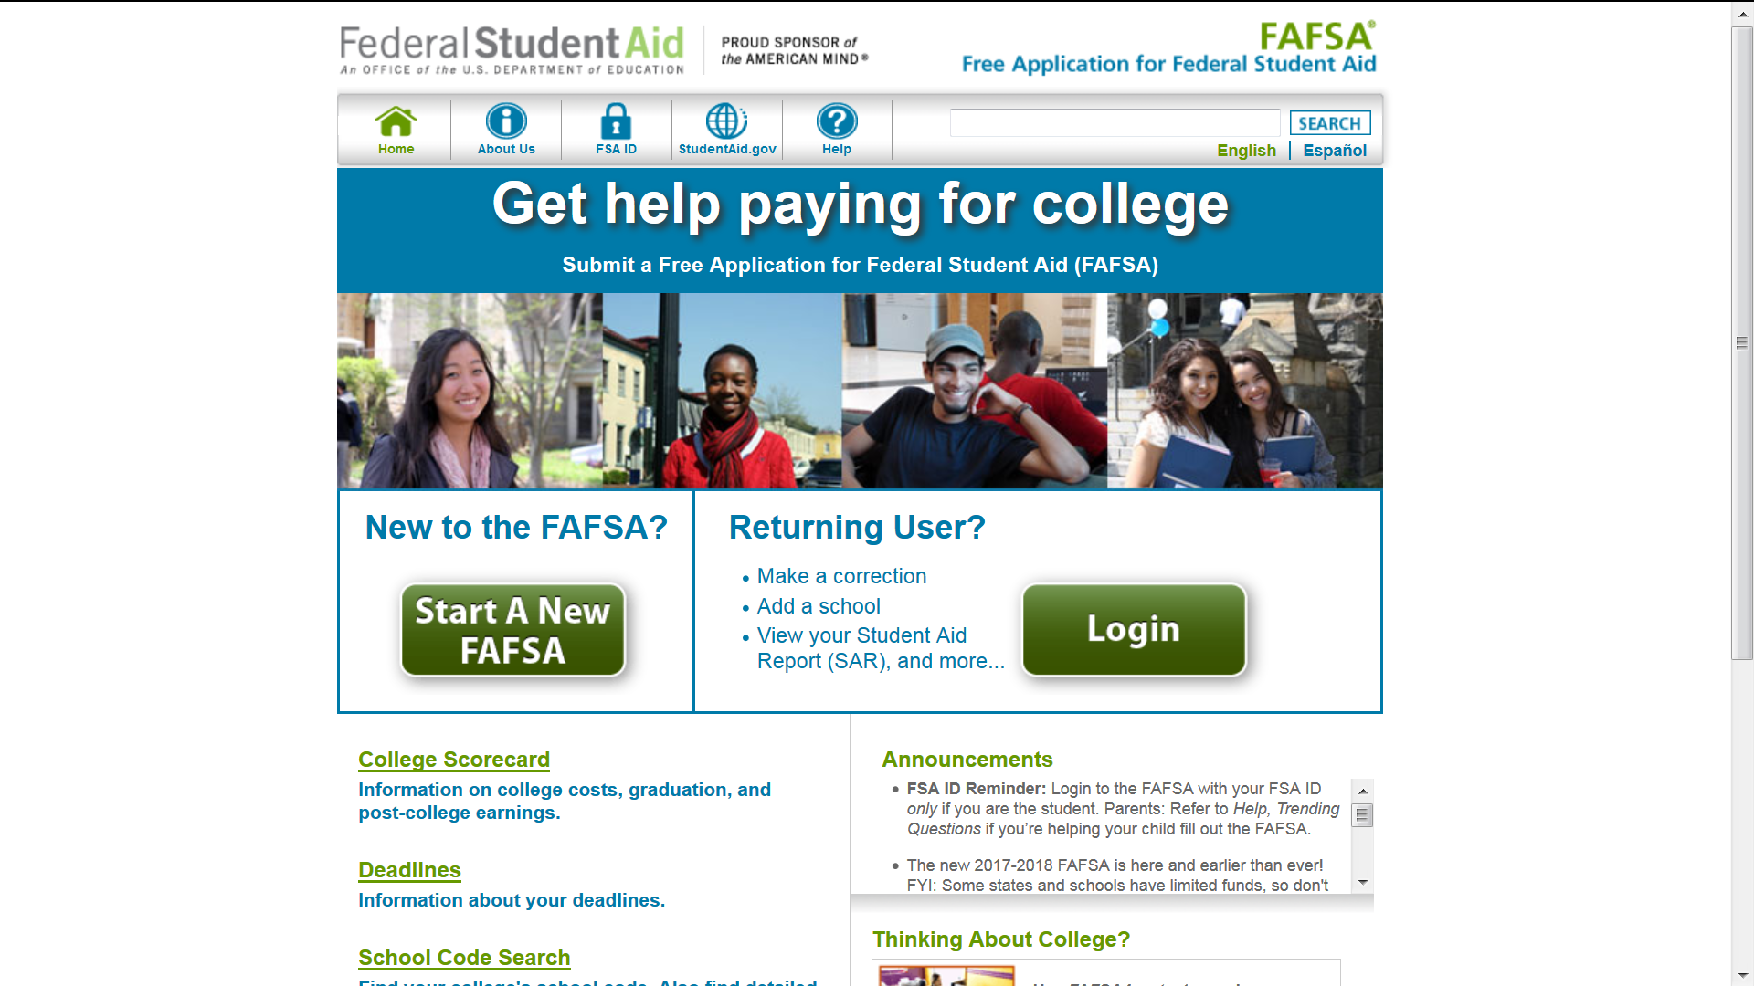

Slide 51
Scholarships
Look at College web-sites
Use Naviance for scholarships list.
CSS Profile-some colleges require that you subscribe this service.
Scholarships are also listed on Naviance.

Slide 52
Athletic Scholarships
http://www.ncaa.org/student-athletes/future/want-play-college-sports

Slide 53
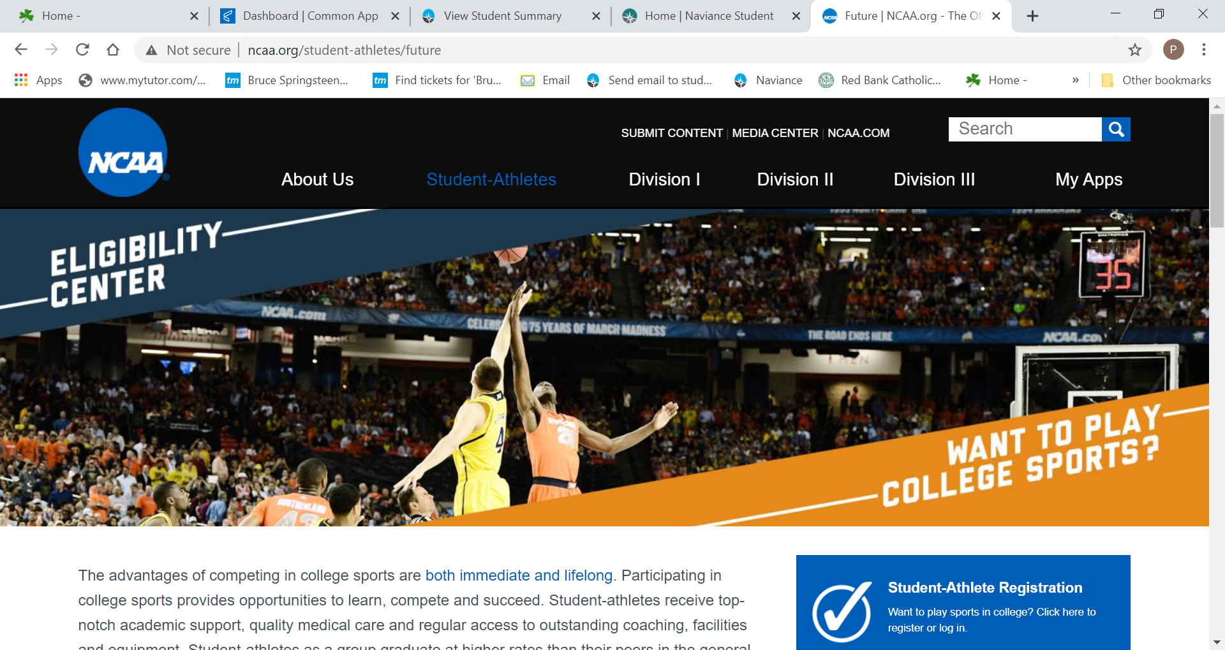

Slide 54
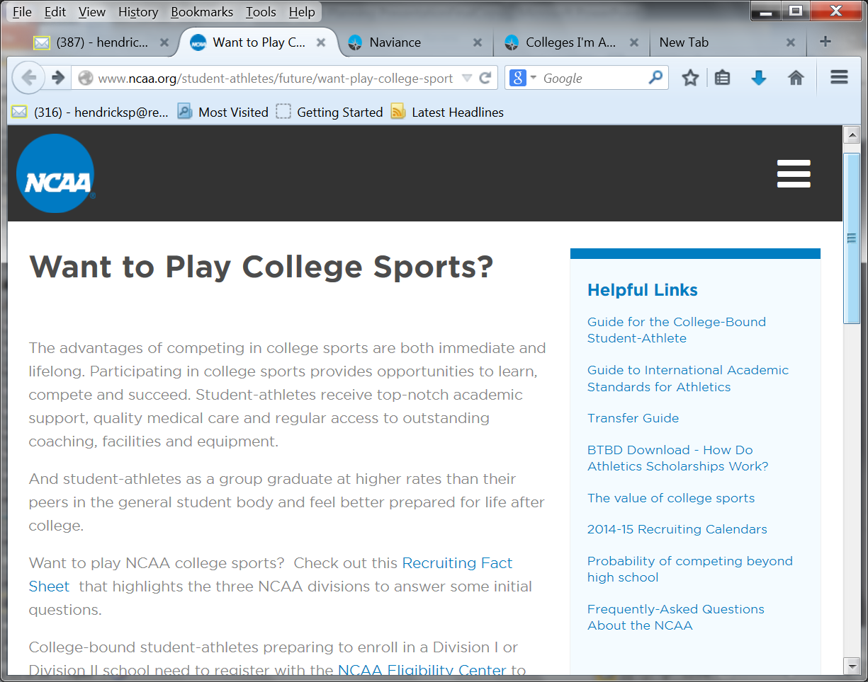
NCAA

Slide 55
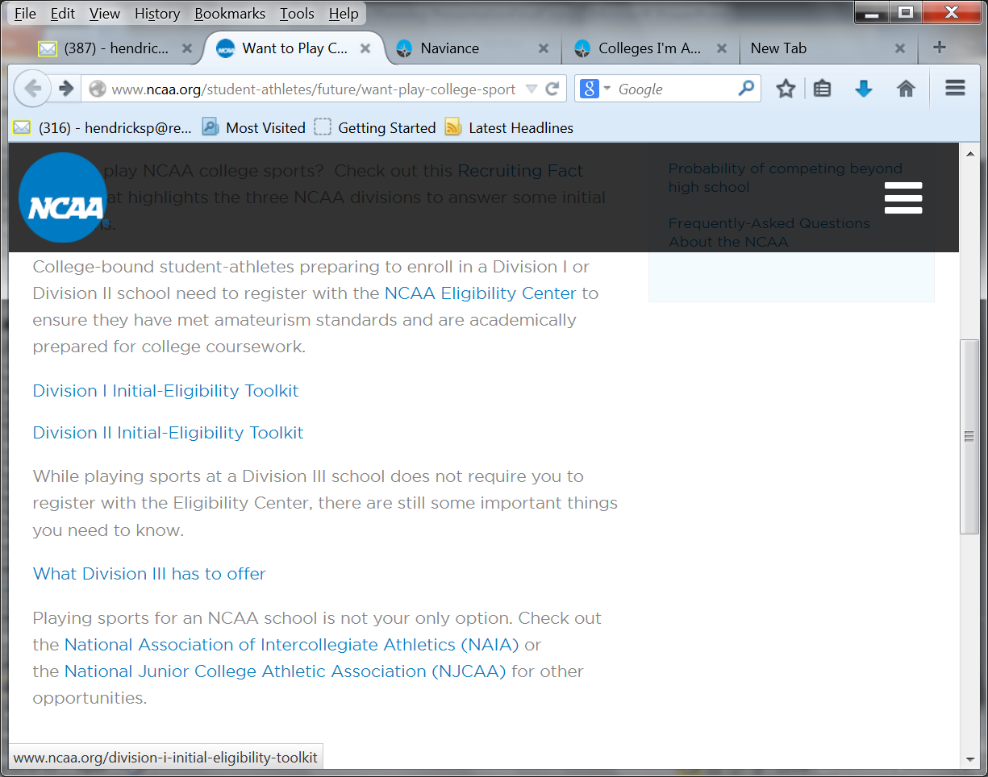
NCAA

Slide 56
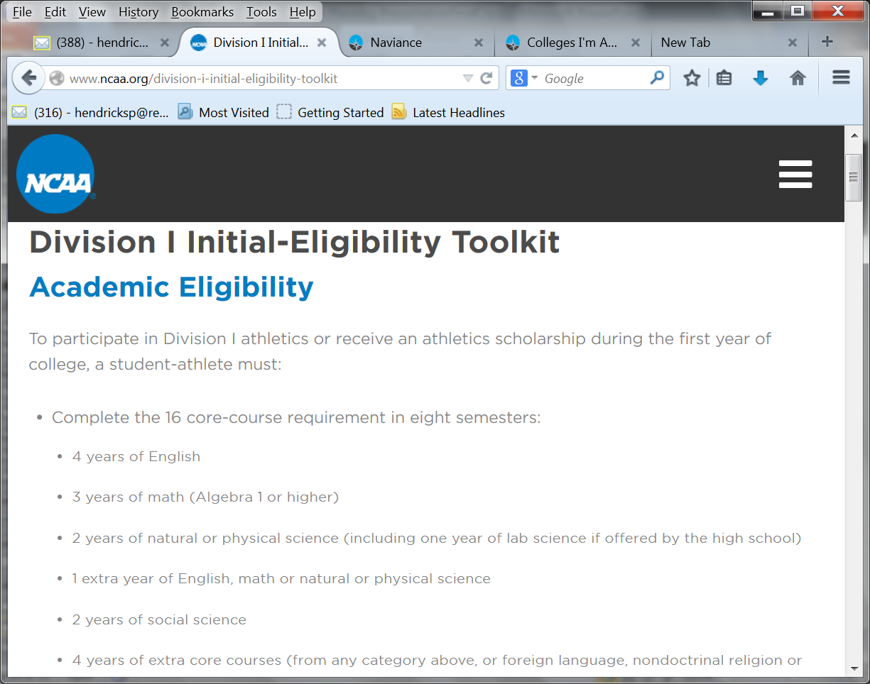

Slide 57
Student Athletes
GPA is important
NCAA Clearinghouse
Colleges do have academic standards-grades are important
NO SLIDING SCALE for 2026/2027

Slide 58
The Common Application
* Rolls over August 1st *
The Common Application is used for undergraduate admissions by more than 700 colleges and universities. Only schools that evaluate applications holistically are allowed to use the common application; that is, the admissions staff must take into consideration things like letters of recommendation and the application essay. The Common Application covers several areas: personal data, educational data, standardized test information, family information, academic honors, extracurricular activities, work experience, a personal essay, and criminal history. Financial aid information needs to be handled on the FAFSA.

Slide 59
SRAR
The Self-Reported Academic Record lists all the classes and associated grades that have been taken or will be taken for high school.
Students will be given a transcript in September in order to accurately input their grades.
Not all schools require the SRAR.

Slide 60
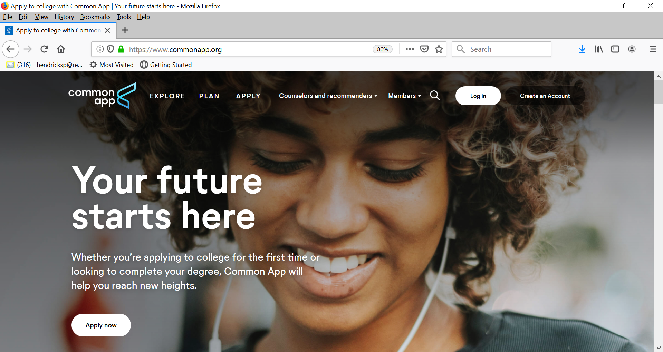

Slide 61
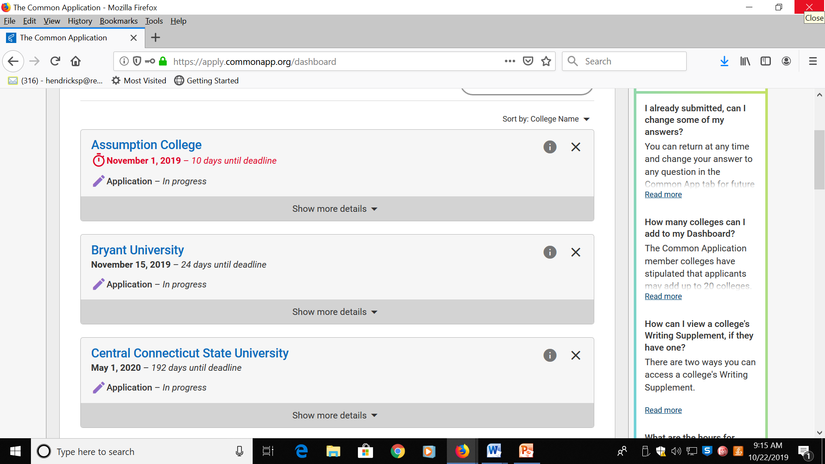

Slide 62
Common App Essay Prompts
1. Some students have a background, identity, interest, or talent that is so meaningful they believe their application would be incomplete without it. If this sounds like you, then please share your story.
2. The lessons we take from obstacles we encounter can be fundamental to later success. Recount a time when you faced a challenge, setback, or failure. How did it affect you, and what did you learn from the experience?
3. Reflect on a time when you questioned or challenged a belief or idea. What prompted your thinking? What was the outcome?
4. Describe a problem you've solved or a problem you'd like to solve. It can be an intellectual challenge, a research query, an ethical dilemma - anything that is of personal importance, no matter the scale. Explain its significance to you and what steps you took or could be taken to identify a solution.
5. Discuss an accomplishment, event, or realization that sparked a period of personal growth and a new understanding of yourself or others.
6. Describe a topic, idea, or concept you find so engaging that it makes you lose all track of time. Why does it captivate you? What or who do you turn to when you want to learn more?
7. Share an essay on any topic of your choice. It can be one you've already written, one that responds to a different prompt, or one of your own design.

Slide 63
Remember…You’re the Consumer
For Students:
Food
Weekends
Popular activities
Largest class
Scheduling
Advisors
Where else did you apply
Getting home
Keep graded papers with teacher comments from Junior Year
For Info session:
Infirmary
Dorm rules
Living off campus
Scheduling
Career center
Advising system
Weekend activities
Classes that close
Cross Application Pool
Need-Blind?
Retention rate

Slide 64
Application Considerations
Senior Courses-Choose wisely-courses will NOT be changed next year…..
Review Curriculum Guide for courses and pre-reqs, as well as new courses.
You are responsible for selecting your courses for next year on POWERSCHOOL.
ACP to Honors
AP Classes (if you qualify)
Strong schedule
Be mindful of courses that you are choosing.
Choose courses that align with your major.
Colleges review our school profile to see what is available to RBC students.
Seniors if they qualify should choose the next level of a class-Honors or AP.

Slide 65
Scholarship Opportunities
RaiseMe College Scholarships | For High School Achievements‎
Search Scholarships | Cappex.com
Scholly – Scholarship Search Tool and College Scholarship Finder App
Your local public school/township websites.

Slide 66
Questions????
????????????????????????????????????????????
????????????????????????????????????????????

