Slide 1
What is Sensory and Fine Motor Skills
Presented by: Bridget Hamilton OT

Slide 2
👂👀🖐️ What Are Sensory Processing Skills?
Sensory processing is how the brain receives, organizes, and responds to information from the senses. These skills help children know how to move, focus, learn, and stay calm during the school day.
Our sensory systems include:
🖐️ Touch – feeling clothing, pencils, textures
🌀 Movement & Balance – sitting upright, moving safely
💪 Body Awareness – knowing where the body is in space
👀 Vision – seeing letters, shapes, and information
👂 Hearing – listening and filtering sounds
👃👅 Taste & Smell – eating and tolerating classroom smells
When sensory processing is working well, children can:
✔ Sit and attend
✔ Follow directions
✔ Write and use school tools
✔ Move safely and confidently
✔ Participate with peers

Slide 3
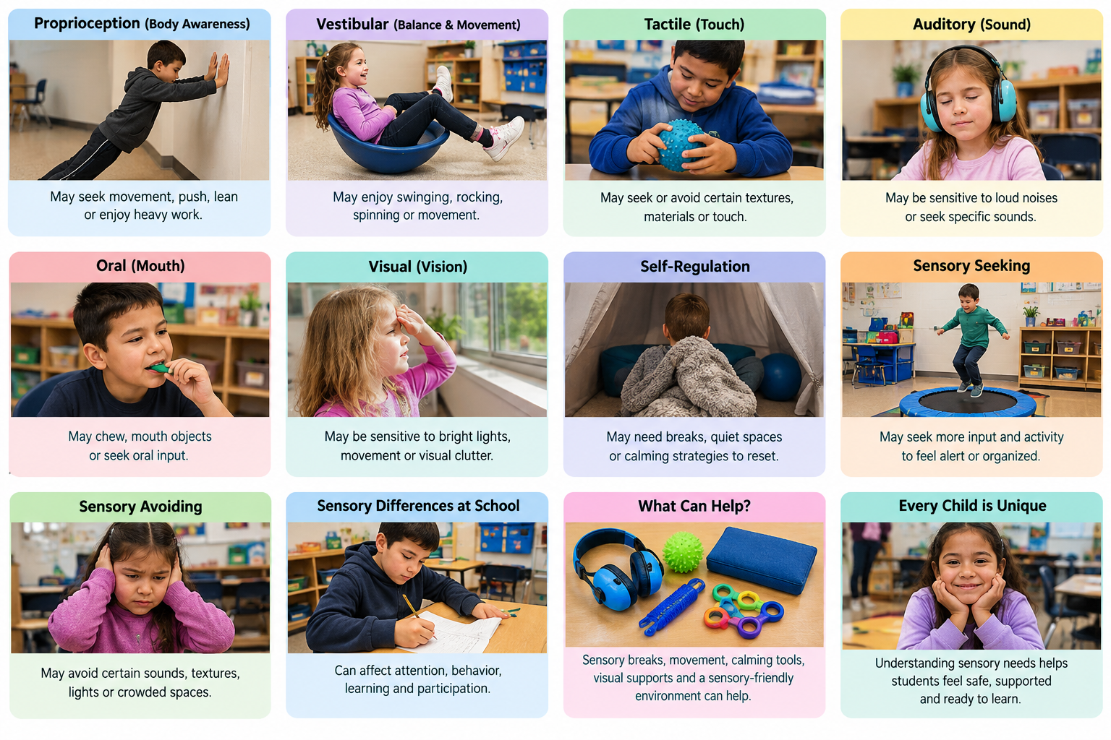

Slide 4
⚠️ What Does It Look Like When a Child Struggles?
Some children process sensory information differently. This may look like:
🔄 Needing constant movement or having trouble sitting still
🔊 Being sensitive to noise or easily distracted
🧍 Appearing clumsy, tired, or unsure of their body
😣 Becoming upset during transitions or changes
✏️ Difficulty focusing on writing or classroom tasks
These behaviors are not intentional—they are the child’s way of trying to feel organized and regulated.

Slide 5




Slide 6
🛠️ How Occupational Therapists Help at School
School-based Occupational Therapists (OTs) help students participate successfully in their school day.
OTs may:
🧩 Teach strategies for self-regulation and attention
🏃 Provide movement or sensory activities
🪑 Recommend classroom supports and tools
📋 Support routines, transitions, and independence
🤝 Work closely with teachers and families
OT services focus on helping children access learning, not changing who they are.

Slide 7
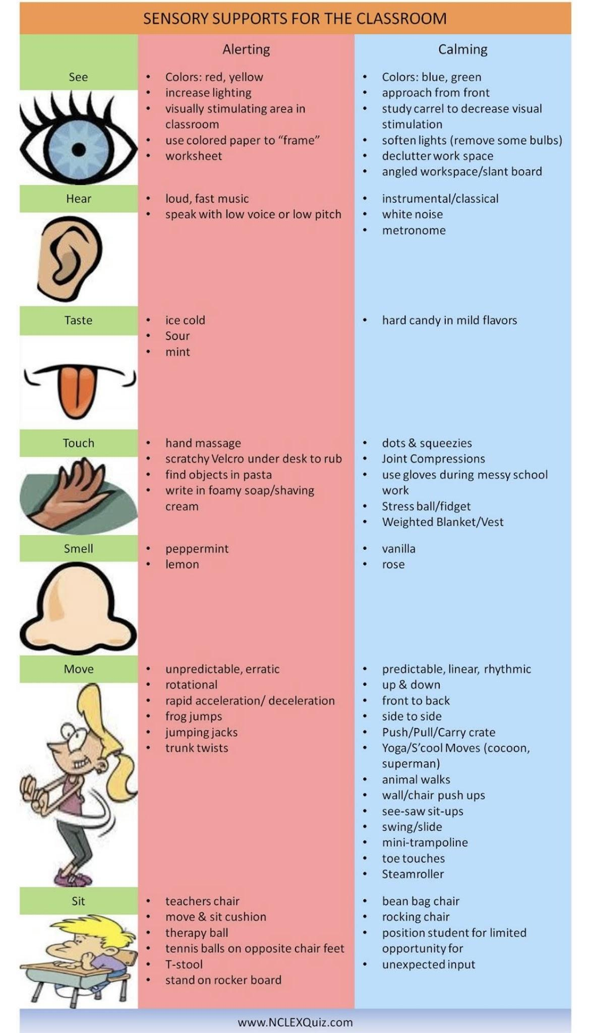

Slide 8
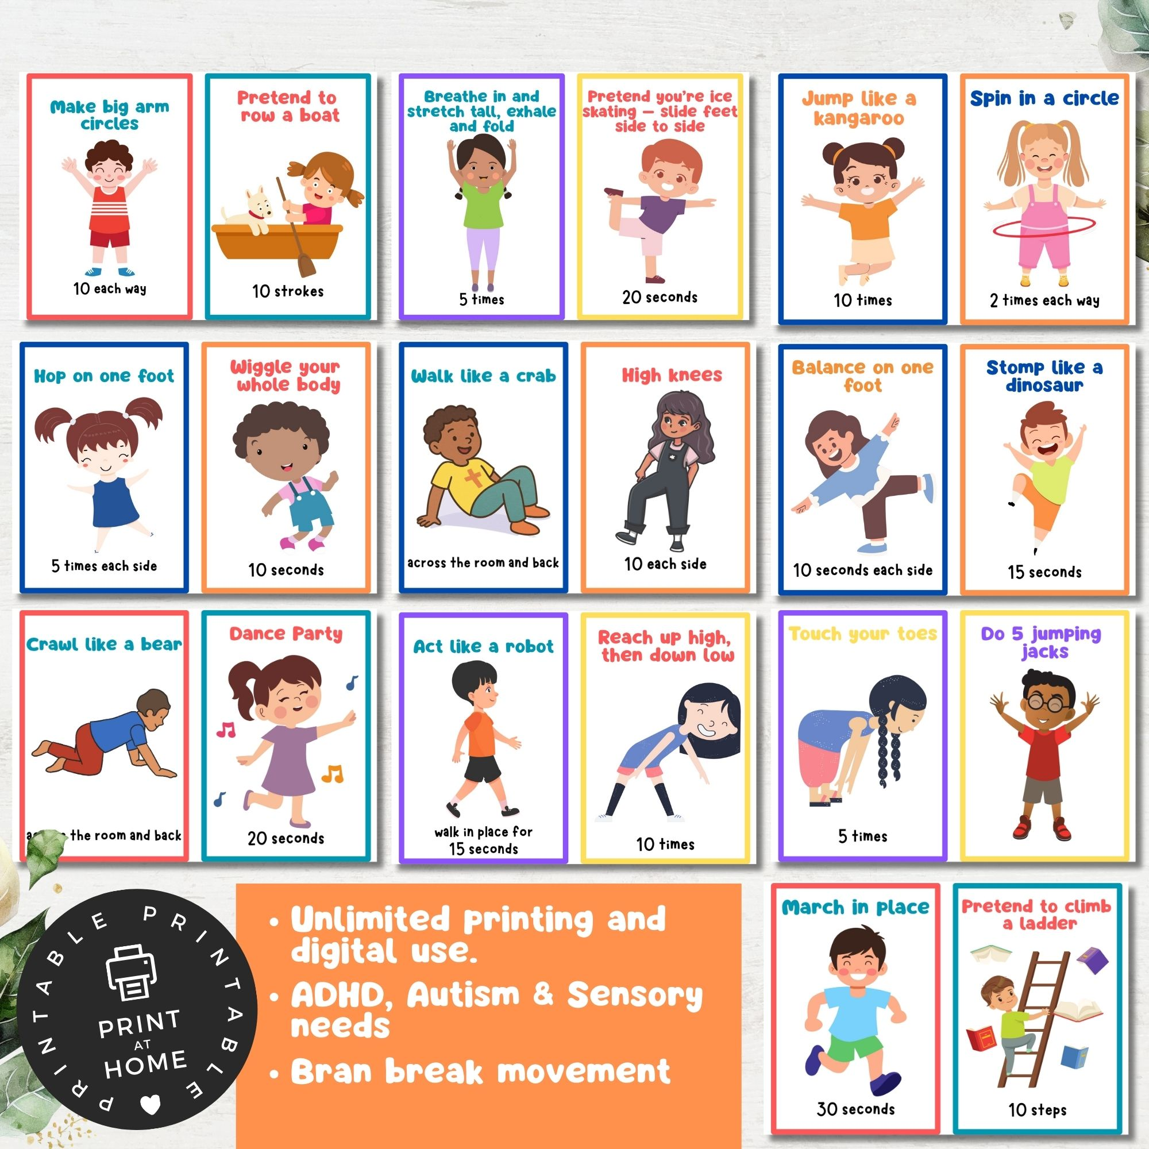
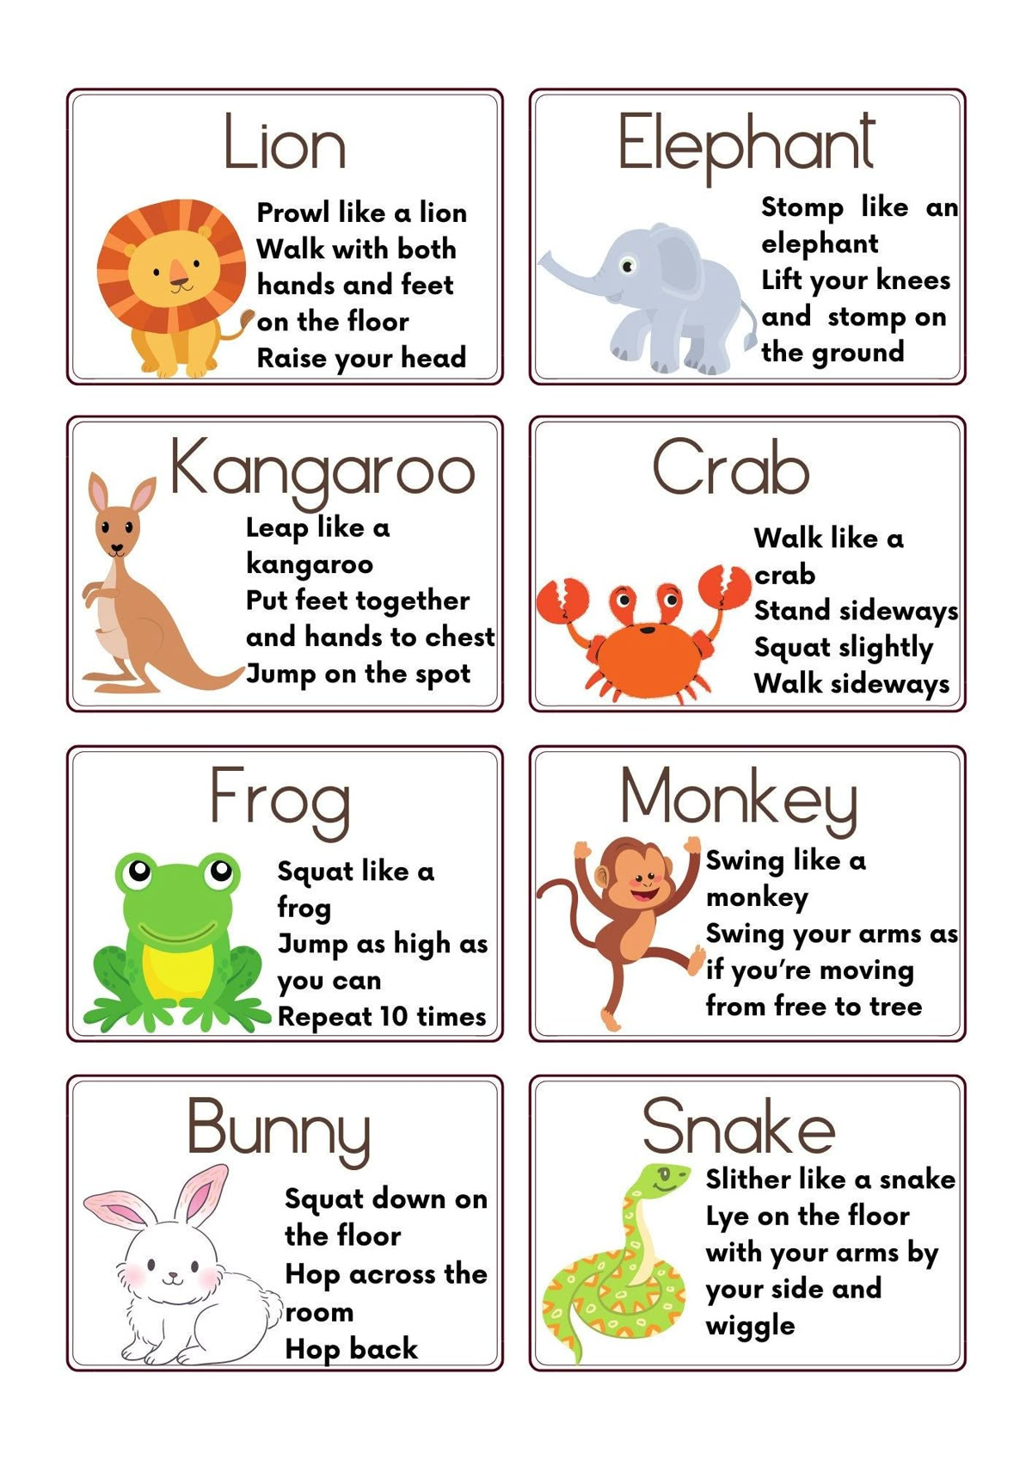
Yoga is good for proprioception and vestibular input

Slide 9
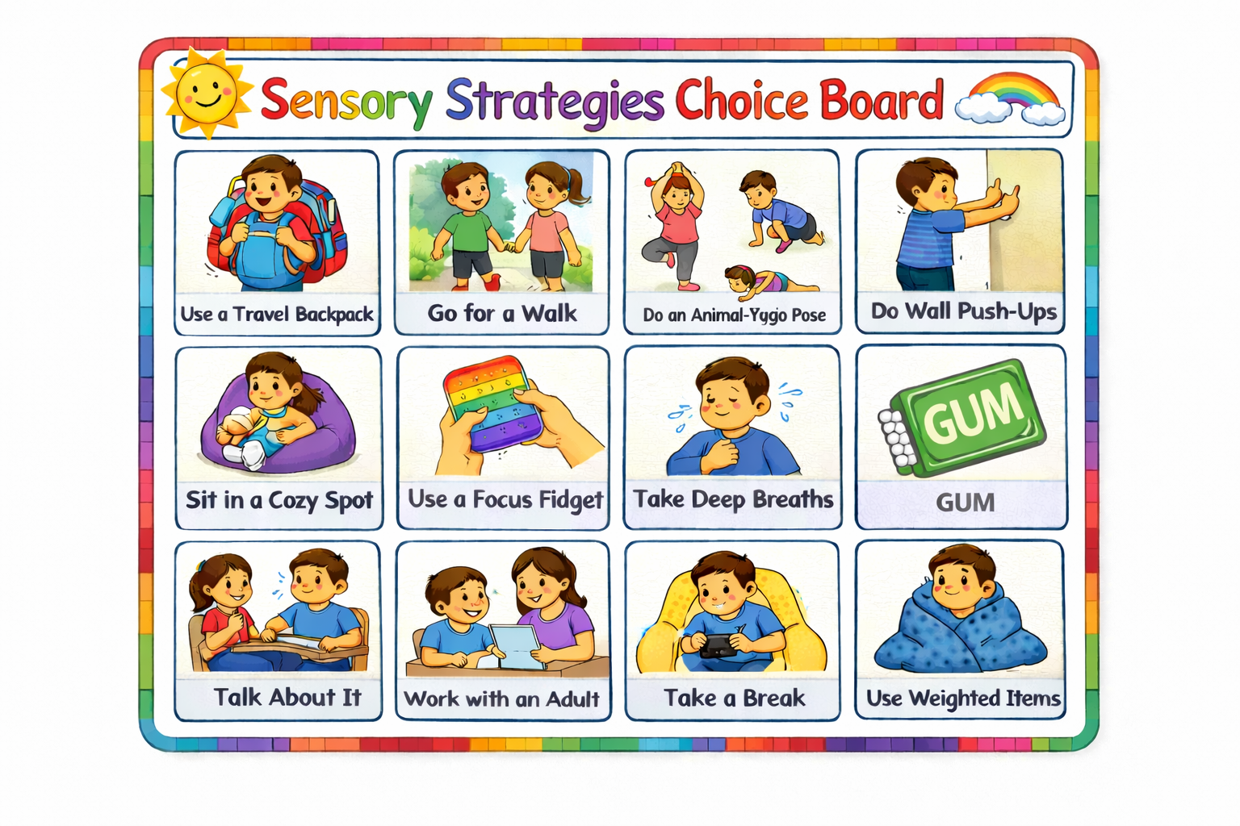
Choices are important!

Slide 10
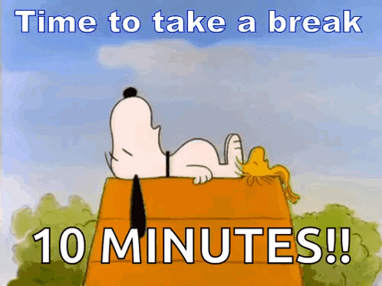

Sensory breaks are short, planned opportunities for a student to get the type of sensory input their body needs so they can return to learning more regulated and ready to participate.
Sensory breaks can support:
Regulation: Help a student calm, organize, or increase alertness.
Attention: Provide movement or sensory input that may help the student refocus on a task.
Body awareness: Activities such as pushing, pulling, carrying, or animal walks provide proprioceptive input.
Movement needs: Allow students who seek movement to move in an appropriate, structured way.
Transitioning: Can help prepare a student to move from one activity to another.
Motor planning: Yoga, animal walks, obstacle courses, and similar activities provide opportunities to plan and coordinate movements.
Stress reduction: A quiet space, breathing, rocking, or calming activity can help when a student is becoming overwhelmed.
Participation: The ultimate goal is to help the student return to the classroom activity and participate more successfully.

Slide 11
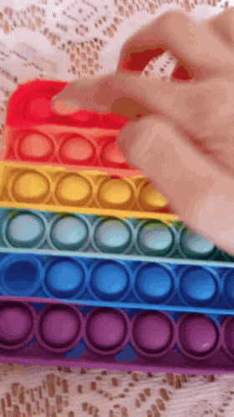
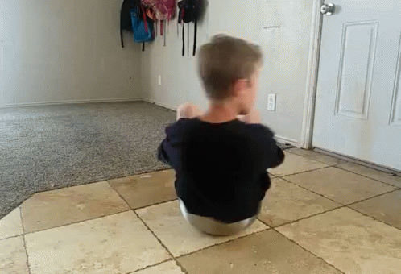
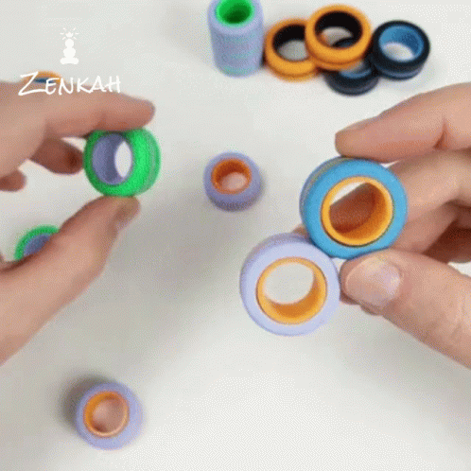

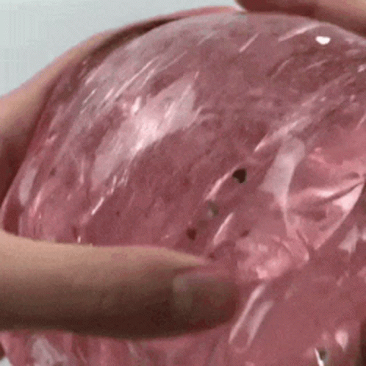
Movement breaks
Hand fidgets

Slide 12
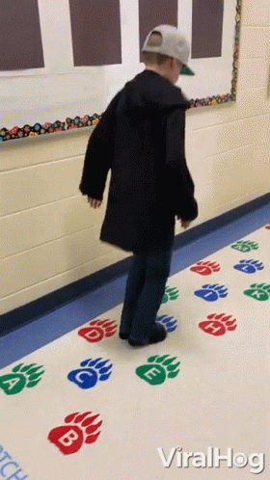
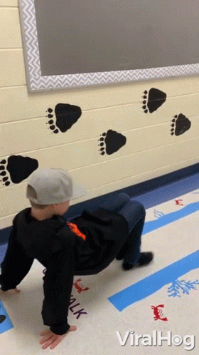
Sensory breaks that include movement and heavy work

Slide 13
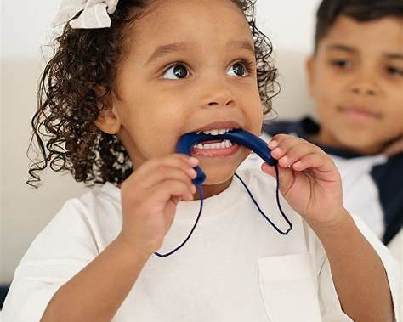
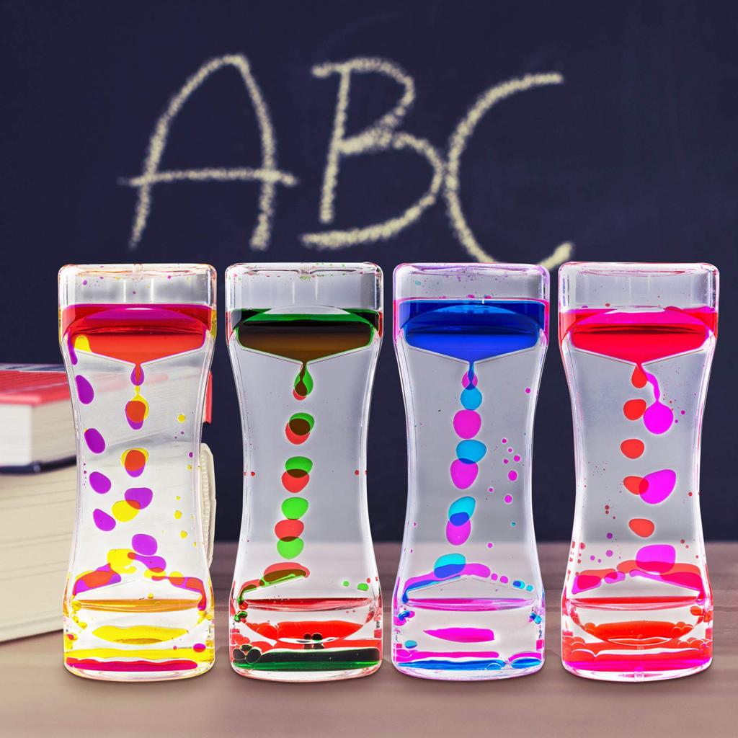
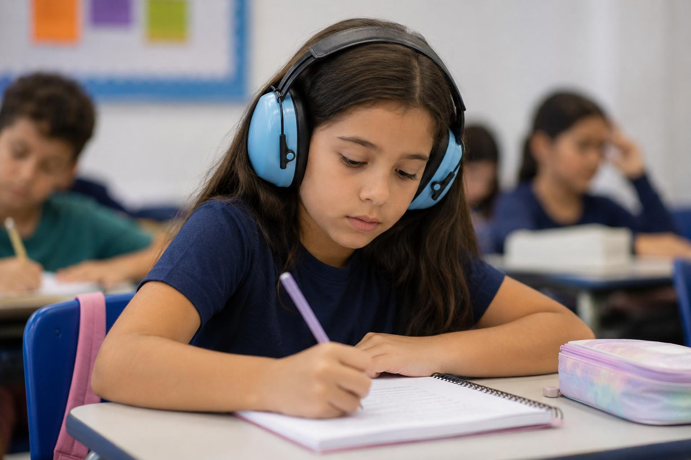
Sensory items such as sensory bottles, a chew necklace or noise cancelling headphones for sensory needs.

Slide 14
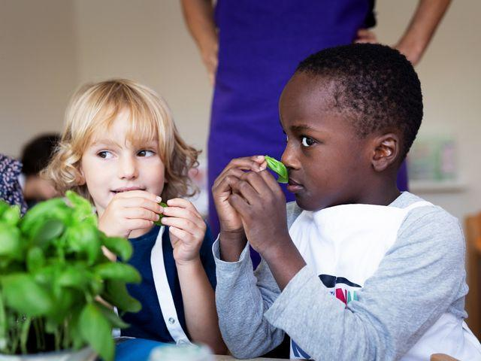


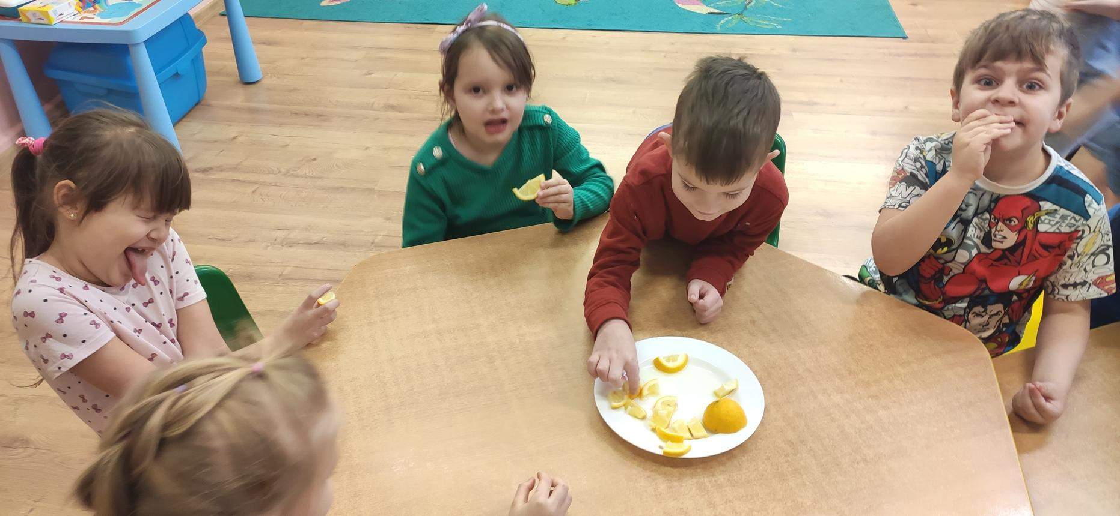
Often calming
Lavender
Vanilla
Mild floral scents
Familiar comforting smells
Gentle, low-intensity scents
Often alerting
Peppermint/mint
Lemon
Orange/citrus
Cinnamon
Strong or unfamiliar scents
Often calming / organizing
Slow drinking through a straw
Cool water
Chewy foods when appropriate
Firm/crunchy foods
Familiar preferred foods
Slow, rhythmic chewing
Often alerting
Cold/crisp foods
Sour flavors such as lemon
Strong flavors
Crunchy foods with strong flavor
Carbonated or fizzy drinks (when appropriate)

Slide 15
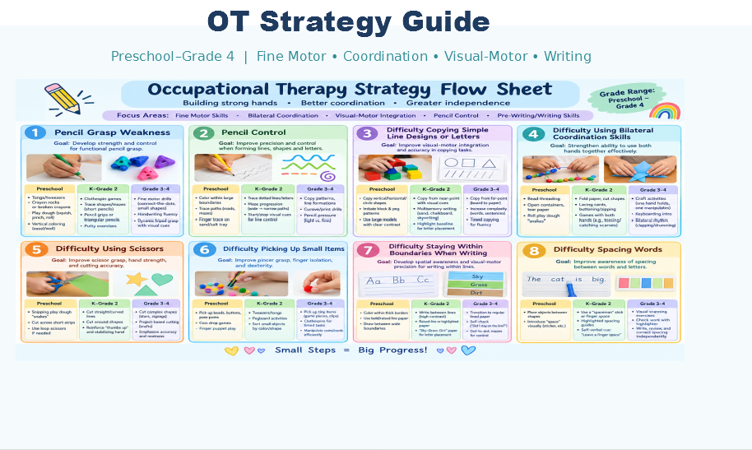

Slide 16
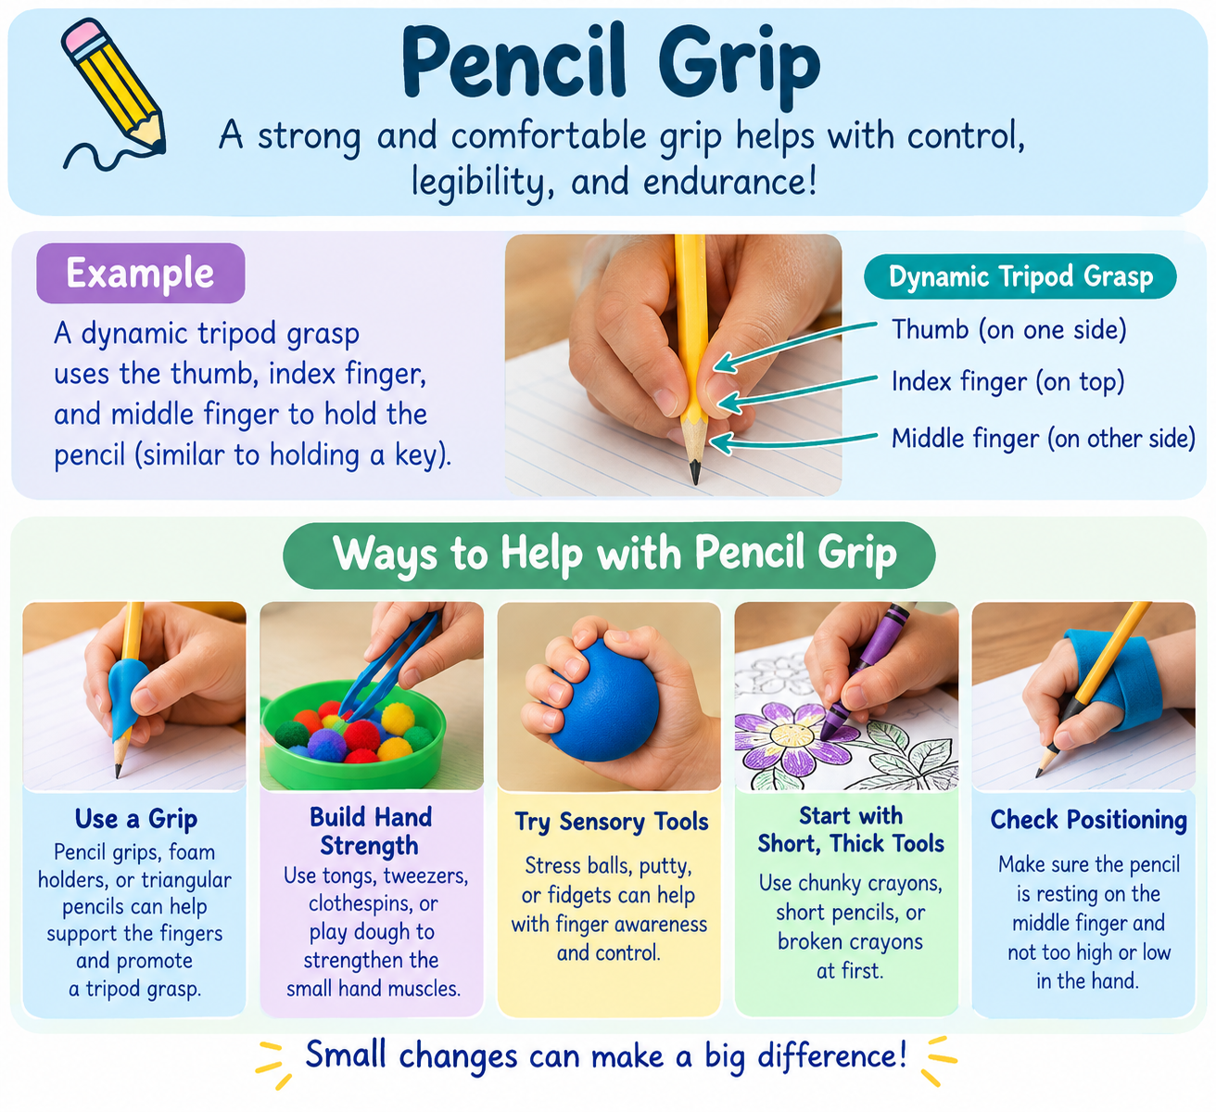
A functional grasp often uses the thumb, index finger, and middle finger to control the pencil, with the ring and little fingers resting against the hand. A tripod grasp is common, but other comfortable, effective grasps may also support legible writing.
Strategies to try:
Use short or broken crayons to encourage fingertip control.
Practice pinching and squeezing play dough.
Use small tongs or clothespins to strengthen finger muscles.
Try a pencil grip if it improves comfort and control.
Elevated writing surface
Hold items in palm with pinky and index finger
Practice finger placement on pencil “car front and back seat”

Slide 17

Questions

