Slide 1



EASTWOOD
LOCAL SCHOOLS
Community Meeting No.4
October 21, 2026
Facilitated by

Slide 2
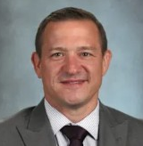
Welcome
Brian Hughes
Superintendent
Notes:
Brian

Slide 3



Agenda
Meet the
team
Inform:
How we got here
Building Recommendation
Questions?
Notes:
GM

Slide 4

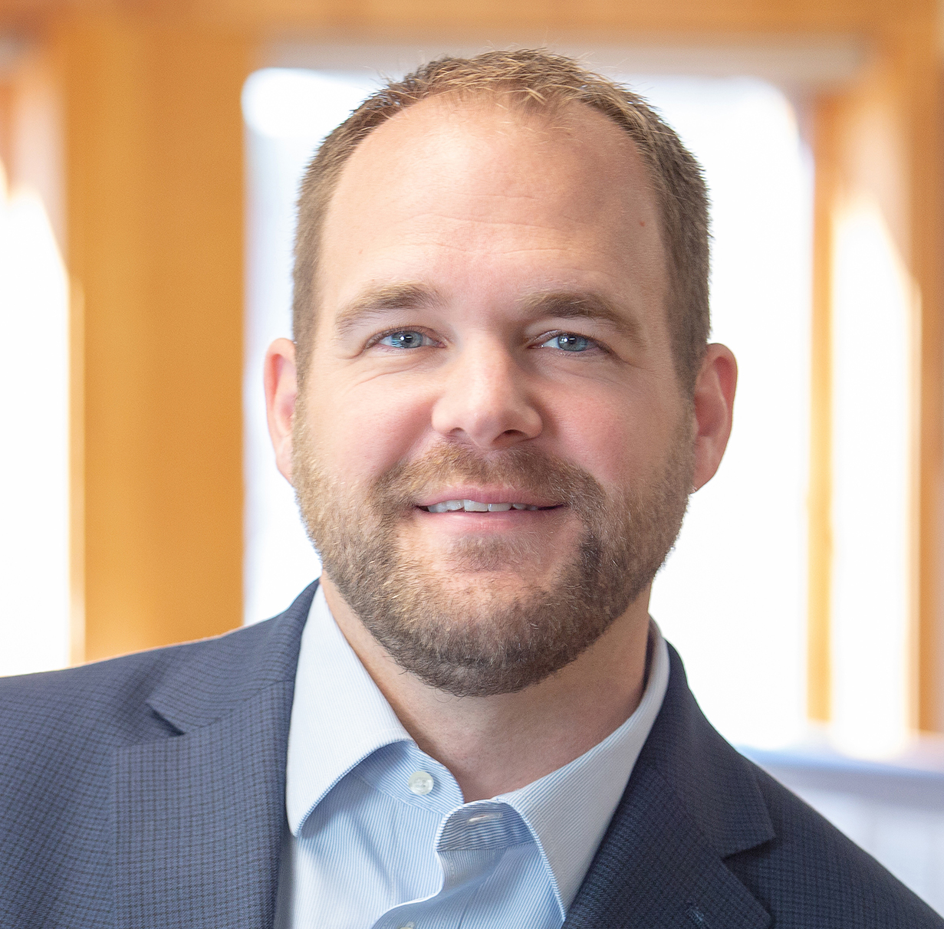
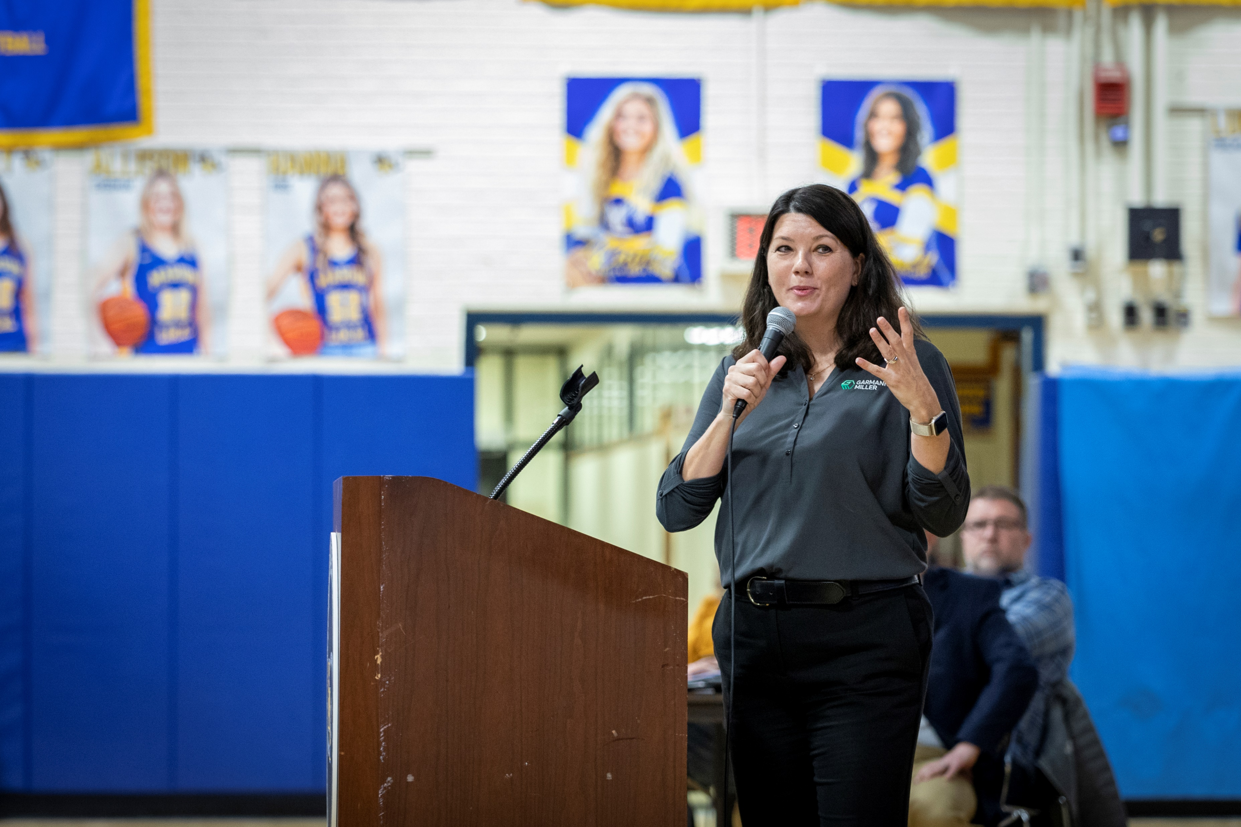
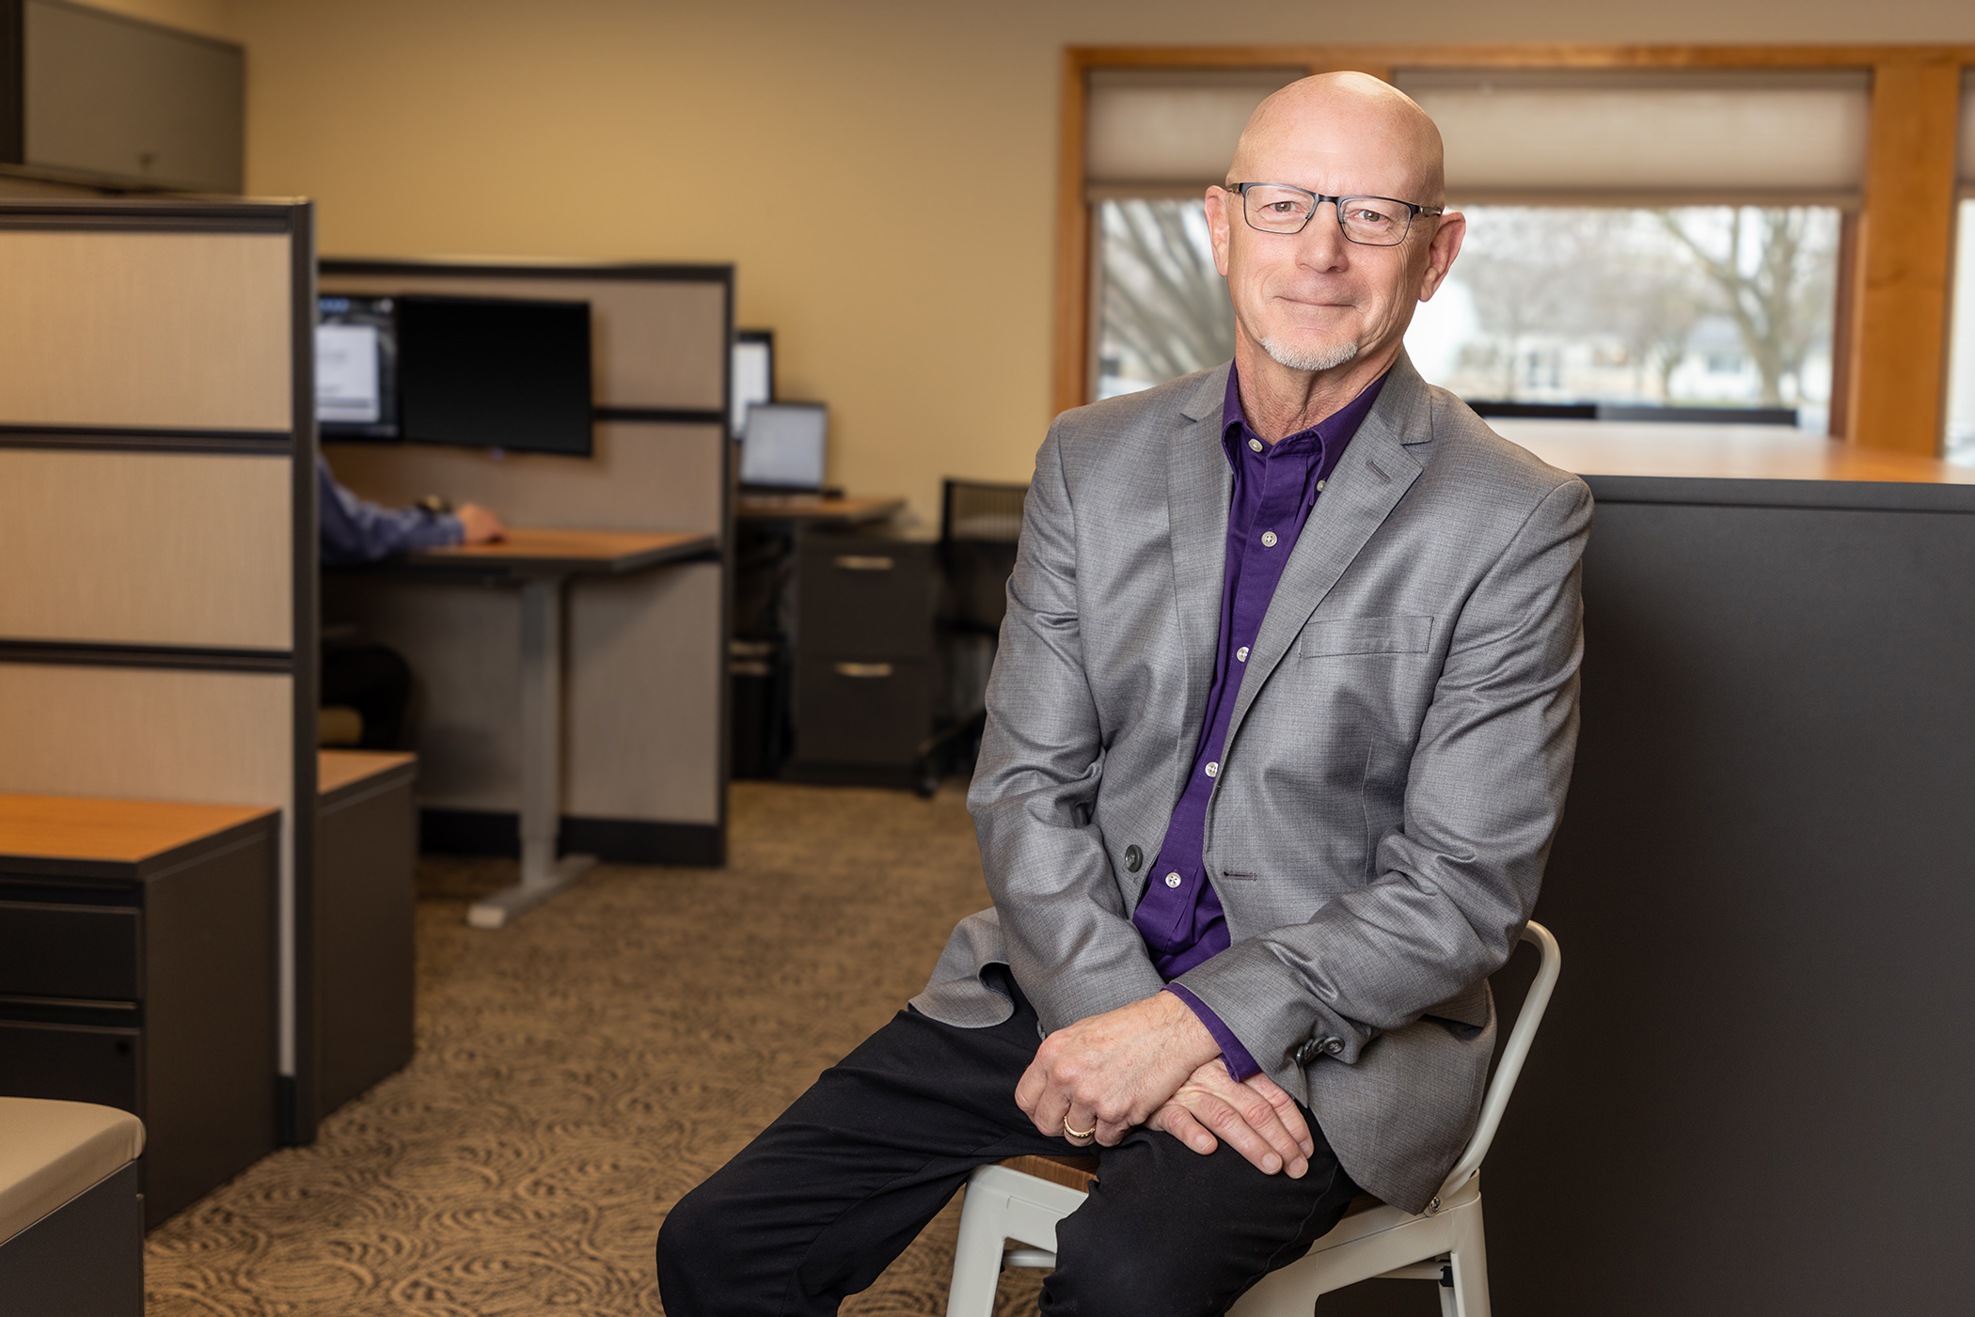
The team
Matt Hibner AIA
Principal & Architect
Monica Bruaw CPSM
Educational Planner
Tim Tarvin
Educational Planner
Notes:
GM

Slide 5
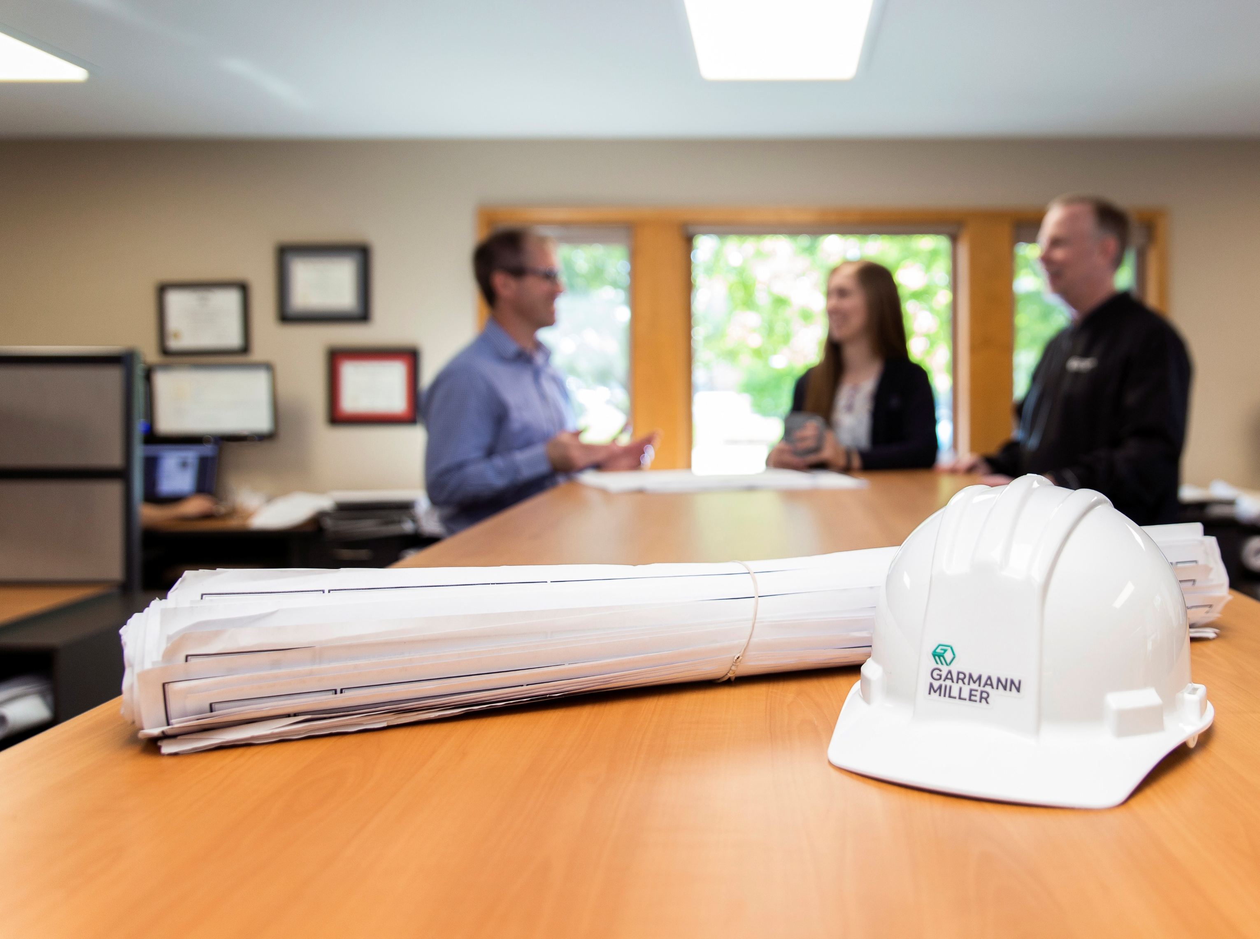
We are
Established 1993 in Minster
Top 50 K-12 planning & design firm; 130+ professionals
No. 1 in U.S. for Client Experience
Notes:
GM

Slide 6
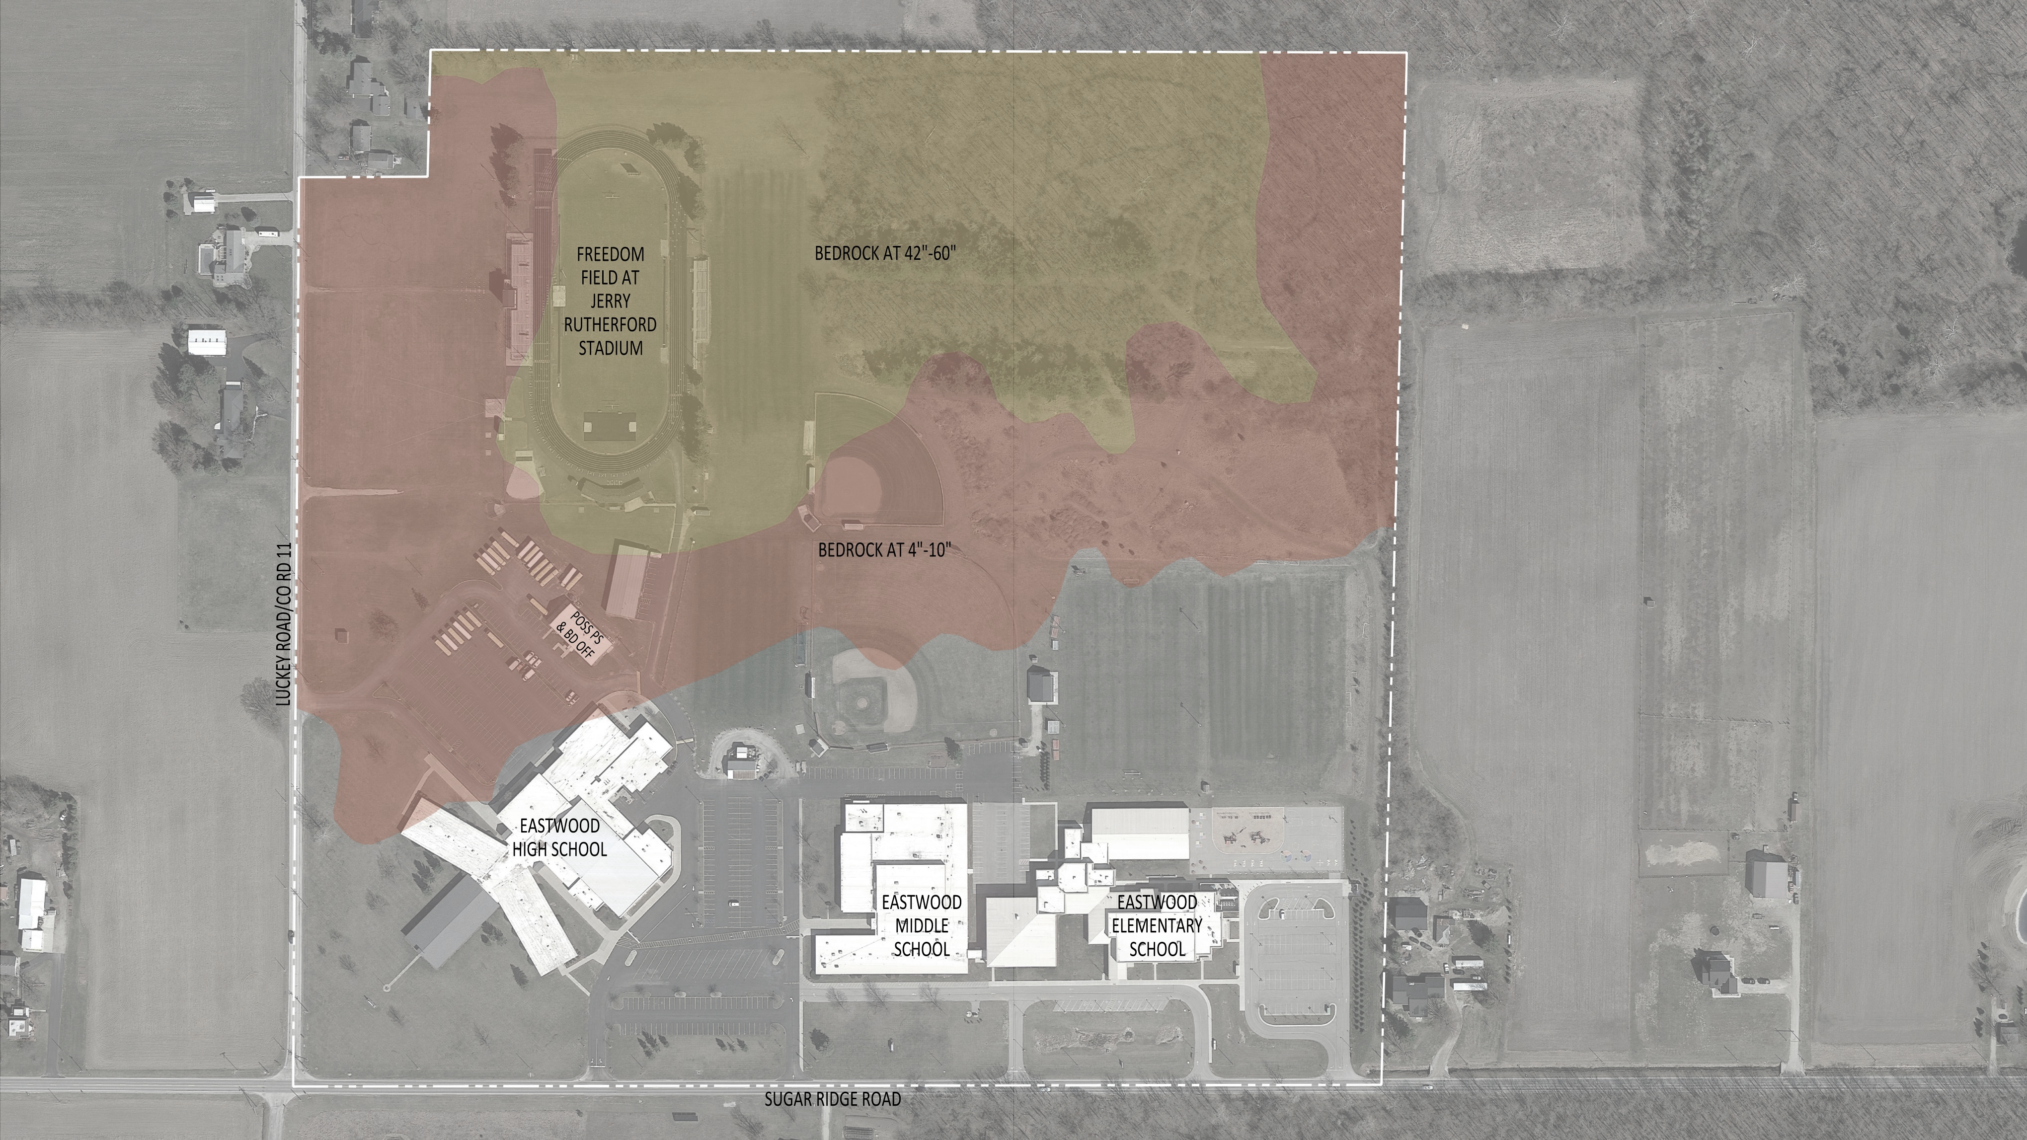
Why are we here?
Notes:
AJ

Slide 7

Notes:
GM

Slide 8
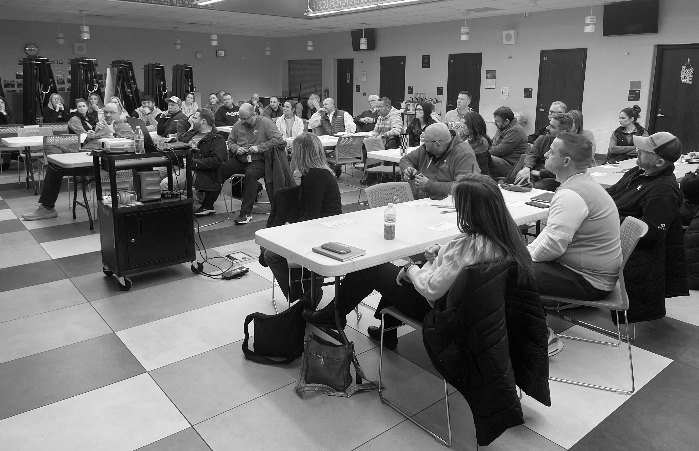
Planning Process
Notes:
GM

Slide 9
2023-2024 Facilities Timeline
August 27, 2023 Superintendent Community Update (Facilities Project- Reno or Replace)
November 1, 2023 Facilities Task Force Meeting (Preventative Maintenance/Big Projects)
November 22, 2023 Superintendent Community Update (Nov. 20- OFCC Resolution/Planning)
December 7, 2023 Staff Survey- Facilities
January 12, 2024 Site Visits (3 different groups/6 Schools Visited)
February 1, 2024 Meeting with OFCC
February 6, 2024 Facilities Task Force Meeting (OFCC/Architect Update/Site Visits)
May 20, 2024 Facilities Task Force Meeting (OFCC Update/Building Options)
July 2, 2024 Facilities Task Force Meeting (OFCC Update/Site Options)
August 19, 2024 Staff Visioning Session
September 25, 2024 Community Visioning Session
October 15, 2024 Completion of Durable Life Skills and revision of Eagle Way
November 4, 2024 Facilities Task Force Meeting (Architect Updates)
November 20, 2024 Superintendent Community Update (OFCC- Not Up for Funding)

Slide 10
2025-2026 Facilities Timeline
November 29, 2025 Request for Qualifications (Master Facilities Planning)
December 15, 2025 BOE- Architect Presentations (Awarded to Garmann Miller)
February 12, 2026 Task Force Meeting #1
February 16, 2026 Building & site assessment validation review
March 4, 2026 Task Force Meeting #2
March 24, 2026 Task Force Meeting #3
April 15, 2026 Community Meeting #1
April 28, 2026 Task Force Meeting #4
May 28, 2026 Task Force Meeting #5
June 15, 2026 Community Meeting #2
July 20 , 2026 BOE Approve Ballot Resolution
September 23, 2026 Community Meeting #3
October 21, 2026 Community Meeting #4
November 3, 2026 Election Day
Notes:
Matt

Slide 11
PLANNING BY THE NUMBERS (2026)
48
5
Task Force Members
3
Task Force Meetings
1
Community Meetings
Recommendation
Notes:
Matt

Slide 12
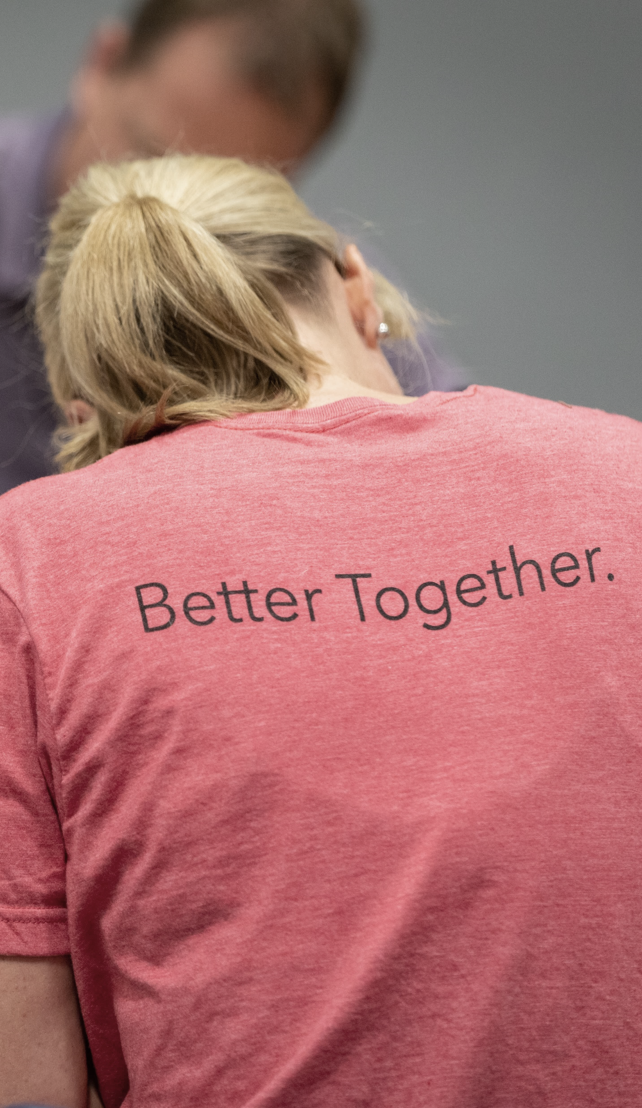

Eastwood Community
Alumni
Teachers
Administrators
BOE member(s)
Parents of current students
Parents of past students
Business owners
Farmers
Manufacturing/industry
Retired
Participated in previous planning effort
Music boosters
Athletic boosters
Notes:
GM

Slide 13
Task Force Members
Monica Leppelmeier
Amy Miller
Christy Miller
Dan Mundrick
Brian Myers
Skip Recker
Brian Sabo
Nikki Sabo
Brytanne Strayer
Jason Unger
Garrett Vetter
John Wagner
Missy Wagoner
Katie Ward
Luke Ward
Corey Weiland
Arik Witker
Kyle Wright
Brianna Allegier
Carolyn Ashby
Jason Back
Corey Bettenbrock
Jillan Bodey
Matt Bostdorff
Roger Bostdorff
Dr. Bratwurst
Matthew Brinker
Jaycee Brown
Nichole Brown
Jared Cooper
Ashley Culp
David Dennis
Dwight Fertig
Sarah Frank
Gary Gardner
Janel Gerwin
AJ Haas
Nick Hannan
Denny Helm
Andrew Hemminger
Jamie Henline
Trent Henline
Adam Hoffmann
Brian Hughes
Jim Kieper
Dean Krukemyer
Rebecca Krukemyer
Kevin Leady
Notes:
GM

Slide 14

Options
Facilities Task Force Recommendation
Notes:
Tim

Slide 15
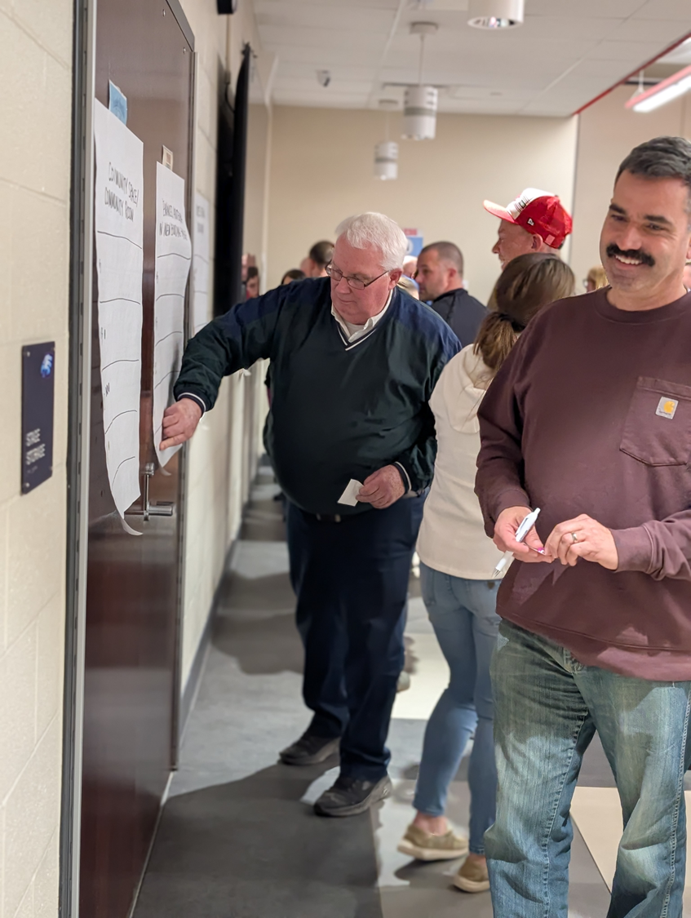
Priority rankings
activity
Priority stickers
$5
$3
$2
$1
50¢
Notes:
Tim

Slide 16
Priority Options
Two separate buildings
One PK-12 building
Save existing HS auditorium
Enhanced auditeria in new building
Site circulation / traffic flow
Vocational/career-tech space
Keeps existing HS gym
Square footage for learning spaces
Maintain athletic field location
Community space/room
Other
Security/Safety is #1 and will be at the forefront of every decision
Notes:
Tim

Slide 17
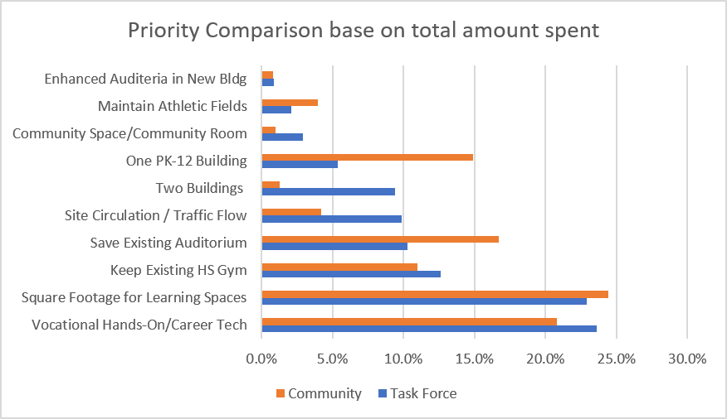
Priority rankings
results
Notes:
Tim

Slide 18

Eastwood’s challenge
Student-centered interactive lessons
Innovative content creation
Enhanced teamwork
Real world problem solving
Ability to adapt to rapidly changing technology
Traditional classrooms
Limited collaboration space
Minimal dedicated breakout areas
Technology used primarily for productivity
What is the
“Eastwood Experience” of tomorrow?
What does the “Eastwood Experience” look like today?
Bridging the gap with facilities that support the experience
Flexible Learning Spaces
Dedicated Collaboration Spaces
Technology Enhanced Classrooms
Dynamic Learning Environments
Notes:
Brian

Slide 19
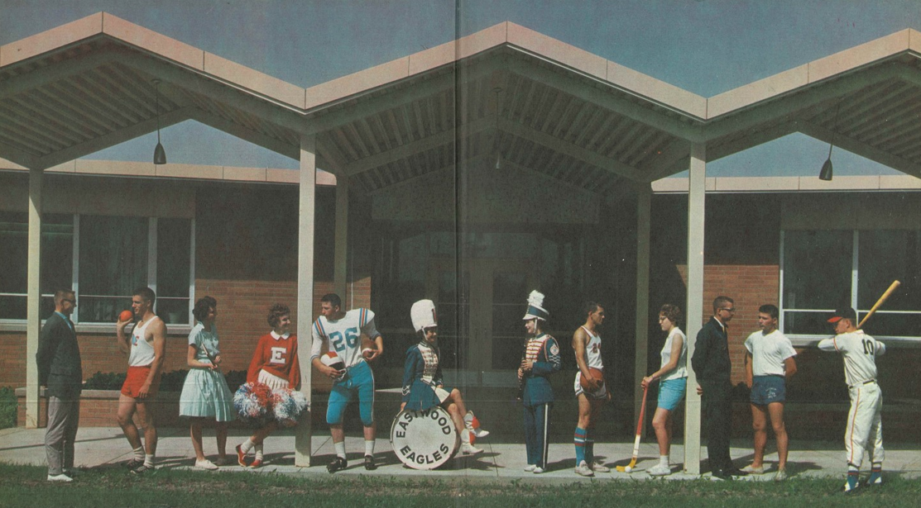
Current facilities
Notes:
GM

Slide 20
Aging Facilities
Heating system
Roofing
Ventilation/air conditioning
Electrical systems
Plumbing and fixtures
Windows
Structure: foundation
Structure: walls and chimneys
Structure: floors and roofs
General finishes
Interior lighting
Security systems
Emergency/egress lighting
Fire alarm
Handicapped access
Site condition
Sewage system
Water supply
Exterior doors
Hazardous material
School safety
Loose furnishings
Notes:
Monica

Slide 21
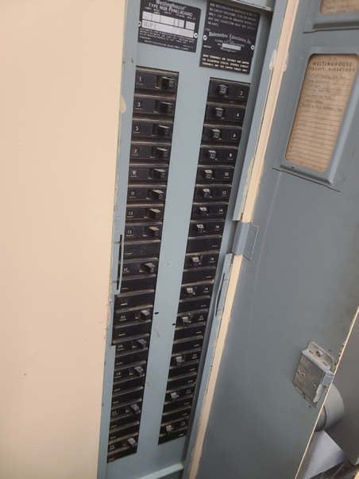
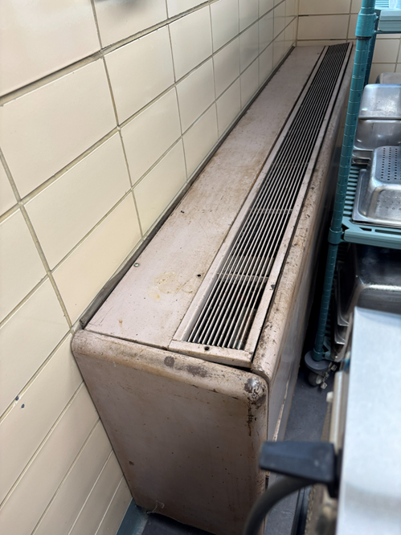
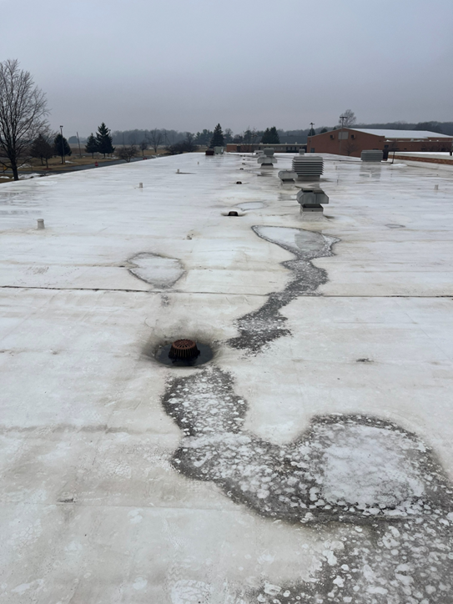
Existing conditions
Notes:
GM

Slide 22
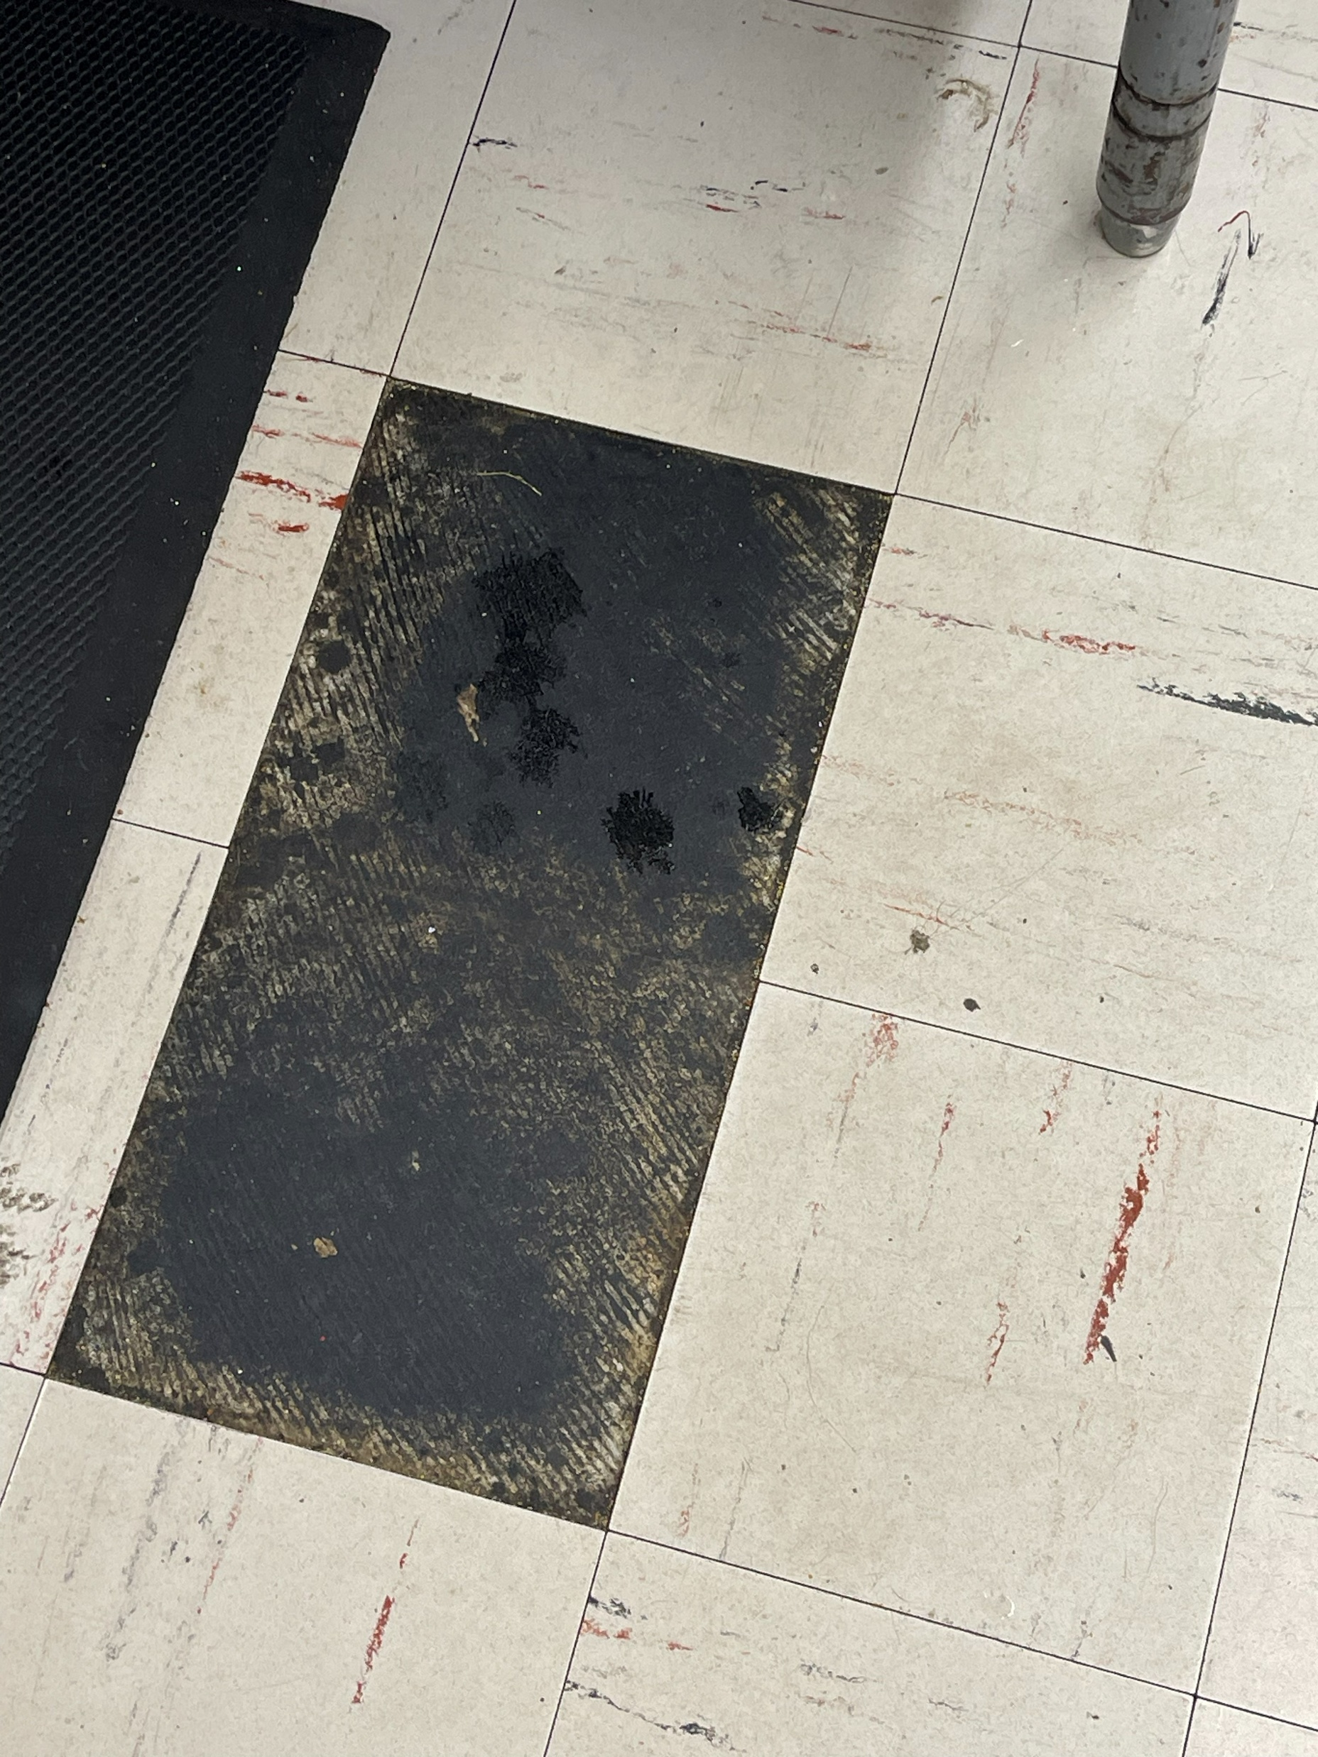
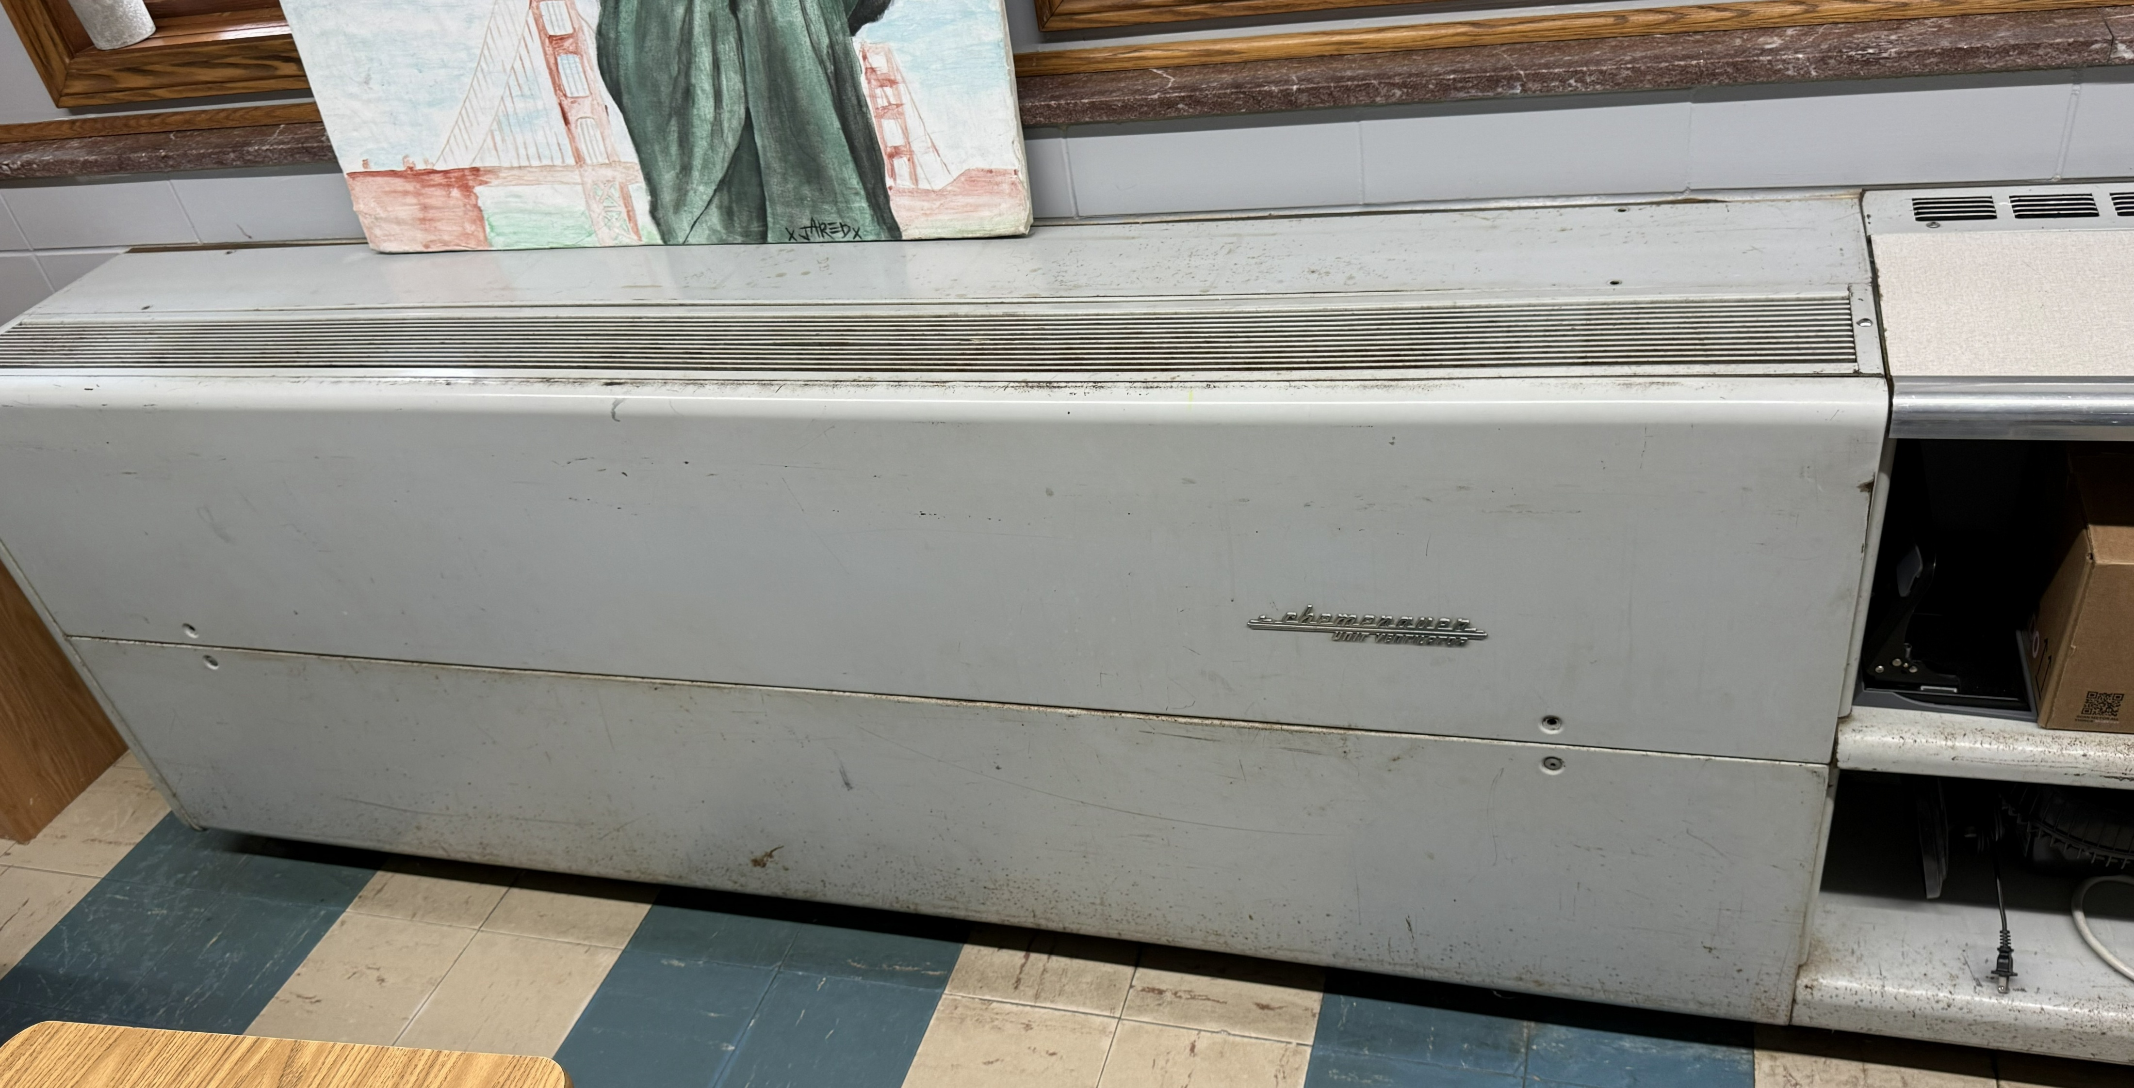
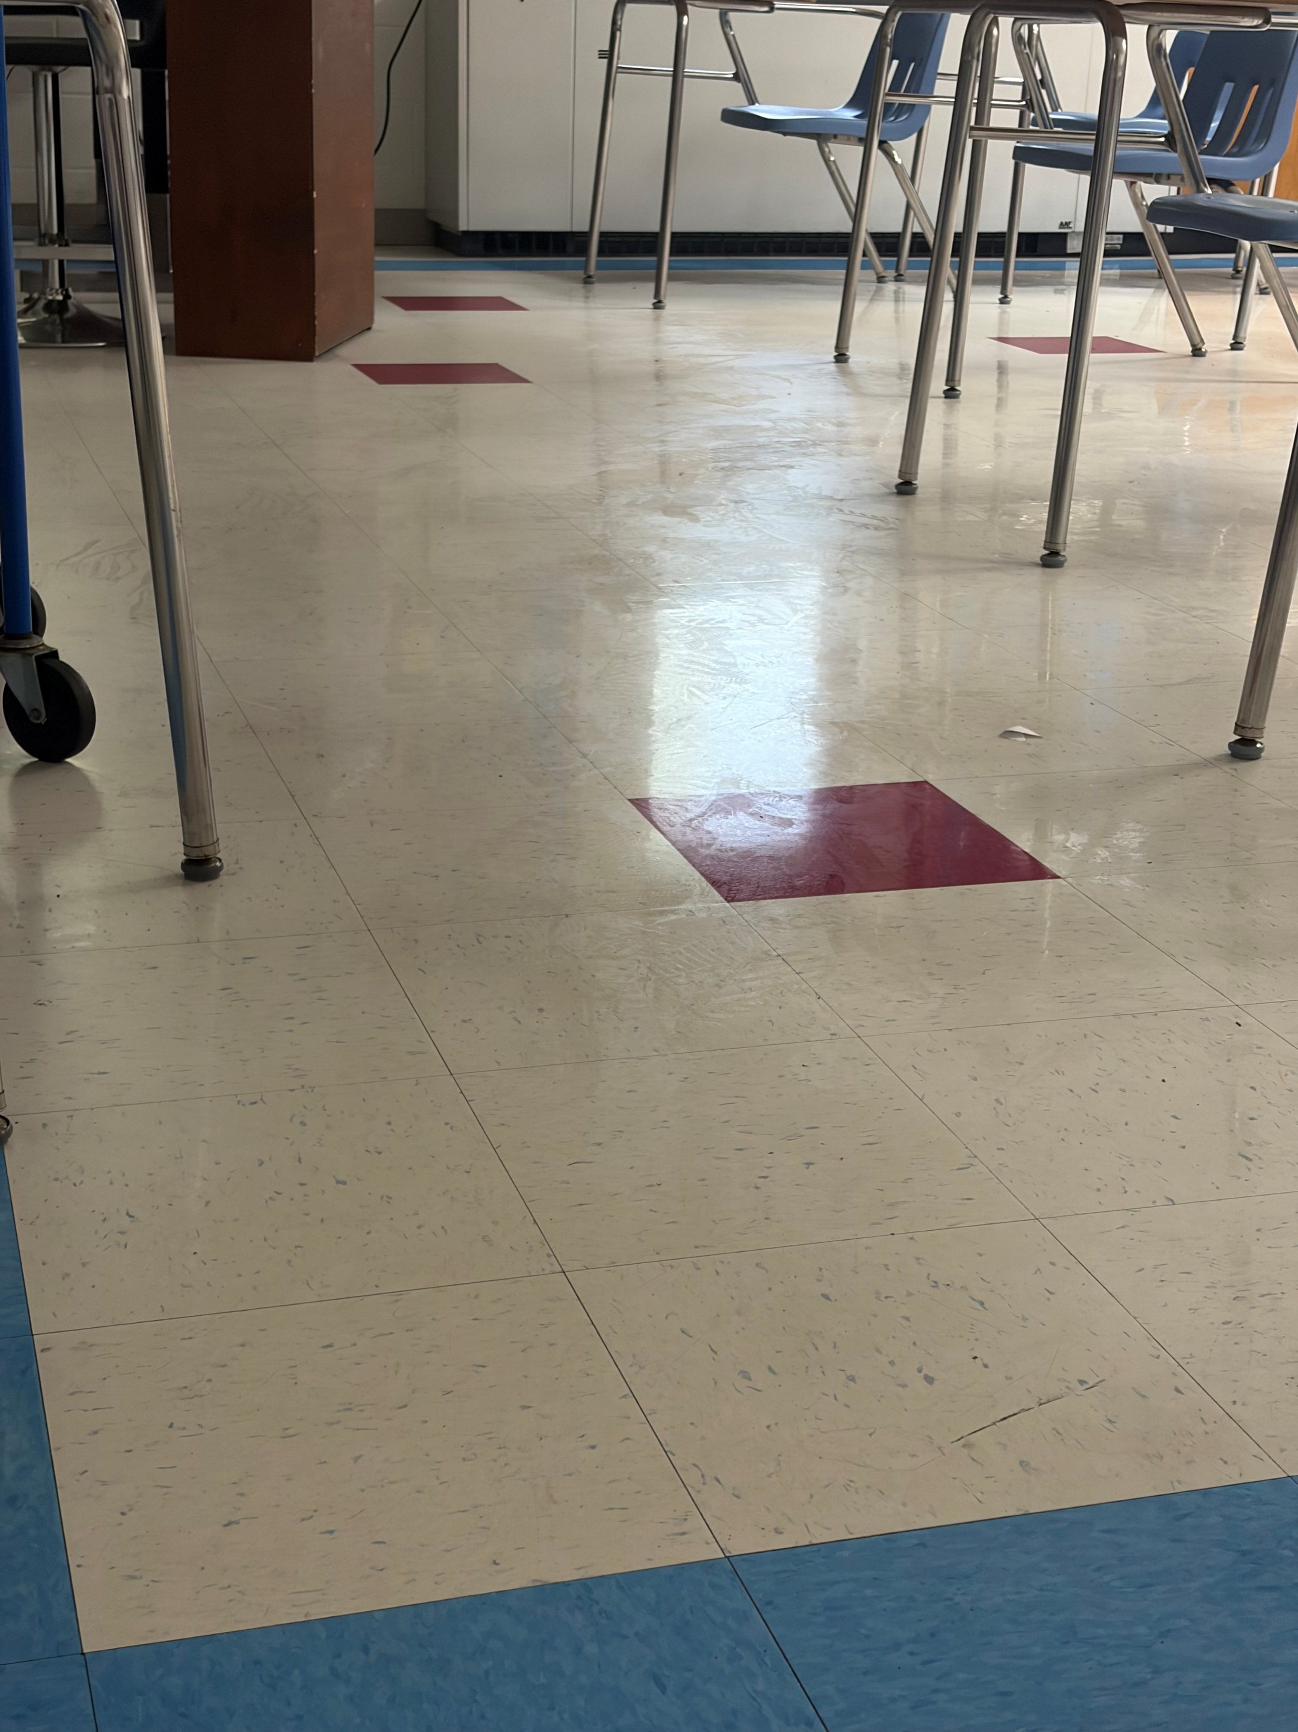
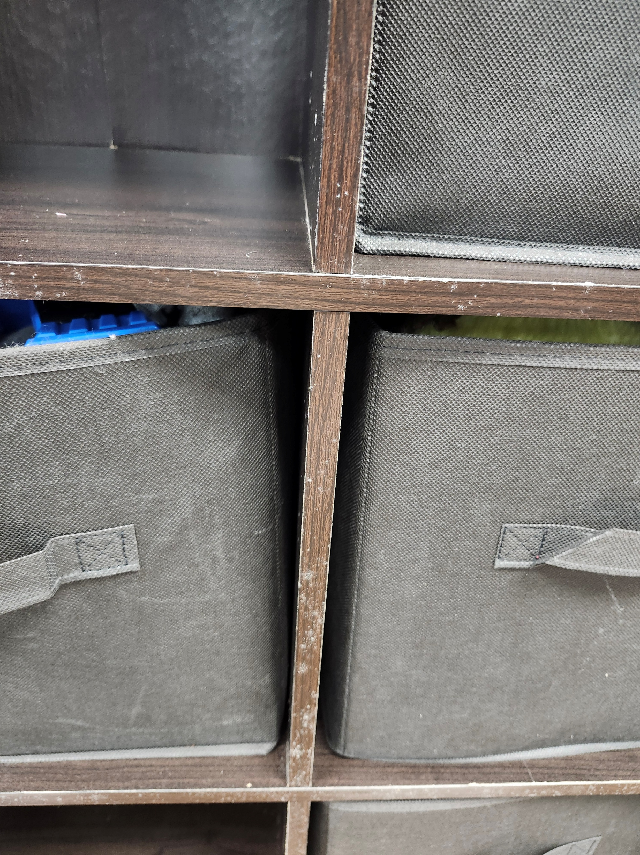
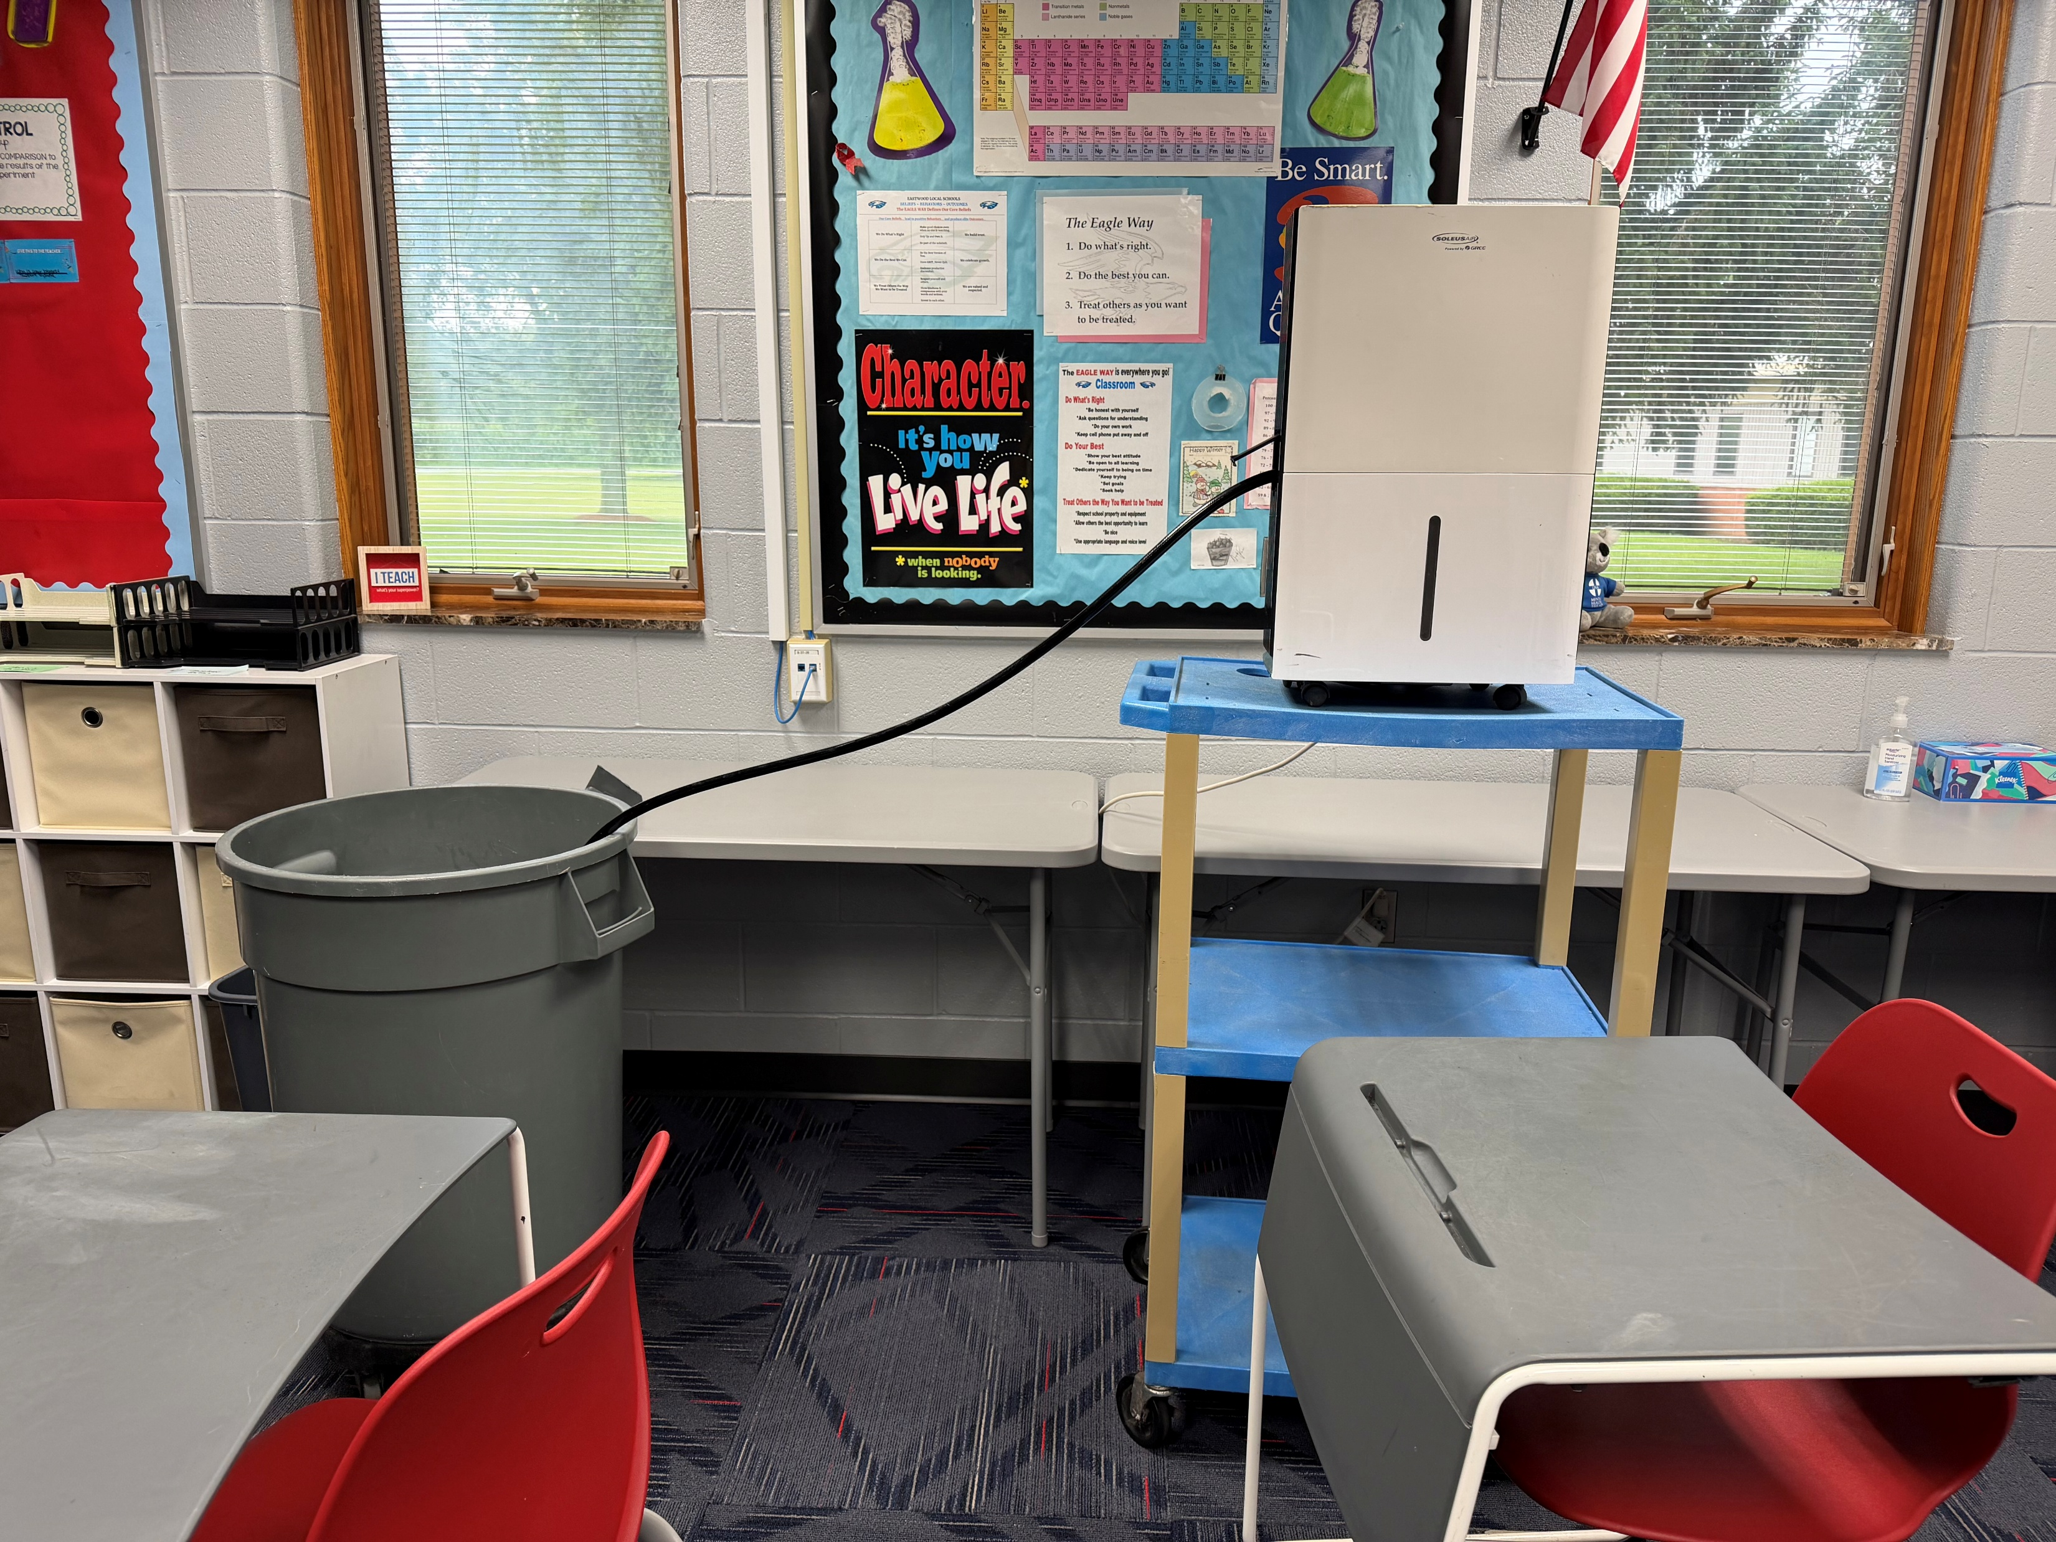
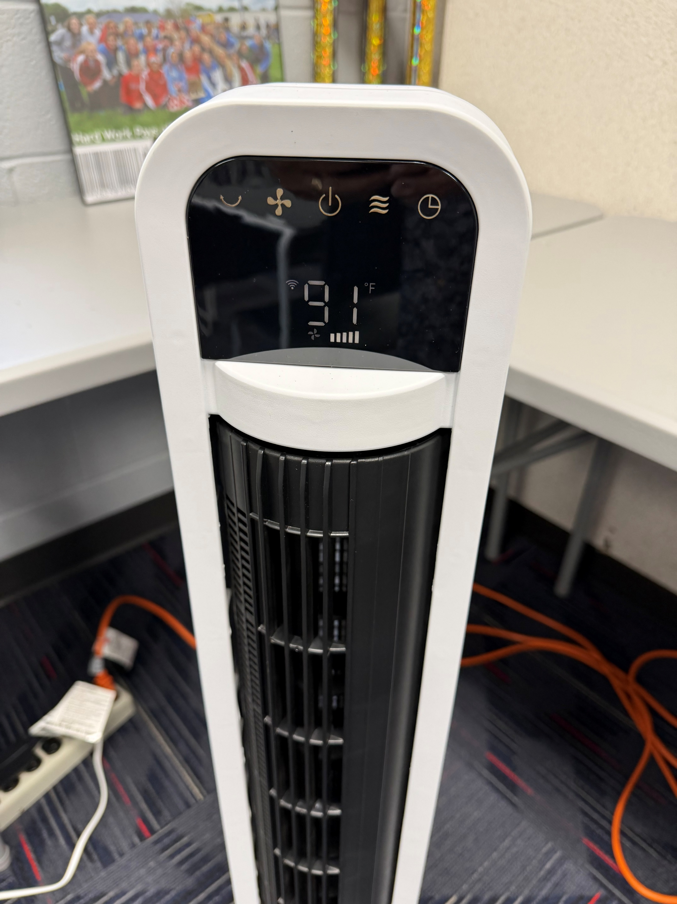
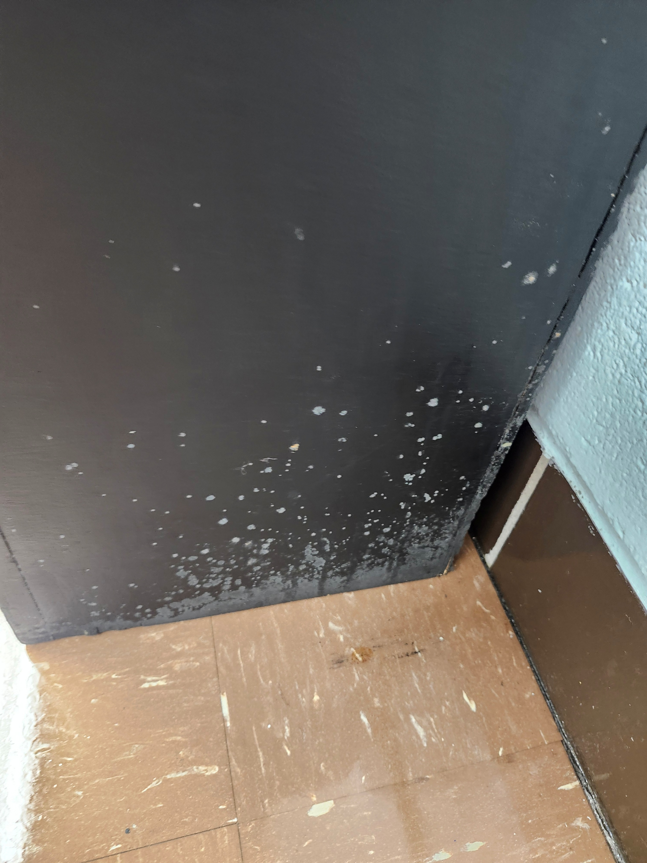
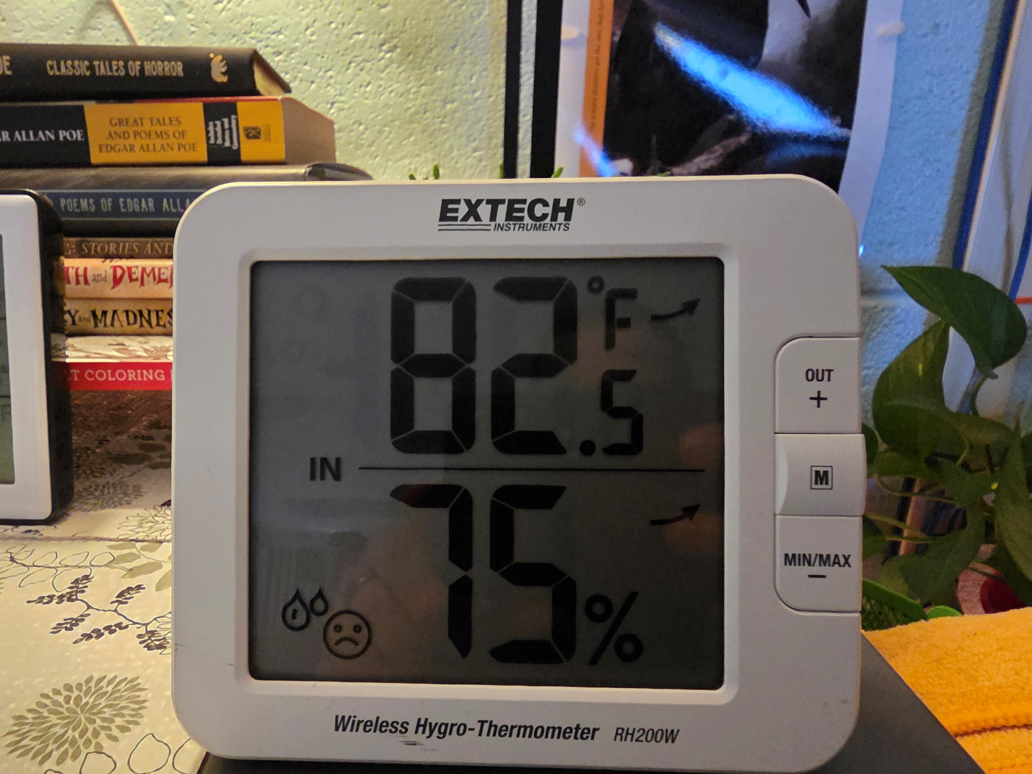
Existing conditions
Notes:
Monica

Slide 23
Existing High School (65 Years Old)
$32-33 million to renovate the High School
74% Renovate to Replace Ratio
-The OFCC recommends replacing when over 66%
Eastwood High School Facilities Assessment
Heating System $6.7 million
General Finishes $4.3 million
Electrical $3.8 million
Roofing $1.7 million
Notes:
GM

Slide 24
Existing Middle School (56 Years Old)
$22-23 million to renovate the Middle School
77% Renovate to Replace Ratio
-The OFCC recommends replacing when over 66%
Eastwood Middle School Facilities Assessment
Heating System $4.4 million
General Finishes $2.9 million
Electrical $2.5 million
Roofing $1.3 million
Notes:
GM

Slide 25


Renovation Costs
To renovate BOTH the High School and the Middle School to code and required standards, the projections are in the range of:
$55 - $57 million
*estimated 12 Million OFCC Funding toward project
Renovation life expectancy – 25 years
New construction life expectancy – 50 plus years
Notes:
GM

Slide 26
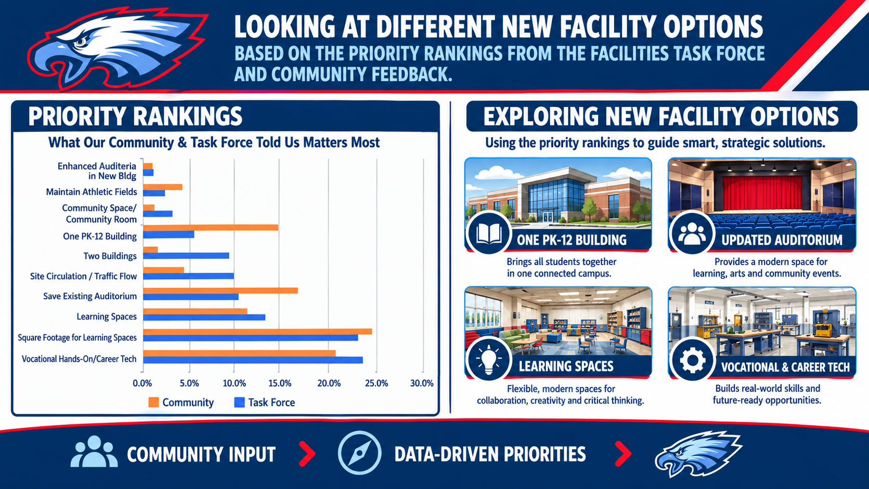
Notes:
GM

Slide 27
Program of Requirements (POR)
Core academic classrooms
Industrial Tech Classroom
Ag-Ed Lab
CAD Lab
Instrumental Room
Vocal Room
Art Room
STEM Lab
MS Auxiliary Gym
HS Competition Gym
Multipurpose PE Room
Personnel Offices
OT/PT Spaces
Therapist Group Offices

Slide 28
What’s included
New 5-12 Building
Classrooms, special education and academic support spaces
Separate space for MS and HS media center, art, instrumental, vocal room, computer rooms
HS competition gym (+/-1,600 seats) with 4 locker rooms
  Current HS Gym has 1668 seats
HS life skills lab
MS tech lab
New offering for STEM
HS Ag-Ed lab with CAD lab adjacent
Shared Services- SRO, NURSE, PT/OT
Notes:
Monica

Slide 29
What’s included
HS Renovation
Relocating the Board of Education offices to the area north of the cafeteria.
Transforming the current cafeteria into a community gathering space.
Converting the existing band room into theater storage.
Repurposing the current woodshop into additional district storage
Converting the existing high school competition gymnasium into the middle school's competition gym.
Reconfiguring the auxiliary gym into flexible practice space, with the potential addition of indoor turf to support a variety of student programs.
Notes:
Monica

Slide 30

Square Footage Comparison
Today
The Elementary,
Middle School and High School combine for a total of
244,941
square feet
(Does not include Board Offices)
Potential
New 5-12 building
Keep existing HS gym, auditorium, surrounding spaces
Eastwood PK-4 school
297,741
square feet
(Does include Board Offices)
Notes:
Monica

Slide 31
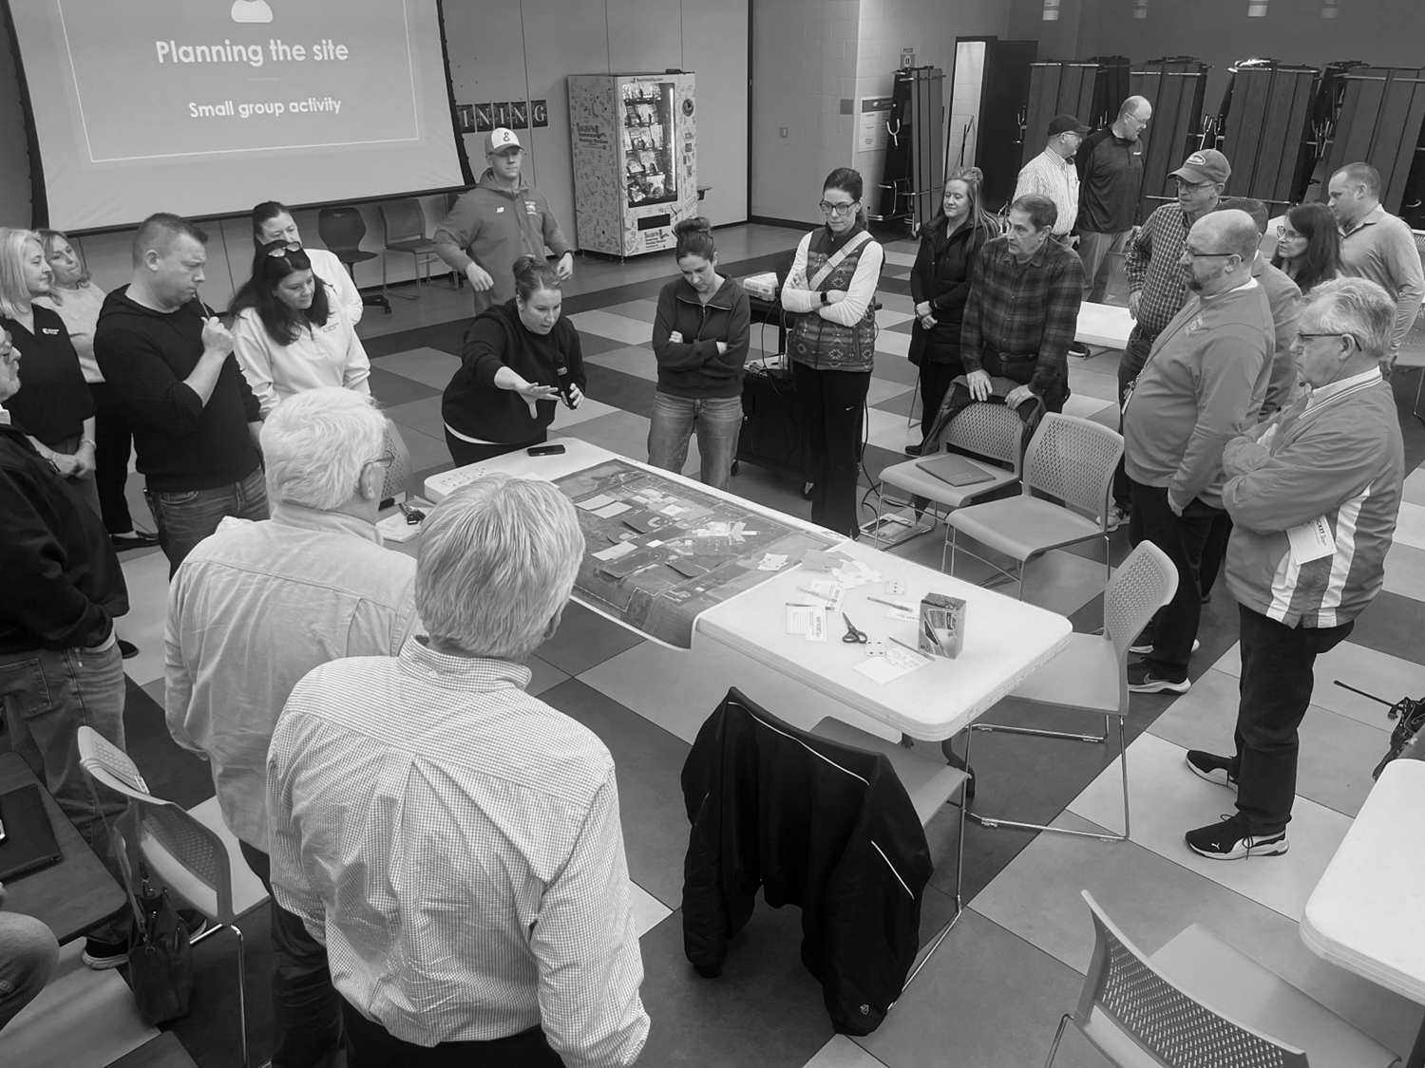
Site Master Plan Activity
What’s possible
Notes:
Jason Unger

Slide 32
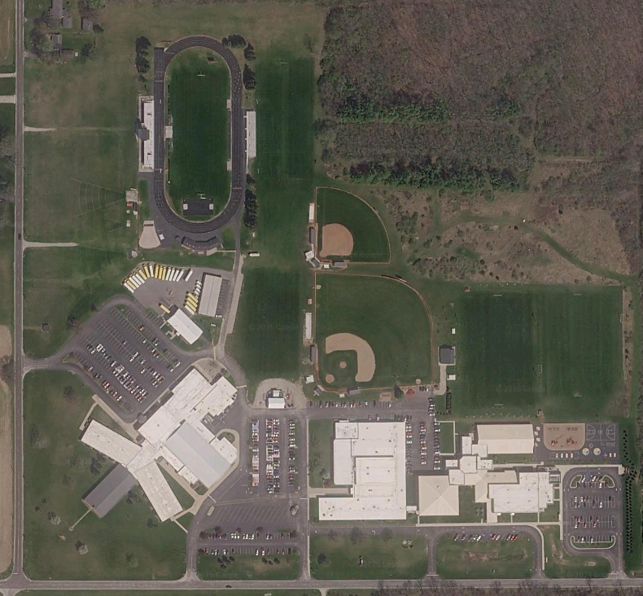
The Eastwood campus
Design the site activity
Notes:
Tim

Slide 33
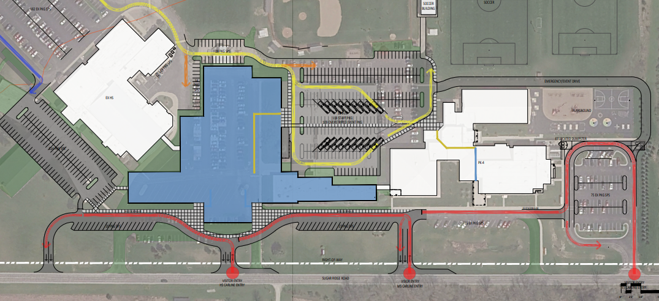
COLUMBIA BLUE OPTION
Notes:
Matt

Slide 34
Building Recommendation
For Visual Placement Only
*Complete Design if Levy Passes
Notes:
Monica

Slide 35
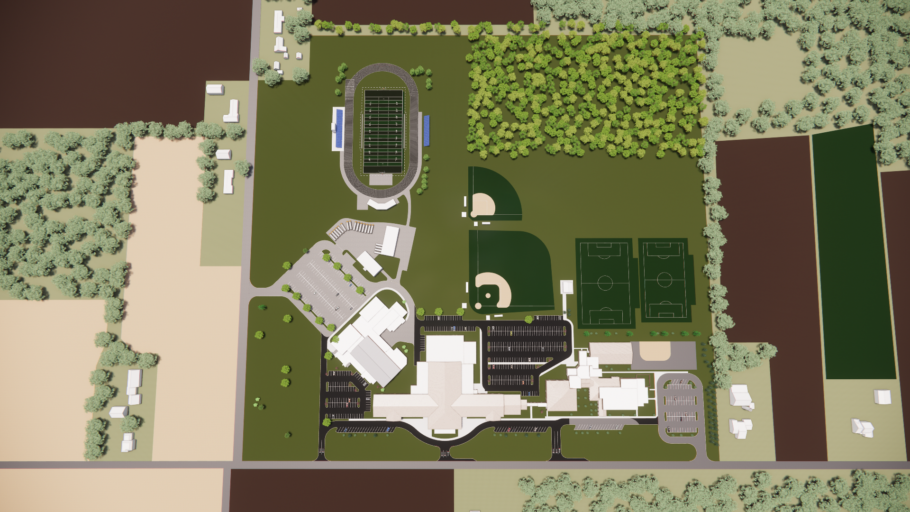
EXISTING HS BUILDING TO REMAIN: 59,853 SF
PROPOSED NEW HIGH SCHOOL / MIDDLE SCHOOL BUILDING: 157,077 SF
EASTWOOD ELEMENTARY: 80,811 SF
Proposed total building square footage: 297,741 sq. ft.
Existing total building square footage: 244,941 sq. ft.
Difference: 52,800 sq. ft. of additional square footage

Slide 36
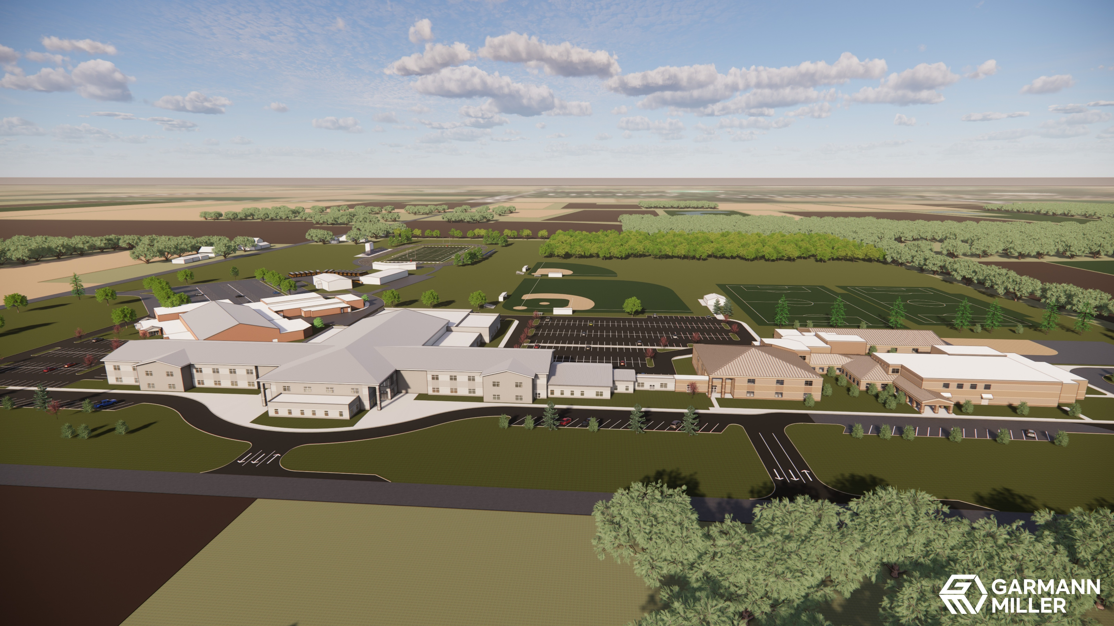
EXISTING HS BUILDING TO REMAIN: 59,853 SF
PROPOSED NEW HIGH SCHOOL / MIDDLE SCHOOL BUILDING: 157,077 SF
EASTWOOD ELEMENTARY: 80,811 SF
Proposed total building square footage: 297,741 sq. ft.
Existing total building square footage: 244,941 sq. ft.
Difference: 52,800 sq. ft. of additional square footage

Slide 37
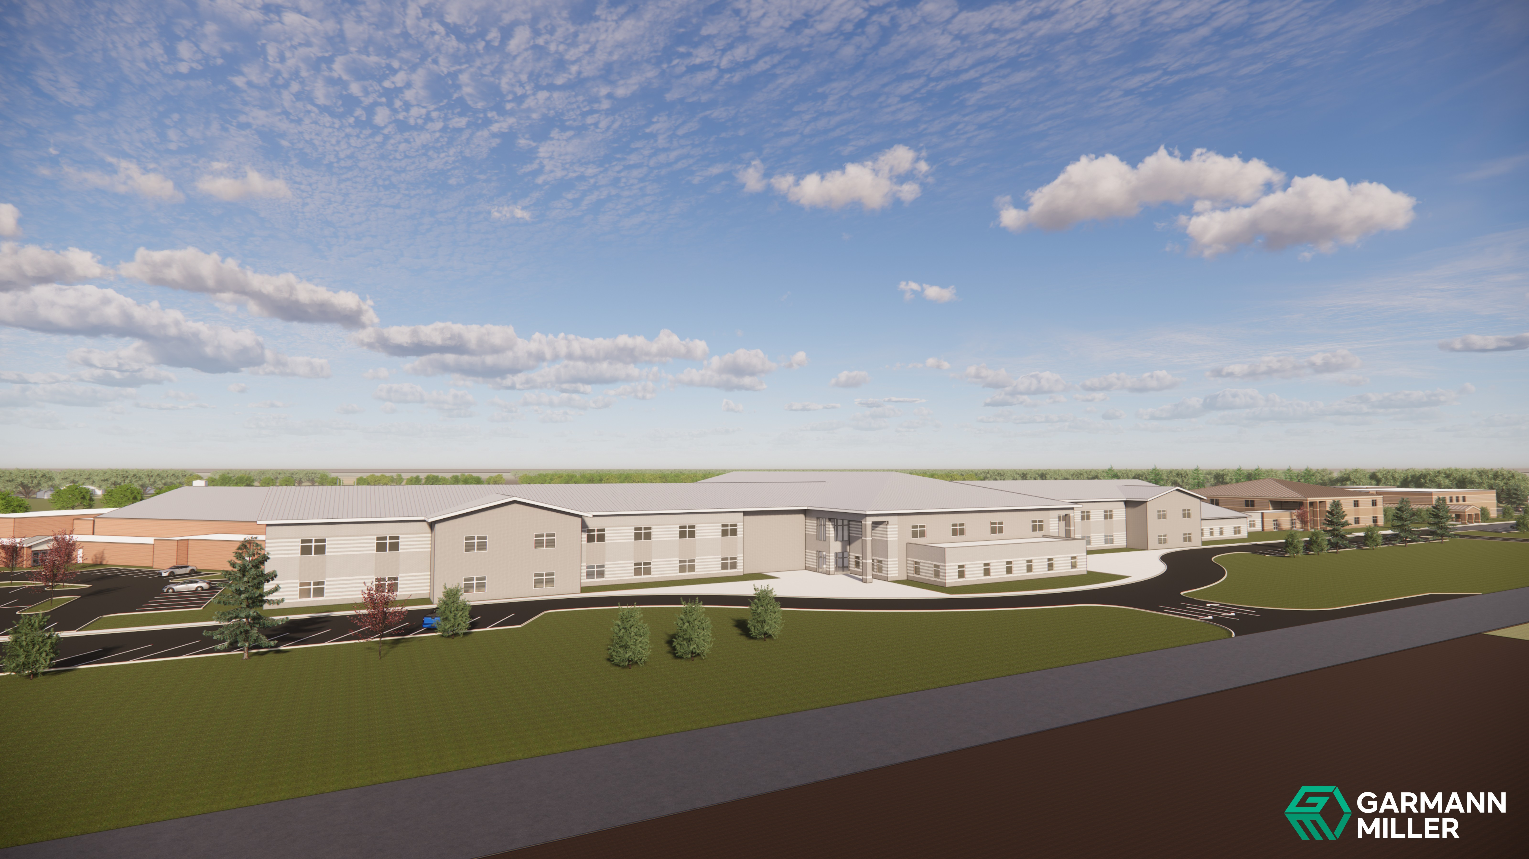
EXISTING HS BUILDING TO REMAIN: 59,853 SF
PROPOSED NEW HIGH SCHOOL / MIDDLE SCHOOL BUILDING: 157,077 SF
EASTWOOD ELEMENTARY: 80,811 SF
Proposed total building square footage: 297,741 sq. ft.
Existing total building square footage: 244,941 sq. ft.
Difference: 52,800 sq. ft. of additional square footage

Slide 38
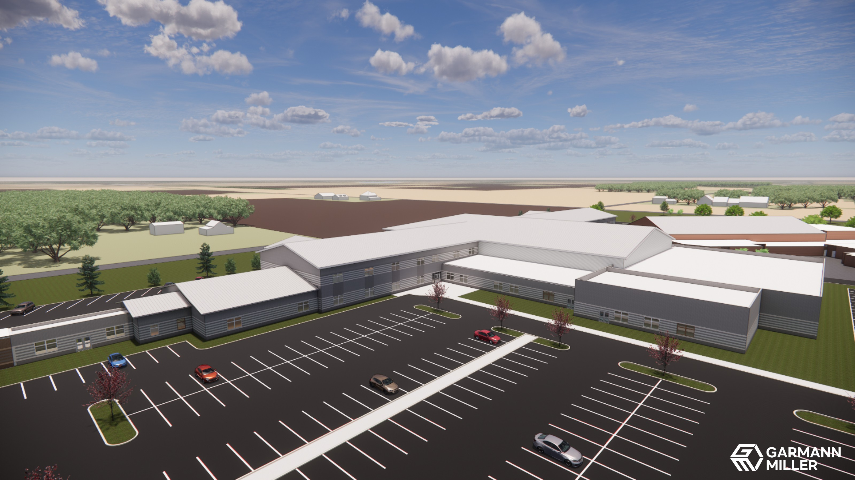
EXISTING HS BUILDING TO REMAIN: 59,853 SF
PROPOSED NEW HIGH SCHOOL / MIDDLE SCHOOL BUILDING: 157,077 SF
EASTWOOD ELEMENTARY: 80,811 SF
Proposed total building square footage: 297,741 sq. ft.
Existing total building square footage: 244,941 sq. ft.
Difference: 52,800 sq. ft. of additional square footage

Slide 39
EXISTING HS BUILDING TO REMAIN: 59,853 SF
PROPOSED NEW HIGH SCHOOL / MIDDLE SCHOOL BUILDING: 157,077 SF
EASTWOOD ELEMENTARY: 80,811 SF
Proposed total building square footage: 297,741 sq. ft.
Existing total building square footage: 244,941 sq. ft.
Difference: 52,800 sq. ft. of additional square footage

Slide 40
Cost Breakdown
Co-funded Project Cost (local cost only) $31,386,277
Locally Funded Initiatives (LFIs) – integral to building $28,584,685
Locally Funded Initiatives (LFIs) – site $2,384,000
Locally Funded Initiatives (LFIs) – existing buildings to remain $10,784,287
Locally Funded Initiatives (LFIs) – miscellaneous $500,000
10% inflation / contingency for LFIs $4,225,297
___________________________________________________________________________________
District’s project cost $77,864,546
State’s project cost $17,654,780
Total project cost $95,519,326
Notes:
Matt

Slide 41

EASTWOOD
LOCAL SCHOOLS
Questions?
creategm.com
Notes:
Matt

