Slide 1

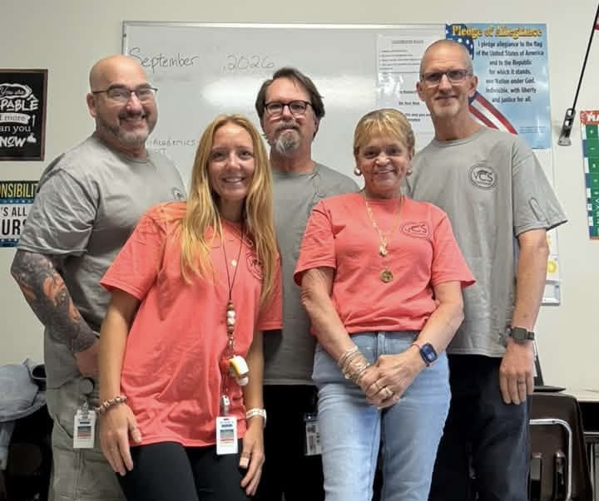

Welcome to HBS!!
Notes:
Hello and welcome to the HBS Title 1 Annual Meeting! We are excited to show you around our school with this virtual tour.

Slide 2


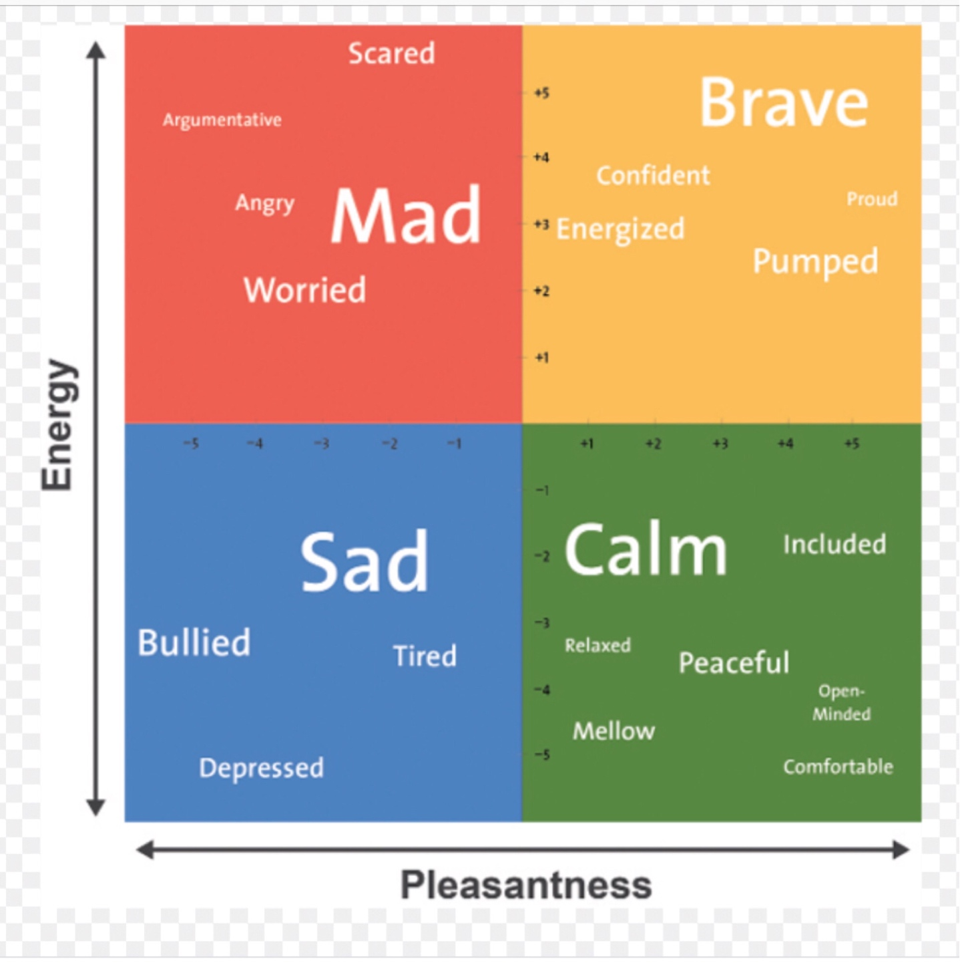

https://www.vcsedu.org/hbs
Notes:
As you probably know, the Day Treatment Program at HBS is designed as a short term placement to provide behavioral support to students requiring close monitoring of behaviors and/or medical management. If you want more information, please click the link and it will take you to our webpage which should answer most questions that you have.

Slide 3
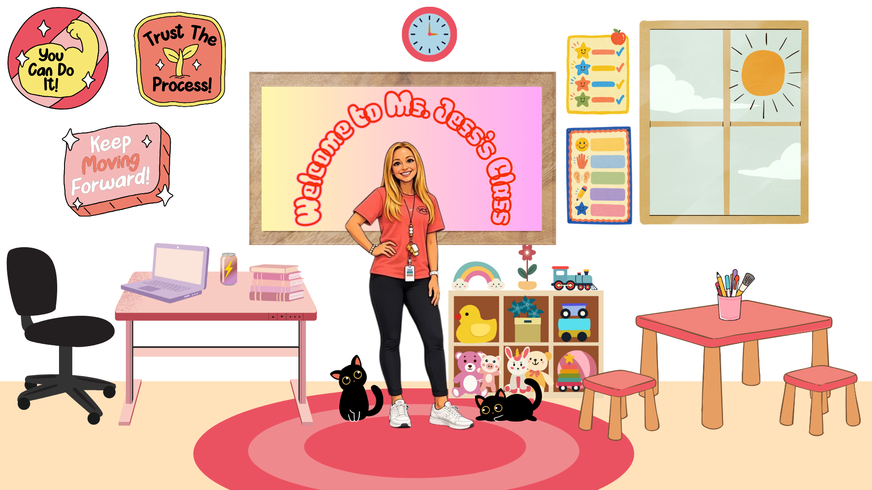








Slide 4


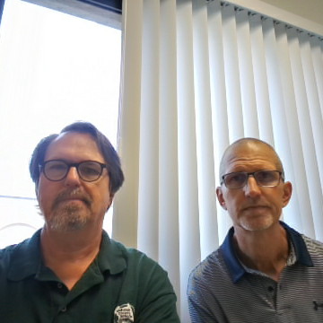

Notes:
In our Secondary classrooms we use Edgenuity as the core curriculum. However, we supplement these online courses with teacher led instruction and often utilize apps and programs such as IXL and Seesaw to create and deliver specialized content on a daily basis, particularly for social skills instruction. We use Microsoft Teams as a communication tool within the secondary classes for students to communicate with the teacher. Students do not have the ability to communicate with each other on any of these platforms. In a typical school day, we have a minimum of two social skills activities included within our academic time with students.

Slide 5

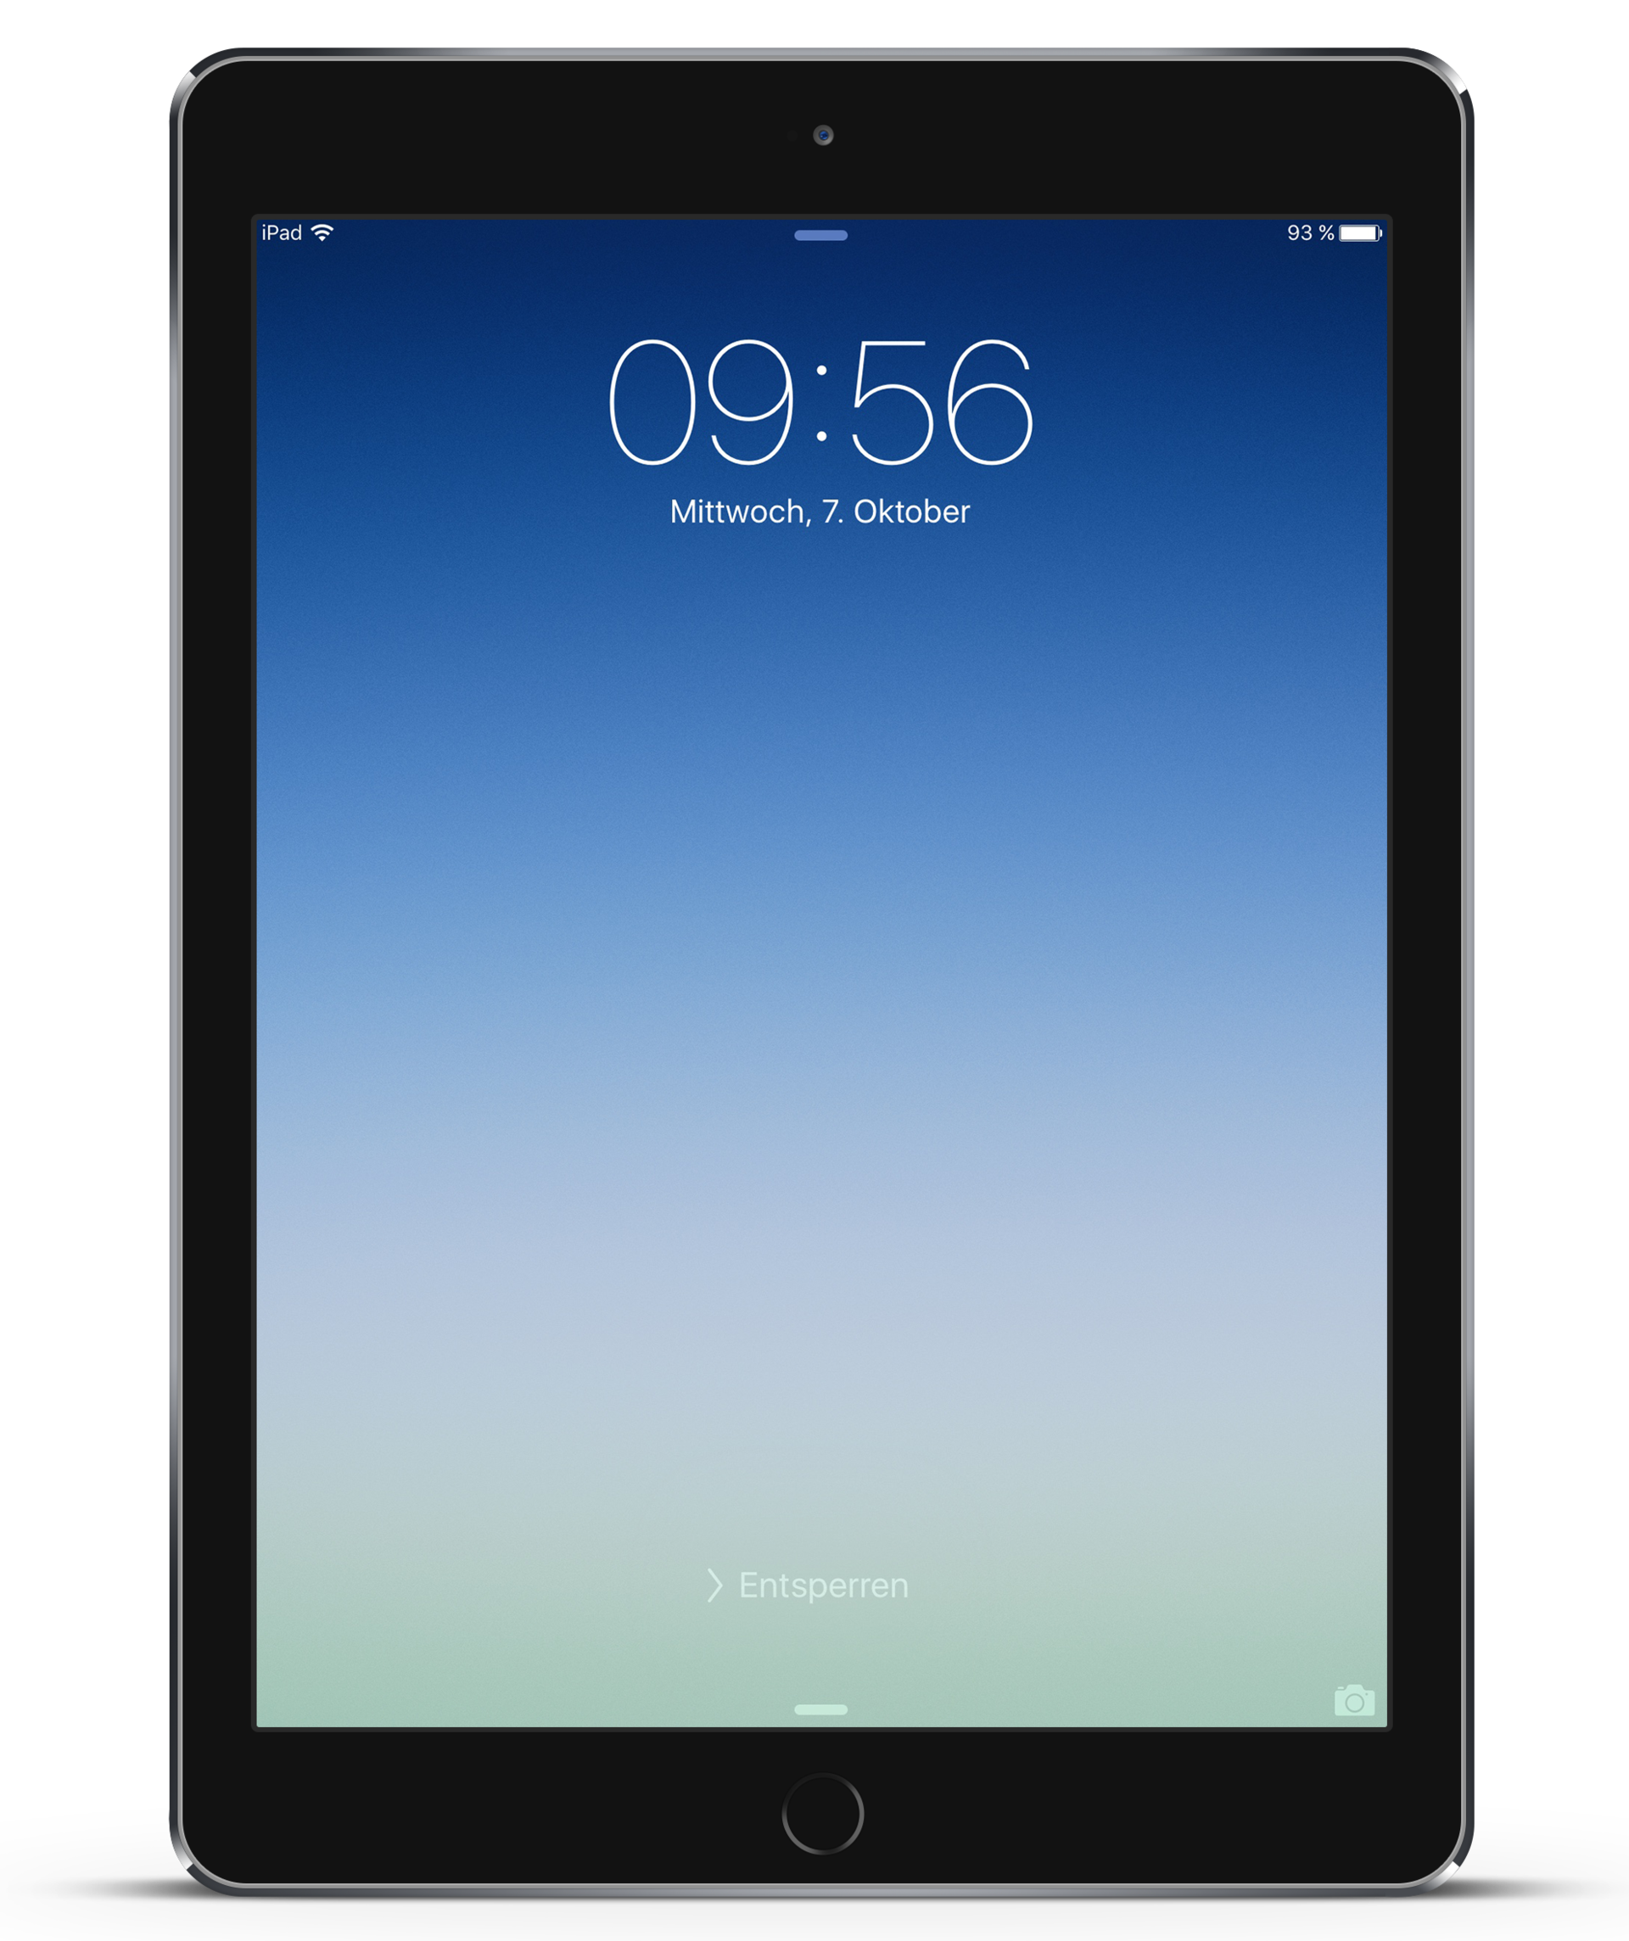
https://www.vcsedu.org/directory/schools/hbs/title-1-services
Notes:
Let’s talk about Title 1 Services. In our school, we use title 1 funds for supplementary classroom materials such as weekly readers. We also received our iPads and all the apps installed on them through Title 1. We have enough iPads to assign one to each student while they are with us at HBS and they utilize them in the classrooms as a supplement to their online curriculum and to access social skills activities. If you would like to know more about Title 1 Services, as well as view resources, please click the link and it will take you to the HBS website which has more information.

Slide 6
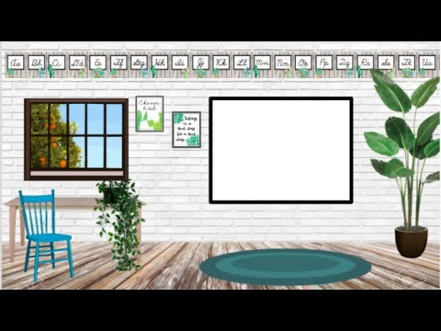
Thank
You!!
Notes:
Thank you for watching our virtual Title 1 Annual Meeting for this school year. If you have any other questions, please check out our website using any of the links provided earlier and always feel free to contact us at HBS. We look forward to another great year and appreciate your support!

