Slide 1


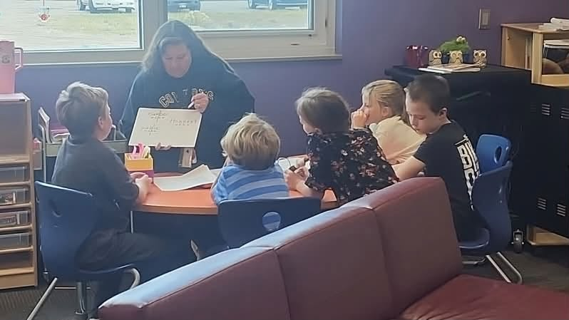
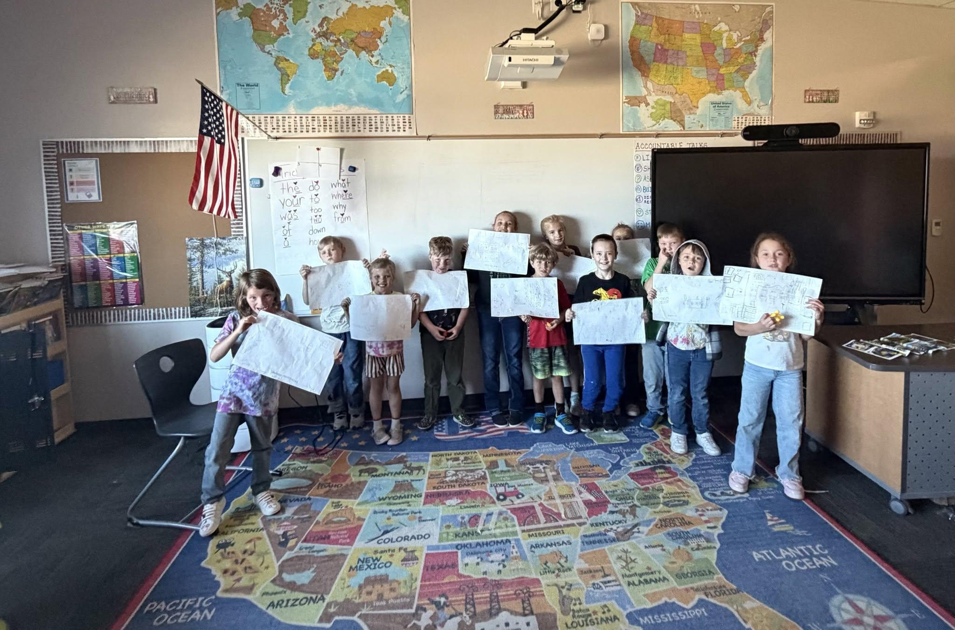
Moffat Consolidated School District #2
STRATEGIC PLAN YEAR 1
2026-2027 Quarter 1 Community Report
Reaching and Achieving: Every Step, Every Day, with Purpose
Presented by Superintendent Andrea Davis

Slide 2
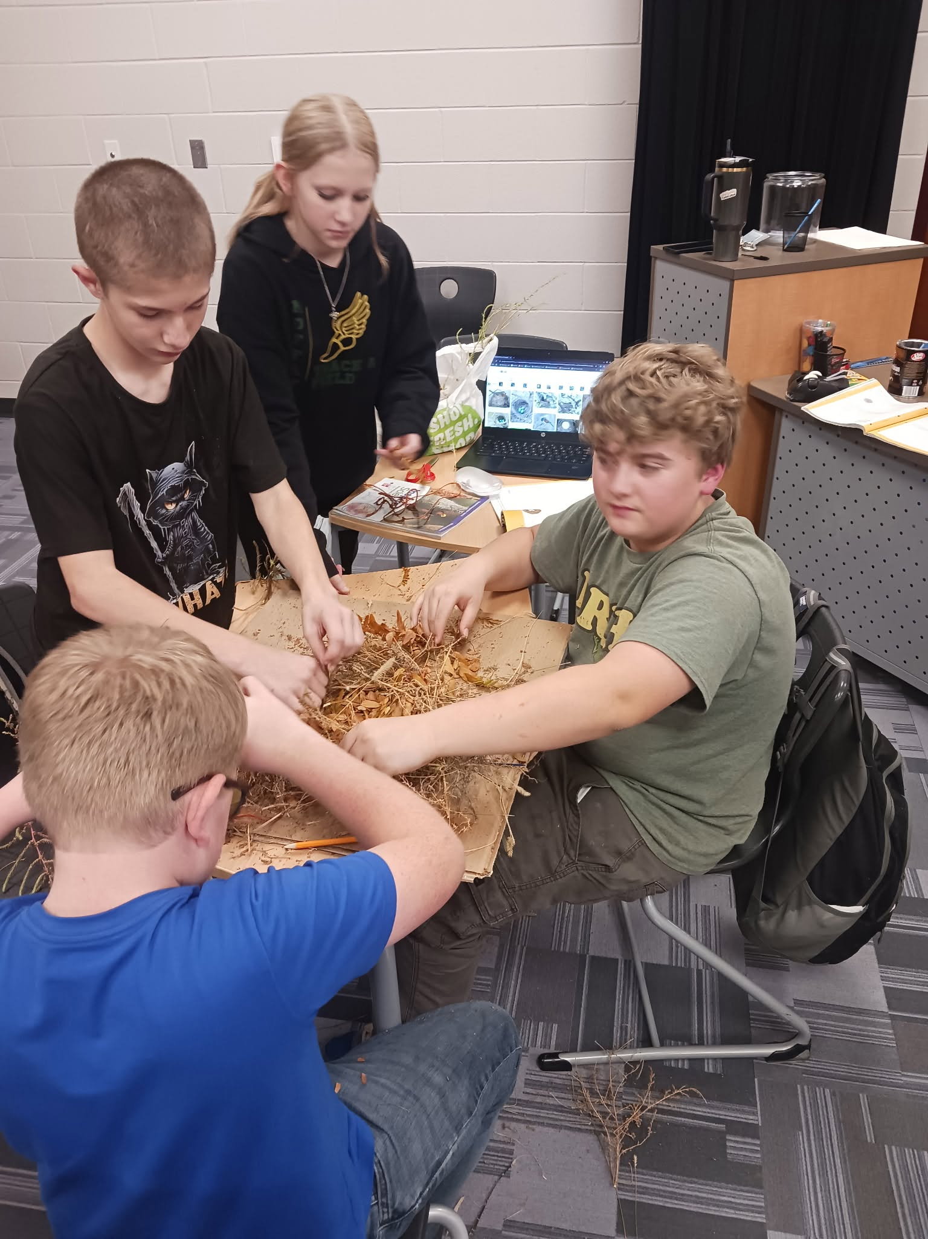
CULTURE & EQUITABLE DISCIPLINE
Establishing a Consistent Culture and Equitable Discipline Framework
DISTRICT BEHAVIOR MATRIX
2026–2027 Handbook Integration
We have updated and integrated our District Behavior Matrix into the 2026–2027 Student & Parent Handbook, following Board of Education approval.
BRONCOS ATTENDANCE NETWORK
Goal to cut chronic attendance rate of 46% in half.
CLASSROOM CONTRACTS
Co-created student agreements active in every classroom district-wide.
CAPTURING KIDS' HEARTS
Positive Classroom Contracts
To foster a positive environment, our Moffat PK-12 staff received Capturing Kids' Hearts training at the Beginning-of-Year, leading to co-created behavior contracts in every classroom.
SCHOOLWIDE "BOOTS" EXPECTATIONS
Be respectful
Own your actions
Operate safely
Think kindly
Strive for success

Slide 3
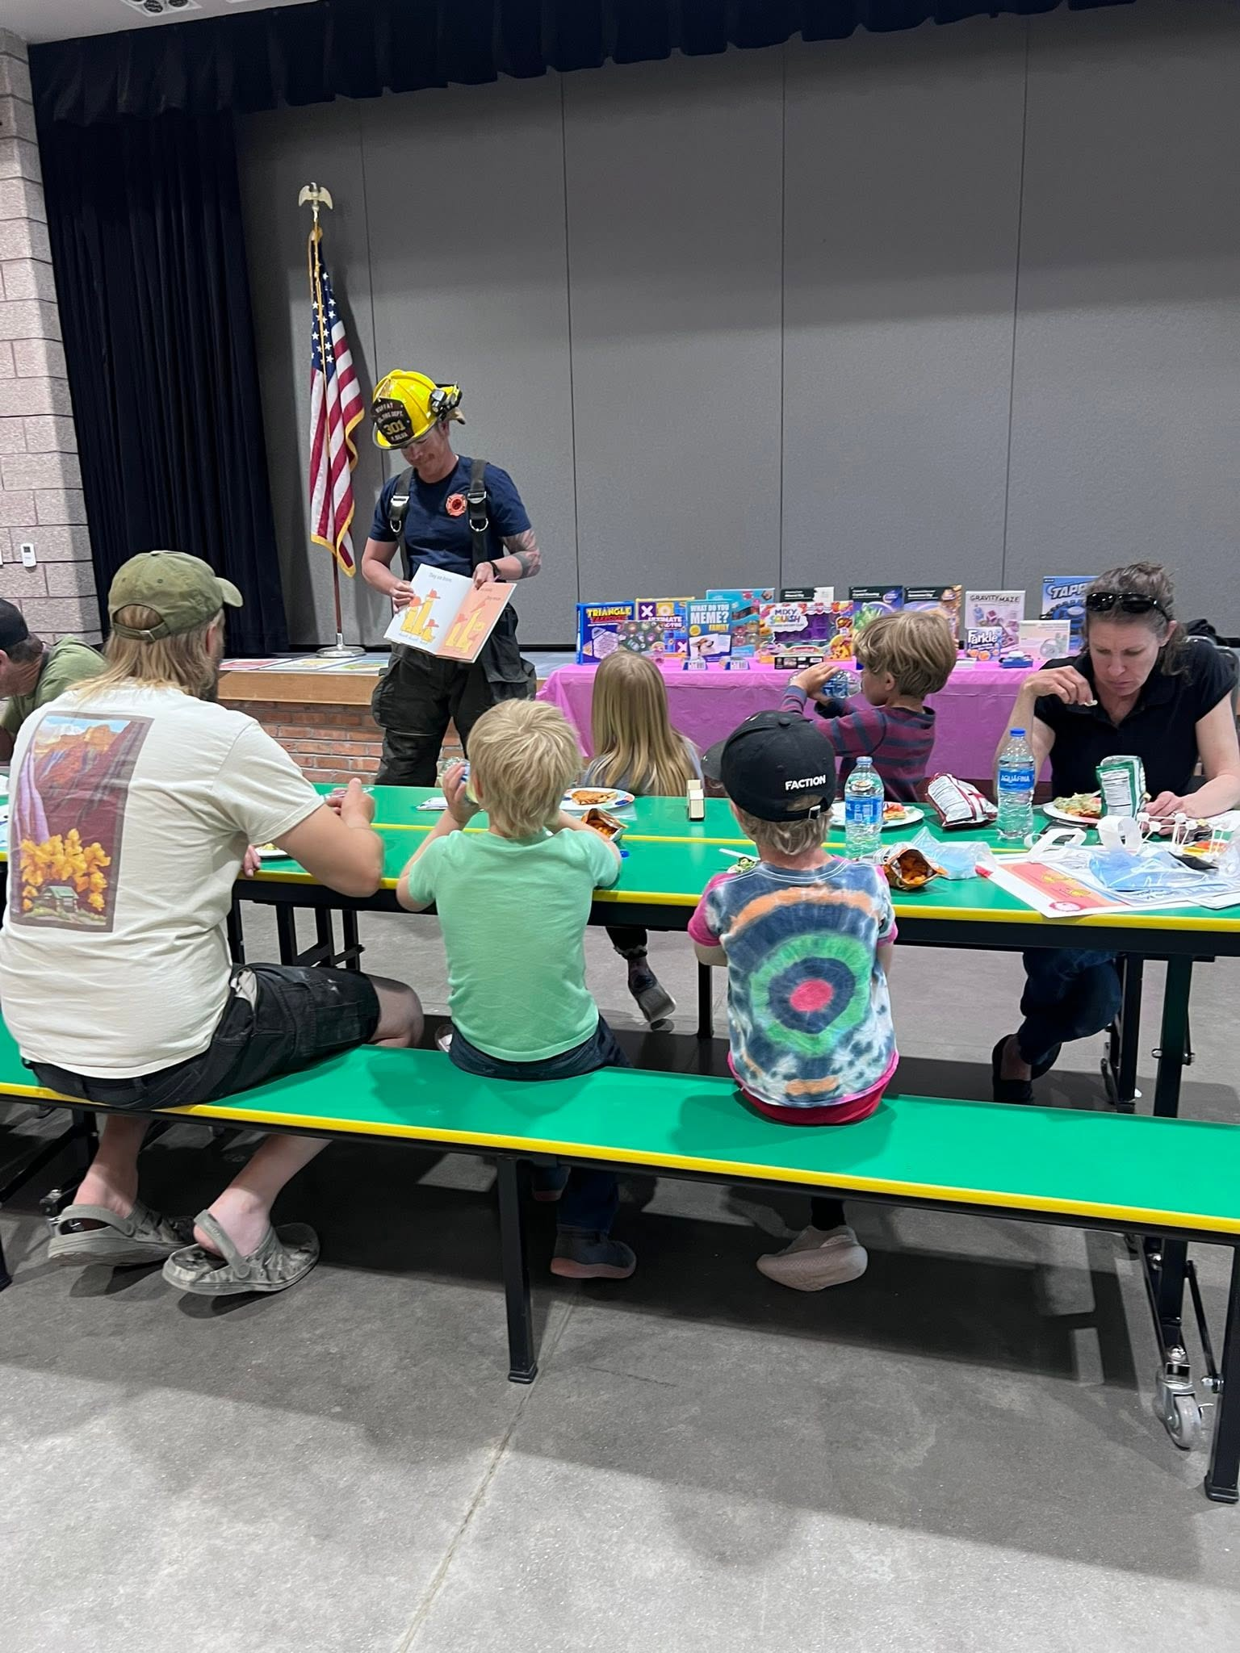
District Accountability & Community Engagement
Launching S-CAP & Enhancing Family Communication
Accountability Framework
Student-Centered Accountability
We are introducing the Student-Centered Accountability Program (S-CAP), a framework designed by rural Colorado districts to evaluate school climate and engagement beyond standardized tests.
Implementation Timeline
• 2026–2027: Introductory Year
• 2027–2028: Full Onboarding
Independent Fall Surveys
• October 1st – October 31st, 2026
• Administered with 100% anonymity by C-PEER at CU Denver to ensure objective feedback.
Outreach Channels
Family Communication
We continue active family outreach across our core communication platforms:
• ALMA
• ClassDojo
• District Social Media
Community Engagement
Next DAC Meeting
November 4th at 5:00 PM
Join our District Accountability Committee session to collaborate on district progress and family engagement.

Slide 4
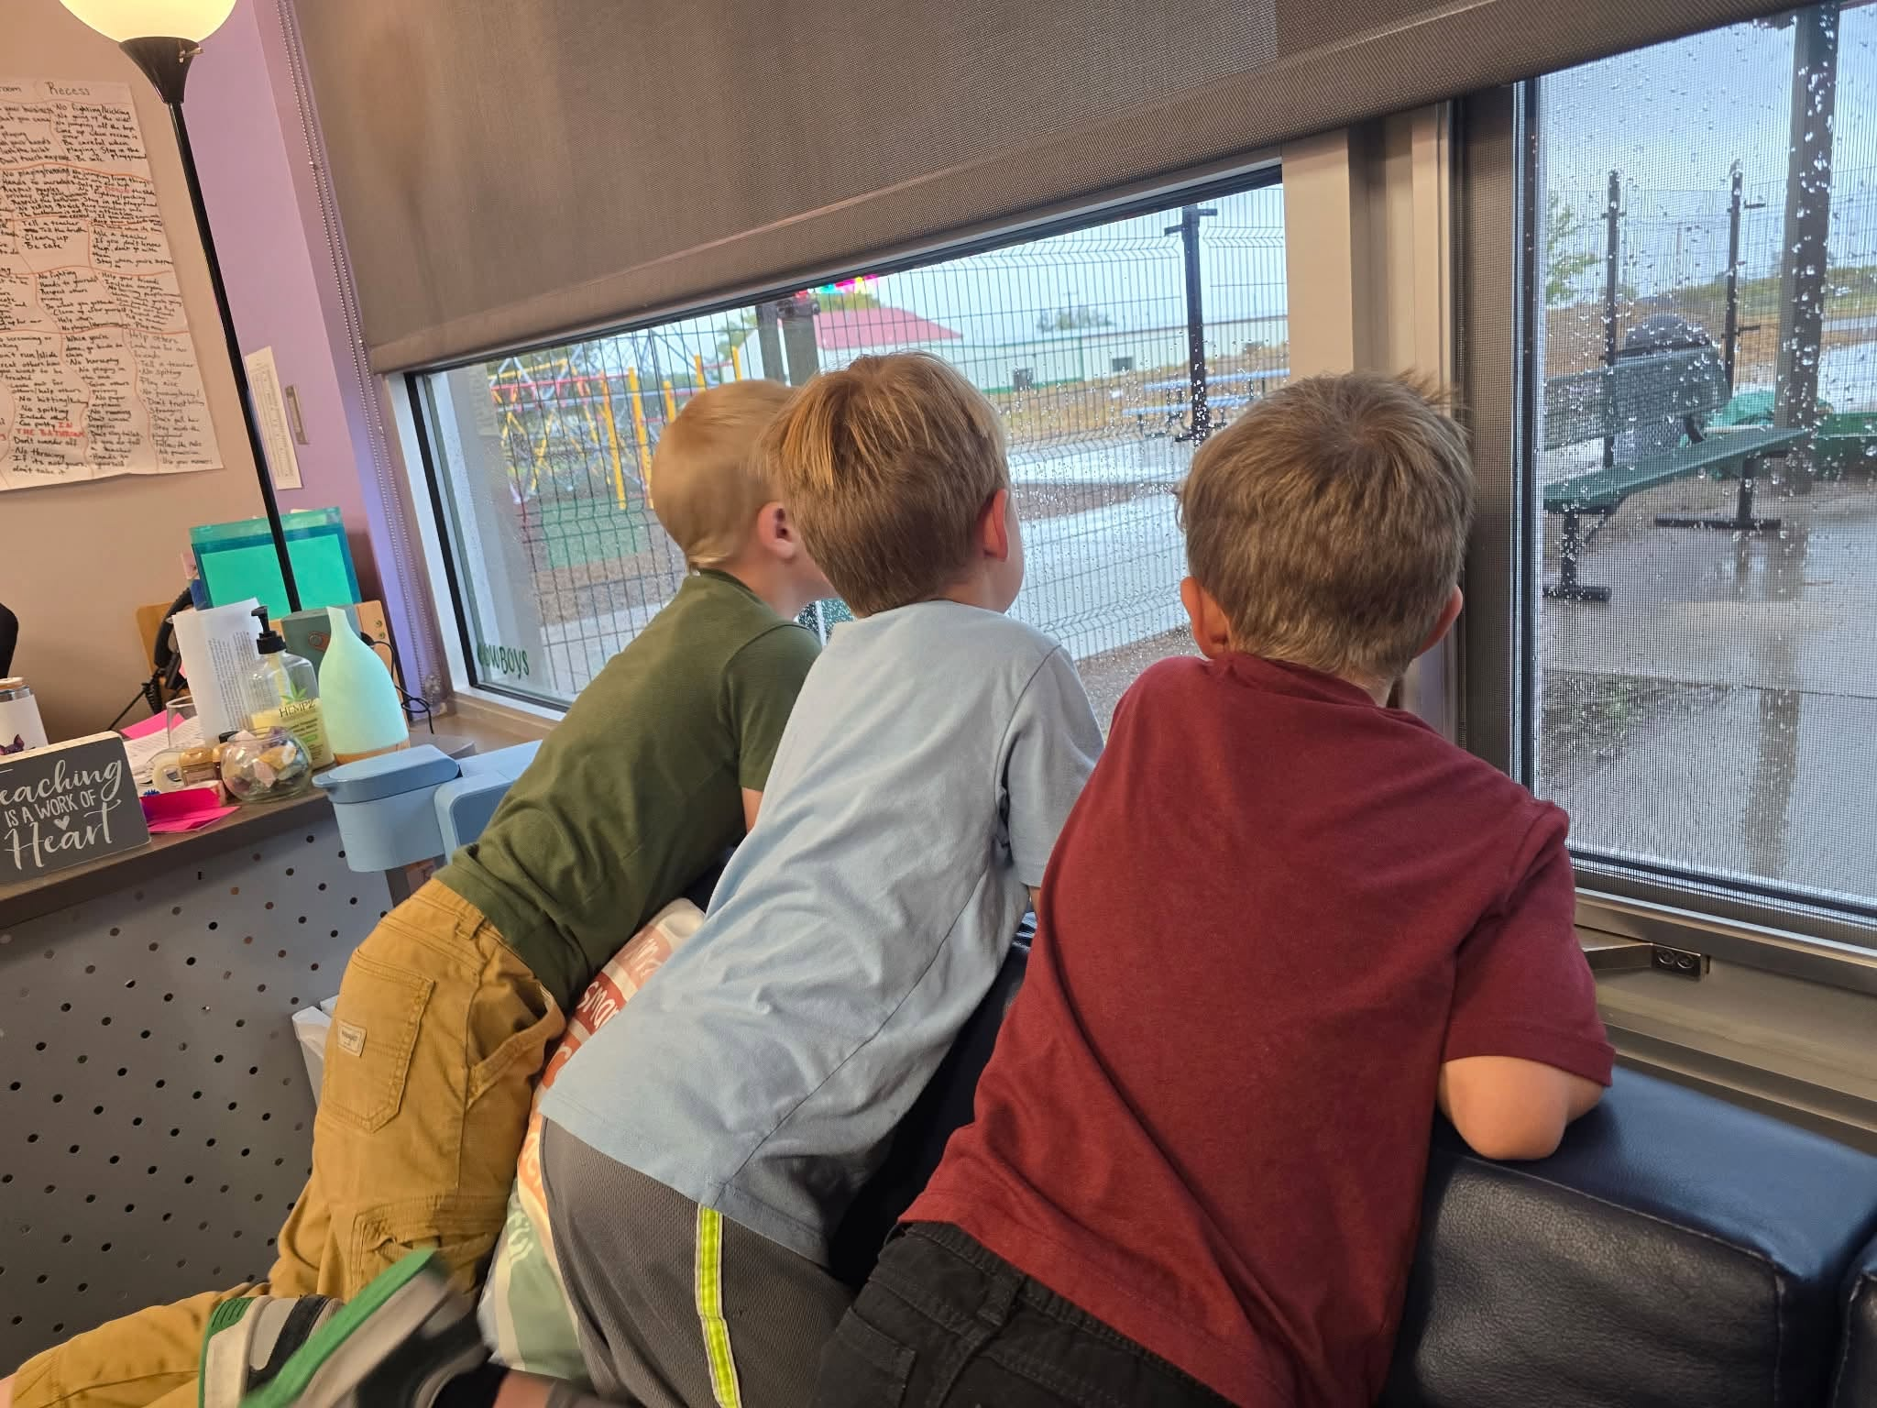
STUDENT SUPPORT & WELLNESS INITIATIVES
Supporting Whole Child Wellness Through Targeted Individualized Plans
1. MTSS TIER STRUCTURES
Our Multi-Tiered System of Supports (MTSS) team and staff members are actively in motion across all grade bands, developing and providing targeted support plans for every area of student need.
2. INDIVIDUALIZED ACADEMIC PLANS (IEP & ALP)
We deliver individualized accommodations for students on IEPs and utilize Advanced Learning Plans to challenge our Gifted & Talented learners.
3. WHOLE-CHILD WELLNESS SCREENERS
In the 2026-2027 quarter 1, we have administered BIMAS and Healthy Minds wellness screeners to identify needs early and guide targeted support team interventions.
Our student support teams are actively delivering targeted interventions for any student self-reporting struggles, ensuring holistic well-being.

Slide 5
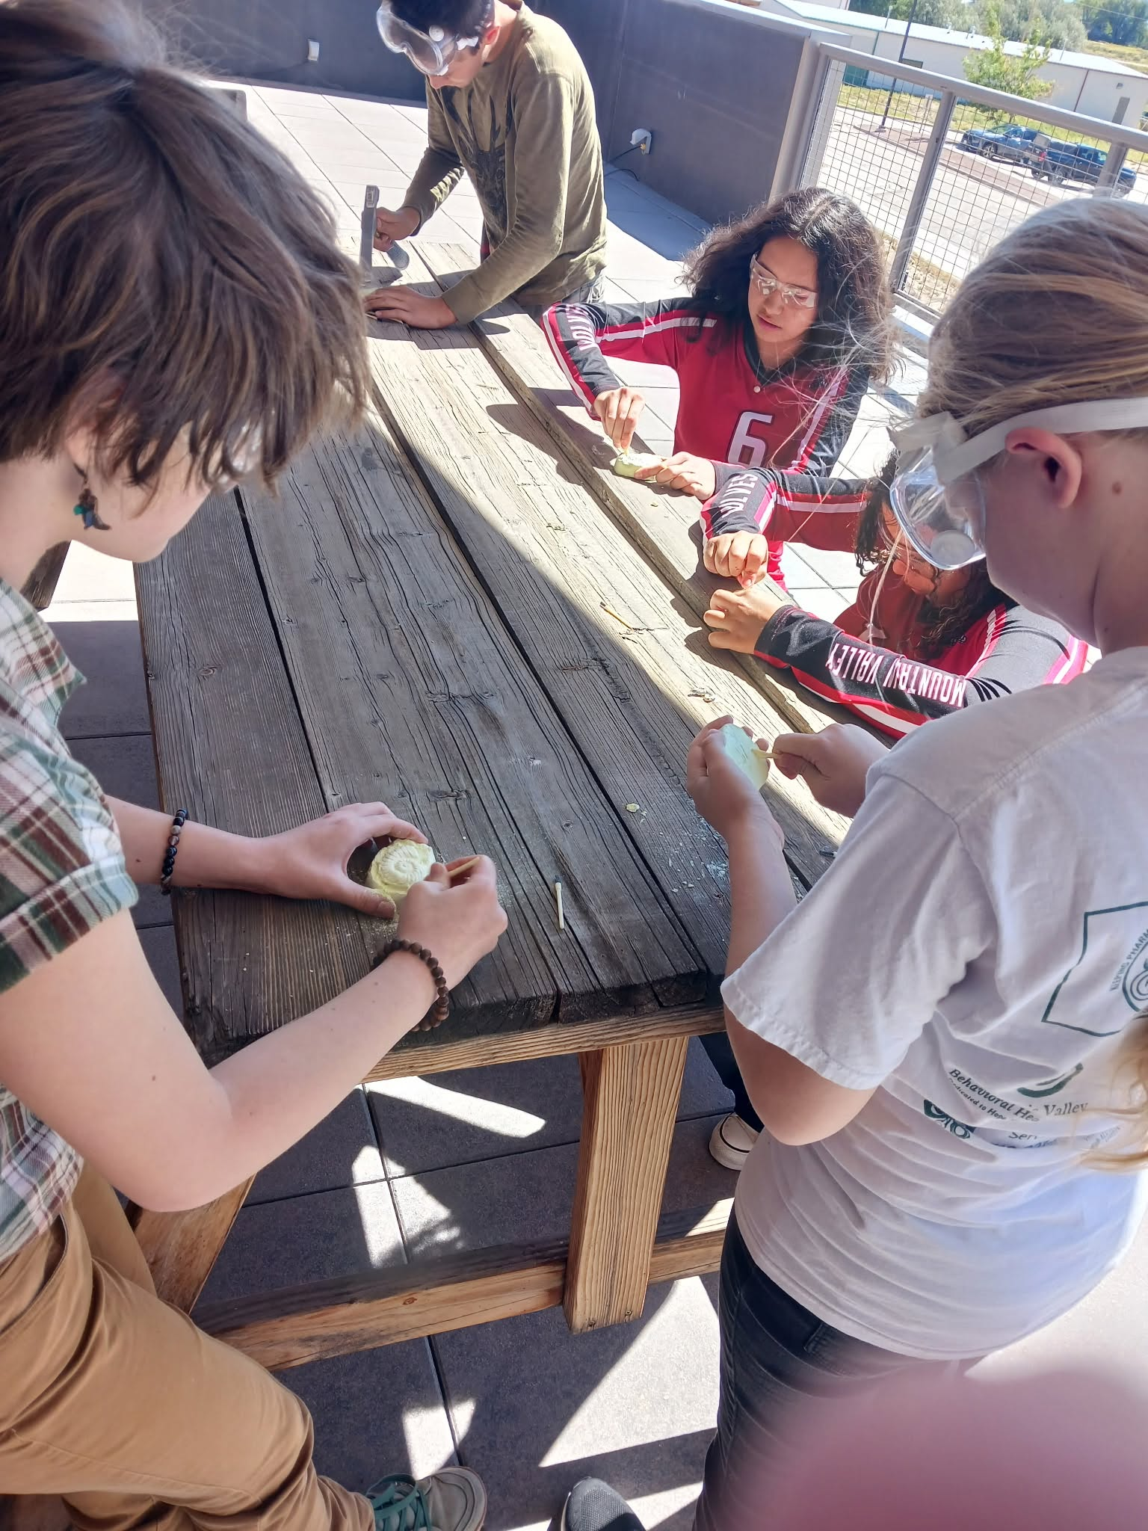
MOFFAT CONSOLIDATED SCHOOL DISTRICT #2
Advancing High-Quality Instruction & Standards
STATE ACCOUNTABILITY STANDARDS
Accredited District rating under CDE Framework
Moffat PK-12 earned a Performance Plan rating
CURRICULUM IMPLEMENTATION
Incorporating engaging, high-quality, standards-based instruction that builds student critical thinking, problem-solving, and core academic skills.
USDA TECHNOLOGY GRANT DEPLOYMENT
70-inch displays with integrated cameras
VR headsets for immersive learning experiences
New Chromebooks deployed district-wide
PROJECT-BASED LEARNING (PBL)
Staff attended PBL World 101 Training in California.
Empowering educators to drive deeper engagement across classrooms.

Slide 6
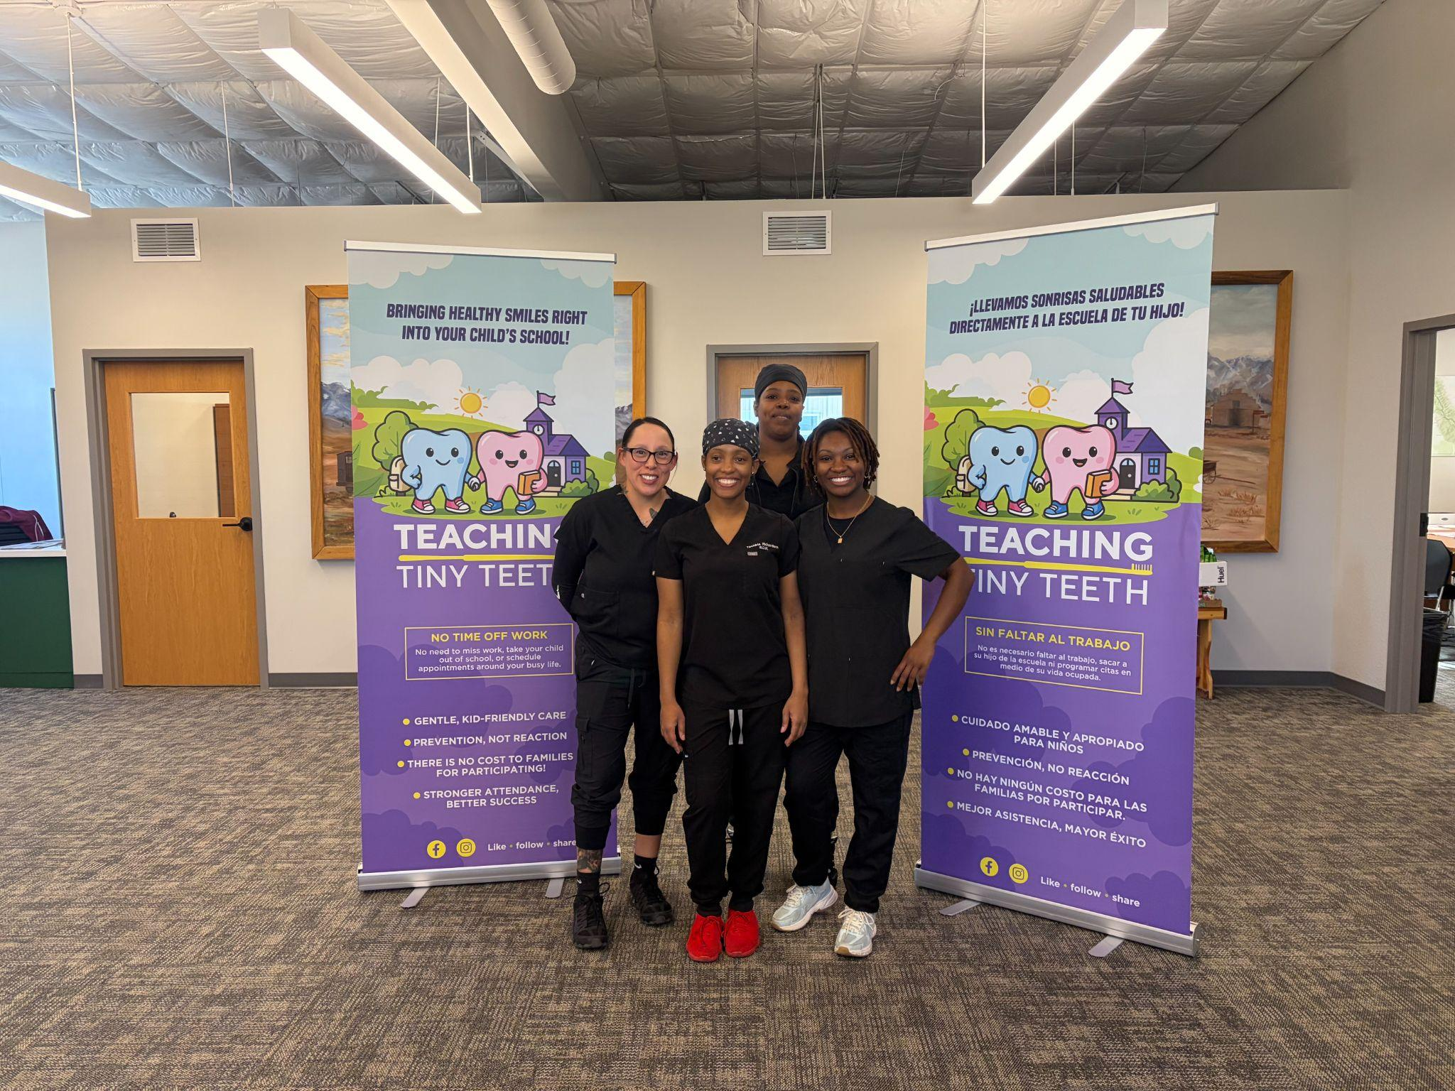
Expanding Community Partnerships & Facilities
Community Support
Wraparound Partnerships
Collaborating with the Saguache County Interagency Oversight Group (IOG) to provide direct linkages to vital wraparound support for district families.
Maintaining an active early-career teacher mentorship program in partnership with San Luis Valley BOCES to support our new teachers.
Infrastructure
Campus Improvements
Repairing and upgrading the main parking lot, HVAC repairs have been made at Moffat PK-12 and the district is purchasing a new school bus to ensure we are able to get our students to and from school, athletics, and learning opportunities.
In partnership with the Town of Moffat a grant application is underway to securing affordable, local housing for district staff.
On-Site Health
Dental & Food Services
Thus far, the District has partnered to bring direct dental care provided through Teaching Tiny Teeth Dentistry alongside the bi-monthly Care & Share Mobile Market.

Slide 7
Pathway Development & Growth
Growing Experiential Learning & Post-Secondary Pathways
Secondary ICAP Experience
Our 9th and 10th-grade District students completed a Secondary ICAP Denver Trip over the summer, visiting Junior Achievement, the CSU Spur Center, and various museums and cultural institutions to explore diverse career pathways.
Post-Secondary Pathway Growth Dashboard - Moffat PK-12
AY 2025–2026 Baseline
39
Earned Concurrent Enrollment Credits
AY 2025–2026 Baseline
0
Work-Based Learning Students
AY 2026–2027 Fall Progress
63
Concurrent Enrollment Credit Hours In Progress
AY 2026–2027 Fall Progress
3
Students Actively Participating in Internships

Slide 8
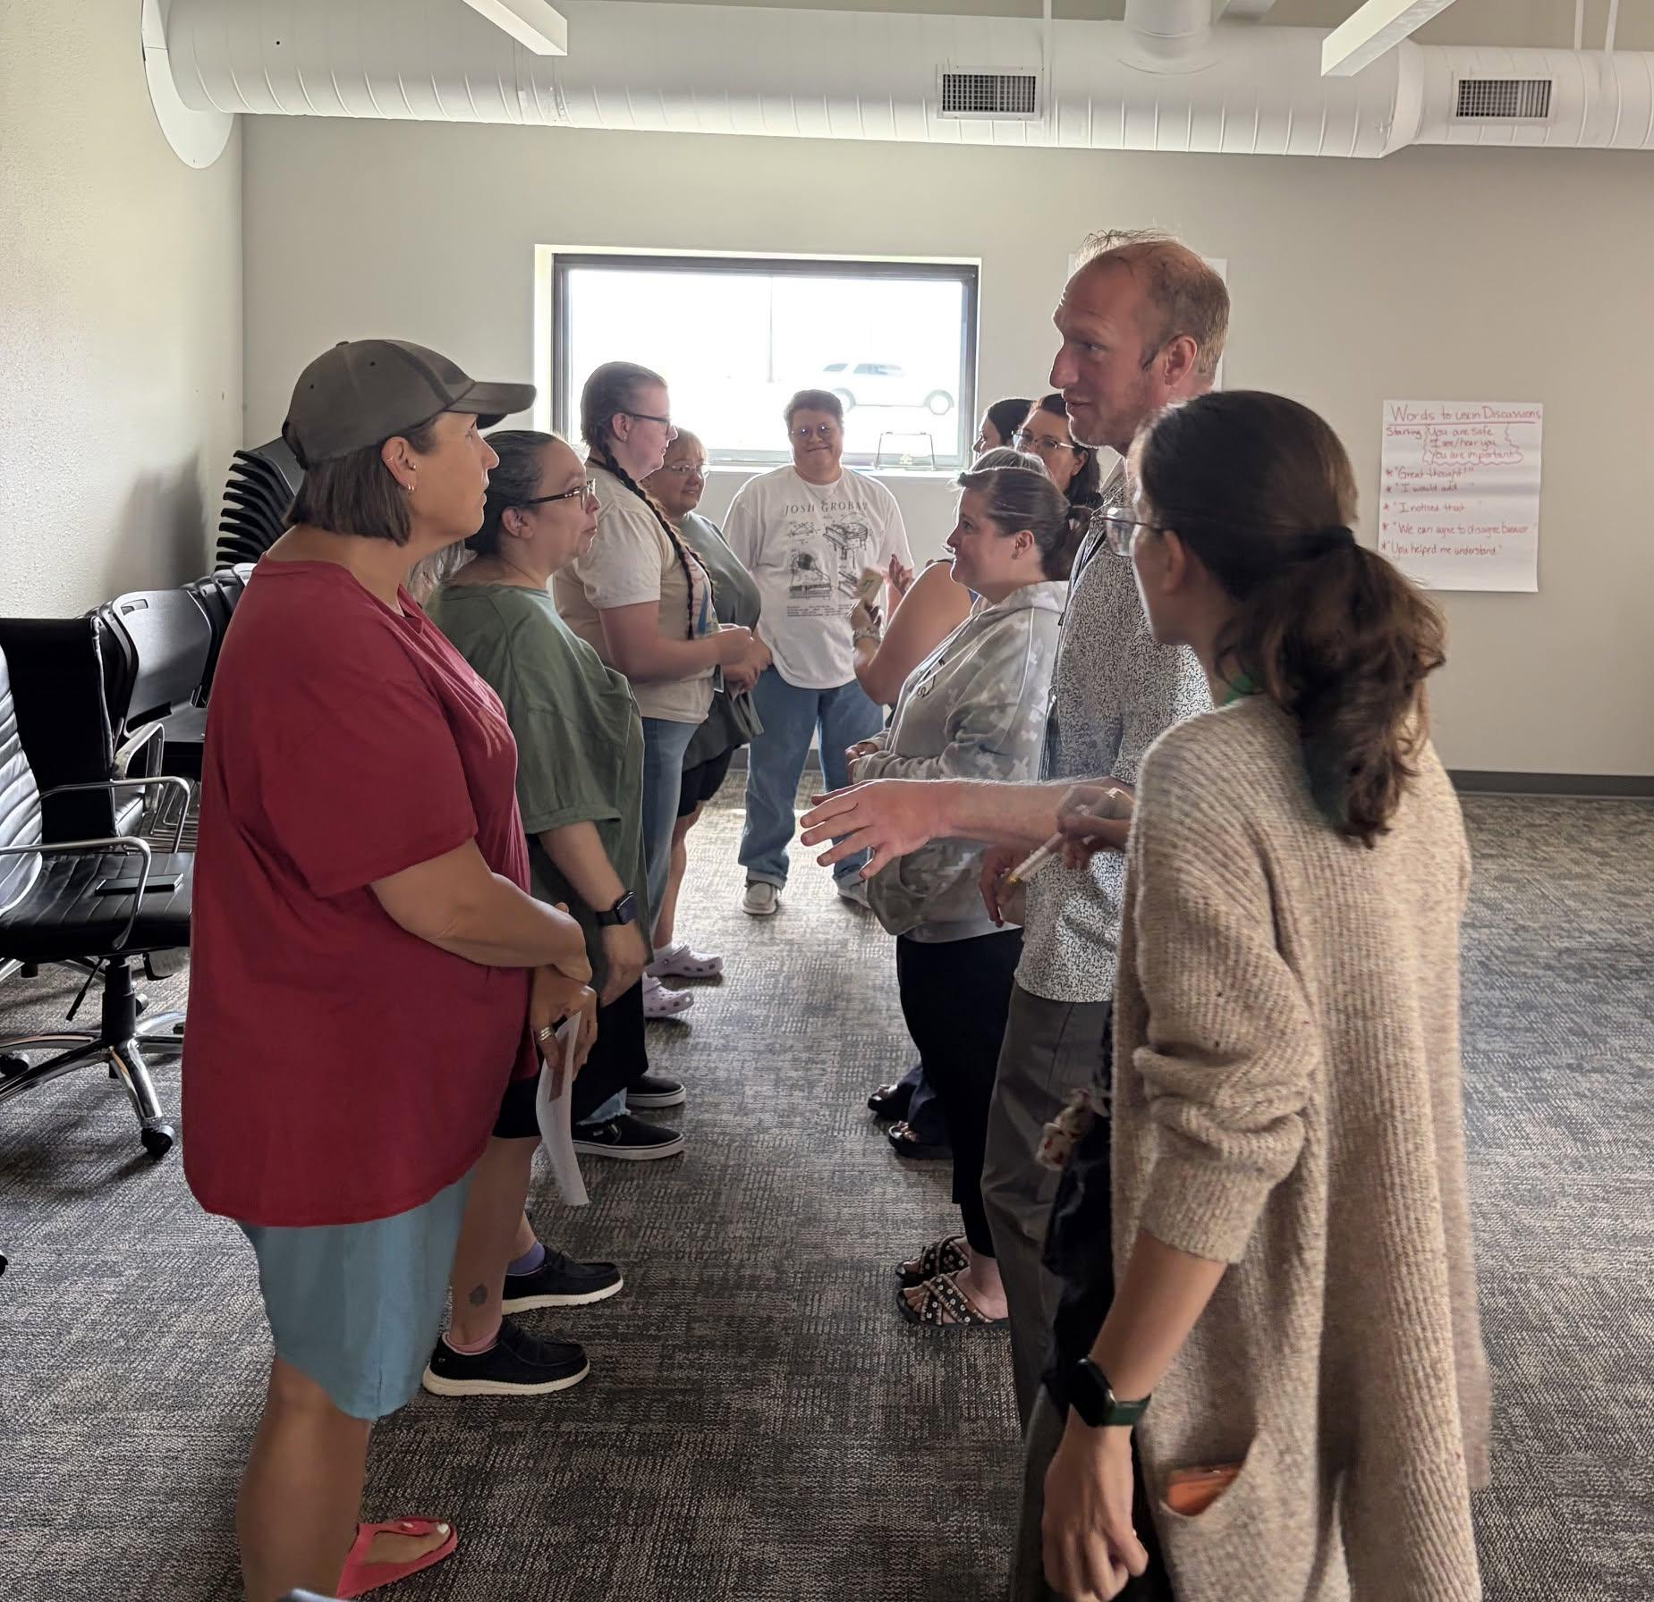
Celebrating Our Dedicated Staff & Next Steps
Staff Recognition
Honoring Campus Dedication
We proudly recognize our dedicated classroom teachers, instructional support personnel, substitute teachers, bus drivers, nutrition service staff, nurses, front office, and district teams for their unwavering commitment to serving students daily across campus.
Looking forward to seeing the community at the Cowboy basketball and track events this season!
Community Call to Action & Important Dates
S-CAP Stakeholder Survey
October 15th – October 31st, 2026
Please complete the survey online
Next DAC Meeting
November 4th @ 5:00 PM
All community members invited
Stay Connected
ALMA • ClassDojo • District Website
Follow for future district updates

