Slide 1



Maximizing School Funding:
Strategic Bond & Levy Campaigns
October 21, 2026
Notes:
Add some color

Slide 2
Introductions
xxx
Cory Bextermueller
K-12 Market Leader
Dr. Mike Mabe
K-12 Client Liaison
xxx
THE VIEW FROM BOTH SIDES

Slide 3
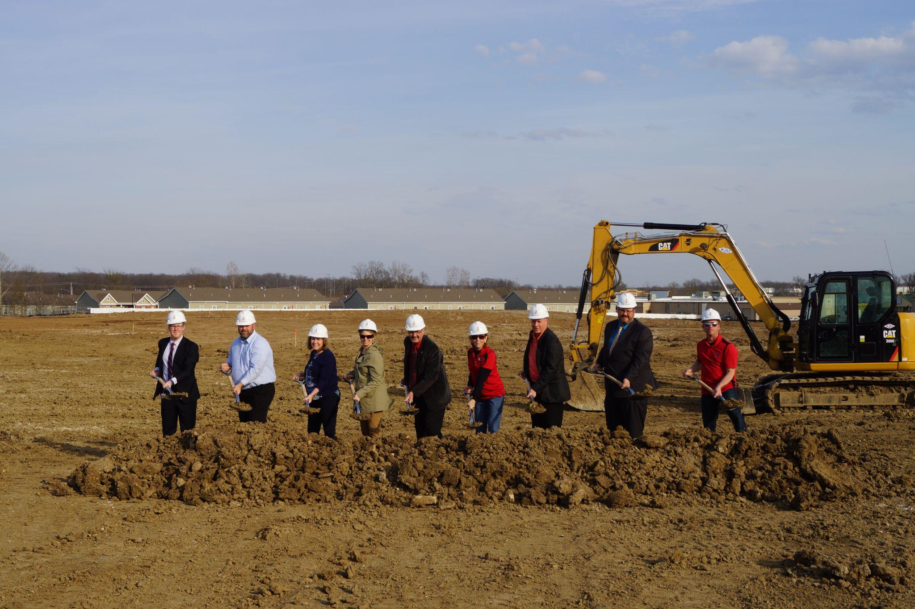
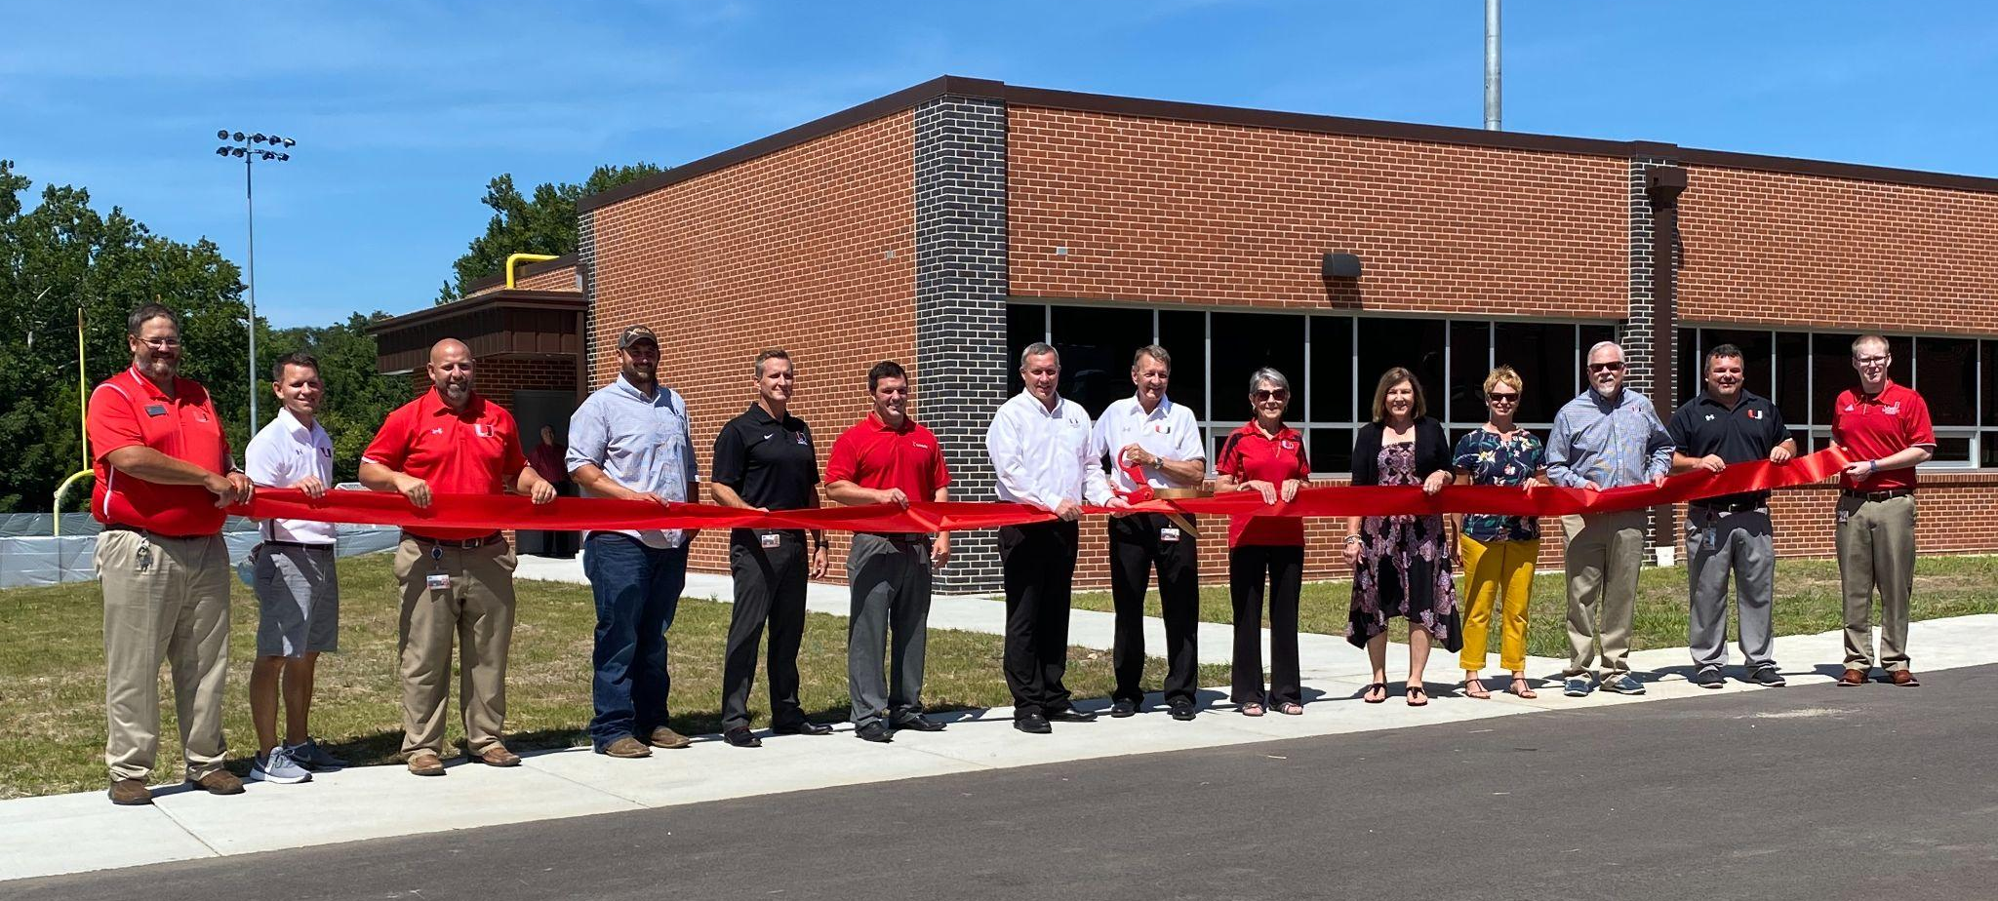
Agenda
Bond & Levy Projects
Programming & Master Planning
Board of Education Level
Documentation
Campaign Process
Question and Answers
Notes:
Delete this?

Slide 4

Overall Strategy
Steps to Generate Data for a Successful Bond Campaign
Notes:
Delete this?

Slide 5


Bond & Levy Projects
How do we decide / define the projects?
Assess facility conditions and capacity needs
Identify educational program enhancements
Review safety and accessibility requirements
Align with long-term district goals and strategic plans
Facility Committee
Bonds, Fund 4, Leases
🍰

Slide 6

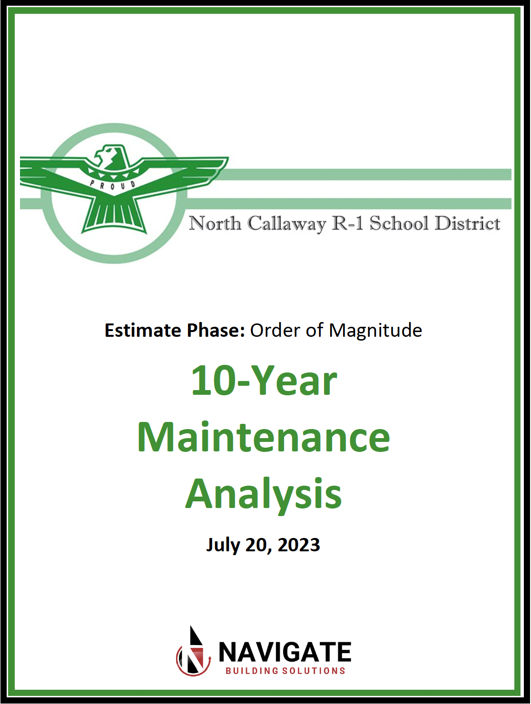
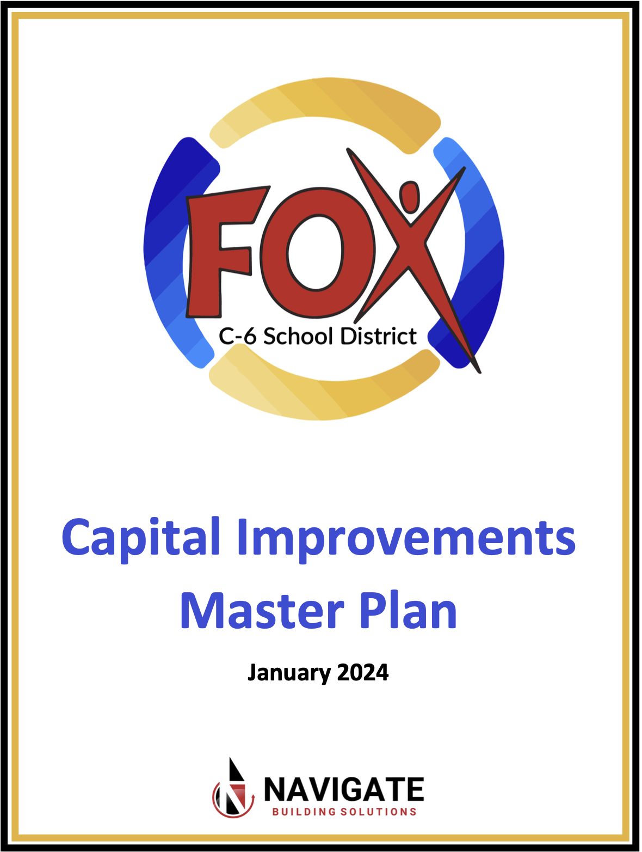
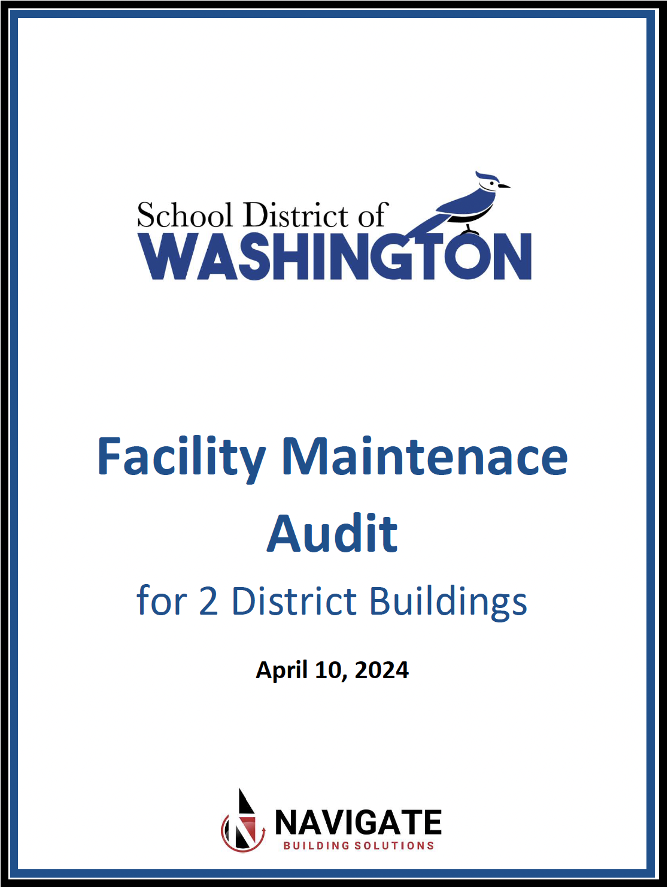
Programming & Master Planning
Developing District Needs and Wants
Needs: Must-have projects essential for safety, compliance, and functionality
Wants: Enhancements that improve the learning environment but are not critical
Conduct stakeholder meetings and surveys to prioritize
Feedback from facility committee
Generate maintenance plan and or master plan

Slide 7
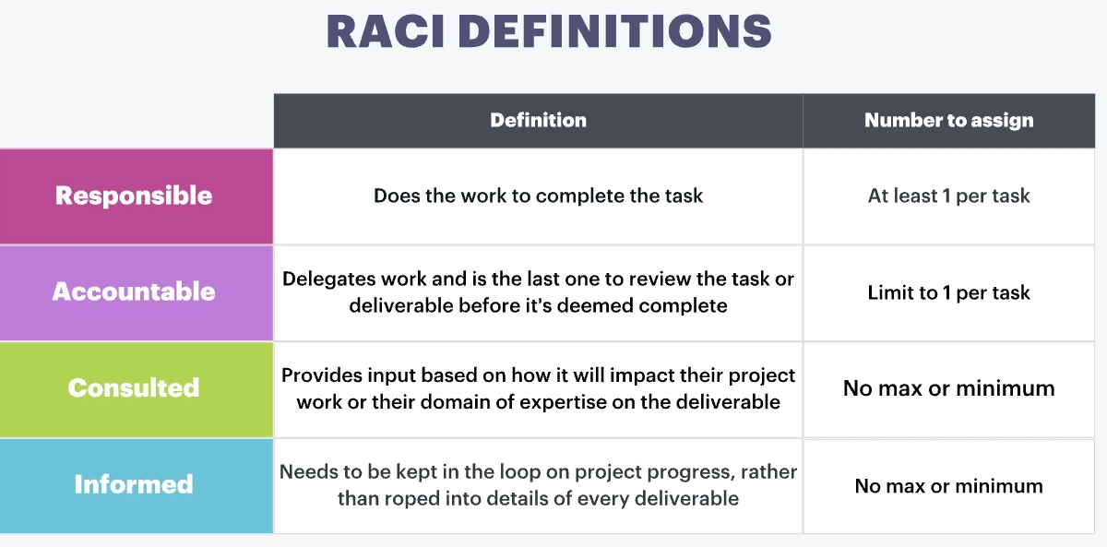
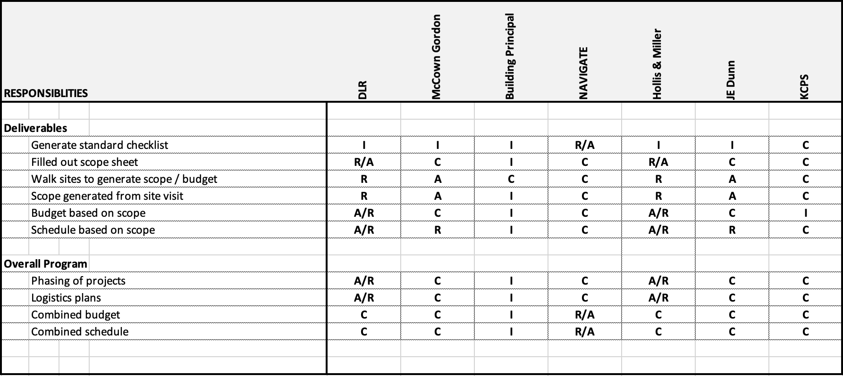
Programming &
Master Planning
MANAGEMENT STRUCTURE
Establishing a clear management structure
Define roles: school board, superintendent, project manager, owner representative
Outline decision-making processes

Slide 8


Programming & Master Planning
FINANCIALS
Tax or No Tax?
  Understand funding sources: bonds, levies, grants, public-private partnerships
  Analyze tax impact and communicate clearly to stakeholders
Who are your financial partners?
  Bond Underwriter
  Bond Counsel
  Bank and/or Investment Company
🍰
Notes:
Note: “Logos $” ???

Slide 9

Programming & Master Planning
FINANCIALS
Arbitrage occurs when a school district (or other public entity) issues tax-exempt bonds, invests the proceeds in higher-yielding investments, and then earns a profit from the difference in interest rates
Regulated by the federal government
Arbitrage only applies to school districts with bond issues of $15,000,000 or more
Strategy of a schedule to help districts avoid arbitrage and retain the additional interest
Notes:
Arbitrage

Slide 10

Programming & Master Planning
STAKEHOLDER ENGAGEMENT
Plan to engage key stakeholders:
Staff
Students
Maintenance
Administration
Board of Education (BOE)
Parents of Students
🍰

Slide 11

Programming &
Master Planning
DESIGN TEAM
Selecting a design team
  Qualifications-based selection
  Experience with K-12 facilities and funding requirements
  Assist with programming and programmatic designs

Slide 12
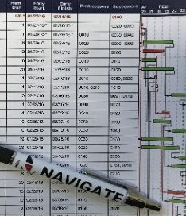
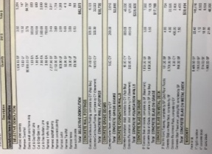
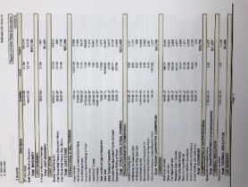
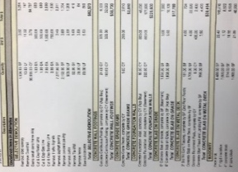
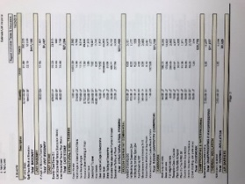
Documentation
Present plan, budget, and schedule
  Clear, data-driven proposals
  Address risk mitigation and contingencies
  Generate master program schedule
Generate and submit bond language
  Legal compliance and ballot preparation

Slide 13
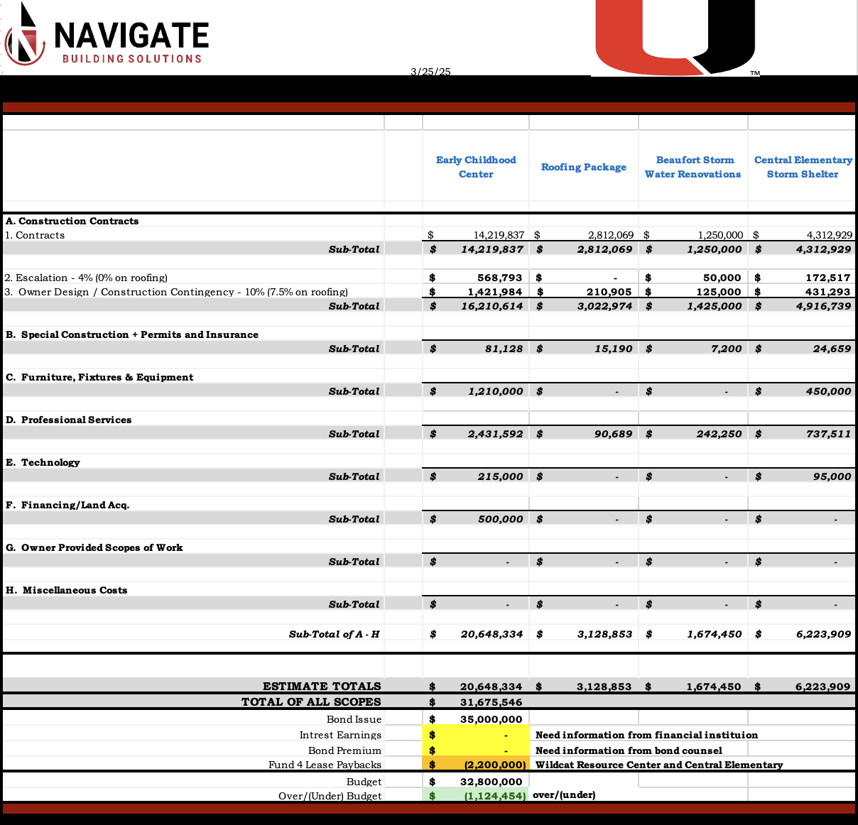
🍰

Slide 14
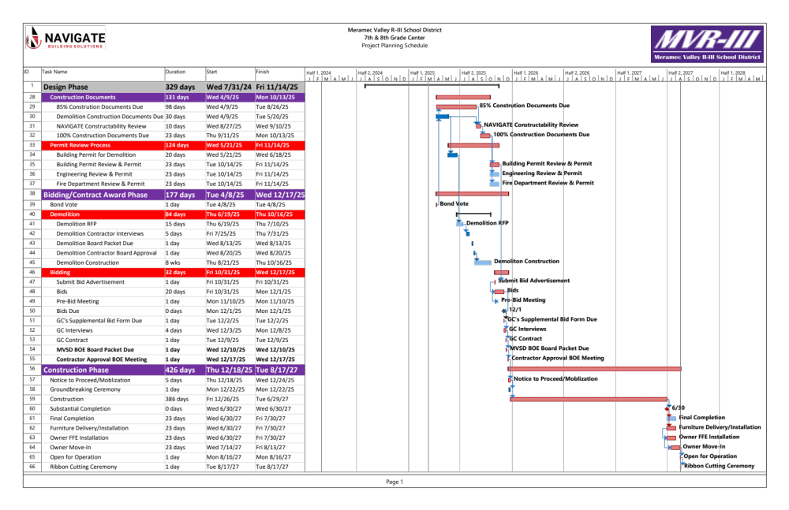

Slide 15
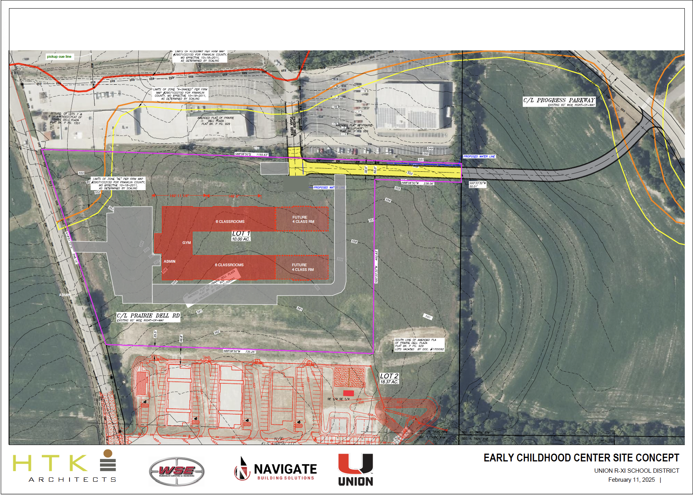
🍰

Slide 16
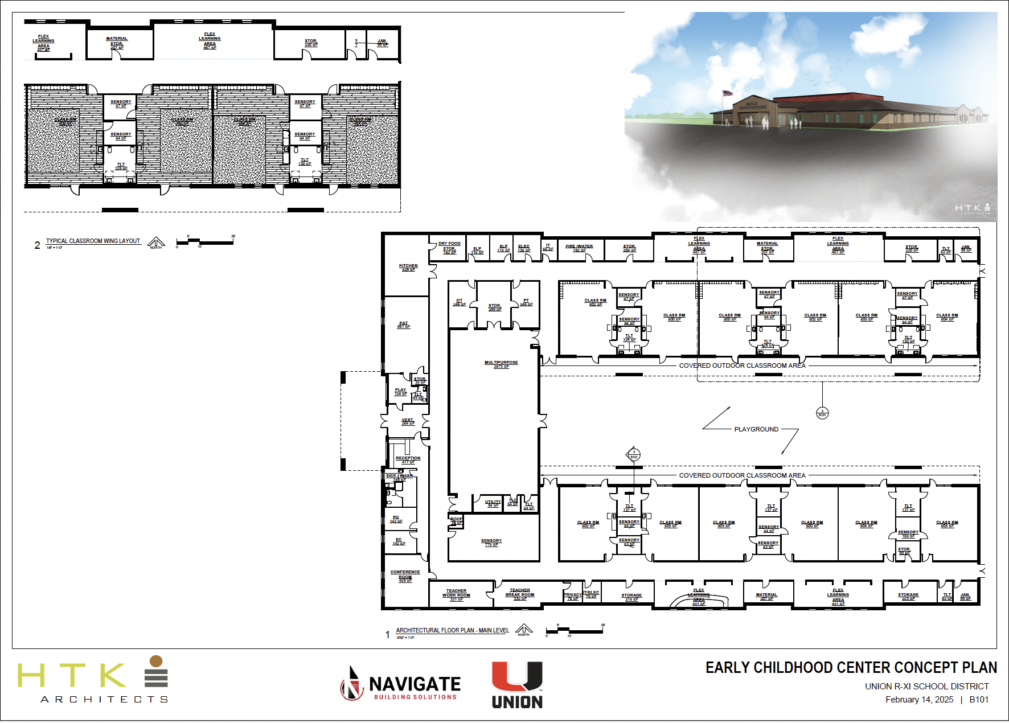
🍰

Slide 17
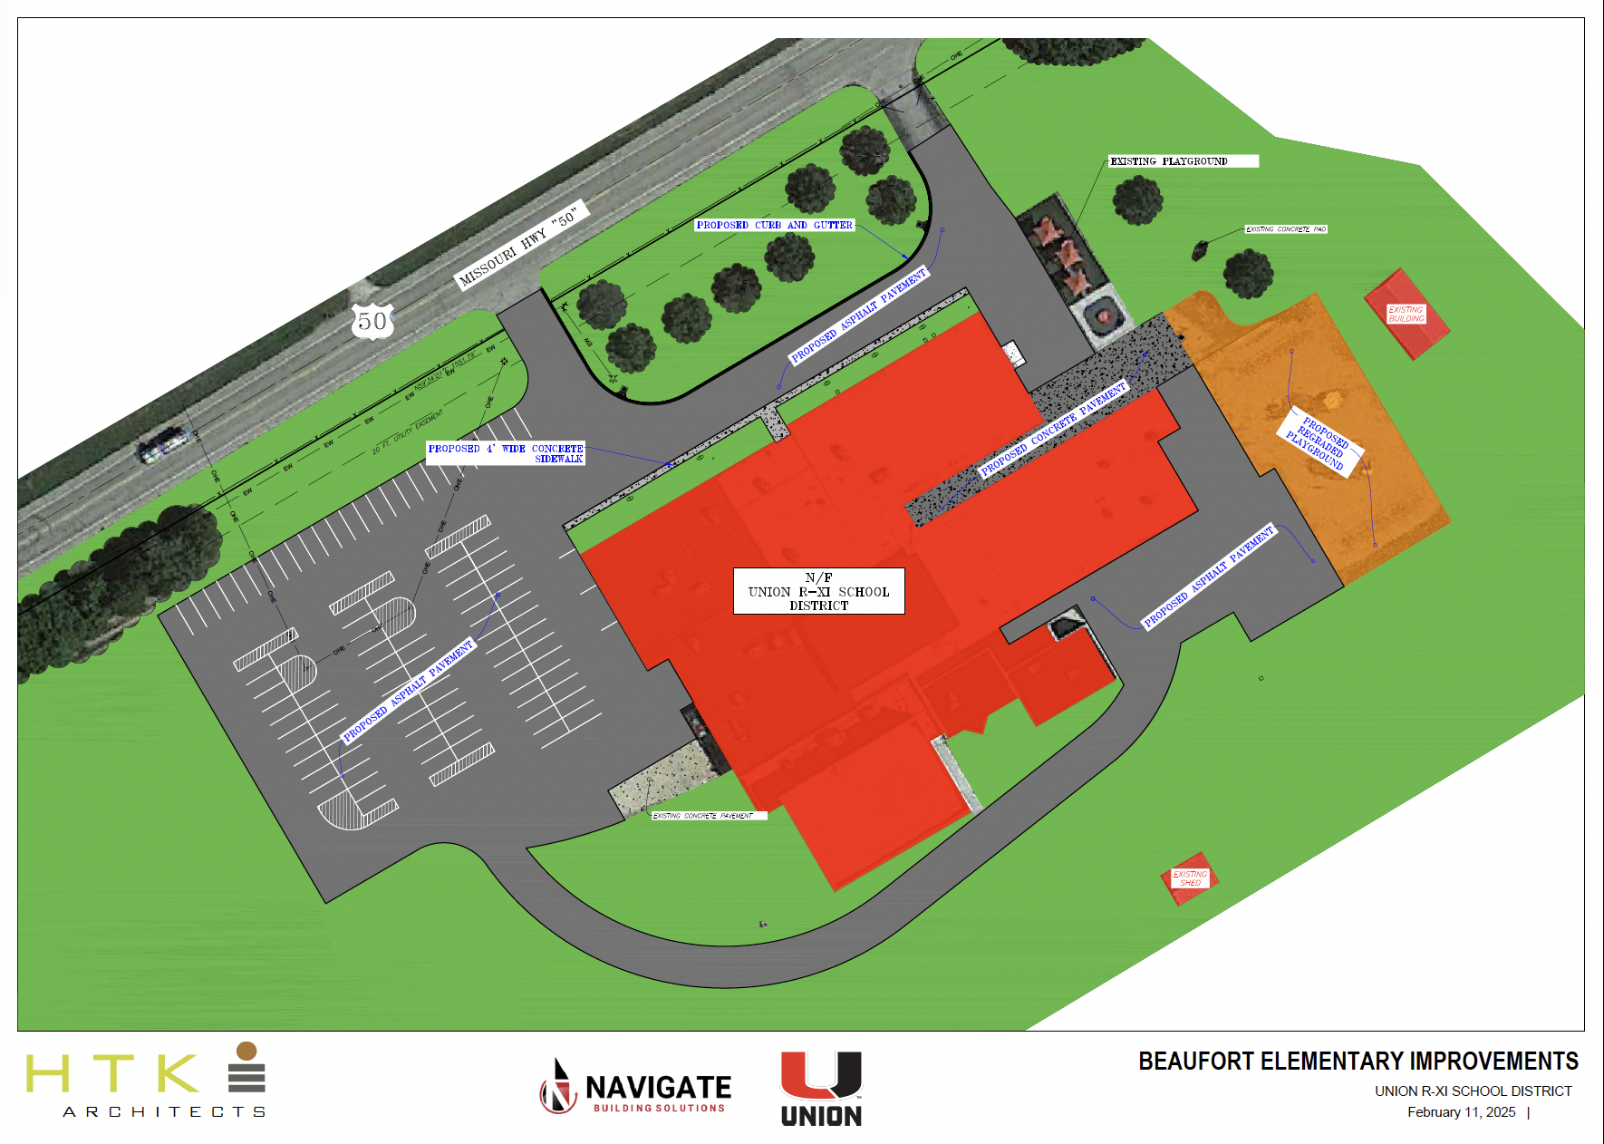
🍰

Slide 18
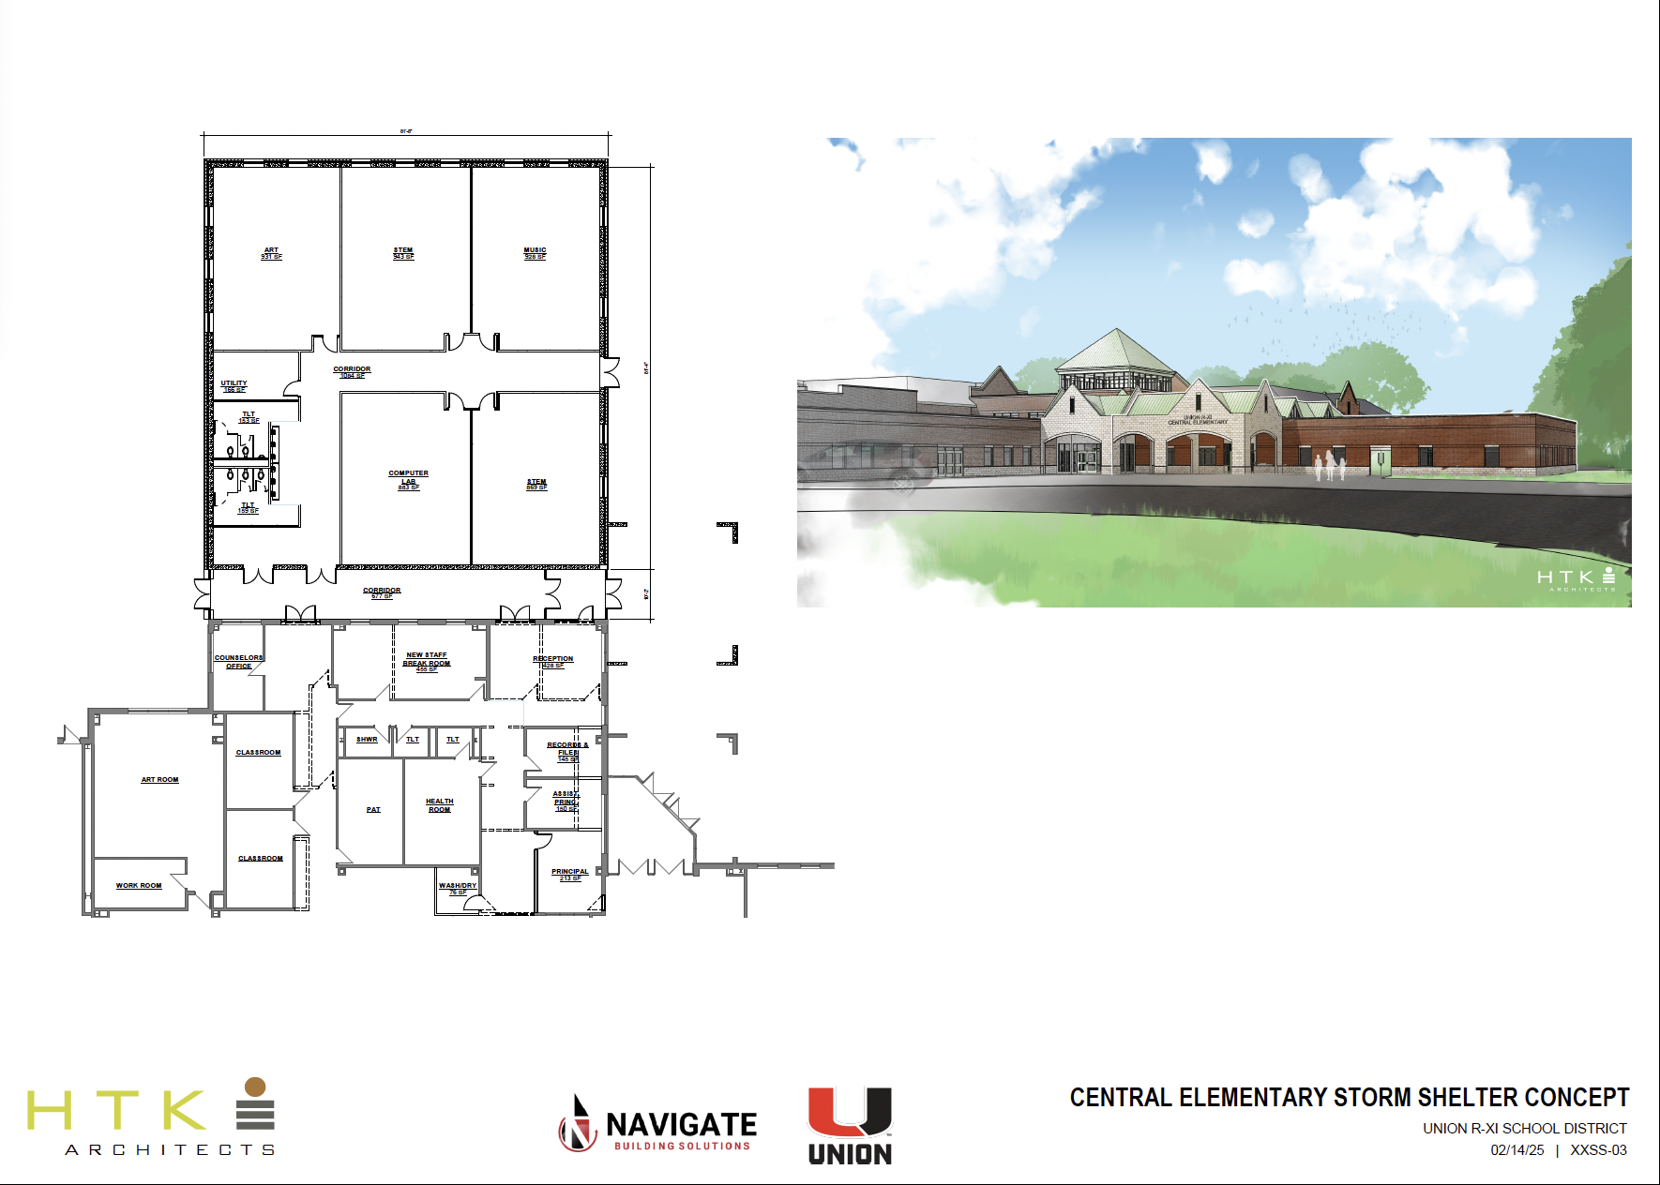
🍰

Slide 19


Campaign Process
COMMUNITY ENGAGEMENT
Vote Yes Committee
  Mobilizing local advocates
  Communicating benefits to the community
Town Hall Meetings
  Transparent discussion forums
  Addressing concerns and misconceptions
Social Media Strategy
  Consistent messaging across platforms
  Engaging content to educate and inform
  Video content to bring the community into the spaces
https://youtube.com/clip/UgkxD7j9VvkdXCwX2fp8dwPin_McxUx8hdiH?si=cXvc4Yv-4eemC5N5
https://youtube.com/clip/Ugkxb8muHaVDS6F7yjJ13MqRt4eXg_BlgQh9?si=8xfLxbowRw1bEqIY
https://youtube.com/clip/UgkxJmYy1tFYN0t-hvyjYvhDftabq7lE_4AC?si=RjfDn3ZNUTvNRR7O
🍰
Notes:
Swap out with more recent links – union, crawford county, steelvile

Slide 20
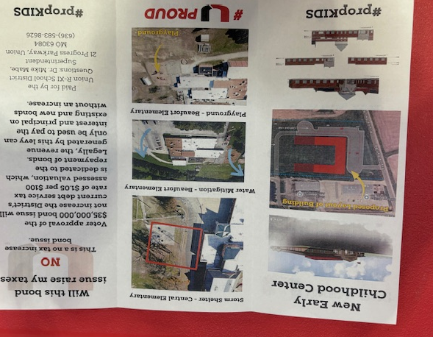
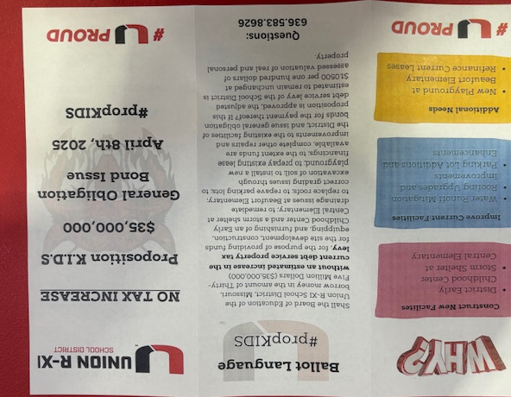
Campaign Process
COMMUNITY ENGAGEMENT
🍰

Slide 21
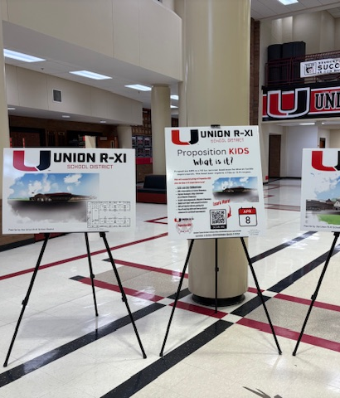
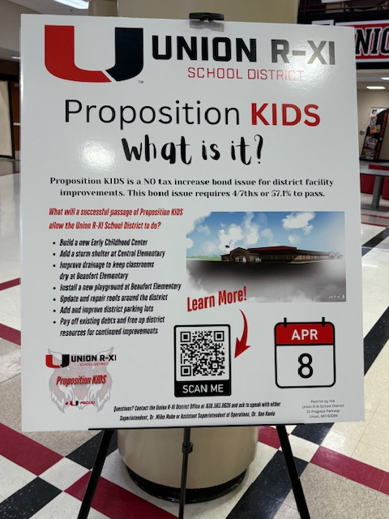
Campaign Process
COMMUNITY ENGAGEMENT
🍰

Slide 22


THANK YOU
QUESTIONS & ANSWERS

Slide 23
Introductions
Cory Bextermueller
K-12 Market Leader
Dr. Mike Mabe
K-12 Client Liaison
THE VIEW FROM BOTH SIDES

