Slide 1



MARE · MISSOURI ASSOCIATION OF RURAL EDUCATION
DIPLOMA
PLUS
The diploma is the starting line. How a small rural district is building a path from graduation into life.
Will Darter, Ed.D.
Superintendent, Everton R-III School District
Notes:
Welcome and thank you. I want to spend our time on one idea: that a high school diploma should be where a student's options begin, not where they end. I'll show you what we are building in Everton, who is building it with us, and why I believe every district in this room can do the same thing, whatever its size.

Slide 2
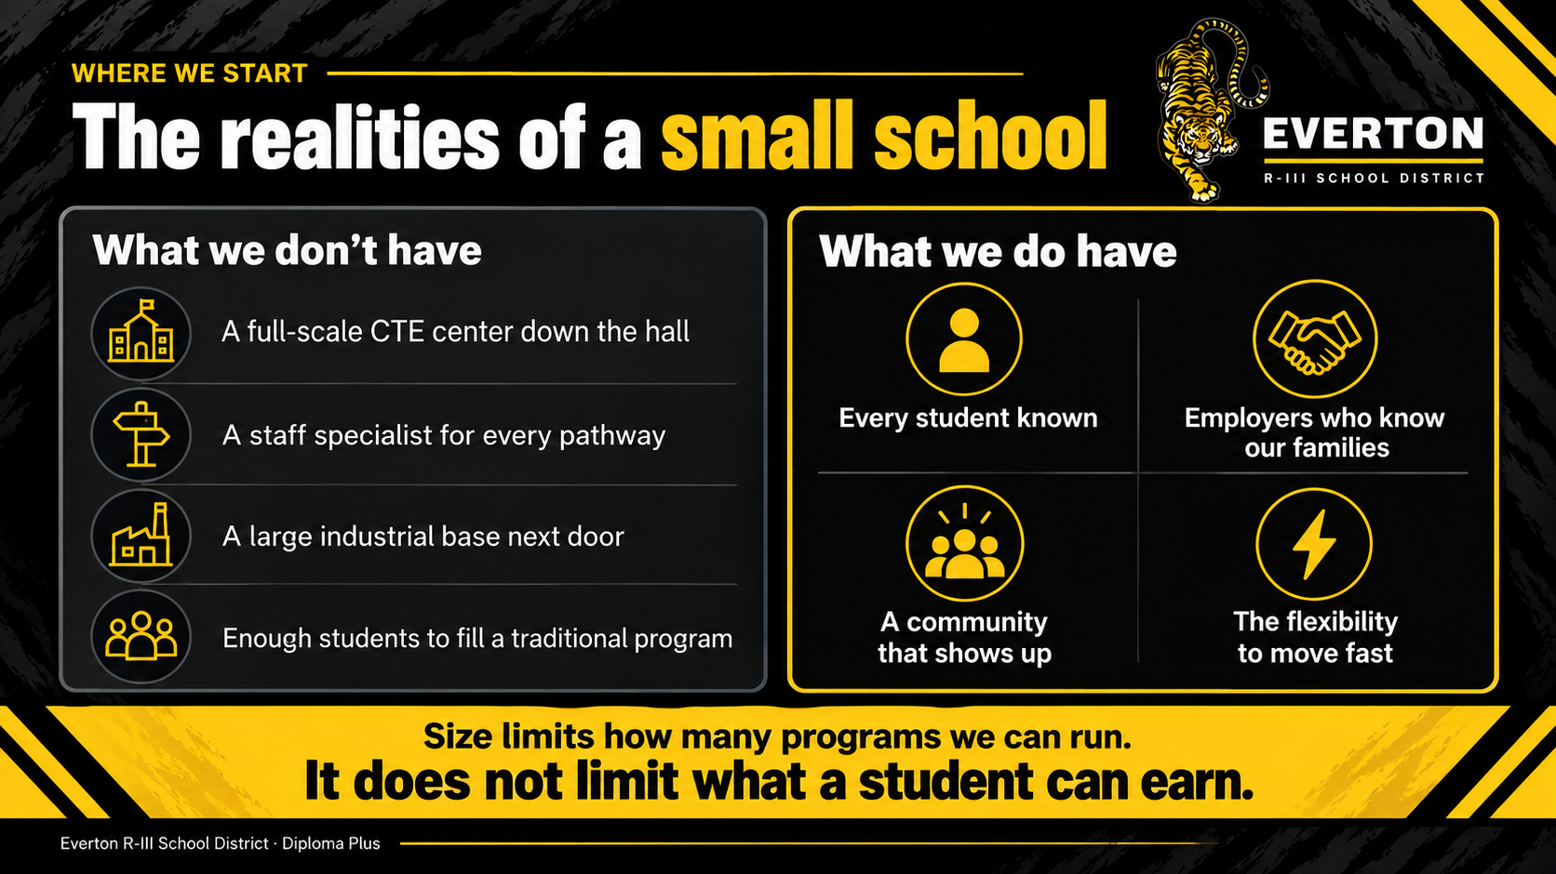
WHERE WE START
The realities of a small school
What we don't have
What we do have
A full-scale CTE center down the hall
A staff specialist for every pathway
A large industrial base next door
Enough students to fill a traditional program
Every student known
Employers who know our families
A community that shows up
The flexibility to move fast
Size limits how many programs we can run.
It does not limit what a student can earn.
Everton R-III School District · Diploma Plus
Notes:
Let's be honest about what small schools are up against. We don't have a career center down the hall. We don't have a specialist for every pathway. Many of us can't fill a traditional program with enough students to justify it. Those are real limits. But look at the right column. We know every kid. Our employers know our families. Our communities show up. And we can change direction in a month instead of a year. Those are advantages big districts would pay for. The question is whether we build on them.

Slide 3
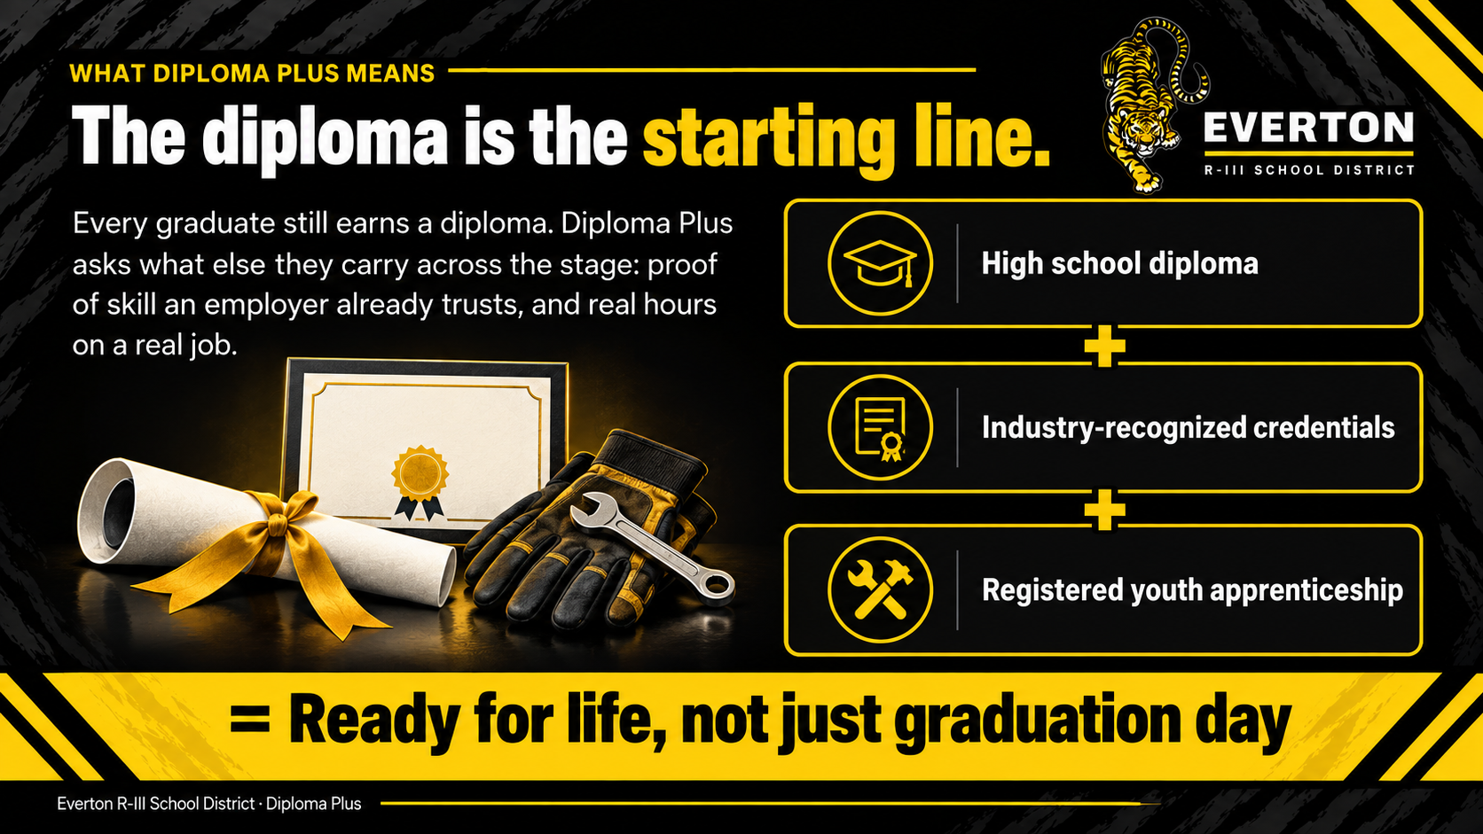

WHAT DIPLOMA PLUS MEANS
The diploma is the starting line.
Every graduate still earns a diploma. Diploma Plus asks what else they carry across the stage: proof of skill an employer already trusts, and real hours on a real job.
High school diploma
+ Industry-recognized credentials
+ Registered youth apprenticeship
= Ready for life, not just graduation day
Everton R-III School District · Diploma Plus
Notes:
Here is the whole idea on one slide. Too many students treat the diploma as the finish line. They cross the stage, and then what? Diploma Plus means the diploma is where things start. On top of it, our students stack industry-recognized credentials, and they stack registered youth apprenticeship hours. When they graduate, they have the diploma, a credential an employer recognizes on sight, and a work record with a mentor who can vouch for them. That is what ready for life looks like.

Slide 4
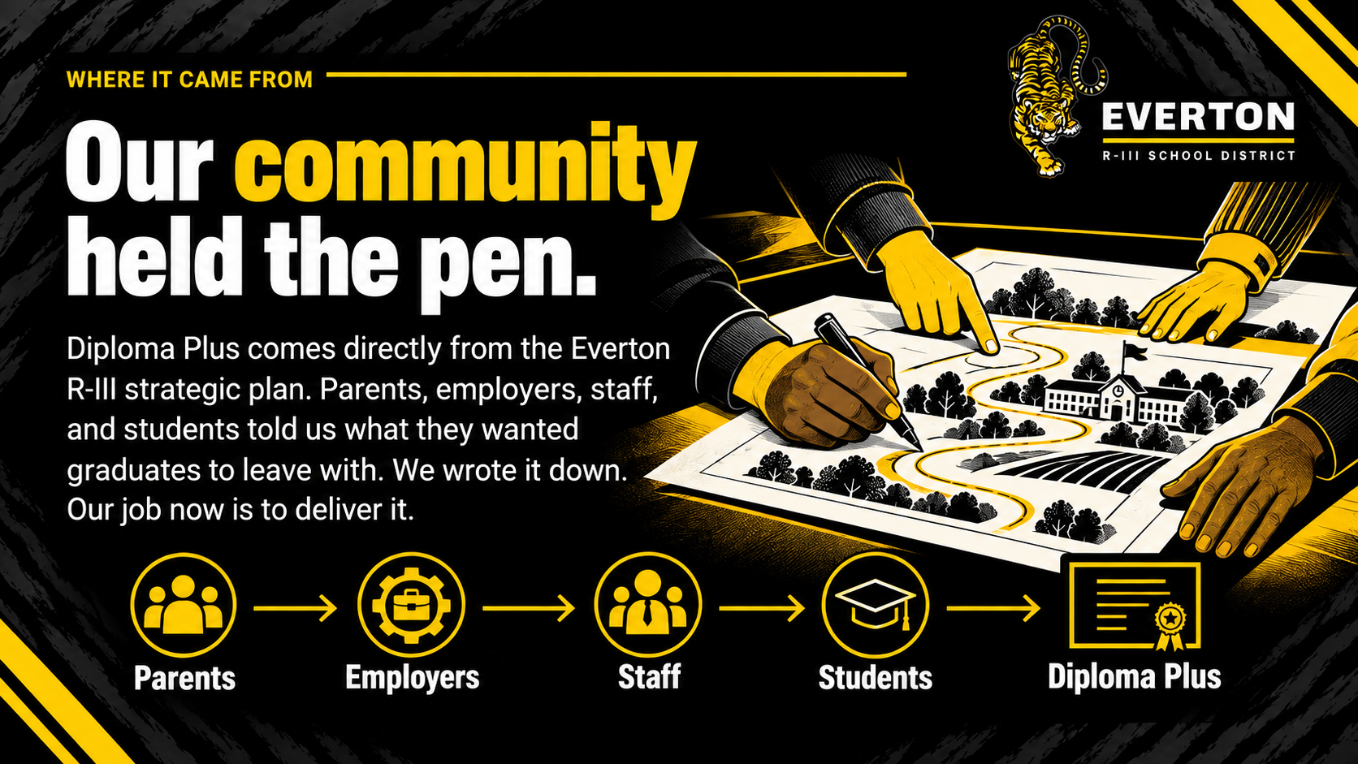
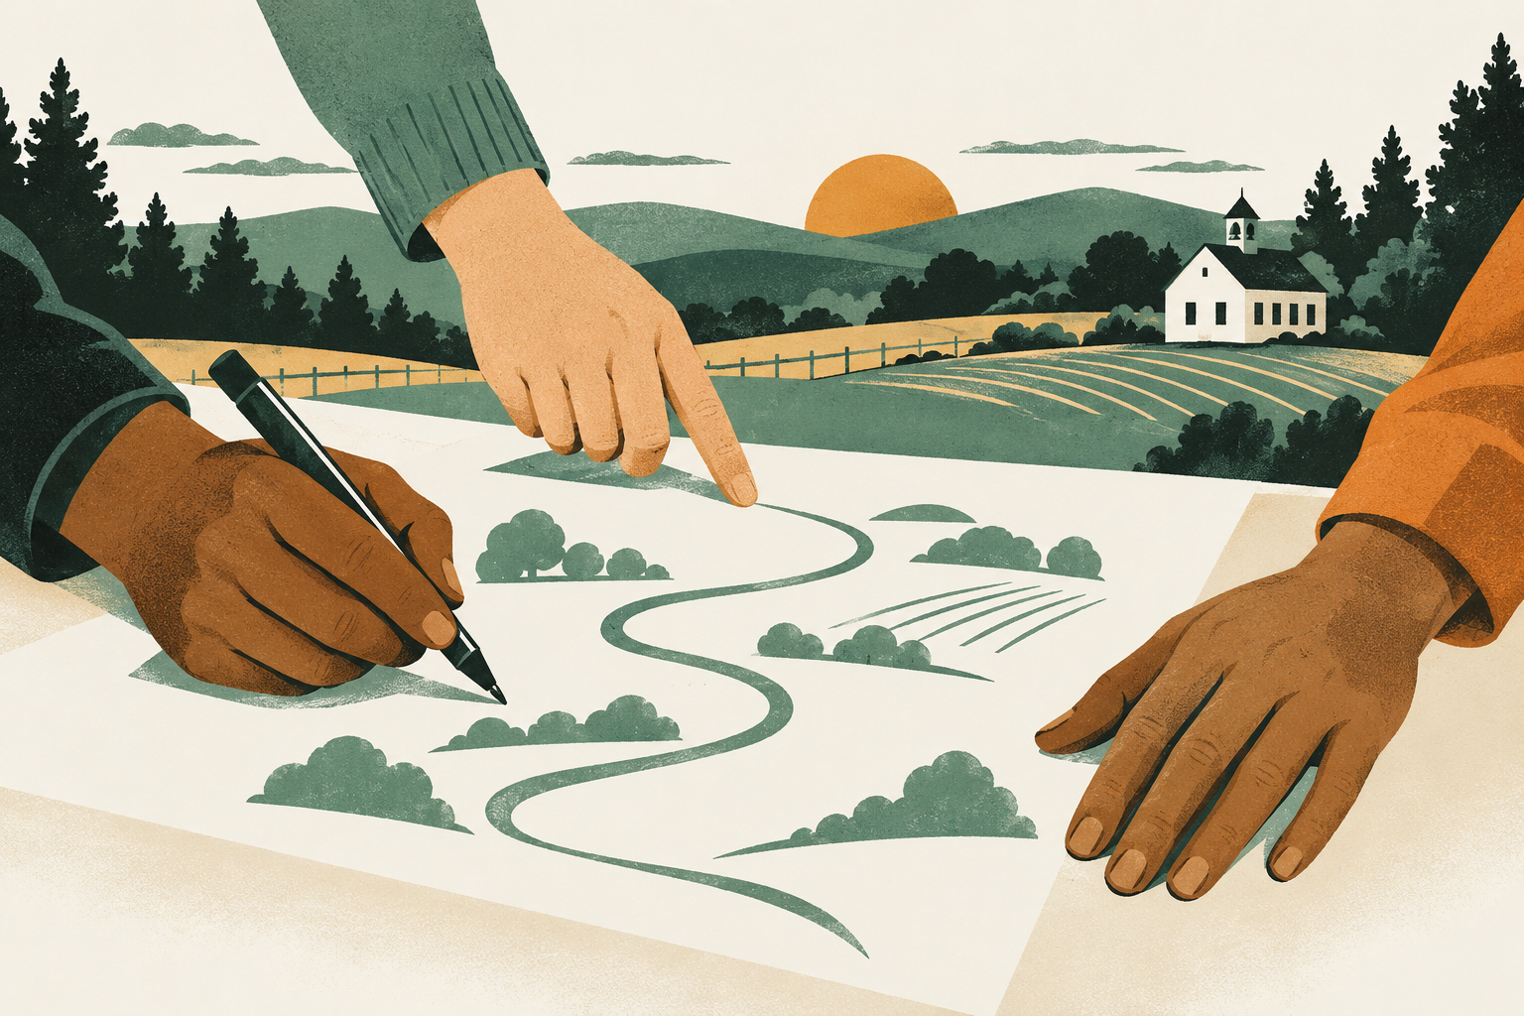
WHERE IT CAME FROM
Our community held the pen.
Diploma Plus comes directly from the Everton R-III strategic plan. Parents, employers, staff, and students told us what they wanted graduates to leave with. We wrote it down. Our job now is to deliver it.
Notes:
I want to be clear about where this came from. This was not a superintendent's idea. It is written in our strategic plan, and the words in that plan came from our community. Parents, local employers, our staff, and our students sat at the table and told us what they wanted a graduate of Everton to be able to do. We held the meetings. They held the pen. So when we execute this plan, we are keeping a promise our community made to its own kids. That changes how the work feels, and it changes who shows up to help. [Read the goal from the strategic plan here.]

Slide 5
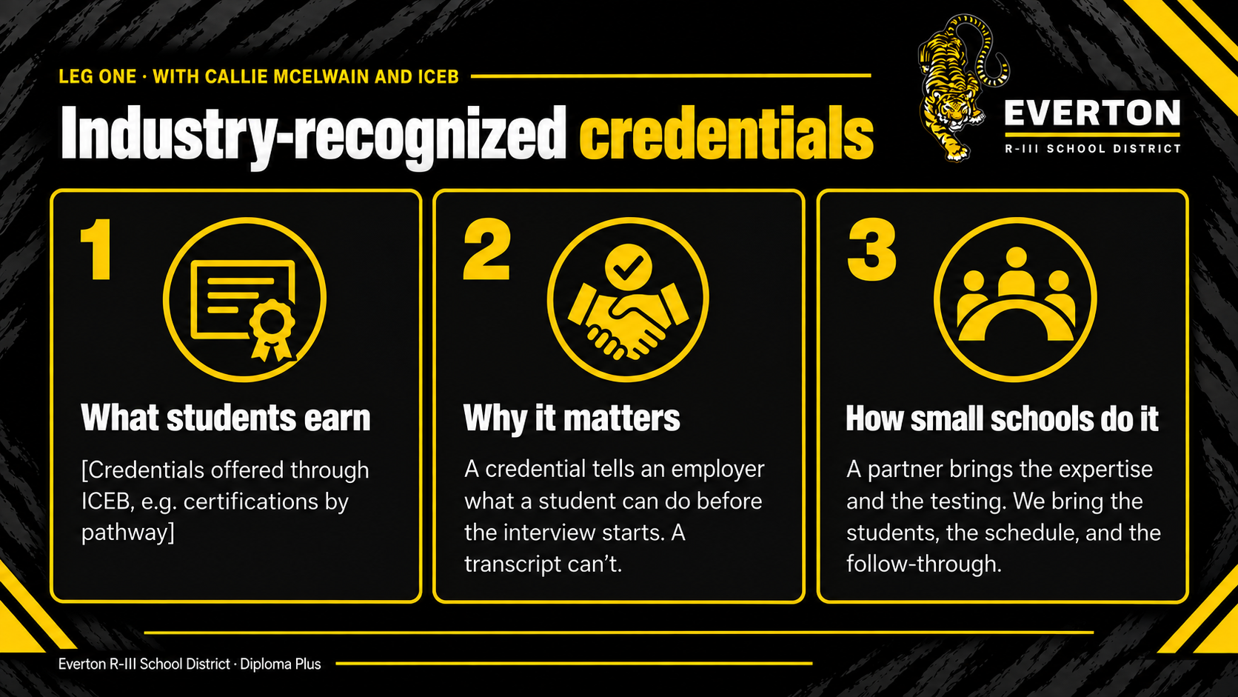
LEG ONE · WITH CALLIE MCELWAIN AND ICEB
Industry-recognized credentials
1
2
3
What students earn
Why it matters
How small schools do it
[Credentials offered through ICEB, e.g. certifications by pathway]
A credential tells an employer what a student can do before the interview starts. A transcript can't.
A partner brings the expertise and the testing. We bring the students, the schedule, and the follow-through.
Everton R-III School District · Diploma Plus
Notes:
The first leg is industry-recognized credentials, and we could not do this without Callie McElwain and ICEB. [Describe Callie's role and what ICEB provides.] Here is why credentials matter. A transcript tells an employer a student passed a class. A credential tells them exactly what the student can do, in language their industry already uses. And here is the small-school lesson: we don't have to build the expertise ourselves. The partner brings the content and the testing. We bring the kids, the time in the schedule, and the follow-through. [Share the number of credentials earned and one student example.]

Slide 6
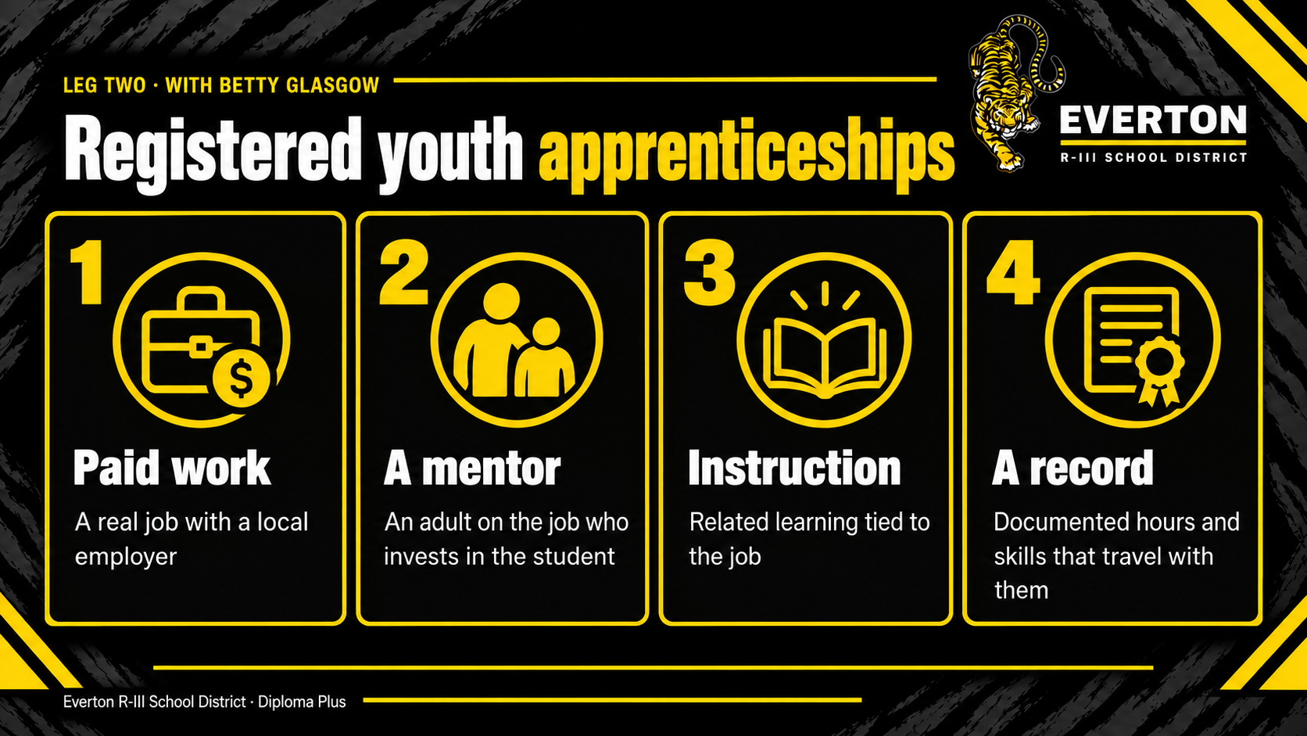
LEG TWO · WITH BETTY GLASGOW
Registered youth apprenticeships
1
2
3
4
Paid work
A mentor
Instruction
A record
A real job with a local employer
An adult on the job who invests in the student
Related learning tied to the job
Documented hours and skills that travel with them
Everton students apprenticed with [local employers]
Everton R-III School District · Diploma Plus
Notes:
The second leg is registered youth apprenticeships, built with Betty Glasgow. [Describe Betty's role.] A registered apprenticeship is not a job shadow and it's not a summer job. It's paid work with a local employer, a mentor on the job, instruction tied to that work, and a documented record of hours and skills that goes with the student after graduation. For a kid in a small town, that means an adult outside the school who knows them, trusts them, and will vouch for them. [Share the number of apprentices, the employers, and one student story.]

Slide 7
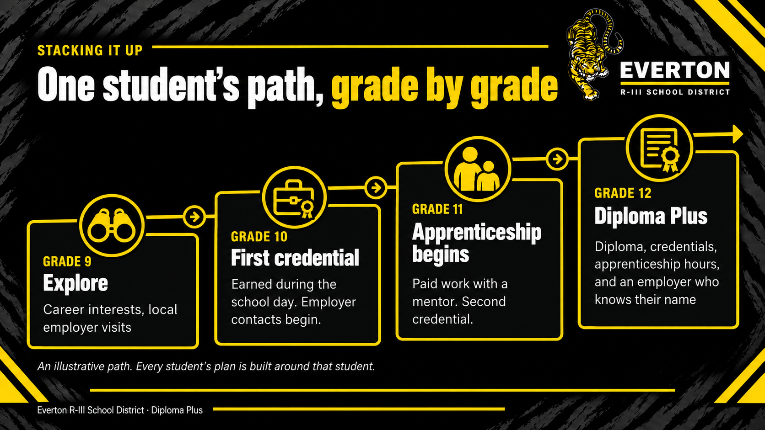
STACKING IT UP
One student's path, grade by grade
GRADE 12
GRADE 11
Diploma Plus
GRADE 10
Apprenticeship begins
Diploma, credentials, apprenticeship hours, and an employer who knows their name
GRADE 9
First credential
Explore
Paid work with a mentor. Second credential.
Earned during the school day. Employer contacts begin.
Career interests, local employer visits
An illustrative path. Every student's plan is built around that student.
Everton R-III School District · Diploma Plus
Notes:
Here's what stacking looks like over four years. This is an example, not a mold; every plan is built around the kid. Freshman year is exploration: what do you like, and who in our community does that work? Sophomore year, a first credential, earned during the school day. Junior year, the apprenticeship starts, paid work with a mentor, and often a second credential. By senior year, that student walks across the stage with a diploma, credentials, real hours on the job, and an employer who knows their name. [Adjust grade levels to match how Everton actually sequences this.]

Slide 8
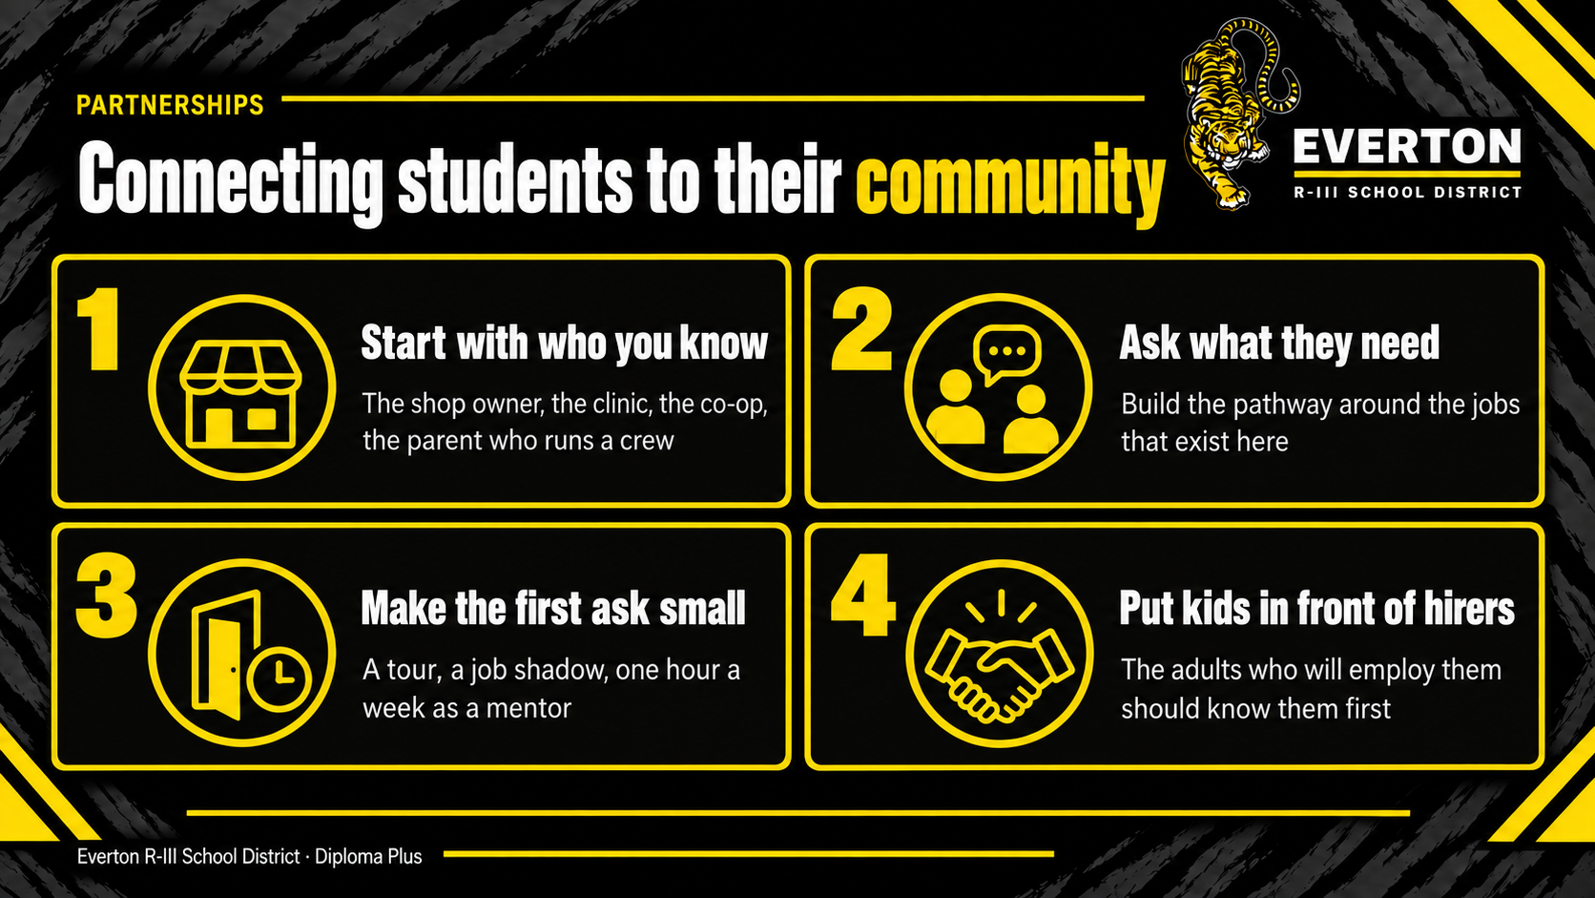
PARTNERSHIPS
Connecting students to their community
1
Start with who you know
2
Ask what they need
The shop owner, the clinic, the co-op, the parent who runs a crew
Build the pathway around the jobs that exist here
3
Make the first ask small
4
Put kids in front of hirers
A tour, a job shadow, one hour a week as a mentor
The adults who will employ them should know them first
Everton R-III School District · Diploma Plus
Notes:
None of this works without partnerships, and in a small town the partners are already around you. Start with who you know: the shop owner, the clinic, the co-op, the parent who runs a crew. Ask them what they need, and build the pathway around the jobs that actually exist in your community. Make the first ask small. A tour. A job shadow. One hour a week as a mentor. Most employers say yes to that, and yes grows. And the goal is simple: the adults who will someday hire our kids should know them before graduation, not meet them after. [Name two or three Everton partners here.]

Slide 9
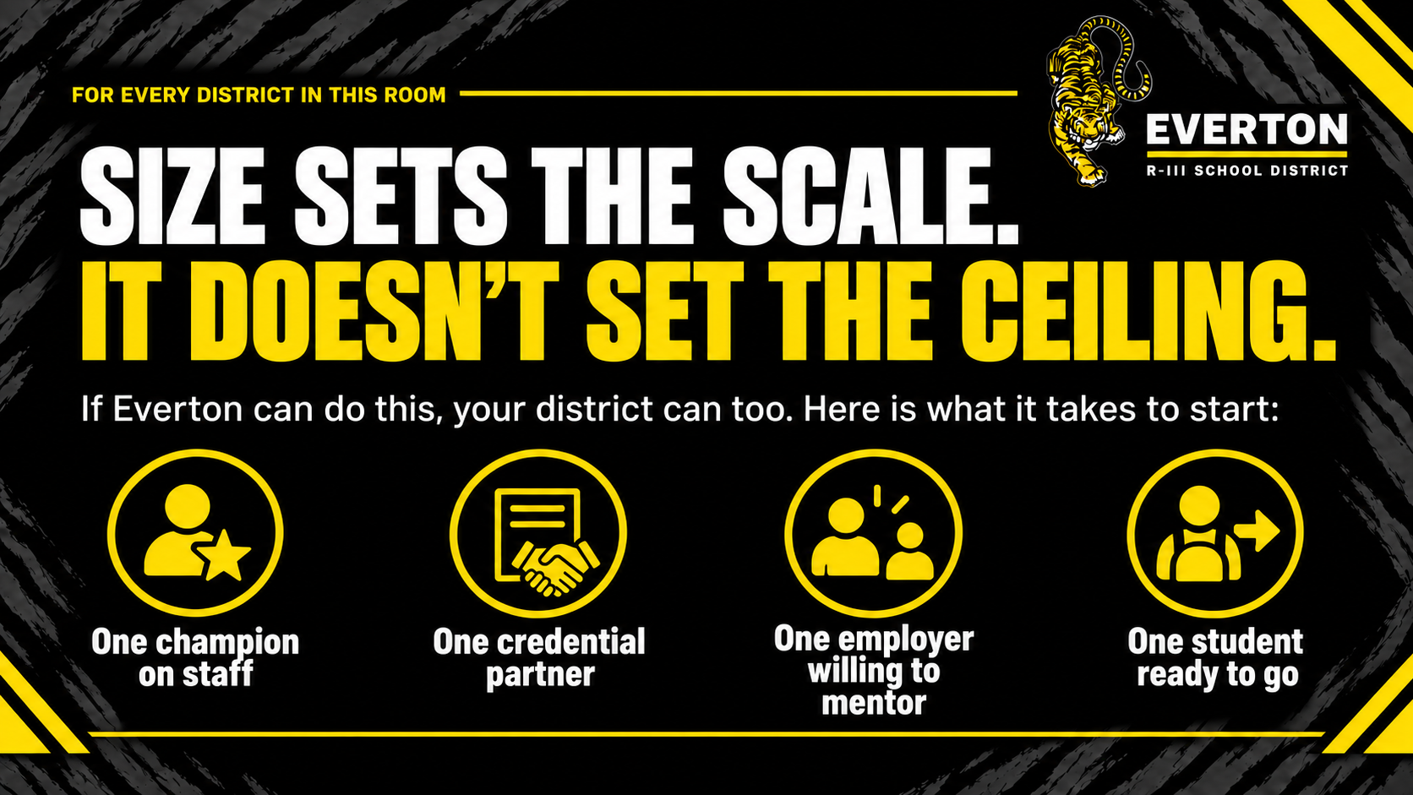
FOR EVERY DISTRICT IN THIS ROOM
SIZE SETS THE SCALE.
IT DOESN'T SET THE CEILING.
If Everton can do this, your district can too. Here is what it takes to start:
One champion on staff
One credential partner
One employer willing to mentor
One student ready to go
Notes:
This is the part I most want you to take home. Everyone in this room can do this, regardless of size. Being small changes the scale. You may start with three students instead of thirty. It does not change the ceiling on what those students can earn. You don't need a new building or a new grant to begin. You need one person on staff who will own it, one credential partner, one employer willing to mentor, and one student ready to go. Start there. The second employer is easier than the first, and the second cohort is easier than the first.

Slide 10
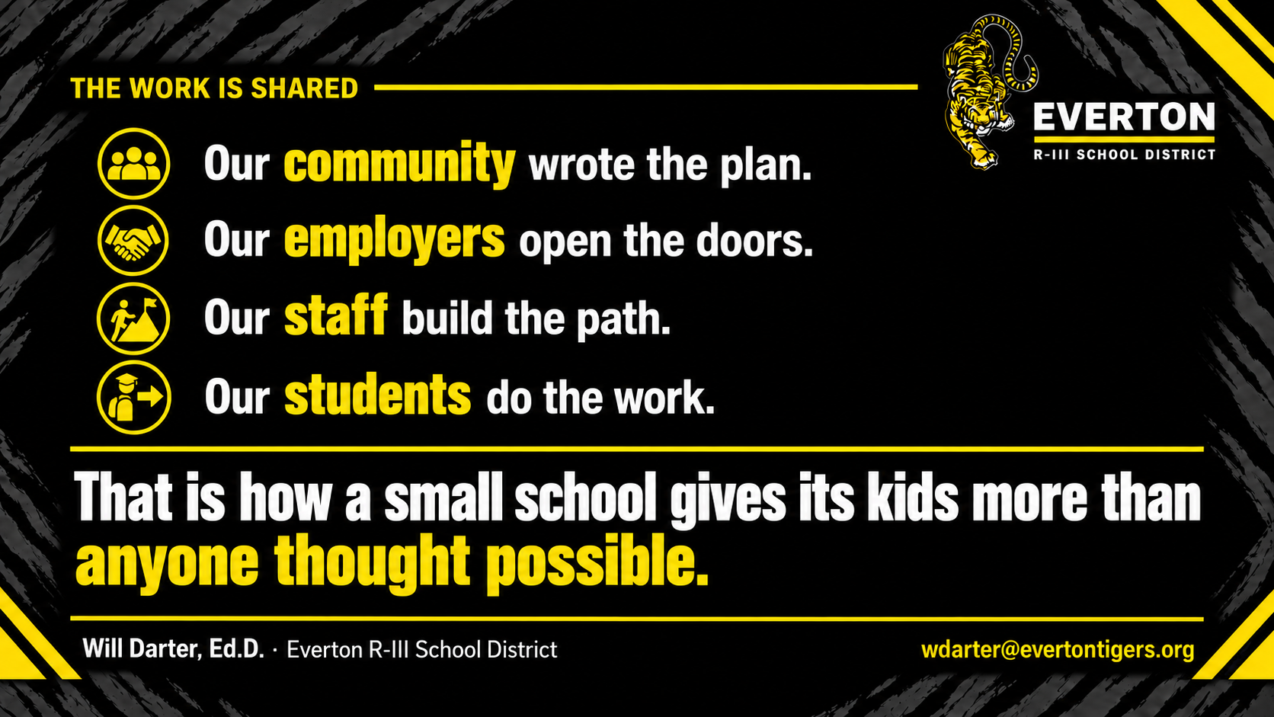
THE WORK IS SHARED
Our community wrote the plan.
Our employers open the doors.
Our staff build the path.
Our students do the work.
That is how a small school gives its kids more than anyone thought possible.
Will Darter, Ed.D. · Everton R-III School District
wdarter@evertontigers.org
Notes:
I'll close with this. No one in Everton does this alone. Our community wrote the plan. Our employers open the doors. Our staff build the path. And our students do the work. When each of those groups carries its part, a small school can give its kids more than anyone thought was possible. I'd love to hear what you're building, and I'm glad to help if you want to start. Questions?

