Slide 1

MES School Improvement Plan 2026-2027
Charting the Path to SUCCESS!
Notes:
Ashley

Slide 2
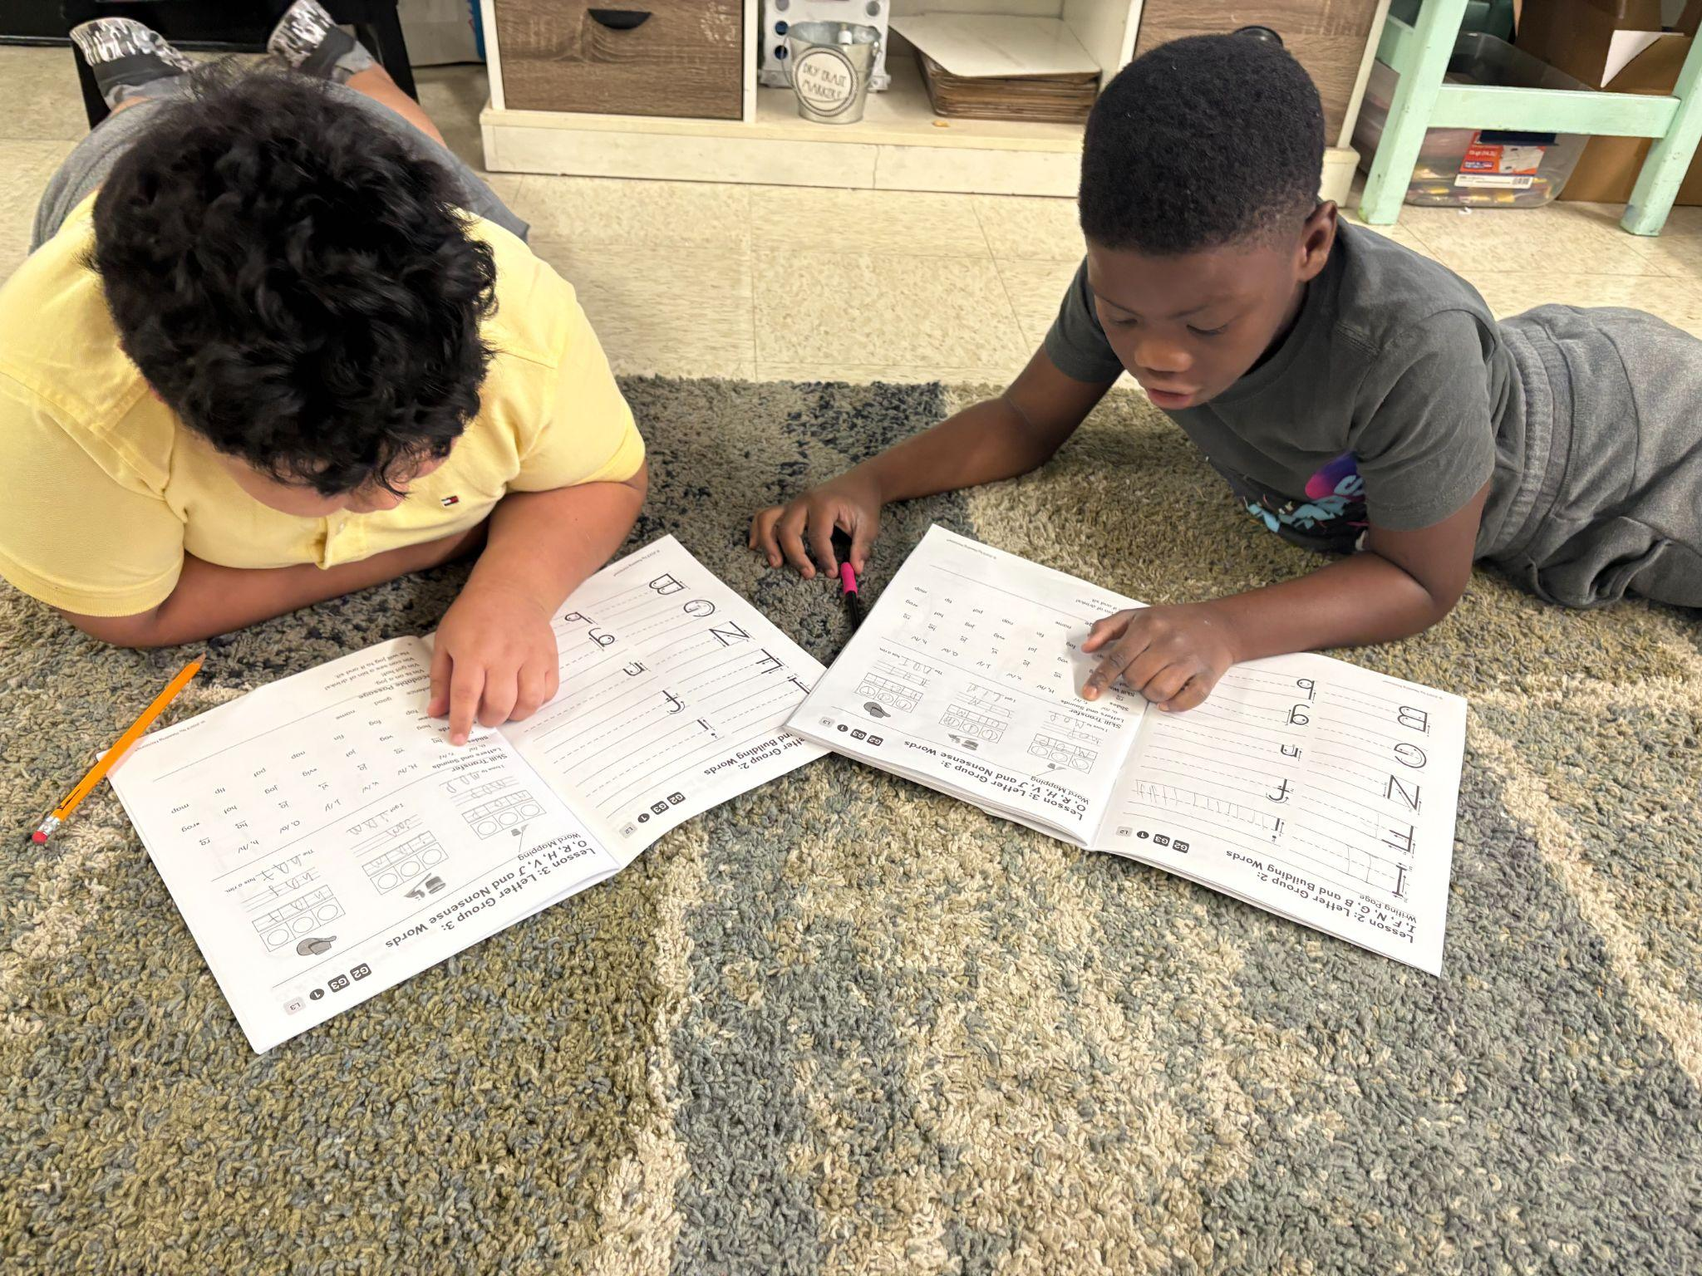
Team Names
Principal- Ashley D. Locklear
Academic Coach- Amy Patterson
SIT Chair- Lisa McIntyre
Notes:
Ashley

Slide 3
Mission and Vision Statements
McLauchlin’s Mission Statement
At J.W. McLauchlin Elementary, we grow lifelong learners by providing solid foundations upon which academic, behavioral and emotional growth can occur. Positive relationships and collaboration exist between the school, home and community to ensure that our students will become productive citizens and future leaders.
McLauchlin’s Vision Statement
At J. W. McLauchlin Elementary School, we provide a safe place to pursue student excellence and achievement by having high expectations, building relationships, and providing rigorous, high-quality instruction for all students.
Notes:
Mrs. McIntyre

Slide 4
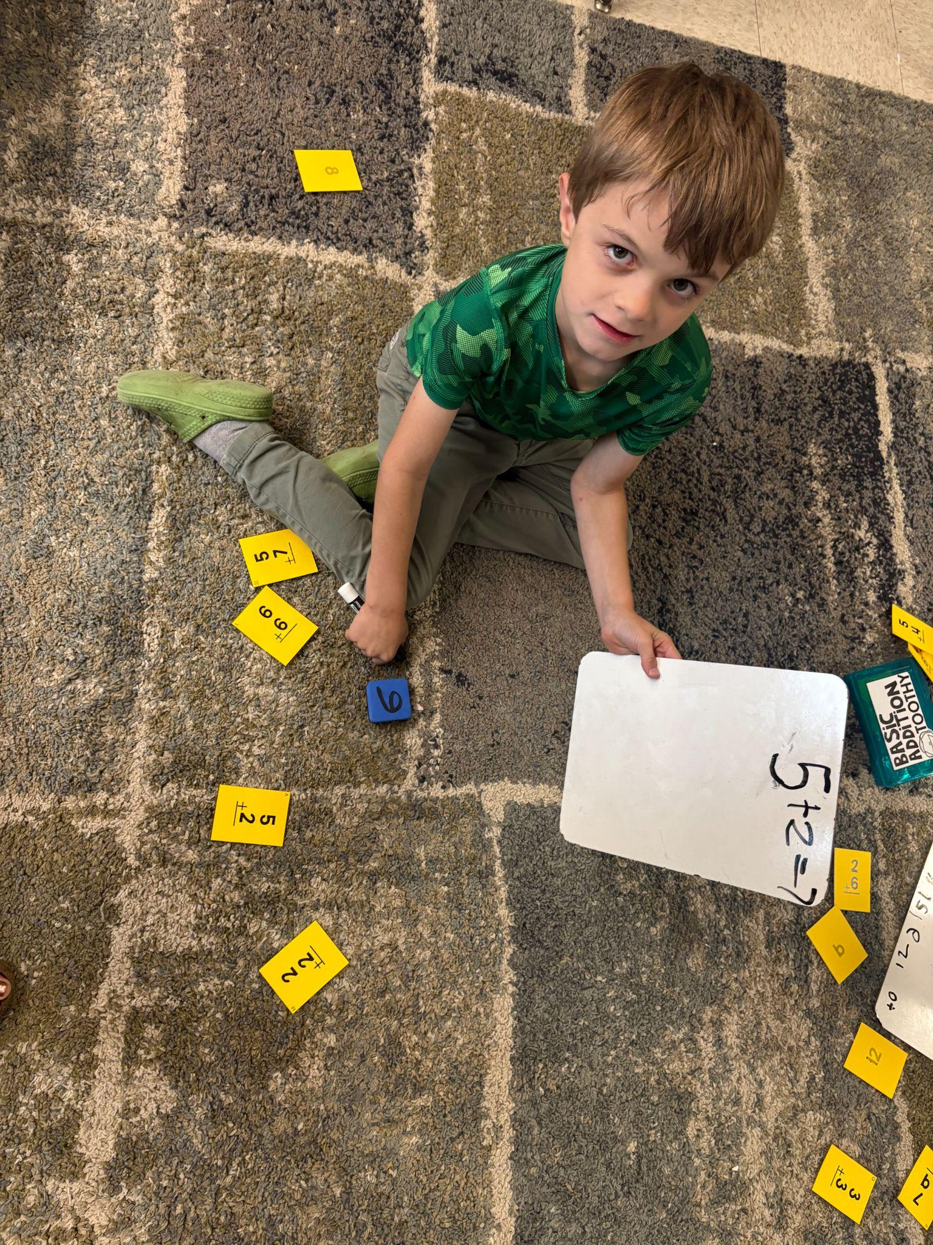
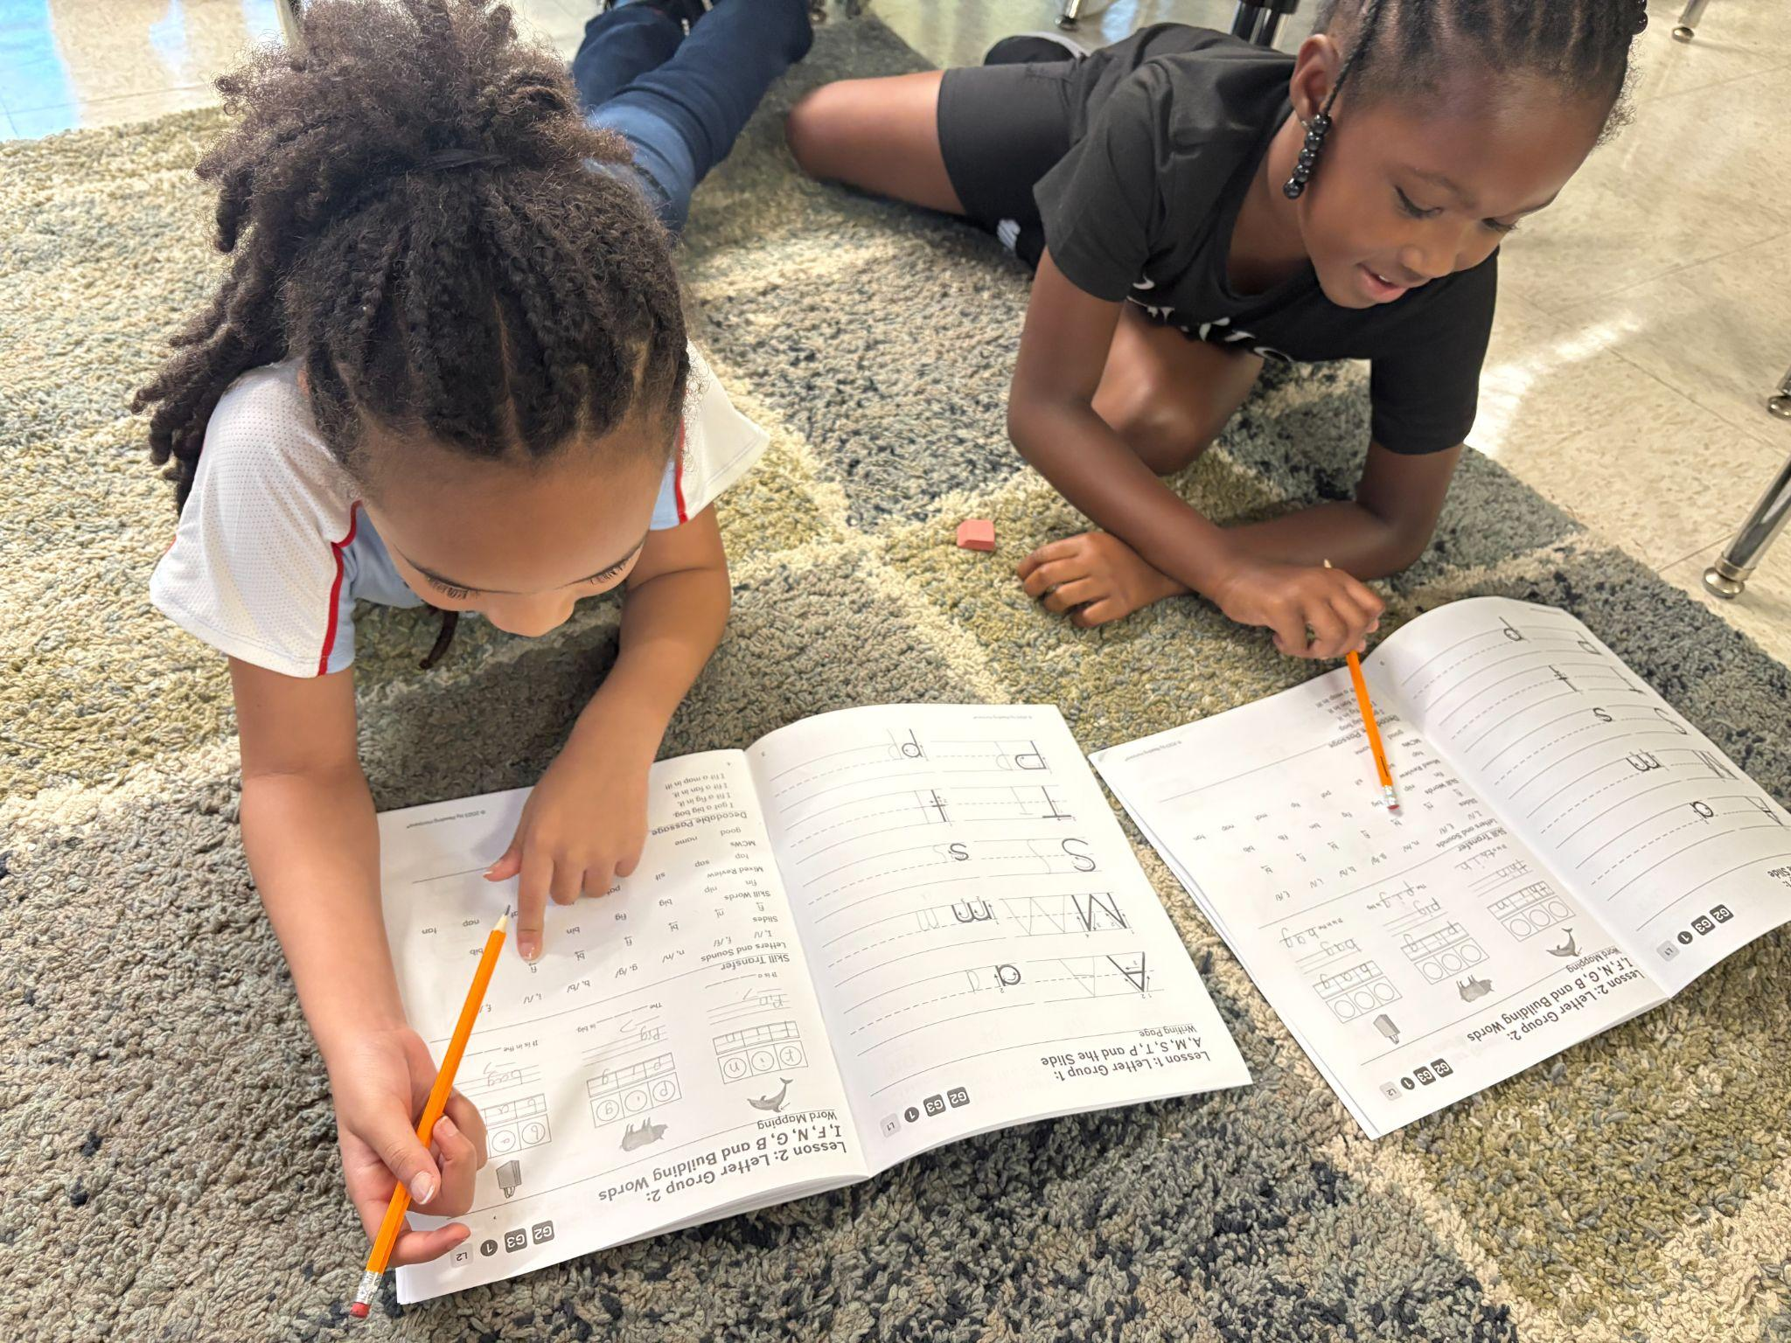
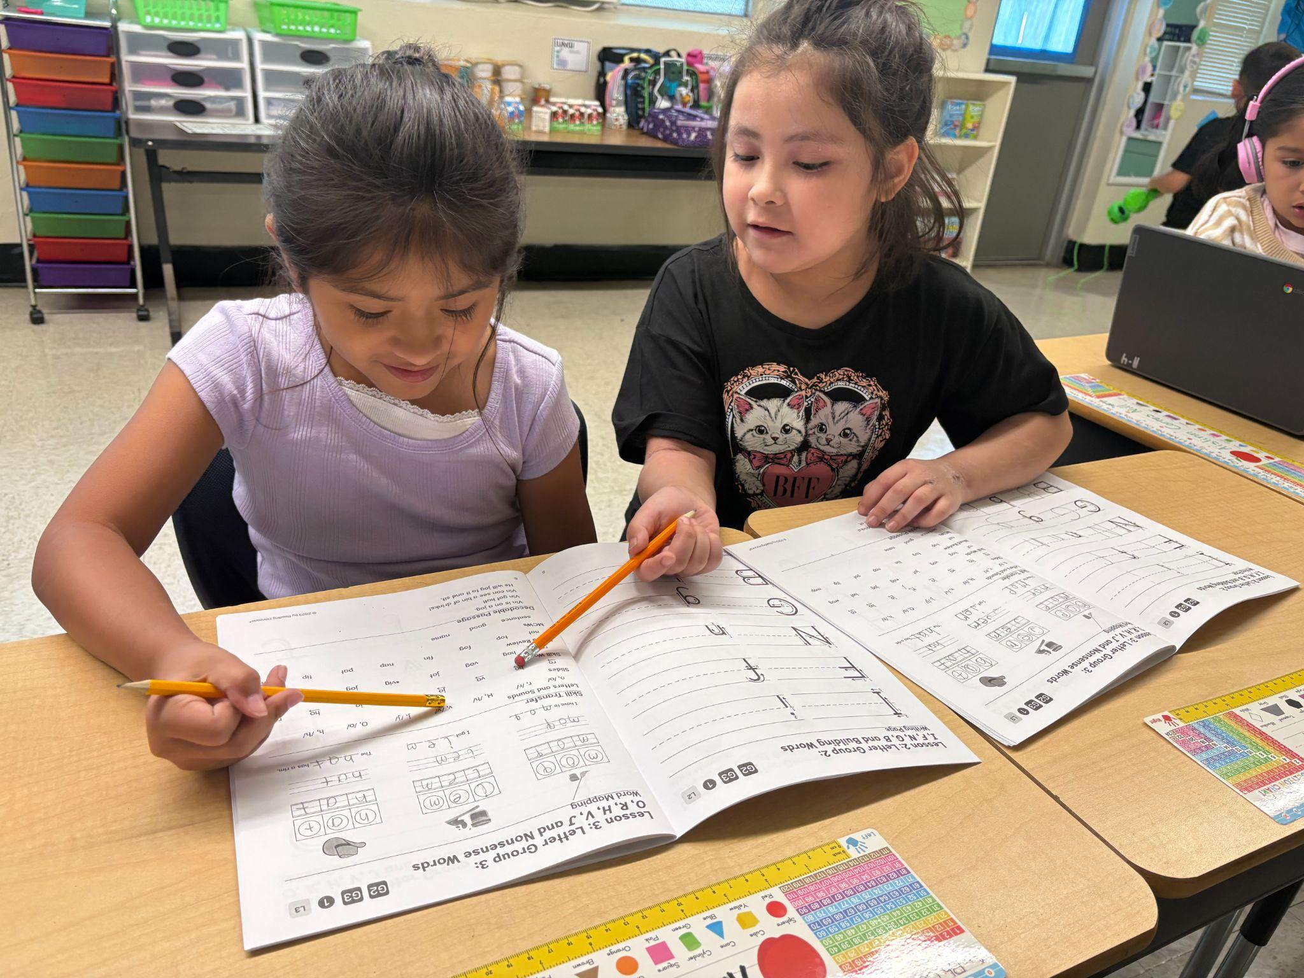
Core Beliefs
We believe every child can succeed.
We believe learning should be engaging, meaningful, and student-centered.
We believe positive relationships are the foundation of learning.
We believe high expectations and equitable opportunities should be provided to all students regardless of background or ability.
Notes:
Mrs. McIntyre

Slide 5
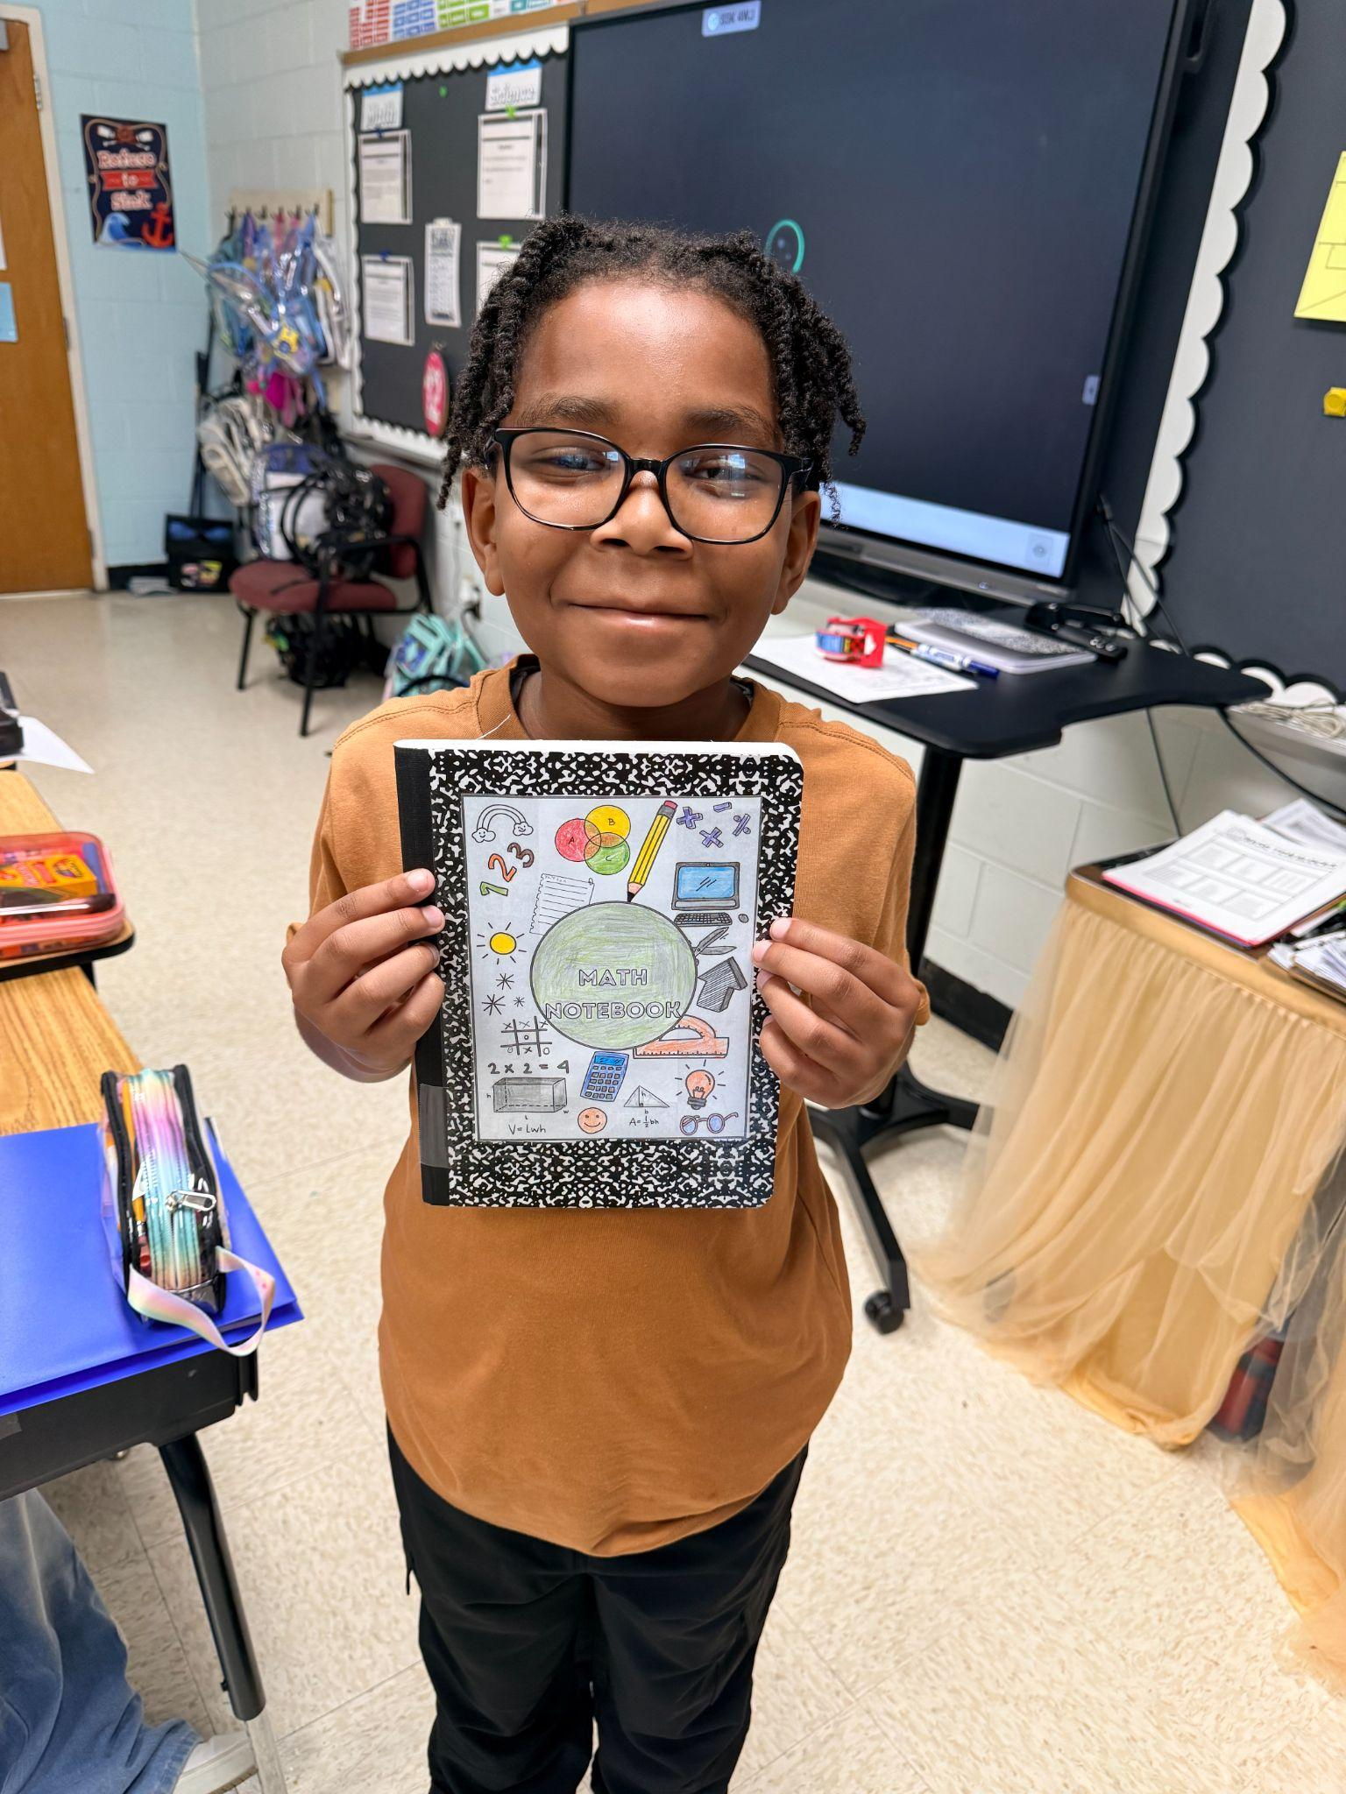
School Overview
Student Enrollment- As of 8/31/26= 268
45 Reassignments
Student Demographics
70- Hispanic/Latino
7- Native American
1- Asian
100- African American
2- Hawaiian or other Pacific Islander
60- White
28- Two or more races
Notes:
Locklear

Slide 6
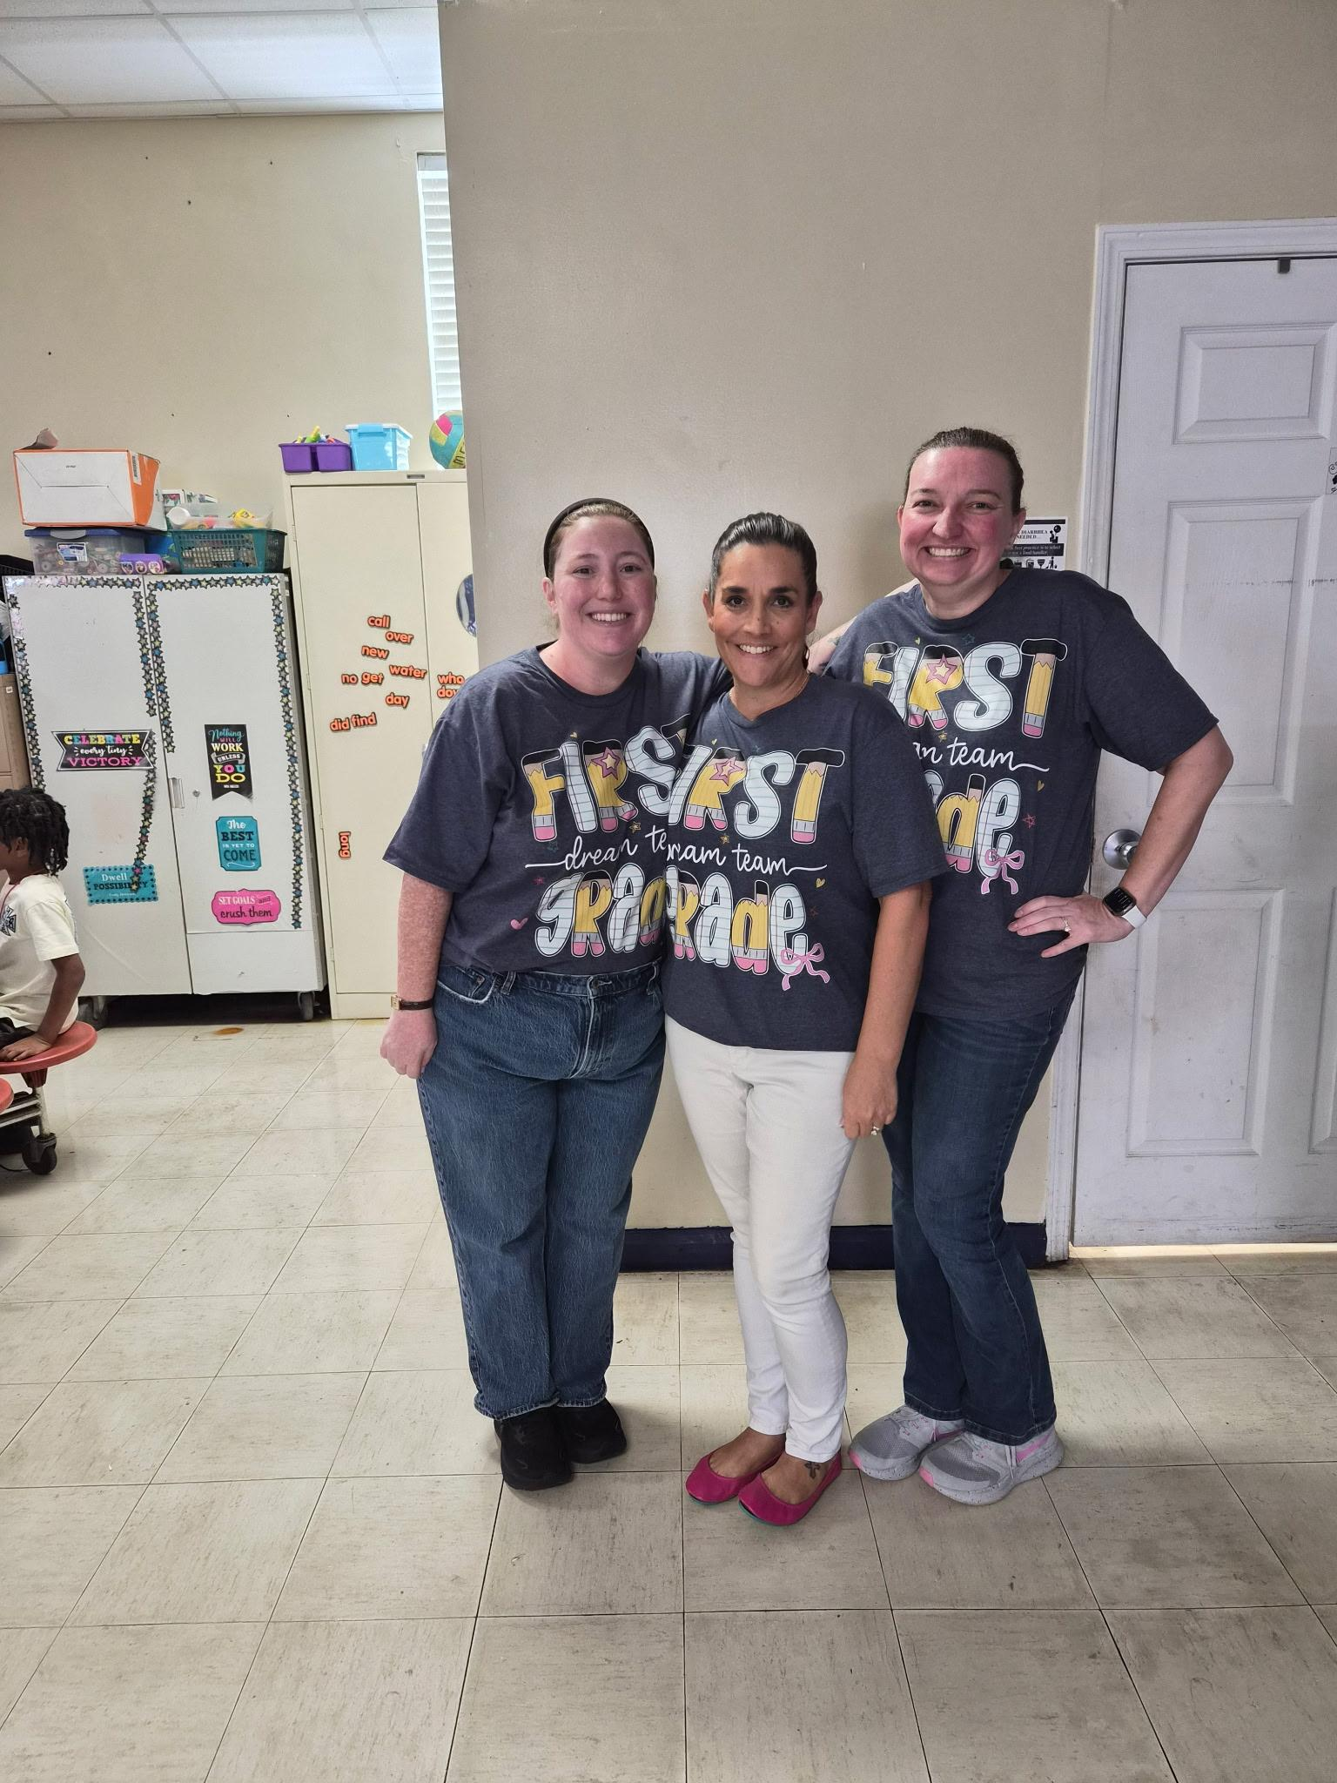
School Overview Continued
Staff Overview= 19 teachers (2 new), 3 support staff, 2 full time resource (PE & Media), and 2 part time resource(Music and Art).
K-3
1st-3
2nd-3
3rd-3
4th-2
5th-2
EC- 2
School Accomplishments/Celebrations:
Teacher Retention
Miss. Shoop - BT of the Year for HCS
Our School Beta Club made School of Distinction for 5th year in a row
School Debate Team won 1st place for district
Notes:
School Overview

Slide 7
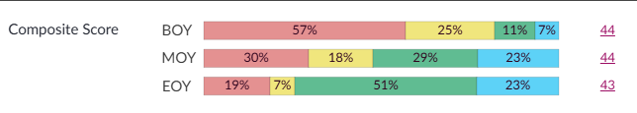
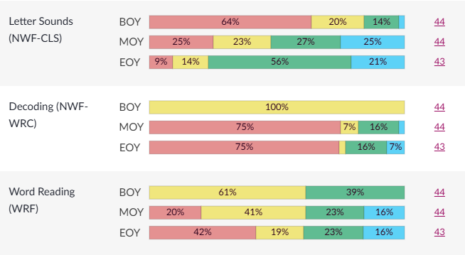
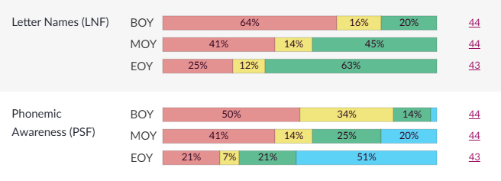
Data Snapshot: mClass
Kindergarten mClass
Notes:
Kindergarten showed the strongest overall growth story
This is probably one of your biggest celebrations.
Kindergarten's Composite Score distribution shifted dramatically from BOY to EOY.
At BOY, 57% of students were in the lowest performance band.
By EOY, that dropped to 19%.
Students in the green performance band increased from 11% to 51%.
Students in the highest band increased from 7% to 23%.
Phonemic Awareness showed particularly strong movement, with the highest performance band increasing from 1% at BOY to 51% at EOY.
Letter Names also showed substantial growth, with 63% of students in the green band at EOY.
“Our Kindergarten data gives us a strong example of what happens when we intentionally focus on foundational literacy skills. We see substantial movement out of the lowest performance levels and into the higher performance bands.”

Slide 8
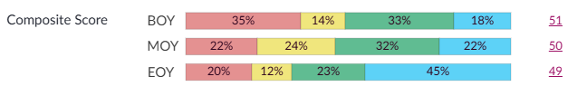
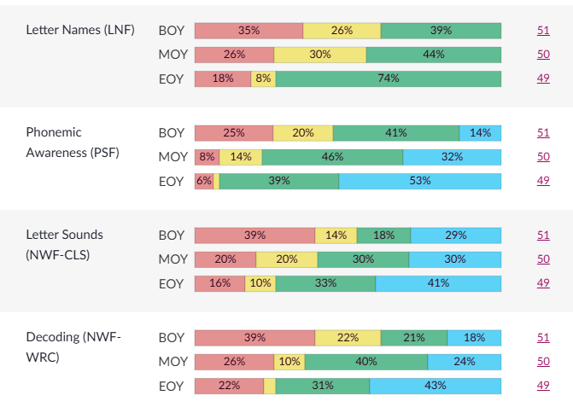
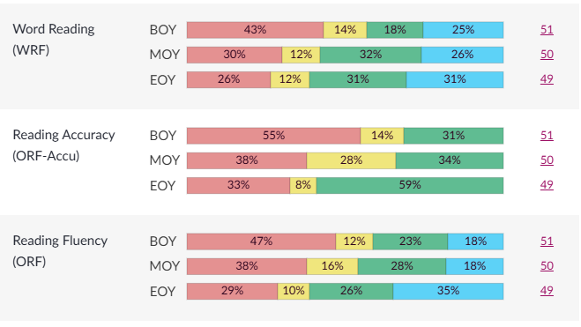
Data Snapshot: mClass
First Grade mClass
Notes:
First Grade maintained strong foundational skill growth
First Grade also has a positive story, even though the overall Composite Score moved from 51 at BOY to 49 at EOY.
Look underneath the composite:
Letter Names: 39% green BOY → 74% green EOY
Phonemic Awareness: 41% green BOY → 39% green + 53% highest band EOY
Letter Sounds: 18% green + 29% highest band BOY → 33% green + 41% highest band EOY
Decoding: 21% green + 18% highest band BOY → 31% green + 43% highest band EOY
Reading Fluency: 23% green + 18% highest band BOY → 26% green + 35% highest band EOY.
Although the composite score decreased slightly, when we disaggregate the data, we see substantial movement into the higher performance bands across several foundational skills. This reminds us why we can't look at the composite score in isolation.”

Slide 9
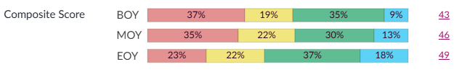
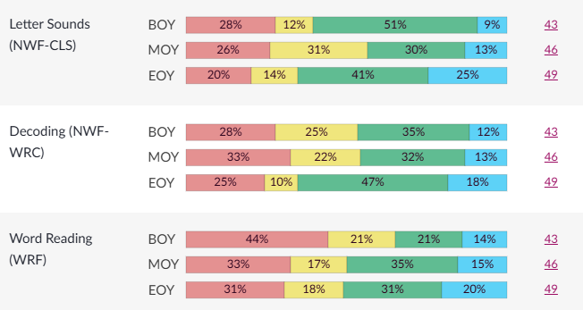
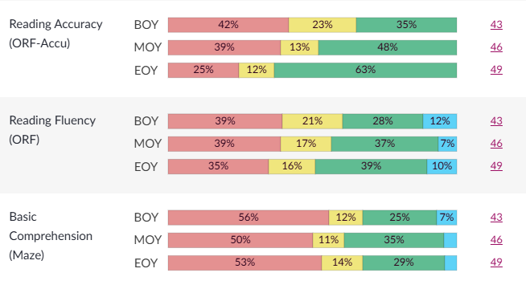
Data Snapshot: mClass
Second Grade mClass
Notes:
Second Grade demonstrated meaningful overall growth
Second Grade has one of the clearest positive composite trends:
Composite: 43 BOY → 46 MOY → 49 EOY
That's a 6-point increase from BOY to EOY.
You can also point out:
Reading Accuracy: 35% green BOY → 63% EOY
Letter Sounds: 51% green → 41% green + 25% highest band
Decoding: 35% green + 12% highest → 47% green + 18% highest
Word Reading: 21% green + 14% highest → 31% green + 20% highest
Reading Fluency: 28% green + 12% highest → 39% green + 10% highest
Basic Comprehension: 25% green + 7% highest → 29% green, with the overall distribution still showing
“Second Grade shows a clear upward trajectory across the year. We moved from a composite score of 43 to 49, and we see particularly strong movement in reading accuracy, decoding, and word reading.”

Slide 10
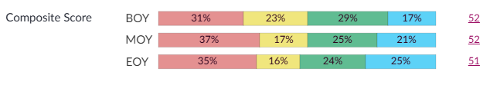
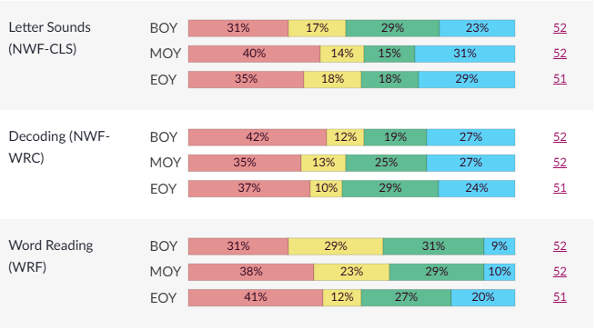
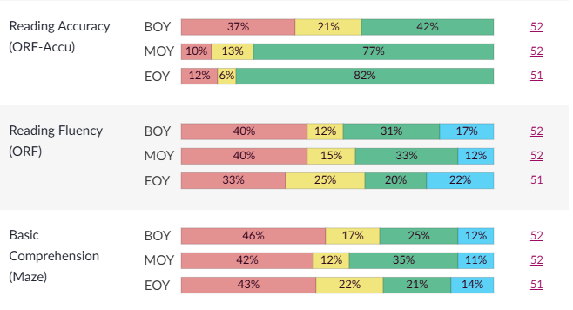
Data Snapshot: mClass
Third Grade Grade mClass
Notes:
Third Grade's strength is reading accuracy
Third Grade's Composite Score was relatively stable:
52 BOY → 52 MOY → 51 EOY.
At first glance, that's not a growth story. But the individual skills tell us something important.
Reading Accuracy is a major strength.
BOY: 42% green
MOY: 77% green
EOY: 82% green
Third Grade's data tells us that accuracy is becoming a strength. The question we need to ask now is: How do we take that accuracy and continue building fluency, automaticity, and comprehension?”

Slide 11
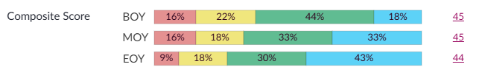
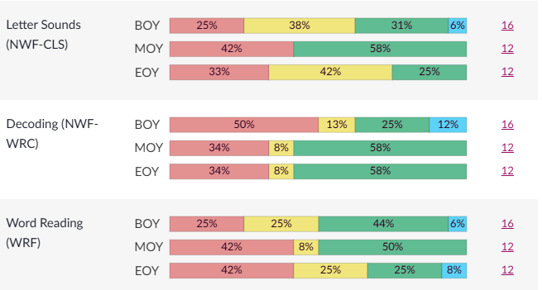
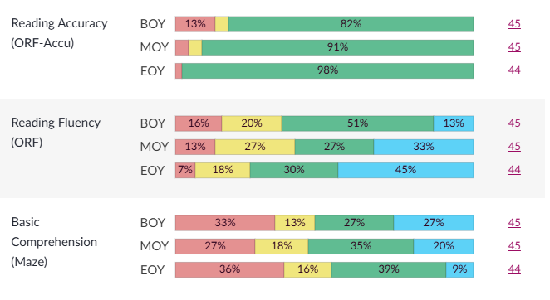
Data Snapshot: mClass
Fourth Grade Grade mClass
Notes:
Fourth and Fifth Grade tell us we need to look closely at fluency and comprehension
Fourth Grade
Composite:
45 BOY → 45 MOY → 44 EOY
But Reading Accuracy was a major strength:
82% green BOY → 91% MOY → 98% EOY.
That's excellent accuracy growth.
However, Basic Comprehension and Reading Fluency provide opportunities for continued attention.
Fourth Grade students are demonstrating that they can read accurately. Our next question is whether they are reading with enough fluency and understanding to fully access grade-level text.”

Slide 12
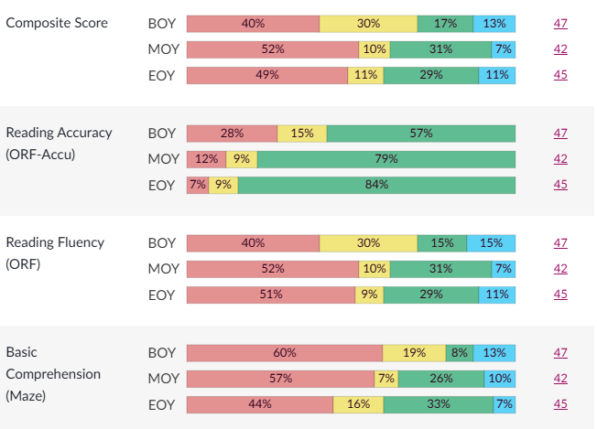
Data Snapshot: mClass
Fifth Grade Grade mClass
Notes:
Fifth Grade: Accuracy is a strength, but fluency/comprehension remain concerns
Fifth Grade Composite: 47 BOY → 42 MOY → 45 EOY
There was recovery from MOY to EOY, but EOY remained below BOY.
The strongest piece is again Reading Accuracy:
BOY: 57% green
MOY: 79% green
EOY: 84% green
But Reading Fluency remains an area for attention:
BOY: 15% green / 15% highest
MOY: 31% green / 7% highest
EOY: 29% green / 11% highest
And Basic Comprehension shows improvement but still leaves a substantial percentage of students in the lower bands:
BOY: 60% lowest
MOY: 57% lowest
EOY: 44% lowest.
“Fifth Grade's accuracy data tells us students have made progress in reading words correctly. Our next level of work is ensuring that accurate reading translates into fluent reading and, ultimately, comprehension.”

Slide 13
What the Data Shows
Next Steps
Evidence of growth - particularly in foundational reading skills
Reading accuracy strengthening across grade levels
Build on the foundational skills to strengthen fluency, automaticity, and comprehension.
Use data to identify students for targeted support and intentionally match instruction to those needs.
Notes:
Our data shows evidence of growth, particularly in foundational reading skills in the primary grades. We also see that reading accuracy is becoming a strength as students move through the grades. Our next step is to build on that foundation by strengthening fluency, automaticity, and comprehension—using the data to identify students who need targeted support and intentionally matching instruction to those needs.”
And I would end with action, rather than ending with the numbers:
“The data isn't just telling us where students are. It's helping us determine where we go next.”

Slide 14
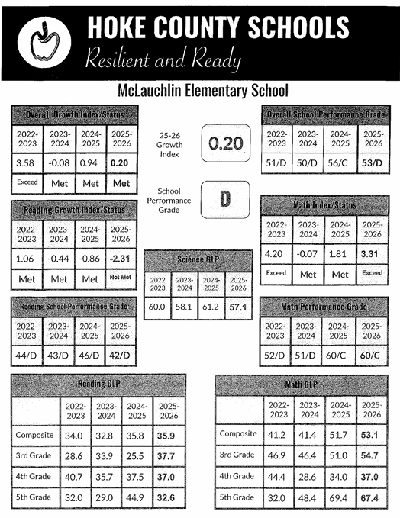
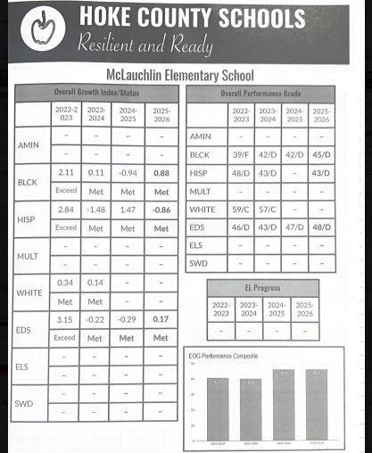
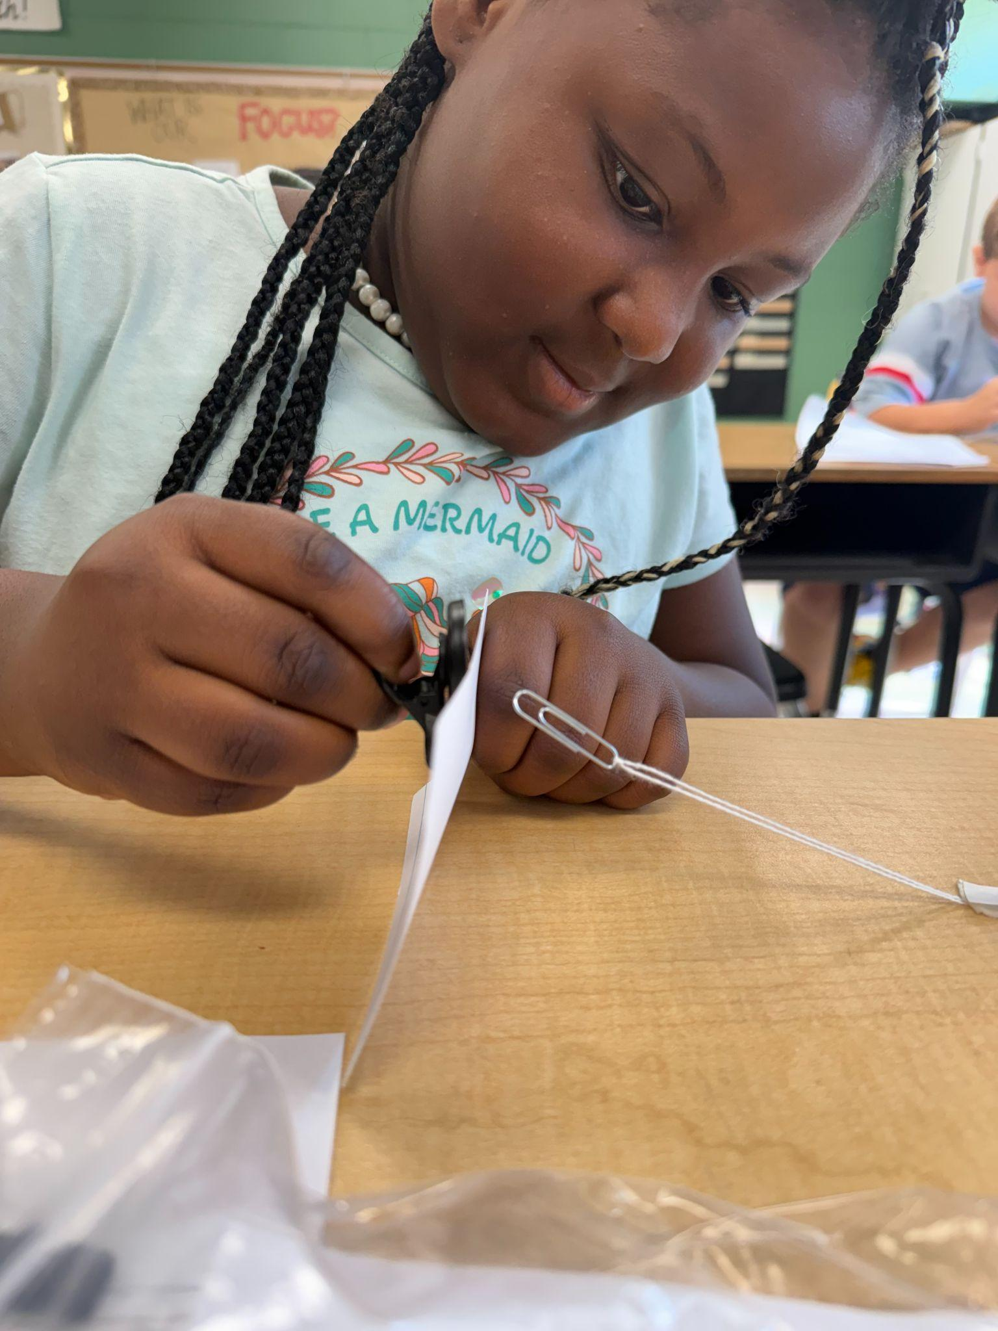
Letter Grade

Slide 15
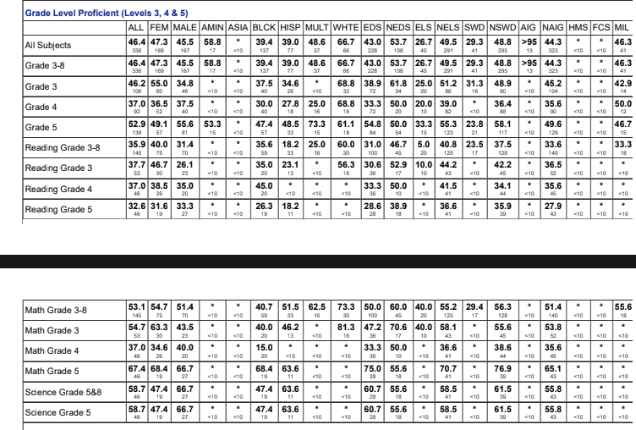
State Proficiency Data
Notes:
Locklear

Slide 16
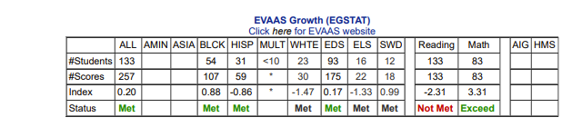
Student Growth Data: 2025-2026 EOG Data
Notes:
Locklear

Slide 17
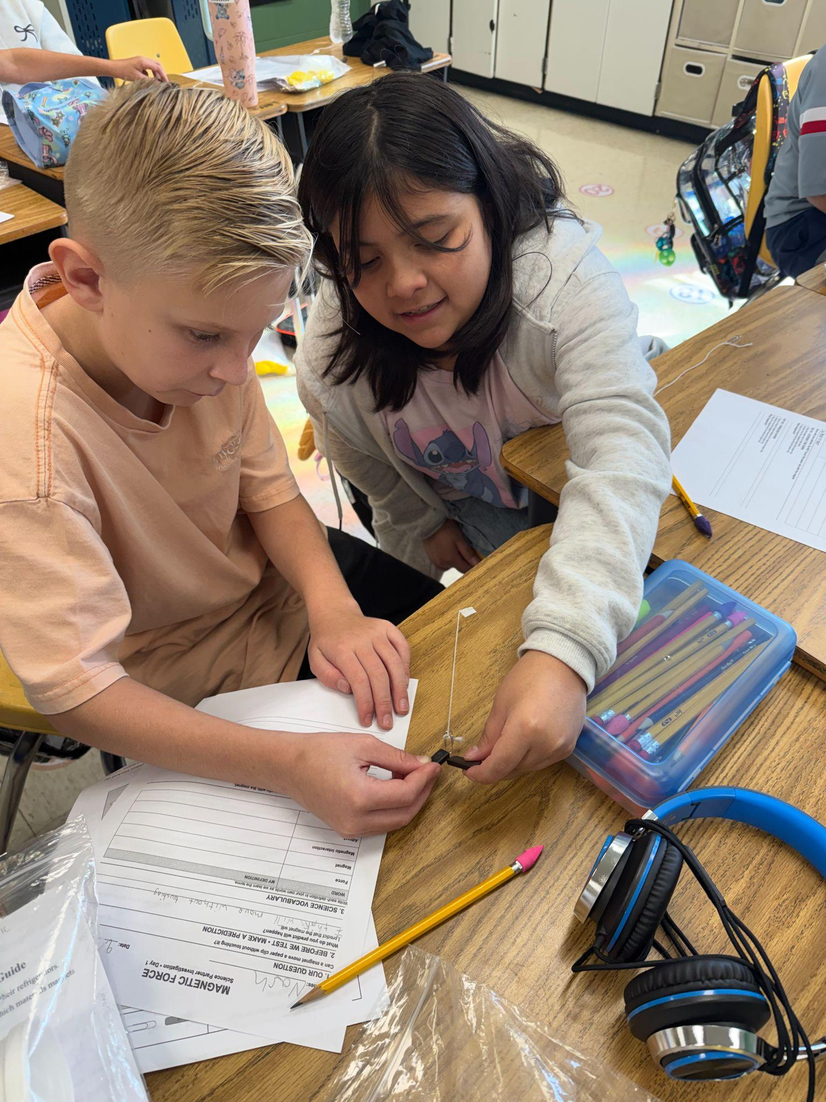
Attendance Rates
End of 25-26- 289 students
Beginning of 26-27- 268 students
Decline of 21 students
* Several students have a pattern of tardies and early pickups
Notes:
Locklear

Slide 18
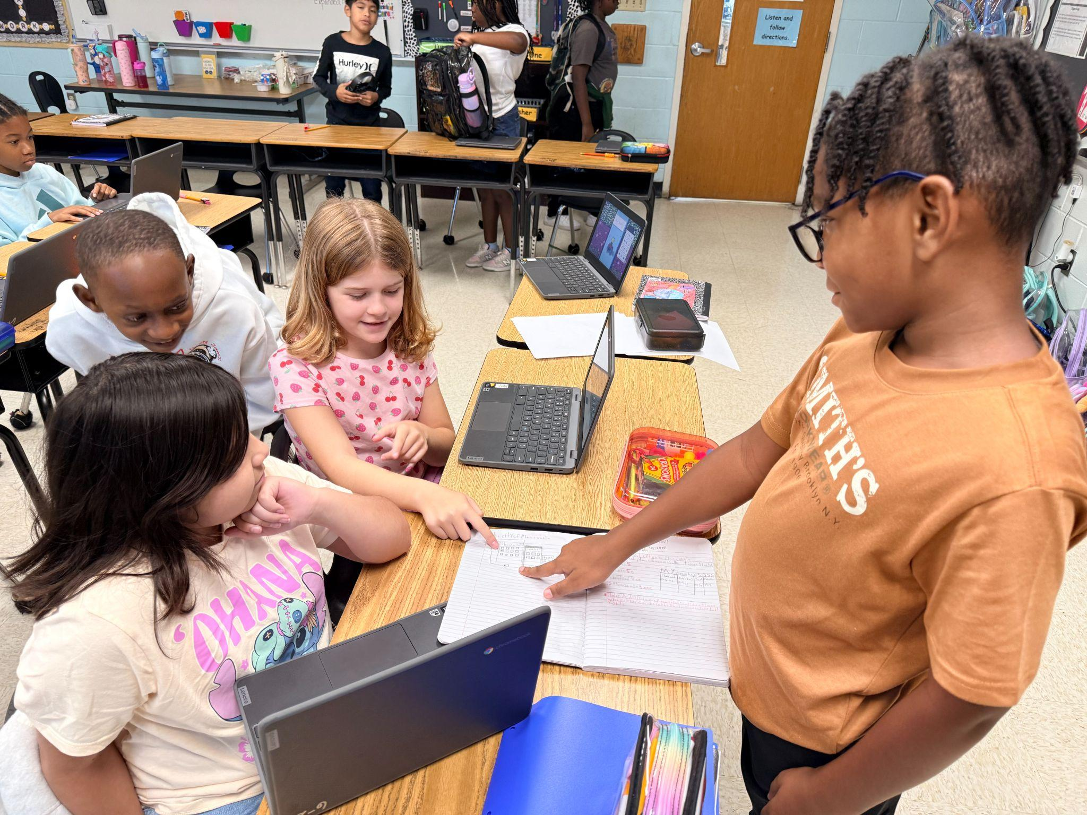
Discipline Data
2025-2026
53 Total Incidents
Classroom- 30
Hallway-7
Playground-5
On bus- 6
Cafeteria- 1
Gym- 2
Restroom- 1
Bus stop- 1
Notes:
Locklear

Slide 19
Subgroup Performance
Notes:
Locklear

Slide 20
Root Cause Analysis
J.W. McLauchlin Elementary exceeded expected growth in mathematics but did not meet expected growth in reading, indicating a need to examine the consistency and effectiveness of literacy instruction, intervention, and progress monitoring across grade levels. A contributing root cause of the school's lack of expected growth in reading is inconsistent implementation of data-driven literacy practices, including the use of assessment data to identify specific reading skill deficits (decoding), the lack of providing targeted small-group instruction (WIN), the lack of monitoring student progress, and adjusting instruction as needed based on student data.
Notes:
Locklear

Slide 21
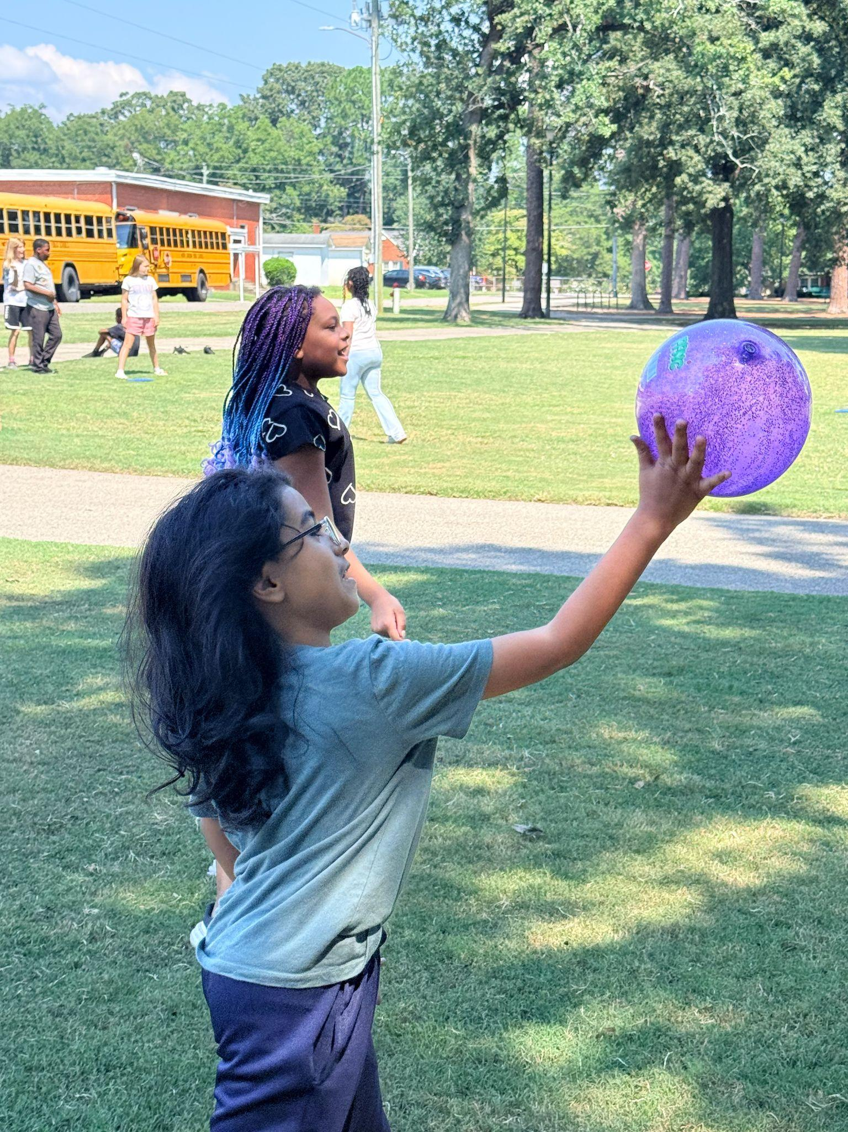
School Improvement Goal: Student Success
Goal 1: Increase K–3 reading proficiency by 10% based on mClass assessments.
Goal 2: Increase 3rd–5th grade overall proficiency by 6% in Reading, Math, and Science End-of-Grade assessments.
Goal 3: Increase proficiency among Black and Hispanic 3rd–5th grade students by 8% on Reading, Math, and Science End-of-Grade assessments.
Usage of scripted curriculum with fidelity
Lesson plan monitoring and feedback
Increase student engagement through intentional integration of strategies
Intentional usage of literacy strategies aligned with standards
Weekly grade level data meetings focused on student challenges/successes with plans developed to address needs
Weekly leadership meetings to identify positive trends and challenges to address in timely manner
Notes:
Mrs. McIntyre

Slide 22
School Improvement Goal: Student Well Being
Goal 1 - By the conclusion of the 2026-2027 school year, 100% of our staff will consistently implement the school PBIS matrix with fidelity using common language. This will be determined by a decrease in behaviors using office referral data.
Goal 2 - By the conclusion of the 2026-2027 school year, 100% of school staff will consistently implement the components of the MTSS model with fidelity. This will be determined by the consistent use of the TIPS document and will include academics, behaviors, and attendance.
Monitor PBIS for fidelity
Analyze discipline data monthly to identify trends and areas of concern
Celebrate staff and student success
PD on MTSS
MTSS school committee monthly meetings
Progress monitoring
Interventions rooted in scaffolding and not remediation/deficit mindset
Notes:
Mrs. McIntyre

Slide 23
School Improvement Goal: Modern and Innovative Learning Environment
Incorporating student choice into assignments
Lesson plan and walk-through feedback based on blended learning and implementation of digital platforms with fidelity
Spotlighting effective instructional strategies in classrooms throughout the school
Goal 1 - By the conclusion of the 2026-2027 school year, 100% of staff will implement blended learning strategies that result in student products that demonstrate an understanding of identified state standards.
Goal 2 - By the conclusion of the 2026-2027 school year, 100% of our staff will implement digital platforms (iReady, mClass, Reading Horizons) with fidelity.
Notes:
Mrs. McIntyre

Slide 24
School Improvement Goal: Excellent Professionals
Goal 1 - At the end of the 2026-2027 school year, we will maintain our teacher retention rate at 90% through the fostering of collaborative, supportive relationships and the empowering of teachers to be successful leaders of education.
Goal 2 - By the conclusion of the 2026-2027 school year, all staff will engage in personalized professional development opportunities that will enable them to meet their individual needs as identified on their Personalized Education Plans and demonstrate growth as determined by EVAAS data.
Offering of choice PD based on staff needs
Coaching sessions based on effective instructional strategies
Increased opportunities for staff to take on leadership roles
Team building activities built throughout the school year
Celebrating staff successes
Including variety of staff members in interviewing prospective new staff members
Notes:
Mrs. McIntyre

Slide 25
School Improvement Goal: Communication and Community Engagement
Goal 1 - By the conclusion of the 2026-2027 school year, school staff will create opportunities for all parents to actively engage in various forms of communication including the offering of feedback, suggestions and expressing of concerns that will foster a more collaborative effort in meeting the needs of all students.
Goal 2 - During the 2026-2027 school year, the school will create a Parent Advisory Council of 10-12 members that will work to actively engage parents in the daily procedures of the school.
Inclusion of greater number of parents on SIT team to include all subgroups at school
Formation of a Family Advisory Team
Quarterly meetings with administrative team to share school news
Bi-annual surveys for parents to complete regarding school operations and suggestions for improvement
Building a group of volunteers to help support learning at the school
Notes:
Mrs. McIntyre

Slide 26
Professional Development Plan
PLCs | Every Monday from 3:00-4:45
mClass Refresher | August 20th
Know-Show Charts | August 31st
Coaching Cycles based on walkthrough data | Ongoing
September Walkthrough Tool | Month of September
Wonders Expectations/Refresher | September 14th
iReady Expectations/Refresher | September 21st
Data Talks | September 28th
Exemplars | October 5th
Notes:
Patterson

Slide 27
Family and Community Engagement
School-Wide Events
Goodies with Grandparents (9/14/26)
Title 1/Curriculum Night (9/24/26)
Book Blast (9/5-9/16)
Fall Festival (10/29)
Veterans Breakfast (11/10)
Literacy Night (12/3)
Math Night (2/18)
Color Run (March TBD)
STEM night (3/18)
Field Day (4/23)
Parent/Student Resources
Mustang Parent Committee
Parent included in SIT meetings
iReady reading (decoding)
School Spirit Nights (skating, Sweet Frog, CiCi’s Pizza, and others)
Color Run (Spring)
Quarterly Newsletter for parents
Weekly Sunday Message
DoJo and Facebook updated 3 times a week
Parent Volunteers
Notes:
Patterson

Slide 28
Budget and Resource Alignment: Title 1
2 Title 1 teacher positions
2 tutors during the school day
After-school tutoring provided by staff in 2nd half of school year
iReady My Path online program
iReady Reading (used schoolwide to close the decoding gap)
Quarterly Data/Planning Days
Instructional Resources
Professional Development (focused on Academics, Family Engagement and School Culture)
Notes:
Locklear

Slide 29
Progress Monitoring and Accountability
Monthly targeted walkthroughs
Weekly planning meetings/coaching sessions with teachers
Weekly PLC meetings after-school (30 minutes- PD/then targeted planning)
Tracking attendance
Data PLC ½ day planning after each check-in
WIN walkthroughs to ensure teachers are using that block effectively
Data Summaries of students on their way to proficiency.
Notes:
Locklear

Slide 30
Celebrations, Next Steps, and Closing
Celebration:
  Exceeded growth in Math.
  EL Population
Our next steps are to strengthen our decoding skills (K-5) to improve fluency and comprehension. This will overall improve our ELA scores.
For the 2026-2027 School Year, at MES we plan to focus on student proficiency. By focusing on student proficiency we will be able to grow all students.
Intentional is our word for the year!
Notes:
Locklear

