Slide 1
MARE Conference Fall 2026
Federal Programs
Getting Ready for 2026 - 2027
DFH
De Frink-Hedglin
DFHConsulting
573/864-9954

Slide 2
Federal Programs - Essential Elements
  Title 1A – Improving Basic Programs Operated by Local Educational Agencies
  Title 1C - Education of Migratory Children
  Title 2A – Supporting Effective Instruction
  Title 3 – Language Instruction for English Learners and Immigrant Students
  Title 4A - Student Support and Academic Enrichment Grant
  Title 5B - Rural Education Initiative

Slide 3
Staying Updated – Federal Programs
Webpage - Federal Programs | Missouri Department of Elementary and Secondary Education (mo.gov)
Federal Programs ListServe Sign Up
  Federal Programs | Missouri Department of Elementary and Secondary Education (mo.gov)
  Fedpro Info Page (mo.gov)

Slide 4
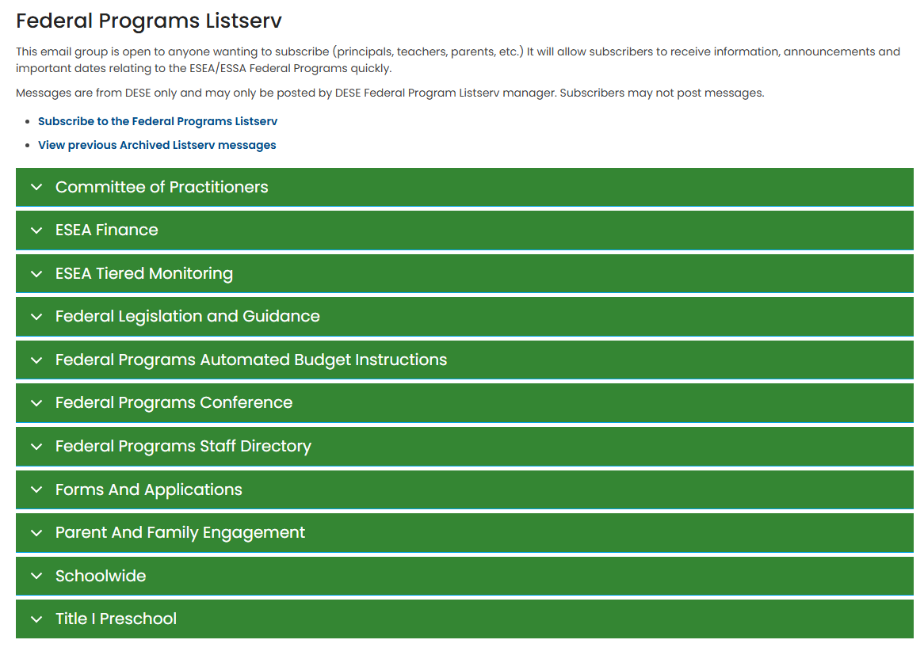
Federal Programs | Missouri Department of Elementary and Secondary Education

Slide 5
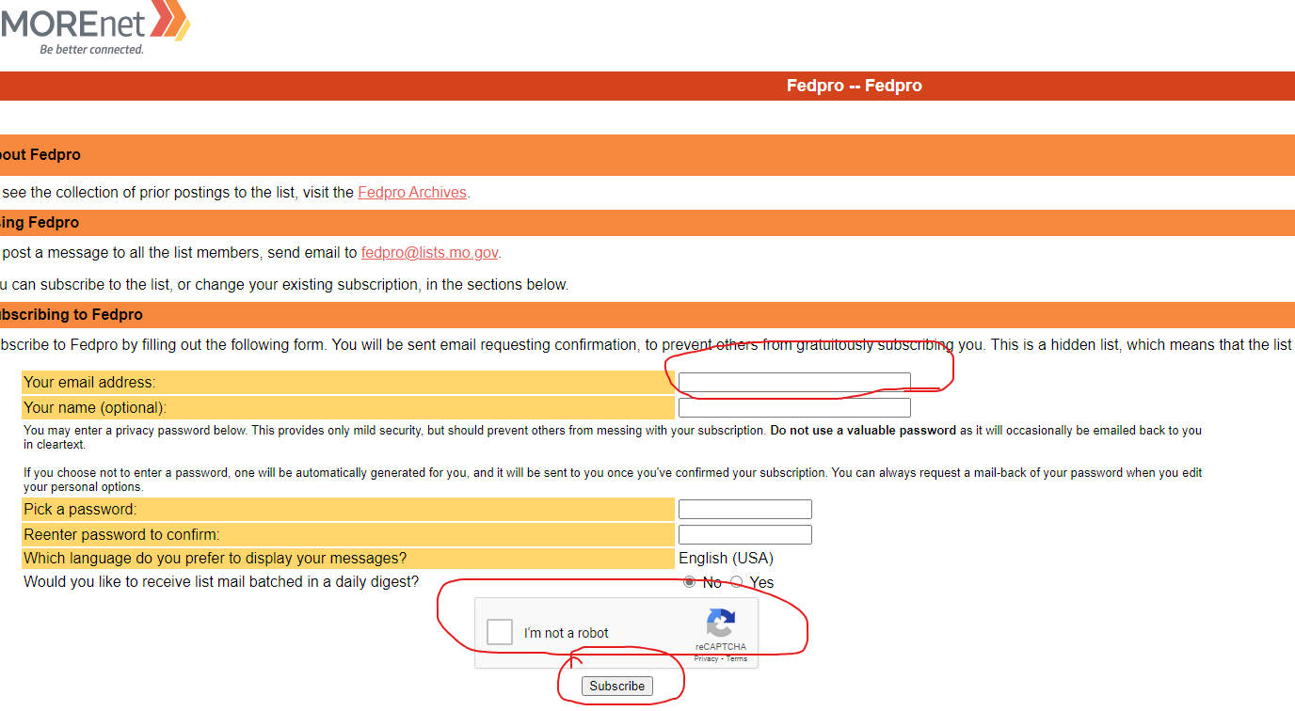
List Serves
Federal Programs | Missouri Department of Elementary and Secondary Education (mo.gov)

Slide 6
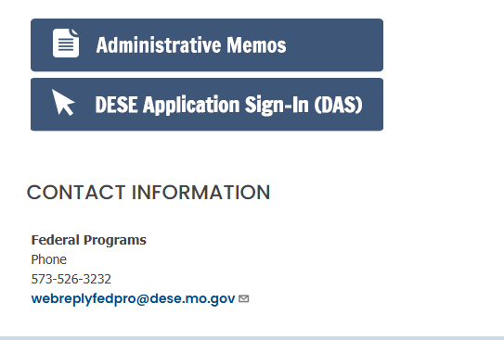
Federal Programs | Missouri Department of Elementary and Secondary Education

Slide 7
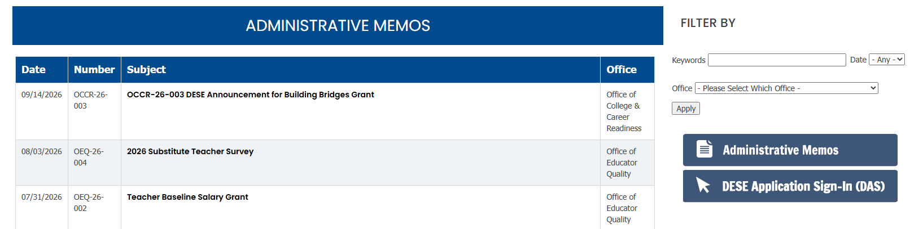
Staying Updated – Administrative Memos
Administrative Memos - DESE Webpage Administrative Memos | Missouri Department of Elementary and Secondary Education

Slide 8
Resources
www.Edweek.org www.Edutopia.org UFLI Foundations | U F Literacy Institute
Federal Programs Federal Programs | Missouri Department of Elementary and Secondary Education (mo.gov)
Federal Programs Administrative Manual Revised Feb 2023 Consolidated Federal Programs Administrative Manual | Missouri Department of Elementary and Secondary Education (mo.gov)
DESE Federal Programs Tiered Monitoring Self-Monitoring Checklists - Tiered Monitoring Checklist | Missouri Department of Elementary and Secondary Education
  ListServes
Federal Programs/ Finance https://lists.mo.gov/mailman/listinfo/fedpro
Homeless McKinney Vento https://dese.mo.gov/quality-schools/federal-programs/homeless-children-youth/listserv
Foster Care - https://lists.mo.gov/mailman/listinfo/webreplyfostercare
Migrant – EL - Title 1C Migrant Education | Missouri Department of Elementary and Secondary Education (mo.gov)
  Family Engagement -
Webpage https://dese.mo.gov/quality-schools/federal-programs/parent-family-engagement

Slide 9
Title 1A Programming
Title 1A Targeted Assistance
Title 1A Schoolwide

Slide 10
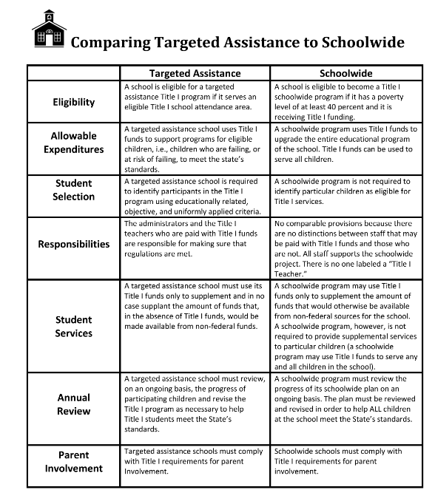
Title 1A Programs

Slide 11
Calendar Reminders – 2026 – 2027 Federal Programs
    BOY Beginning of the Year Checklist – August 2026 – October 2026
    MOY Middle of the Year Checklist – November 2026 - February 2027
    EOY End of Year Checklist – March 2027 – June 2027
    March 31, 2027 – deadline for obligation of funds for any federal program
    Spring 2027 – Review & revise LEA/Schoolwide plans for 2027-2028 - must be in epegs Consolidated Application for June 30 2027 submittal
    April 15 , 2027 – Submit Monitoring – Cohort 3
      T1A – April TM requirement - Title 1A, T2A & T4A evaluation meeting agenda and minutes
      April 30, 2027 – Deadline for any revisions / amendments for any federal program – no exceptions
    June 30 , 2027 – Submit ESEA Consolidated Budget Application
    July 1, 2027– start of fiscal year 2027– 2028

Slide 12
Consolidated Application - ePeGs “Remember to’s”
MUST HAVES -
Budgets = plans = budgets = plans
Plans = identified priorities = budgeted salary allocations = supporting data staffing = core data staff reporting
“REMEMBERS” -
Requests for Payment – can be 2x / month w/ no active revision/amendment in process

Slide 13
FedPro Epegs system - “Rule of 30’s”
  Budgets = Plans
  June 30, 2026 - ePeGs submittal for 2026 - 2027
  September 30, 2026 – FER (Final Expenditure Report)
  March 30 (31), 2027 – last obligations for 2026-27
  April 30, 2027 – Last ePeGs revision / amendment
  June 30, 2027 – ePeGs submittal for budgets & plans
  July 1, 2027 - 2027 - 2028 budget year starts

Slide 14
Carryover Reminders
Title I.A Carryover -
  LEAs with an allocation of less than $50,000 may carry over up to 100% of their allocation
  LEAs with a Title I.A allocation of $50,000 or more have 15% maximum carry over of allocation past September 30th
  (9/30 report)
  DESE may grant a waiver for T1A carryover once every three years if the LEAs request is reasonable and necessary (have plan)
Title 2 & 4A Carryover = 100% of allocation (no stockpiling)

Slide 15
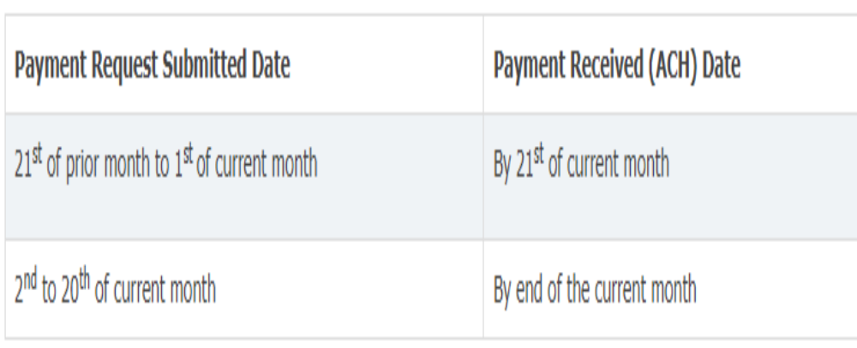
Payment Requests – Submit & Paid

Slide 16
ePeGs Tips & Suggestions
2026 – 2027 Include in planning and ePeGs application –
All Title Budget Grids & Supporting Data: Revise and update budget grids i.e. Teachers, Paras, PD, Material and Supplies etc.
Core Data: Verify all Teachers, Paras, etc. are coded correctly to the title section they are being paid from (Title I, II, III, IV. V).
All Data Matches Up: All data must match in budgets, supporting data, core data

Slide 17
FedPro Reporting
Core Data Submittal - October 15, 2022
October 15, 2026- certification for MOSIS –
  Screen 18 Educator Certification
  Screen 20 Course & Assignment
  Match to 2026 – 2027 ePeGs Supporting Data pages for T1A, T2A, T3, T4A
  T1A Reading vs T1 ELA definitions
  4 Week Certification Clarification

Slide 18
Title 1A – Allowable Uses For Served Buildings
•Supplemental instructional teachers/paras (salaries/benefits)
•Instructional/Teaching Methods Coach
•Counseling, school-based mental health programs, mentoring services
•Pre-K and summer programs
•Aides (non-instructional services)
•Instructional materials
•Parent liaison/coordinator
•PD - staff stipends/substitutes
•PD presenters/supplies/materials
•Parent engagement activities
Before/after school tutoring
Concurrent/dual enrollment programs
AP courses/exams
Career and college readiness activities/services
Direct student services — credit recovery, academic acceleration
Online subscriptions, software license fees
Homeless liaison
Support for homeless students
Equitable services for nonpublic students
Reference Admin Manual Feb 2023

Slide 19
Title 2A – Allowable Uses
Use for K-12 – all buildings
Use w/ PDC 1% funds for PD
Developing/improving evaluation and support system
Developing initiatives in recruiting, hiring teachers
Reducing class size (CSR)
SNS applies
Providing PD - K-12 – vertical teams
  Tech, literacy, assessment, curriculum, etc
Reference Admin Manual Feb 2022 – pg 70 - 73

Slide 20
Title 4A - Use of Funds
Well Rounded Educational Opportunities –
  access to foreign language, arts, music
  Support for college/career counseling, FAFSA
  Improving instruction for STEM, computer science
  Access to AP/IB/dual enrollment
  Support instruction for American history, civics, economics, geography, etc
  Safe and Healthy Students
  Promote / provide community and parent involvement in schools ,school-based mental health and counseling, reduce exclusionary discipline, support dropout prevention, re-entry /credit recovery programs, healthy lifestyle, prevent bullying and/or violence, community relationships
  Technology
  PD for staff/ tech capacity & infrastructure, support digital learning
  Source: Admin Manual Feb 2023 Pg 94

Slide 21
Start of School Requirements
Resource Update - Admin Manual updated Feb 2023 -
Consolidated Federal Programs Administrative Manual | Missouri Department of Elementary and Secondary Education (mo.gov)
Enrollment forms Must Be Shared With Families – Migrant questions / Homeless questions / EL – English Language survey
Policies Must Be Distributed - Tiered Monitoring requirement
Parent Engagement Policy - Source: LEA ePeGs Plans Public View
Schoolwide Title 1A Policy - Source: LEA ePeGs Plans Public View

Slide 22
Start of School Requirements
Hold each Title 1 served building's start of school T1 meeting
Distribute Title 1 Parent/Child/School Compact, Parent’s Right to Know Letter, ESEA Complaint Procedures, distribute T1 event surveys
Update Screen 3 Core data for any fedpro name changes
Review ePeGs Consolidated Application for Final Approval status
McKinney-Vento requirements - Hold M-V district staff meeting & M-V community / agency meeting or share info by email
Foster Care requirements – hold district & agency meetings
Start Title 1A PK services (if applicable)
Start Nonpublic Title 1 services (if applicable)

Slide 23
Required Meetings Title 1
***Title I Annual Meeting – Fall 2026 – Monitored – October 2026
Convened at beginning of the school year at each T1A served building
◦ All T1 patrons invited to attend
◦ Must address three required elements (school’s Title I participation, Title I requirements, and parents’ rights to be involved)
Handouts/notifications to all patrons – documents vs digital
***Title I Evaluation Meeting – Monitored – April 2027
Convened at the end of the school year – monitored April cycle
Review of students’ achievement data, parents’ evaluations, and school-parent compact(s)
Identifying strengths and weaknesses of the program(s) per needs assessment

Slide 24
Program Evaluation - Surveys
Spring evaluation meetings must include results of:
Annual (March 2027) Parent / Family Program Surveys
Any Title 1 Events throughout 2026 - 2027 – Activity Surveys (reading nights, parent involvement activities, etc)

Slide 25
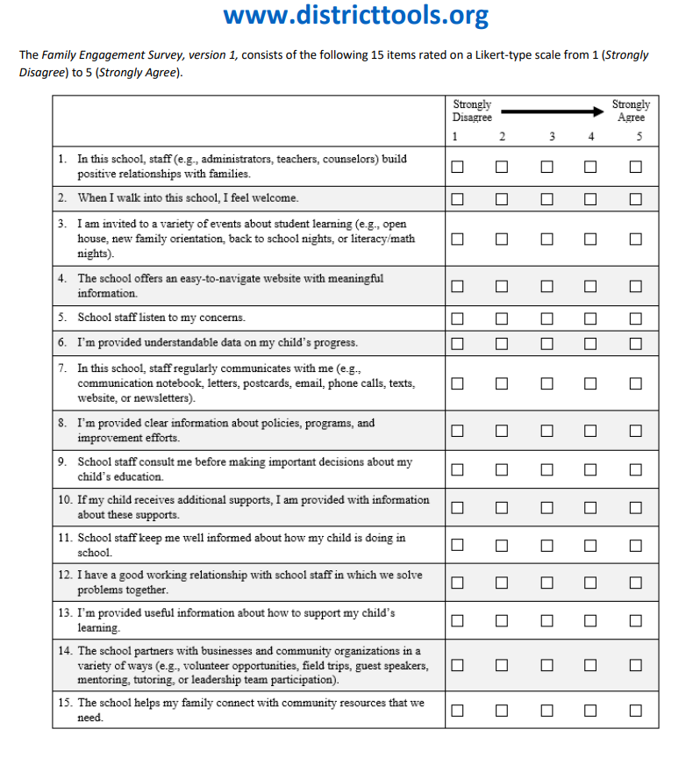
Title 1A Family / Parent Program Survey

Slide 26
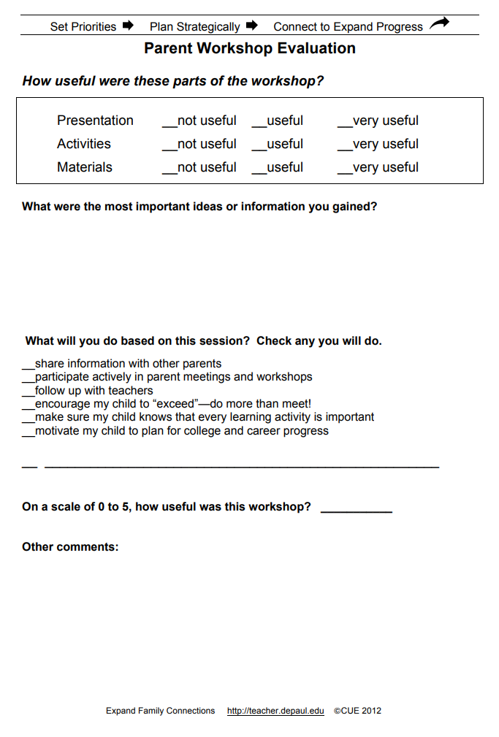
Title 1 Activity / Family Event Surveys

Slide 27
EOY Program Evaluation - Spring
***Title 1 Evaluation Meeting
Required annually at the end of the school year
Monitored – April 15, 2027 submittal
Includes review of students’ achievement data and school-parent compact(s)
  Includes identifying strengths and weaknesses of the program(s) per needs assessment
  Parent & family evaluation surveys results review
  Activity / event surveys review

Slide 28
EOY Program Evaluation - Spring
***Title 1, 2, 4 Evaluation Meeting
Required annually at the end of the school year
Monitored – April 15, 2027
1 meeting can serve for review of all Federal Programs – must include
  Agenda must include specific sections
  Minutes must be thorough
  Attendees must be appropriate for each program

Slide 29
All Meeting Sign-Ins
 | Building Name ________________ ATTENDEE NAME | Meeting Date ______________ ATTENDEE SIGNATURE | Meeting Name / Purpose ________________ ROLE (PARENT/TEACHER, ADMINISTRATION, PATRON, ETC)
1.
2.
3.

Slide 30
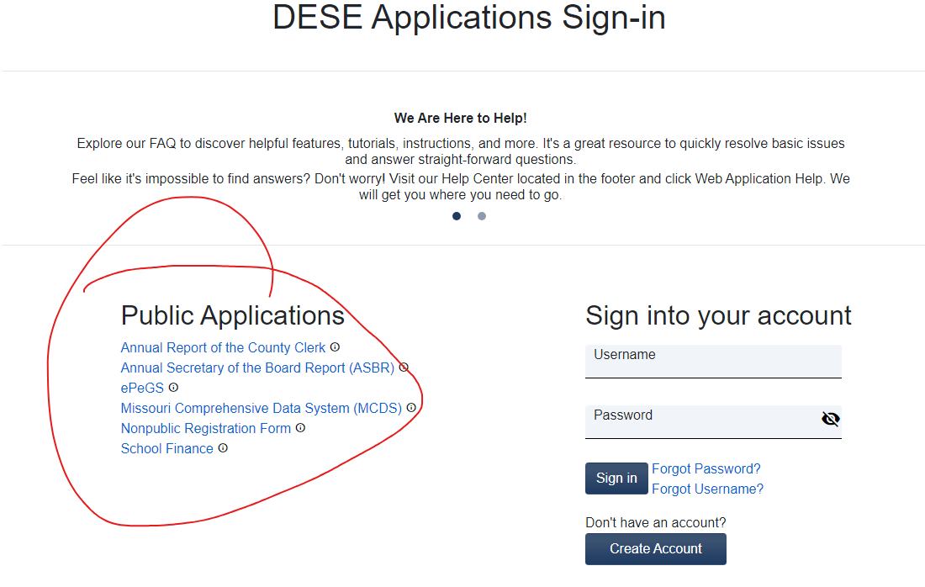
DESE Applications Sign-in (mo.gov)
**Use Public View for handouts in fall meetings**

Slide 31
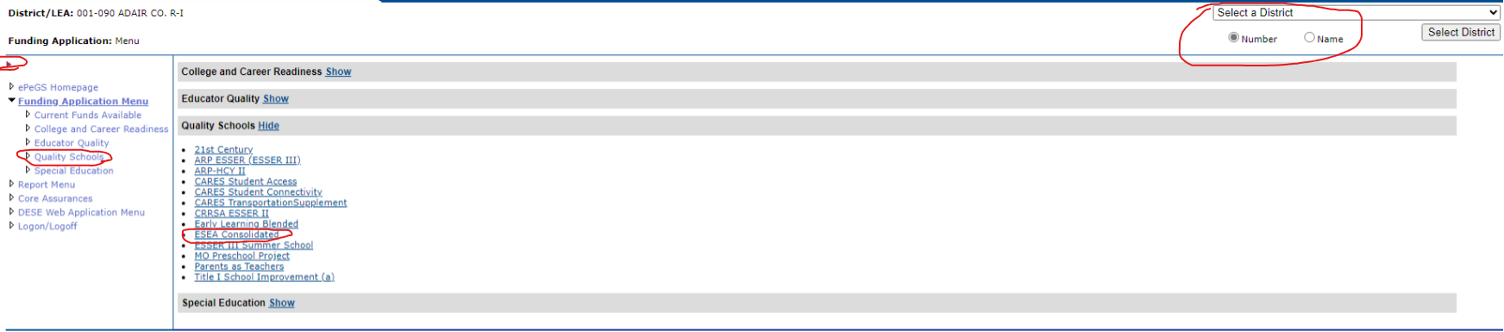
Navigating ePeGs

Slide 32
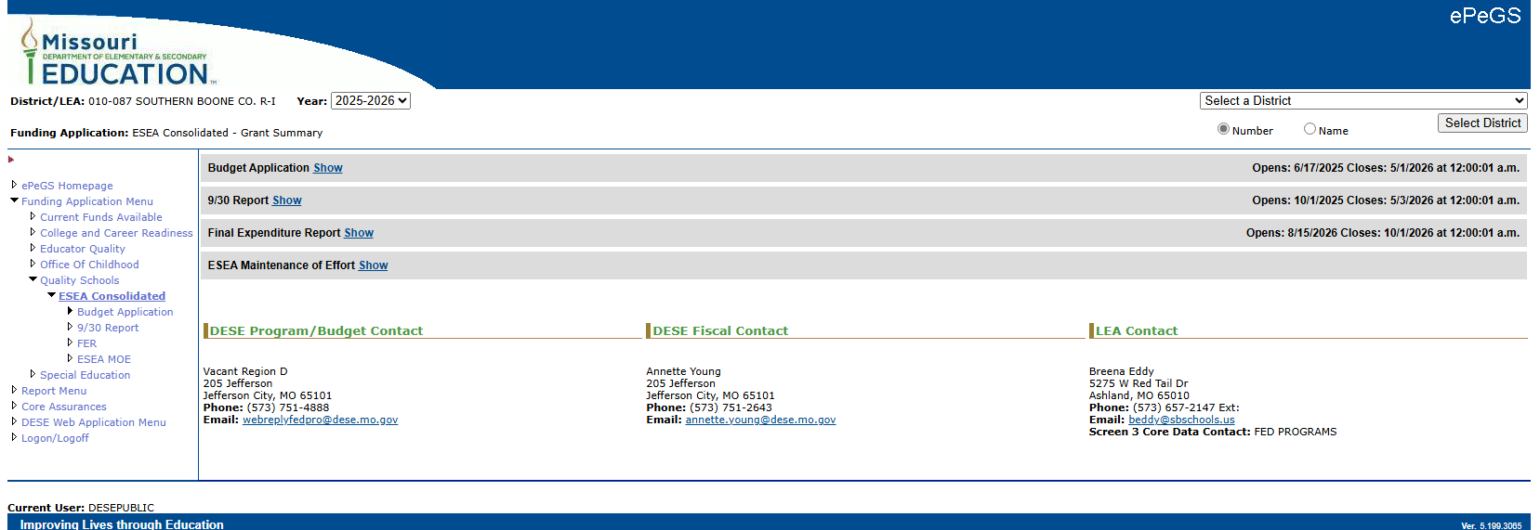

Slide 33
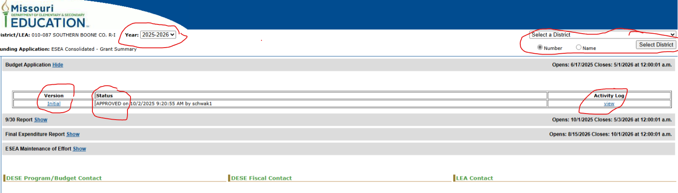

Slide 34
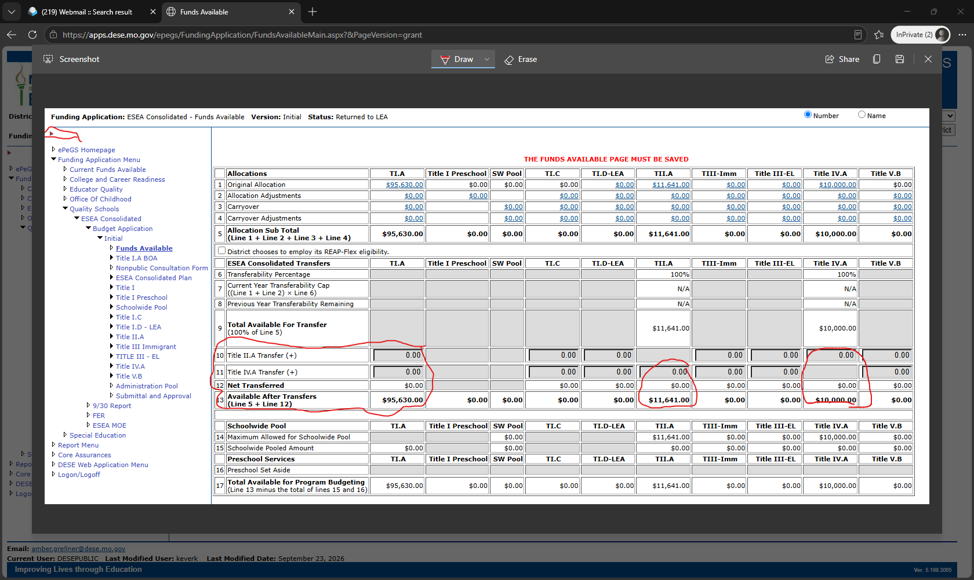
Funding Transferability / Flexibility

Slide 35
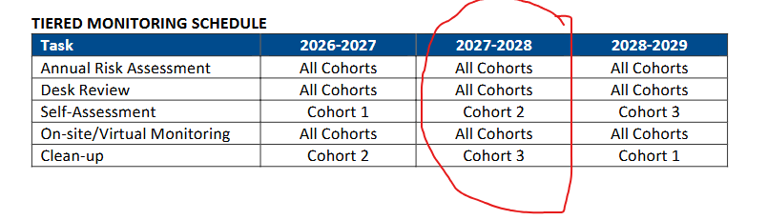
ESEA Finance Monitoring Guide | Missouri Department of Elementary and Secondary Education

Slide 36
FedPro Tiered Monitoring
Tiered Monitoring – LEAs by Cohort
  Cohort 1 – 2026–2027
    (submittal through 2026 - 2027)
    (possible in-district visits ’27 – 28)
  Cohort 2 – 2027 – 2028
  Cohort 3 – 2028 – 2029

Slide 37
Tiered Monitoring Submittals 2026 - 2027
October 15, 2026 – General Provisions / Title 1A / Title 4A
November 15, 2026 – T1C Migrant / T3 LEP
November 30, 2026 - Federal Programs Finance Due Date
December 15, 2026 – Title 1A Program
January 15, 2027 – McKinney-Vento Homeless Program & Policies
February 15, 2027 – Migrant / English Language / Foster / T1D Neglected & Delinquent / McKinney-Vento Training
April 15, 2027 – Evaluation Meetings T1A / T2A / T4A
April 15, 2027– Nonpublic Evaluation Meeting (if applicable)

Slide 38
Policy Examples – October Submittal 2026 - 2027
MSBA – Missouri School Boards' Association | Home (mosba.org)
Title 4A Internet Safety – EHB – AP1 Technology Safety
Title 1A - McKinney Vento Homeless - IGBCA – AF1
Title 1A - Foster Students – IGBE – AP1
Title 1A – Parent & Family Involvement – LEA/District – IGBC-AF1 ** SUBMIT PUBLIC EPEGS PLAN
Title 1A – Parent and Family Involvement – Building – IGBC – AF2 ** SUBMIT PUBLIC EPEGS PLAN
Migrant Students – IGBCB – AP 1
English Learners (EL) – IGBH – AP1 / Lau Plan

Slide 39
MCE – Missouri Consultants for Education - Missouri Consultants for Education (moconed.com)
Title 4A – Internet Usage – Policy 6320 AE – 6320 Regulation
Title 1A - McKinney Vento Homeless – Policy 2260 – Identification, Enrollment, etc.
Title 1A - Foster Students – Policy PRF 2760 – Foster Transportation, BID, etc.
Migrant Students – Policy PR 2270 – Identification of students, etc.
English Learners (EL) – Policy 6180 EL Procedures, Home Language Survey, etc

Slide 40
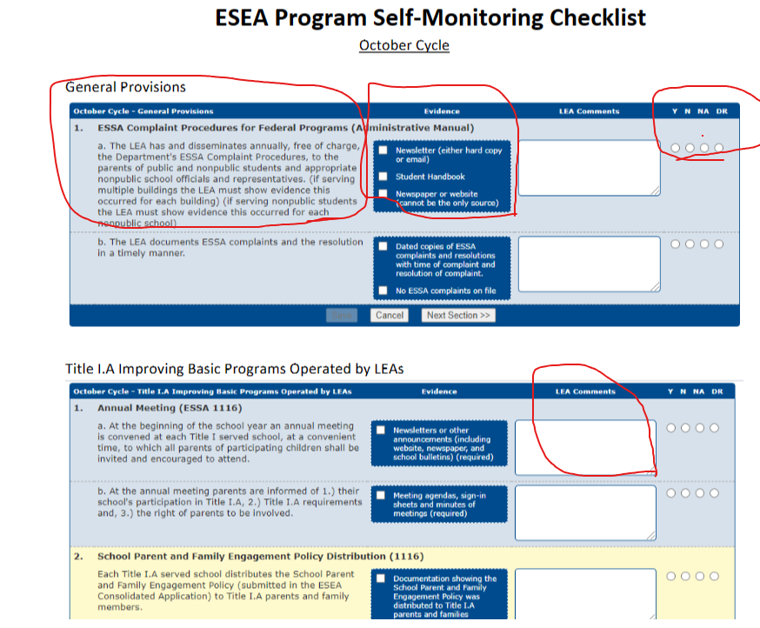

Slide 41
FedPro Annual Conference
October 4-6, 2026
September 2027???
Columbia MO
Check Conference Link at Federal Programs | Missouri Department of Elementary and Secondary Education

Slide 42
De Frink-Hedglin
DFHConsulting dfhconsulting@socket.net
573/864-9954
Technical Assistance
Federal Programs
Program Plans
Program Budgets
Tiered Monitoring
Coaching & Preparation
Phone Consultation
Virtual Assistance
In-District Training
Staff Workshops
On-going Assistance
DFH

