Slide 1
Financial Aid
Cindy Newell
Assistant Director
Office of Student Financial Assistance | Kansas State University
Phone: 785.910.8867 | Email: cnewell@k-state.edu

Slide 2
Topics We Will Cover
Identify funding sources
Discuss the different types of aid
Free Application for Federal Student Aid (FAFSA)
Common Errors
General Timeline
Notes:
Session description: Help find funding to cover the entire cost of college at any school in the country.

Slide 3

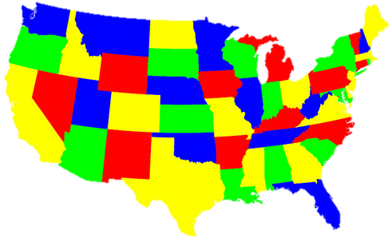


Sources of Financial Aid
Federal
Apply annually using the FAFSA
Aid may be Need based or Non-need based
Priority dates vary
State
Commonly include residency requirements
Awarded on both Merit & Need
Deadlines vary by state
Institutional
Awarded on both Merit & Need
Aid may be Gift Aid or Self-Help Aid
Deadlines vary by institution
Private
Multiple Sources
Awarded on both Merit & Need
Deadlines vary

Slide 4
Types of Financial Aid
Scholarships
Not Paid Back
Awarded on Merit
Grants
Generally Not Paid Back
Awarded on Financial Need
Work-Study
Earned Money
Awarded on Financial Need
Loans
Borrowed Money
Some Awarded on Financial Need

Slide 5

Private Aid
Sources include - community foundations, businesses,
charitable organizations and churches
Companies may have scholarships or educational benefits available to children of employees
Private Student Loan Alternatives
– May have better rates depending on credit.
  Usually require a co-signer for students.
  Can be awarded up to a students remaining cost of attendance.
Notes:
Our website on private scholarships:
https://www.k-state.edu/sfa/aid/scholarships/outside-scholarships/
https://www.usd232.org/Page/5294
http://scholarshipsmvhs.weebly.com/

Slide 6

Institutional Aid/Scholarships
Award aid based on both merit and need
Scholarships may require transcripts/ACT scores
Aid may be gift aid or self-help aid
Uses information from the FAFSA and/or institutional applications
Apply by the Priority Deadlines!
  Check website for date deadlines.

Slide 7
State Grants/Scholarships
State of Kansas Grant
  Kansas Comprehensive Grant (FAFSA required and submitted by school’s priority date)
Kansas State scholarship (Complete Kansas Scholars Curriculum, ACT scores, FAFSA, financial need)
Others: Teacher, Nursing and Kansas Promise

Slide 8

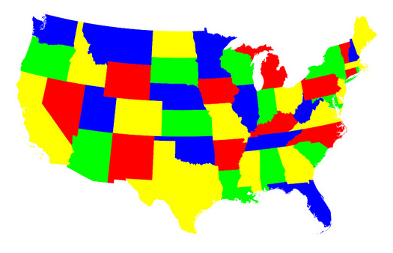
State of Kansas Scholarships and Grants
Apply online at sfa.kansasregents.org
Kansas State Scholarship
Kansas Teacher Service Scholarship
Kansas Nursing Service Scholarship
Kansas Military Service Scholarship
Kansas Hero’s Scholarship
Notes:
https://www.kansasregents.org/students/student_financial_aid
https://www.kansasregents.org/scholarships_and_grants

Slide 9
State of Kansas Scholarships and Grants
Apply online at sfa.kansasregents.org
Kansas Comprehensive Grant
Kansas Career Technical Workforce Grant
Kansas Career Work Study Program
Fee Waiver Programs
ROTC Tuition Waiver
National Guard Educational Assistance Program

Slide 10
Federal Grants
Federal Pell Grant, Iraq and Afghanistan Service Grant (IASG)
Supplemental Educational Opportunity Grant (SEOG)
Teacher Education Assistance for College and Higher Education Grant (TEACH)
Must complete the FAFSA (www.studentaid.gov) to be eligible
Award amounts will vary based on the results of the FAFSA
Generally awarded to undergraduate students pursuing first bachelor’s degree
Notes:
IASG = Iraq and Afghanistan Service Grant
SEOG = Supplemental Educational Opportunity Grant
TEACH = Teacher Education Assistance for College and Higher Education Grant

Slide 11
Federal Direct Loans
Student is the borrower
Interest rates are fixed for the life of the loan
Repayment begins after 6-month grace period
Flexible repayment plans available
2026-27 Direct Loan Interest Rate: 6.52%
(rates change annually based on the market)
Subsidized
  Based on need
  U.S. Department of Education will pay (subsidize) the interest that accrues while in school
Unsubsidized
  not based on need
  nearly everyone qualifies

Slide 12
Parent PLUS Loans
Parent(s) is/are the borrower
The parent or step-parent who applies must demonstrate good credit history in order to borrow the loan
  If a parent is unable to borrow (denied) a parent PLUS loan, a student may be eligible for additional unsubsidized loan.
Repayment begins immediately but can be deferred upon request
New in 2026-2027 - $20,000 yearly limit/$65,000 student lifetime limit
2026-27 PLUS Loan Interest Rate: 9.07%
(rates change annually based on the market)

Slide 13
Federal Work Study (FWS)
Provides access to part-time jobs while attending school
Many student positions are available on-campus even if FWS is not awarded to you
Work schedules may be flexible
Earnings through FWS help with your future need-based eligibility

Slide 14
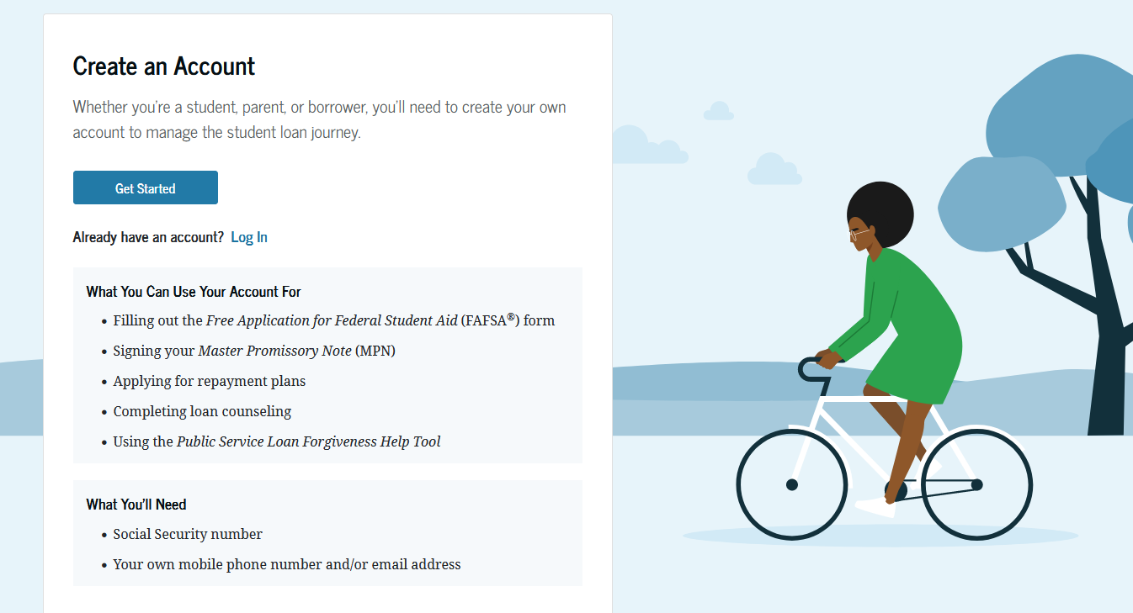
Get a Federal Student Aid ID (FSA ID)
Website: https://studentaid.gov
Student AND Parent(s) must create an FSA ID
Will be used by students and parents throughout the aid process, including subsequent school years

Slide 15
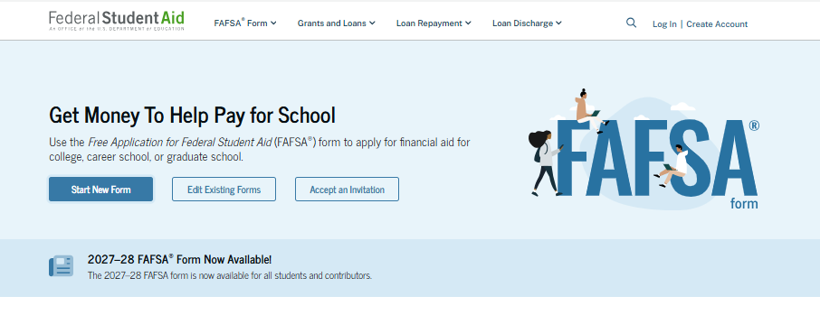
Completing the FAFSA
Notes:
Studentaid.gov
FAFSA® Form Landing Page view
The user may land on this page using a direct link to the FAFSA® form or selecting the "Complete the FAFSA® Form" link under the “FAFSA® Form" menu on the StudentAid.gov home page. The FAFSA® Form Landing Page directs new users to the “Start Here” button and returning users to the “Log In” button. For the purpose of this presentation, the applicant is beginning a new application.

Slide 16
Free Application for Federal Student Aid (FAFSA)
A standard application that collects demographic and financial information about the student and family to calculate the Student Aid Index or SAI
Completed online which prevents errors, incorporates skip-logic and offers “help” for common questions
FAFSA may be filed NOW for students attending college Fall 2027/Spring 2028
Utilizes income information from 2 years previous to the academic year for which the student requests aid (2025 tax year)

Slide 17
Information needed to complete
Studentaid.gov ID and password
Contributor information (Name, email)
2025 federal tax return
Child support received, if applicable
Asset information (Primary home, retirement account, small family owned business, family farms are NOT reported.) Examples: Business/Farm net worth, investments, rental properties, savings/checking, CDs
List of schools

Slide 18
Common errors
Demographic information incorrect (Social Security number, Date of Birth, using nickname instead of legal name)
Read very, very carefully
Not providing “consent” to having tax information transferred
Not signing
Not submitting the application

Slide 19
Recent FAFSA Changes
EFC renamed SAI, or Student Aid Index
Child support received for the last complete calendar year
Small businesses and family farms do NOT need to be reported.
No longer use number in college in SAI calculation
Changes to Parent PLUS Loans ($20,000 per year/$65,000 lifetime per student)
Loan proration
Notes:
Other changes to calculate SAI:
IPA significantly increased
Removal of state tax allowances, etc.

Slide 20
Special Circumstances
“Life Happens” – Events occur that cannot be documented on the FAFSA
Meet with financial aid advisor to discuss Professional Judgment Appeal
  Our office will review and request additional information, if necessary, which may include a correction to the FAFSA
Examples Include:
  Change in employment status
  Unusual medical expenses not covered by insurance
  Parents paying on educational loans
  Change in parent marital status
  Unusual dependent care expenses

Slide 21
Unusual Circumstances
Dependency Override – conditions that justify an adjustment to a student’s dependency status based on a unique situation
Meet with Financial aid advisor to determine if the unique situation qualifies for an Independent Appeal.
Examples for an Independent Appeal
  human trafficking
  refugee or asylee status
  parental abuse or abandonment
  incarceration

Slide 22
General Timeline
Now – Submit college admissions applications
Now – Create StudentAid.Gov account and password
Now – FAFSA for 2027-2028 should be open
Spring – Start to receive financial offer notifications from schools
All year – Applying for private scholarships as they become available

Slide 23

Questions?

