Slide 1
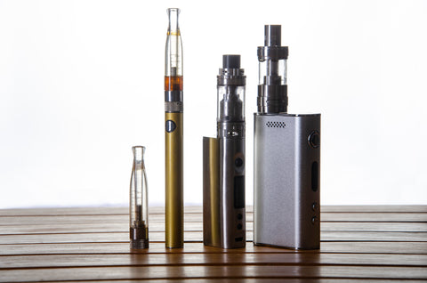
IT’S JUST A VAPE PEN, RIGHT?
VAPE PENS are everywhere, but what we are quickly finding out is what is actually inside those vape pens.
Here’s what we know:
There are no absolutes when you talk a vape pen or e- cigarette. There are vapes that work for nicotine, flavored oils without nicotine, marijuana and even synthetics.
Many people are vaping marijuana, right in front of you, and you may have no idea. Therein lies the rub.

Slide 2
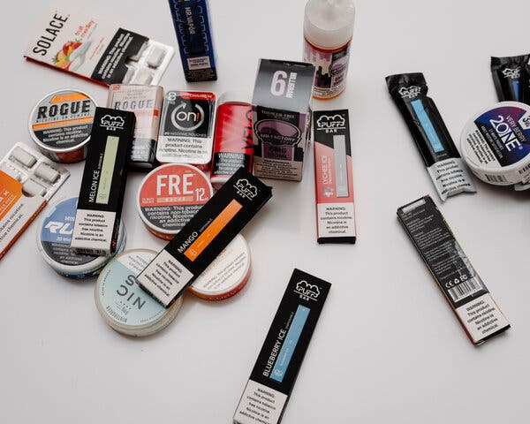
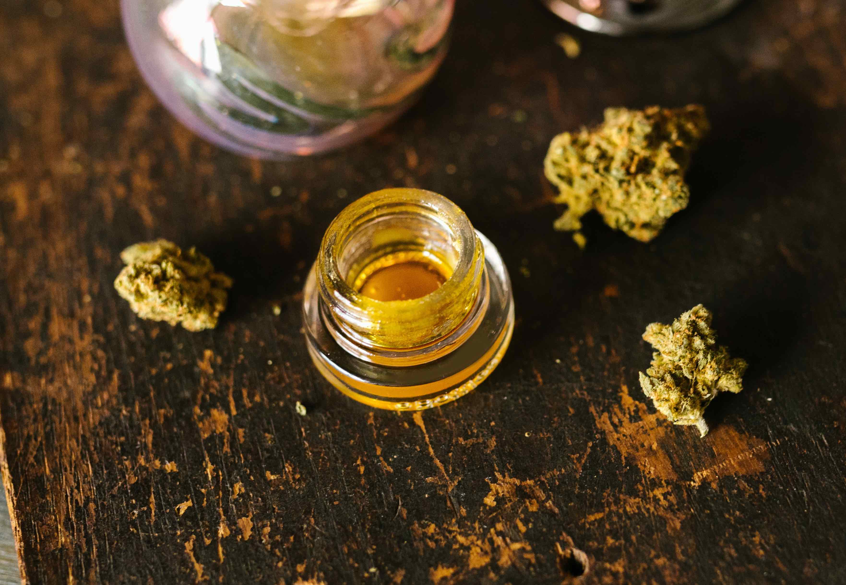
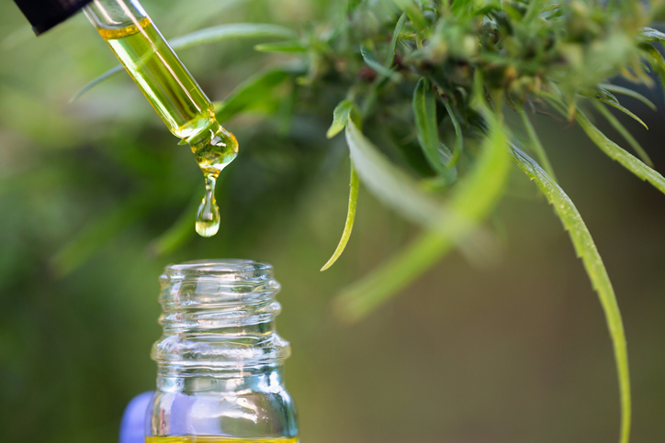
WHAT’S INSIDE THAT PEN…
-In the January/February issue of Campus Safety there was an article on the use of marijuana concentrates and their popularity. Marijuana concentrates and vape pens are the perfect marriage.
-Concentrates come in oil, wax or crystal form, and the current version of vape pens can work for all three.
-The tricky part…You can’t simply look at someone smoking from a vape pen and know what is inside.

Slide 3

Delta 9 THC
Generally, when referencing the common terms of ‘THC’, ‘weed’, or ‘cannabis’ it means Delta-9 THC(Tetrahydrocannabinol). Delta-9 is what we all know weed to be.

Slide 4
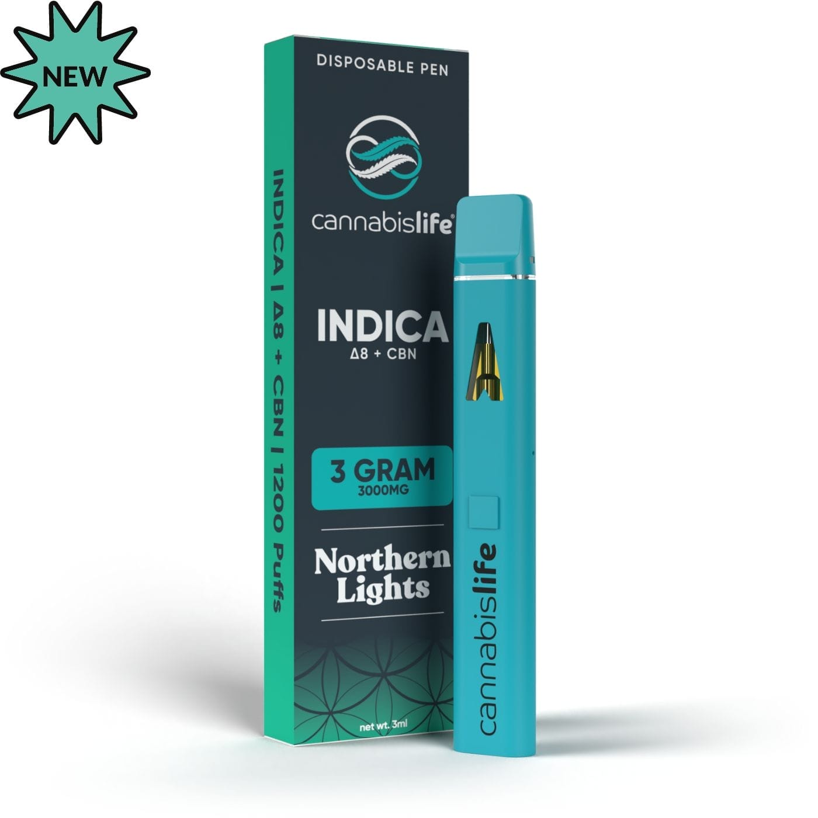
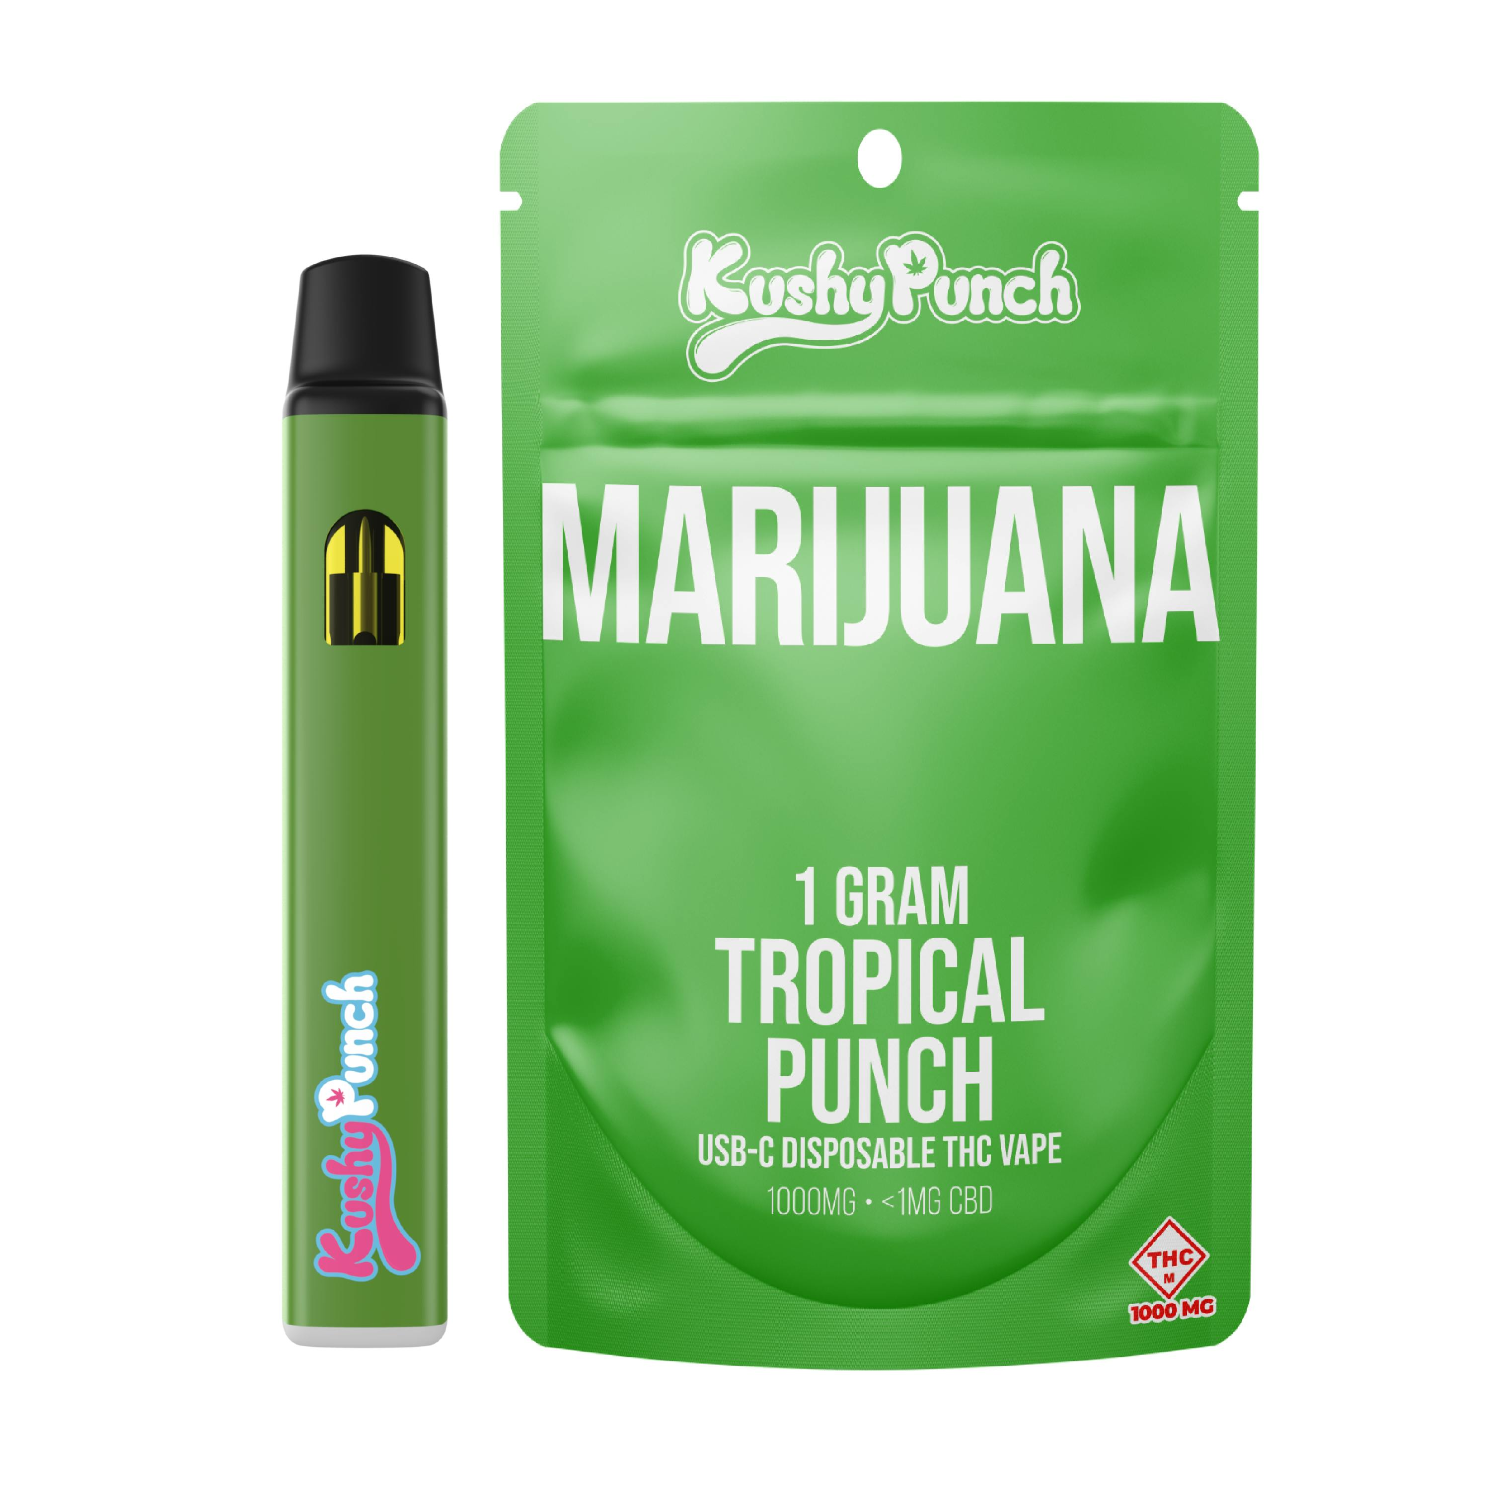
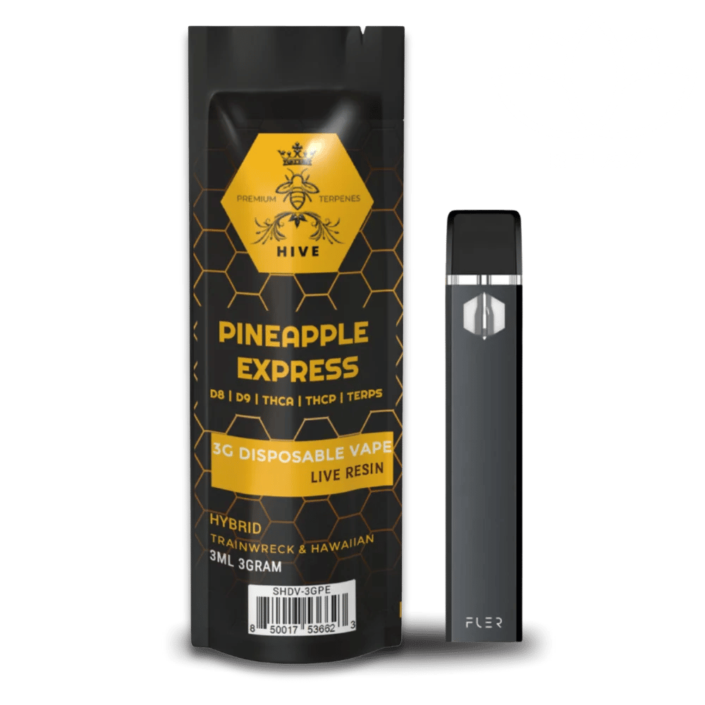
How can you figure out what someone is actually smoking?
The baseline when dealing with vape pens is there are NO ABSOLUTES.
Many of the pens you see that are being used for nicotine look similar to some of the pens in the drug world and vice/versa. NO ONE SUSPECTS YOU’RE INHALING A DRUG!
Over the last few years, vape pens for drug use have become popular. They can be colorful, small and very discrete, with the latter being a large selling point to these various pens.
Imagine sitting in class, at a stop light next to a police car, in a movie theater taking a hit of a drug and no one around you even suspects drug use? Or sitting in a classroom…..

Slide 5

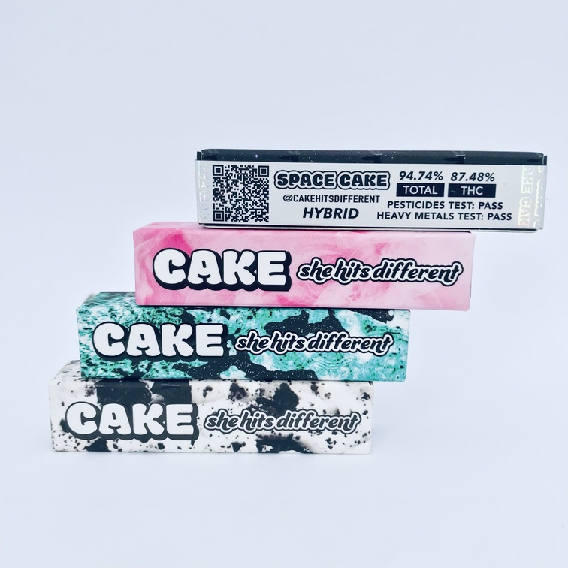
So how can this be done and others might not detect it?
Marijuana concentrates can be hard to detect, carry very little odor and are not a green, leafy substance. Once you place these various forms of marijuana into a quality vape pen, that pen can produce little to no odor thereby reducing or eliminating the known odor of marijuana.

Slide 6
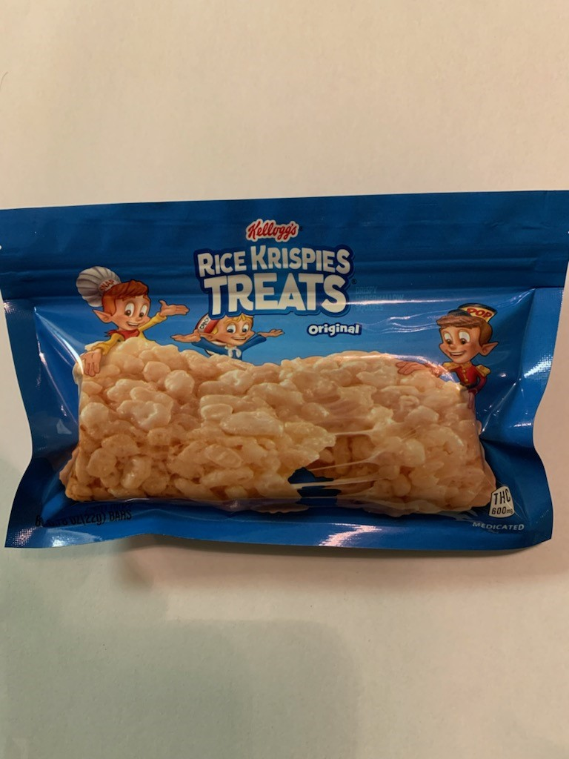
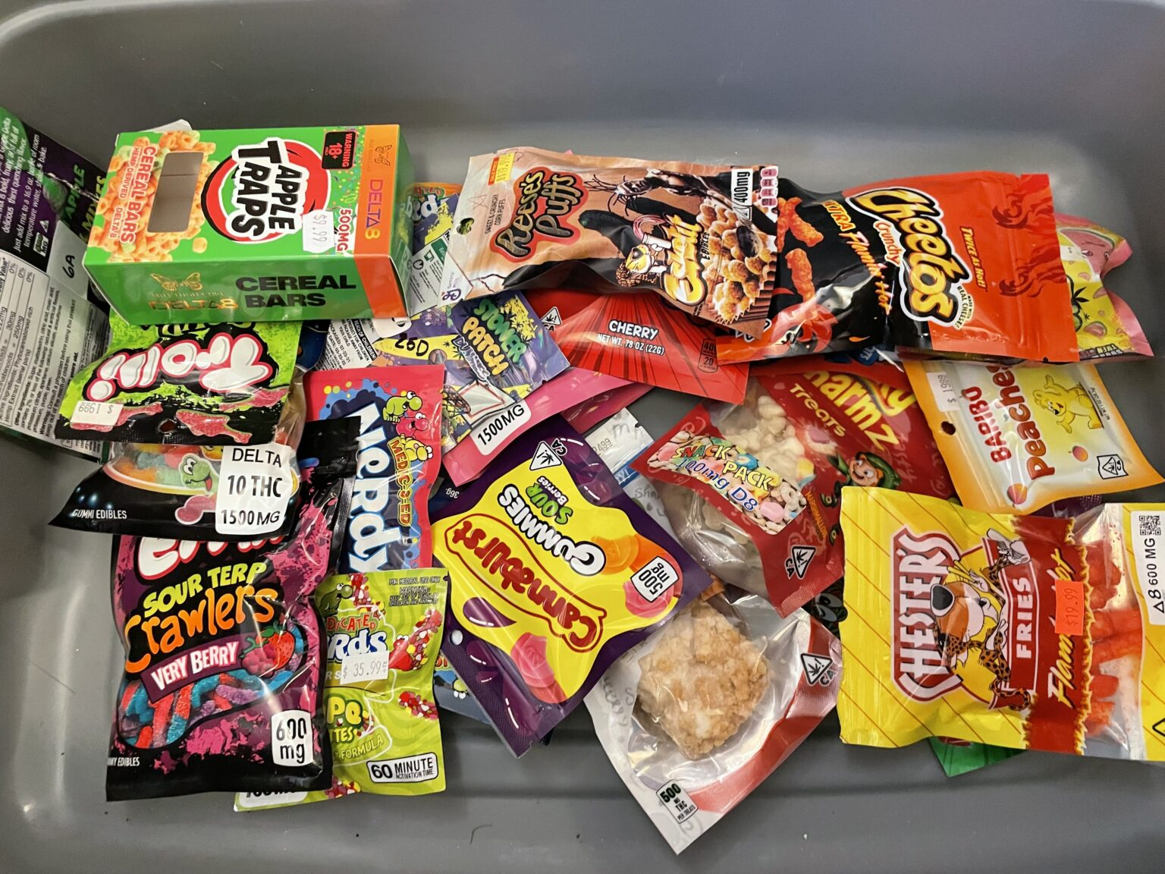
Edibles

Slide 7
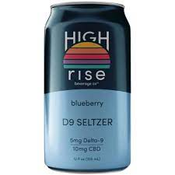
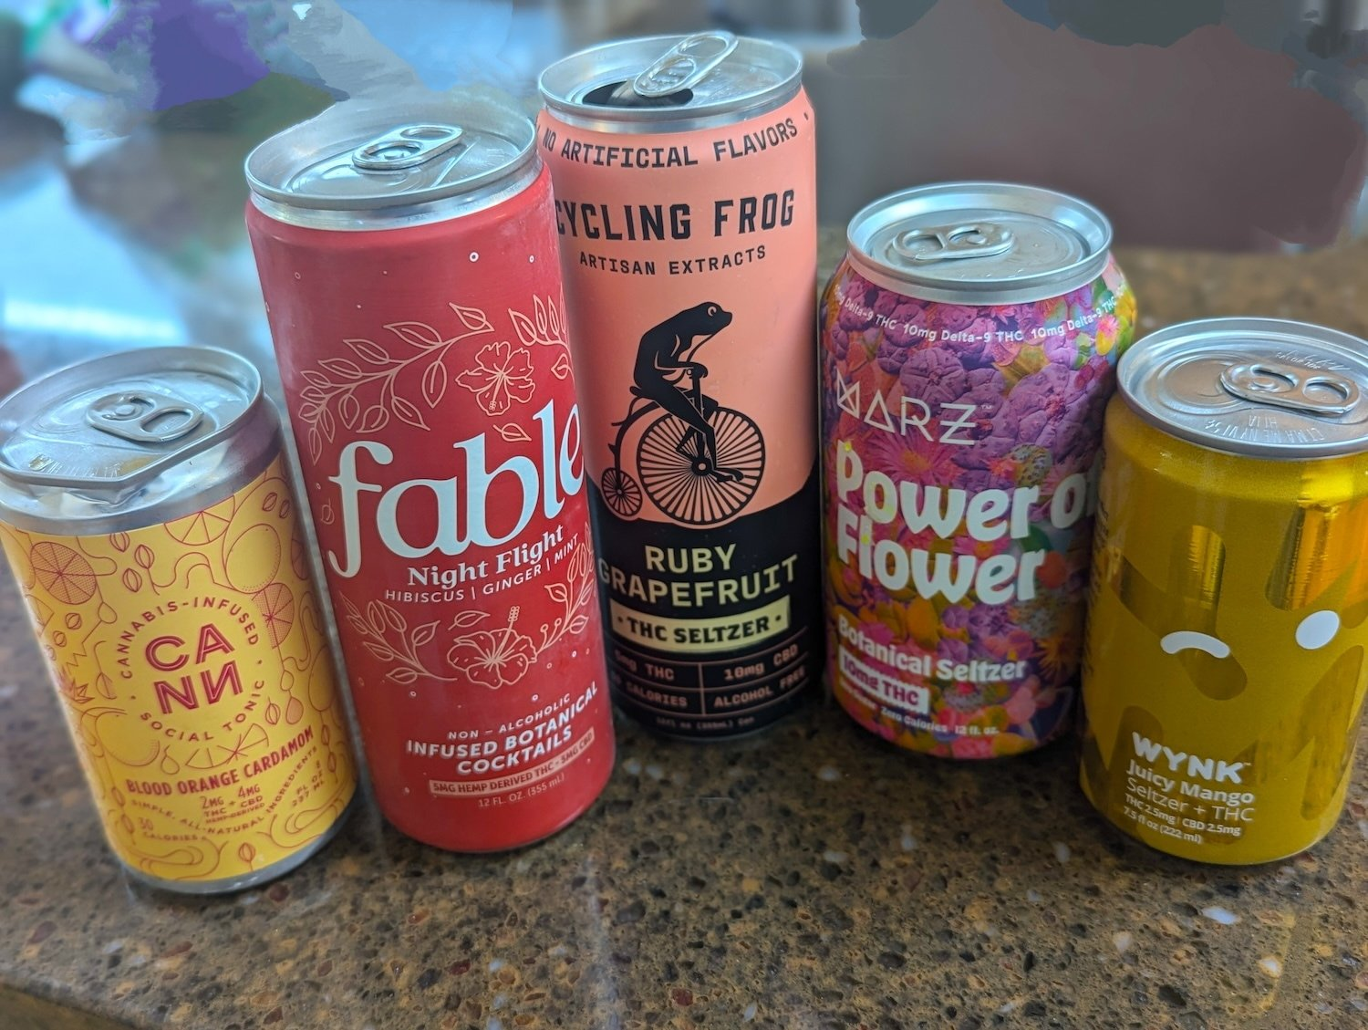
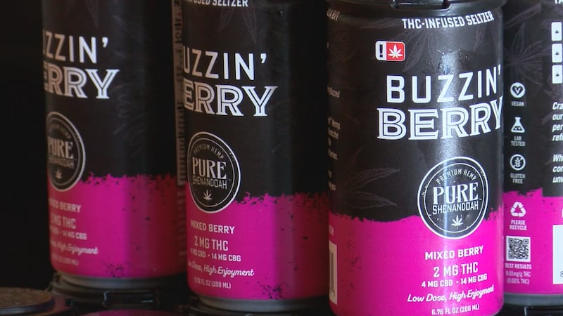
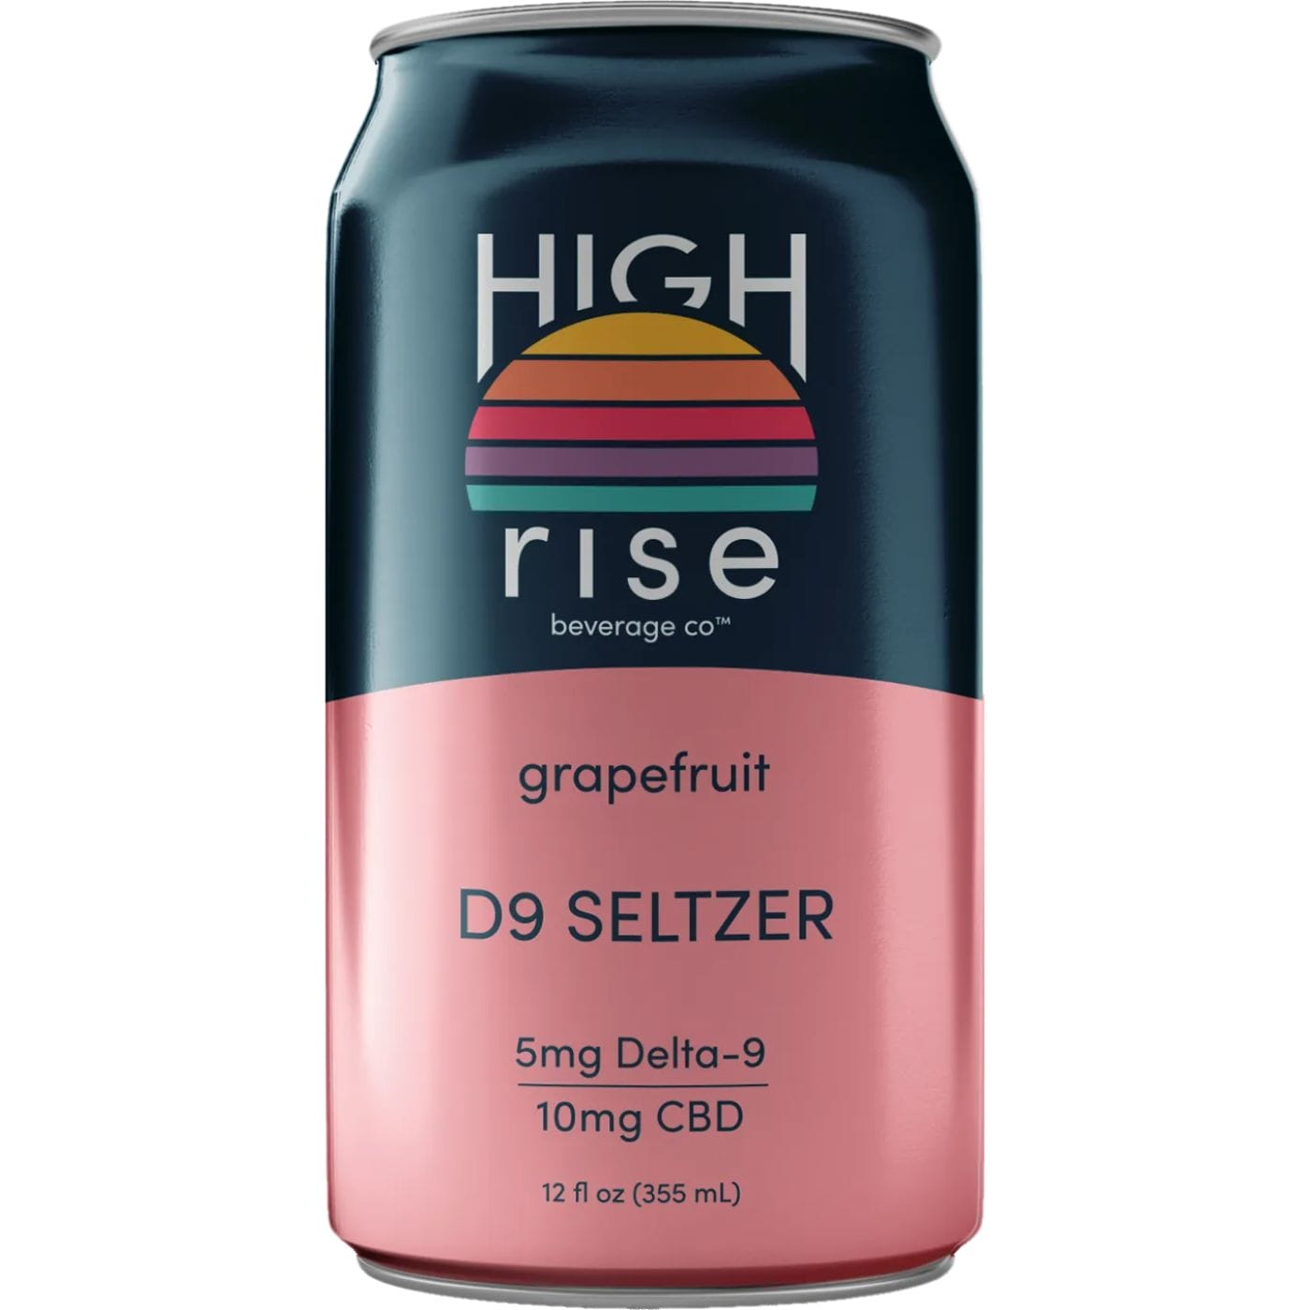
Cannabis drinks

Slide 8
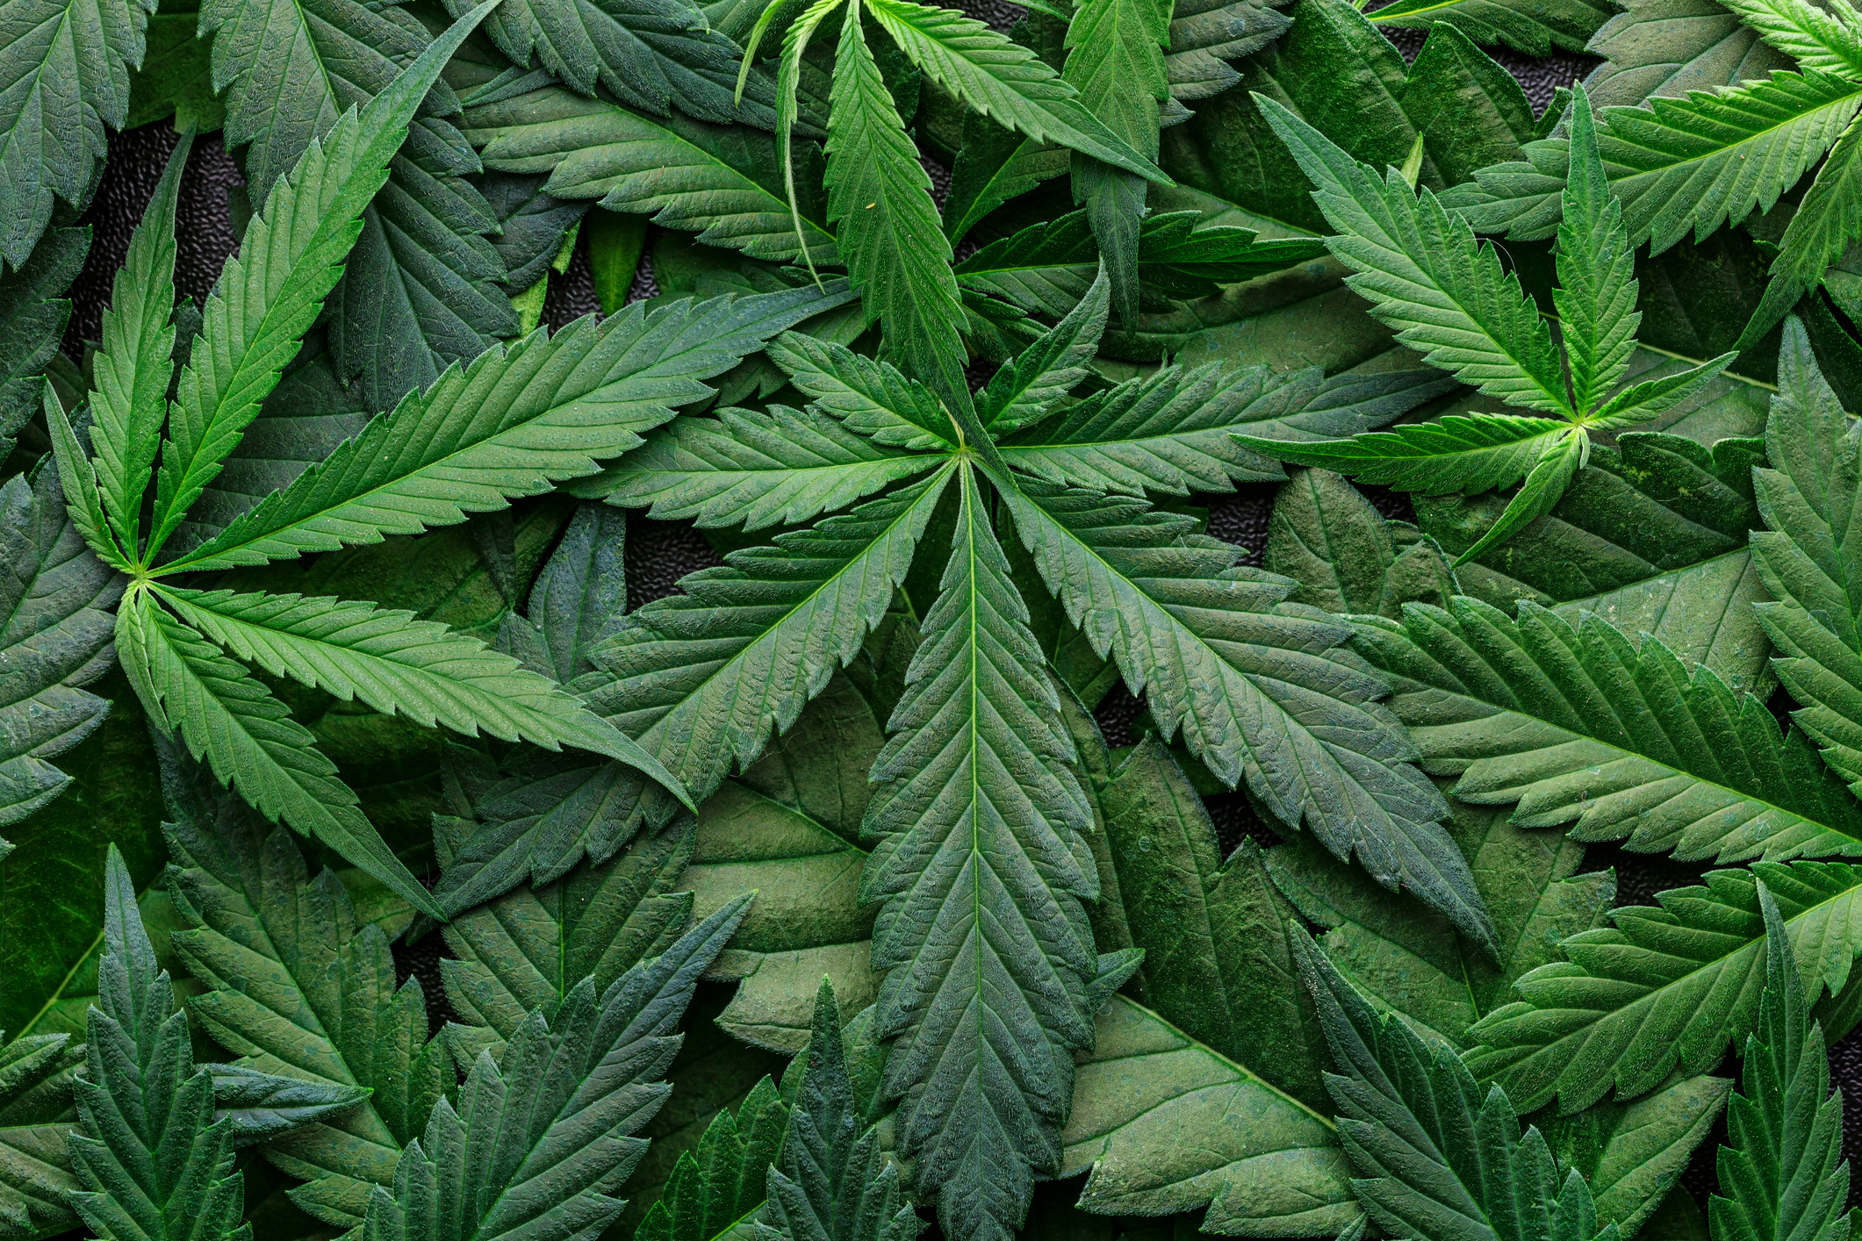
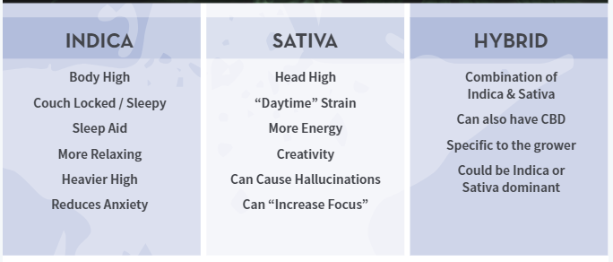
MARIJUANA:
INDICA, SATIVA AND HYBRIDS
Many Cannabis users and retail (state legal) locations will highlight three different “strains, aka classifications, of Cannabis. These strains are Indica, Sativa, and Hybrid. Product forms include: leaf, edibles, and concentrates (dabs). The particulars for each of the strains are below.

Slide 9
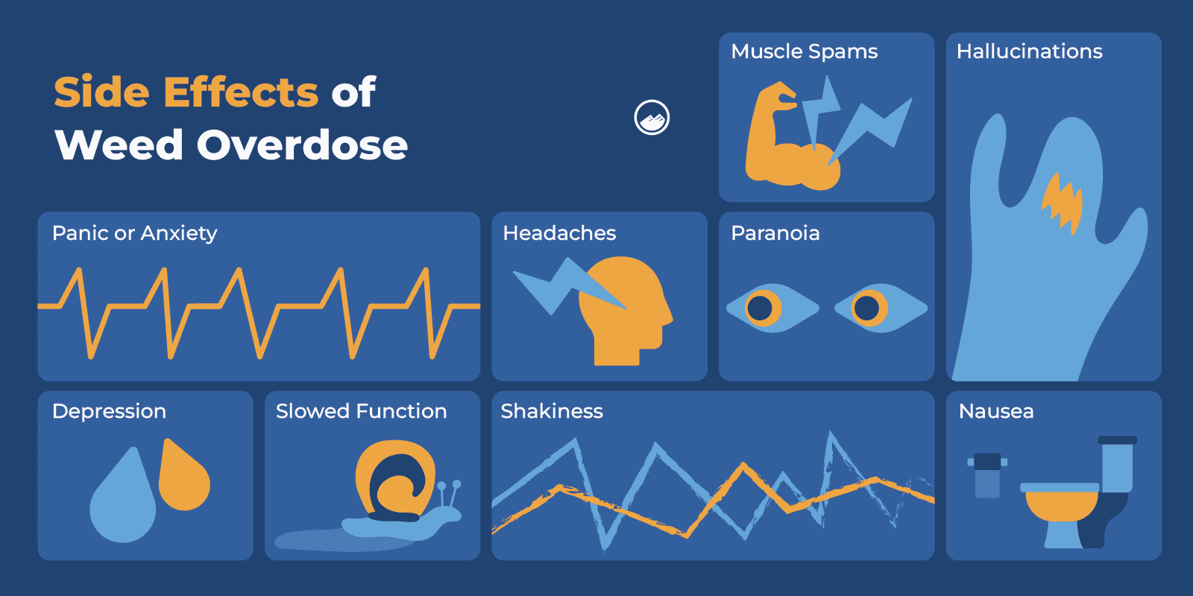
Can you overdose on THC??

Slide 10
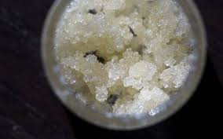
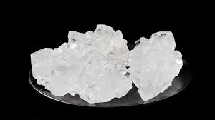
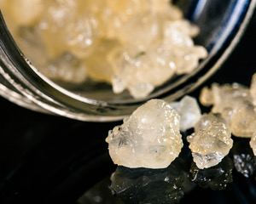
What is THCA
THCA looks like white crystals (see picture), larger crystals or a white, powder-like substance. This drug will not look like traditional cannabis (a loose leaf, bud or herbal substance).
Sometimes flavorings or “sauce” from the marijuana plant, also known as terpenes, will be added to the THCA product. When the terpenes are added, the crystals have more of an amber or brown coloring (or off-white colored crystals).
THCA is a concentrated form of marijuana but is NOT a traditional dab. Although, many users smoke THCA in a similar way to concentrates.
THCA turns into THC when heated, and once heated, the THC content consistently reaches 95-99%THC levels. This product can be smoked out of a bong, also known as an “oil rig,” and / or vaped, as well.

Slide 11
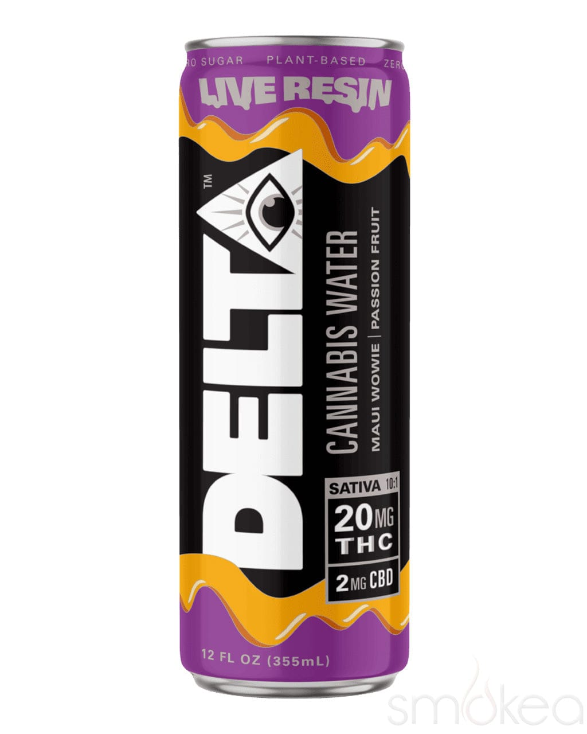
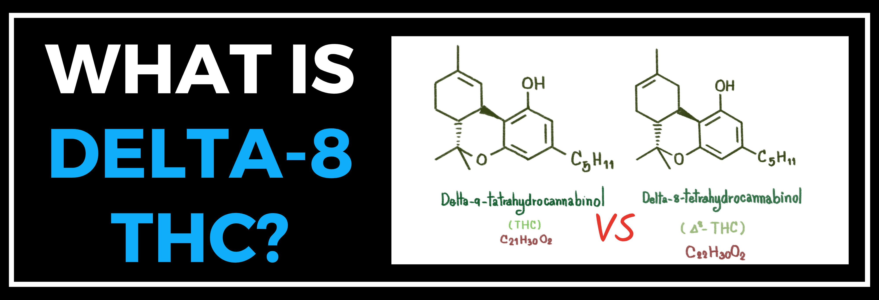
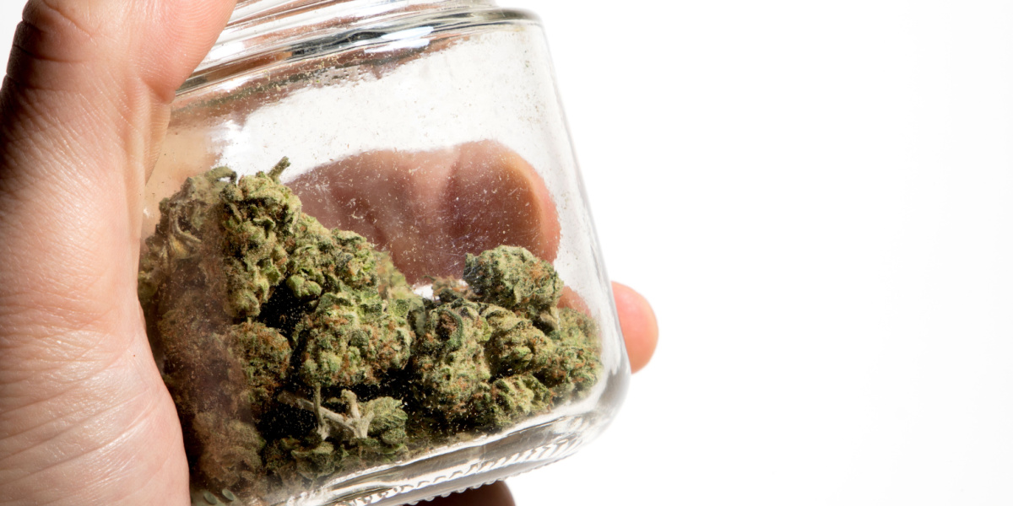
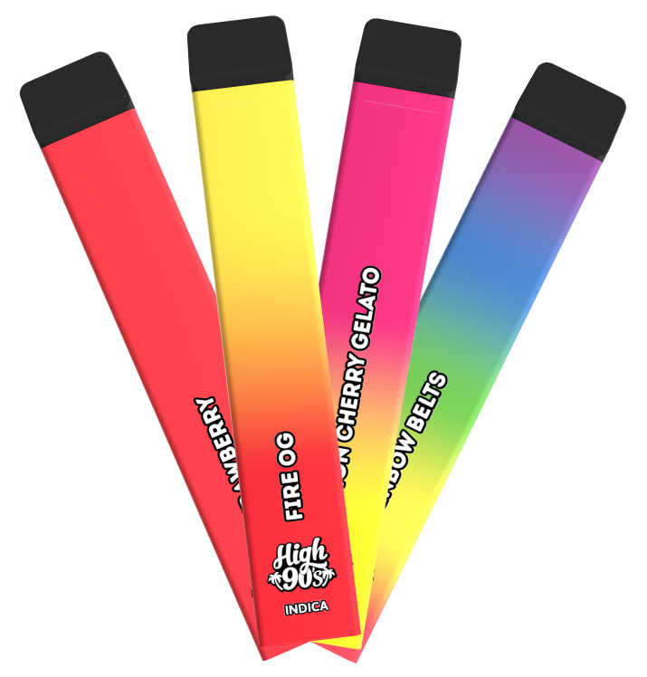
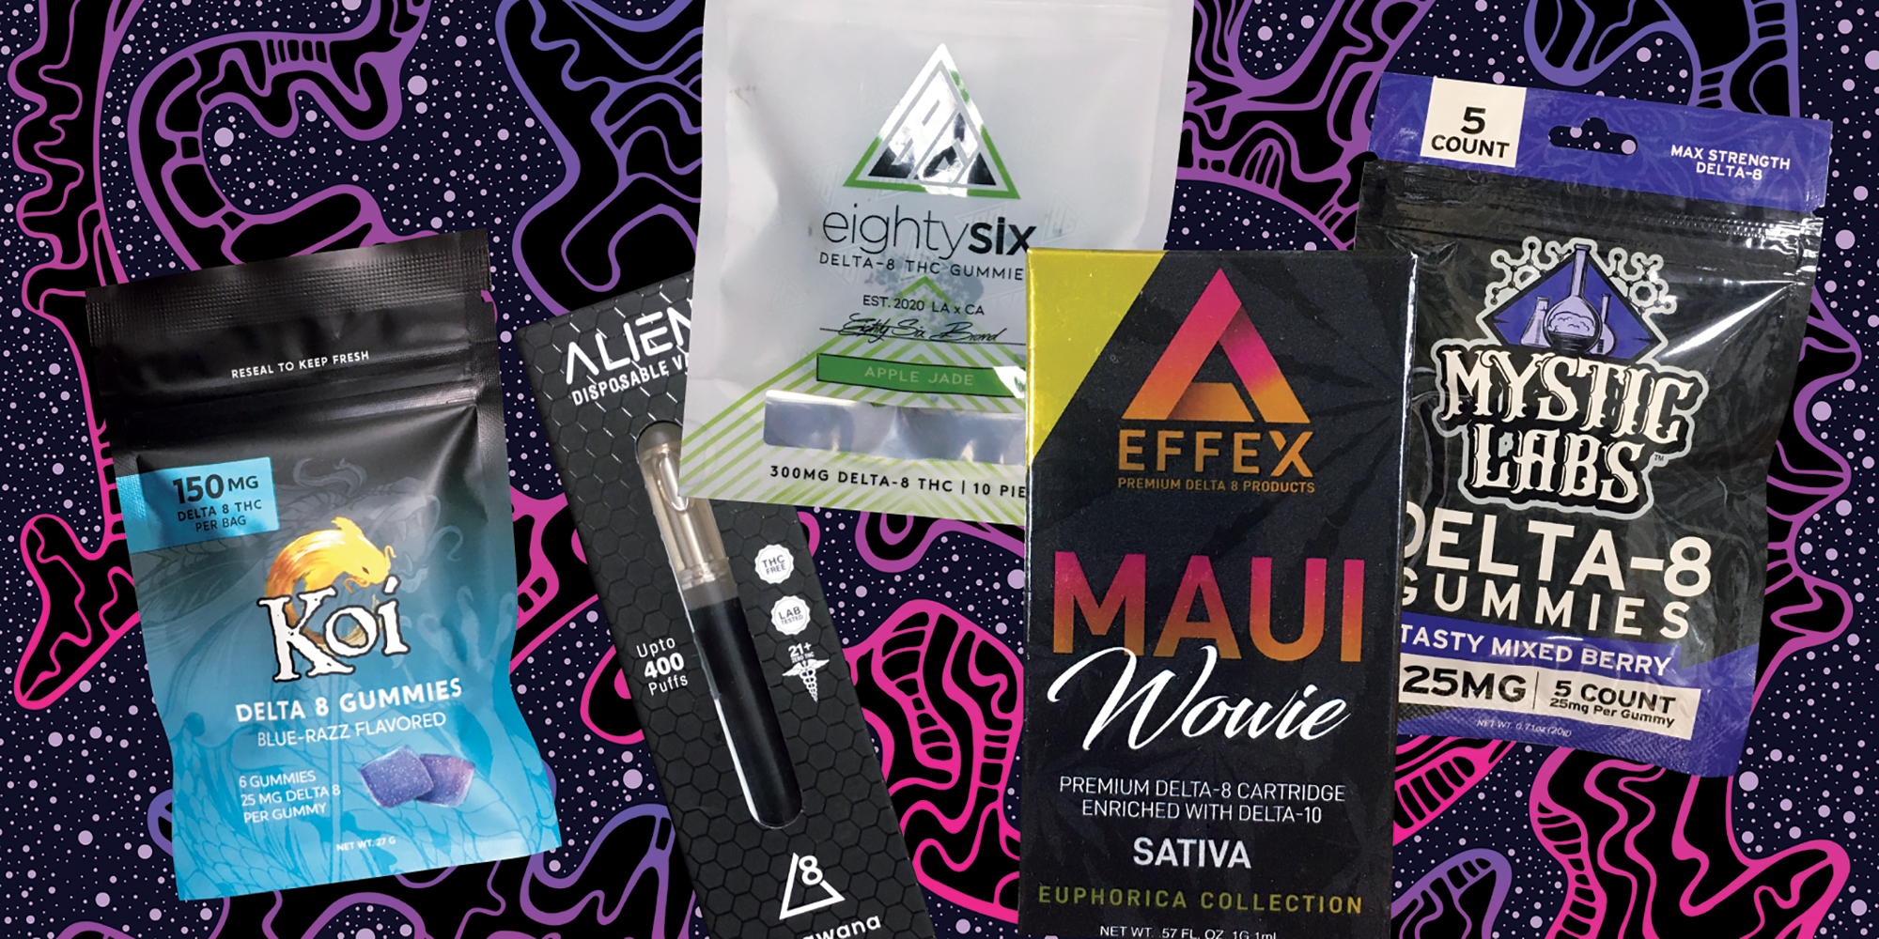
Delta-8 THC is a compound from the cannabis plant.
Many users of Delta-8 feel that it gives them about half the high of traditional weed (Delta-9). Users also report that the high also doesn’t last “nearly as long” as Delta-9 THC.
Why do they use Delta-8?
• Helps with nausea
• Perceived by some users to be legal in many areas
• Readily available.
• Although not a new compound, it is a new cannabis trend for youth
• Not all labs can test for it, making it popular for some on probation or parole
We are findingDelta-8 in many of the same forms we have traditionally seen Delta-9, including vape cartridges, wax, leaf, mixed with some CBD products etc.
Notes:
In regard to the promotion and marketing of Delta-8 THC, we are seeing billboards on major highways, marketing in shopping malls (where youth frequent), sales of various forms in cannabis dispensaries, and sales in the local gas stations.

Slide 12
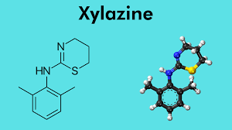
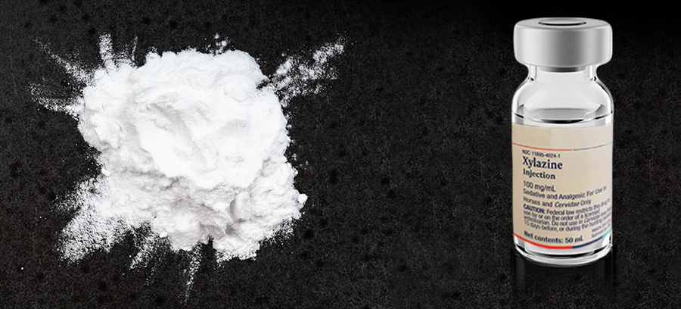
XYLAZINE
XYLAZINE IS A VETERINARY MEDICINE used to sedate animals
This depressant is NOT a controlled substance and not FDA approved for human use. When used in veterinary clinics it comes in a liquid form and is generally used before surgery or procedures.
For street level drug use Xylazine is used to enhance and prolong the high of opioids such as heroin and fentanyl.
The drug could be in powder form or pressed into misidentified pills.
Xylazine is a cheap “cutter” for opioids and does increase the potency of various opioids
Something to note is when Xylazine is present, is it reduces the effectiveness of Narcan, and in some cases you will not see a reversal of the overdose. When you suspect an opioid overdose, you still SHOULD administer Narcan as it will impact the heroin, fentanyl or other opioids.
Notes:
When you suspect an opioid overdose, you still SHOULD administer Narcan as it will impact the heroin, fentanyl or other opioids .Of note, the northeast which is a region that has been hit very hard by this drug. Xylazine damages or destroys the tissue around injection sites leading to large skin and tissue damage and large sores. In some areas where Xylazine is very popular you will see people walking around with large bandages where their sores have been treated by medical personnel or community medical volunteers Due to the powerful nature of this drug and open accessibility you can expect to see an increase in popularity of Xylazine in the street level drug supply. “P&P from VT here. We have been seeing a lot of individuals with this. Wounds that could not be explained.

Slide 13
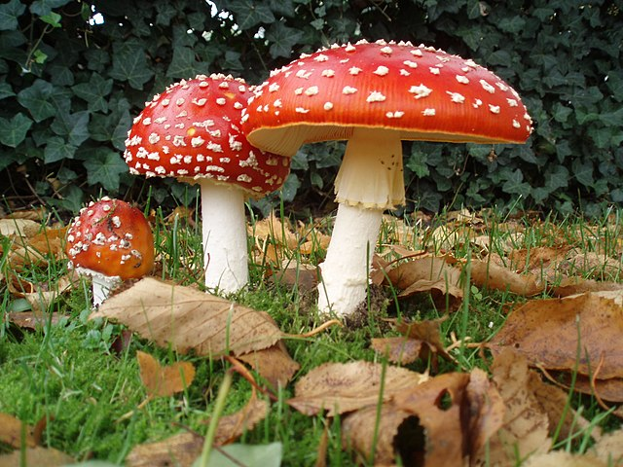
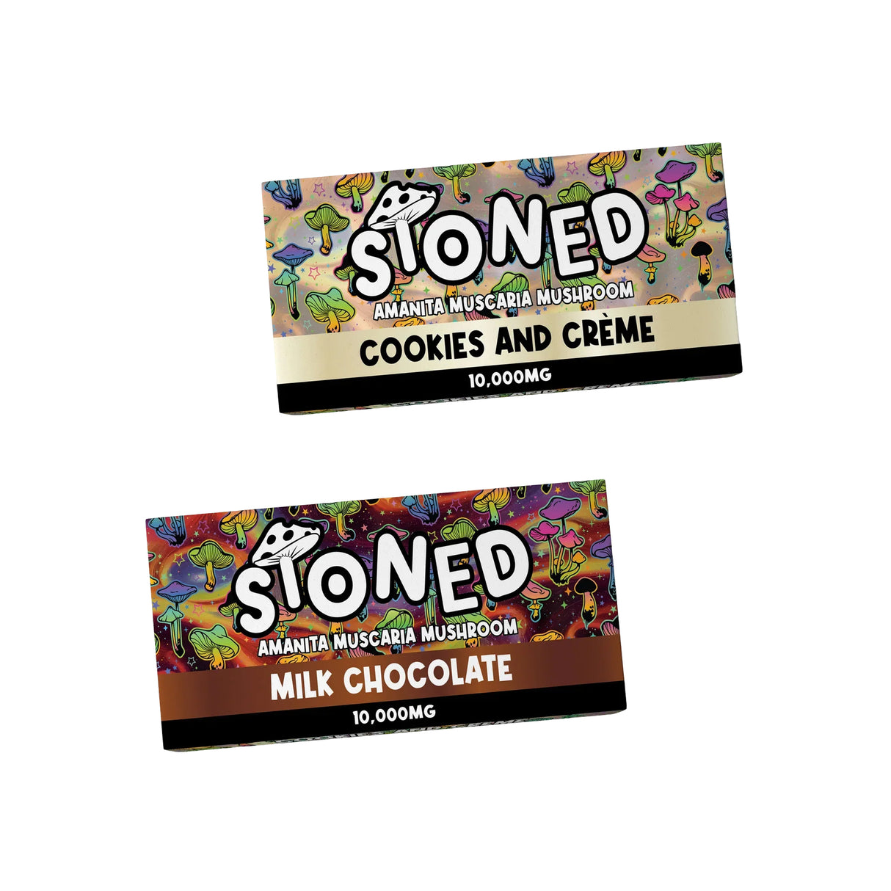
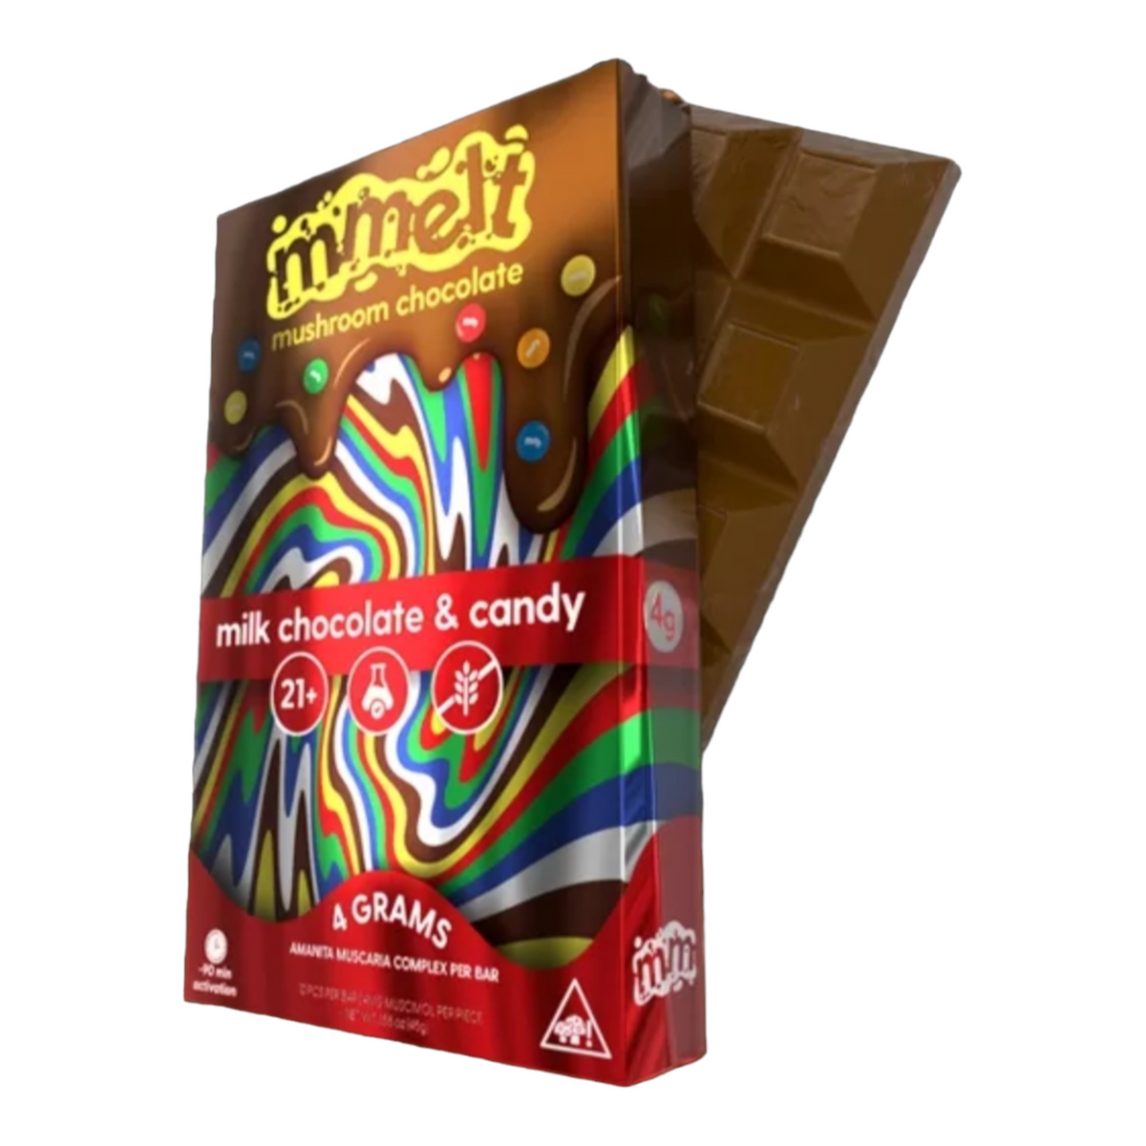
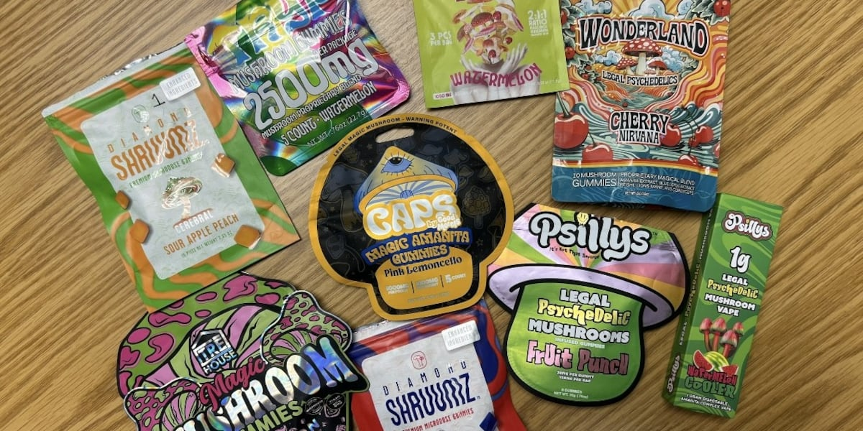
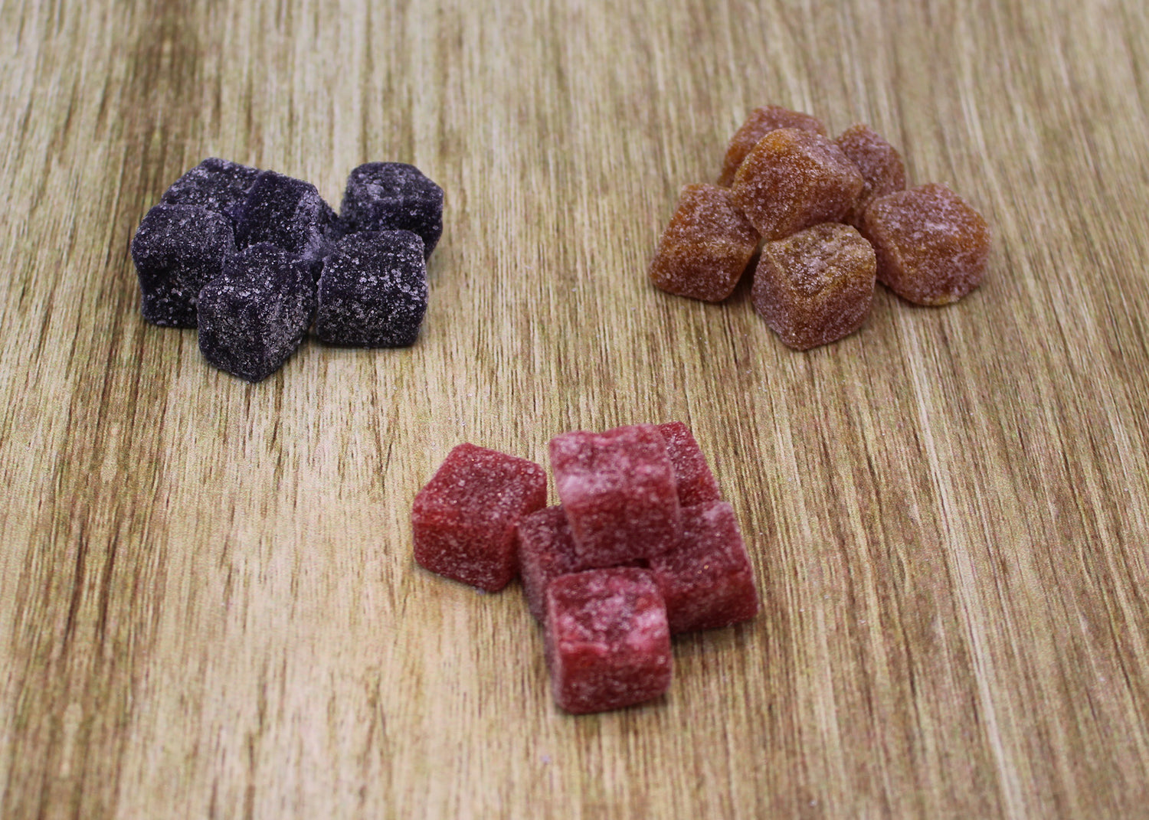
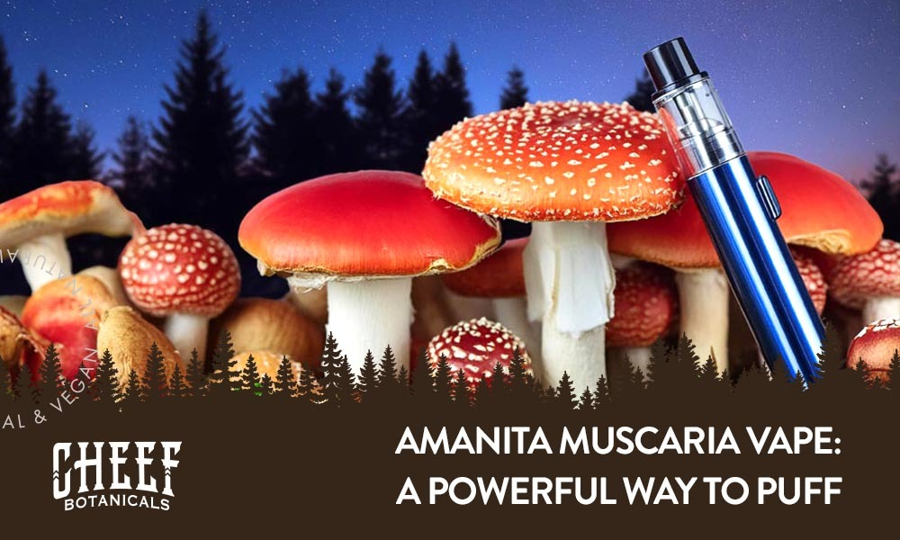
WHAT IS AMANITA…
The drug is called Amanita Muscaria, which is being sold and marketed as a legal form of mushroom.
This drug works similar to Psilocybin mushrooms in high doses but is not flagged in drug tests. Amanita is sold as an alternative to avoid state laws and may be unknown to the common professional.
Amanita has also been coined as the “Delta 8 of the hallucinogen world”.
Why is Amanita one of the next major drug trends?
Amanita is being sold as a legal alternative to hallucinogens in many states and is being sold in smoke shops, gas stations and a few shopping malls.
It generally comes in gummy form (see picture) or candy bar form. And most recently, in vape pens.
Individuals are dosing it higher to reach a euphoria comparable to Psilocybin.
Most of the Amanita packs being consumed contain between 3-6 gummies.
Notes:
Why is Amanita the next major drug trend? Amanita is being sold as a legal alternative to hallucinogens in many states and is being sold in smoke shops, gas stations and a few shopping malls. It generally comes in gummyform (see picture) or candy bar form. And most recently, in vape pens. Youcan expect more forms of mushrooms to emerge. It is important to note thatAmanita helps users avoid (drug) testing standards.The next question I am asking is “Why did this trend turn so quicklyto Amanita?” This leads me to believe that more psychedelics arecoming. Some places have decriminalized or legalized medicinalpsilocybin and there is research being done on Psilocybin regardingtreatment for PTSD, depression, etc. With this research, comespsilocybin products now found on the streets. For example, at aschool conference in the south, this summer, I had a SRO share a casewhere a 9-year-old, 4th grader, ate some of “mommy’s chocolate bar.”She overdosed on what turned out to be a Psilocybin candy bar thatshe found in the refrigerator. Unfortunately, when products like thisget redirected (to the streets), we see issues like we saw at thebeginning of cannabis legalization and an increase in youthaccessibility.For more specific information ondrug trends/trainings you can go toIN 2018 THE CDC RELEASED AN ARTICLE ON AMANITA.Please read this article as it can be a dangeroussubstance that is important to be aware of:https://www.cdc.gov/mmwr/volumes/68/wr/mm6821a4.htmIn recent months, I have interviewedseveral smoke shop clerks and users ofAmanita and I have received many of thesame reports. Many of these individualsare dosing it higher to reach a euphoriacomparable to Psilocybin. Most of theAmanita packs being consumed containbetween 3-6 gummies. There appearsto be several companies putting thisproduct out and undoubtedly therewill be more Amanita or other over thecounter psychedelics coming. (Like whatwe saw with cannabis variants such asDelta 8, 10 and 11.) We should expectother forms of mushrooms to emerge.Be aware that many of these will not bedetected in field drug tests or lab tests.“You can’t stopwhat you don’t know.”

