Slide 1

ACCESS Timing in Colorado
CDE Assessment Division
Fall 2026
Notes:
Welcome. This session covers the new Colorado time limits for WIDA ACCESS.
You will learn three things:
1. The time limit for each domain and grade cluster.
2. When the limits start to count for accountability.
3. How to check student test times in WIDA AMS.
The second half of the deck is reference material. Use it for planning and for staff and family questions.

Slide 2
Agenda
Colorado Law: C.R.S. 22-7-1006.3(1)(e)
Student-Centered Testing
Historical Expectations
ACCESS Item Information
Colorado Timing Expectations
Accountability
Student Status Report in WIDA AMS
    Why Timing Matters
    Data-Informed Decision Making
    Colorado Redesignation

Slide 3
Update to Testing Practices: Colorado Law
Colorado Law: C.R.S. 22-7-1006.3(1)(e)
Duty to Review: The Colorado Department of Education must evaluate testing rules.
Security & Administration: CDE updates policies to prevent cheating, leaks, and errors.
Goal: Protect the fairness and accuracy of statewide testing.
09/25/26
Notes:
Colorado law, C.R.S. 22-7-1006.3(1)(e)(I), tells CDE to review and update assessment administration and security policies as necessary.
The purpose is to keep state test results accurate and fair.
The ACCESS time limits are one of these updates.

Slide 4
Update to Testing Practices: Student-Centered
Student-centered
  Standardized time spent testing
  Return to learning
  Equitable results
09/25/26
Notes:
The time limits keep the focus on the student.
Each student has a set amount of time for each domain. Then the student goes back to class.
All students test under the same limits. This makes results comparable across schools and districts.

Slide 5
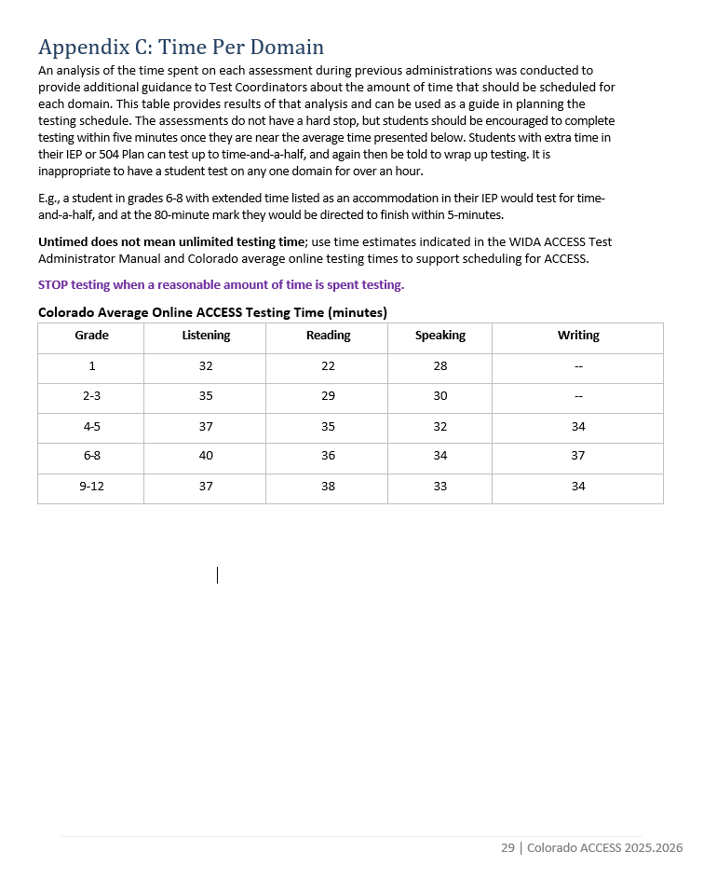
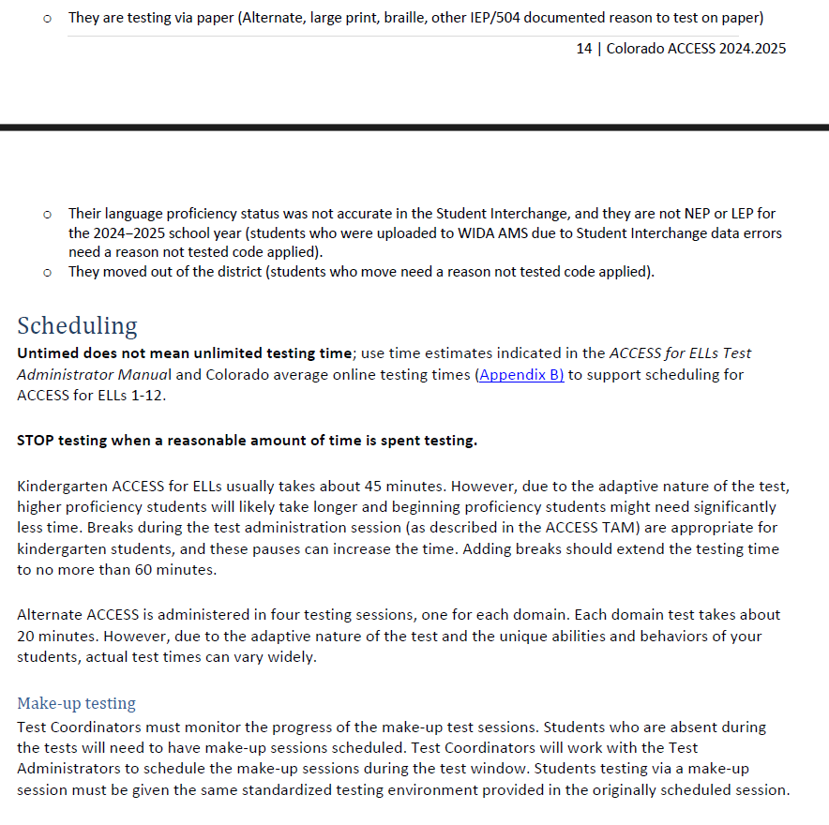
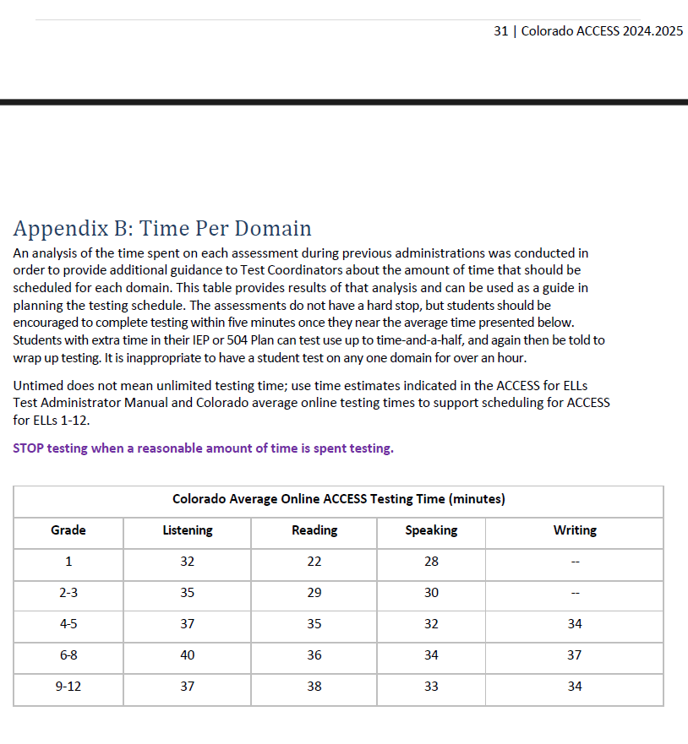
Historical Expectations
09/25/26
Notes:
This idea is not new. The 2024-25 and 2025-26 Colorado ACCESS manuals already said that untimed does not mean unlimited.
Those manuals told test administrators to:
- Stop testing after a reasonable amount of time.
- Not let a student test on one domain for more than one hour.
- Let students with extended time in an IEP or 504 plan test up to time-and-a-half.
What is new: Colorado now sets a maximum time for each domain. In 2027-28, those limits connect to accountability.
Point out that the new Reading and Writing limit for grades 4-12 is 75 minutes. That is more than the old one-hour guidance.

Slide 6
ACCESS Item Information
ACCESS Item Information
Listening | Reading | Speaking | Writing
Adaptive based on English proficiency Max: 24 items Grouped into 6-8 folders | Adaptive based on English proficiency Max: 30 items Grouped into 8-10 folders | Tier based on Listening & Reading performance Tier Pre-A: 3 tasks grouped into 3 folders. Tier A: 6 tasks grouped into 3 folders. Tier B/C: 6 tasks grouped into 3 folders. | Tier based on Listening & Reading performance Tier A grade 1: 3 subtasks. The added subtask lets the youngest students show what they know on an easier, lower-PL subtask. Tier A: A folder with multiple subtasks factored together into one holistic task/score. Tier A grades 2-12: 2 subtasks Tier B/C, all grades: 1 task
09/25/26
Notes:
Listening and Reading are adaptive. The test gives easier or harder items based on student answers.
The Speaking and Writing tier comes from Listening and Reading results. For this reason, students take Listening and Reading first.
The item counts are maximums. Many students see fewer items.

Slide 7
Colorado ACCESS Time Limits
Colorado ACCESS Testing Time in Minutes
Grade Clusters | Listening | Reading | Speaking | Writing
1 | 55 | 55 | 55 | 55
2-3 | 55 | 55 | 55 | 55
4-5 | 55 | 75 | 55 | 75
6-8 | 55 | 75 | 55 | 75
9-12 | 55 | 75 | 55 | 75
Students with disabilities (SWD) who have extended time documented in their IEP or 504 plan may be scheduled for an additional 15 minutes.
Some students may be eligible for time-and-a-half testing.
09/25/26
Notes:
These are the maximum testing times for each domain. They apply to ACCESS Online and ACCESS Paper.
- Grades 1-3: 55 minutes for each domain.
- Grades 4-12: 55 minutes for Listening and Speaking. 75 minutes for Reading and Writing.
Compare these limits to the 2025-26 data on slide 22. On average, students finished each domain in about 36 to 42 minutes. Most students have more time than they need.
Students with extended time in an IEP or 504 plan get extra time. Use the link at the bottom of the slide for the exact amount.

Slide 8
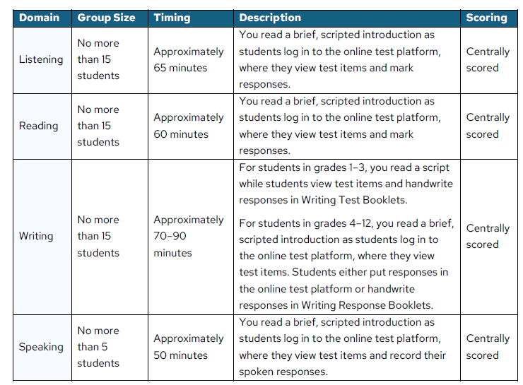
Colorado Time ~ WIDA Guidance
WIDA ACCESS Online Timing
“These are timing estimates. They are provided for scheduling and planning purposes. They include time for tasks like seating students, distributing and collecting test materials, and going over test directions. Refer to the following table for details of in-seat testing time by domain, and visit your member/state page on the WIDA website for additional local timing guidance.” (WIDA TAM p. 60)
Note the difference: WIDA timing is session time; Colorado is testing time.
Notes:
WIDA gives these times as estimates for scheduling. They include time to seat students, hand out materials, and read directions.
Use the WIDA estimates to plan rooms and sessions.
Use the Colorado limits on slide 7 to monitor each student's testing time.
TAM means Test Administrator Manual.

Slide 9
Colorado Test Time
Testing time begins once the student selects the “Begin The Test” button; at the end of testing the test will return to the “Sign In” screen.
The online test does not have a built-in clock. Colorado test administrators will need to keep track of time manually for both online and paper testers.
Reminder
Due to the interactive one-on-one administration, ACCESS for Kindergarten and Alternate ACCESS are not timed. Those tests are to be administered following the built-in "go on" and "stop" procedures in the test administrator script.
Notes:
This slide tells you when the clock starts and stops.
- Start: the student selects the "Begin The Test" button.
- Stop: the test returns to the "Sign In" screen.
The online test does not show a clock. Test administrators must track time themselves for online and paper tests.
Tips for test administrators:
- Write the start time for each student when they begin.
- Use a visible clock or timer in the room.
- Give a time reminder before the limit, at 15 minutes and 5 minutes left.
ACCESS for Kindergarten and Alternate ACCESS are not timed. These tests are one-on-one. Follow the "go on" and "stop" steps in the test administrator script.

Slide 10
Accountability
Beginning in 2027-2028
WIDA ACCESS Tests That Go Beyond the Allowed Time
Districts will receive scores for tests that go beyond the allowed time, but those scores will not be included in accountability (similar to a CMAS score suppression).
  Tests with an acceptable explanation for going beyond the allowed testing time (e.g., a student left the test session unexpectedly due to illness or an appointment, or a student experienced technical issues) will be included in accountability reporting.
This year, 2026-2027, is for practice and learning
09/25/26
Notes:
2026-27 is a practice year. Use it to learn the limits and build good habits. Accountability does not change this year.
Starting in 2027-28:
- If a student goes over the time limit, the district still gets the score.
- That score does not count in accountability.
- Exception: the score counts if there is an acceptable reason. Examples: the student got sick, left for an appointment, or had a technical problem.
Tell test administrators to write down the reason when it happens. Do not wait until after the window closes.

Slide 11
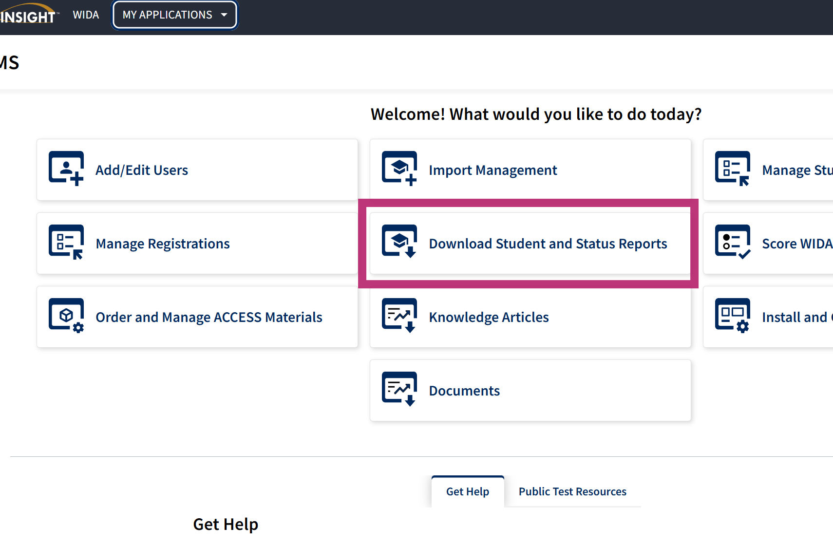
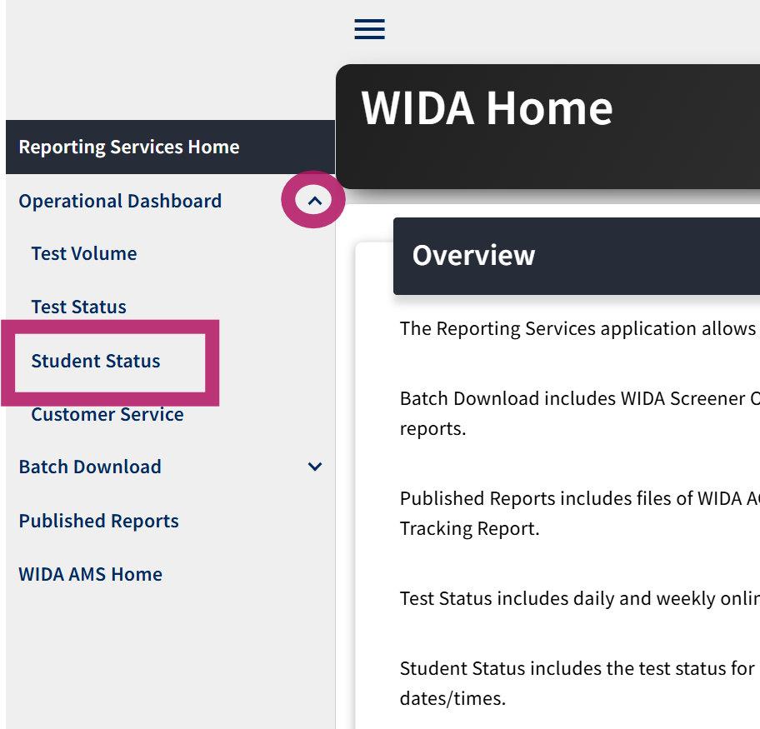
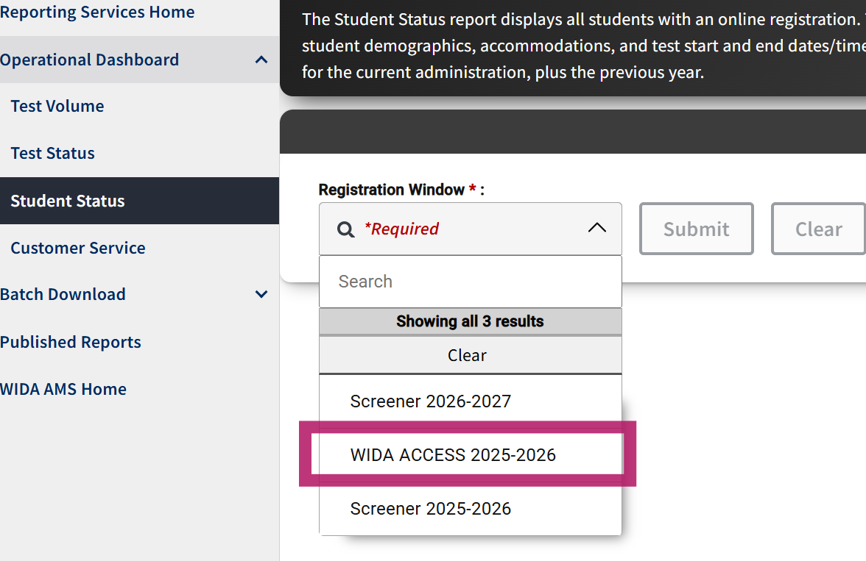
WIDA AMS
09/25/26
Notes:
Use the Student Status Report in WIDA AMS to check test times.
1. Log in to WIDA AMS.
2. Select Reporting, then Student Status.
3. Select the registration window for this school year.
The screenshot shows the 2025-2026 window as an example. This year, select WIDA ACCESS 2026-2027.

Slide 12
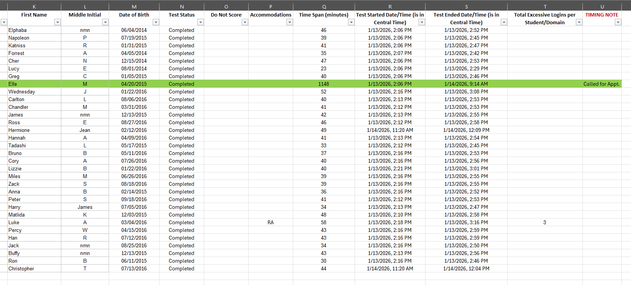
Example of Student Status Report with Column Added for Timing Note
Fictional students. The Student Status Report contains student PII and should be treated as secure.
Notes:
This report uses sample data with fictional student names.
- The Time Span column shows the minutes from test start to test end.
- The highlighted student shows 1,148 minutes. The student left for an appointment and finished the next day.
- The Timing Note column is not part of the report. You add it yourself to record the reason.
Time Span includes paused time, so it can be longer than the time the student actually tested.
The start and end times on this report are in Central Time, not Mountain Time.

Slide 13
For 2027-2028
Column U in the example report on the previous slide would be sufficient documentation for an acceptable explanation for time.
Reminder: this year is for practice and learning.
Notes:
Starting in 2027-28, a test that goes over the time limit can still count for accountability if there is an acceptable reason.
The Timing Note column on the previous slide is enough documentation. Column U is the column you add to the Student Status Report.
What to do:
1. When a student goes over the limit, write the reason in the Timing Note column.
2. Keep the note short and specific. Examples: left for an appointment, became sick, had a technical problem.
3. Write the note when it happens or as soon as possible. Do not wait until the end of the testing window.
This year, 2026-27, is for practice. Use it to build the habit of tracking time and writing notes. There is no effect on accountability this year.
Remember: the report has student information. Store it securely.

Slide 14

Why Timing Matters
Why Timing Matters
09/25/26
Notes:
The next slides explain why timing matters.
Use them when staff, families, or students ask why Colorado set limits.

Slide 15
A Timed Assessment
A timed assessment gives every student the same window to show what they can do.
A time limit turns an open-ended task into a measurable, comparable one.
A timed assessment protects instructional time.
09/25/26
Notes:
A time limit gives every student the same amount of time.
It turns an open task into one we can measure and compare.
It also protects time for instruction.

Slide 16
Standardization Creates Fair Comparisons
Every student works under identical conditions.
Untimed testing turns pacing and endurance into hidden variables.
A fixed time window removes an uncontrolled factor from score interpretation.
09/25/26
Notes:
When all students test under the same conditions, we can compare their results.
With no limit, speed and stamina become hidden factors in the score.
A fixed time removes one factor we cannot control.

Slide 17
Timing Strengthens Score Validity
Time limits support a more valid interpretation of what test scores measure.
Controlled timing supports stronger claims about what a score actually means.
Time spent and performance together reveal more about a student’s readiness than performance alone.
09/25/26
Notes:
Time limits help us understand what a score means.
A score from controlled conditions supports stronger conclusions.
Time and performance together tell us more about a student than performance alone.

Slide 18
Timing Supports Logistics and Security
Fixed windows let districts plan rooms, staff, and schedules with confidence.
  Students return to learning sooner.
  Test administrators return to teaching sooner.
Untimed testing turns a single test into an open-ended commitment.
Shorter test windows reduce the risk of relaxed proctoring, outside device use, and content sharing.
09/25/26
Notes:
Fixed times help districts plan rooms, staff, and schedules.
Students and test administrators go back to class sooner.
A test with no limit can take up an unknown amount of time.
Shorter sessions also lower security risks, such as weak supervision, phone use, and shared test content.

Slide 19
Timing Shows Readiness for Content
Students who need more time need ELD instructional support and ML accommodations on content assessments.
Timed ELP assessment helps prevent false positives for redesignation.
Timed ELP assessment now prepares students for content assessments, in cases of redesignation when the ML extended time accommodation is no longer available.
09/25/26
Notes:
A student who needs much more time may need more English language development support. Talk with the ML team about that student's instruction.
Content tests, such as CMAS and SAT, have fixed unit times. ACCESS now works the same way, so students practice under the same type of conditions.
Timed results also help us avoid moving a student out of ML services before the student is ready.

Slide 20
Key Points
Support students with practice, not by removing the clock.
Timing standardizes conditions and strengthens score validity.
Timing supports test security and logistics.
Timing shows that students have skills they can carry beyond the test.
09/25/26
Notes:
Four points to remember:
1. Support students with practice. Do not remove the time limit.
2. Timing gives all students the same conditions and makes scores more meaningful.
3. Timing helps test security and planning.
4. Timing shows that students can use their skills outside the test.

Slide 21
Data-Informed Decision Making
09/25/26
Notes:
This section shows 2025-26 Colorado ACCESS timing data.
Use it to see how the limits compare to how long students actually tested.

Slide 22
ACCESS Timing, All Grades (in minutes)
ACCESS Timing, Grades 1-12 (in minutes)
ALL GRADES
Domain | Mean | Median | Mode
Listening | 41.78 | 41 | 41
Reading | 36.41 | 35 | 31
Speaking | 37.87 | 39 | 41
Writing | 39.57 | 39 | 36
Outliers were removed. Domain times used in calculations range from 15 to 120 minutes (SY25-26)
09/25/26
Notes:
These are 2025-26 Colorado averages for ACCESS Online, grades 1-12.
- Mean: the average time.
- Median: the middle value.
- Mode: the most common value.
The data does not include times under 15 minutes or over 120 minutes.
Key point: in every domain, the average student finished well under the 55-minute limit.

Slide 23
ACCESS Timing, Grades 1-3
Grades 1-3
Domain | Grade | Mean | Median | Mode
Listening | 1 | 32.48 | 32 | 30
Reading | 1 | 26.04 | 23 | 16
Speaking | 1 | 34.32 | 34 | 27
Listening | 2 | 41.05 | 41 | 39
Reading | 2 | 30.57 | 28 | 15
Speaking | 2 | 36.16 | 37 | 38
Listening | 3 | 40.44 | 40 | 39
Reading | 3 | 33.65 | 33 | 35
Speaking | 3 | 34.29 | 35 | 37
Reminder: Grades 1-3 take Writing on paper, so no timing data is available.
09/25/26
Notes:
Grades 1-3: the averages for all domains are between 26 and 41 minutes.
The limit for these grades is 55 minutes for each domain.
Grades 1-3 take Writing on paper, so there is no Writing time data.

Slide 24
ACCESS Timing, Grades 4-5
Grades 4-5
Domain | Grade | Mean | Median | Mode
Listening | 4 | 42.56 | 42 | 41
Reading | 4 | 38.3 | 38 | 40
Speaking | 4 | 39.81 | 41 | 41
Writing | 4 | 37.81 | 37 | 30
Listening | 5 | 43.01 | 42 | 41
Reading | 5 | 39.53 | 40 | 39, 44
Speaking | 5 | 40.26 | 41 | 40
Writing | 5 | 38.47 | 37 | 35
09/25/26
Notes:
Grades 4-5: the averages are between 37 and 44 minutes.
The limit is 55 minutes for Listening and Speaking, and 75 minutes for Reading and Writing.
Where two numbers show in the Mode column, both values occurred the same number of times.

Slide 25
ACCESS Timing, Grades 6-8
Grades 6-8
Domain | Grade | Mean | Median | Mode
Listening | 6 | 45.88 | 45 | 42, 43
Reading | 6 | 38.56 | 38 | 29
Speaking | 6 | 40.13 | 41 | 39
Writing | 6 | 40.7 | 40 | 40
Listening | 7 | 45.15 | 44 | 41
Reading | 7 | 40.11 | 40 | 36
Speaking | 7 | 41.86 | 42 | 39
Writing | 7 | 41.65 | 41 | 32
Listening | 8 | 44.82 | 44 | 42
Reading | 8 | 40.48 | 40 | 36
Speaking | 8 | 38.03 | 38 | 23
Writing | 8 | 42.64 | 43 | 37
09/25/26
Notes:
Grades 6-8: the averages are between 38 and 46 minutes.
Grade 6 Listening has the highest average, at about 46 minutes. That is still under the 55-minute limit.

Slide 26
ACCESS Timing, Grades 9-12
Grades 9-12
Domain | Grade | Mean | Median | Mode
Listening | 9 | 44.88 | 44 | 41
Reading | 9 | 40.8 | 41 | 39
Speaking | 9 | 39.13 | 40 | 25
Writing | 9 | 40.13 | 40 | 42
Listening | 10 | 43.71 | 43 | 39, 40
Reading | 10 | 39.76 | 40 | 37
Speaking | 10 | 41.44 | 43 | 42
Writing | 10 | 38.84 | 38 | 32, 37
Listening | 11 | 43.06 | 42 | 39
Reading | 11 | 39.94 | 40 | 47
Speaking | 11 | 37.61 | 38 | 25
Writing | 11 | 39.36 | 38 | 32
Listening | 12 | 41.76 | 41 | 39
Reading | 12 | 37.91 | 37 | 36
Speaking | 12 | 35.82 | 33 | 24
Writing | 12 | 37.99 | 37 | 29
09/25/26
Notes:
Grades 9-12: the averages are between 35 and 45 minutes.
All averages are well under the limits.

Slide 27
Content Test Timing Spring 2026
(time available in minutes, per unit)
CMAS
ELA/CSLA | 90*
Math | 65
Science | 65 (grades 5 & 8) 50 (grade 11)
Social Studies | 65
College Board (PSAT and SAT)
Reading and Writing | 64
Math | 70
*Multilingual Learners averaged just under an hour of testing time per unit.
09/25/26
Notes:
These are the Spring 2026 unit times for CMAS and for PSAT and SAT.
Students already test under fixed times on these content tests.
On CMAS ELA, multilingual learners used just under one hour per 90-minute unit on average.

Slide 28
Colorado Redesignation
Colorado Redesignation
09/25/26
Notes:
This section covers how Colorado decides when a student no longer needs ML services.

Slide 29
Colorado Redesignation Criteria
Updated Guidance: Spring 2027
Colorado sets its own redesignation criteria based on Colorado students
  Standardized assessment procedures
    ELP assessment
    Content assessment
09/25/26
Notes:
Colorado sets its own redesignation criteria, based on data from Colorado students.
The criteria use standardized assessment results from two sources: the English language proficiency test and content tests.
CDE will review the criteria and share updated guidance in spring 2027.

Slide 30
ACCESS Timing Conversations
Fall 2026
Invited Districts
Over 1,000 ACCESS testers or
Over 20% of student population*
August 18 & September 2
Shared with
CLDE Directors, September 24
ACEE, September 25
*2025-2026 Pupil Membership Statistics
District | K-12 Count | NEP/LEP Count | NEP/LEP Percent
Adams 12 Five Star Schools | 33,039 | 4,897 | 14.8%
Adams County 14 | 4,976 | 1,812 | 36.4%
Adams-Arapahoe 28J | 38,197 | 14,330 | 37.5%
Center 26 JT | 588 | 157 | 26.7%
Charter School Institute | 20,966 | 3,369 | 16.1%
Cherry Creek 5 | 51,844 | 6,584 | 12.7%
Denver County 1 | 89,210 | 23,225 | 26.0%
Eagle County RE 50 | 6,073 | 1,393 | 22.9%
Fort Morgan Re-3 | 3,327 | 689 | 20.7%
Garfield 16 | 1,196 | 319 | 26.7%
Garfield Re-2 | 4,642 | 1,082 | 23.3%
Greeley 6 | 22,778 | 4,434 | 19.5%
Holly RE-3 | 279 | 73 | 26.2%
Jefferson County R-1 | 74,177 | 3,746 | 5.1%
Lake County R-1 | 884 | 221 | 25.0%
Mapleton 1 | 6,943 | 2,012 | 29.0%
Roaring Fork RE-1 | 5,621 | 1,273 | 22.6%
School District 27J | 24,290 | 3,179 | 13.1%
Sheridan 2 | 924 | 282 | 30.5%
St Vrain Valley RE1J | 32,279 | 2,742 | 8.5%
Summit RE-1 | 3,378 | 773 | 22.9%
Weld Re-8 Schools | 2,437 | 489 | 20.1%
Westminster Public Schools | 7,282 | 2,030 | 27.9%
09/25/26
Notes:
CDE met with districts that have more than 1,000 ACCESS testers or where NEP and LEP students are more than 20 percent of enrollment.
Those meetings were on August 18 and September 2.
CDE then shared this information with CLDE directors on September 24 and with ACEE on September 25.
Use this slide to show that districts helped shape this guidance.

