Slide 1


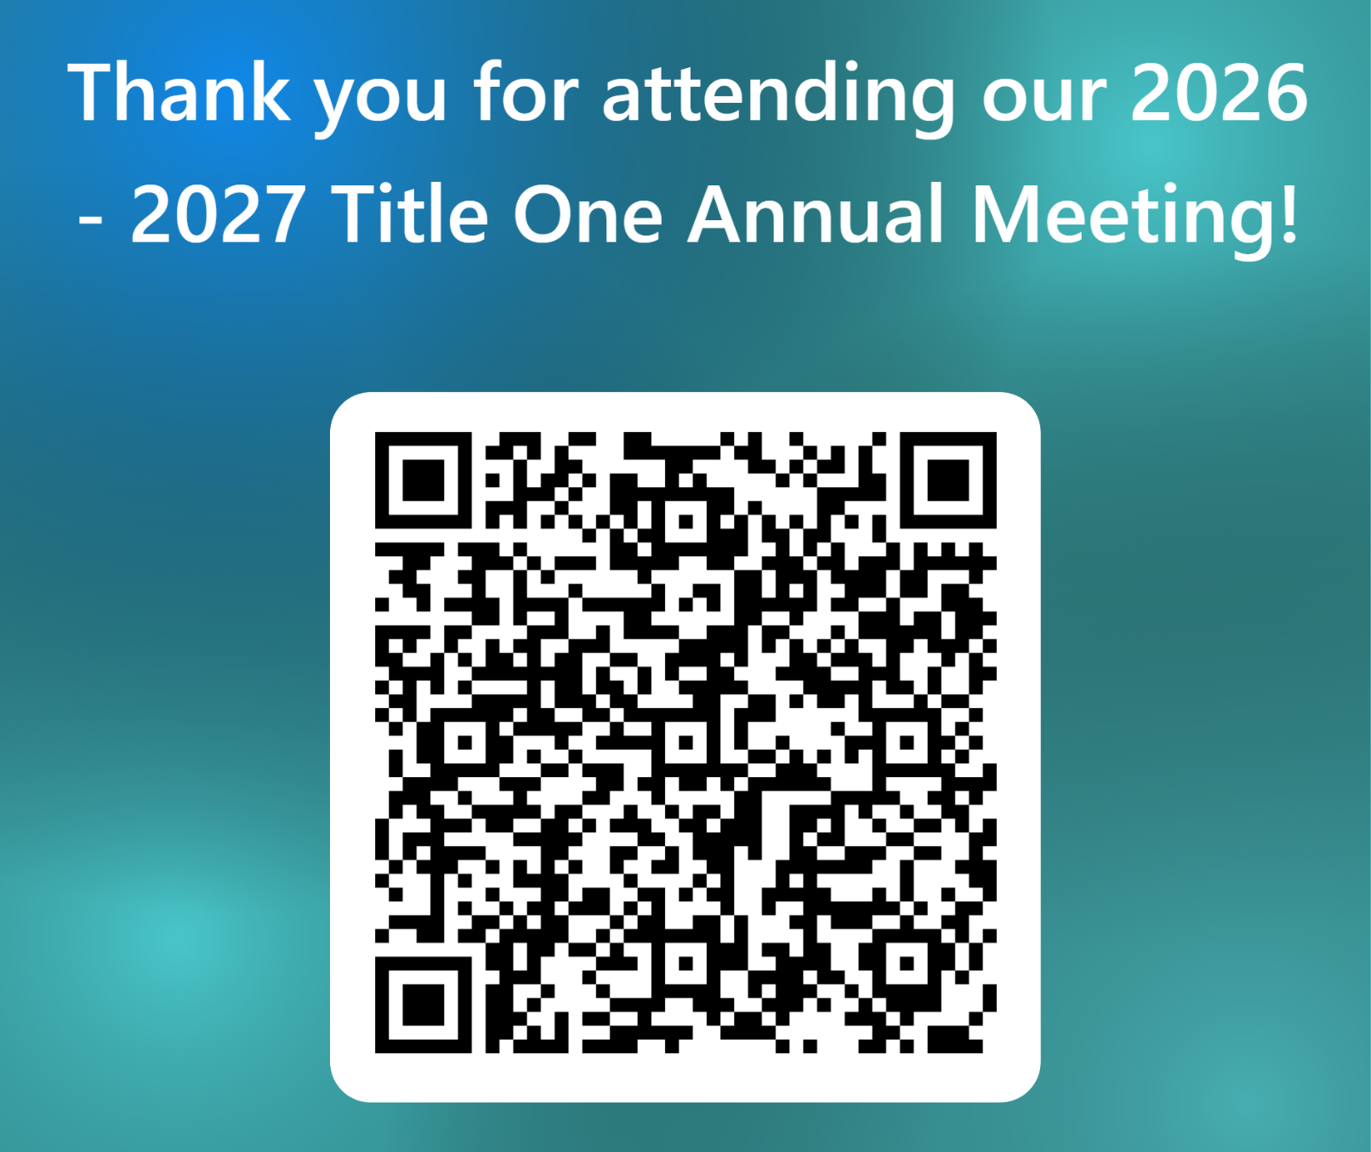

MILDRED HELMS ELEMENTARY
IB WORLD SCHOOL
Welcome!
Scan the QR Code to
sign-in
SHANNON BRENNAN - PRINCIPAL
DAUTIE CRAIG - ASSISTANT PRINCIPAL

Slide 2


MILDRED HELMS ELEMENTARY IB WORLD SCHOOL
We did it!
We are proud to be a Nationally Certified
Magnet School!
Thank you to our amazing community of students, teachers, and families for making this possible!

Slide 3


MILDRED HELMS ELEMENTARY
IB WORLD SCHOOL
Magnet School of Distinction
Magnet Schools of America recognizes Mildred Helms Elementary IB World School as a Magnet School of Distinction for 2026!

Slide 4
MILDRED HELMS ELEMENTARY
IB WORLD SCHOOL
Congratulations!
We are an A school!
Three years in a row!

Slide 5

MILDRED HELMS ELEMENTARY
IB WORLD SCHOOL

Slide 6
MILDRED HELMS ELEMENTARY
IB WORLD SCHOOL
School Office Hours:
Breakfast:
Dismissal: 3:10pm
9:00am - 3:10pm
8:35am - 8:55am
SHANNON BRENNAN - PRINCIPAL
DAUTIE CRAIG - ASSISTANT PRINCIPAL

Slide 7
MILDRED HELMS ELEMENTARY
IB WORLD SCHOOL
Please be in the car circle by 3:10 p.m.
Transportation Changes:
All transportation changes must be called into the office prior to 1:30 p.m.
SHANNON BRENNAN - PRINCIPAL
DAUTIE CRAIG - ASSISTANT PRINCIPAL

Slide 8
MILDRED HELMS ELEMENTARY
IB WORLD SCHOOL
On time daily attendance impacts all learners.
Please make appointments outside of school hours when possible.
SHANNON BRENNAN - PRINCIPAL
DAUTIE CRAIG - ASSISTANT PRINCIPAL

Slide 9




MILDRED HELMS ELEMENTARY
IB WORLD SCHOOL
MHES Dress Code
All students must adhere to the requirements of the uniform policy as followed:
Shirts: solid-colored, collared polo-style shirt in light blue, navy blue and red only. Shirts should be free from design or logos greater than a quarter in size. Mildred Helms school spirit shirts may be worn on Fridays.
Bottoms: khaki or navy colored uniform bottoms. This includes shorts, pants, capris, skorts, skirts, jumpers (shorts or leggings of the same solid color/length may be worn underneath skirts/jumpers). Shorts should follow Pinellas County dress code of mid –thigh length or longer.
NO gym shorts, leggings, jeggings, yoga pants or jeans.
Closed toed shoes appropriate for outdoor play should be worn everyday.
Uniforms can be found throughout Pinellas County at local retail stores.
Please provide a change of uniform for students in Pre-K and Kindergarten.

Slide 10

MILDRED HELMS ELEMENTARY
IB WORLD SCHOOL
Adopt a Class!
Sponsor a class with a tax-deductible donation of $150!
Contact Ms. Cheryl Hauburger in the front office today!

Slide 11

OPEN HOUSE
&
Annual Title I Meeting
Mildred Helms Elementary
IB World School
August 26, 2026
Dolphin café’
Mrs. Brennan. Principal
Mrs. Craig, Assistant Principal
Notes:
This is a classroom edition- ANYTHING in orange is to be changed by the classroom teacher at the school.
Welcome parents to your classroom and let them know we have a brief meeting before we get started on open house portion.

Slide 12
ALL ABOUT TITLE I
> Title 1 is the largest federal assistance program for our nation’s School
> The program serves 83 schools in Pinellas County including eligible students in 38 non-public schools
>
WHAT IS TITLE I SUPPLEMENTAL RESOURCES?
Definition: provided in addition to what is already present of available to complete or enhance it.
Notes:
All about Title I...
let parents know that we are proud to be a Title I school and let them know that it is the largest federal assistance program for our students and schools.

Slide 13
TITLE I FUNDING PROCESS
  Federal Government
What does this mean for your child’s school??
With the help of parents, staff and students, the school makes a budget and activities to help support the education for the children in the school in the best way possible...
How?
Glad you asked...
On the next slide you will see our budget and list of events scheduled for the year.
2. Florida Dept. of Education
3. Pinellas County Schools
4. Mildred Helms IB World School!!!

Slide 14
2%
TITLE I SCHOOLWIDE BUDGET:
MILDRED HELMS ELEMENTARY IS PROVIDED $108,500.00 TO PAY FOR SUPPLEMENT RESOURCES AND PROGRAMS FOR INCREASE STUDENT ACHIEVEMENT.
59%
5%
34%
Total Allocation - $108,500.00
Personnel - $93,769.19
Professional Development Resources - $4000.00
Contract Binders for Teachers - $2,108.72
Instructional Materials - $8,946.89
Family Engagement Resources: $5900.00
Mildred Helms Elementary IB World School
Title I 2026-27 Budget
Notes:
FOR THE TEACHER-
this slide is to explain what the budget from Title I is being used for- Please go over the highlights and let them know the next page is a QR code for them to give input on the budget and this year's events. *if they do not have a phone, please provide with a written document to fill out
FOR THE SCHOOL TO PUT IN INFORMATION
Please remove the word sample.
Change EVERYTHING in ORANGE to be geared to your school.
List your budget line items- such as MTSS coaches or reading/math intervention teachers, liaison for the crate, professional development for staff, trainings offered to parents, student led conferences/STEM night/Etc.

Slide 15
Title I Schoolwide Planning and Input
Please take a moment and help us with our Title I planning for the school year. We appreciate your help and partnership in the education of our school

Slide 16

SCHOOL’S CURRICULUM
IB Primary Years Programme
Core Curriculum
TO LEARN MORE ABOUT STATE ASSESSMENTS VISIT THE FLORIDA DEPARTMENT OF EDUCATION’S WEBSITE, FLDOE.ORG/ACCOUNTABILITY/ASSESSMENTS
Mathematics
Science
Florida Benchmark for Excellent Student Thinking Standards (B.E.S.T) form the framework of everything taught at school. www.fldoe.org
Reading
Writing
STAR Assessments
FAST Assessments
Science Assessments
PM Cycle testing, etc.

Slide 17
Working Together for Student Sucess
School Improvement Plan (SIP)
Title I Schoolwide Plan
TITLE I
SCHOOL
Parent and Family Engagement Plan
School- Parent- Student Compact
PARENT/FAMILY
SCHOOL

Slide 18

PARENT AND FAMILY ENGAGEMENT PLAN (PFEP)
The PFEP Sections include information about the following:
  Parent trainings to increase student achievement
  Staff trainings for engaging parents
  Communication methods between home and school
  Flexible meeting times
  Accessibility for Parents
  Coordinating with other Federal Programs

Slide 19

PARENT- SCHOOL- STUDENT COMPACT
By signing the Parent-School-Student Compact, Mildred Helms Elementary IB World School teachers, staff, parents and students agree to work together to share the responsibility of helping students meet or exceed state, district and school academic goals.
Please review and sign your child’s compact.
OUR GOAL IS TO RECIEVE 100% SIGNED COMPACTS
Notes:
the PURPOSE of the compact is to foster student achievement.
The Parent-School-Student Compact is updated every year to include parent, student, teacher and staff input. Parent, student, teacher and staff comments are welcome at any time during the year.
*** Schools please remove the sample that does not reflect your school (elementary or secondary) ***
**Elementary- Please look inside your child's planner, we have 2 times we are to sign the planner for a Parent/Teacher Conference explain to your parents we are looking for 100% signed compacts.
**Secondary- Please have copies for each family and have them sign and collect them during at the end on the way out of the classroom

Slide 20


School Report Cards ​
​
  School Grade and Overview​
  Population and Enrollment ​
  Assessments – Academic Achievement, Growth, and Population​
  Assessments – English Language Learners ​
  Graduation and Beyond​
  Educator Qualifications and Equity ​
  Long-Term Goals and Interim Progress​
  Accelerated Course Enrollment ​
  Per-Pupil Expenditures ​
  National Data​
​Available online at School Report Cards ​
​
  School Grade and Overview​
  Population and Enrollment ​
  Assessments – Academic Achievement, Growth, and Population​
  Assessments – English Language Learners ​
  Graduation and Beyond​
  Educator Qualifications and Equity ​
  Long-Term Goals and Interim Progress​
  Accelerated Course Enrollment ​
  Per-Pupil Expenditures ​
  National Data​
​Available online at https://edudata.fldoe.org/ or Front Office ​

Slide 21
PARENT ADVISORY COUNCIL (PAC)
  The District has a Parent and Family Engagement Plan. The summary of the plan is in the Title I School & Family Partnership Overview.​
  You may access the full plan at www.pcsb.org/titleone​
  The Parent Advisory Council (PAC) is responsible for reviewing and revising the District PFEP. ​
  PAC will meet virtually or in-person with the district’s Title I staff.​
  Each school is committed to having at least one member representative on PAC. ​
  PAC meets twice a year, if you are interested in representing our school please notify, Insert contact person

Slide 22
THANK YOU FOR LISTENING!

Slide 23
MILDRED HELMS ELEMENTARY
IB WORLD SCHOOL
6:00 – 6:30 pm: Session 1 Teacher Presentations
6:30 pm – 6:45 pm: Visit Specialists
6:45 – 7:15 pm: Session 2 Teacher Presentations

