Slide 1
COBIS Changemakers Competition
Create
Collaborate
Change
the World
Create · Collaborate · Change the World
Assembly presentation 2026–27
COBIS Student Council · Pearson

Slide 2
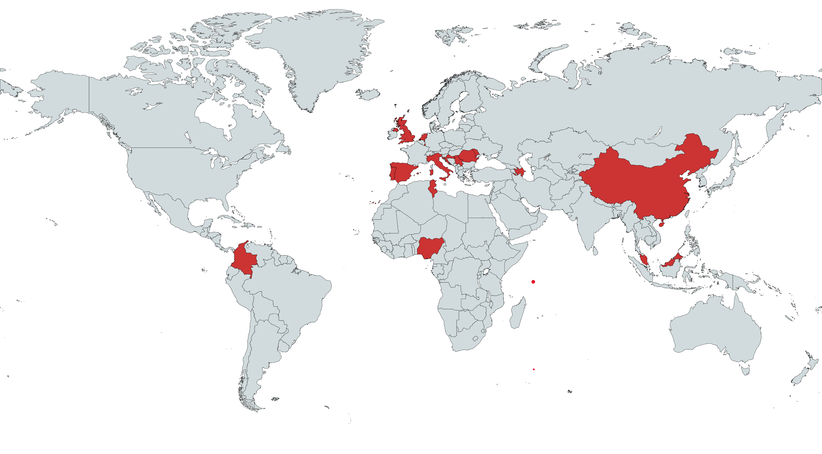
Introduction to the Competition – What is it?
Created by students, for students
Designed by the COBIS Student Council, from ideas put forward by its members
Make a difference where you live
Teams design and deliver a project that has a positive impact on their school or local community
Open to Years 1–13
Free to enter for students at COBIS Member and Applicant Schools
Sponsored by Pearson
Share your project with schools across the global COBIS network
The map shows the countries represented on the COBIS Student Council

Slide 3
What is a Changemaker?
“A changemaker is someone who sees a problem and takes action to solve it.
Projects focus on one (or both) of these areas, based on the UN Sustainable Development Goals (SDGs):
People and Communities
Helping others and making our communities fairer, healthier and kinder.
For example:
Fundraising initiatives
Community outreach projects
Supporting people who need help
Environment and Climate Action
Protecting nature and tackling climate change in our local area.
For example:
Sustainability campaigns
Conservation efforts
Reducing waste and pollution

Slide 4
Why It Matters: Facts & Figures
17
Global Goals (SDGs) agreed by all UN Member States in 2015, to be achieved by 2030
Source: United Nations
Only 35%
of SDG targets are on track or making moderate progress – we need to speed up!
Source: United Nations, 2025
1.8 billion
young people aged 10–24: the largest generation of youth in history
Source: United Nations
19–23 million
tonnes of plastic waste leak into lakes, rivers and seas every year
Source: UN Environment Programme
272 million
children are out of school around the world
Source: UNESCO, 2025
88
countries with COBIS schools – that’s 278,000 students who could be changemakers!
Source: COBIS

Slide 5
Key Messages
Start local You don’t have to change the whole world – start with an issue in your school or community.
1
Small actions add up Every action, big or small, has the potential to create lasting impact.
2
Students lead It’s your idea, your plan and your action – teachers are there to support you.
3
Teamwork makes it work Mix ages, skills and ideas: teams of up to 10 can include different year groups.
4
Everyone is a changemaker Every participant receives a Certificate of Participation.
5

Slide 6
Why Should You Take Part and What Can You Win?
Why take part?
What can you win?
Winners and runners-up in each category receive:
A personalised COBIS Certificate
A feature on the COBIS website and social media
A chance for their project to be shown at the COBIS Annual Conference 2027
Inspire change
Make a genuine difference in your school, local community or environment.
Develop key skills
Build leadership, collaboration, communication and problem-solving skills.
Amplify student voice
Show the power of student-led action across the global COBIS community.
Gain recognition
Winning projects may be featured across COBIS channels and shown to an international audience.
Everyone wins something! Every participant gets a Certificate of Participation.

Slide 7
Who Can Enter?
Students in Years 1–13 (Key Stages 1–5) at COBIS Member and Applicant Schools
Teams of up to 10 students
Mix your year groups – different ages bring different ideas
One entry per school per category – our school will choose its entry through its own selection process
Free to enter!
Junior Category
Key Stages 1–2
Years 1–6 (or equivalent)
Senior Category
Key Stages 3–5
Years 7–13 (or equivalent)

Slide 8
How Does it Work?
1
2
3
4
5
Identify a local issue or challenge
Plan and carry out a student-led project
Create a 5-minute video showcasing your work
Complete the supporting submission form
Submit your entry through your school
Your 5-minute video should show:
The aim of your project
Why you chose it
The strategies you used to tackle the issue
The impact of your project
The lessons you learnt along the way
How you plan to continue or develop it

Slide 9
What Are the Judges Looking For?
A panel of judges will look for:
1
2
3
A clear, meaningful goal
and the reasons for choosing it
Effective strategies
for tackling the issue, clearly explained and justified
Student leadership and teamwork
students play an active role in tackling the issue
4
5
6
Demonstrable impact
the difference you made, clearly explained
Lessons learnt
what you discovered while carrying out the project
A creative, engaging video
that tells the story of your project

Slide 10
Meet Last Year’s Changemakers: 2025–26 Winners
Students across the COBIS network took action on issues they cared about. Congratulations to:
Junior Category (KS1–2)
Senior Category (KS3–5)
WINNER
Ocean Gatekeepers
RUNNERS-UP
LFG Changemakers Project
WINNER
Empowering the Girl-Child Project
RUNNERS-UP
Operation Smile
Watch the winning videos on the COBIS Changemakers Competition webpage at cobis.org.uk
Teacher tip: play one of the winning videos now to show students what’s possible!

Slide 11
Ideas to Get You Started
Not sure where to start? Here are some ideas – but the best projects begin with a real issue you care about.
People and Communities
Raise money or collect donations for a local charity
Start a reading buddy or homework club for younger students
Collect food, clothes or school supplies for families in need
Plan activities to brighten the day of older people nearby
Help new students feel welcome at school
Environment and Climate Action
Launch a recycling or anti-litter campaign
Plant trees or create a garden for bees and butterflies
Organise a beach, river or park clean-up
Cut energy, water or food waste at school
Swap single-use plastics for reusable alternatives

Slide 12
Let’s Talk! Discussion Questions
Turn to the person next to you and talk about…
1
What is one problem in our school or local community that you would like to change?
2
Who does this problem affect, and how?
3
What could a team of students do about it in the next few months?
4
Does your idea fit People and Communities, Environment and Climate Action – or both?
5
How would you know that your project had made a difference?

Slide 13
How to Take Part: Key Dates & Next Steps
Oct – Dec 2026
14 Dec 2026
26 Feb 2027
12 Mar 2027
May 2027
Form teams, choose your project, start taking action and select your school’s entry
Registration deadline (midday UK time)
Submissions open (midday UK time)
Submission deadline (midday UK time)
Winners announced!
Next steps at our school
1
Talk to your teachers if you would like to take part
2
Get a team together – up to 10 students from any year group
3
Start spotting issues in our school and local community

Slide 14
Teacher Involvement
Any COBIS school staff/teachers that have relevant experience or interest in Geography, Outdoor Education, Humanities, Sustainability/Environmental/Eco or Extracurricular Events are welcome to assist in the judging process of this competition.
To register your interest in judging the competition, please contact kirsty.smith@cobis.org.uk.
In school, staff can help teams get started – forming teams, planning safely and filming the video – while keeping the project student-led.
Interested in judging?
Help choose the winning projects and see student-led action from schools across the COBIS network.
Email:
kirsty.smith@cobis.org.uk

Slide 15
Top Tips and Encouragement to Take Part
Start small and local
a focused project can make the biggest difference
1
Be a Changemaker!
Create · Collaborate ·
Change the World
Want to take part? Speak to
your teachers now!
Registration closes 14 December 2026
Ask the people affected
find out what they really need
2
Give everyone a role
leaders, researchers, organisers and filmmakers
3
Collect evidence as you go
photos, videos, numbers and feedback show your impact
4
Plan your 5-minute video early
and tell the story of your journey
5

