Slide 1

What You
Need to Know
About Financial Aid
September 2026

Slide 2
Topics We Will Discuss
What is financial aid, cost of attendance (COA), student aid index (SAI), and financial need?
Categories, types, and sources of financial aid
Free Application for Federal Student Aid (FAFSA®)
Special and unusual circumstances
*Unless otherwise noted, screenshots are taken from the U.S. Department of Education’s 2027-28 FAFSA® Prototype

Slide 3
What Is Financial Aid?
Financial aid consists of funds provided to students and families to help pay for postsecondary educational expenses

Slide 4




What Is Cost of Attendance (COA)?
Tuition and fees
Housing and food (living expenses)
Books, course materials, supplies, and equipment
Miscellaneous personal expenses
Transportation

Slide 5
What Is Student Aid Index (SAI)?
Number resulting from the evaluation of a student’s (and family’s) approximate financial resources for a student’s postsecondary education
Student contribution
Parent contribution
(for dependent students)

Slide 6
What Is Financial Need?
Cost of attendance (COA) – Student aid index (SAI) = Financial need

Slide 7
Categories of Financial Aid
Need-based aid
Non-need-based aid

Slide 8
Types of Financial Aid
Scholarships
Grants
Loans
Work-Study Employment
Self-Help Aid
Gift Aid

Slide 9
Scholarships
Scholarships
Grants
Loans
Work-Study Employment
Self-Help Aid
Gift Aid

Slide 10
Grants
Scholarships
Grants
Loans
Work-Study Employment
Self-Help Aid
Gift Aid

Slide 11
Work-Study Employment
Scholarships
Grants
Loans
Work-Study Employment
Self-Help Aid
Gift Aid

Slide 12
Loans
Scholarships
Grants
Loans
Work-Study Employment
Self-Help Aid
Gift Aid

Slide 13
Sources of Financial Aid
Federal Government
Employers
States
Private Sources
College and Universities

Slide 14
Federal Government
Largest source of financial aid
Aid provided primarily based on financial need
FAFSA is required each year
Eligibility requirements must be met

Slide 15
Federal Student Aid Programs
Federal Pell Grant
Federal Supplemental Educational Opportunity Grant (FSEOG)
Teacher Education Assistance for College and Higher Education (TEACH) Grant
Federal Work-Study (FWS)
Federal Direct Student Loans (Direct Loans)
Federal Direct PLUS Loans

Slide 16
Federal Pell
Pell Grant for eligible workforce programs
Limitations on Pell Grant eligibility
  Student is not eligible for the Pell Grant if:
    SAI exceeds twice the maximum Pell Grant amount; or
    Student’s nonfederal grants and scholarships cover entire COA (even if otherwise eligible)

Slide 17
Parent PLUS
New borrowers on or after July 1, 2026:
  Annual loan limit: $20,000 per dependent student
  Aggregate loan limit: $65,000 per dependent student
Legacy borrowers may borrow at previous loan limits for the shorter of:
  3 academic years; or
  Time for student to complete program

Slide 18
States
Residency requirements usually apply
Aid may be merit or need based
Eligibility determined using the FAFSA and/or state aid applications
Deadlines vary by state

Slide 19
TASFA
Usually accepted by public colleges in Texas
Students are not eligible to complete the FAFSA, but are considered to be lawful residents of Texas.
  Documentation may be requested by the school : Valid TX driver’s license, current Visa, I94 record, Employment Authorization Card, I-797 Approval notice.
Not in addition to the FAFSA, but instead of the FAFSA
Documentation of income is required (a copy of a federal income tax return transcript from the IRS)
Paper application is available at www.collegeforalltexans.com
Online application is available at https://www.highered.texas.gov/our-work/empowering-our-students/tasfa/

Slide 20
TASFA
Usually accepted by public colleges in Texas
Students are not eligible to complete the FAFSA, but are considered to be lawful residents of Texas.
  Documentation may be requested by the school : Valid TX driver’s license, current Visa, I94 record, Employment Authorization Card, I-797 Approval notice.
Not in addition to the FAFSA, but instead of the FAFSA
Documentation of income is required (a copy of a federal income tax return transcript from the IRS)
Paper application is available at www.collegeforalltexans.com
Online application is available at https://www.highered.texas.gov/our-work/empowering-our-students/tasfa/

Slide 21
Colleges and Universities
Aid provided based on both merit and financial need
Aid may be gift aid or self-help aid
Eligibility determined using the FAFSA and/or institutional applications
Deadlines and application requirements vary by institution

Slide 22
Private Sources
Foundations, businesses, churches, civic,
and charitable organizations
Deadlines and applications procedures vary
Begin researching private sources early

Slide 23
Employers
Scholarships opportunities for children of employees
Educational benefits

Slide 24
Federal Student Aid Estimator
Early estimation regarding SAI and possible Title IV aid available
Requires demographic, income, and asset information
https://studentaid.gov/aid-estimator

Slide 25
Free Application for Federal Student Aid (FAFSA®)
Collects demographic and financial information
Information used to calculate the student aid index (SAI)
Colleges use SAI to offer financial aid
Available in English and Spanish
  Assistance available in additional languages

Slide 26
Free Application for Federal Student Aid (FAFSA)
May be filed at any time during an academic year, beginning on or around the October 1st prior to the academic year for which the student requests aid
For the 2027-28 academic year, the FAFSA will be available by October 1, 2026
Colleges may set FAFSA priority dates

Slide 27


Free Application for Federal Student Aid (FAFSA)
Online FAFSA
PDF FAFSA

Slide 28
Benefits of Using Online FAFSA
Simplified application process
Built-in edits to prevent costly errors
Skip-logic allows student and/or parent to skip unnecessary questions
No need to manually enter federal tax information (FTI)
Real-time processing and immediate corrections
Pre-filled information to reduce repetitive data entry
More detailed instructions and “help” for common questions
Ability to check application status online

Slide 29
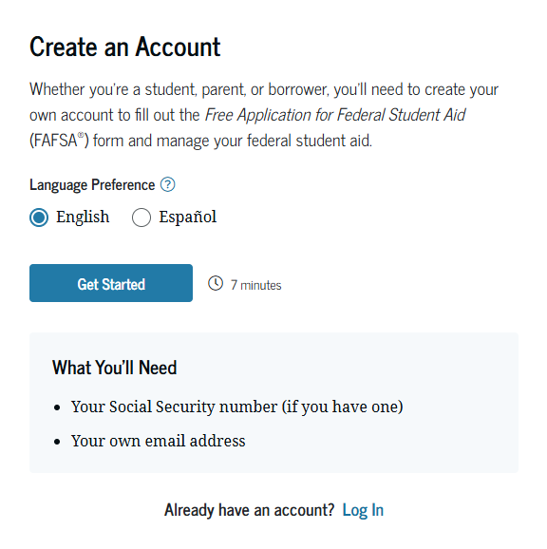
StudentAid.gov Account Username and Password (FSA ID)
Used for FAFSA completion and access to certain U.S. Department of Education websites
Student and parent must create own FSA ID
May be used throughout financial aid process, including subsequent school years
Only the owner should create an
FSA ID
Apply at https://studentaid.gov/fsa-id/create-account/launch

Slide 30
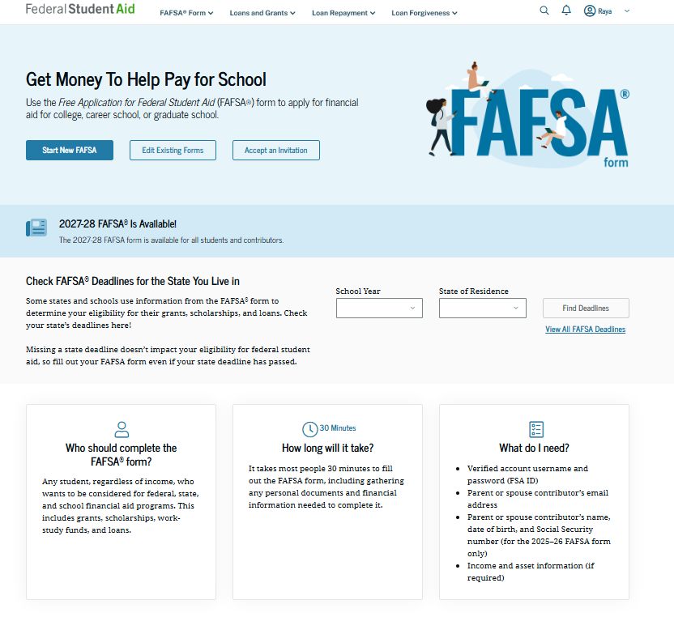
Online FAFSA

Slide 31
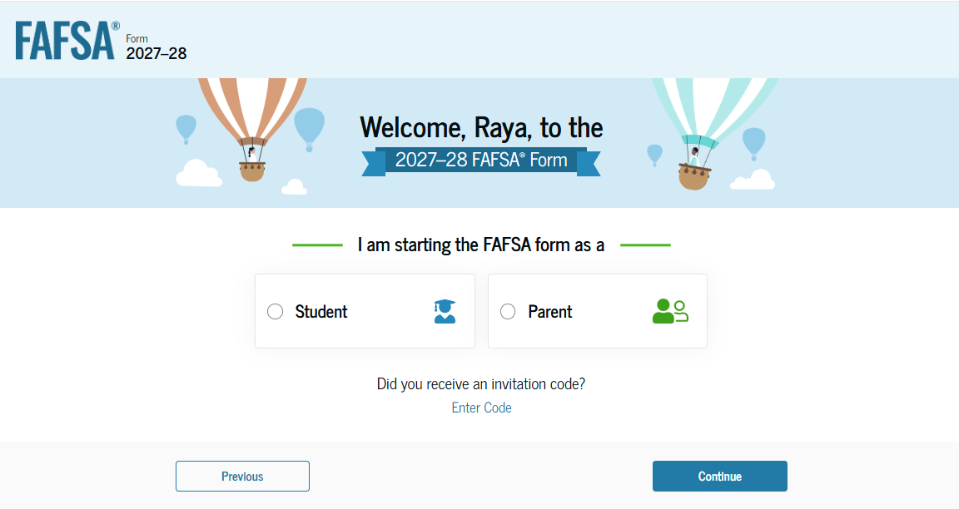
Online FAFSA

Slide 32
FUTURE Act Direct Data Exchange (FA-DDX)
Allows for an individual’s federal tax information (FTI) to be directly transferred from the IRS to the FAFSA
Consent is required by all contributors on FAFSA
IRS transfers information to populate FAFSA income questions for most tax filers
Eliminates manual entry of tax and income information

Slide 33
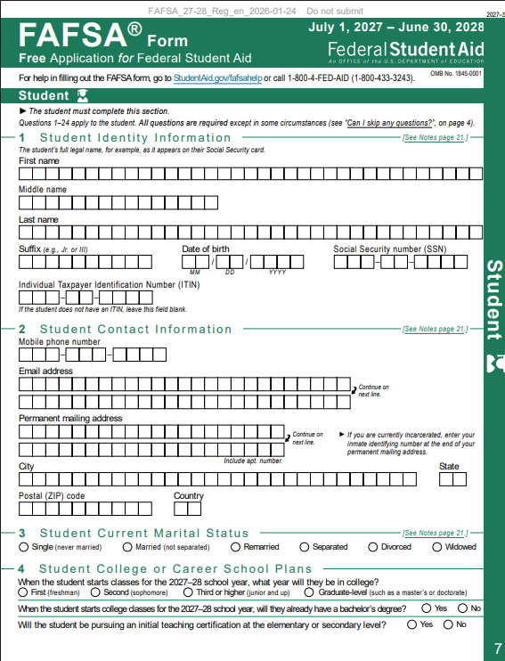
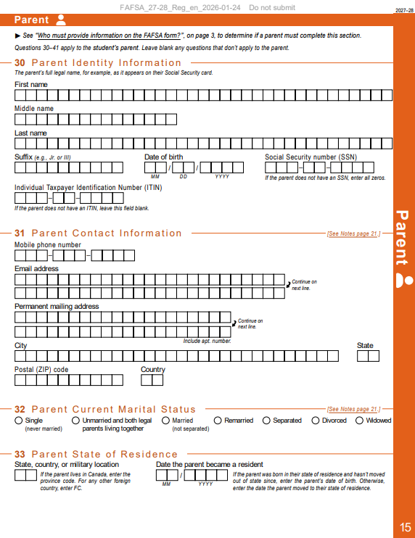
PDF FAFSA
Can use the PDF FAFSA to review questions that will be asked on online FAFSA for student and parent(s), if applicable
Source: U.S. Department of Education, 2027-28 FAFSA Draft

Slide 34
Student Information
Identity and contact information
Consent and approval for FTI transfer from IRS
Marital status
School year
Personal and unusual circumstances

Slide 35
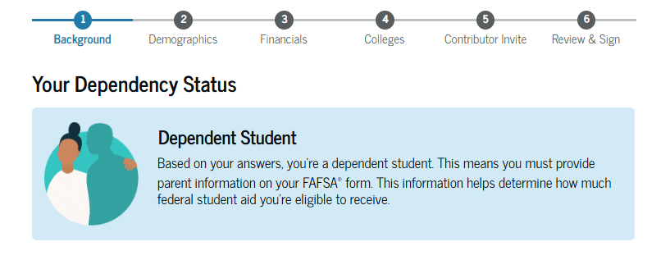
Student Dependency Status
Born before January 1, 2004?
Married?
Graduate or professional student?
Active-duty military?
Veteran?
Children or legal dependents?
Orphan, ward of the court, foster care?
Emancipated minor or legal guardianship?
Homeless or self-supporting and at risk of homelessness?

Slide 36
Unusual Circumstances
Conditions that justify an institution making an adjustment to a student’s dependency status
  Cannot contact parent or contact poses risk to student
Student does not provide parental data on FAFSA
    Considered provisionally independent
Student follows institution’s process for dependency override determination

Slide 37
Student Information
Demographic information
Citizenship status
Parents’ education status
Parent killed in line of duty
High school completion information

Slide 38
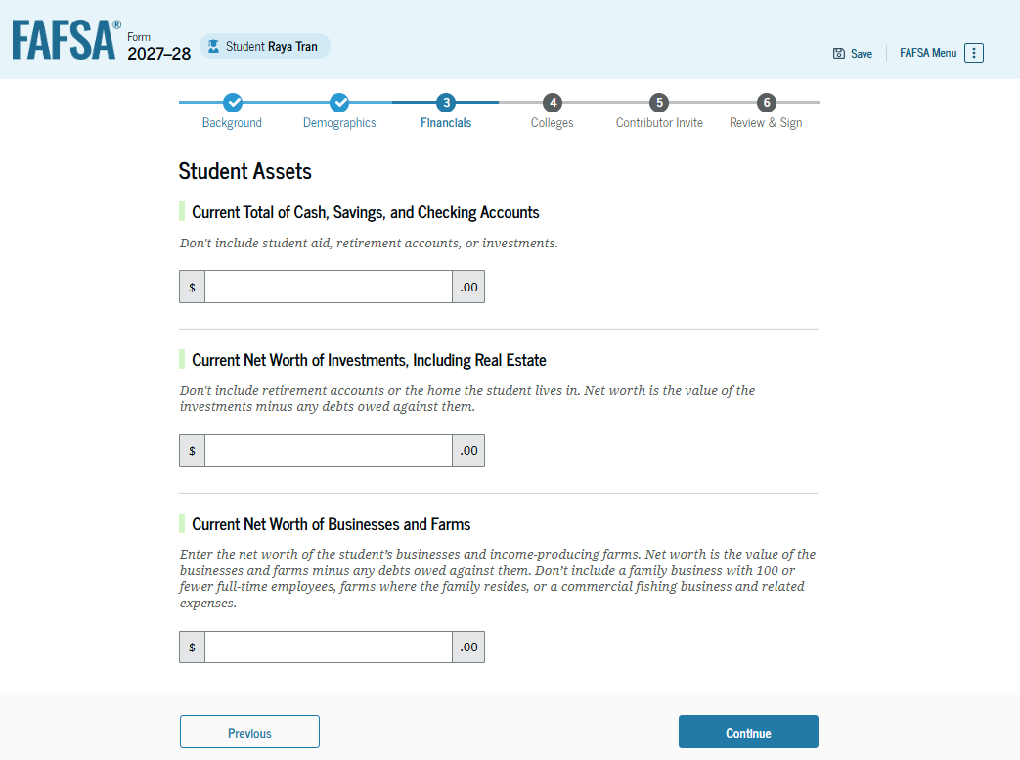
Student Financial Information
Tax return information
  Minimal questions if
  FTI transferred from IRS
Asset information

Slide 39
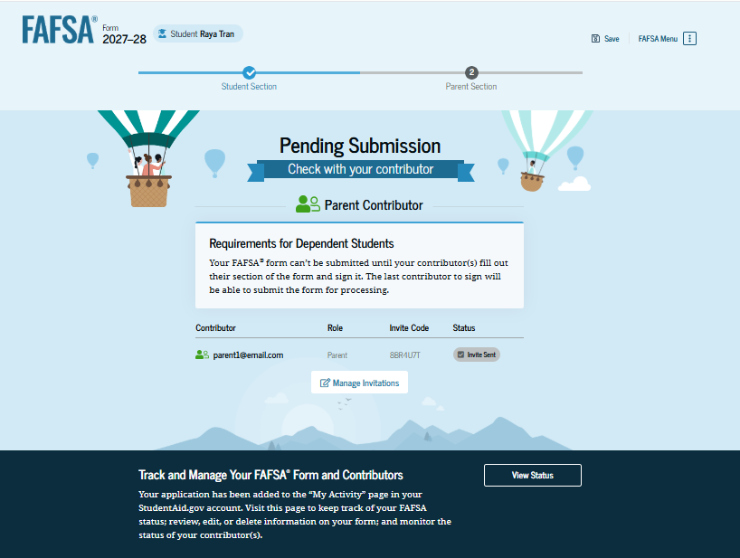
Student Section Completion
College selection
Contributor invitation
Review of information and signature

Slide 40
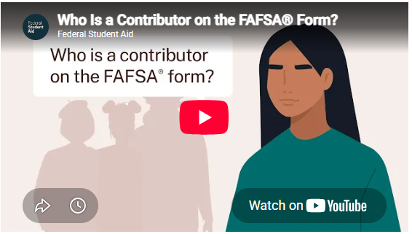
FAFSA Contributors
Individuals required to provide information on the FAFSA
Can include the:
  Parent
  Parent spouse or partner
  Student’s spouse
  Student
Source: Federal Student Aid, Understanding the FAFSA Form

Slide 41
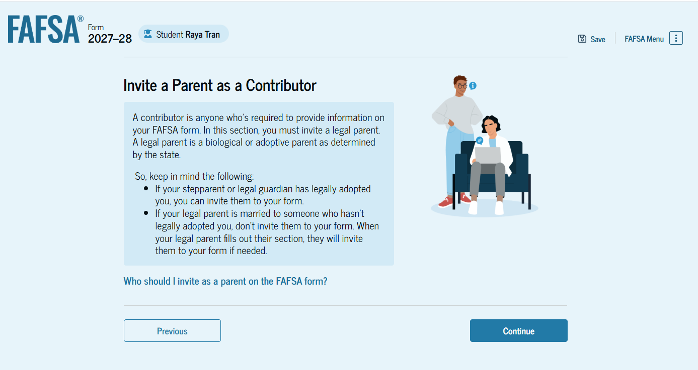
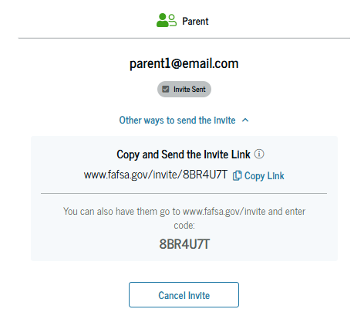
Student Invites Parent to FAFSA
Student enters parent email address to invite them to complete parent portion of the FAFSA
Invitation link or invitation code can be shared directly

Slide 42
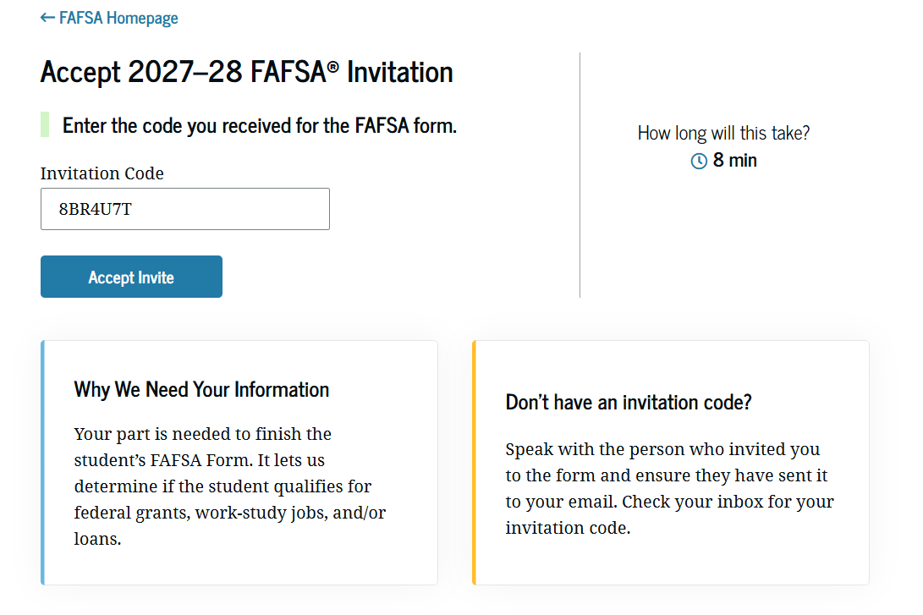
Parent Invitation
Accept email invitation or use invitation link or invitation code to complete parent portion of student’s FAFSA
Parents must use FSA ID to access FAFSA

Slide 43
Parent Information
Identity and contact information
Consent and approval for FTI transfer from IRS
Marital status
State of residence

Slide 44
Parent Financial Information
Receipt of means-tested federal benefits in the previous two years
Tax filing status
Family size and number in college
Tax return information
  Minimal questions if FTI transferred from IRS
Assets
Parent spouse or partner information (if applicable)

Slide 45
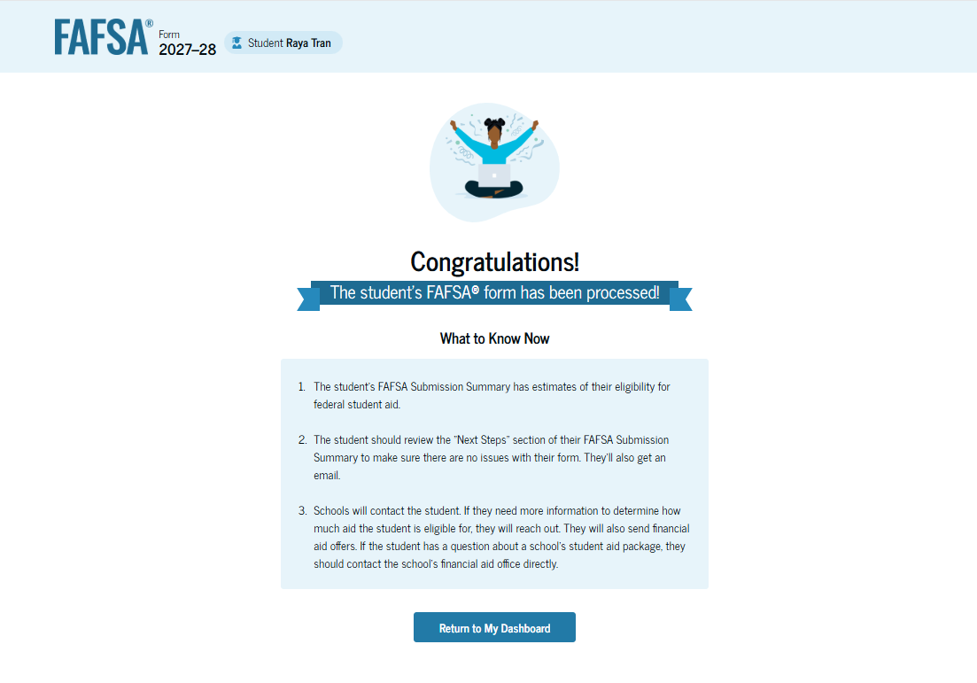
Parent Section Completion
Review of information
Signature and submission of FAFSA

Slide 46
Other Considerations
If independent student is married and filed taxes separately, spouse information is required as well
Consent to transfer FTI from the IRS is required for all contributors
  Including student, student’s spouse (if applicable), parent, and parent’s spouse (if applicable)
Students, parents, and preparers may start, complete, and submit a FAFSA

Slide 47
Who Is Included in Family Size?
Dependent Applicants
Student
Independent Applicants
Parent (and spouse)
Parent’s dependent children, even if they live apart from the parent temporarily, such as for college enrollment*
Other people if they live with the parent*
Student (and spouse)
Student’s dependent children, even if they live apart from the student temporarily, such as for college enrollment*
Other people if they live with the student*
*Include only if providing more than half of their support between July 1, 2027 and June 30, 2028

Slide 48
FAFSA Processing Results
FPS
Student
College
Institutional Student Information Record (ISIR)
FAFSA Submission Summary (electronic or paper)

Slide 49
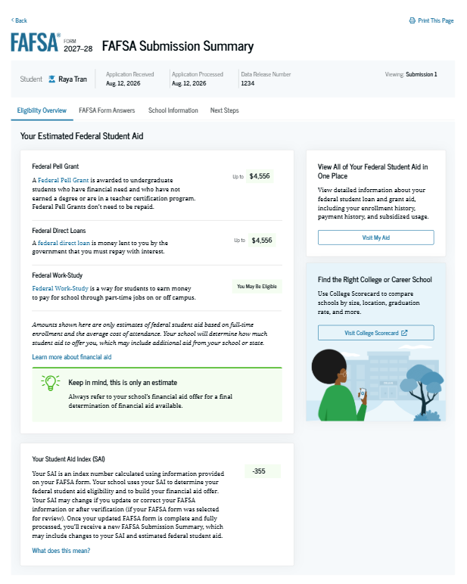
FAFSA Submission Summary
Four sections:
  Eligibility Overview
  FAFSA Form Answers
  School Information
  Next Steps
Ability to print summary

Slide 50
Making Corrections
If necessary, corrections to FAFSA data may be made by:
Using online FAFSA;
Updating paper FAFSA Submission Summary; or
Submitting documentation to college’s financial aid office

Slide 51
Special Circumstances
Different than unusual circumstances (dependency overrides)
Unique conditions exist that cannot be documented with the FAFSA, or circumstances have changed since filing
Student should contact institution’s financial aid office for more information
Decisions are final and cannot be appealed to U.S. Department of Education

Slide 52

Special Circumstances
Unusual uncovered medical/dental expenses
Secondary school tuition
Extraordinary dependent care costs
Parent or spouse death
Additional family members in college
Loss of employment or income
Divorce

