Slide 1


Kindergarten School Readiness (KSR) Data Collection
Justin Chrisco – Data Coordinator
1

Slide 2
Agenda
Background
Collection Timelines
Assessments
Data Pipeline
Resources
Recap
2

Slide 3
Background
Passed in 2008, Colorado Achievement Plan for Kids (CAP4K) requires districts to report school readiness data to the Colorado Department of Education.
Part of an aligned system of public education, school readiness assessments were recognized by the General Assembly as a critical element of aligned assessments continuing from preschool to elementary (C.R.S. 22-7-1002).
The kindergarten school readiness (KSR) assessments assess the varying skill levels and knowledge with which students enter kindergarten (C.R.S. 22-7-1002 (2)) and inform individual learning plans for each publicly funded student (C.R.S. 22-7-1014).
In March 2020, the State Board of Education voted to change the reporting system to include named domains.
In May 2026, HB26-1050 made individual learning plans optional for students meeting requirements in the six domains and the interim reading assessment
Notes:
KSR is part of CAP4K
Collection moved from counts of domains met (1 out of 6, 5 out of 6)
Ultimately the goal is for alignment and informing individual learning plans
Collection itself to get an overall trend and meet statutory requirements

Slide 4
Collection Timeline
Students are assessed with in the first 60 calendar days of the school year
October 6^{th,} 2026 – Collection opens
November 13^{th,} 2026 – Checkpoint
December 11^{th,} 2026 – Collection closes
Notes:
Key dates.
10/6 maybe a holiday for some districts but collection will be opened
Target upload date – This is a soft target but beneficial for finding issues early and have them corrected before actual deadline – avoids a rush towards winter break

Slide 5
Assessments – Required Domains
As required by Colorado law (Section 22-7-1004 (1)(b) C.R.S.), school readiness includes the following domains
Domain | Domain description
Physical Well-being and Motor Development | A child's ability to use small and large muscles to engage in learning activities and to meet his/her own needs.
Social and Emotional Development | A child's ability to follow limits, persist with learning tasks, make friends, and take care of his or her own needs.
Language and Comprehension Development | A child's ability to listen and understand, to express his/her thoughts and needs and to engage in appropriate conversations.
Cognition | Executive function skills and approaches to learning, including a child's ability to persist, to solve problems, engage, and organize information.
Literacy | Foundational reading skills, writing, comprehension, and engagement in literacy.
Mathematics | Early numeracy skills including number, quantity, and mathematical thinking.

Slide 6
Assessments – Domain Coverage
Assessments covering all domains
  COR for Kindergarten - HighScope Educational Research Foundation
  Desired Results Developmental Profile for Kindergarten (DRDP-K) - WestEd
  DIAL-4 Developmental Indicators for the Assessment of Learning - NCS Pearson, Inc.
  GOLD® - Teaching Strategies
  North Carolina Kindergarten Entry Assessment
Assessments covering some domains
  Acadience Math K-6, Acadience Learning Inc. /Voyager Sopris Learning
  Brigance Early Childhood Screens III, Curriculum Associates, LLC
  FastBridge earlyMath, Renaissance Learning, Inc.
  FastBridge earlyReading, Renaissance Learning, Inc.
  FastBridge SAEBRS, Renaissance Learning, Inc.
  Istation's Indicators of Progress (ISIP), Imagination Station, Inc.

Slide 7
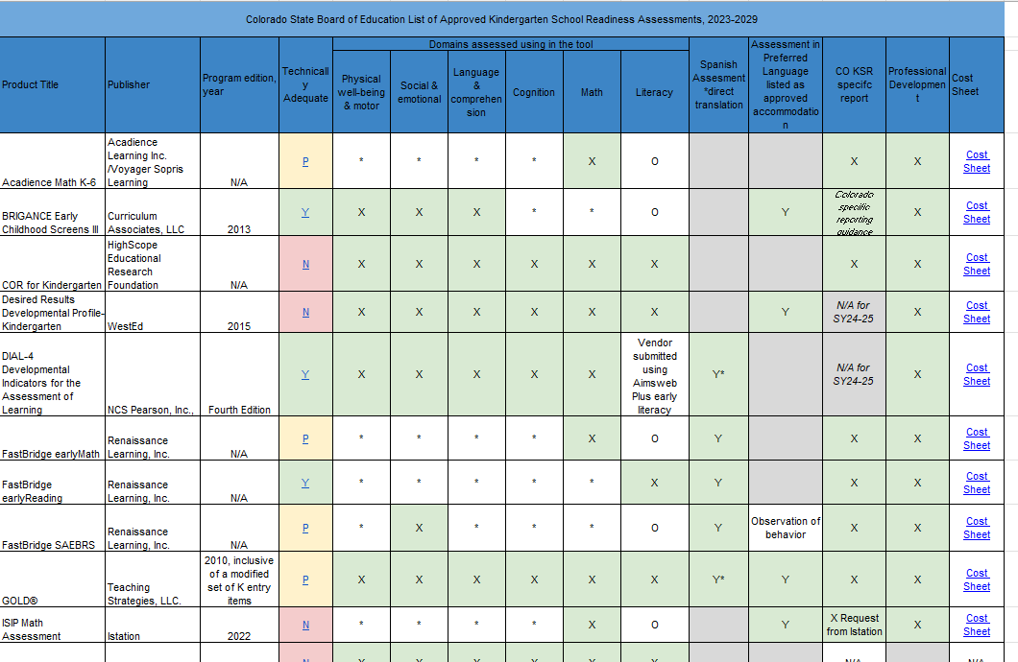
Assessments – Matrix and Support
Assessment Choices and School Readiness Plans

Slide 8
Data Pipeline
User roles
File prep
File load process
Error resolution
Finalize and submit

Slide 9
User Roles
KSR LEA Viewer – Can view data reported to CDE but can not edit.
KSR LEA User – Can view, edit and upload data. Responsible for creating and uploading data files and correcting data errors.
KSR LEA Approver – Same privileges as LEA User but can also finalize data sets
Communication lists generated based on roles
IDM Support
Notes:
LAM grants access
Need an approver
Communications will be based on the users in the KSR collection roles

Slide 10
File Prep: Basics
Changes: 26-27 additional race ethnicity fields added. South Asian and Middle Eastern or North African
Many assessments have exports that fit the file layout
  Vendors were notified of the changes and confirmed they could meet the new file layout
KSR data is aggregated at the school level
Primary data points are:
  Total students assessed
  Number of students meeting or exceeding by domain
  Domain
  Assessment used
Demographic data:
  Gender
  Free or reduced lunch status
  Ethnicity
Notes:
Touch base with vendor or know contact info

Slide 11
File Prep: Troubleshooting
If the data is not exporting from the vendor platform, please check the following:
  Have teachers finalized their data?
  Has it been 24 hours since the data were finalized?
  Is the data in the correct checkpoint/benchmark period?
    Examples: Fall/BOY, Winter/MOY, Spring/EOY. The data should be entered in the Fall/BOY checkpoint.
    The data cannot be automatically transferred into a different checkpoint by the vendor. The data will need to be manually re-entered by the district.
  Was the data entered in the correct license?
      Sometimes it is difficult to distinguish the preschool and kindergarten licenses from a vendor offering both. Make sure you are logged into the correct license (kindergarten).
      The data cannot be automatically transferred into a different checkpoint by the vendor. The data will need to be manually re-entered by the district.
If none of these work, please contact your vendor directly.

Slide 12
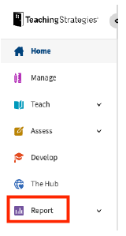
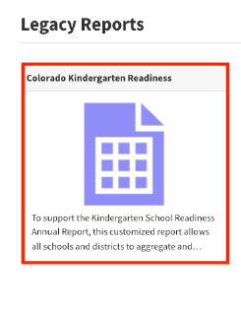
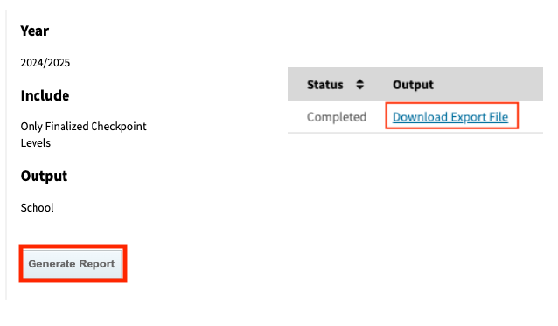
Assessments – TS Gold Report
Teaching Strategies Gold - Login Instructions
Notes:
Must be an administrator in TS Gold to get the report
Providing this information as TS is widely used
Layout has changed – but you should see -> Legacy reports -> Colorado Kindergarten Readiness

Slide 13
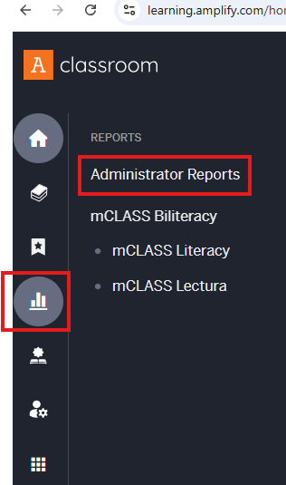
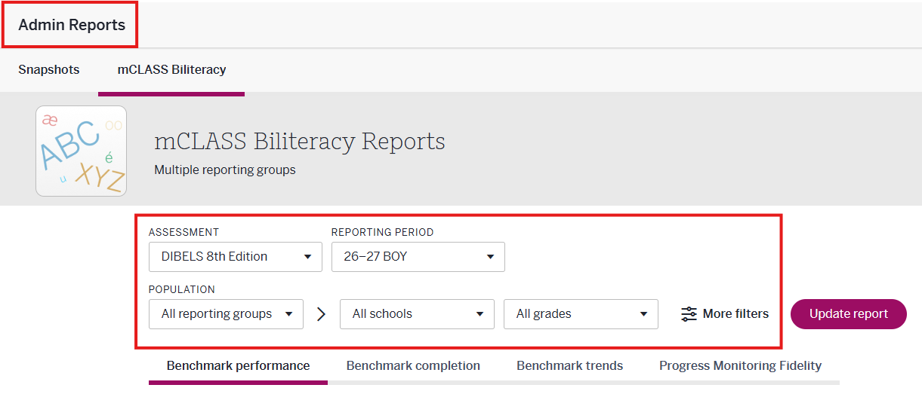
Assessments – DIBELS Overview
Notes:
Used for the literacy component
From Amplify – Administrator Reports
Assessment
Reporting period = BOY
Population = District
All Schools
All Grades -> K

Slide 14
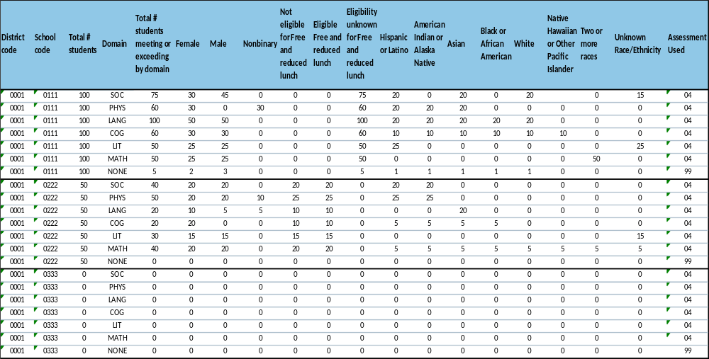
File Prep: Reviewing Data
District, School, Assessment code – Text format
Gender, lunch status, and ethnicity – must equal students meeting or exceeding by domain
None domain – assessment code = 99
Notes:
Switch to live file

Slide 15
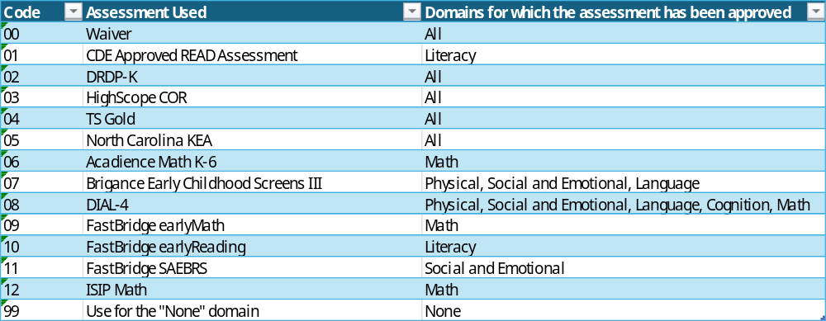
File Prep: Assessment Coding

Slide 16
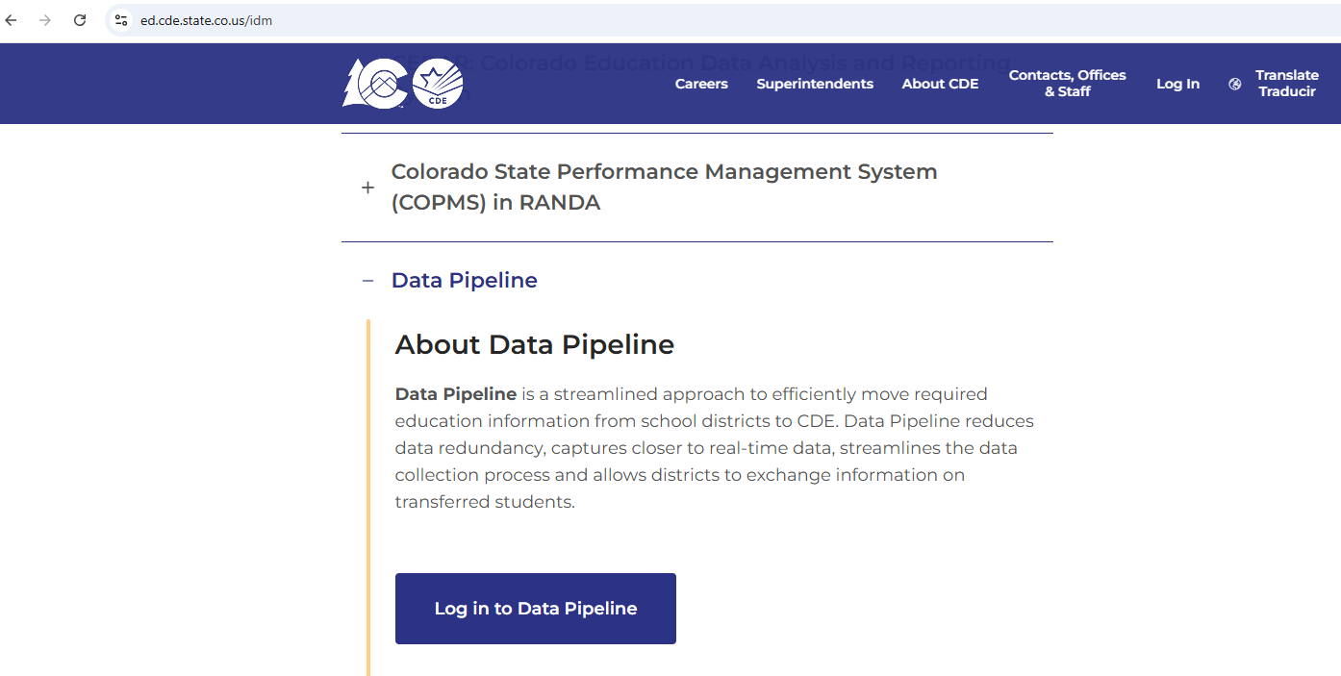
File load process: Data Pipeline
Data Pipeline
Notes:
Data pipeline resources – Training

Slide 17
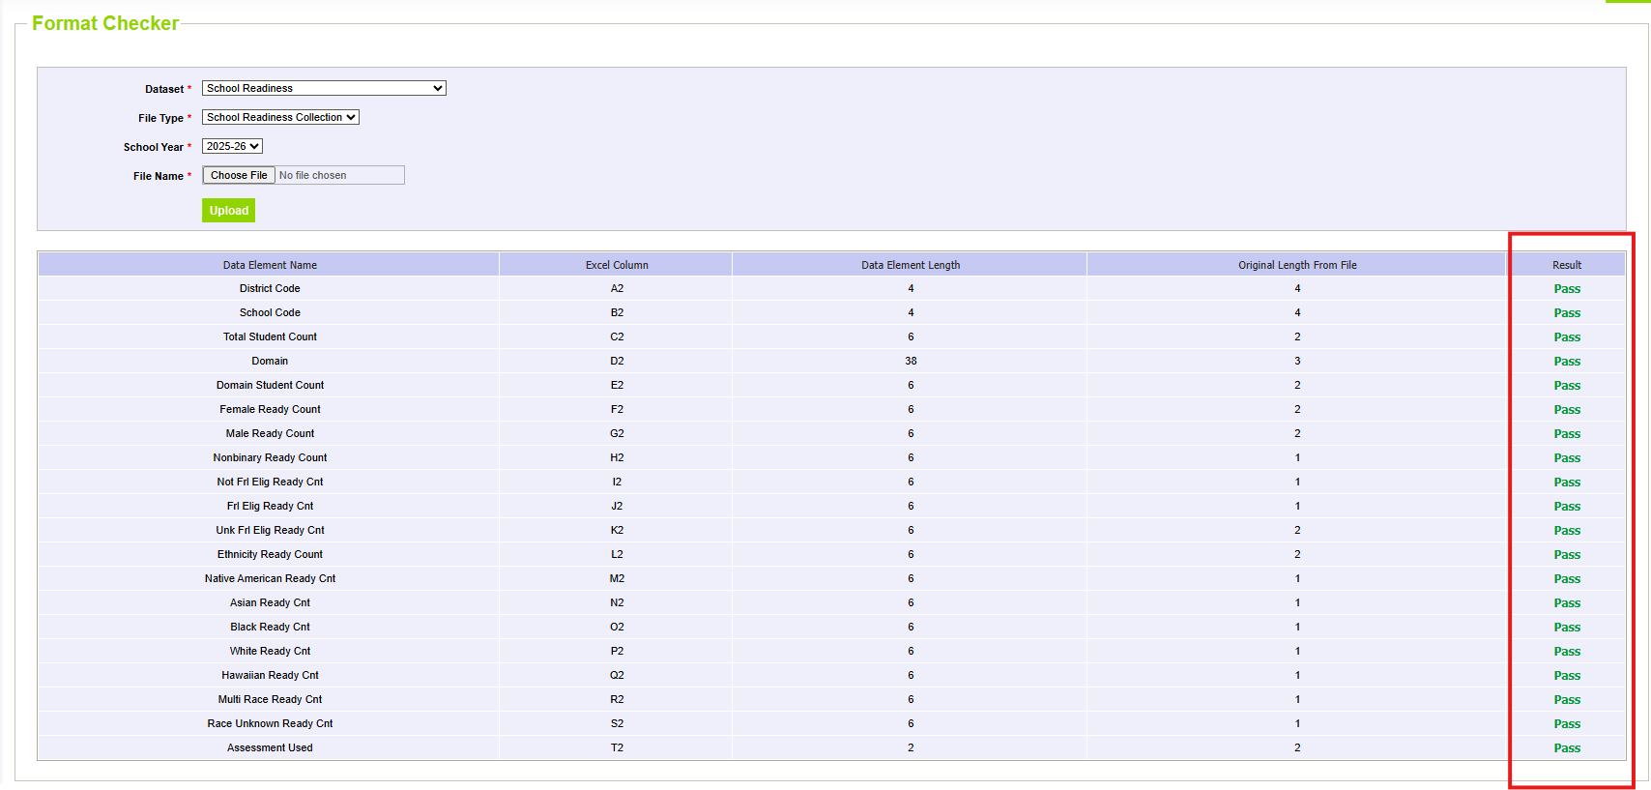
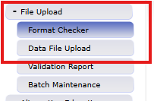
File load process: Format Checker
Format Checker – Ensures that the file will load to data pipeline
Notes:
Before uploading use the Format checker – it is optional though
If the format is incorrect an email will be generated with a description of the error
Some formatting errors can still exist and the error email will note an internal database error and to contact CDE. If this happens carefully review the file to make sure it matches the file layout
Still can have errors after uploading

Slide 18
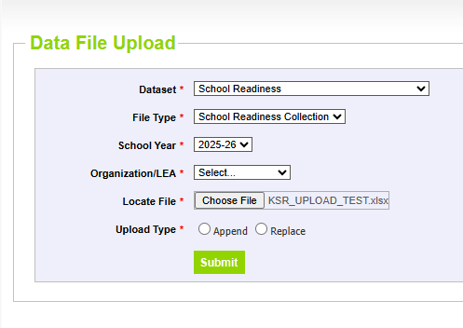
File load process: File Upload
Select Dataset School Readiness and remaining fields will automatically populate
  Dataset = School Readiness
  File type = School Readiness Collection
  School Year = Current Year
  Organization/LEA = Select your organization
File name can’t have spaces or special characters
Upload Type – Recommended to use Replace
Notes:
Should default
Decide Append or Replace. Replace is recommended.
File name can’t have spaces

Slide 19
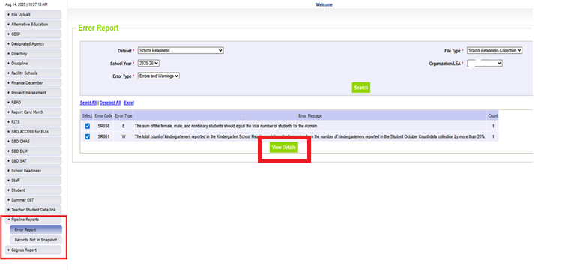
Error resolution: Error Report
After uploading a file an email will be sent summarizing record count and errors
If errors exist, use the pipeline reports (Error Report) for details on the errors
Fix errors and reload file, repeat until file is error free

Slide 20
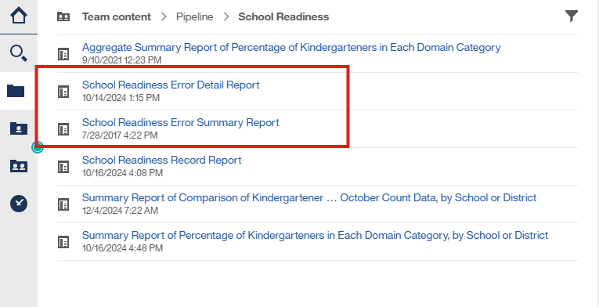
Error resolution: Cognos
School Readiness Error Detail Report
      Provides row level detail

Slide 21
Error resolution
Common Errors
  Assessment code for the None domain – Use 99 for all None domains.
  Demographic counts don’t sum to students meeting or exceeding for the domain
  School serves kindergartners but currently doesn’t have any kindergartners enrolled
    Error code SR070
    Request an exception
      KSRData@cde.state.co.us

Slide 22
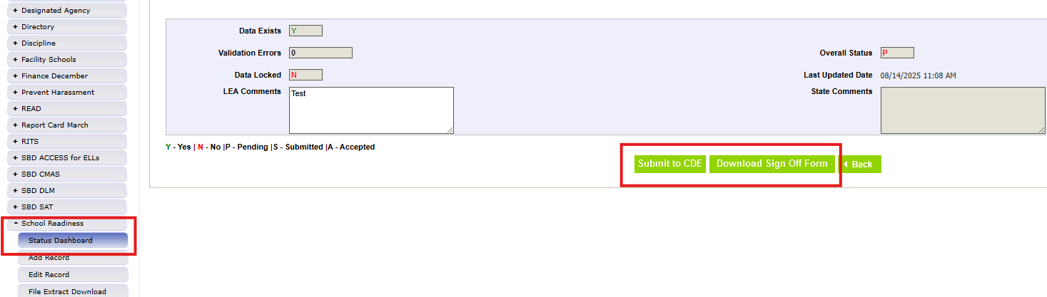
Finalize and Submit: Data Pipeline Status Dashboard
Once all errors are resolved and warnings are reviewed finalize and submit the data set
Select Status Dashboard for School Readiness -> Submit to CDE
Download, sign and return sign off form

Slide 23
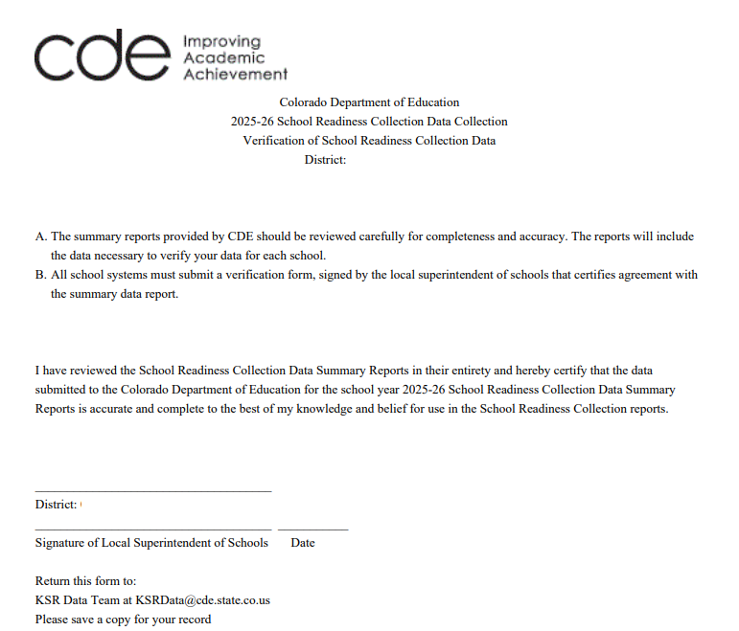
Finalize and Submit: Sign-off page
Sign and return form to KSRData@cde.state.co.us

Slide 24
Recap
October 6^{th,} 2026 – Collection opens
November 13^{th,} 2026– Target upload
December 11^{th,} 2026 – Collection closes
Data is aggregated at the school level
  Seven domains per school
  “None” domain – Assessment Code 99
Resources
  Kindergarten School Readiness Data Collection
  School Readiness
  Data Pipeline
Contact - KSRData@cde.state.co.us

