Slide 1

Empowering Parent Councils in your LEA
Mary Andrews, Executive Director
Parent Information Center of Delaware 2026

Slide 2
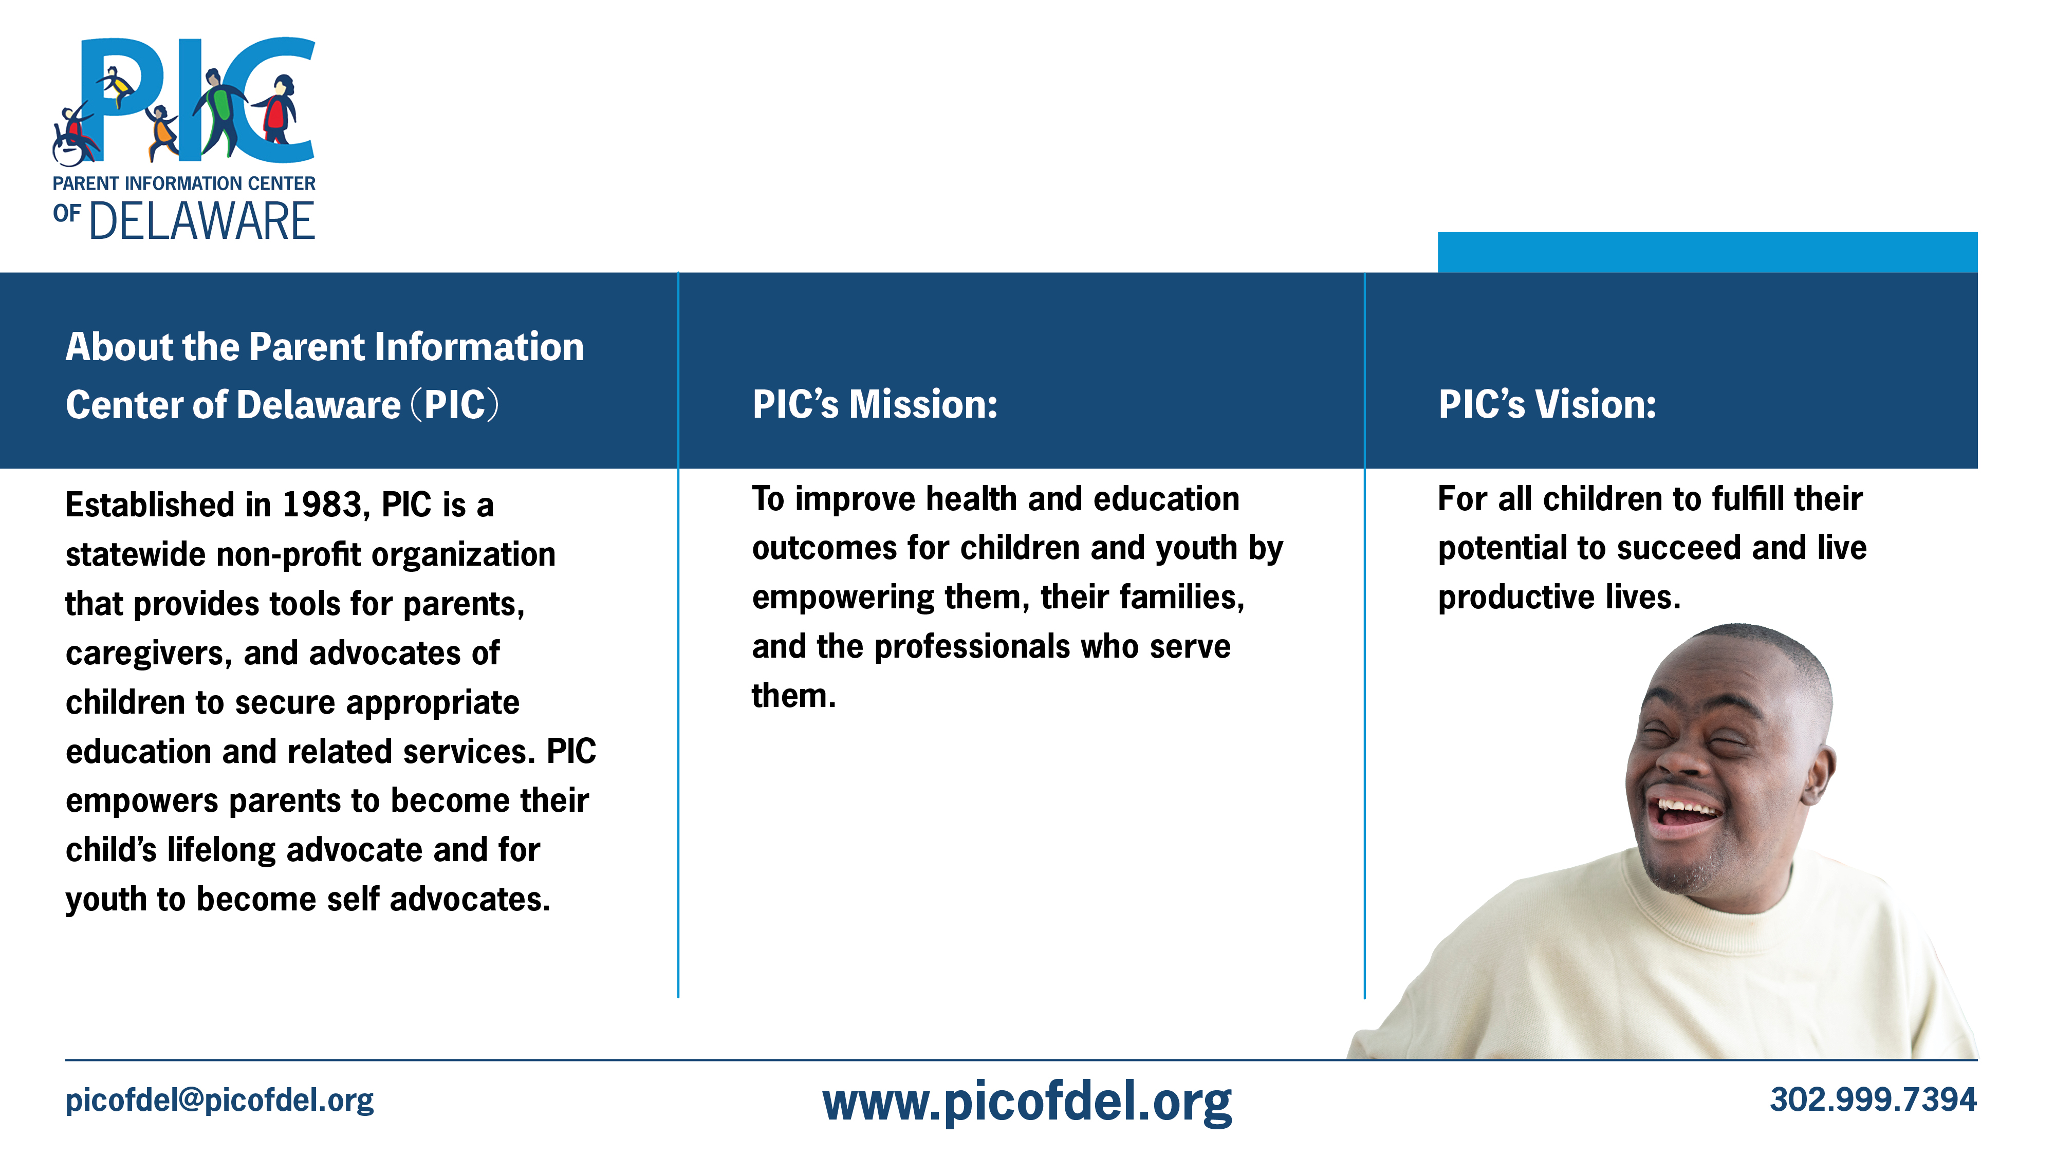

Slide 3
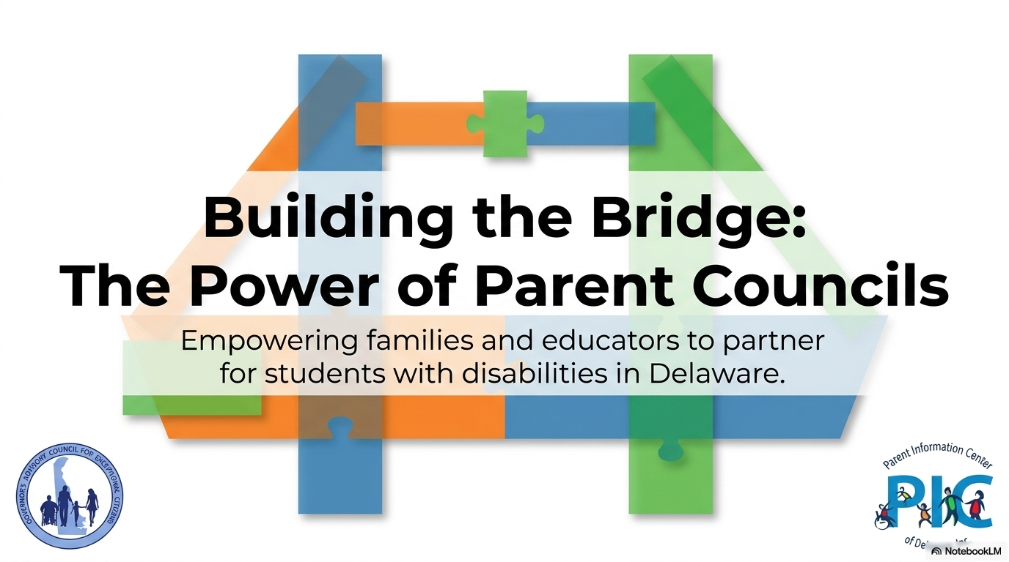

Slide 4

Building Successful Parent Councils:
What works / what doesn’t
Successes?
Challenges?
What does your parent council need to be successful?
If resources were unlimited, what would an ideal parent council look like, and how could we maximize its impact on students, families, and schools?

Slide 5

Parent Councils
25.0 Parent Councils
25.1 Each school district and charter school enrolling any child with a disability shall, on an annual basis, contact the parents of each such child to attempt to facilitate the creation and maintenance of a Parent Council for the parents of students with disabilities.
25.2 Parent Councils will advocate generally for students with disabilities and provide person-to-person support with individual parents and children.
25.3 Each school district and charter school shall collaborate and coordinate with existing parent groups and other information and support groups to facilitate creation, maintenance, and effectiveness of the Parent Councils.

Slide 6
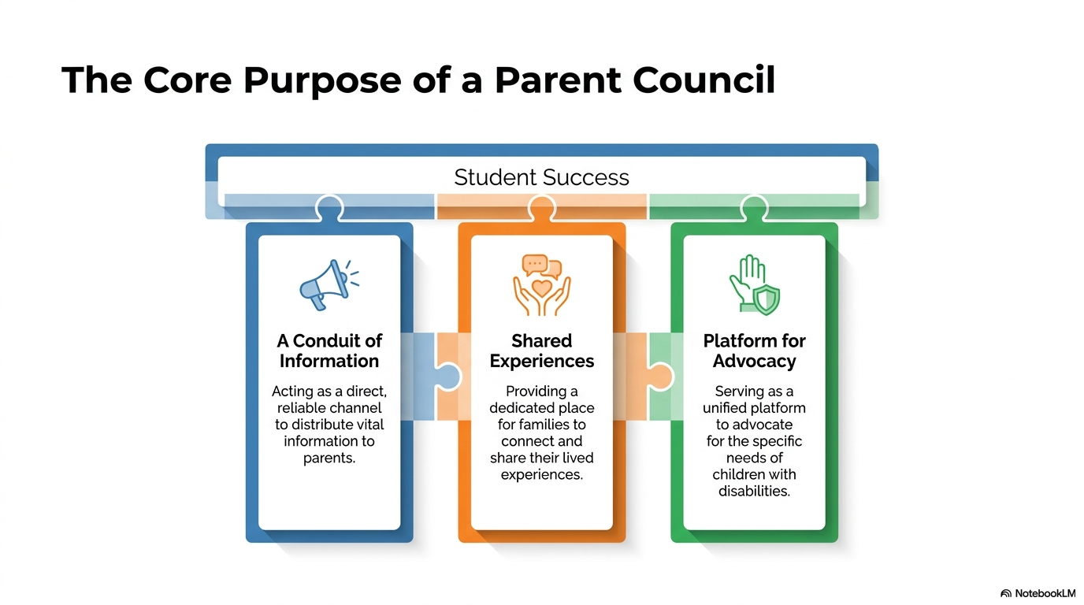

Slide 7
Benefits of Parent Councils
Outreach – can engage families of students with disabilities so they are involved in helping to shape local special education programs and policies.
Positive Relationships – Effective parent councils engage parents and school leaders to establish shared goals and priorities that benefit students with disabilities. They connect with teachers, child study teams, and community resources as sources of support for helping improve programs and services.
Collaborative problem solving – while team members bring different perspectives, everyone shares a common mission – improving outcomes for students receiving special education services.
Systems Change – parent councils can communicate the needs of parents whose children receiving special education services and can inform and provide school leaders about unmet needs identified through parental input

Slide 8
Benefits of Parent Councils?
Trusted source of information - parent councils can strengthen the bridge between the school and district families. Members education themselves about school policies and channels of communication can be a source for parents who may need information, support and resources from their school and can steer them in the appropriate direction.
Information sharing – Parent councils can provide an opportunity for districts to share information with all parents about instructional programs, professional development opportunities, and other matters related to special education.
Improved services and programs - changes that come about as a result of input from parent councils are responsive to the identified needs of the school community
Effective resource allocation – parents can provide valuable input regarding allocating resources, identifying and establishing priorities.

Slide 9
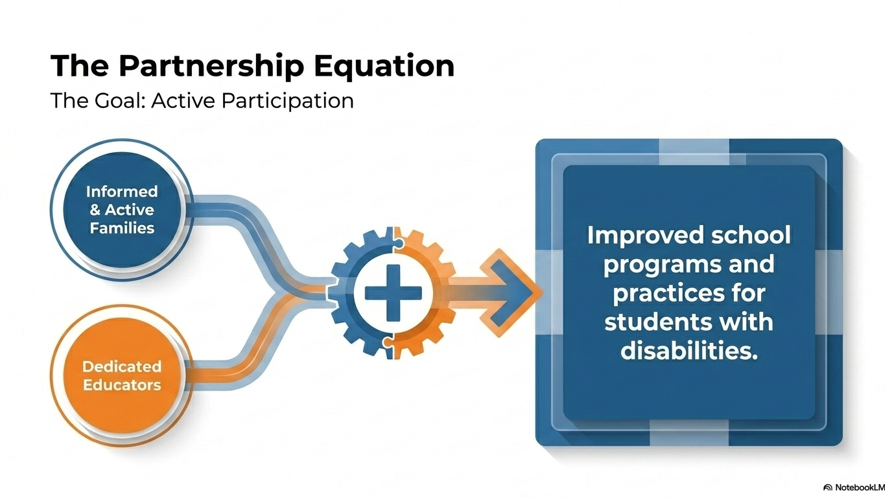

Slide 10
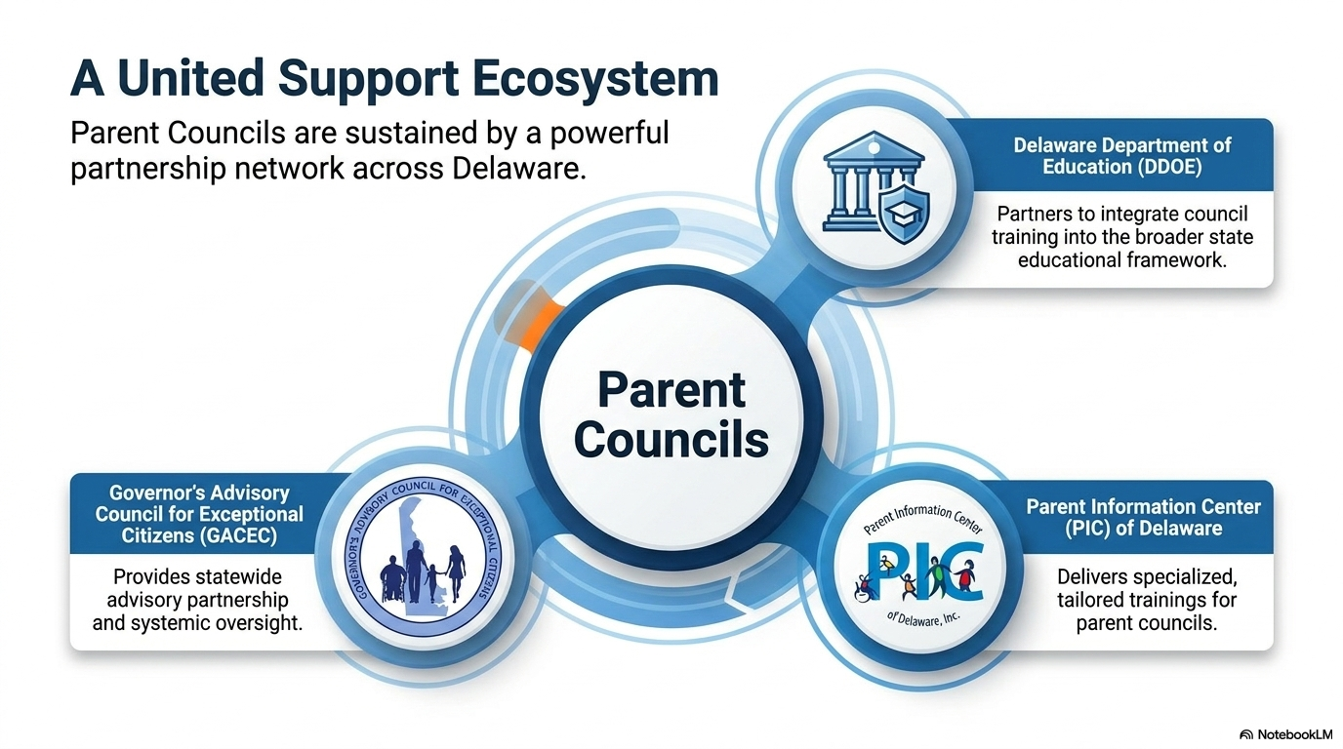


Slide 11
Parent Councils: A Dual Approach to Systemic Change
General Advocacy
Individualized Support
Advising on school-wide practices, policies and procedures.
Improving broader special education programs and influencing district level policy – impacting all students
Helping families navigate the special education process in your district
Offering opportunities for peer-to-peer support & share experiences
Opportunities to build and strengthen school – family partnerships and improve student outcomes

Slide 12
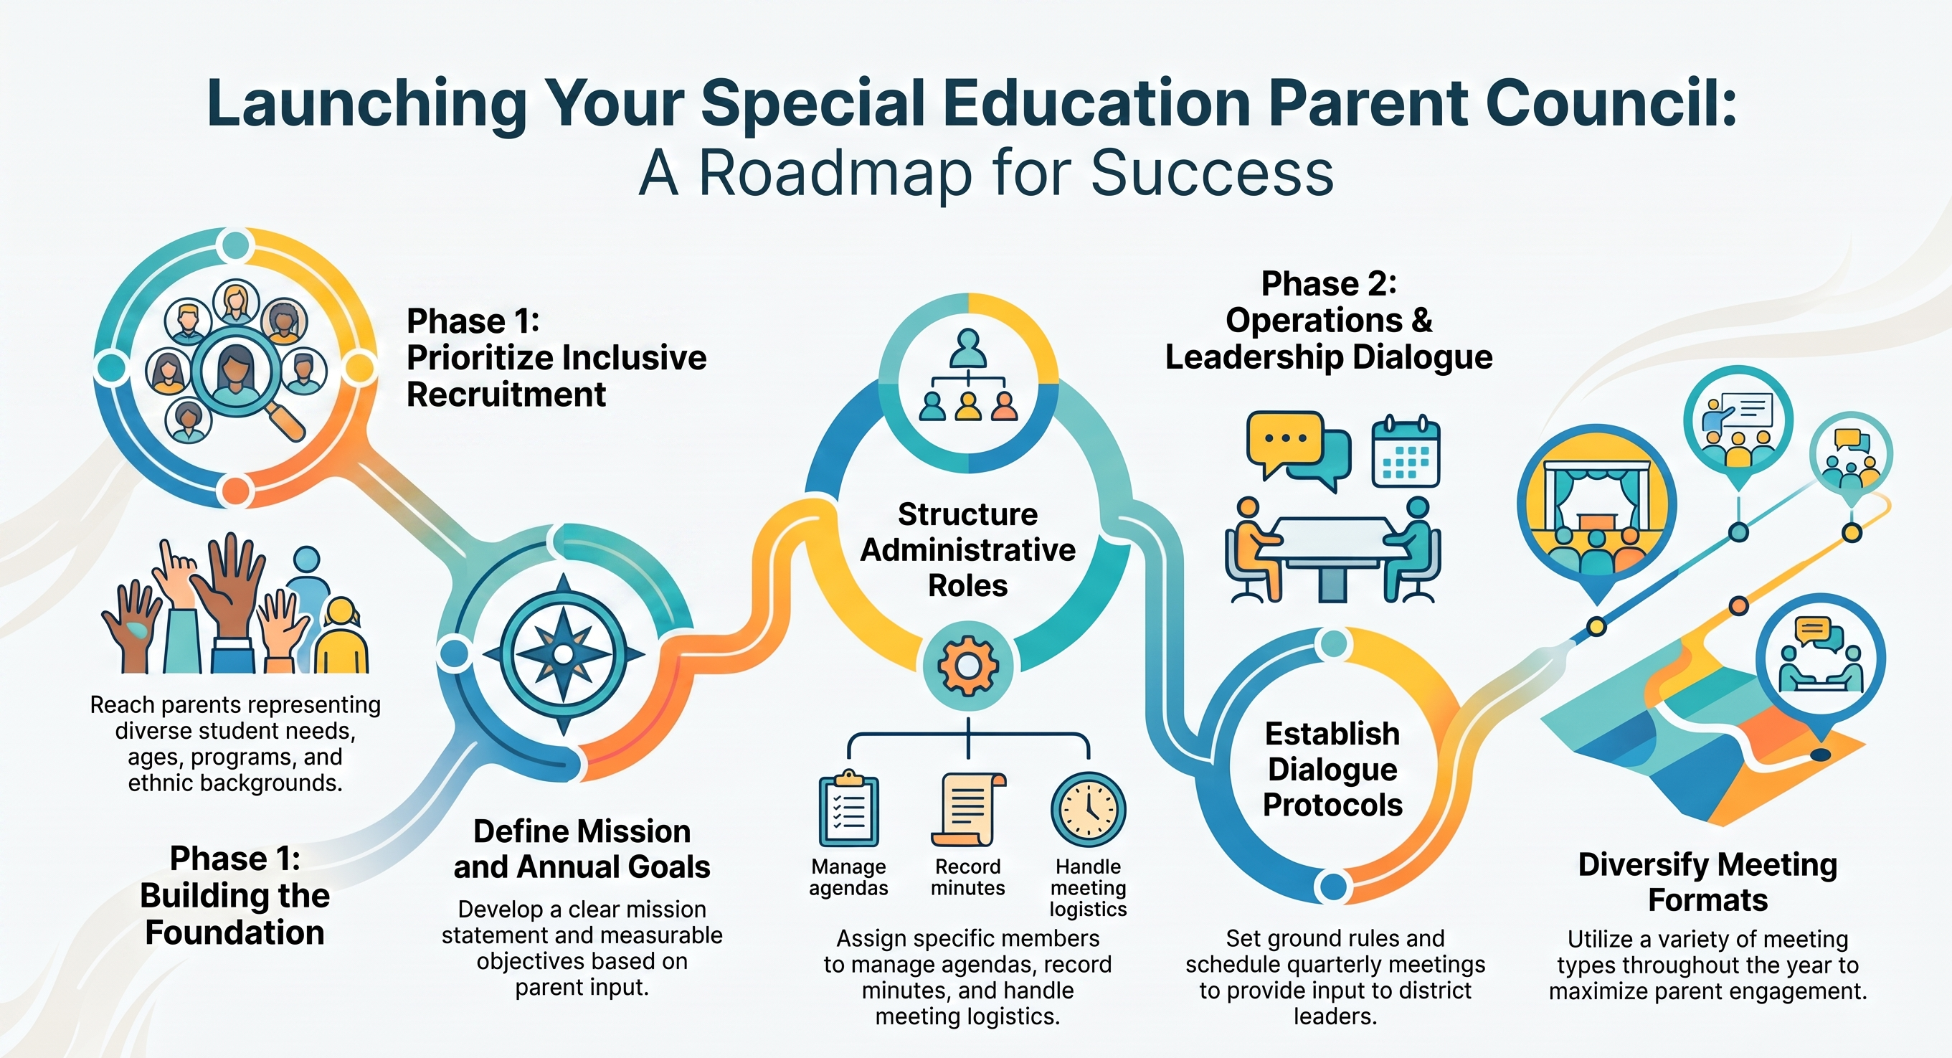

Slide 13
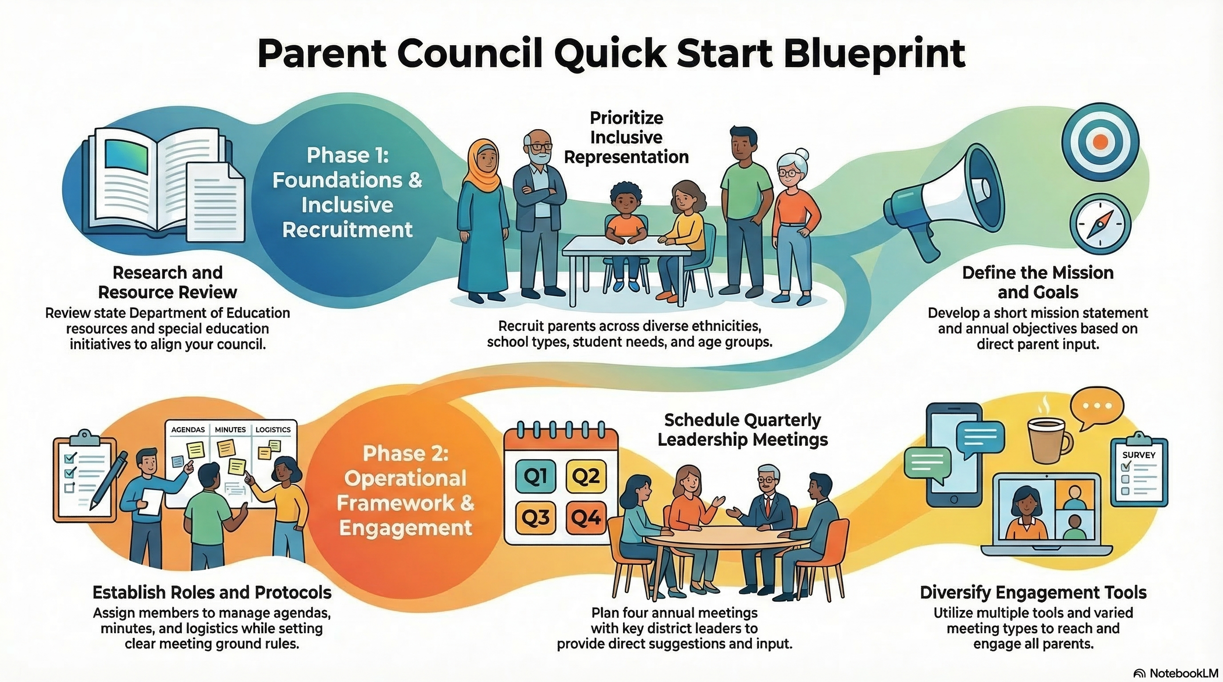

Slide 14
Roles & Responsibilities
ALL Members
Parent Members
Understand the function of the parent council
Develop and maintain knowledge of regulations pertaining to the special education process.
Identify the roles and responsibilities of members
Participate in outreach that extends to the larger community.
Record and distribute meeting minutes
Establish connections with school committees such as PTA/PTO and community resources.
Attend and offer oversight/participation for activities and events.
Explore meetings and events held in other districts.
Seek representation from other schools in the district and connect with other parent leaders.
Distribute information to families via a wide range of channels
Notes:
Things to consider: distributing responsibilities such as taking minutes, preparing agendas, and managing membership and contact information among several individuals to ensure the council's operations are well-supported

Slide 15
Group Dynamics:
Key Assumptions:
Teams must value diverse membership and ideas
Each member has expertise
Teams must have a common purpose
Team members need to trust one another
Trust allows members to share in decision-making and responsibility
Opportunities to build and strengthen school – family partnerships and improve student outcomes

Slide 16
Positive Interdependence
Identify team goals and purpose
Use distributed leadership functions
  Rotate roles, share tasks and resources
  Roles: facilitator, recorder, time-keeper
Develop a common understanding of the group’s scope of work and authority
  e.g., ask: What kind of decision-making power does this group have?
Identify common rewards and opportunities
Interpersonal Skills
Develop group norms indicating desired behaviors/types of communication
  Examples: arrive on time, respect diverse points of view, no judging during creative problem-solving
Develop communication and conflict resolution skills
  All group members need to practice their best communication and collaboration skills
  Learning to deal with conflict is key
Opportunities to build and strengthen school – family partnerships and improve student outcomes

Slide 17

Empowering Parent Councils
Establish Regular Communication: Plan for quarterly meetings with key district leaders. These meetings serve as a dedicated space to provide direct input and suggestions from the parent council.
Define Roles and Responsibilities: Clearly determining the roles and responsibilities of parent council members ensures that leadership knows who to contact for specific issues. This includes identifying members to manage specific tasks like taking minutes, preparing agendas, and managing logistics.
Set Clear Protocols: It is essential to establish meeting protocols and basic ground rules for all collaborative settings and meetings. This helps ensure that interactions remain professional and productive.
Stay Informed on Initiatives: Reviewing information related to statewide special education initiatives and resources (such as those on the Delaware Department of Education’s website) allows the council to engage with district leadership from an informed perspective.
Represent a Diverse Voice: Working to ensure the council reflects the diversity of the district, as well as different schools and student needs, ensures that the collaboration with leadership is inclusive of the entire community's concerns.
Community Partnerships: Working with community partners to present on topics, assist with meeting facilitation and provide other services or resources for council members.
Opportunities to build and strengthen school – family partnerships and improve student outcomes

Slide 18
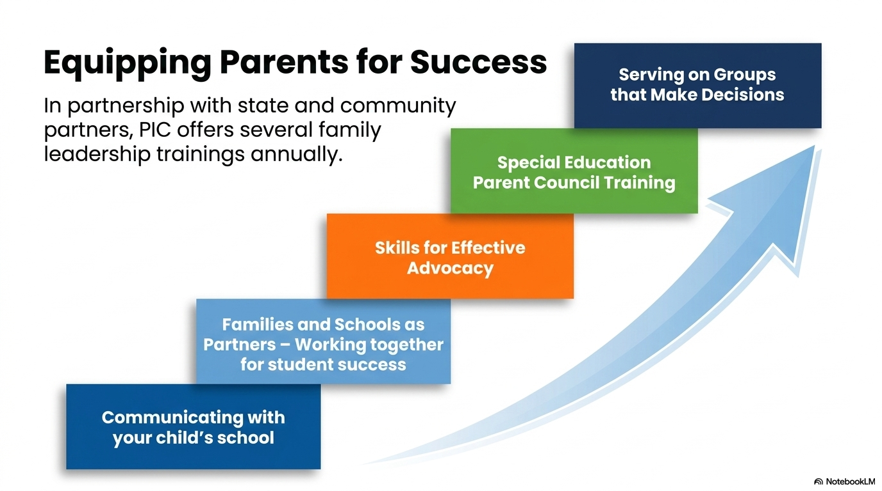

Slide 19
Barriers
Capacity: Staff & Families
Established Vision & Mission of Council
Lack of Participation
Lack of Consistent Engagement
Lack of Trust
Established Norms, Roles & Responsibilities of council members
Established process for recruitment, engagement
Other barriers?
Possible Solutions?
Opportunities to build and strengthen school – family partnerships and improve student outcomes

Slide 20
Building Successful Parent Councils:
What is one key takeaway from today's session or an idea that you believe could strengthen parent councils in your district?
Notes:
Begin thinking about your district’s parent council: What are the successes; challenges? If money and resources were not an issue – how would you improve your parent council to support youth and families as intended?

Slide 21
