Slide 1

New Castle County
Special Education
Parent Council
10/7/2026

Slide 2
NCC Special Education Parent Council
Shared Vision: To empower families, amplify their voices, and form a partnership between home and school to build an inclusive, equitable, and supportive educational community across New Castle County where every child receiving special education services thrives.

Slide 3
NCC Special Education Parent Council Who’s Who?
District | Director | Parent Council Contact
Appoquinimink | Kristine Peters, EdD, NCSP | Patrique O’Gilvie
Brandywine | Natalie Hess, Ed.D. | Natalie Hess, Ed.D.
Christina | Becky Ryan | Patty Knapp
Colonial | Erica Boykin | Beth Murray
New Castle Co Vo-Tech | Sharon Horrocks | Tristan Spates
Red Clay | Sarah Celestin, Ed.D. | Stacey Pellicano

Slide 4
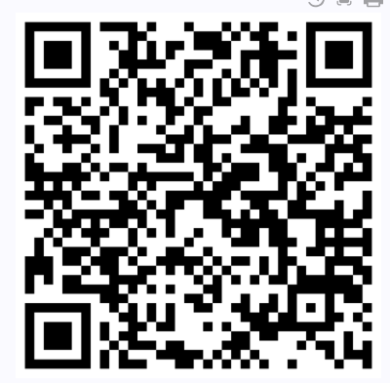
Family Contact Information
Using the survey link in the chat (or QR Code to the right), please share your:
first and last name
school district
school
email & phone (preferred contact info)
future topics of interest
This information will be used by your school district for follow-up. Thank you!
Notes:
Survey Link: https://forms.gle/qHptgB5X6EsiF1JX8

Slide 5

Parent Information Center of DE
Mary Andrews, Executive Director
A Sussex County native and mother, Mary Andrews has spent over two decades advocating for Delaware families. Inspired by her own experience growing up with a disability, she joined the Parent Information Center of Delaware in 2018 and rose to Executive Director in 2026. Today, she leads statewide special education advocacy and serves on both the Governor’s Advisory Council for Exceptional Citizens and the State Rehabilitation Council.
Meedra Surrate, Director of Training & CEO of Education Consulting Plus, LLC
A dedicated parent and special education advocate, Meedra Surratte brings over 20 years of experience advancing educational equity for Delaware's underserved children and families. Holding degrees in Organizational Dynamics and Special Education, she specializes in family engagement, capacity building, and school partnerships. Her extensive advocacy includes serving as Delaware’s aRPy Ambassador, a CASA volunteer, an Educational Surrogate Parent and member of the Governor’s Advisory Council for Exceptional Citizens.

Slide 6

Next Meeting
3rd Wednesday of the Month
6:00 -7:00 via Zoom
11/4 - Navigating the IEP
Presented by Red Clay Consolidated SD

