Slide 1
Hmong International Academy
State of the School Presentation
Monday, October 12, 2026
Accountability,
Innovation, and
Research
Notes:
PLEASE READ BEFORE PRESENTING: All red text in brackets signifies an item that needs to be customized based on your school. Before you present this to parents, please make sure you've customized all red text and that the text color is changed back to black/white (whatever color the rest of the text around it is)

Slide 2


Agenda
Hmong International Academy: WHO WE ARE
Mission and vision
Strengths
Challenges
OUR SCHOOL IMPROVEMENT PLAN
Goals and strategies
Sharing student progress
TITLE I
Overview of Title I
How we’re using our Title I funds
Title I and Family Engagement
Title I Compact
FAMILY ENGAGEMENT PLAN
Review & Approve
Notes:
1 min

Slide 3
Hmong International Academy
Who We Are

Slide 4
Who We Are
Mission
Hmong International Academy (HIA) will promote academic growth and achievement by engaging learners in a relevant and rigorous curriculum. HIA also aims to preserve and share the Hmong culture, while honoring all cultures in preparing ambassadors for the future.
Vision
Hmong International Academy (HIA) will prepare culturally competent students for success in a 21st century environment.
School Stats
HIA currently has 229 students -- 31.0% African American students, 28% Asian students, 21% LatinX students,10% White students, 6.1% Indigenous students and 3.9% students who identify as two or more races.
Hmong International Academy (HIA) is a PreK-5 school located in North Minneapolis. HIA is a diverse community that is also home to a Hmong One-way Dual Language Program. Although HIA has a Hmong program that aims to share language and culture with all students, while honoring all students and families and their cultures, languages, and voices.
Hmong DDL Classes for native speakers, band for 5th graders, and full day Hi-5
HIA is honored to be working with these Community Partners: YWCA BEACONS, Change Inc., Good in the Hood
Notes:
3-5 min

Slide 5
Our Current Reality
Strengths
Community and Relationships (staff to staff, staff to students, staff to families)
Positive School Climate & Culture
Diverse School Community
Staff Collaboration
Inclusion model for students
Academic Interventions
Onsite Mental Health Therapy
Challenges
Student Attendance
Long term and short-term planning
Site Council, creating more opportunities for family input and feedback, etc.
Notes:
3-5 min
Your School’s Current Reality
You can take this directly from your SIP Portal Main Page & Need Analysis
Share strengths about your school’s programs, your progress from the previous year, and what you are looking forward to this school year.

Slide 6
Our School Improvement Plan

Slide 7

What’s a School Improvement Plan?
Our school improvement plan:
Sets the goals that our school community is working to achieve
Identifies the strategies or activities that will help us reach those goals together
Every Minneapolis Public School is required to develop, implement, and monitor a school improvement plan.
Notes:
2 min

Slide 8
Our School Improvement Plan
Academic Goal:
READING: The percentage of all students in grades K-5 at Hmong International Academy who are proficient in reading will increase from 13% to 17% as measured by FAST Overall Literacy.
Strategy to achieve our goal:
Our Evidenced-Based Practice (EBP) is helping students to Build Comprehension.
Notes:
10 min total for all goal/strategy slides
Complete one slide for each goal (you can copy and paste this slide if you have more than three goals)

Slide 9
Our School Improvement Plan
Academic Goal:
MATH: The percentage of all students in grades K-5 at Hmong International Academy who are proficient in math will increase from 22% to 26% as measured by FastBridge Overall Math.
Strategy to achieve our goal:
Our Evidenced-Based Practice (EBP) is Mathematical Discourse.
Notes:
Complete one slide for each goal (you can copy and paste this slide if you have more than three goals)

Slide 10
Our School Improvement Plan
School Climate Goal:
The percentage of all students in grades K-5 at Hmong International Academy who have consistent attendance (>90%) will increase from 38% to 50%.
Strategy to achieve our goal:
Our Evidence-Based Practice (EBP) is Family Engagement for Student Success
Notes:
Complete one slide for each goal (you can copy and paste this slide if you have more than three goals)

Slide 11
How We Measure Student Progress
We want to make sure our students are learning as much as possible, so we use state and district assessments to determine their strengths and areas for growth. The results of these assessments help us figure out how we can better support our students in the classroom.
Assessments help us answer questions such as:
Are we teaching what we think we are teaching?
Are students learning what we intend for them to be learning?
Are all students improving and being appropriately challenged?
Some of the assessments our students will take this year are:
FAST
MCAs
Notes:
5 min

Slide 12

How We’ll Share Student Progress with You
Throughout the year, we’ll share information with you about how your student is doing in the classroom.
We’ll do it in the following ways:
Parent-Teacher conferences on October 13th & 14th and February 11th & 12th.
Quarterly report cards will be backpacked home with students.
Families are welcomed to contact teachers at anytime regarding their student’s progress.
Notes:
3 min

Slide 13
Data Points for Co-interpretation
Notes:
You MAY use this portion of slides IF you want to use this time with families to share data and co-interpret.

Slide 14
Title I

Slide 15
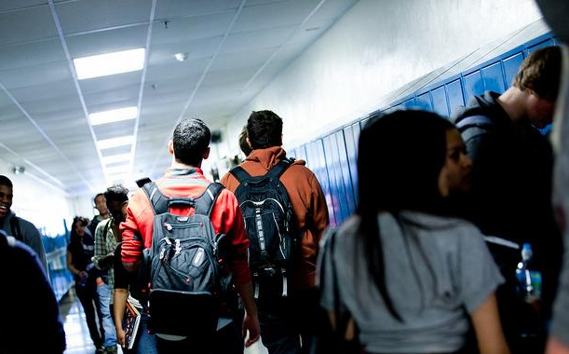
What is Title I?
  Title I is a federal program that provides money to schools and districts to help them ensure all children have an equal opportunity to get a high-quality education and achieve proficiency on our state’s academic standards and assessments.
  Title I supports our School Improvement Plan, and the funding we receive helps us reach our goals.
Notes:
2 min
Mention: Title I programs are available to schools with the greatest concentration of low-income families. If appropriate, you could reference the Application for Educational Benefits form and its role in this.

Slide 16
HIA is a schoolwide Title I program, which means all our students are able to benefit from the services we provide with our Title I funding.
  For the 2026-2027 school year, we received $237,821 in Title I funding which includes $2,720 in Title I Family Involvement.
  We are required to use Title I funding to improve the academic achievement of all students and engage YOU, our families, in that process!
Notes:
2 min

Slide 17
How We’re Using our Title I Funding
Curriculum and Instruction Support
Our Title I money is being used for a Reading Teacher and Student Support Staff.
Family Engagement
HIA plans to use the Title I Family Engagement money for the following events:
  Family Involvement Days
  Hmong New Year
  Black History Month
  Spring Showcase
  Promotions
  Site Council/ Caregiver Meetings
Notes:
5-10 min

Slide 18

As a family member in a Title I School, you have the right to…
Request information from the district about whether your student’s teacher meets State licensing approval for the grade and subject being taught, is teaching with a waiver, and/or has certification for the field being taught
Request information about the qualifications of any paraprofessional providing instruction
Know how your child’s school is rated on its state test scores
Expect regular communication with your school in a language that you can understand
Work with other families and staff to develop a compact between our school and our families
Help plan how money for family involvement should be spent
Work with teachers, other families, and the school principal to develop a family engagement plan
Ask for a meeting with your school principal or your child’s teacher at any time
Notes:
5 min

Slide 19
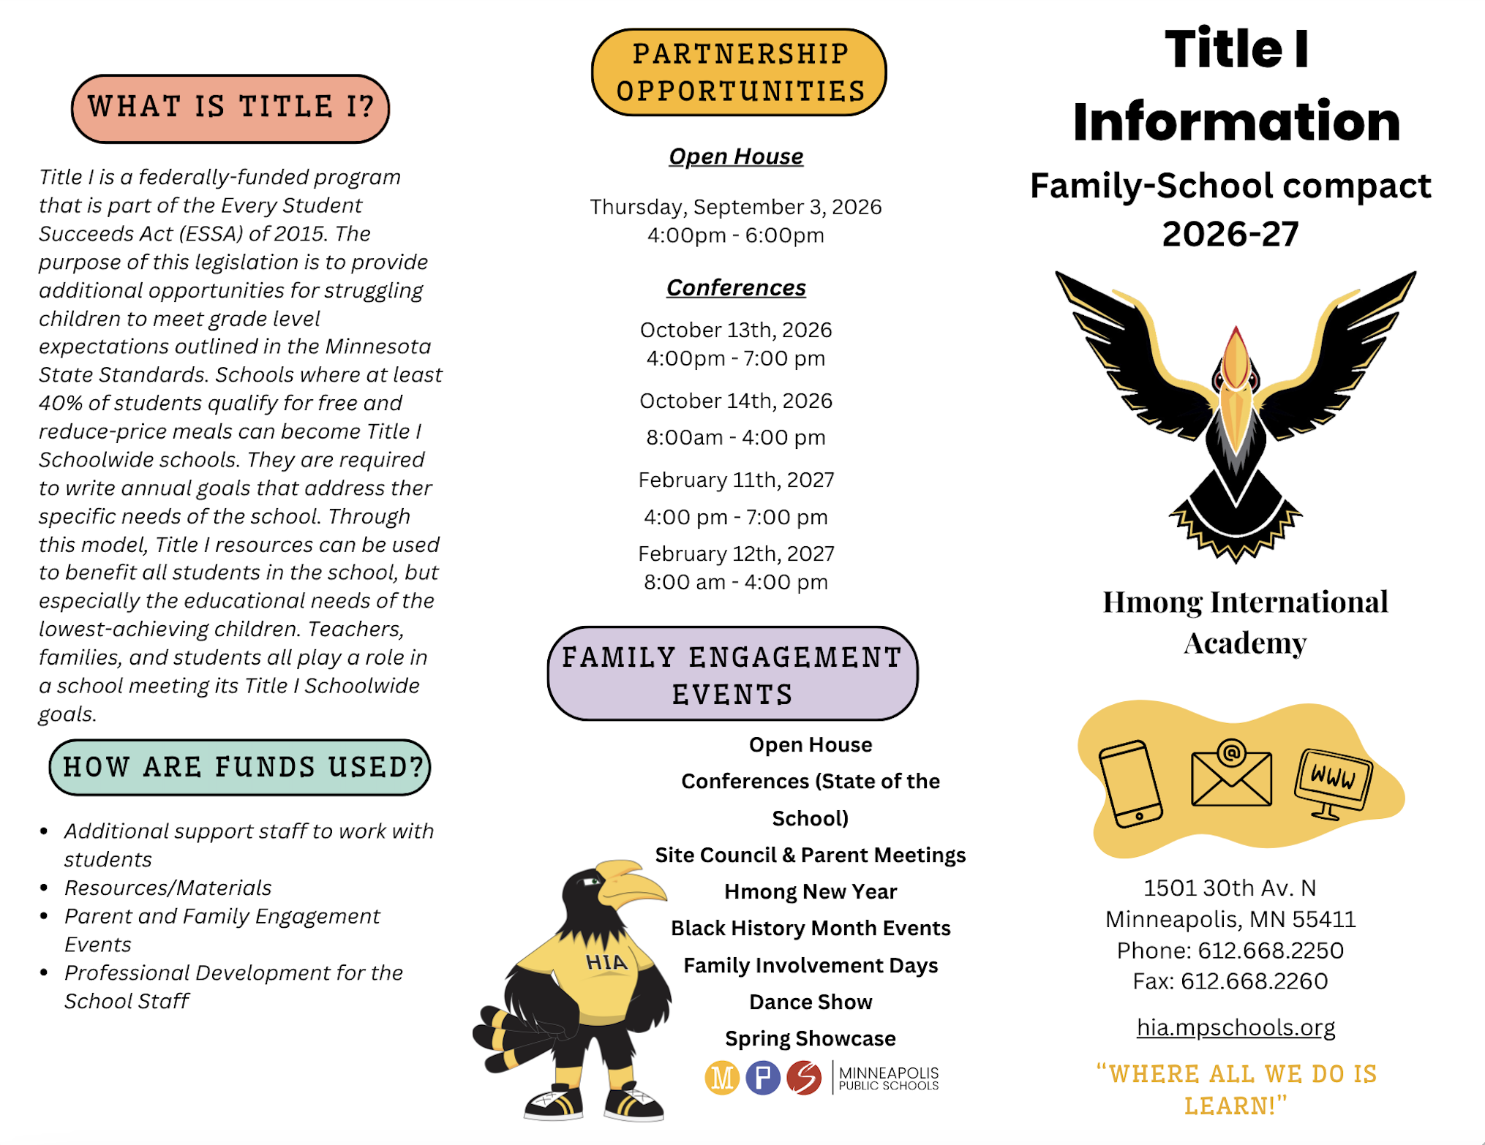
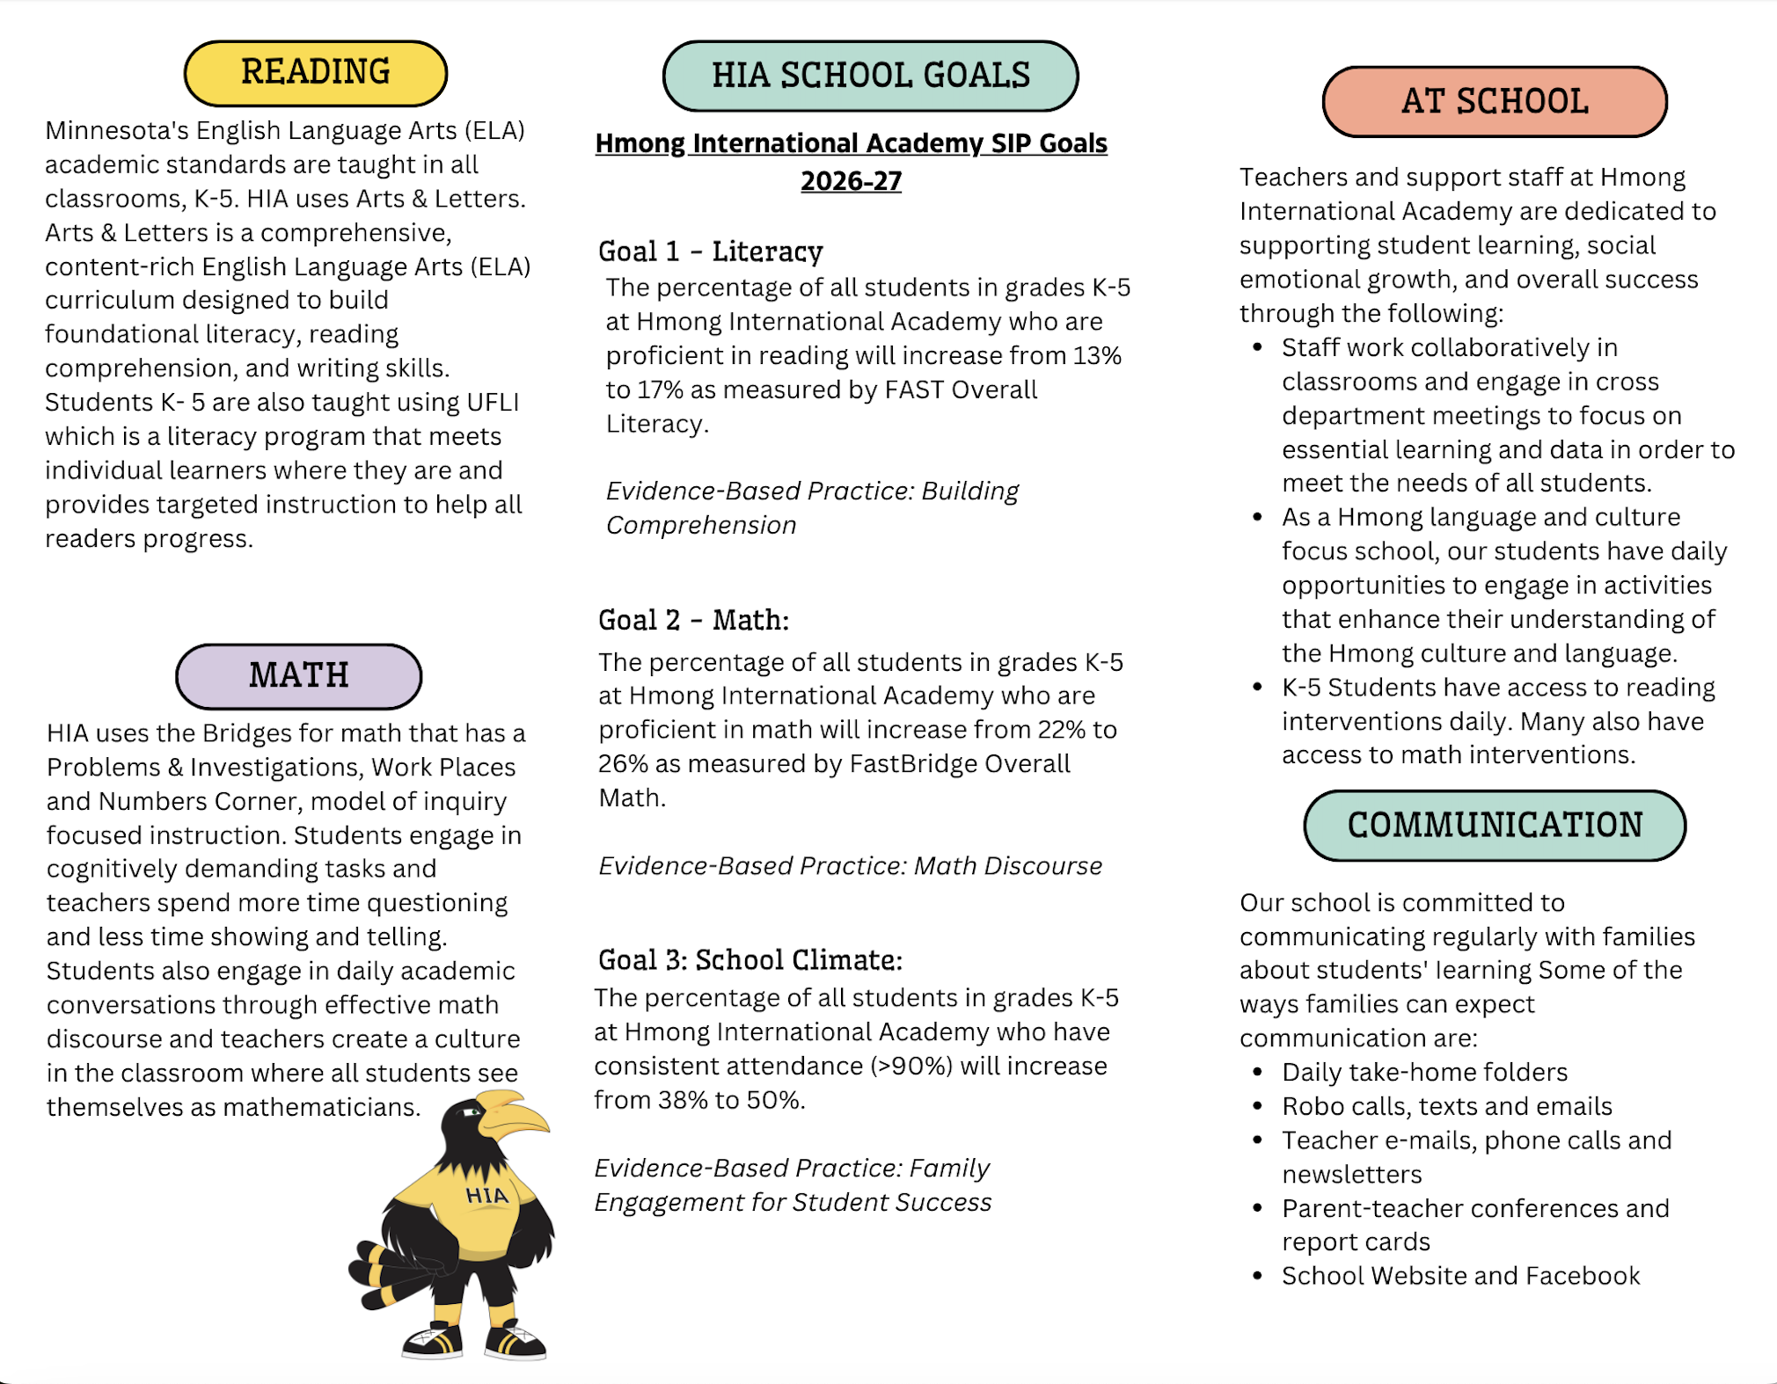
Title I Compact
Notes:
2 min
Mention: Title I programs are available to schools with the greatest concentration of low-income families. If appropriate, you could reference the Application for Educational Benefits form and its role in this.

Slide 20
Our Family Engagement Plan
August
Open House
October
Conferences
Indigenous Peoples Day/Native American Caregiver Event
Latino Heritage Month
November
Food Distribution
UFLI Classroom Visits
December
Winter Wonderland @ MOA
Food Distribution
Hmong New Year Celebration
Notes:
Complete one slide for each goal (you can copy and paste this slide if you have more than three goals)

Slide 21
Our Family Engagement Plan
January
Band Performance
Food Distribution
February
Black History Month Celebration/Events
Food Distribution
Conferences
March
Food Distribution
Notes:
Complete one slide for each goal (you can copy and paste this slide if you have more than three goals)

Slide 22
Our Family Engagement Plan
April
UFLI Classroom Visits
Food Distribution
May
Asian American Pacific Islander Heritage Month Event
Band Performance
Dance Extravaganza
Food Distribution
June
Field Day
Promotions for Hi5, K and 5th Grade
Notes:
Complete one slide for each goal (you can copy and paste this slide if you have more than three goals)

Slide 23
Opportunities for Families to be Involved!
We want your input on our:
School Improvement Plan goals and strategies
Family Engagement Plan
School-Family Compact
You can find all these documents on our school website!
We’d love to see you at the following school events:
Parent-Teacher Conferences on October 13th and 14th and February 11th and 12th!
We would also love to see you at our school events. Some dates are still to be determined but we will do a good job of informing families about the dates as they are decided!
  Family Involvement Days
  Hmong New Year (December 17, 2025)
  Black History Month Celebration (TBD)
  Band Performances (January 16, 2026 & May 15, 2026)
  Spring Showcase (April 30, 2026)
  Dance Show (May 22, 2026)
  Field Day (June 1, 2026)
Participate in Site Council! HIA is currently recruiting caregivers for our Site Council! Please let us know if you would be interested. We plan to meet quarterly.
Visit your child’s classroom or volunteer at our school!
Talk to your child’s teacher about events and issues that may affect your child’s work or behavior.
Notes:
5 min
Say that families can give input on the SIP, FEP, and Compact at site council meetings that will be advertised
Talk about your school’s policy for families visiting and volunteering

Slide 24

School Staff Information
Principal
Gao N. Xiong, 612.668.2250, gao.xiong@mpls.k12.mn.us
Family Liaison
Dana Aguilar Alvarado, 612.668.1919, dana.aguilar@mpls.k12.mn.us
Notes:
1 min
It might be helpful here to describe the role of your family liaison and how they support families.

Slide 25
Thank you for joining me tonight!
I appreciate you!

