Slide 1
Scholarship Search
Engaging the Giant©

Slide 2

AGENDA
Where to start?
External vs. Internal
YOUniquely You
Pick your number of stones (scholarships)
College Endowments = apply early!
Celebrate any progress

Slide 3
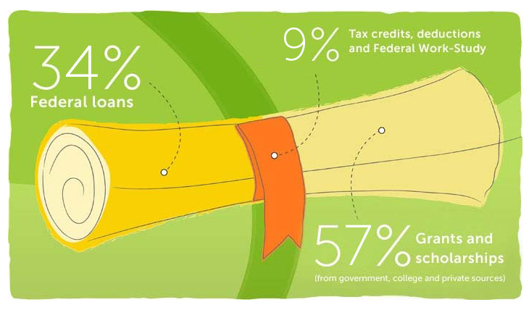
A LOOK at the NUMBERS
*www.bigfuture.collegeboard.org

Slide 4
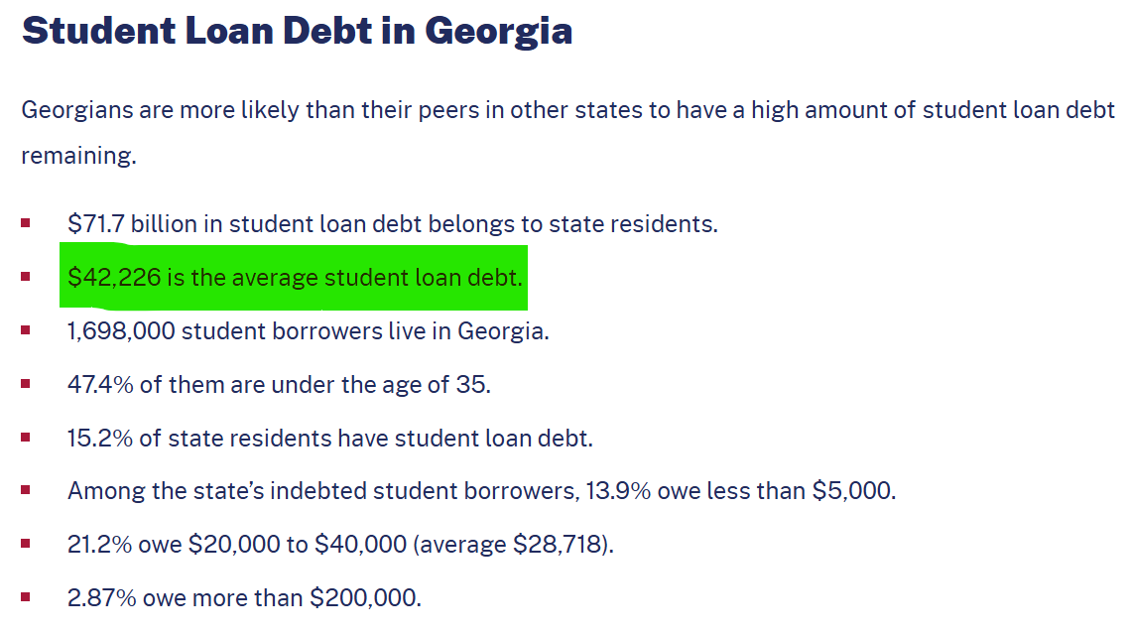
GEORGIA STUDENT DEBT
*https://educationdata.org/student-loan-debt-by-state

Slide 5
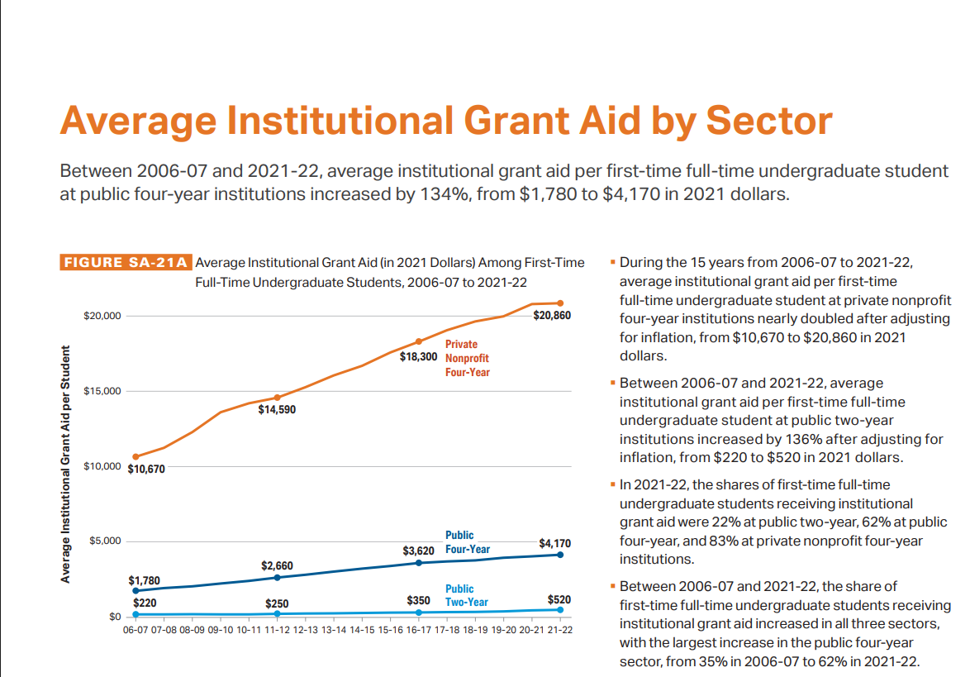
AVERAGE GRANT AID
*College Board, Trends in College Pricing & Student Aid 2024

Slide 6


Quick scholarship distinction
External – Scholarships
earned outside school.
You can take with you.
Examples include:
Georgia EMC
Rotary Club/Optimist
HOPE (in Georgia)
Dixie Youth Baseball
Ty Cobb Foundation
Internal or Institutional – Scholarships earned within the school/tied to school in which you apply.
Only available through
Financial Aid office.
Examples:
Berry Bonner @ Berry Colllege
Southern Leaders @ GA Southern
Highlander @ Presbyterian College

Slide 7

Consider this word picture

Slide 8

Turn the funnel upside down

Slide 9
ETHNICITY
Hispanic Scholarship Fund
Asian & Pacific Islander American Scholarship Fund
NAACP
Jackie Robinson Foundation
Ron Brown Scholarship
National Iranian American Council

Slide 10
TALENTS
Orchestra
Band
Creative Arts
Photography
Performing Arts
Film Making
Athletic abilities can open other internal scholarships

Slide 11
MEMBERSHIPS
Sons/Daughters of the Revolution
Fraternity/Sorority
Professional Associations

Slide 12
AFFLIATIONS
Church
Knights of Columbus
Girls/Boys Scouts
Boys & Girls Clubs of America
Beta Club
National Honor Societies
Youth Sports Organizations

Slide 13

MEDICAL CONDITIONS
Michael Yasick ADHD Scholarship
ADHD
Cancer
Asthma
Any diagnosed illness or
condition
Most have FREE support in
college
Anne Ford Scholarship (Learning Disabilities)

Slide 14

PERSONAL CHARACTERISTICS
Twins Scholarship

Slide 15
CAREER INTERESTS
Engineering
Accounting
Military Service
ROTC programs
Georgia National Guard/Army National Guard
STEM
Public Service Loan Forgiveness (PSLF)
Check out the professional organizations of your potential career. Many associations have scholarships once your Major is declared.

Slide 16
HOBBIES & EXTRACURRICULARS
Youth Soccer
Ham Radio
Youth Baseball – Dixie Youth scholarships
Student place of employment (Chick-fil-a, Kroger, YMCA, etc.
Tuition Reimbursement – you are paid back by Publix, PetsMart, etc.

Slide 17
PARENTAL CONNECTION
Military
“Legacy” scholarship to parent’s Alma Mater
Employment – check with Human Resources

Slide 18


LARGE CORPORATIONS
Consider which brands or products YOU and your family frequently use – a scholarship program might be available!

Slide 19

Casting a wide net
Scholarships to which
most people can apply.

Slide 20
FINANCIAL INSTITUTIONS
These resources are a great “wealth” of information.

Slide 21
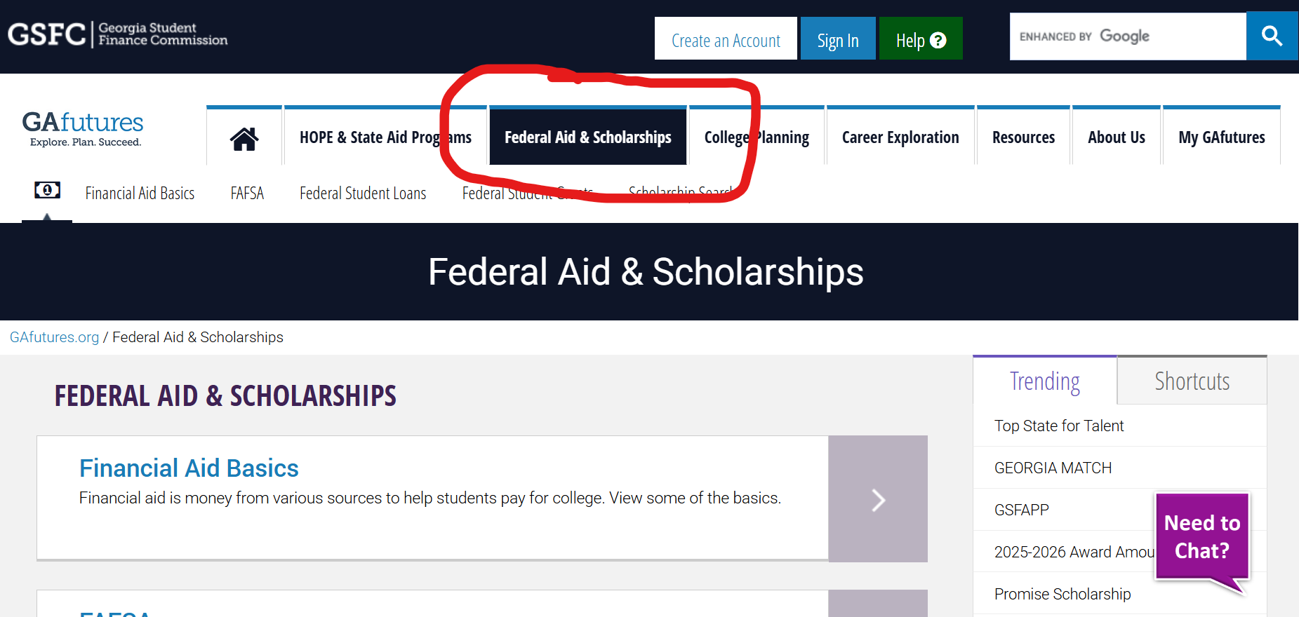
GAfutures.Org

Slide 22
HOPE Scholarship
Regular - Eligible with a 3.0 GPA in CORE subjects
Zell Miller - 3.7 CORE GPA + SAT (1200) or ACT (25)
FOUR Rigor course passed in high school (list on website)
Must apply through GA Futures.org

Slide 23
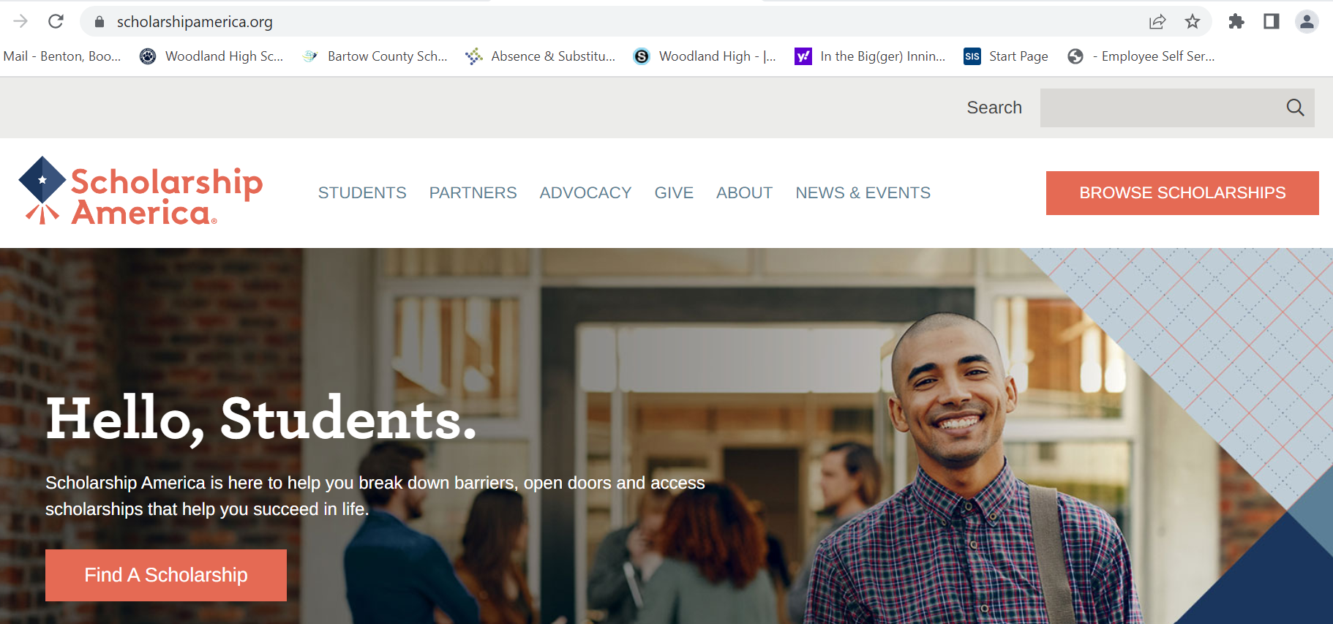
Other great websites

Slide 24

Other great websites

Slide 25
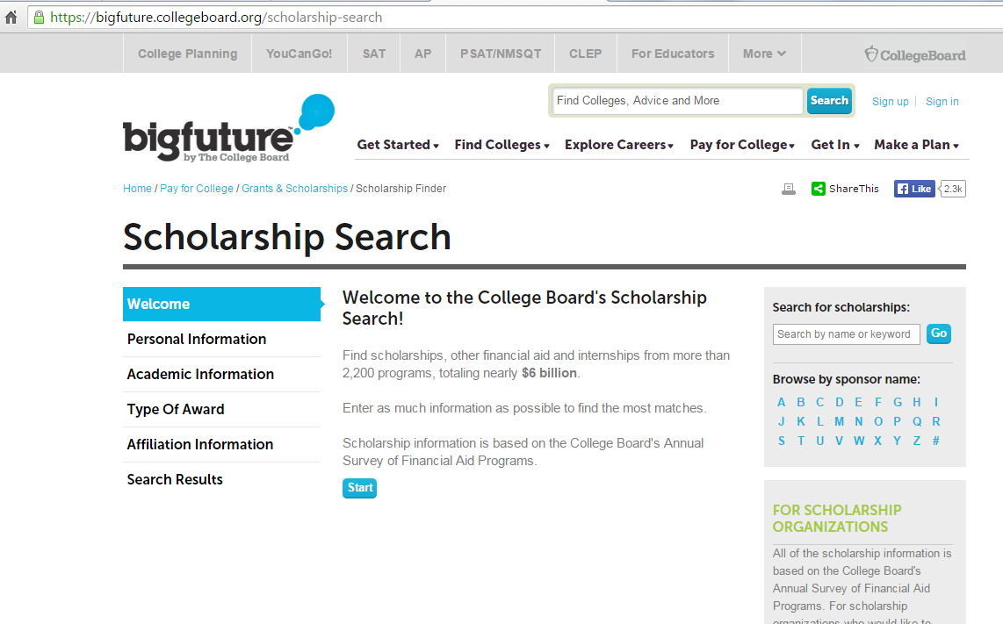
BIG FUTURES via COLLEGE BOARD

Slide 26
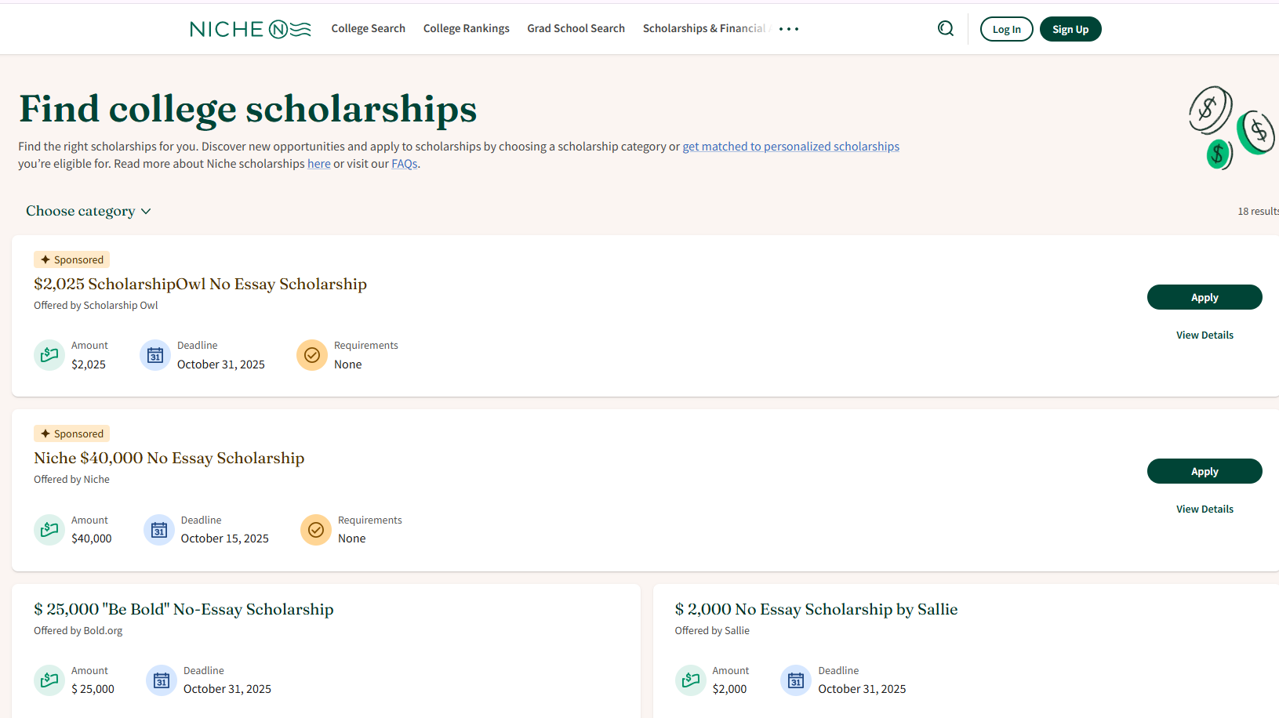
NICHE ( + college searches & rankings)

Slide 27
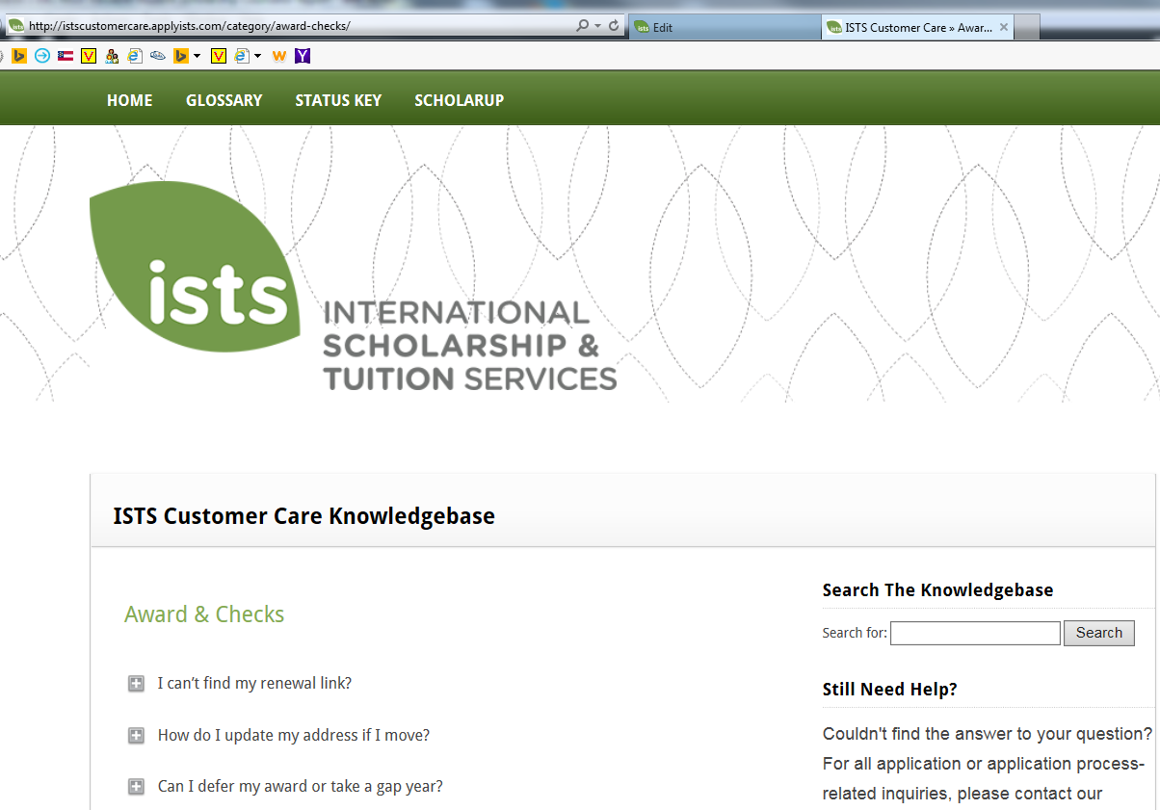

Slide 28

New Concepts
“To date, over 350,000 students, representing 1 out of 2 high schools in America, are earning scholarship dollars from nearly 200 colleges across the country!”

Slide 29
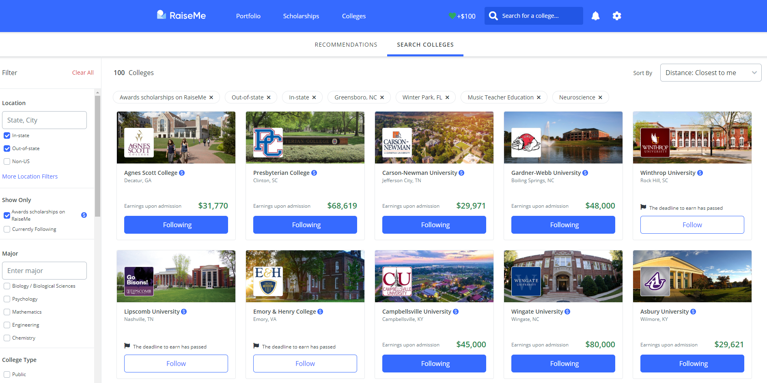
REAL EXAMPLE (Taylor Benton)

Slide 30
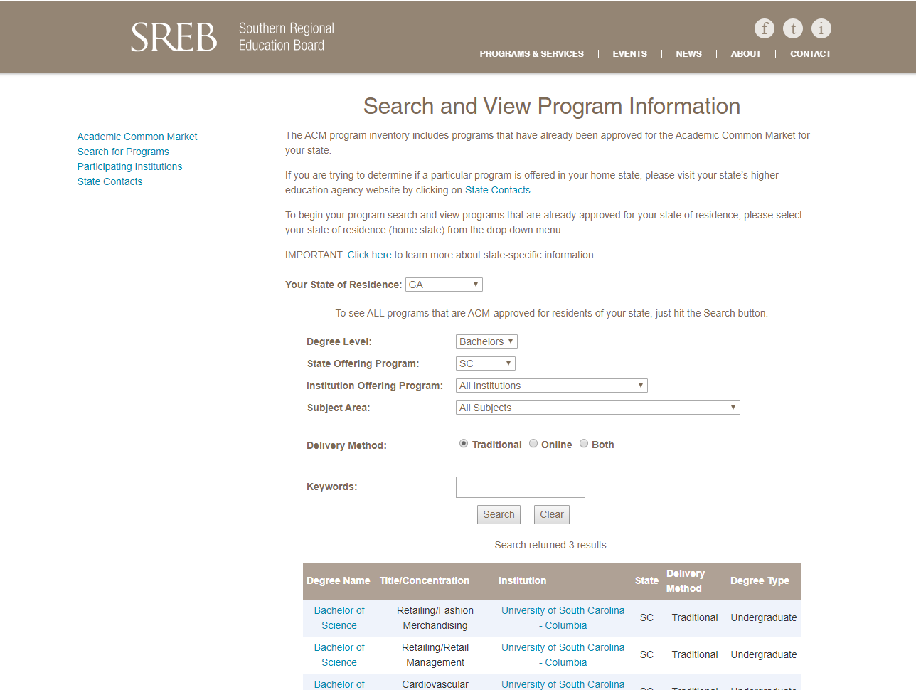
Academic Common Market

Slide 31
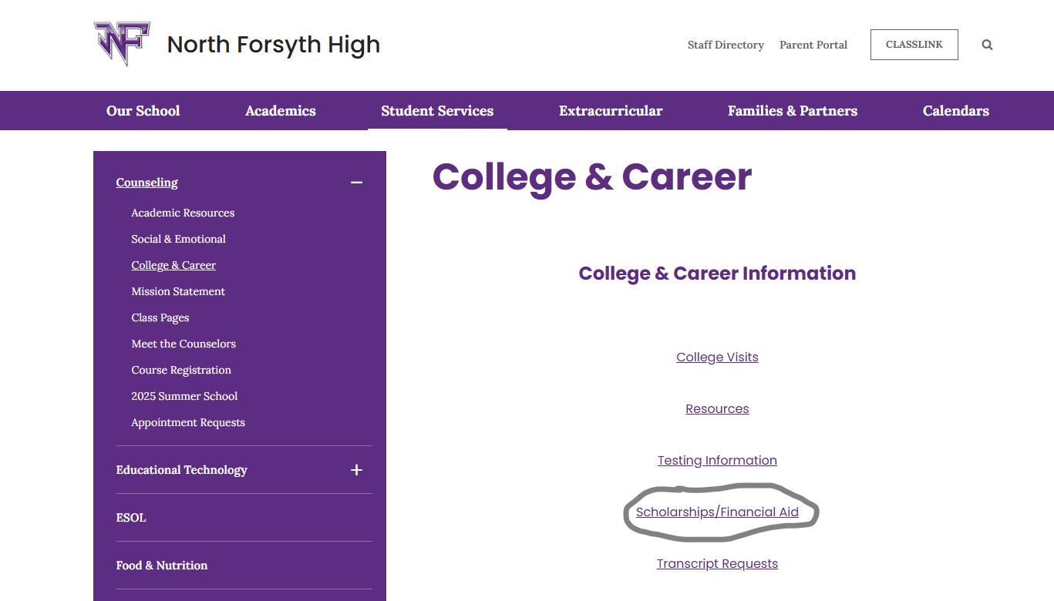
Help from your school
Scholarship List compiled by NoFo Counseling department located on the Counseling website

Slide 32
Another trick . .

Slide 33

Pick the number of stones!
How many scholarships can you reasonably apply for?
Do something everyday!
Multiple scholarships can be added together!
Shoot for your mark
ENGAGE the Giant!

Slide 34
A word about FAFSA
FAFSA is now open!
$$Maximum Federal Pell Grant award
for the 2025-26 award year was $7,395
*www.studentaid.gov
www.gafutures.org

Slide 35

Don’t forget to explore the internal scholarships from your chosen college!
Check the college/university website OR their Financial Aid Office.

Slide 36

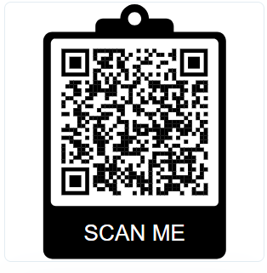
Please give us your feedback!

Slide 37


One of my favorites . . .

Slide 38

QUESTIONS?

Slide 39

Raffle Time!

