Slide 1
Financial Aid at a Private Institution
What You Need to Know

Slide 2

Learning the Basics
What is a private institution?
  An independent institution of higher education that is funded primarily through student tuition, private donations, and endowments rather than by state or federal governments.
What does this mean for students?
  We accept state and federal grants and loans, while also providing in-house scholarships for 100% of our students.
  Often, more financial aid is available for individual students at a private institution.

Slide 3
How Does Financial Aid Work?
- Cost of Attendance
- Financial Aid
- Net Price
MIND THE GAP!

Slide 4
How Does Financial Aid Work?
When students apply to YHC, they are awarded a Merit Award based on their high school GPA.
Students who file a FAFSA or GSFAPP will also be awarded state and federal funding based on their eligibility.
Some grants and scholarships can only be used for tuition costs, while others can be used for room, board, and fees.
The balance that remains after all financial aid is applied is the net cost for the semester/year.

Slide 5
Grants VS Loans
Grants
Loans
Financial Aid Awards that do NOT need to be repaid.
Pell Grant, HOPE, ZELL, GTEG, Institutional Aid.
Financial Aid Awards the MUST be repaid.
Federal Loans, Parent PLUS Loans, Private Loans

Slide 6
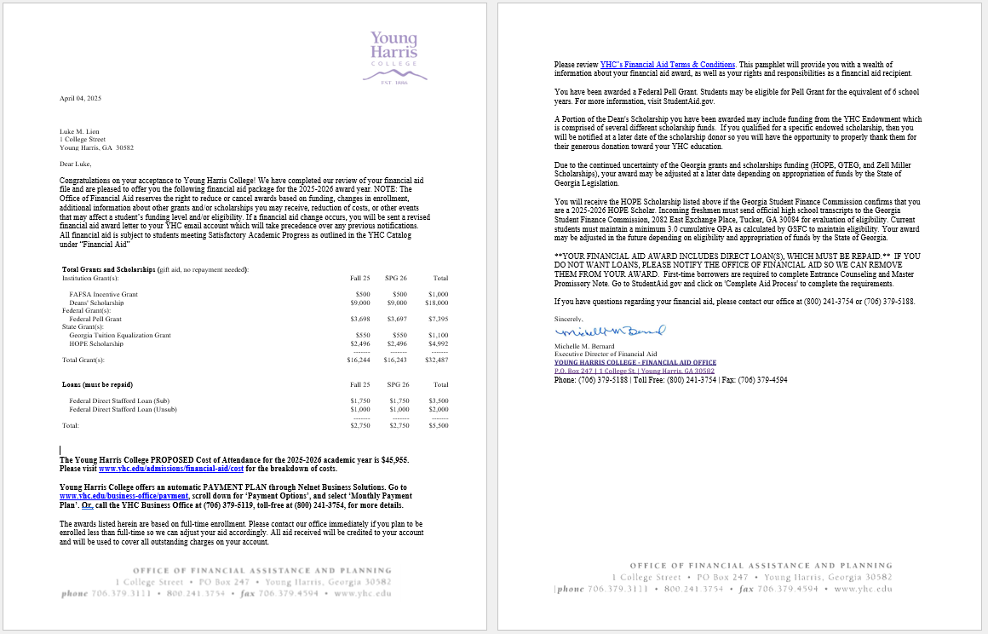
Financial Aid Awards
Handout page 2 & 3

Slide 7
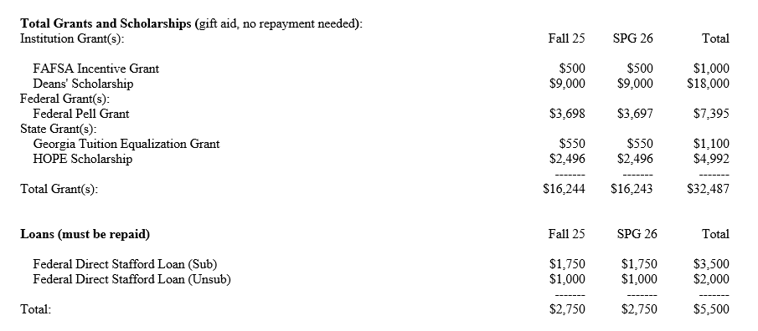
Financial Aid Awards
SAMPLE

Slide 8
Financial Aid Awards
SAMPLE

Slide 9
Financial Aid Awards
SAMPLE

Slide 10
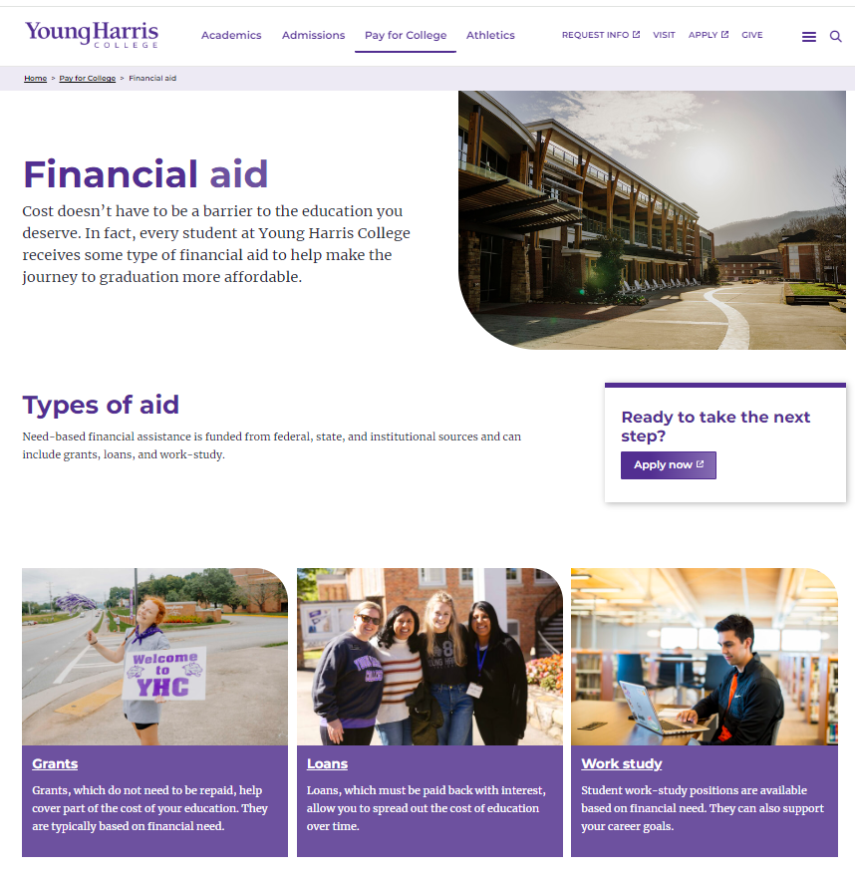
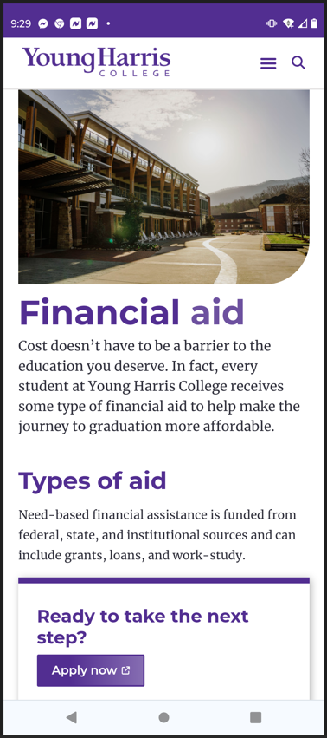
Financial Aid Resources

Slide 11
Financial Aid Resources/Options
https://www.yhc.edu/pay-for-college/financial-aid/
Federal aid (StudentAid.gov) — Pell Grants, FSEOG, Direct Loans, Direct PLUS Loans (parents), FWS
Georgia state aid (GAfutures.org) — HOPE, Zell Miller, TEG,
United Methodist Church (GBHEM.org, UMHEF.org)
Handout page 4 & 5

Slide 12
Financial Aid Resources/Options
Other scholarships (fastweb.org, scholarships.com)
Private loans (bank, credit union, online provider)
YHC student employment — Apply for jobs online by signing in to the Handshake platform with YHC email address and password, then search for “YHC Student Employment”.
Federal Work-Study/FWS — eligibility based on need as established by FAFSA, requires I-9
Handout page 4 & 5

