Slide 1
HOPE Program
Helping Outstanding Pupils Educationally Program
Notes:
Now let’s discuss financial aid opportunities offered by the state of Georgia.
Click

Slide 2

Helping Outstanding Pupils Educationally Program
HOPE Scholarship
Zell Miller Scholarship
HOPE
Grant
HOPE Career Grant
Zell Miller Grant
Notes:
Think of the HOPE Program as a family and the Georgia Lottery as the parent. The HOPE Program provides money to assist students with their educational costs.
click

Slide 3


Hope program
Basic Eligibility Requirements
Student must:
Be a U.S. citizen or eligible non-citizen
Be a Georgia resident (as determined by College/University)
Be working towards the first undergraduate program
Be in Good academic standing (SAP)
Attend a HOPE eligible institution
Attention Male Students: Georgia state law requires Selective Service registration for males (18+ years old) to qualify for state aid programs.
Notes:
These are the general eligibility requirements for the HOPE Program.
Selective Service: Georgia state law requires Selective Service registration for males that are 18 years older and older to qualify for Georgia’s state aid programs, which includes HOPE and Zell Miller Scholarships and Grants.

Slide 4
Hope program
HOPE vs Zell Miller Scholarship
Program Eligibility
HOPE
Scholarship
Zell Miller Scholarship
High School HOPE GPA
Rigor credits
SAT Score
ACT Score
3.0
4
N/A
N/A
3.7
4
1200
25
Notes:
When comparing the HOPE and the Zell Miller Scholarship, here is a chart that summarizes the eligibility for each.
Pause
Click

Slide 5
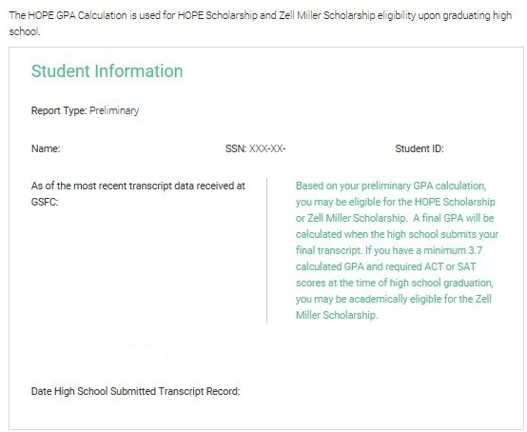
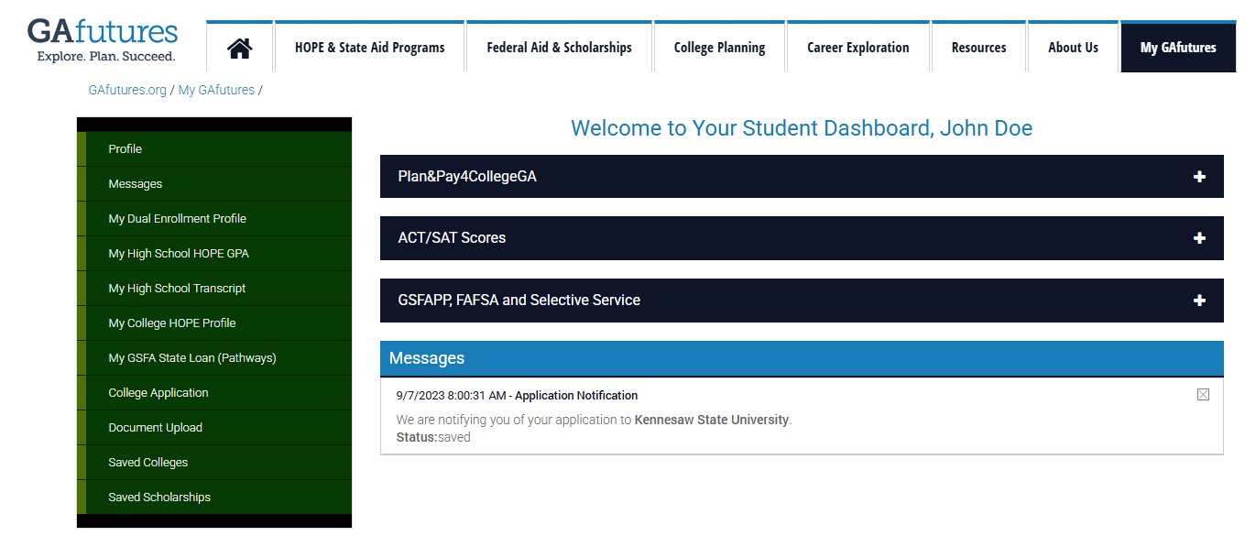
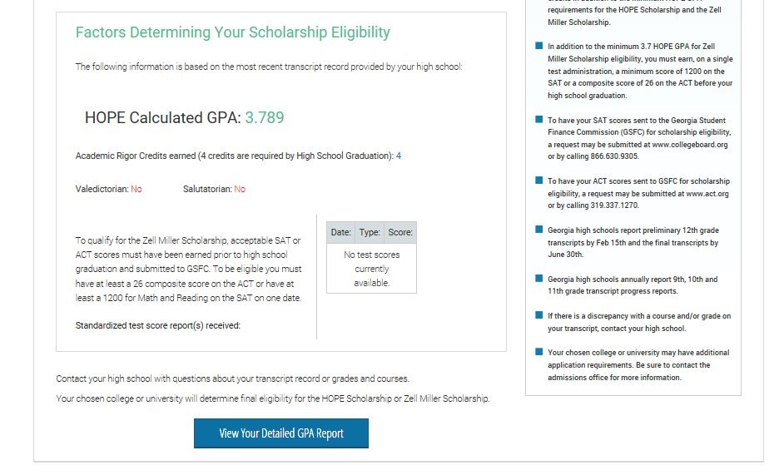
HOPE program
My High School HOPE GPA
Log in to GAfutures.org account to access your HOPE GPA.
Notes:
You can begin checking your HOPE GPA through your My GAfutures account starting in the 10th grade.* Don’t have an account? It’s quick and easy to create one!
Your My High School HOPE GPA page includes your student information, your HOPE GPA as calculated by GSFC based on transcripts sent by your Georgia high school, rigor credits, ACT/SAT scores if you’ve taken them, and more information about the eligibility requirements of the HOPE and Zell Miller Scholarships.

Slide 6
HOPE program
College HOPE GPA
Maintain 3.0 college HOPE GPA at all checkpoints:
End of every Spring semester/quarter
30/45 attempted semester/quarter hours
60/90 attempted semester/quarter hours
90/135 attempted semester/quarter hours
Three-term Checkpoint, if enrolled less than full-time for first three semesters/quarters
Notes:
Students are able to track their college HOPE GPA on GAfutures by logging in, clicking on “My GAfutures” and then on their “College Profile”.
Click

Slide 7
HOPE program
ZELL MILLER SCHOLARSHIP
Maintain 3.3 college HOPE GPA at all checkpoints:
End of every Spring semester/quarter
30/45 attempted semester/quarter hours
60/90 attempted semester/quarter hours
90/135 attempted semester/quarter hours
Three-term Checkpoint, if enrolled less than full-time for first three semesters/quarters
Notes:
Maintaining the Zell Miller Scholarship is similar to the HOPE. The checkpoints are the same, but a student must have at least a 3.3 college HOPE GPA.
Click

Slide 8
HOPE PROGRAM
HOPE & Zell Miller Scholarships
Students can lose eligibility due to one of the following:
College HOPE GPA requirement not met (3.0 for HOPE; 3.3 for Zell Miller)
Reaching maximum attempted hours: 127 attempted semester credit hours or 190 quarter credit hours
Failing to use funds within ten years of high school graduation or equivalent
  Exception for active duty military service in United States Armed Forces
Received bachelor’s or first professional degree
Notes:
Now that we’ve discussed eligibility for the scholarships, these are ways that students will be ineligible for the scholarships.
Students will lose their eligibility when they:
-don’t meet the college HOPE GPA requirement at the checkpoints
- attempt 127 credit hours
-don’t use the scholarship within ten years after graduating from high school
OR
-earn a bachelors degree.
Click

Slide 9
Hope program
HOPE PROGRAM GrantS
HOPE Program
HOPE
Scholarship
Zell Miller
Scholarship
HOPE
Grant
Zell Miller
Grant
HOPE Career Grant
Notes:
Now let’s talk about the grants.
Click

Slide 10

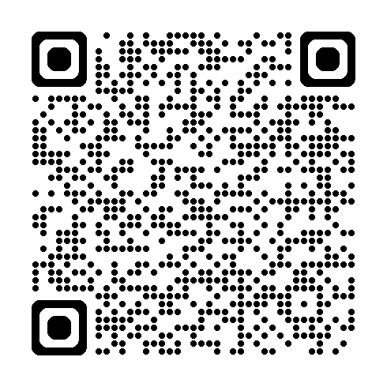
HOPE PROGRAM
HOPE Grant Basic Eligibility
Meet general eligibility requirements for HOPE Program
Enrolled in certificate or diploma program
High school diploma/GED not required
No high school GPA and/or test scores required
Types of Programs
Diploma programs are designed to be completed in about 1 to 2 years.
Certificate programs are designed to be completed in a shorter time frame compared to degree programs. They can range from a few months to a year.
Notes:
Like all components of the HOPE Program, the general eligibility requirements will also apply to the grants.
Yet, what’s different is that grants can only be used for students who are enrolled in a certificate or diploma program.
Also, there is no high school HOPE GPA requirement, and test scores are not considered.
Click

Slide 11

HOPE PROGRAM
HOPE Grant Basic Eligibility
Maintain 2.0 college cumulative GPA at the following checkpoints:
  30 paid semester credit hours
  60 paid semester credit hours
Maximum 63 paid semester hours
Notes:
To maintain the HOPE Grant, a student must have a 2.0 college HOPE GPA at the checkpoints.
Click

Slide 12

HOPE PROGRAM
Zell miller Grant Basic Eligibility
Minimum 3.5 college cumulative GPA
Checkpoints at the end of each term enrolled
Must be a HOPE Grant recipient initially
Paid retroactively for first term
Maximum 63 paid hours
Notes:
A student may qualify for the Zell Miller Grant at the end of each semester that the student earns a 3.5 GPA.
To keep the Zell Miller Grant, she must maintain at least a 3.5 college HOPE GPA every term.
Just a side note, a student would not be eligible for the Zell Miller Grant until one semester is completed because they would have to have at least a 3.5 college HOPE GPA.
Click

Slide 13
HOPE PROGRAM
HOPE CAREER Grant Basic Eligibility
The HOPE Career Grant is available to HOPE Grant-qualified students who enroll in select majors specifically aligned with industries in which there are more jobs available in Georgia than there are skilled workers to fill them.
Automotive
Aviation
Certified Engineer Technician
Commercial Truck Driving
Computer Programming
Computer Technology
Construction
Diesel Equipment Technology
Early Childhood Care & Education
Electrical Line Worker
Health Sciences
Industrial Maintenance Technology
Law Enforcement and Criminal Justice
Logistics
Movie Production and Set Design
Practical Nursing
Precision Manufacturing
Welding and Joining Technology
Notes:
The HOPE Career Grant has become a great financial resource for many students.
Students receiving the HOPE Grant or the Zell Miller Grant may also be eligible for additional financial assistance from this program.
This program was created to boost enrollment in high-demand certificate and diploma programs such as Commercial Trucking, Early Childhood Care/Education and Practical Nursing.
There are 17 in-demand career fields with more than 300 approved certificate and diploma programs eligible for the HOPE Career Grant.
Five new fields were added in FY 2018: Construction, Aviation, Electrical Line Work, Logistics and Automotive Technology.
The award is a fixed amount depending on the program and number of hours the student is enrolled.
You can find a list of approved programs and award amounts at GAfutures.org
This program is not available for dual enrollment students.

Slide 14
Hope program
HOPE vs Zell Miller Scholarship
HOPE Scholarship
Zell Miller Scholarship
Public Institutions (full-time)
Private Institutions (full-time)
100% of previous year’s standard tuition rate
$2,985 per semester (fall, spring, summer) $2,034 per quarter (fall, winter, spring, summer)
100% of current year’s standard tuition rate
$2,985 per semester (fall, spring, summer) $2,034 per quarter (fall, winter, spring, summer)
HOPE Scholarship
Zell Miller Scholarship
Public Institutions (full-time)
100% of previous year’s standard tuition rate
100% of current year’s standard tuition rate
Notes:
When comparing the HOPE and the Zell Miller Scholarship, here is a chart that summarizes the eligibility for each.
Pause
Click

Slide 15
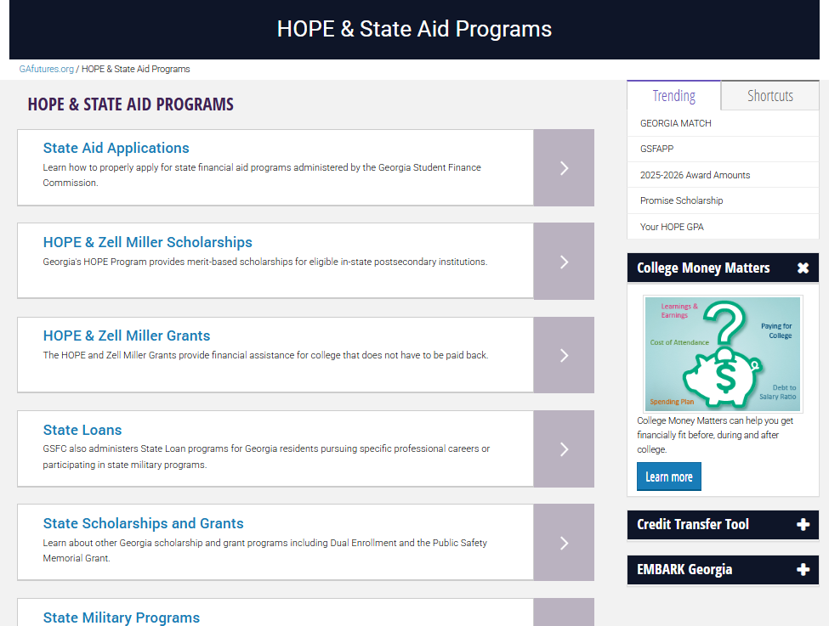
Georgia student finance commission
Apply for state programs
Notes:
Applying for state programs is very easy. Go to the Gafutures homepage and select the HOPE & State Aid Programs tab, then select the State Aid Applications link.

Slide 16
Notes:
GEORGIA MATCH is a simple way for you to know where you are eligible for admission (to be admitted to college), based on your high school calculated HOPE grade point average (GPA) through 11th grade. We want to make it easy for you to see where you could attend college in Georgia based on your current academic record and to apply to institutions you are most interested in attending!

Slide 17
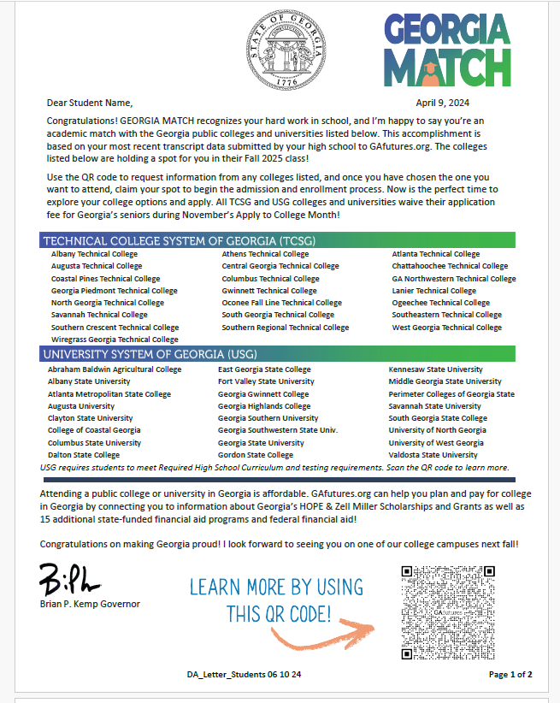
Georgia Match
Georgia Match letter
High school students will receive a letter from Governor Brian Kemp in the Fall of their senior year.
The letter will list all USG and TCSG institutions for which the student meets preliminary academic eligibility for admission (based on their calculated HOPE GPA GSFC has on record at the time of the letter).
Notes:
Georgia Student Finance Commission sends a letter to every* Georgia high school senior. *Every student with a high school transcript on file, with a valid address and calculated HOPE GPA from 11th grade.

Slide 18
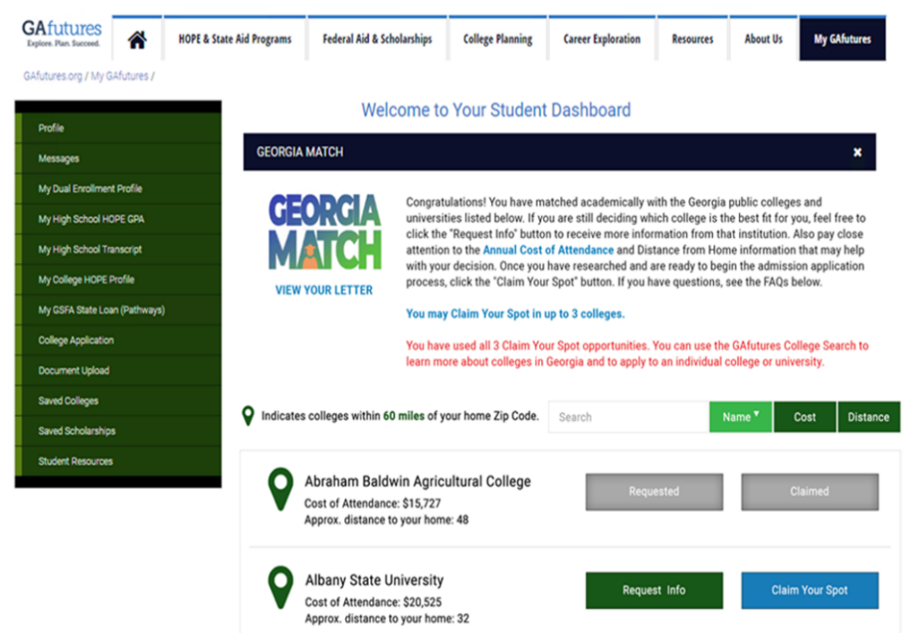
Georgia match
Georgia match dashboard
GEORGIA MATCH Dashboard will be available immediately when letters are mailed.
Student signs in or creates a student GAfutures account to access the dashboard.
Notes:
Students can view a copy of their official letter by clicking "View Your Letter"
Closest institutions are indicated
Students can search by institution name and sort by cost and distance

Slide 19

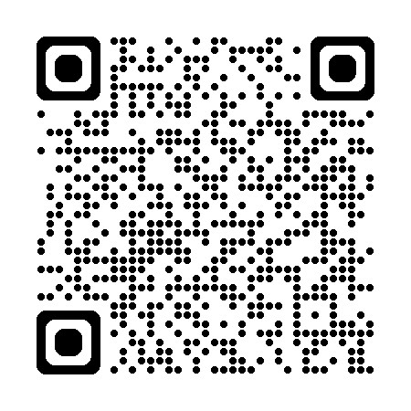
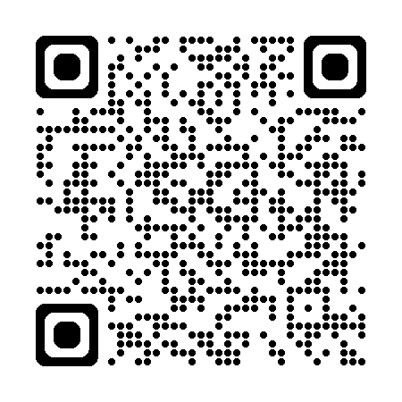
College Search Tool
Search for colleges and universities in Georgia and across the country, using attributes such as public/private, size of school, or programs offered.
Georgia’s FREE online resource to help students plan, apply, and find affordable ways to pay for college.
College MONEY MATTERS
Financial literacy education so you are better equipped to make smart financial choices in relation to planning, applying, and paying for college.
Notes:
This is Georgia’s primary resource to help students plan, apply, and find affordable ways to pay for their post-secondary education.

Slide 20







resources
CONTACT US
outreach@gsfc.org
aroberts@gsfc.org
(800) 505-4732
(404) 707-1550
Notes:
You can also call our 800 number or email our Client Services with any questions you may have.

