Slide 1

Scholarships
Where to find them and application tips
Martha Zender- Sehome High School

Slide 2


Slide 3

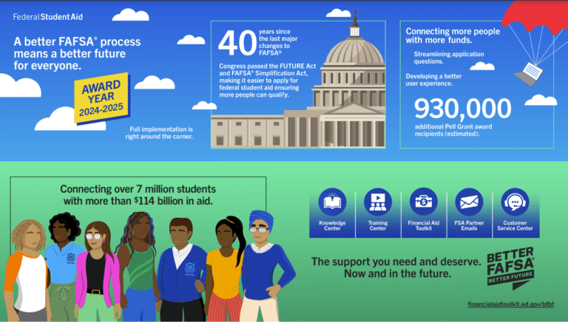
Talk to your parents.
Are they willing to share their information for the FAFSA?
Are they willing to apply for a Parent Plus Loan?
Can they help you fund your college education?
This Photo by Unknown Author is licensed under CC BY-ND
This Photo by Unknown Author is licensed under CC BY-NC-ND

Slide 4



Slide 5

Additional Dates:
Thursday, November 19th
Options High School
6:00-8:00pm
Wednesday, January 13th
Squalicum High School
6:00-8:00pm

Slide 6
Know where you are going and what it will cost! *
Bellingham Technical College Whatcom Community College | $ 4,431 $ 5,450
Eastern Washington University | $ 8,037
Western Washington University | $ 8,808
The Evergreen State College | $ 8,643
Central Washington University | $ 9,417
UW Seattle | $13,406
Washington State University | $14,358
Gonzaga University Saint Martin’s University | $58,390 $48,264
Seattle University Seattle Pacific University | $59,400 $45,648 * Tuition only, doesn’t include fees or room and board…for one year.
www.collegetuitioncompare.com

Slide 7
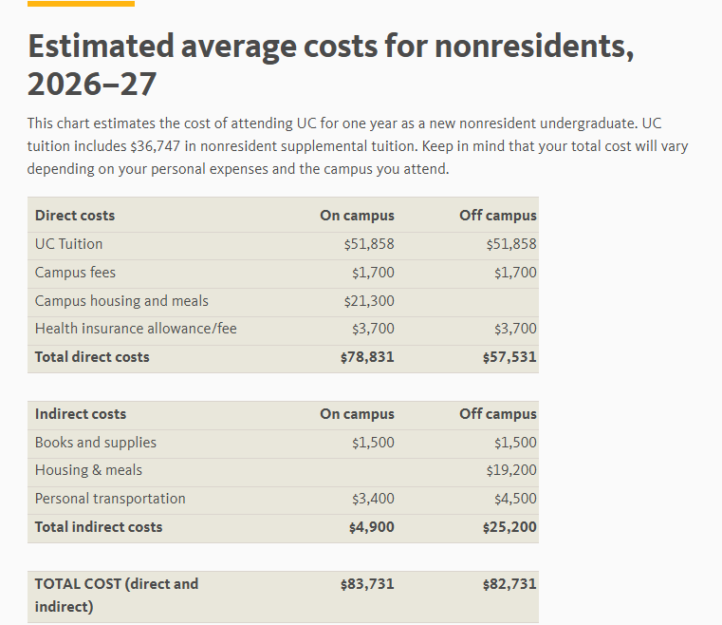
Out of state-UC

Slide 8
Costs to consider
Tuition & Fees
Room and board
School supplies/equipment (laptop, books/codes)
Room needs: refrigerator, bedding, storage
Travel expenses- Tickets for airfare? Snow tires?
Extra food and personal hygiene
Extracurricular spending money- Greek life, clubs
Emergency unexpected items

Slide 9

How will you pay for college?
Scholarships- “free money”
Loans
Work Study- part of financial aid- best employers!
Savings/college account
Parents’ income*
Your income- summer jobs
*Have you discussed with your parents how much they will be able to help you with your college expenses?

Slide 10

Where do I find the
Scholarships through the college you apply to.
Merit and Academic Scholarships- athletic too!
Outside scholarships- check your high school bulletin! We will be taking a look at that!
Your parents’ place of employment …or yours.
Scholarship Search Engines- WashBoard, Scholarship of America
Summer job- great for the extra expenses!
Working a job on campus

Slide 11



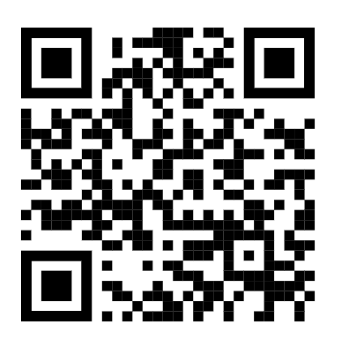
Bacc- STEM, healthcare and trades
Up to $22,500! Must attend WA state
Career and Tech- $1,500 per quarter!
https://waopportunityscholarship.org/
Opens Jan 14
Deadline Feb 26th
Apply for the fall quarter in April

Slide 12
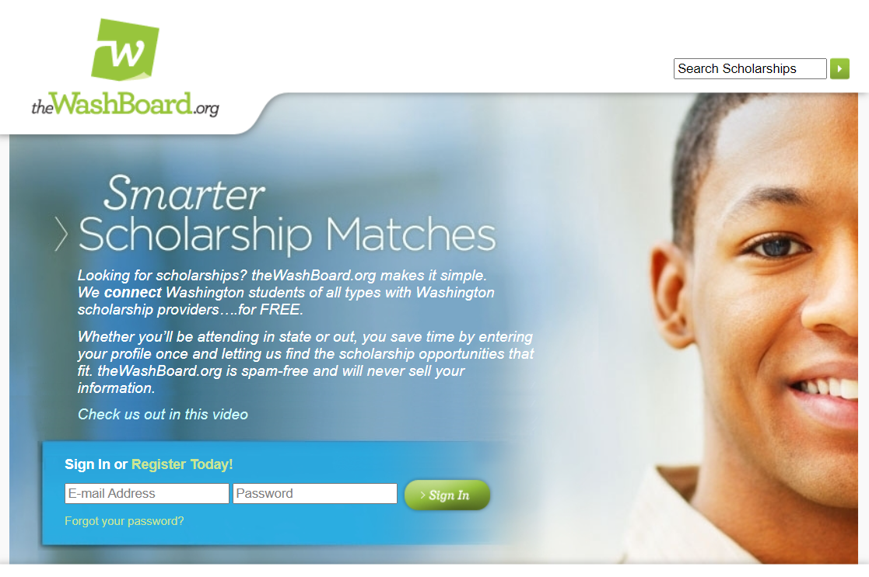
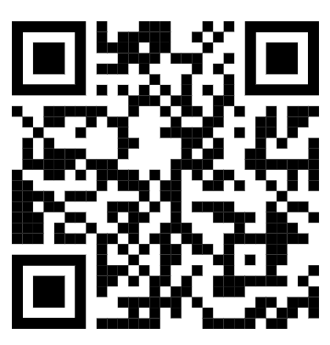
Can be more financial need based. Complete profile, update every quarter. Informational videos by college students on financial aid and scholarships.

Slide 13
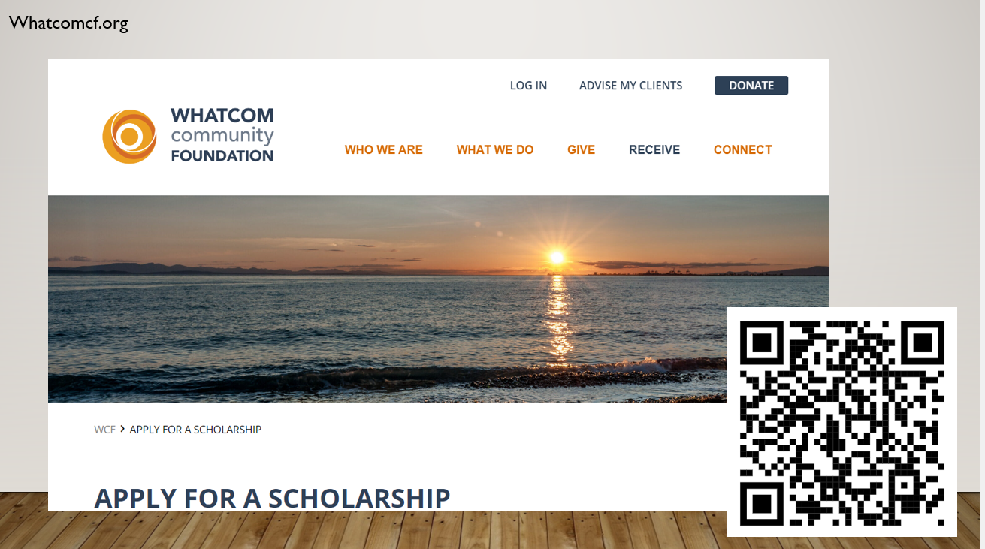

Slide 14

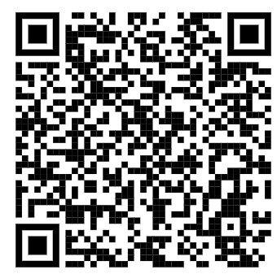

Slide 15
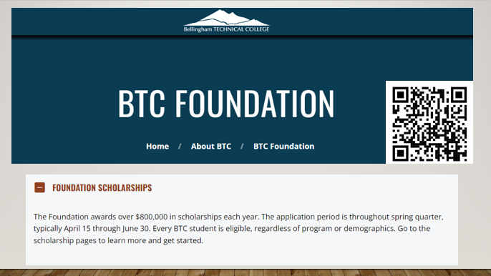

Slide 16
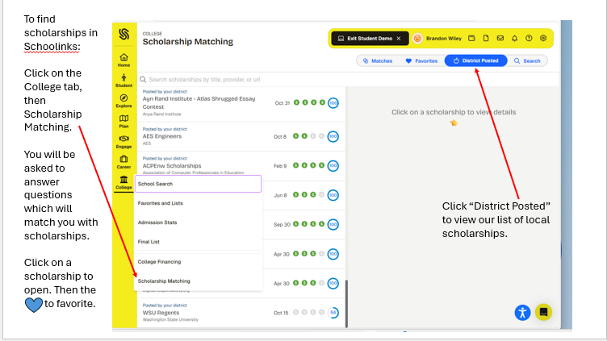

Slide 17

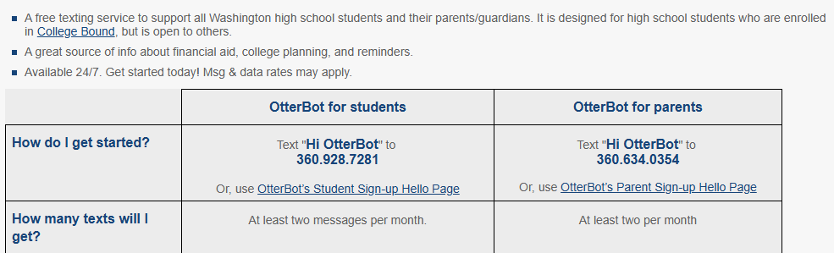
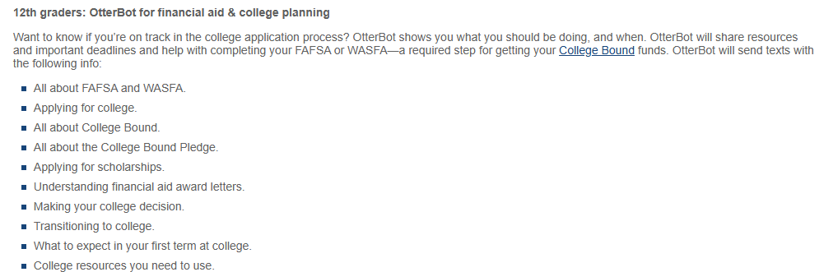

Slide 18
Create a Spreadsheet
Deadline | Scholarship | Website | Requirements- additional info | Amount | Won/ renewable | Thank-you

Slide 19

The Letter of Rec
How many letters do you need for each scholarship?
Complete the Brag sheet in Schoolinks and send it to the adult you are requesting a letter from.
What sources are they requesting them from?
Give your recommender at least 3 weeks- know your deadlines!
Let them know what the criteria is.
Create an autobiographical sketch to share with your letter writers
Conveys your unique qualities
Helps letter writers know who you are
Remember to say

Slide 20

Set up a professional email account
Never invest more money than the cost of a stamp
Answer the optional questions- this should result in twice as many scholarship matches.
NEVER share your SSC#, bank or credit card numbers, mother’s maiden name
Clear up FaceBook, Instagram, blogs…
Know when the scholarship will be paid out and how
Will they pay the college directly?
When will the payment be made? Typically after the first quarter or semester
More Helpful Tips

Slide 21

Time to get to work!
Set up a time each week to check scholarship resources and websites… it will pay off!
“The more you put yourself out there the greater your chance of success.”
Confessions of a Scholarship Winner

