Slide 1
School board meeting
September 29, 2026

Slide 2
Superintendent’s report
SUPT. DR. KIM HIEL
Notes:
Good evening Chair Prince, Vice Chair Brooks, school board members and stakeholders:
This evening, I would like to provide an update on our CTE or Career and Technical Education programs. Our three comprehensive high schools now offer courses across all nine new CTE strands. Osseo Senior High’s new automotive space is already buzzing with students district-wide, Maple Grove is gearing up for Trimester 2 metal manufacturing in its new lab, and Park Center will soon be starting classes in its new Family Consumer Science classrooms.
Park Center’s Advanced Marketing class has officially launched its school store. It is the first high school to open its doors with the launch of The Cove, where Pirates can now find school gear and plenty of Pirate pride. It is part of Osseo Area Schools’ growing Career and Technical Education (CTE) Business programming and gives students a chance to experience what it takes to run a real business. Students can apply skills in marketing, accounting, inventory, customer service, merchandising and market research while serving their own school community. By the end of the year, Osseo Senior and Maple Grove's stores will be open for business as well. After a year of planning, all high schools students are now transported to the CTE class they are interested in.
We appreciate all of the work that district staff including the CTE Director Dr. Tanya Drake has done to make these programs successful.

Slide 3
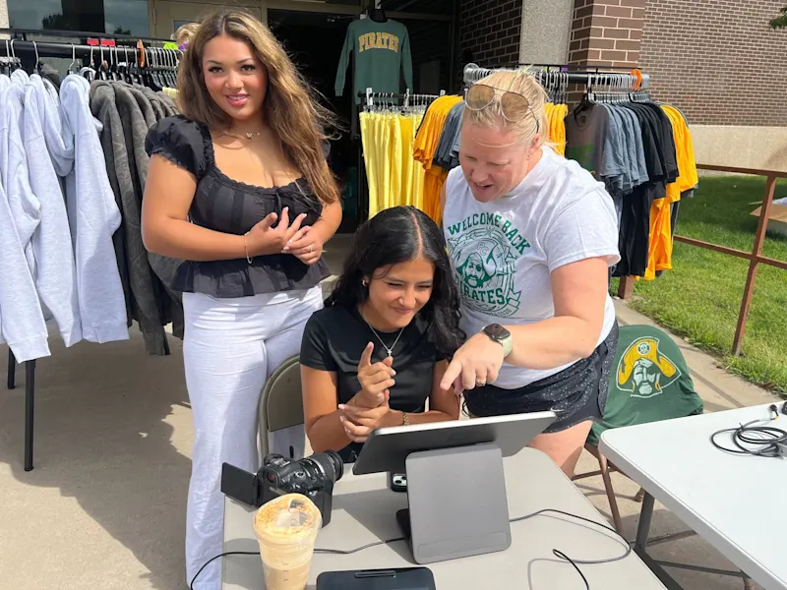
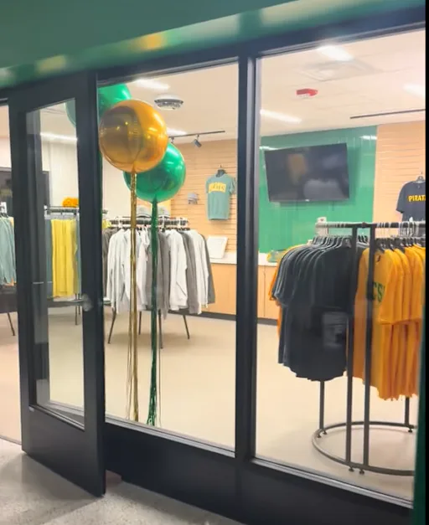

Slide 4
Points of Pride
SUPT. DR. KIM HIEL AND CABINET MEMBERS
Notes:
KIM
A regular part of the superintendent’s report is to share Points of Pride in our district.
By sharing our Points of Pride, we are taking time to recognize and celebrate, the scholars, staff and community members who are contributing to the accomplishment of our mission.
I have members of our District Cabinet here to assist in sharing some examples from the last month.

Slide 5

Notes:
In the area of ACHIEVING DREAMS
Dr. Hiel and staff across the district were excited to welcome students back on Sept. 8 for the first day of school. Students and staff are ready for another great year of learning!

Slide 6
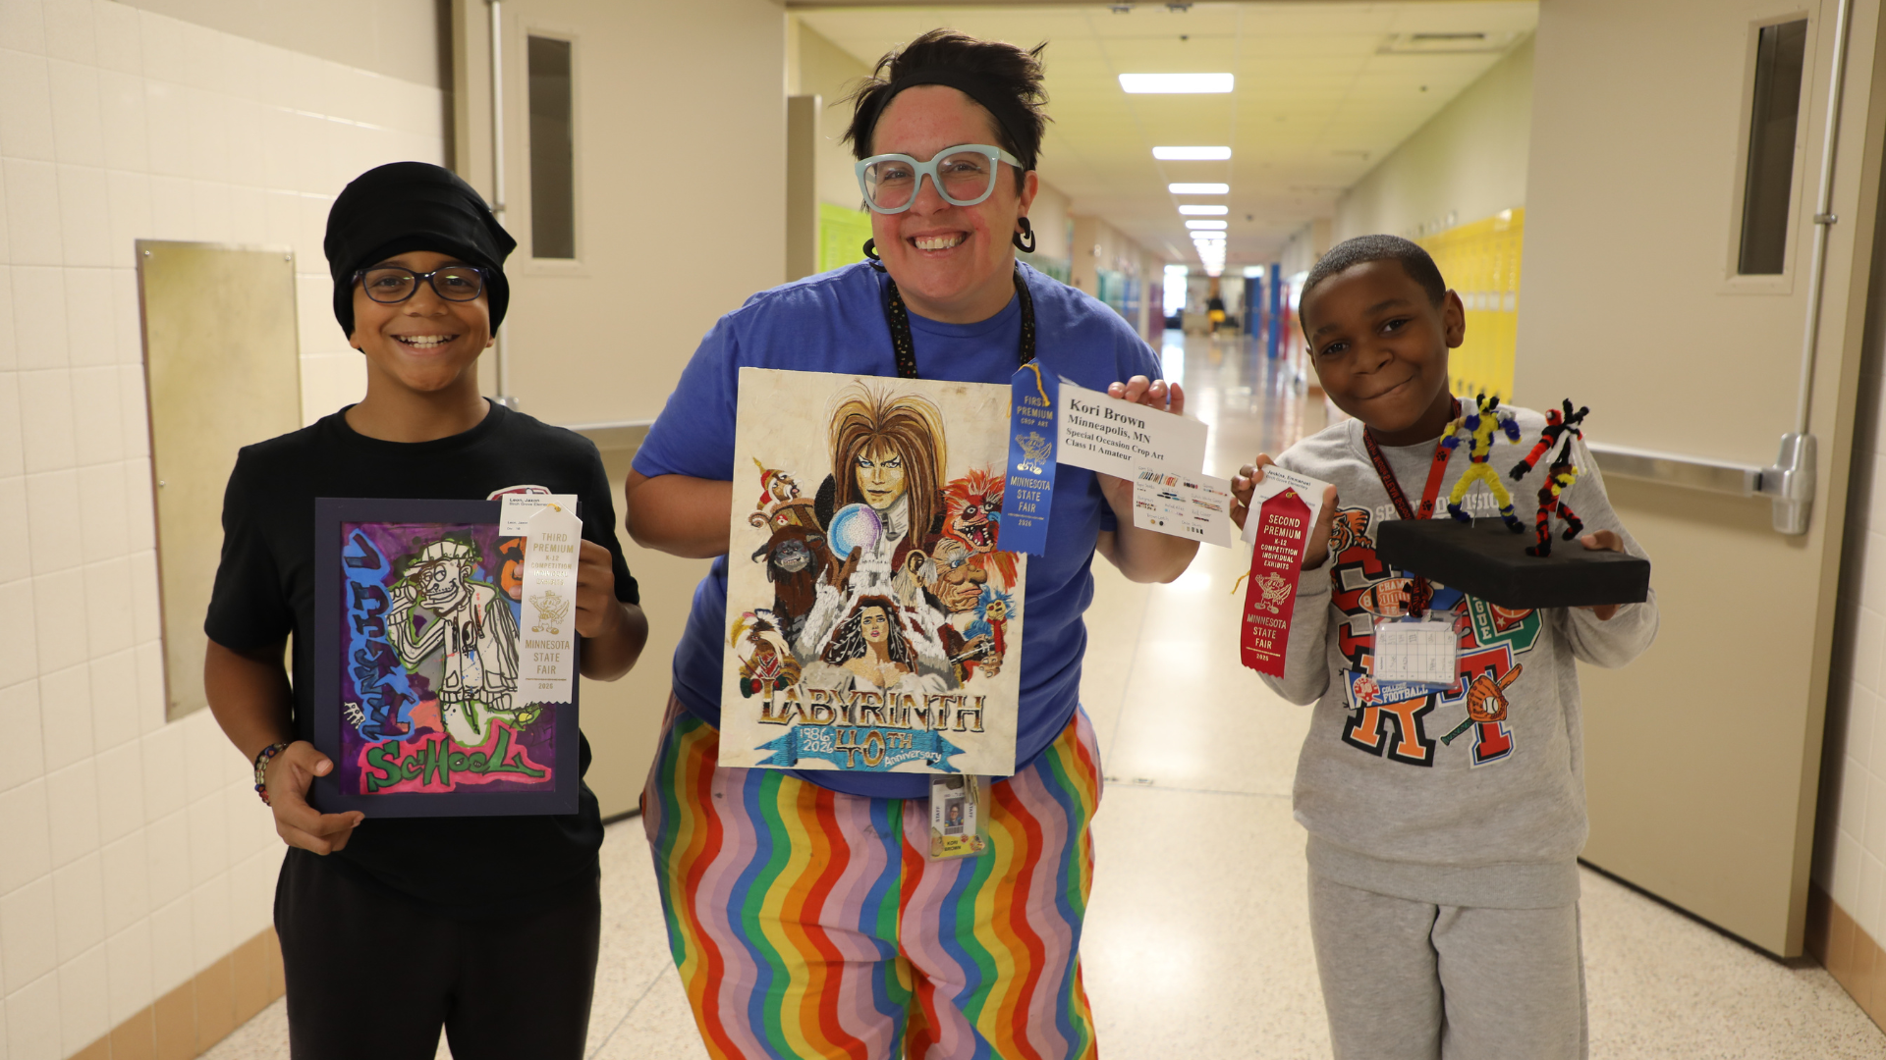
Notes:
This year, three Birch Grove School for the Arts’ artists, visual arts teacher Kori Brown and two students, walked away with awards from the annual Minnesota State Fair fine arts competition.
Emmanuel Jenkins, who has moved up to Brooklyn Middle STEAM School as a sixth-grader since submitting his pipe cleaner art, placed second in the fifth grade: sculpture category.
Birch Grove fifth grade student Jaxon Leon placed third for his graffiti art in the fourth grade drawing: marker category.

Slide 7
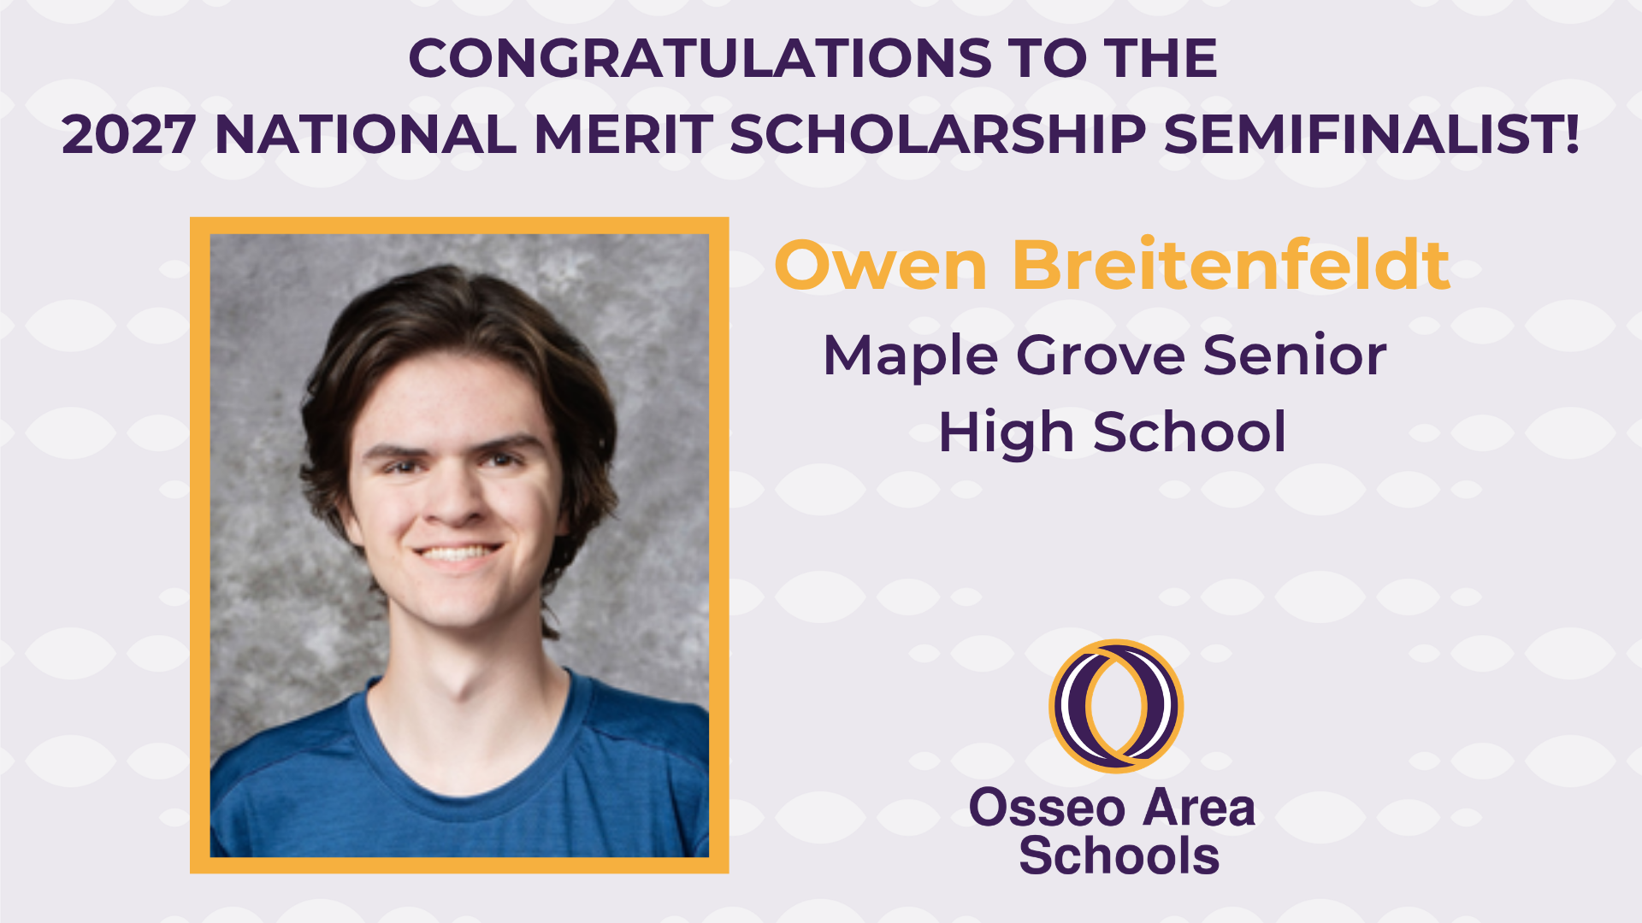
Notes:
Congratulations to Maple Grove Senior High School senior Owen Breitenfeldt for being named a 2027 National Merit Scholarship Semifinalist! Breitenfeldt was one of more than 16,000 semifinalists named nationally and scored among the top 1 percent on the PSAT out of 2.7 million students!

Slide 8
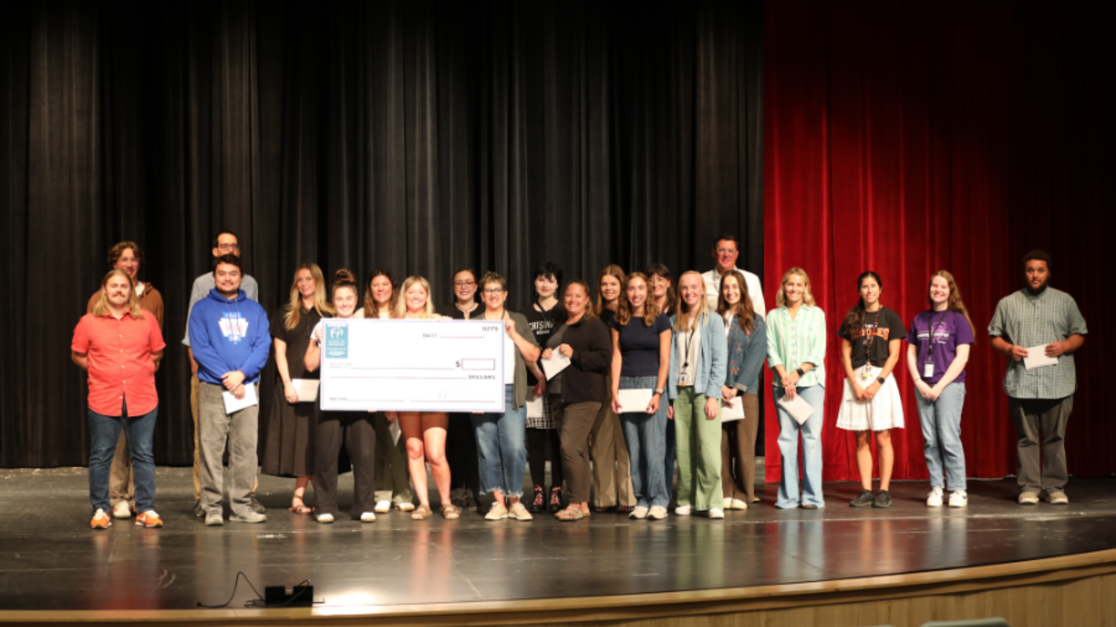
Notes:
In the area of CONTRIBUTING TO COMMUNITY
The District 279 Foundation launched their new Strong Start Initiative leading up to the school year.
Strong Start supports the newest educators in the district by helping cover the cost of setting up their first classrooms. The initiative helps create welcoming, well-equipped learning environments that inspire and prepare scholars for the school year.
To kick off the initiative, District 279 Foundation trustees presented each new educator with $250 on Aug. 24 during Osseo Area Schools’ New Teacher Workshop. The funds will help educators purchase supplies and materials to set up their first classrooms.

Slide 9
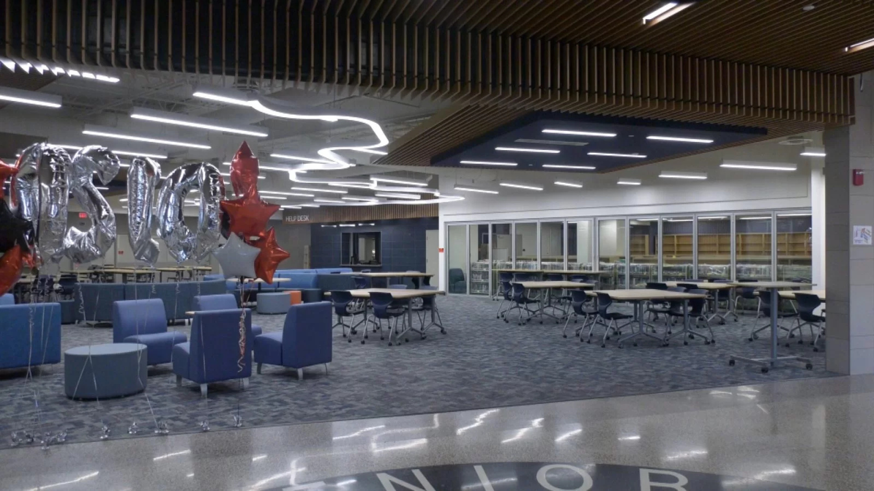
Notes:
In the area of LIFELONG LEARNING
CCX Media recently showcased a few of the latest projects completed with the Building a Better Future plan. Projects featured included renovated media centers and outdoor classrooms at elementary schools, the auto shop at Osseo Senior High School and the student-run school store at Park Center Senior High School.

Slide 10
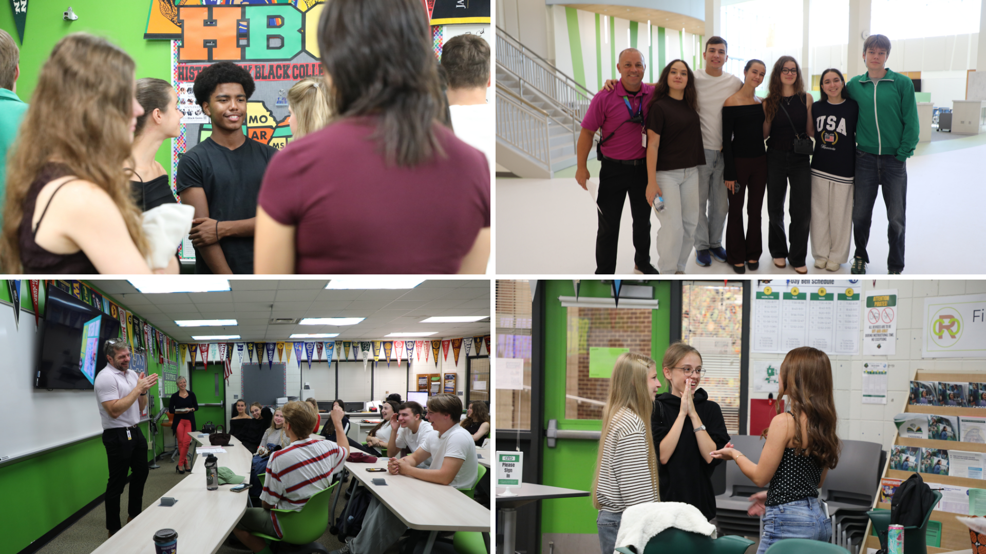
Notes:
Osseo Area Schools welcomed a group of approximately 20 Ukrainian students Sept. 9, who spent a day learning all about what education looks like in the district. The visiting students spent time at Park Center Senior High School and Aspen Ridge Elementary School before visiting with Dr. Hiel.
The Ukrainian students recently wrapped up a five week trip to Minnesota through a program called YouLEAD, which provides an immersive learning experience on the state’s businesses, non-profits, government systems and education.

Slide 11
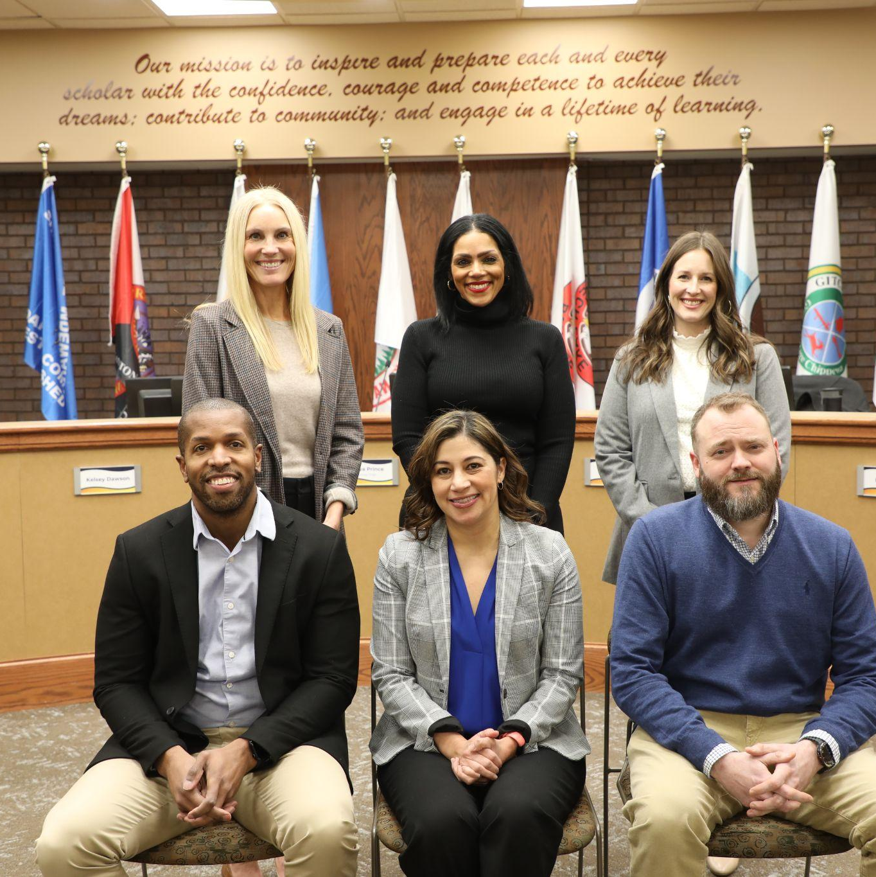
School Board Appreciation Month
Notes:
In the area of MISSION DRIVEN EMPLOYEES
September is School Board Appreciation Month in Minnesota, and Osseo Area Schools is deeply grateful for the time and energy board members put into enhancing the success and well-being of every student in the district. Thank you, Thomas Brooks, Kelsey Dawson, Erica Foster, Sarah Mitchell, Tanya Prince and Keith Tate!

Slide 12
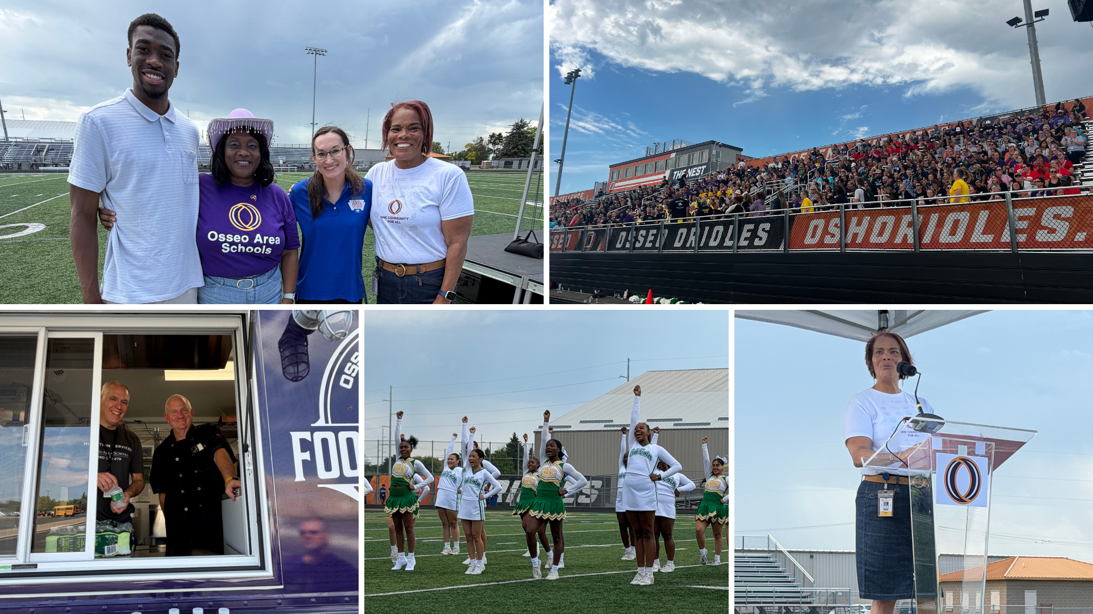
Notes:
Osseo Area Schools’ staff celebrated the beginning of the new school year with an all-staff event Sept. 3 at Osseo Senior High School. Staff from across the district came together as a community to enjoy lunch and snacks from a variety of food trucks, watch student performers and hear from district leaders.

Slide 13

Notes and reminders
Constitutional amendment on the ballot this fall that impacts school funding: OsseoSchools.org/Amendment
Stay tuned to OsseoSchools.org/BetterFuture for the latest on construction projects
Notes:
A few final notes and reminders for tonight.
There is a constitutional amendment on the ballot this fall that impacts school funding. The amendment seeks to change the funding disbursement levels of an existing state fund and does not raise taxes or fees. To learn more, visit OsseoSchools.org/Amendment
To stay up-to-date on construction projects across the district, visit our district social media pages or OsseoSchools.org/BetterFuture.

Slide 14
School board meeting
September 29, 2026

