Slide 1
School board meeting
August 25, 2026

Slide 2
Superintendent’s report
SUPT. DR. KIM HIEL
Notes:
Good evening Chair Prince, Vice Chair Brooks, school board members and stakeholders:
As we prepare to welcome our students and families for the 2026–27 school year, I want to begin with something that is easy to overlook:
School does not stop when students leave our buildings in June.
While our hallways may have been quieter and our classrooms may have looked a little different, the work of serving students never stopped. Across our district, hundreds of staff members have spent the summer preparing, supporting, building, cleaning, planning, hiring, communicating, and creating the conditions for another successful year.
And today, I want to say thank you.
To our Kidstop staff, thank you for providing safe, engaging and caring spaces for our students throughout the summer. Your work reminds us that supporting children and families extends well beyond the traditional school day and school calendar.
To our Targeted Services teams, thank you for creating opportunities for students to learn, grow and experience enrichment during the summer months. Your work helps ensure that learning, curiosity and connection continue throughout the year.
To our Nutrition Services team, thank you for making sure students and families had access to nutritious meals—not only within our district programs, but also through food provided at parks throughout our communities. This is what it means to see the whole child and to understand that learning and well-being are connected.
To our custodial and facilities teams, thank you for the incredible work you have done to prepare our buildings for students and staff. You have cleaned, repaired, organized and refreshed our spaces—and you have done much of this while navigating construction, renovation and the many complexities of our Building the Better Future projects. Your work is often behind the scenes, but the impact is front and center when students walk through our doors.
To our Enrollment and Student Services teams, thank you for the important work that continued throughout the summer to welcome new families, support student transitions, answer questions and ensure students were ready for the start of the school year.
And to the many departments that continued their work throughout the summer—Human Resources and hiring, Finance, Transportation, Teaching and Learning, Communications, Technology, Student Services, Operations, and so many others—thank you.
You have been working to fill positions, prepare buses and routes, manage resources, support technology, develop curriculum, communicate with families, prepare professional learning, process enrollment, support buildings and programs, and solve countless challenges that most people will never see.
This is the work behind the welcome.
We are grateful for your work.
A strong school district is not built by one department, one school, or one person. It is built through the collective work of people who understand that every role matters because every role ultimately connects back to a student.
As we begin this new school year, let us carry that same spirit forward.
We have important work ahead of us. We will continue to celebrate what is working, examine what needs to improve, and—consistent with our work around Finding the Barriers to Excellence—have the courage to identify what may be getting in the way of our students, staff and schools reaching their full potential.
But before we move forward, we should pause and recognize how much has already been accomplished.
Thank you for the care, professionalism and commitment you have shown throughout the summer.
Now, it’s time to open the doors.
Time to welcome our students.
Let's reconnect with our families.
We are: One community for all—where we are intentional to ensure all are heard and valued.

Slide 3
Points of Pride
SUPT. DR. KIM HIEL AND CABINET MEMBERS
Notes:
A regular part of the superintendent’s report is to share Points of Pride in our district.
By sharing our Points of Pride, we are taking time to recognize and celebrate, the scholars, staff and community members who are contributing to the accomplishment of our mission.
I have members of our District Cabinet here to assist in sharing some examples from the last month.

Slide 4
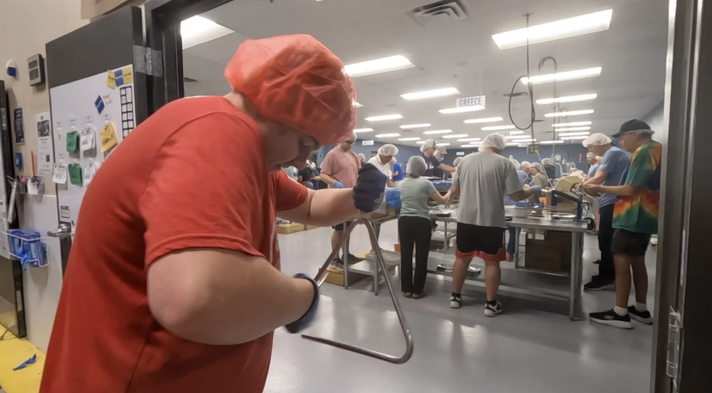
Notes:
In the area of CONTRIBUTING TO COMMUNITY:
Osseo Area Schools began offering a varsity letter program in community service last spring, which recognizes dedicated students who volunteer a minimum of 120 verified hours.
CCX Media recently featured one of the district’s first letter-earners, Park Center Senior High School’s Logan Corwin.
Keelie Sorensen, Park Center’s activities coordinator, said “The community service varsity letter creates another space for students to be safe and find their joy and find their passion, and also learn things and build connections. I definitely saw that in Logan. He was really excited, really passionate about what he did, and also really humble about the hours he put in.”

Slide 5
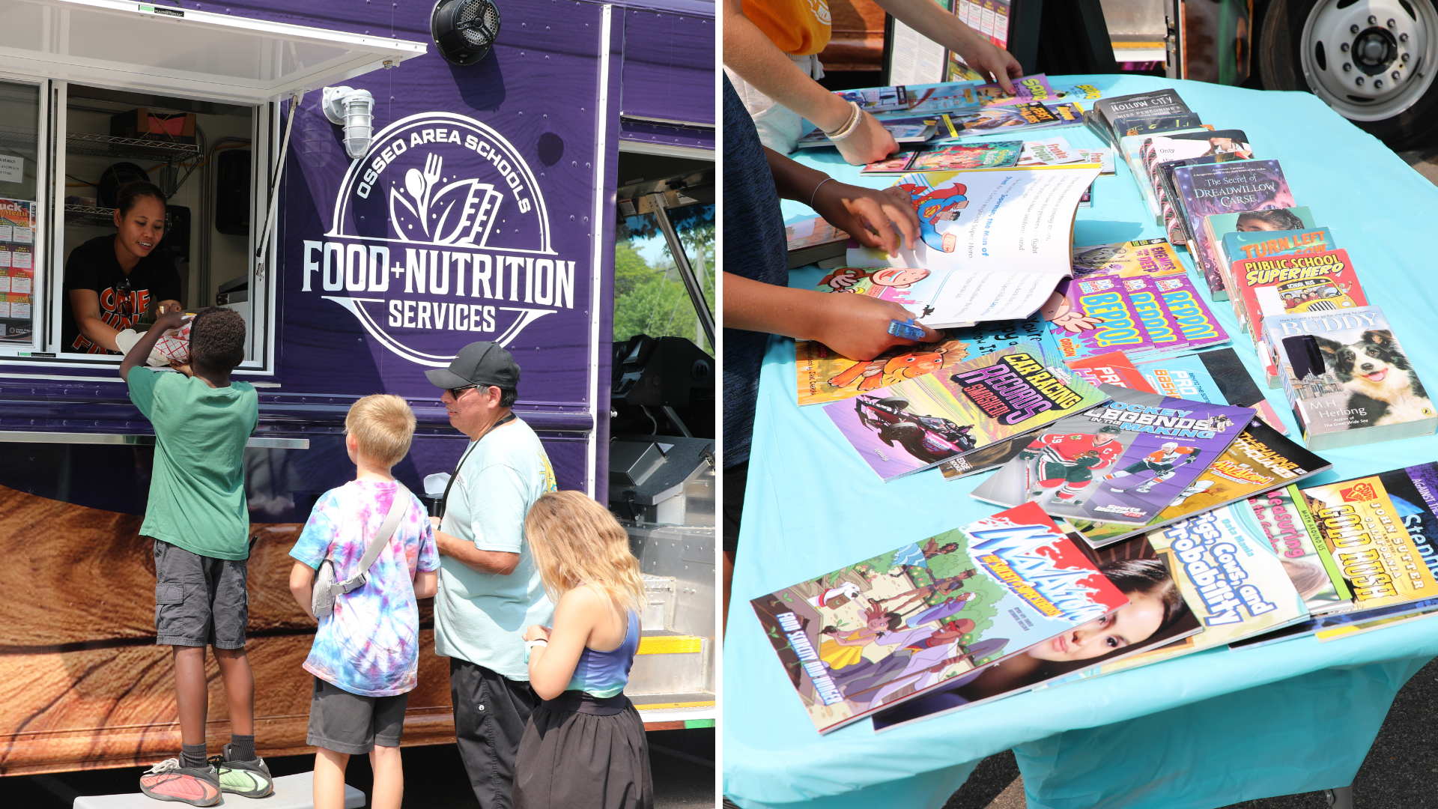
Notes:
Osseo Area Schools’ food truck had a busy summer season, visiting various sites from the Brooklyn Park and Brooklyn Center Rec on the Go program to provide free lunches to youth ages 18 and under through the federally funded Summer Food Service Program.
Thanks to a generous donation from a local publisher and coordination efforts from the district’s nutrition services department, the food truck stops also included free books for children and teens to bring home.

Slide 6
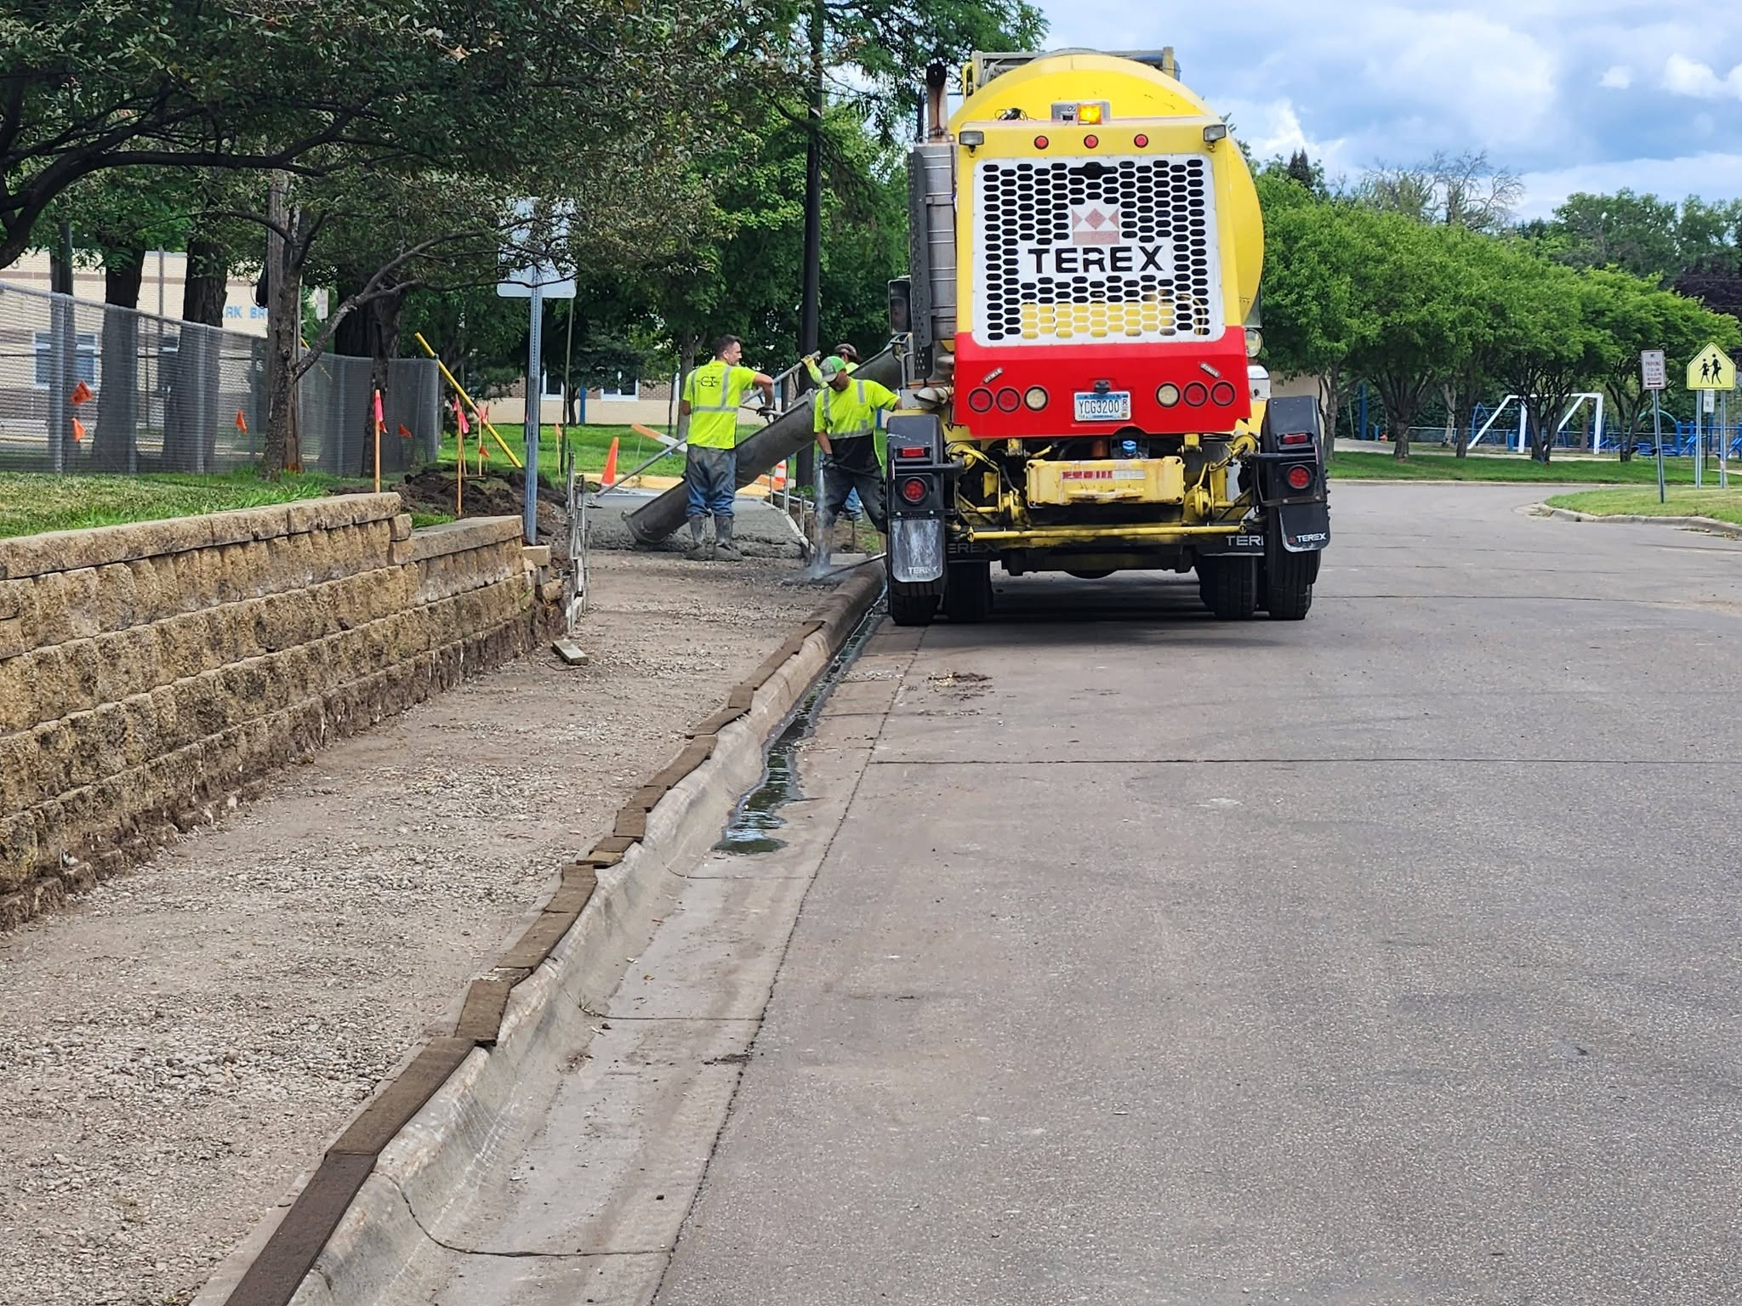
Notes:
Osseo Area Schools teamed up with the city of Brooklyn Park to obtain Safe Routes to School grant funding for the addition of sidewalks on several streets around Park Brook Elementary School, increasing safety for students who walk to or from the school.
Sidewalks are being installed from the school up Hampshire Ave. to Brooklyn Boulevard, from the school to Kentucky Ave and up to Brooklyn Boulevard, and along 73rd Ave N.
Sidewalks will be plowed by the city of Brooklyn Park, ensuring a safe and clear route for families.

Slide 7

Notes:
In the area of ACHIEVING DREAMS:
Six schools from Osseo Area Schools were recently included in a list of 97 schools statewide to receive recognition from the Minnesota Department of Education (MDE) for their sustained commitment to Positive Behavioral Interventions and Supports (PBIS).
The schools include Basswood, Cedar Island and Weaver Lake: A Science, Math & Technology School at the elementary level, along with 279Online, North View Middle School and the Osseo Area Learning Center at the secondary level.
PBIS is an evidence-based, tiered framework for supporting students’ behavioral, academic, social, emotional, and mental health.

Slide 8
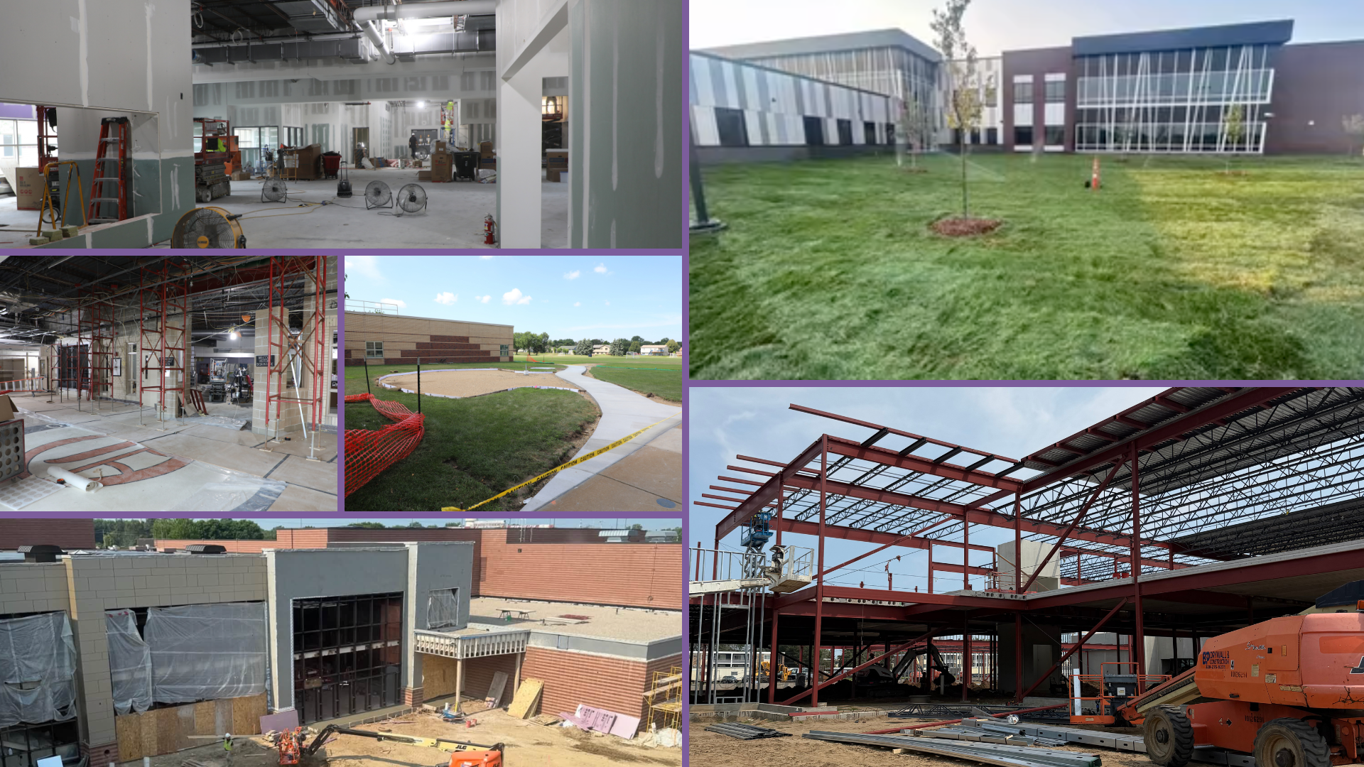
Notes:
Nine schools are currently undergoing construction thanks to the community’s support of the Building a Better Future referendum, with projects wrapping up in time for the new school year at the new Aspen Ridge Elementary, Fernbrook and Edinbrook elementary schools, Osseo and Maple Grove middle schools and Osseo Senior High. Ongoing projects will continue into the school year at Maple Grove and Park Center senior high schools and the former Crest View Elementary School site, which will begin a naming process this fall.
Construction work at all sites continues to remain on-budget and on-time with the exception of a couple of minor delays at Osseo Middle School and Maple Grove Senior High School.

Slide 9
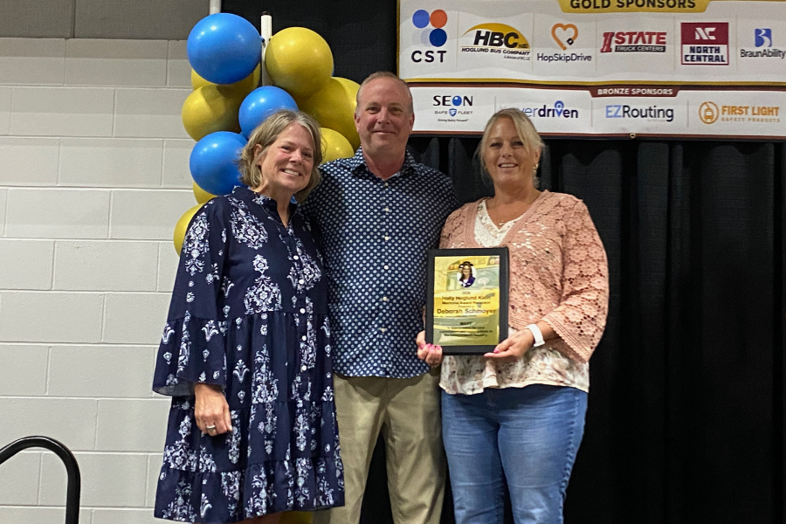
Notes:
In the area of MISSION DRIVEN EMPLOYEES:
Deb Schmoyer, a transportation router for Osseo Area Schools with 24 years in the industry, recently won the 2026 Holly Hoglund Klein Memorial Award.
Given by the Minnesota Association for Pupil Transportation, the award honors outstanding women who have demonstrated extraordinary dedication, leadership and commitment to student safety in school transportation.
Jim Greeley, assistant director of transportation said “Deb has consistently demonstrated a dual commitment to fiscal responsibility and student welfare, designing routes that maximize efficiency without ever compromising the care and safety of the children she serves. Her routing decisions reflect not just logistical expertise, but a genuine understanding of what it means to be trusted with the transportation of thousands of students each day.”

Slide 10
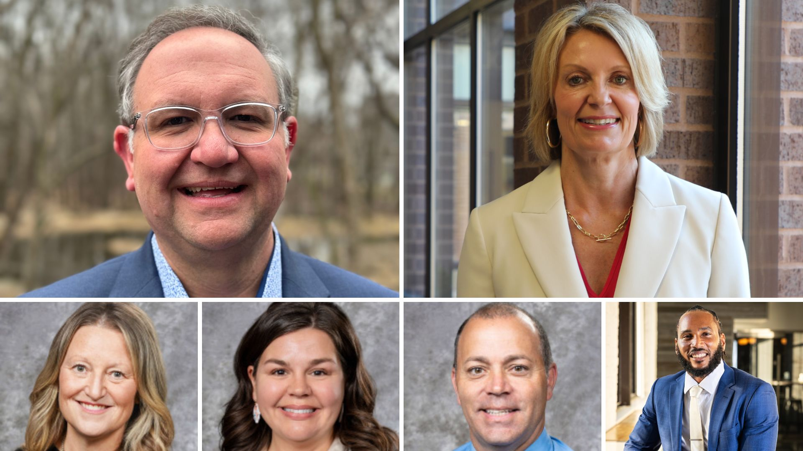
Notes:
Osseo Area Schools extends a warm welcome to two new assistant superintendents, Dr. Jason Bodey and Amy Tollefson. Bodey and Tollefson join Dr. Bryan Bass and Dr. Steven Flisk in supporting core district goals for high-quality educational experiences for every learner.
The district also welcomes four new lead principals for the 2026-27 school year, including Patrick Smith at the newly opening Aspen Ridge Elementary School, Robert Ware at Brooklyn Middle STEAM School, Lindsey Patterson at Rush Creek Elementary School, and Kim Berling, who served as interim principal at Osseo Senior High School last year and now has officially been named the school's lead principal.
Please join us in offering a warm welcome these educational leaders!

Slide 11

Notes:
In the area of LIFELONG LEARNING:
This summer, students of all ages engaged in Community Education’s summer programming across the district at multiple school locations.
More than 2,200 students registered for Camp ROCKS! Mini camps throughout the eight-week span of hands-on learning and fun at Rice Lake Elementary School.
Nearly 350 Middle school students took part in five weeks of academics and enrichment activities through the district’s Game On and OMG middle school programs.
Over 1,450 students took part in the summer Kidstop school-age childcare at four elementary schools across the district.
Adult Basic Education (ABE) partnered with the Nutrition Services department with a focus on preparing students for a food safety certification exam that can help them advance their careers.

Slide 12

Notes and reminders
The first day of school is Tuesday, Sept. 8. Detailed information is at OsseoSchools.org/BackToSchool Remember, new attendance boundaries kick off.
Stay tuned to OsseoSchools.org/BetterFuture for the latest on construction projects
Notes:
A few final notes and reminders for tonight.
The first day of school is Tuesday, Sept. 8. All you need to know this back-to-school season is at OsseoSchools.org/BackToSchool. One important reminder I wanted to bring to the forefront, though, is that new attendance boundaries are kicking off. Looking forward to seeing you Sept. 8!
So much has gone on construction-wise over the summer. A lot was shared on our district social media channels the last several weeks. You can continue to stay tuned at OsseoSchools.org/BetterFuture.

Slide 13
School board meeting
August 25, 2026

