Slide 1
School board meeting
June 23, 2026

Slide 2
Superintendent’s report
SUPT. DR. KIM HIEL
Notes:
Good evening Chair Prince, Vice chair Brooks , school board members and stakeholders:
As we close another school year, I find myself reflecting on just how quickly time moves. In many ways, it feels like we were just opening doors in September – welcoming students back, setting goals, and preparing for what we hoped would be a meaningful year of learning and growth. And yet here we are, already at the end of another chapter.
This year brought its share of challenges, as every year does. We were called to adjust, to rethink, and at times to shift quickly in order to meet the evolving needs of our students and staff. What stands out most is not the difficulty itself, but the way our educators, leaders, and support staff responded – with care, professionalism, and an unwavering focus on students. That responsiveness is what keeps a system strong. It is what allows learning not just to continue, but to thrive.
And alongside those challenges, there was so much joy. We gathered at plays and concerts where students shared their creativity and courage. We filled gyms, fields, and auditoriums with sports, celebrations, and community pride. We marked milestones at graduation ceremonies that reminded us of both beginnings and endings. And in every classroom, hallway, and learning space, we witnessed growth – sometimes quiet, sometimes extraordinary, but always meaningful.
Wishing you a summer filled with rest, gratitude for the difference you’ve made, and just enough humor to remember: the work will always be there – but so will the sand in your shoes, the unread emails, and the well-deserved reminder that joy is also part of the job.

Slide 3
Points of Pride
SUPT. DR. KIM HIEL AND CABINET MEMBERS
Notes:
A regular part of the superintendent’s report is to share Points of Pride in our district.
By sharing our Points of Pride, we are taking time to recognize and celebrate, the scholars, staff and community members who are contributing to the accomplishment of our mission.
I have members of our District Cabinet here to assist in sharing some examples from the last month.

Slide 4
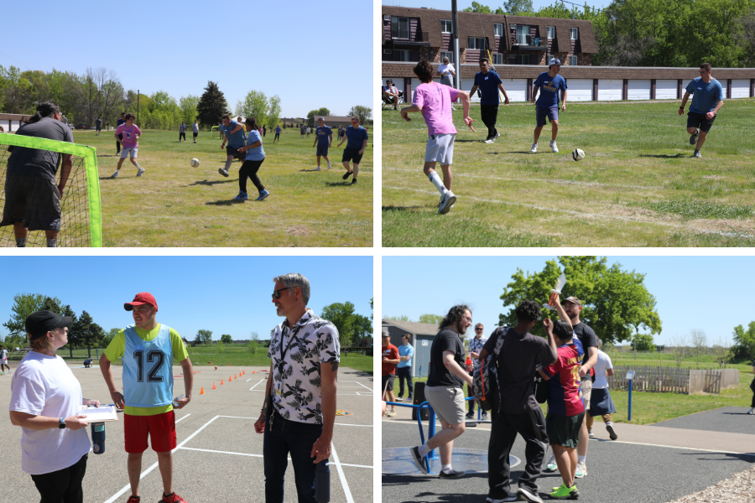
Notes:
In the area of CONTRIBUTING TO COMMUNITY:
The Osseo Education Center hosted a unique event on May 15, when they held a soccer invitational amongst their own students and those from our neighboring school districts’ transition programs.
Special Olympics Minnesota jumped in to support the event with donations to cover the cost of equipment and rented portable toilets.
OEC Principal PC Clymer said this is the first time he and others can remember local transition programs coming together in this way, and he said the school hopes to make the soccer invitational an annual event based on this year’s success.

Slide 5
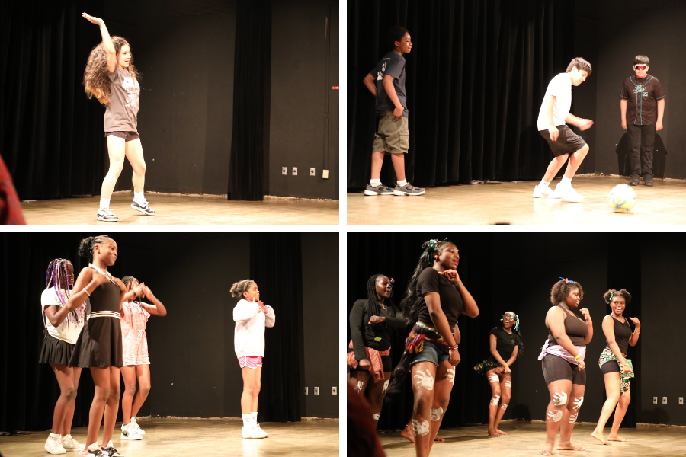
Notes:
North View Middle School hosted a talent show during its advisory period May 29. The show featured a range of enthusiastic and talented performers such as dancers, singers and soccer players.

Slide 6
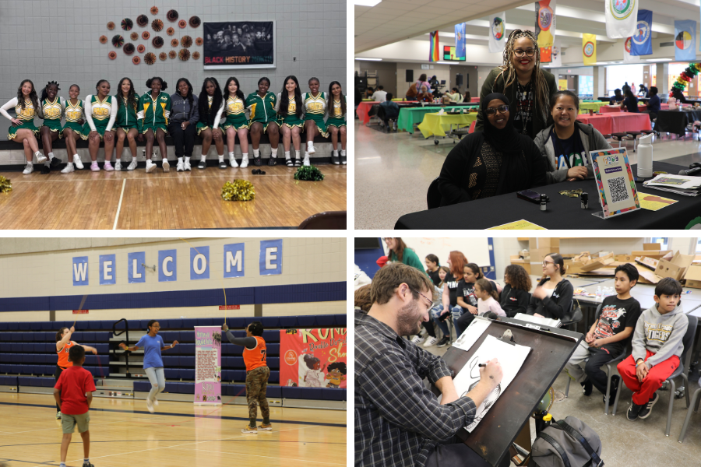
Notes:
Osseo Area Schools’ Family and Community Engagement group hosted a Black History Month celebration May 9. Rescheduled from the typical February timeframe, students, their families and community members were welcomed to North View Middle School for a festival
The event included food trucks, Black small business vendors, Double Dutch jump roping, a presentation about Historically Black Colleges and Universities (HBCUs), caricature artists, a deejay, performances and a fashion show.
Performances at the 2026 event included the Maple Grove Senior High Crimsonettes, Park Center Senior High School’s cheer team, dance performances by the Afrocontigbo Dance Company and Hiddo Soor International, a fashion show by Park Center’s East African club and more.

Slide 7
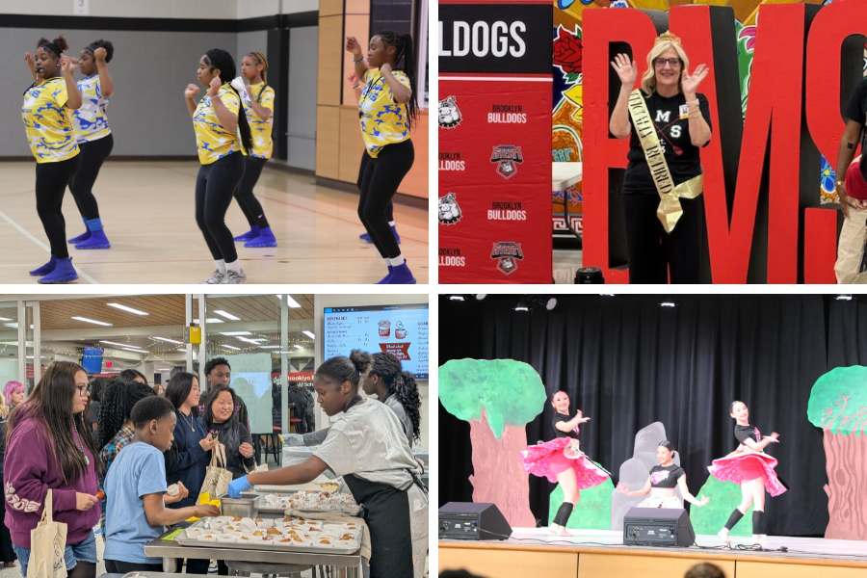
Notes:
In the area of ACHIEVING DREAMS:
Best Buy’s Geek Squad Academy spent two days at Brooklyn Middle STEAM School May 13 and 14, offering a variety of technology-related classes during students’ elective class times.
Some of the topics covered during Geek Squad Academy’s visit included:
3-D design
“AI Why” that taught students about how best to utilize AI and creating their own AI through a program called Doodle Detector
Lessons on internet safety and digital footprints
Coding and programming
Using DSLR cameras and more

Slide 8
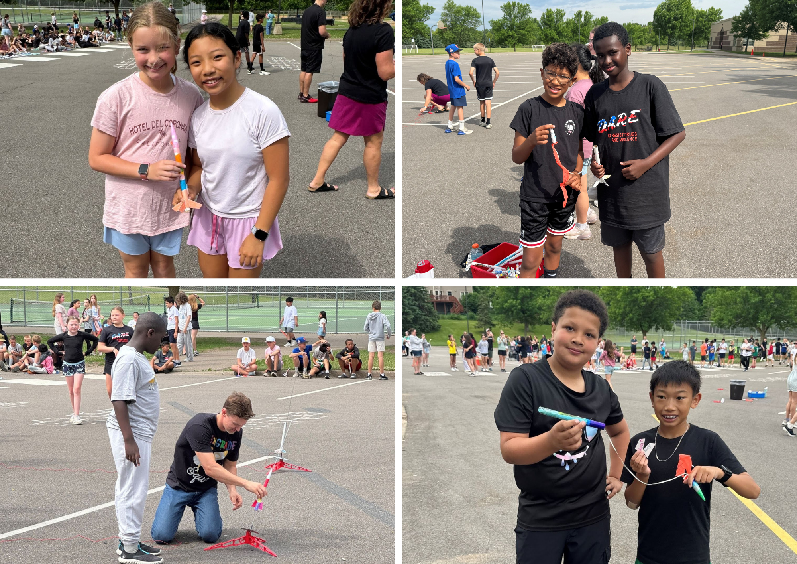
Notes:
Rush Creek Elementary School hosted their annual fifth grade rocket launch event on June 4.
The event’s theme was “Blasting off to Middle School.”

Slide 9
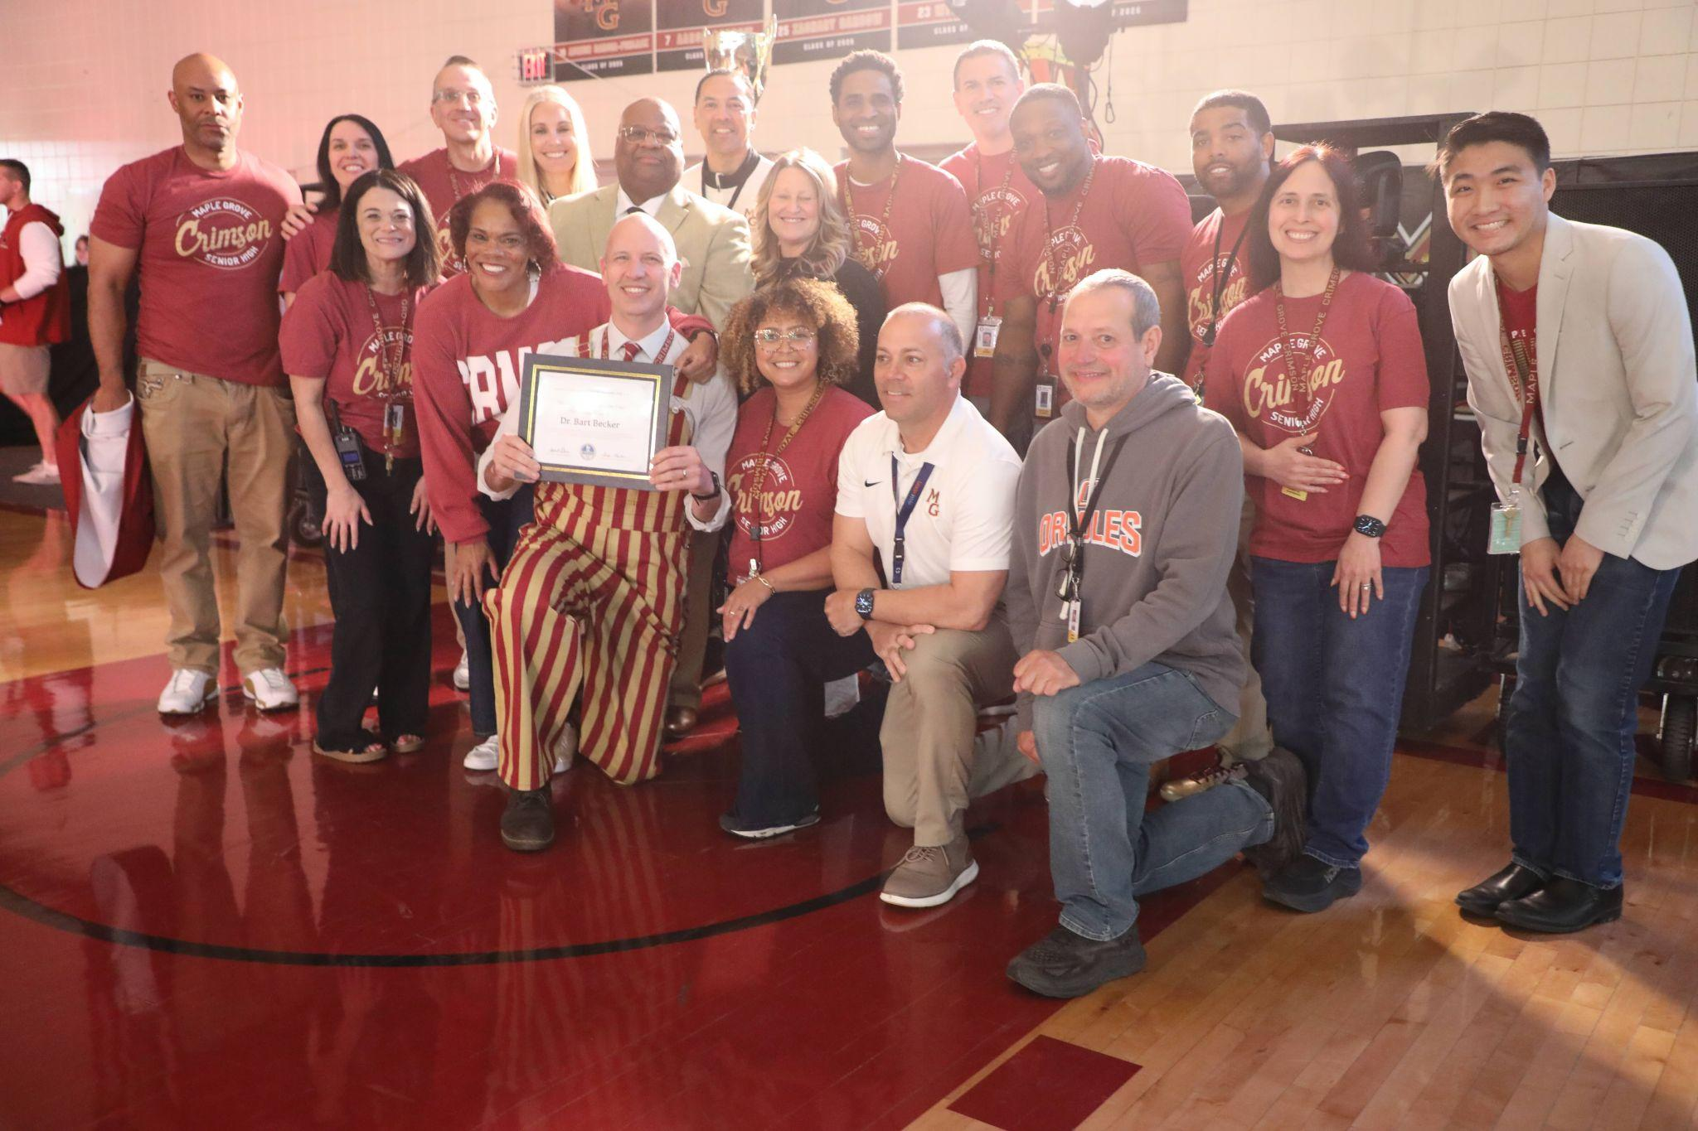
Notes:
In the area of MISSION DRIVEN EMPLOYEES:
Maple Grove Senior High School Principal Dr. Bart Becker was selected as this year’s Principal of the Year through the Minnesota Association of Secondary School Principals (MASSP) Hennepin Division.
Greg Martin, President of MASSP Hennepin Division, attended the school’s May 22 spring pepfest to surprise Becker with the award alongside other school and district leaders.
The MGSH student body enthusiastically celebrated Becker’s award, chanting his name and cheering as he accepted the plaque.

Slide 10
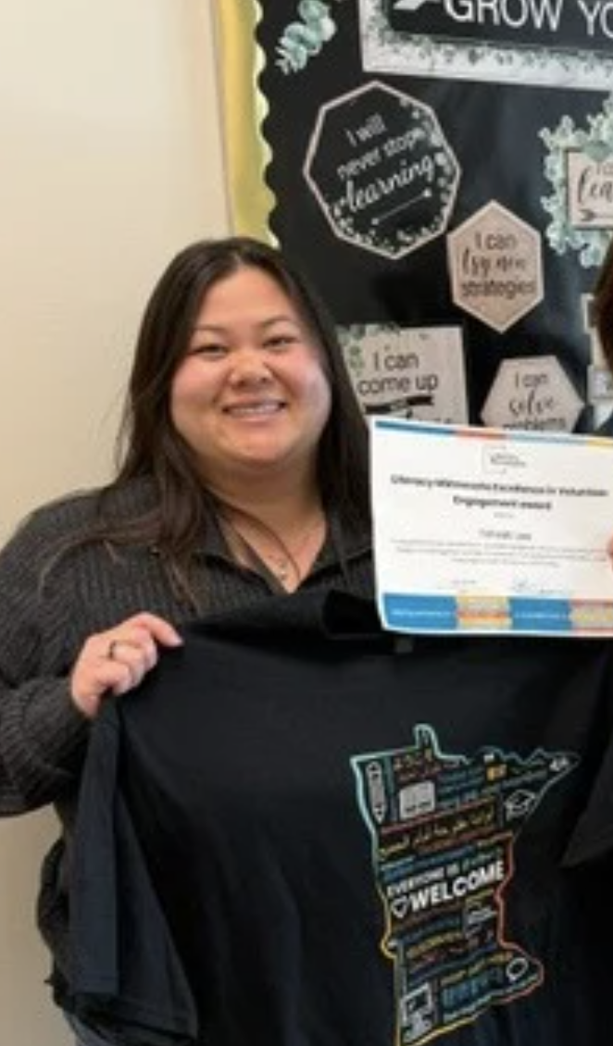
Notes:
Tshiab (“Chee-ah”) Lee, a volunteer coordinator for Adult Basic Education, was recently recognized for her excellence in connecting volunteers with students and classrooms with an Excellence in Volunteer Engagement award from Literacy Minnesota.
In her role, Lee recruits volunteers, supports classroom and one-on-one tutoring placements, and matches volunteers with students based on academic goals and areas of interest.
Tshiab (“Chee-ah”) said “Being able to work with volunteers has opened a new perspective for me. Seeing the impact our volunteers have on our students brightens my day.”

Slide 11
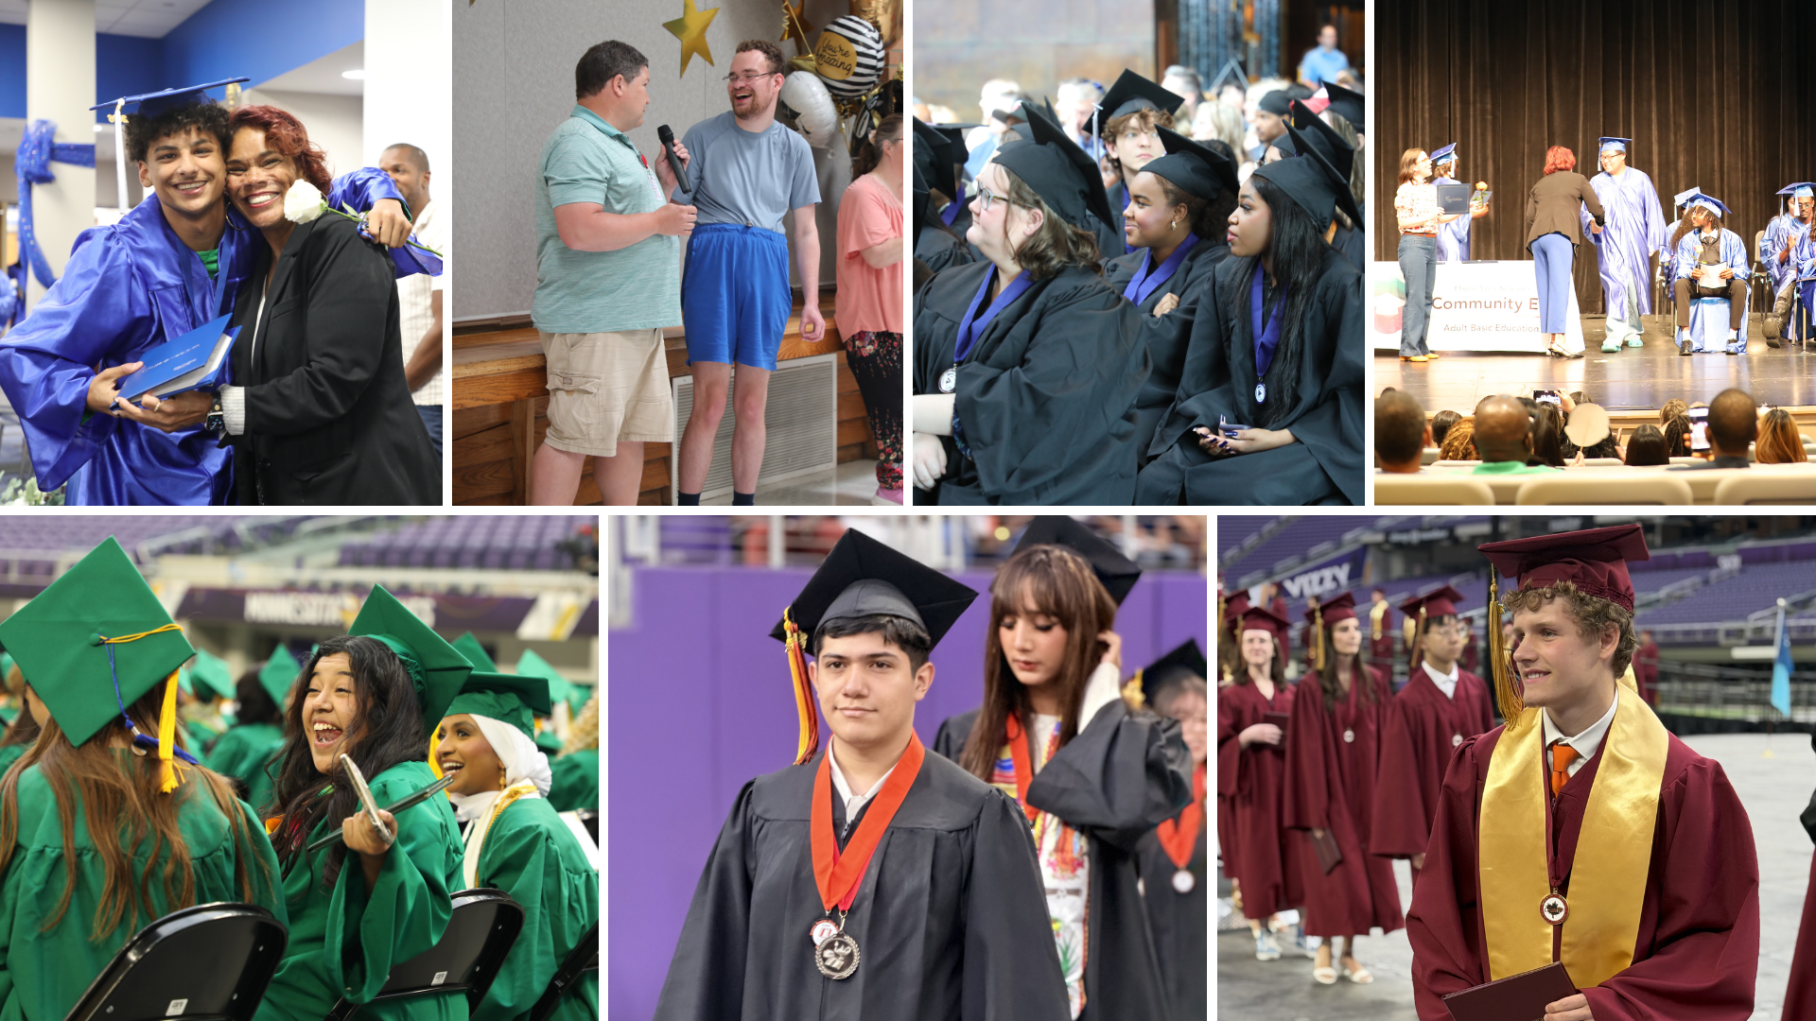
Notes:
In the area of LIFELONG LEARNING:
Osseo Area Schools hosted seven graduation ceremonies between May 29 and June 7 for students graduating from our high schools, the Osseo Education Center’s transition program and Adult Basic Education.
We are so proud of our class of 2026 graduates, who are well-prepared for their next steps thanks to all of the Osseo Area Schools staff who aided in their educational journeys.

Slide 12

Notes and reminders
Summer learning opportunities, OsseoSchools.org/Summer
Breakfast and lunch available to children through Aug. 21. More at OsseoSchools.org/FreeMeals
Stay tuned to OsseoSchools.org/BetterFuture for the latest on construction projects
Notes:
A few final notes and reminders for tonight.
Families can explore summer programs for children from early childhood through high school. Many kick off soon! Visit the Osseo Area Schools’ Summer programs website at osseoschools.org/summer to learn about each enrichment opportunity, camp and program.
Breakfast and lunch will be available to children through the federally funded Summer Food Service Program from June 10 through Aug. 21. Any child 18 years of age or younger may participate. Meals must be consumed at the specified locations in person. View the locations and schedule at osseoschools.org/freemeals.
Continue to stay tuned to OsseoSchools.org/BetterFuture for the latest on construction projects.

Slide 13
School board meeting
June 23, 2026

