Slide 1
School board meeting
May 19, 2026

Slide 2
Superintendent’s report
SUPT. DR. KIM HIEL
Notes:
Good evening Chair Prince, Vice chair Brooks , school board members and stakeholders:
Good evening. As we head into the final weeks of the school year, my reflections are centered on connection. A school district cannot thrive in isolation. To build a strong, resilient community, we must intentionally lean on and support one another – our schools, families and stakeholders alike.
We saw the magnificent impact of these connections at the Osseo Education Center (OEC) Soccer Invitational this past Friday, where our transition scholars welcomed athletes from four neighboring districts. Supported by Special Olympics Minnesota, the fields were overflowing with pure joy and connections.
Our local partners are just as vital. The Maple Grove Police Department recently stepped up to collaborate with the Special Olympics as well – a wonderful partnership highlighted on my Instagram page. These moments prove that when the city, law enforcement and the school district partner, we amplify positive impact for our entire community.
Our schools are in one of our busiest seasons of celebration. Whether it’s the harmonies at our spring choir concerts, the creativity in our school plays, the memories made at prom, or the ultimate milestone of graduation. It’s so great to see the culmination of all that our scholars have accomplished over these last several months and years. Their big smiles go from ear to ear! Congratulations on a job well done scholars!
I want to thank you - our community stakeholders - who have leaned in to support our scholars this year. Thank you! We’re finishing strong, together.

Slide 3
Points of Pride
SUPT. DR. KIM HIEL AND CABINET MEMBERS
Notes:
A regular part of the superintendent’s report is to share Points of Pride in our district.
By sharing our Points of Pride, we are taking time to recognize and celebrate, the scholars, staff and community members who are contributing to the accomplishment of our mission.
I have members of our District Cabinet here to assist in sharing some examples from the last month.

Slide 4
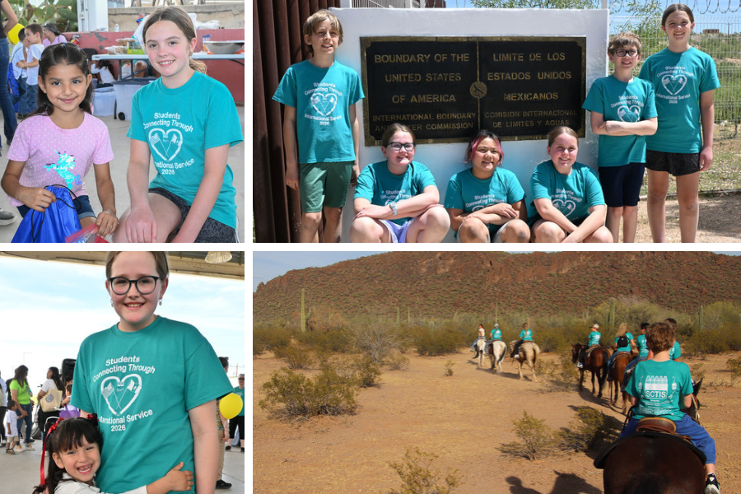
Notes:
In the area of CONTRIBUTING TO COMMUNITY:
Students from four district elementary schools, including Basswood, Elm Creek, Oak View and Park Brook, spent the first part of this school year raising money for the organization Students Connecting Through International Service to support a school in Sonora, Mexico.
In April, fifth grade student representatives from each participating school traveled to Arizona to deliver supplies and funds and to participate in cultural and community activities with the students from the Mexican school.

Slide 5
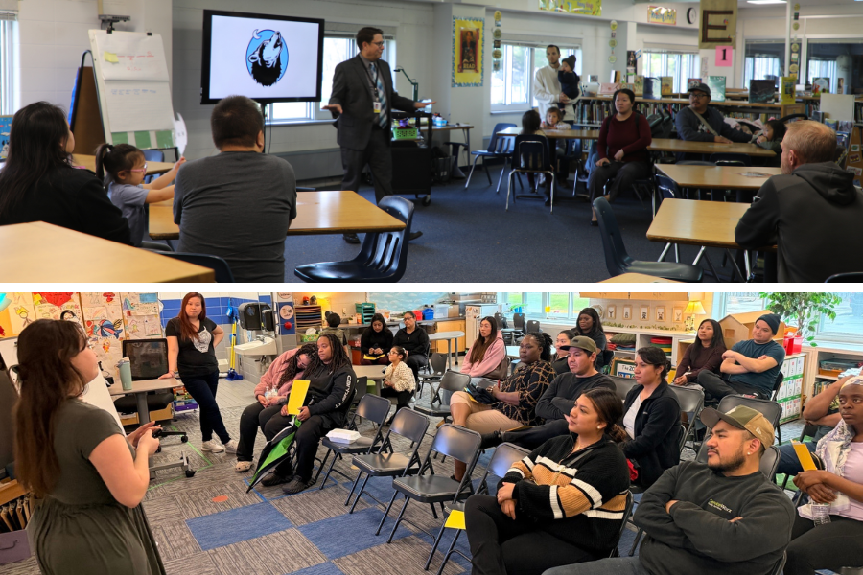
Notes:
Each district school that will receive new students due to attendance boundary changes this fall is hosting a welcome event before the 2026-27 school year begins.
Several events have already taken place. Some have been planned in conjunction with annual events the schools host, such as a multicultural night, a STEAMfest or a Family Fitness Night; others are taking place as standalone events like ice cream socials for new families or new family orientation meetings.

Slide 6
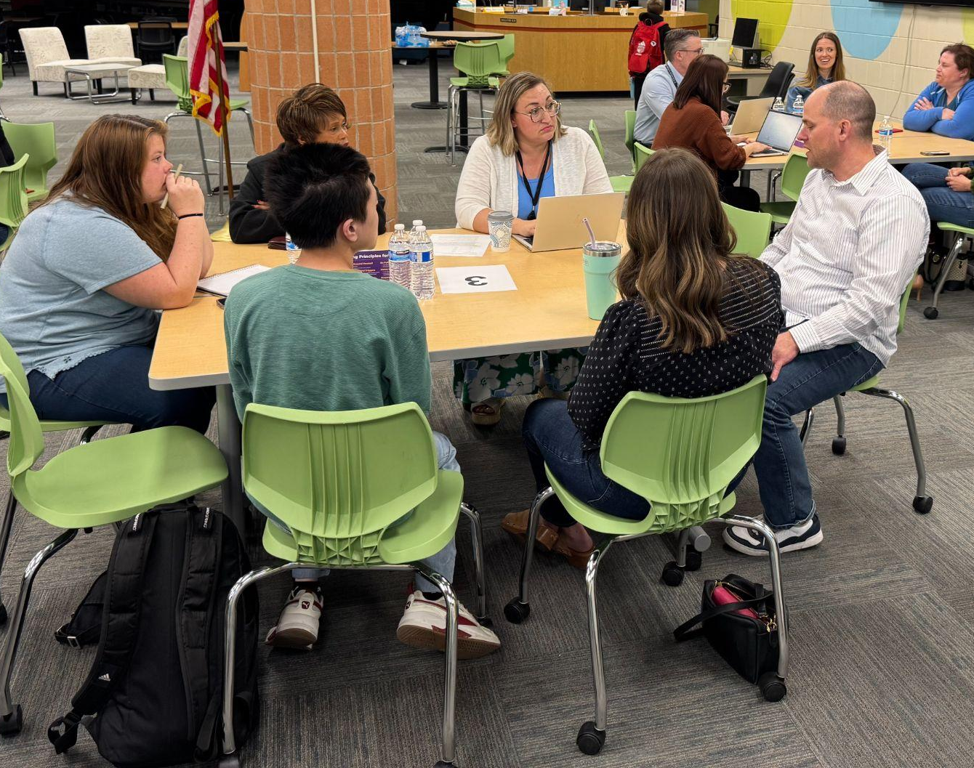
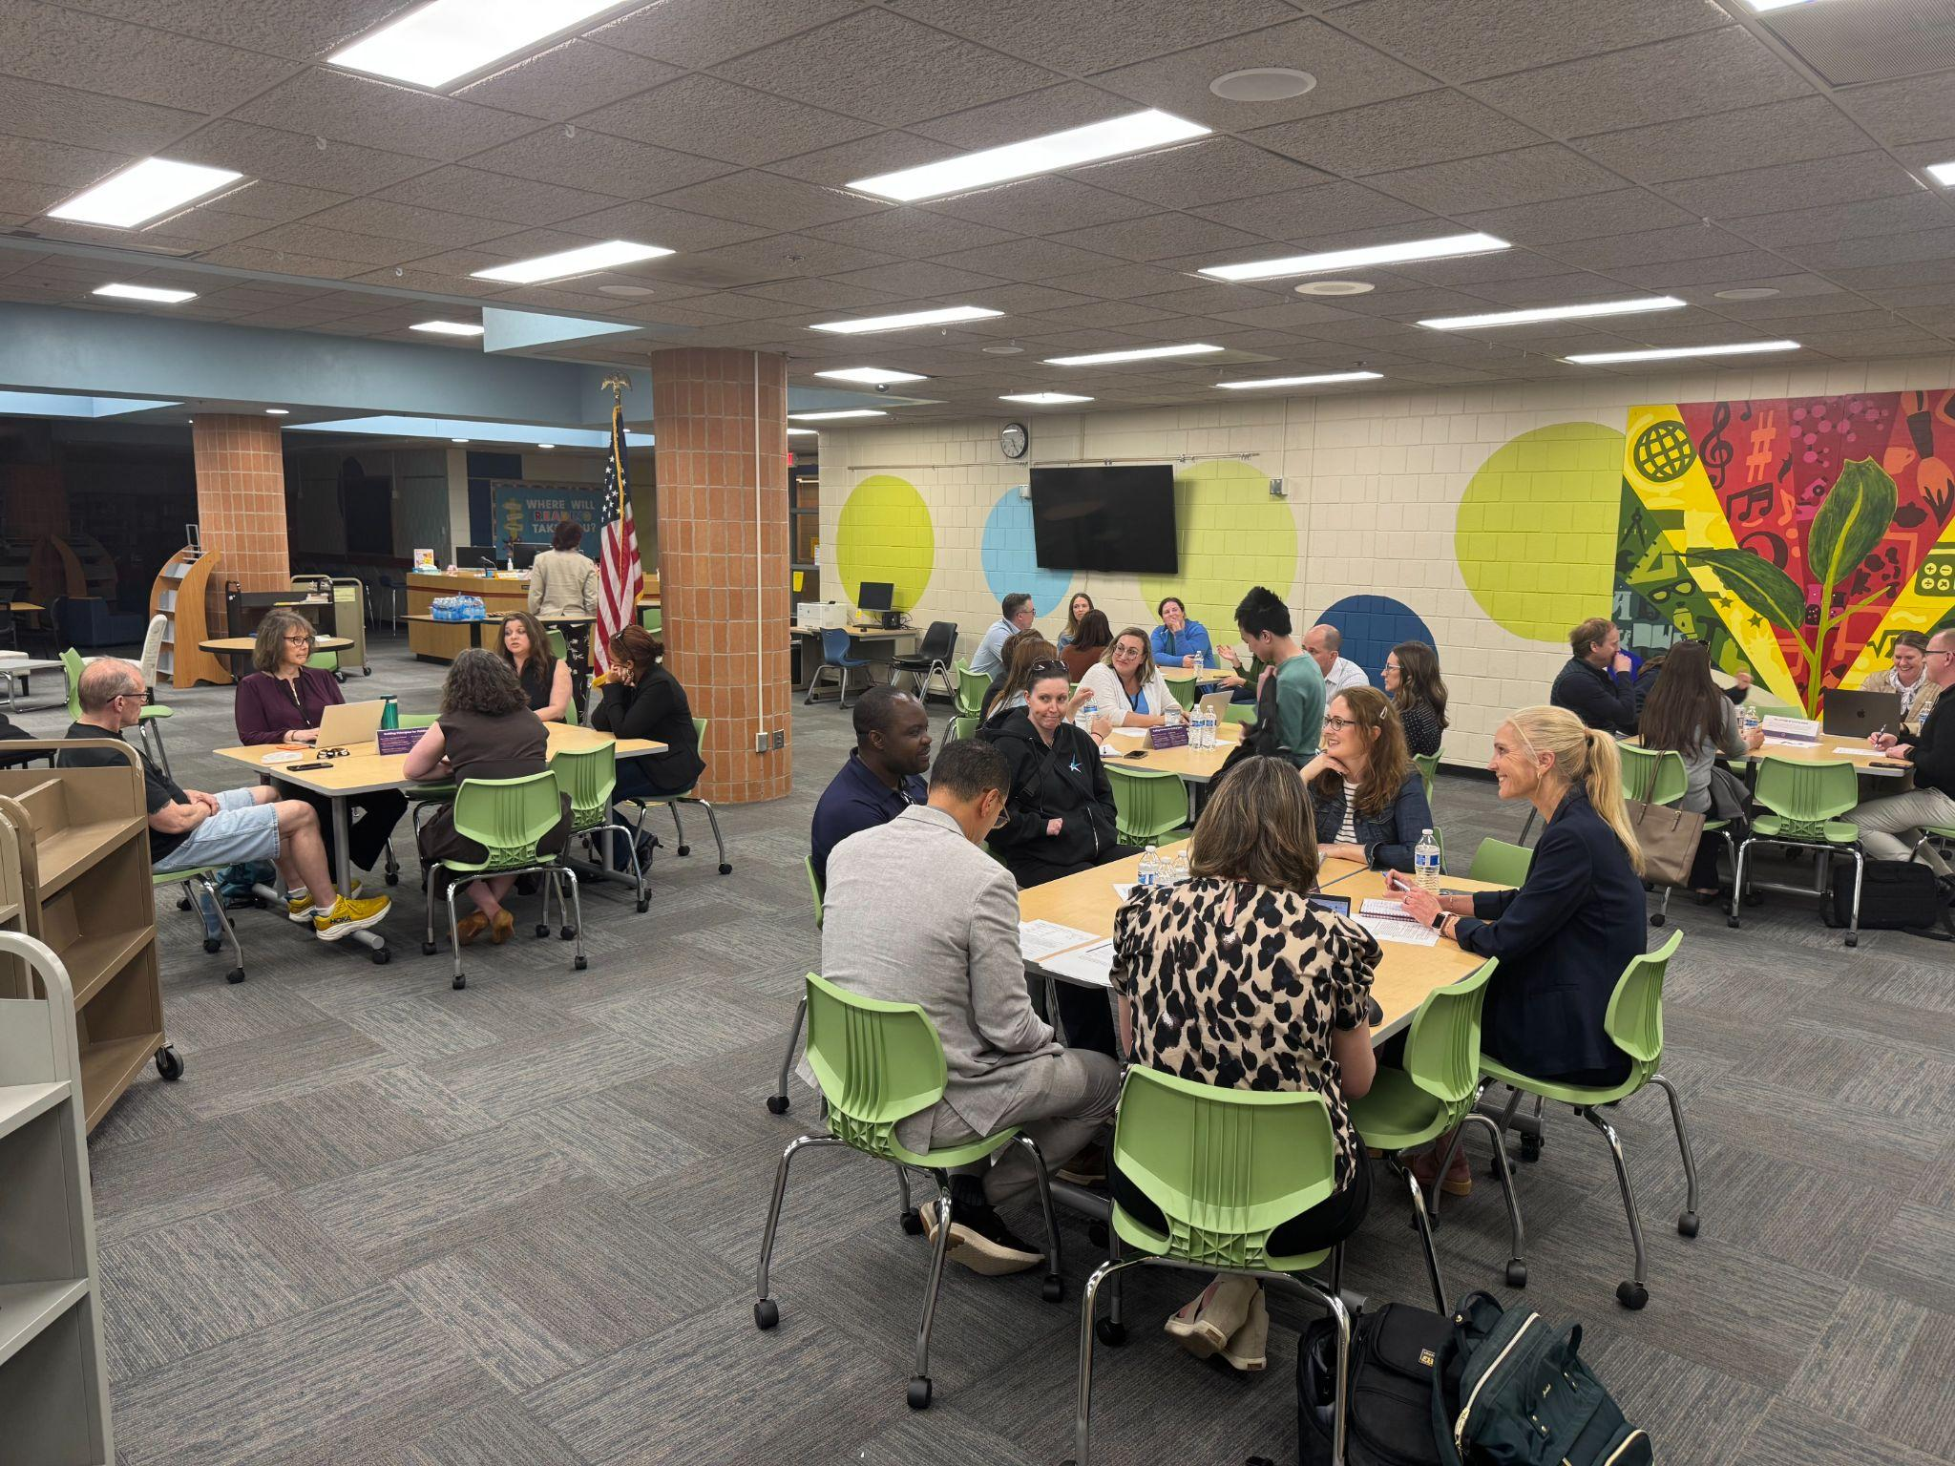
Notes:
On May 12, the district completed its last of three Community Conversation meetings held this school year.
Community Conversations have given parents and community members opportunities to share their opinions and learn more about issues they care about, such as safety, class sizes, discipline and more.
An overview of what was discussed and community feedback will be available for the school board and community to review ______.

Slide 7
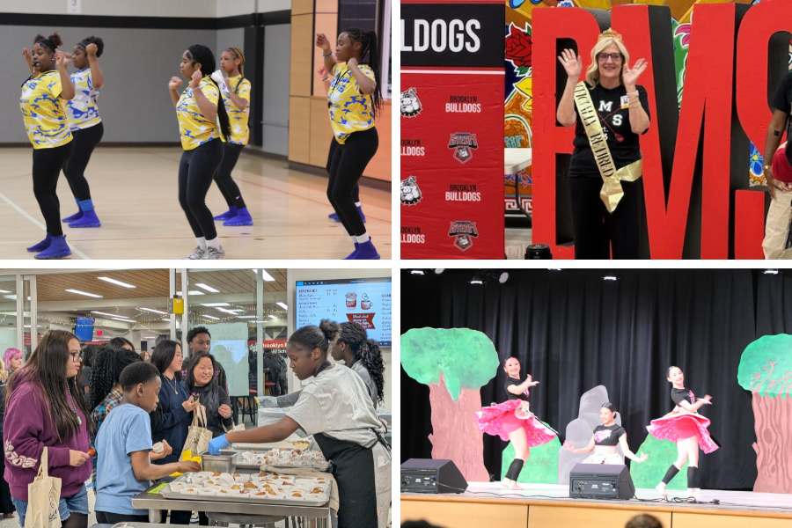
Notes:
Brooklyn Middle STEAM School hosted a multifaceted event the evening of April 30, which included:
A showcase of the students’ science, technology, engineering, math and arts projects from throughout the school year
A multicultural show
Bulldog Cafe offerings, where students baked and served snacks and treats from around the world
And a celebration of the school’s long-time principal, Kim Monette, who will soon retire
The event served to bring the community together to celebrate one another and recognize the students’ academic growth in STEAM subjects.

Slide 8
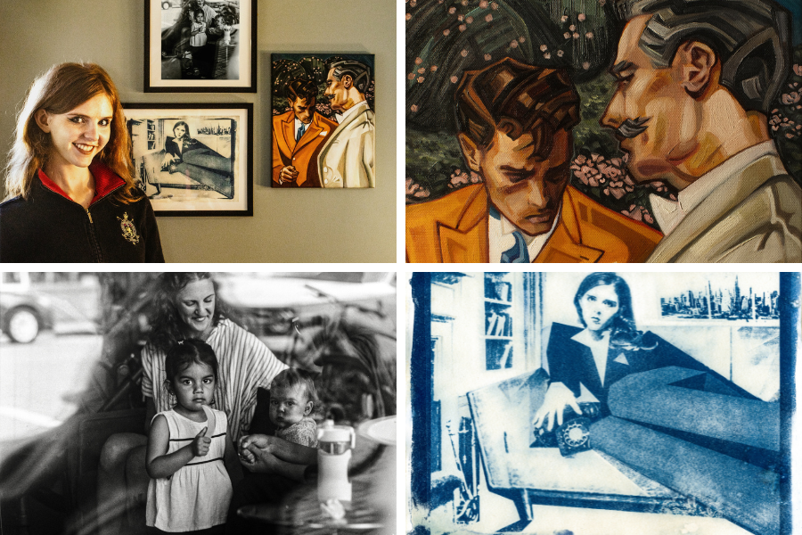
Notes:
In the area of ACHIEVING DREAMS:
This winter, Osseo Senior High School junior Mina Hirdler received nine Gold Key awards for her regional Scholastic Art & Writing Award entries.
This spring, Hirdler learned that three of her entries advanced to receive national awards, including the National American Visions Award for her photography piece “228 on Central,” taken in downtown Osseo.
OSH art teacher Jennifer Cremer-Peterson said “This is an extraordinary achievement, representing some of the highest recognition at both the state and national levels - basically, the best in the state.”

Slide 9
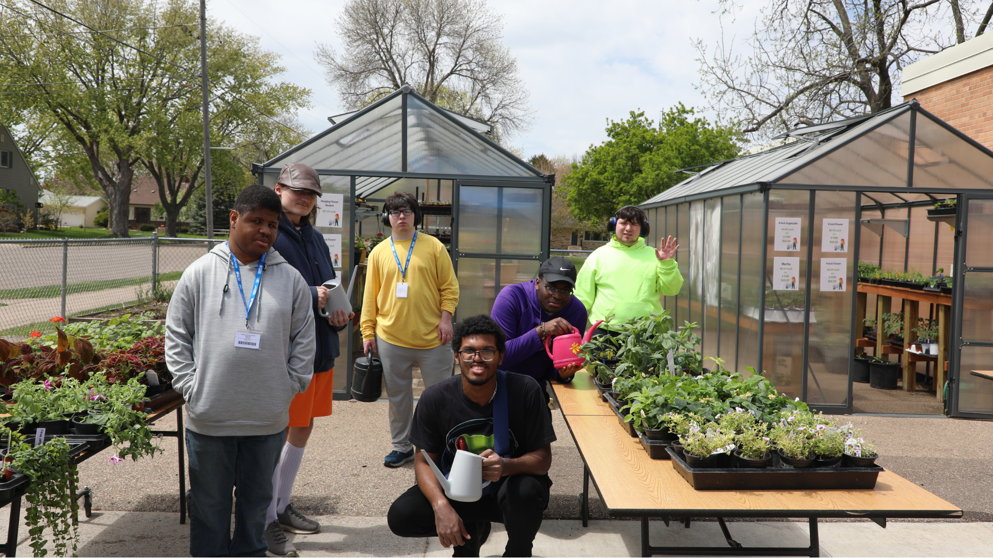
Notes:
Students in the Gardening Community Club at the Osseo Education Center have the opportunity to be part of a yearlong class on gardening that covers everything from the science behind plants, soils and the growing cycle to hands-on experiencing planting and tending to a variety of plants.
OEC students are now selling their plants at a greenhouse sale, which runs every Thursday and Friday in May from 9 a.m.-2 p.m. at the OEC.
Offerings include annuals, perennials, herbs, vegetables, hanging baskets and more.
Gardening club teacher Stella Warira said the class aims to teach students about gardening for their own personal enjoyment and also so they have the skills needed to apply for a job at a local greenhouse, if desired.

Slide 10
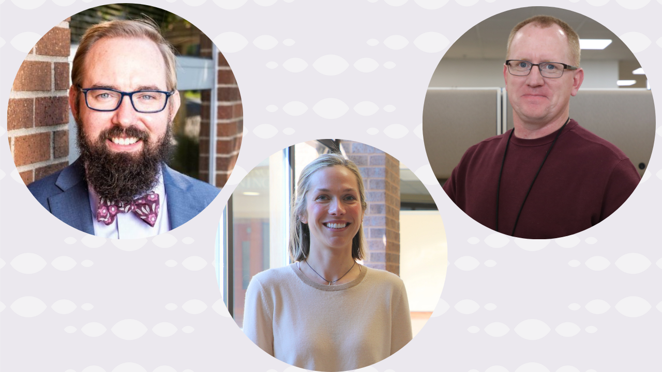
Notes:
In the area of MISSION DRIVEN EMPLOYEES:
The Consortium for School Networking (CoSN), a professional association for leaders in education technology, inducted a trio of Osseo Area Schools employees into its 2026 Volunteer Hall of Fame at a conference April 14.
The winners include Johannah Arndt, technology coordinator; Ryan Cox, director of technology; and Anthony Padrnos, executive director of technology.
The Hall of Fame recognizes outstanding individuals for their efforts in improving technology, enhancing digital access and leading AI or school safety initiatives.

Slide 11
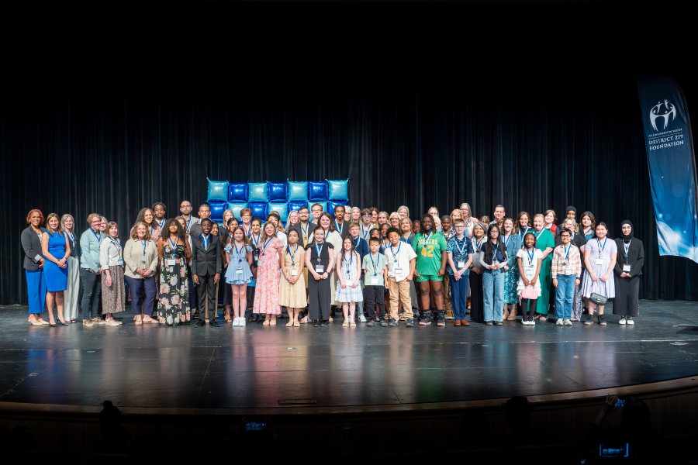
Notes:
In the area of LIFELONG LEARNING:
The District 279 Foundation’s 2026 Investment in Youth Celebration took place on Sunday, May 3 at Park Center Senior High School.
This year, 72 award recipients were celebrated for their significant investment in one of the following categories:
Developing their own talents or learning
Helping the community
Modeling for youth
Overcoming adversity
The betterment of education
Award recipients included students, staff and district volunteers.

Slide 12

Notes and reminders
Graduation ceremonies are being held May 29-June 7
The last day of school is June 5
Summer learning opportunities, OsseoSchools.org/Summer
Staty tuned to OsseoSchools.org/BetterFuture for the latest on construction projects
Notes:
A few final notes and reminders for tonight.
Graduation ceremonies are being held May 29-June 7 for the Osseo Area Learning Center, Osseo Education Center, Adult Basic Education, 279Online and Park Center, Osseo and Maple Grove senior high schools. To learn more, visit osseoschools.org/2026graduation.
The last day of school is June 5
Families can explore summer programs now for children from early childhood through high school. Visit the Osseo Area Schools’ Summer programs website at osseoschools.org/summer to learn about each enrichment opportunity, camp and program that will be offered.
Continue to stay tuned to OsseoSchools.org/BetterFuture for the latest on construction projects.

Slide 13
School board meeting
May 19, 2026

