Slide 1
School board meeting
April 21, 2026

Slide 2
Superintendent’s report
SUPT. DR. KIM HIEL
Notes:
Good evening Chair Prince, Vice chair Brooks , school board members and stakeholders:

Slide 3
Points of Pride
SUPT. DR. KIM HIEL AND CABINET MEMBERS
Notes:
A regular part of the superintendent’s report is to share Points of Pride in our district.
By sharing our Points of Pride, we are taking time to recognize and celebrate, the scholars, staff and community members who are contributing to the accomplishment of our mission.
I have members of our District Cabinet here to assist in sharing some examples from the last month.

Slide 4

Notes:
In the area of CONTRIBUTING TO COMMUNITY
Construction has officially begun on the district’s new community learning center on the former site of Crest View Elementary School in Brooklyn Park.
The new learning center will serve all ages with programming that the community helped to determine. Some of its uses will include:
Early childhood and preschool programming
Community partnerships
An American Indian Cultural Center
Spaces for professional development, academic support, summer targeted services, tutoring and credit recovery
The community learning center is tentatively set to open fall 2027.

Slide 5

Notes:
It’s that time of year when district elementary schools officially begin to welcome the upcoming class of kindergarten students at Kindergarten Information Nights.
These events will take place at each elementary school between April 2 and May 19 with the exception of Aspen Ridge Elementary School, which will host their Kindergarten Information Night August 19.
These events allow incoming kindergarteners and their families the opportunity to meet teachers and school leaders, learn about daily schedules and curriculum, explore classrooms and school spaces, and ask questions about transportation, services and school programs.

Slide 6
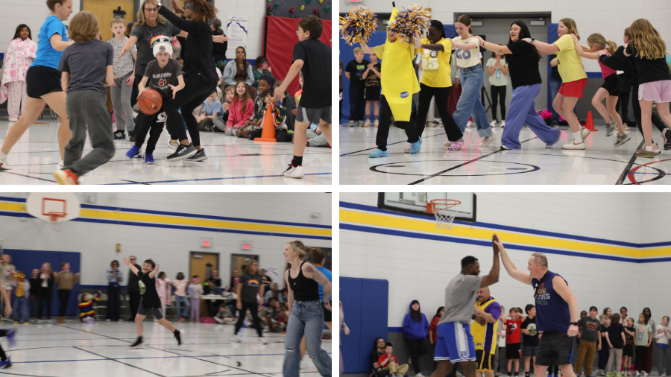
Notes:
Oak View Elementary School recently came up with a fun way to introduce its fifth grade students to their new middle school principal, Maple Grove Middle School’s Xavier Reed. Reed joined Oak View’s staff team at the fifth grade student versus staff basketball game on April 10.
The school’s younger students cheered enthusiastically at the game, which ended in favor of the staff with a score of 26-18.

Slide 7
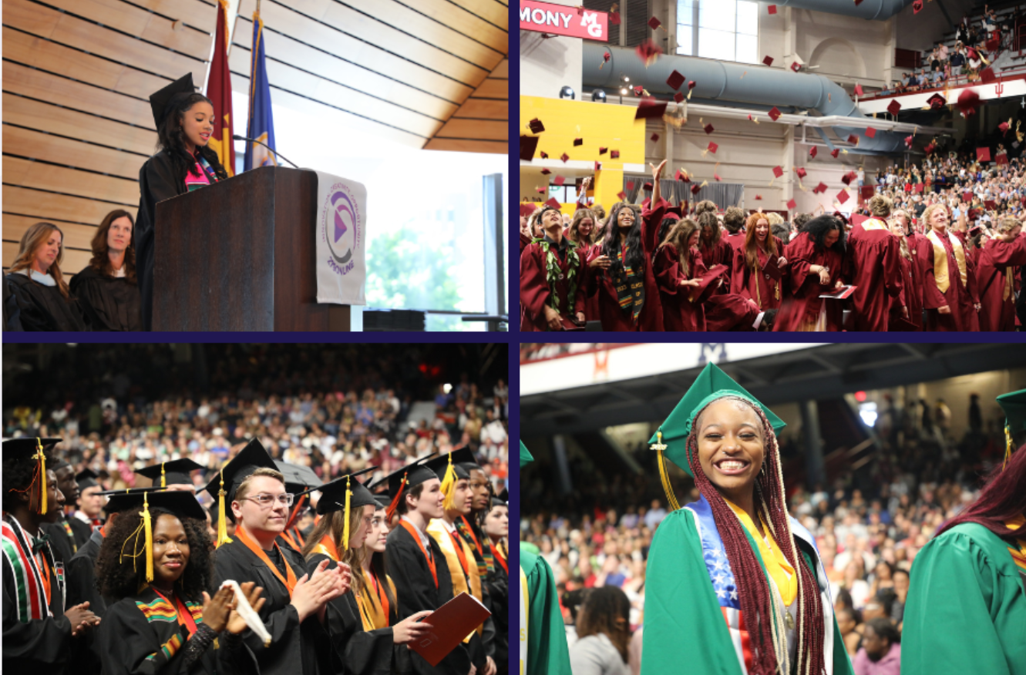
Notes:
In the area of ACHIEVING DREAMS:
The district received positive news regarding 2025 graduation rates from the Minnesota Department of Education in early April, with Osseo Area Schools’ four-year graduation rate exceeding the state average for the second year in a row.
Overall, the district graduated 85.4% of students in 2025 compared to 84.9% at the state level.
In addition to exceeding the state average, the district’s graduation rates rose .8% over 2024 and represents the highest mark achieved under the current measuring methosed used by MDE.

Slide 8
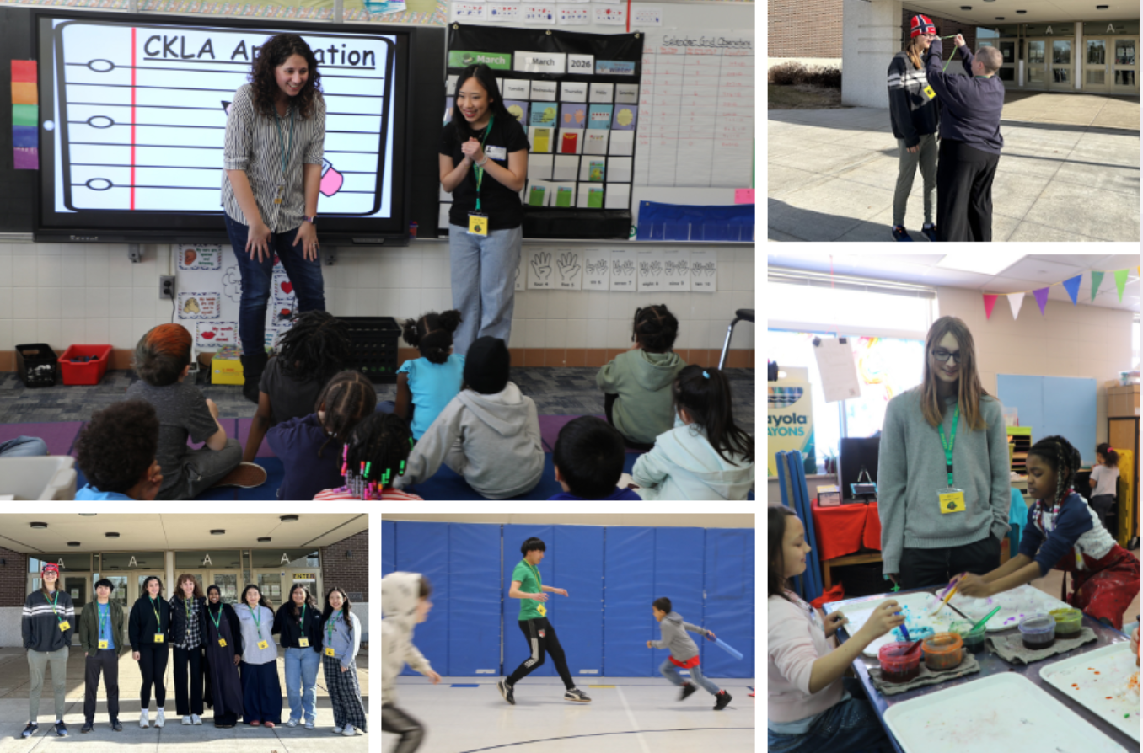
Notes:
Students from Park Center Senior High School are taking part in a full-year course on exploring the teaching profession, which is a concurrent credit course with St. Cloud State University.
As part of the class, students have become teacher cadets and are spending two mornings a week at Birch Grove School for the Arts, where they are completing field experiences with the same teacher and students throughout the spring.
These field experiences provide a hands-on opportunity for potential future educators to explore the teaching profession and for relationship-building and mentorship from teachers to teacher cadets.

Slide 9
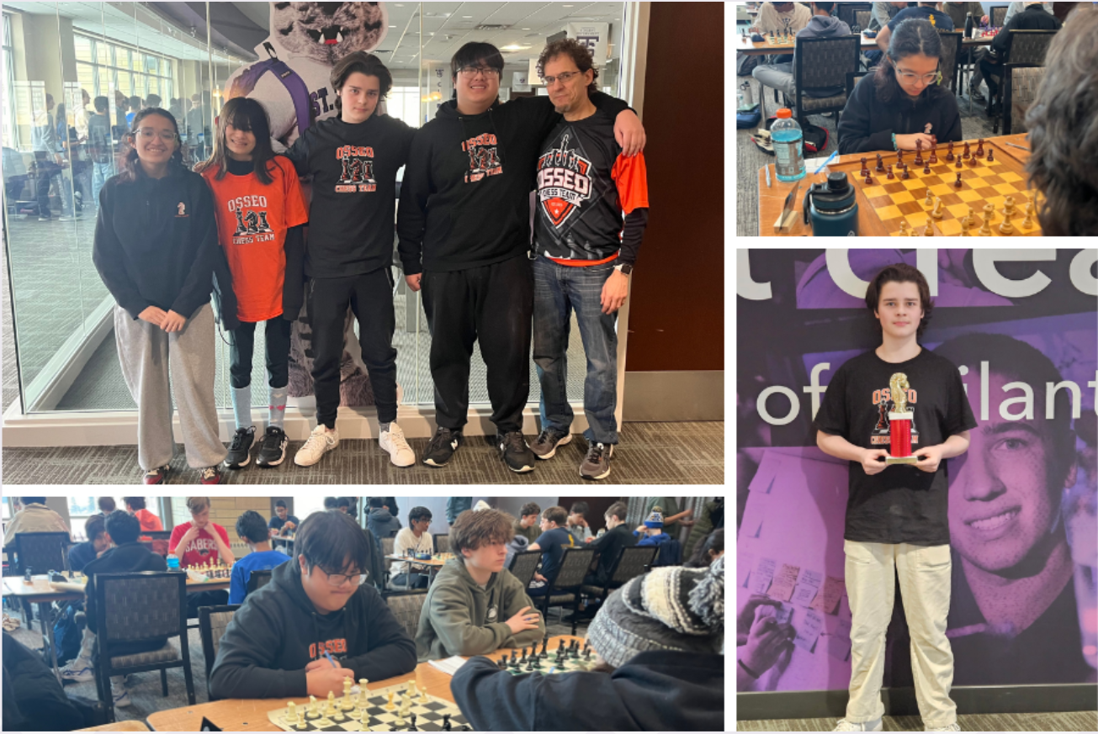
Notes:
Four students from Osseo Senior High School competed at the Scholastic State Chess Championship last month at the University of St. Thomas. The students competed in seven rounds of two-hour matches with 380 other participants.
Competing students included:
Senior Aria Reickard (RYE-curd)
Senior Harmony Shah
Sophomore Alvin Moua
And freshman Dominic Moss, who placed second in his category and marking the best performance for a OSH chess player at the state championship in school history!

Slide 10

Notes:
In the area of MISSION DRIVEN EMPLOYEES:
Osseo Area Schools’ counseling departments continue to strive for excellence and best practice in their field, and that dedication was evident recently with the announcement that four additional district schools have achieved a Model Program designation this year through the American School Counselor Association (ASCA).
This designation, called Recognized ASCA Model Program or RAMP, has now been earned by 15 district school counseling programs. Only about 1,200 schools nationwide have received this recognition over the past 22 years, making it a rare distinction.
The newest designees include Fair Oaks, Garden City and Oak View elementary schools and North View Middle School.

Slide 11
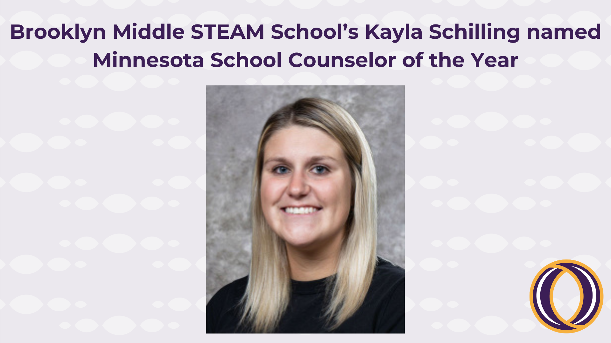
Notes:
Brooklyn Middle STEAM School social worker, Kayla Schilling, has been named Minnesota School Social Worker of the Year for 2026.
Schilling was nominated by co-workers and will be formally recognized at a Minnesota School Social Work Association event May 29.
BMS Principal Kim Monette said “Kayla’s heart shows in so many ways; she always puts students and families first. She is endless in her desire to ensure that students and families’ needs are met, are cared for, safe and always know that they belong. She is one of a kind!”

Slide 12

Notes and reminders
This year’s final Community Conversation is being held on May 12, OsseoSchools.org/CommunityConvo
Summer learning opportunities, OsseoSchools.org/Summer
Staty tuned to OsseoSchools.org/BetterFuture for the latest on construction projects
Notes:
A few final notes and reminders for tonight.
Families can explore summer programs now for children from early childhood through high school. Visit the Osseo Area Schools’ Summer programs website at osseoschools.org/summer to learn about each enrichment opportunity, camp and program that will be offered.
This year’s final Community Conversation is being held on Tuesday, May 12. Please visit OsseoSchools.org/CommunityConvo for further details and to provide some feedback to help us prepare of the evening’s topics - whether you can come or not.
With the change in weather you might start seeing even more construction. Continue to staty tuned to OsseoSchools.org/BetterFuture for the latest.

Slide 13
School board meeting
April 21, 2026

