Slide 1
School board meeting
March 17, 2026

Slide 2
Superintendent’s report
SUPT. DR. KIM HIEL
Notes:
Good evening Chair Prince, Vice Chair Brooks, Board members, staff, families, students, and community partners.
While the weekend’s snowstorm reminded us that winter isn't quite finished, our schools are already feeling the spring heat of Trimester 3. This transition represents a fresh start for our scholars as they dive into new courses and opportunities. It’s an exciting time of year to witness the growth that happens when a new challenge begins.
I wanted to take a minute to highlight a couple of recent community connections I’m proud of:
Our Brooklyn Park community members received a postcard with a QR code to a new One Community For All booklet. The booklet details the opportunities at Brooklyn Park school sites for our community members to take part in - including Targeted Services, early childhood programs, youth and adult enrichment, facility use, etc. - It also talks about local Building a Better Future project updates. Check it out at OsseoSchools.org/OneCommunity.
Additionally, don’t miss your opportunity to share your thoughts on our school calendar. This is the first time our community is being welcomed to participate in the planning process. Go to OsseoSchools.org/CalendarInput - by Thursday - to provide your insights. The feedback shared will help inform calendars for 2027-28 and beyond.
As I’ve visited schools recently, I’m consistently inspired by the daily brilliance in our classrooms. I see educators holding space for scholars and colleagues, meeting the new trimester with curiosity and resilience. Whether it’s a kindergartener mastering a new skill or a senior eyeing the finish line, the energy of growth is palpable. Our schools remain vibrant places of connection, even as we navigate the changing seasons. Osseo Area Schools continues to lead because of this - from classroom wins to state-level competitions. Thank you to our families for partnering with us to make it all possible, and our staff for their dedication and hard work. I wish all a restorative and safe Spring Break.

Slide 3
Points of Pride
SUPT. DR. KIM HIEL AND CABINET MEMBERS
Notes:
A regular part of the superintendent’s report is to share Points of Pride in our district.
By sharing our Points of Pride, we are taking time to recognize and celebrate, the scholars, staff and community members who are contributing to the accomplishment of our mission.
I have members of our District Cabinet here to assist in sharing some examples from the last month.

Slide 4
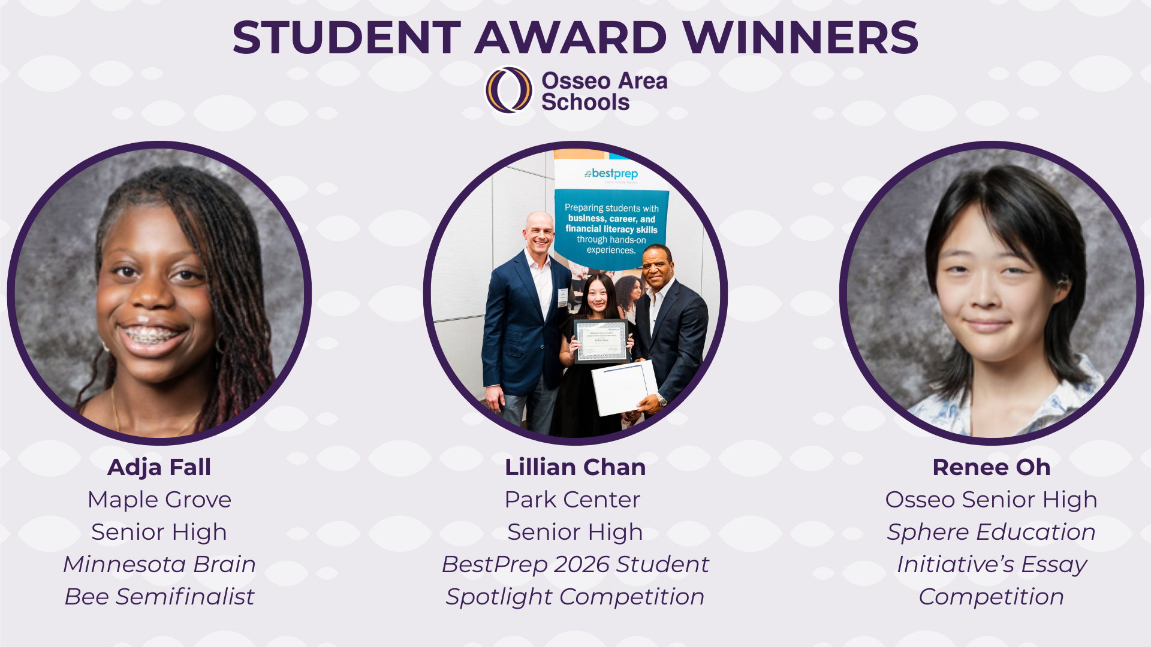
Notes:
In the area of ACHIEVING DREAMS
Across the district, high school students have been receiving awards recognizing their outstanding achievements.
Maple Grove Senior High School junior Adja Fall recently earned semifinalist honors at the Minnesota Brain Bee, organized by the University of Minnesota Graduate Program in Neuroscience for the International Neuroscience Competition.
Park Center Senior High School’s Lillian Chan recently placed in the top 20 in the BestPrep 2026 Student Spotlight Competition. Chan and the other top 20 winners were recognized at BestPrep’s Educational Forum on Feb. 11 at the Minneapolis Convention Center.
Osseo Senior High School senior Renee Oh was recently awarded $2,500 as an honorable mention prize winner for Sphere Education Initiative’s essay competition in honor of the 250th anniversary of the Declaration of Independence.

Slide 5
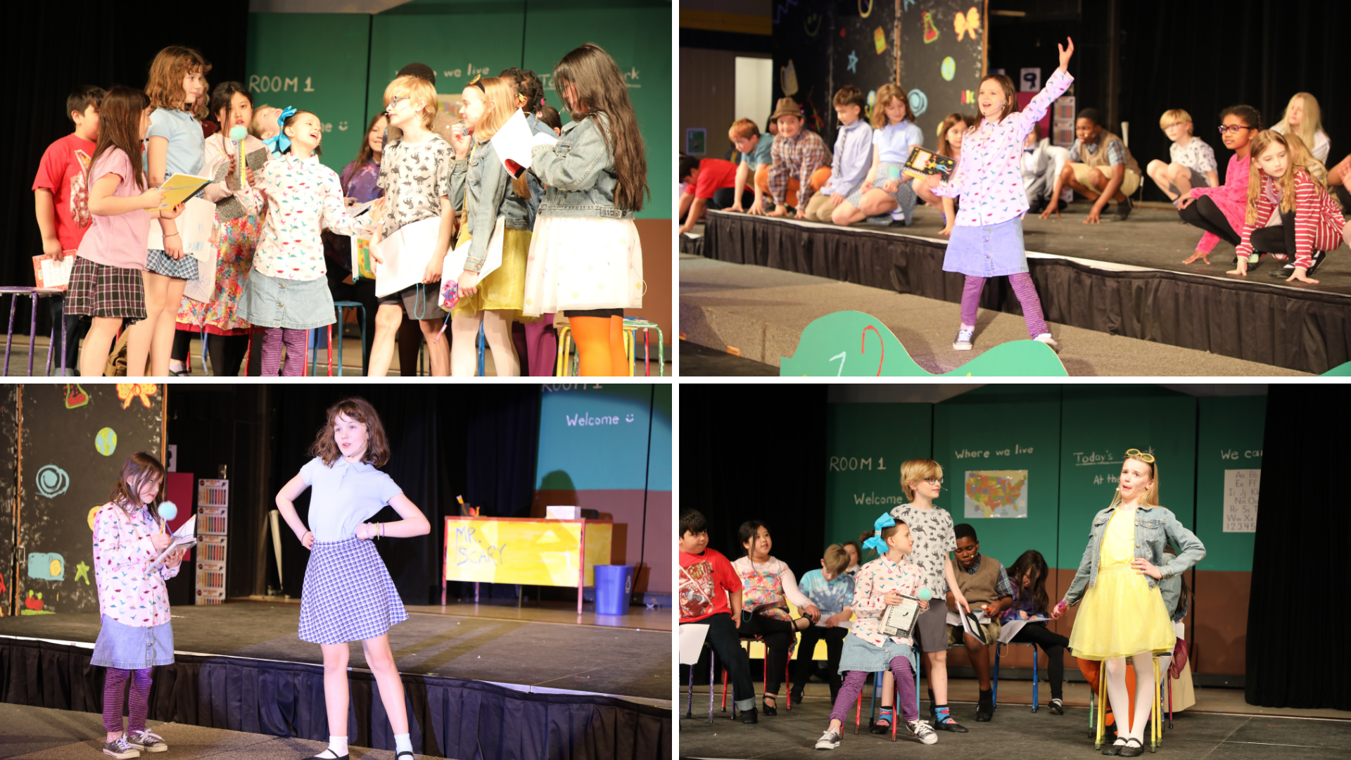
Notes:
A cast and crew of 50 Birch Grove School for the Arts student thespians took to the stage March 6-8 for this year’s spring musical, “Junie B.'s Essential Guide to School.”
Cataleya Allende Carmona, a fifth grader who plays the role of Camille said, “The show is really fun and it fits our school’s vibes.”

Slide 6
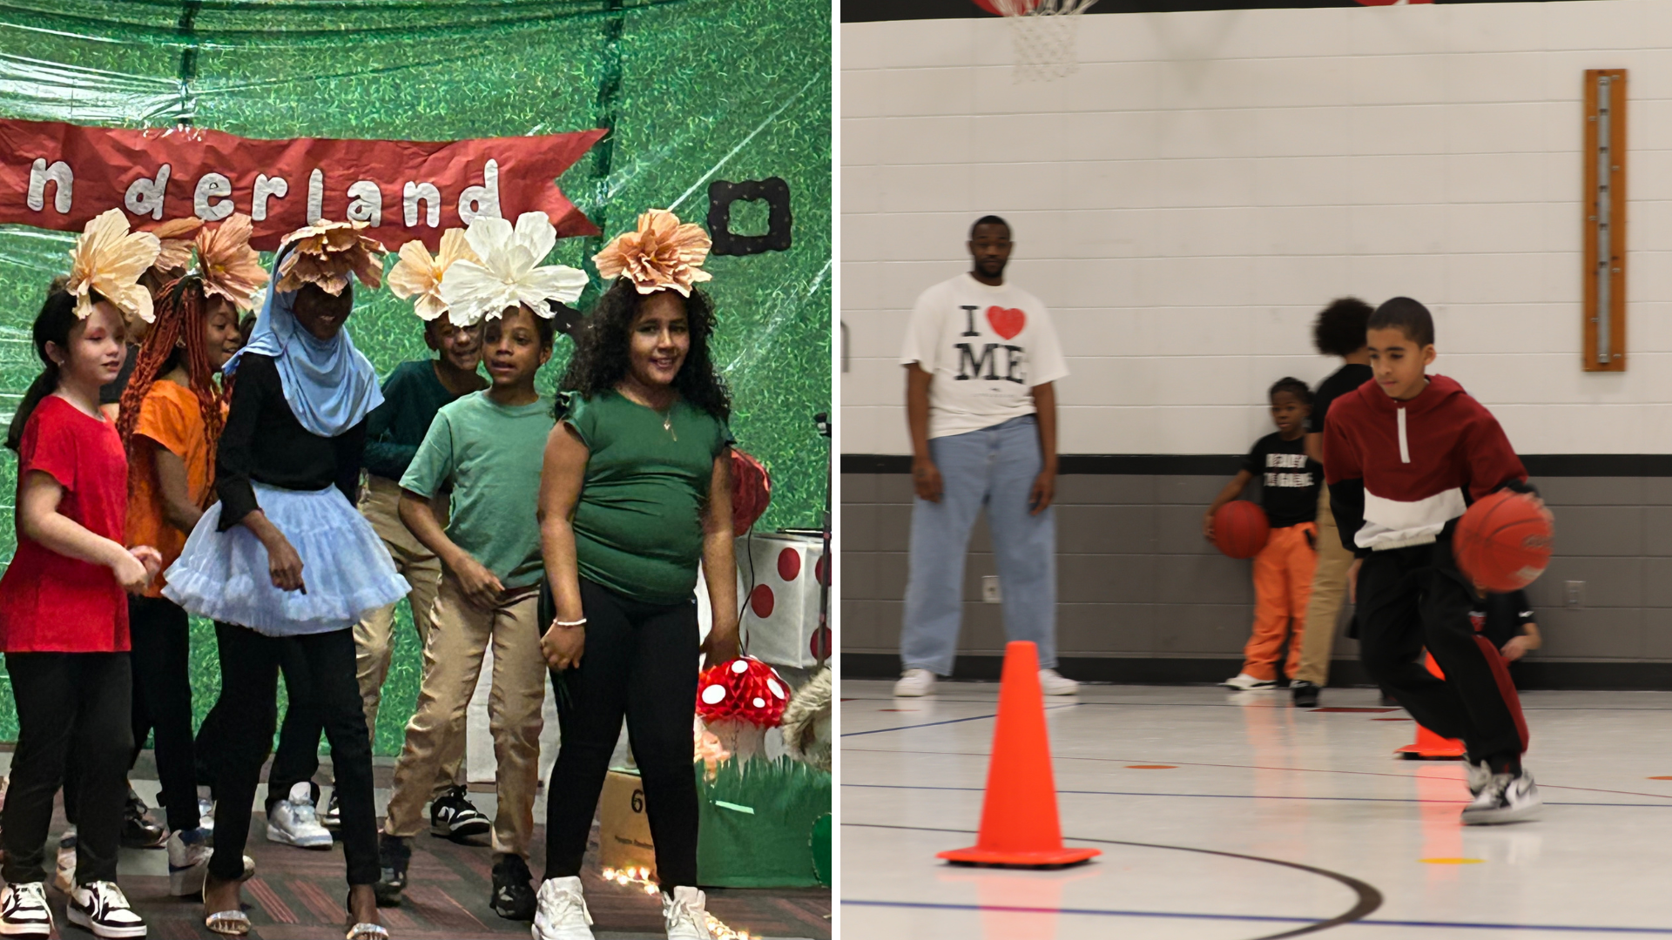
Notes:
In the area of CONTRIBUTING TO COMMUNITY:
Thanks to Community Education, students at Edinbrook Elementary School have recently participated in various events and activities to help promote their emerging leadership skills, including a basketball club and a theater club, who recently put on a production of "Alice in Wonderland."

Slide 7
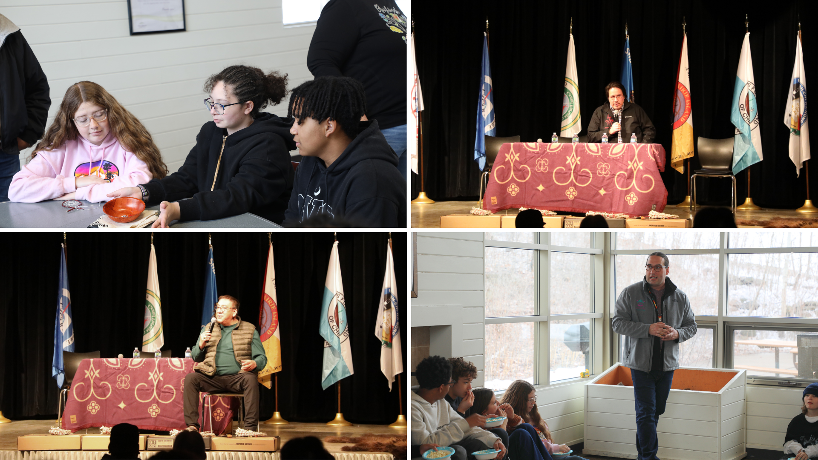
Notes:
In the area of LIFELONG LEARNING
The Osseo Area Schools American Indian Education department recently hosted a variety of events for district students and families.
On Feb. 17 and 18, middle school students from across the district traveled to Fish Lake Regional Park to participate in a variety of cultural activities and a traditional style meal with the American Indian Education department. Students made dream catchers, went for a walk to notice different things in nature, played traditional native board games, listened to a story from Coordinator Ethan Neerdaels, and enjoyed a lunch of bison and hominy soup, wild rice, cornbread and berries.
On the evening of Feb. 19, the American Indian Education hosted a winter storytelling event at North View Middle School. Staff, students, families and community members gathered to listen to four indigenous storytellers share cultural and traditional knowledge, passed down orally for generations. To kick off the evening, attendees gathered to enjoy a welcome and feast. The storytellers travelled from near and far for the event. The evening served as an opportunity to come together, listen and learn.

Slide 8
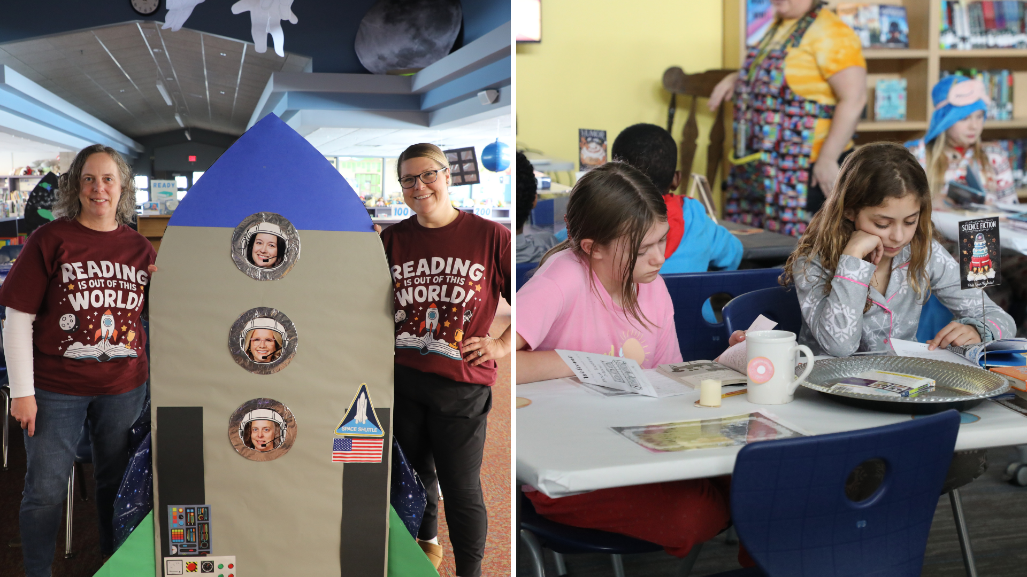
Notes:
February was I love to read month, and throughout the district library media specialists went above and beyond to encourage reading in a fun, new way.
Students at Fernbrook Elementary School got out of this world with a transformed library. The space-themed library was full of rocket ships, astronauts with different staff members' faces, planets, space rocks, the moon and the sun. During their library visit, students read the book “Touch the Sky” and watched footage from a rocket launch. They also had the opportunity to read different space-themed books from the digital library on their devices.
Students at Cedar Island Elementary School participated in a bakery book tasting. The book tasting allowed students to sample new genres of books in a fun and creative way. Students moved around tables in the library, decorated like a bakery, trying a new genre of book at each table. Students sampled the book by reading the front, back and first few pages, filling out “menus” with three words to describe the cover, what they liked from the first few pages and giving it a rating out of five mixing spoons. Students tried new genres from fantasy to animals to adventure.

Slide 9
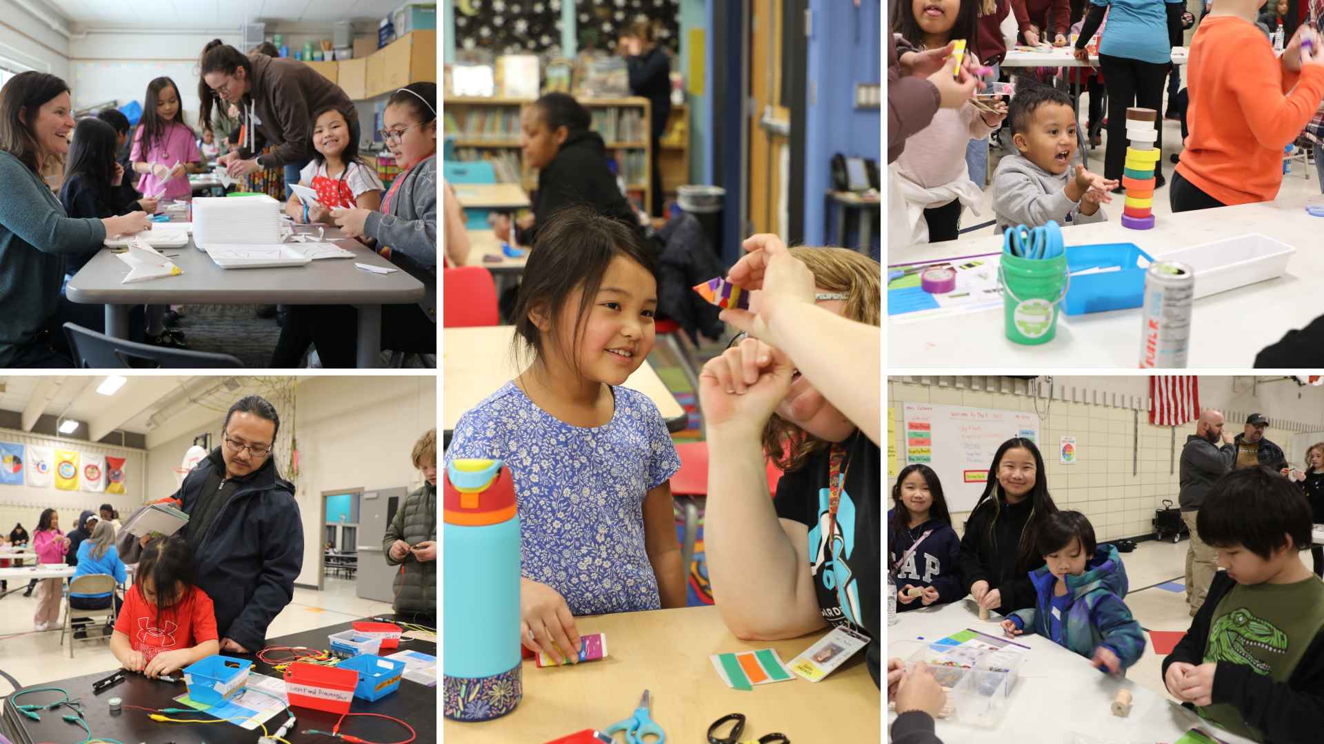
Notes:
Palmer Lake and Garden City elementary schools recently hosted science, technology, engineering and math (STEM) events, providing opportunities for expanded learning and out-of-the-box thinking for students and their families.

Slide 10
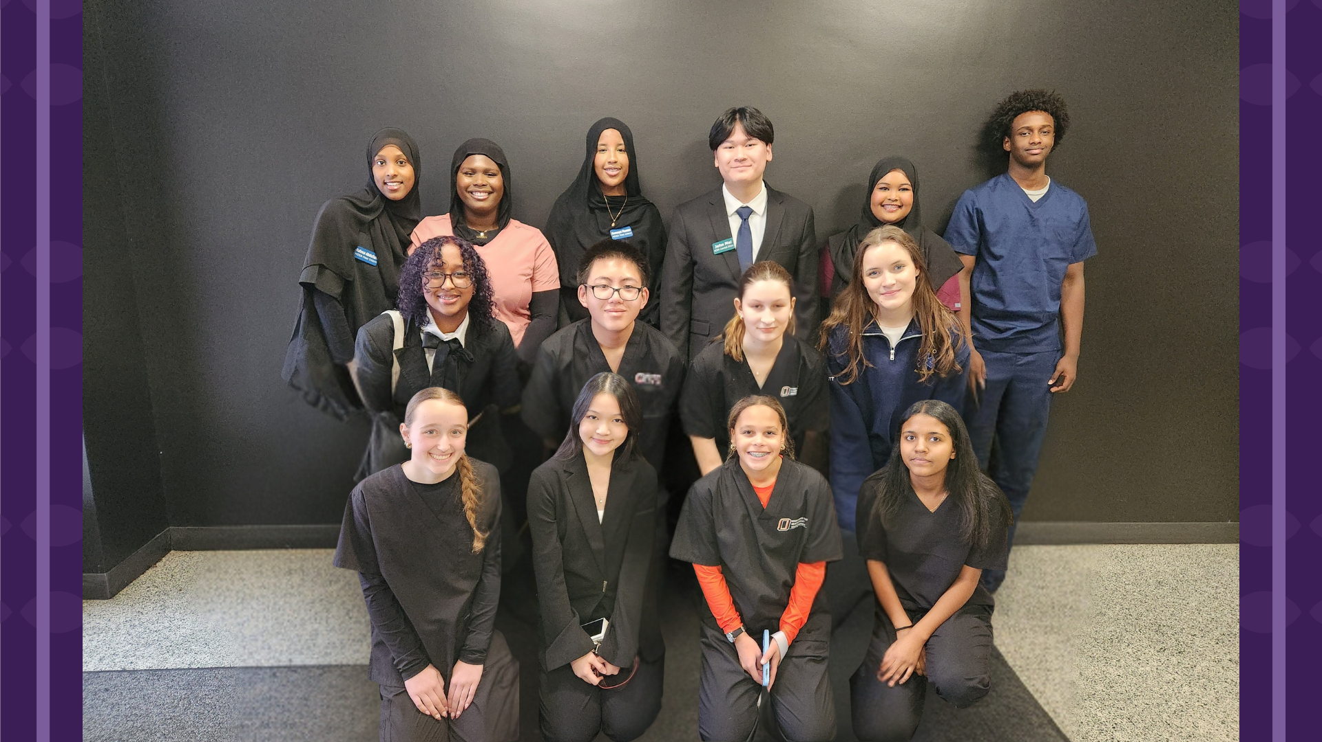
Notes:
Osseo Senior High's HOSA - Future Health Professionals demonstrated outstanding performance at the Region 1 Mid-Winter Conference on Jan. 5. The conference serves as preparation for the Minnesota HOSA State Competition in March.
HOSA is an integral part of OSH's Health Science Career & Technical Education and magnet program, preparing students for a variety of careers in healthcare. The Health Science Magnet Program is designed to support and build future leaders in Health Science and Medical fields. The program provides authentic learning experiences that prepare students to achieve their future goals in medicine. Students develop practices through hands-on, project based experiences in a professional work setting. Health Science students graduate with college credits, professional certifications, internship experiences, and memories for a lifetime. Students across the district can attend health science classes at OSH.

Slide 11
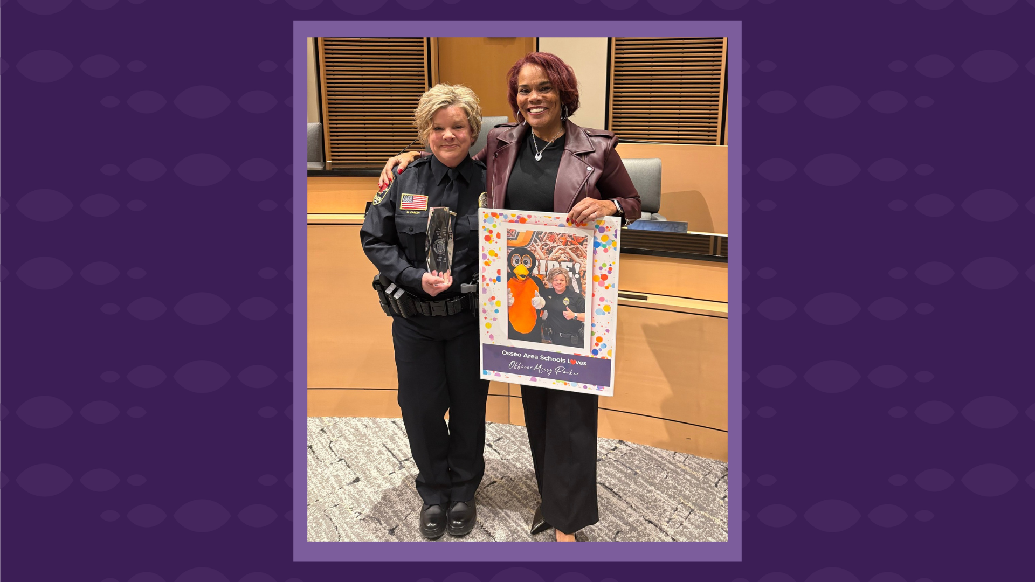
Notes:
In the area of MISSION DRIVEN EMPLOYEES
On Feb.17, Osseo Senior High School’s School Resource Officer, Detective Missy Parker, was named the 2025 Officer of the Year at the City of Maple Grove 2025 Public Safety Awards. Supt. Dr. Kim Hiel was present at the city council meeting to watch Detective Parker receive her award and thank her for all she does for OSH students and staff!

Slide 12

Notes and reminders
Summer learning opportunities: OsseoSchools.org/Summer
March 20: No school for students
March 23-27: Spring break
April 3: No school for students
Share your feedback on the school calendar at OsseoSchools.org/CalendarInput
Notes:
A few final notes and reminders for tonight.
Families can explore summer programs now for children from early childhood through high school. Visit the Osseo Area Schools’ Summer programs website at osseoschools.org/summer to learn about each enrichment opportunity, camp and program that will be offered.
There will be no school for students March 20-27, with spring break taking place March 23-27. There will also be no school for students on April 3.
A just one final reminder, calendar feedback can be shared at OsseoSchools.org/CalendarInput.

Slide 13
School board meeting
March 17, 2026

